Slide 1
COMPUTER VISION
Week 4
Lecture 5 (17/08/2026)
0714 02 CSE 4239

Slide 2
Seven Ideas That Set Up Deep Learning
1
Learning Algorithms
2
Capacity & Generalization
Task T, Performance P, Experience E
Underfitting, overfitting
3
Estimators
4
MLE & Bayesian Inference
Bias, variance, consistency
Maximum likelihood
5
Classic Algorithms
6
Stochastic Gradient Descent
Logistic regression, SVMs, kernels, PCA, k-means
Scaling optimization to huge datasets
7
Why Deep Learning?
Curse of dimensionality & manifold learning

Slide 3
“Learns from experience E…”
A computer program is said to learn from experience E with respect to a class of tasks T and performance measure P, if its performance at tasks in T, as measured by P, improves with experience E. — Mitchell (1997)
T
P
E
Task
Performance
Experience
What the model does: classify, regress, transcribe, translate…
A quantitative measure — accuracy, error rate, log-likelihood
Data the algorithm is allowed to see while learning

Slide 4

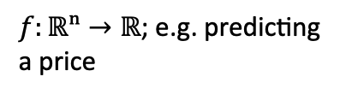

Many Tasks Reduce to a Function $f(x)$
1
2
3
4
Classification
Regression
Transcription
Machine Translation
$f:ℝⁿ→\{1,…,k\}$; e.g. object recognition
$f:ℝⁿ→ℝ$; e.g. predicting a price
Unstructured input → discrete text (OCR, speech)
Symbol sequence → symbol sequence
5
6
7
8
Structured Output
Anomaly Detection
Synthesis & Sampling
Density Estimation
Output is a vector with internal structure (parsing)
Flag atypical events, e.g. fraud detection
Generate new examples resembling training data
Learn $p_{model }(x)$ itself, e.g. $p_{model}≈p_{data}$

Slide 5

Measuring P, and What E the Model Sees
Performance Measure, P
Experience, E: Supervised vs. Unsupervised
Classification / transcription → accuracy or error rate (0–1 loss)
Density estimation → average log-probability assigned to examples
Always evaluated on a held-out test set — not the training data
Choosing P is often ambiguous: whole-sequence accuracy vs. partial credit? small errors vs. rare large ones?
Unsupervised: dataset of features only — learn $p(x)$ or its structure (clustering, density estimation)
Supervised: each example has a label/target $y$ — learn $p(y|x)$
Not a rigid split: chain rule lets you convert one into the other, $p\left(x\right)=Π p(x_{i}|x_{<i})$
Reinforcement learning: agent interacts with an environment (beyond this chapter)

Slide 6


Linear Regression: A Minimal Learning Algorithm
Model & Cost
Recipe Preview
Prediction: $ŷ = wᵀx (+ b)$
Loss (MSE): $MSE = \frac{1}{m} ‖ŷ − y‖²$
Closed-form solution: $w = (XᵀX)⁻¹Xᵀy$
Dataset: $(X, y)$ pairs
Model: $wᵀx (+ b)$— a hypothesis space of linear functions
Cost function: mean squared error on training data
Optimizer: solve for zero gradient in closed form
Adding weight decay $λwᵀw$ trades training fit for smaller weights — our first taste of regularization

Slide 7
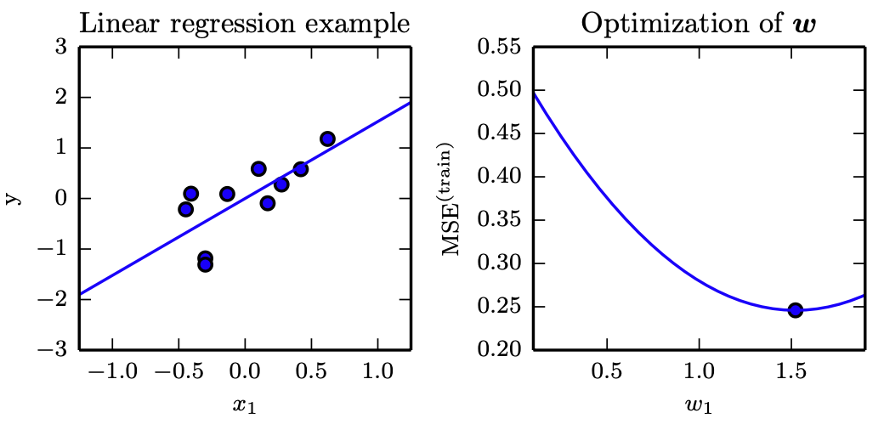
Linear regression

Slide 8
Training Error Is Not the Goal — Test Error Is
Training error: computed and minimized on the training set — this alone is just optimization
Generalization (test) error: expected error on new, unseen inputs from the same data-generating distribution
i.i.d. assumptions: train & test examples are independent and identically distributed, drawn from data
Two levers control performance:
  (1) make training error small,
  (2) keep the train–test gap small
Two Failure Modes
↓
Underfitting
Model can't even fit the training data — capacity too low
↑
Overfitting
Model memorizes training quirks that don't generalize — capacity too high
Capacity: informally, the range of functions a model can represent — controlled by the hypothesis space (e.g. polynomial degree).

Slide 9
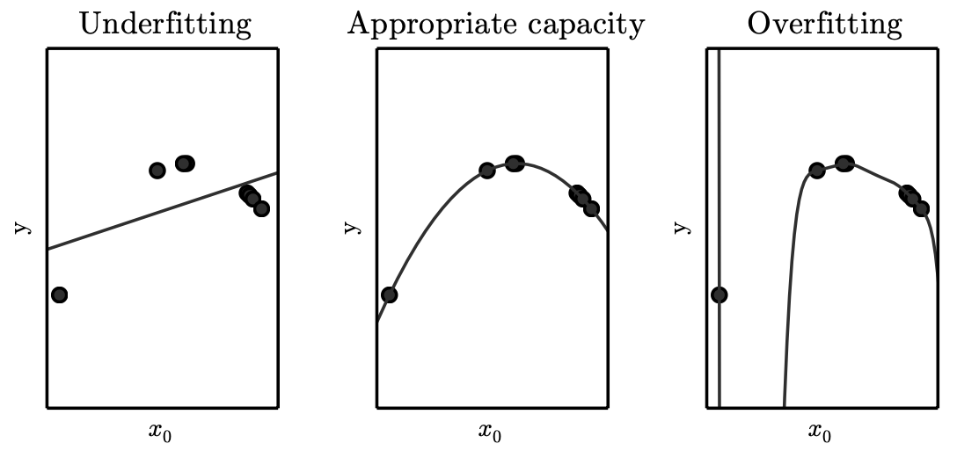
Underfitting and Overfitting in Polynomial Estimation

Slide 10
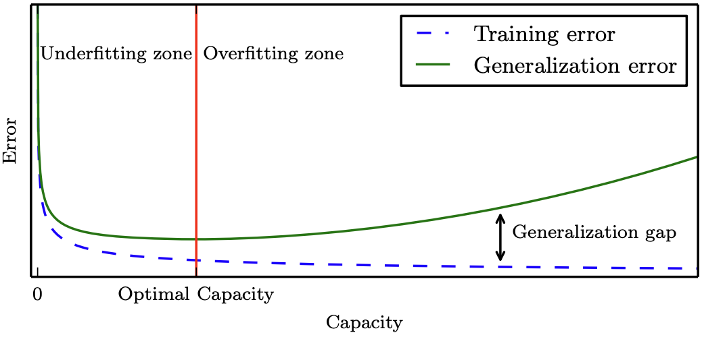
Generalization and capacity
Notes:
Underfitting zone: both errors high
Overfitting zone: gap between train & generalization error widens
No Free Lunch theorem: averaged over all possible tasks, no algorithm beats any other — we must pick a capacity fit to the task

Slide 11
Validation & Cross-Validation
Training set (~80%)
Validation set (~20%)
Test set
Held out from the original “training data” pool
k-Fold Cross-Validation
Validation set: used to select hyperparameters — its error slightly underestimates true generalization error
Test set: touched exactly once, after all tuning, to report final generalization error
Never touched until the very end
Each fold takes a turn as the test split; results are averaged — makes efficient use of small datasets.

Slide 12

MAXIMUM LIKELIHOOD ESTIMATION
Pick the $θ$ That Makes the Data Most Probable
The Estimator
Interpretation: Minimizing KL Divergence
MLE ≡ minimizing D_KL(p̂_data ‖ p_model) — making the model distribution match the empirical data distribution
Equivalent to minimizing cross-entropy between the empirical and model distributions
Mean squared error is exactly the cross-entropy between the empirical distribution and a Gaussian model — this is why linear regression's MSE cost is principled, not arbitrary
Products of many probabilities underflow numerically → take the log; argmax is unchanged
Equivalent to minimizing the negative log-likelihood (NLL)
19

Slide 13
WHY MLE?
MLE Is (Asymptotically) the Best Estimator
Consistency: under two conditions, θ_ML → true θ as m → ∞
(1) the true distribution p_data lies inside the model family p_model(·;θ)
(2) p_data corresponds to exactly one value of θ (identifiability)
Statistical efficiency: among consistent estimators, MLE achieves the lowest possible MSE as m grows — the Cramér–Rao lower bound
Practical takeaway: MLE is the default choice for machine learning; add regularization (e.g. weight decay) when m is too small and overfitting appears
Linear Regression = MLE
Model y | x as 𝒩(y; ŷ(x;w), σ²). Maximizing the resulting conditional log-likelihood with respect to w is algebraically identical to minimizing MSE_train.
This is why MSE “just works” — it's maximum likelihood in disguise, under a Gaussian noise assumption.
20

Slide 14
Reading
Deep learning book
  Chapter 5: https://www.deeplearningbook.org/contents/ml.html

