Slide 1
COMPUTER VISION
Week 7
Lecture 9 (08/09/2026)
0714 02 CSE 4239

Slide 2
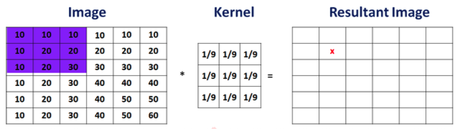
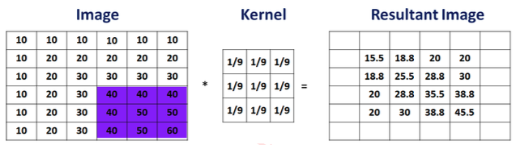
Padding: Understanding the problem

Slide 3
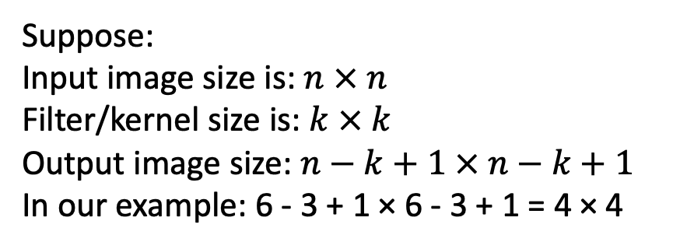
Padding: Understanding the problem
Problem 1: size of output image is different than the input image.
Problem 2: filter is not applied on the boundary pixels.
How to find size of output image after application of convolution operations?
Suppose:
Input image size is: $n × n$
Filter/kernel size is: $k × k$
Output image size: $n−k+1 × n−k+1$
In our example: 6 - 3 + 1 × 6 - 3 + 1 = 4 × 4
Shrinking output: means only few times this operation
can be applied before image shrinks to the level that it losses information (problem when we build deep CNN).
Information loss: compared to other pixels in the output image (corner boundary pixel only used once).

Slide 4
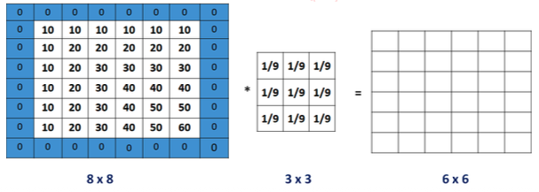
Padding
Solution for both the problem highlighted in previous slide is to “pad” the image before applying convolution

Slide 5
Dealing with image boundary
To compensate, padding or extension modes have been developed:
  zero: set all pixels outside the source image to 0
  constant (border color): set all pixels outside the source image to a specified border value
  clamp (replicate or clamp to edge): repeat edge pixels indefinitely
  (cyclic) wrap (repeat or tile): loop “around” the image in a “toroidal” configuration
  mirror: reflect pixels across the image edge
  extend: extend the signal by subtracting the mirrored version of the signal from the edge pixel value.

Slide 6
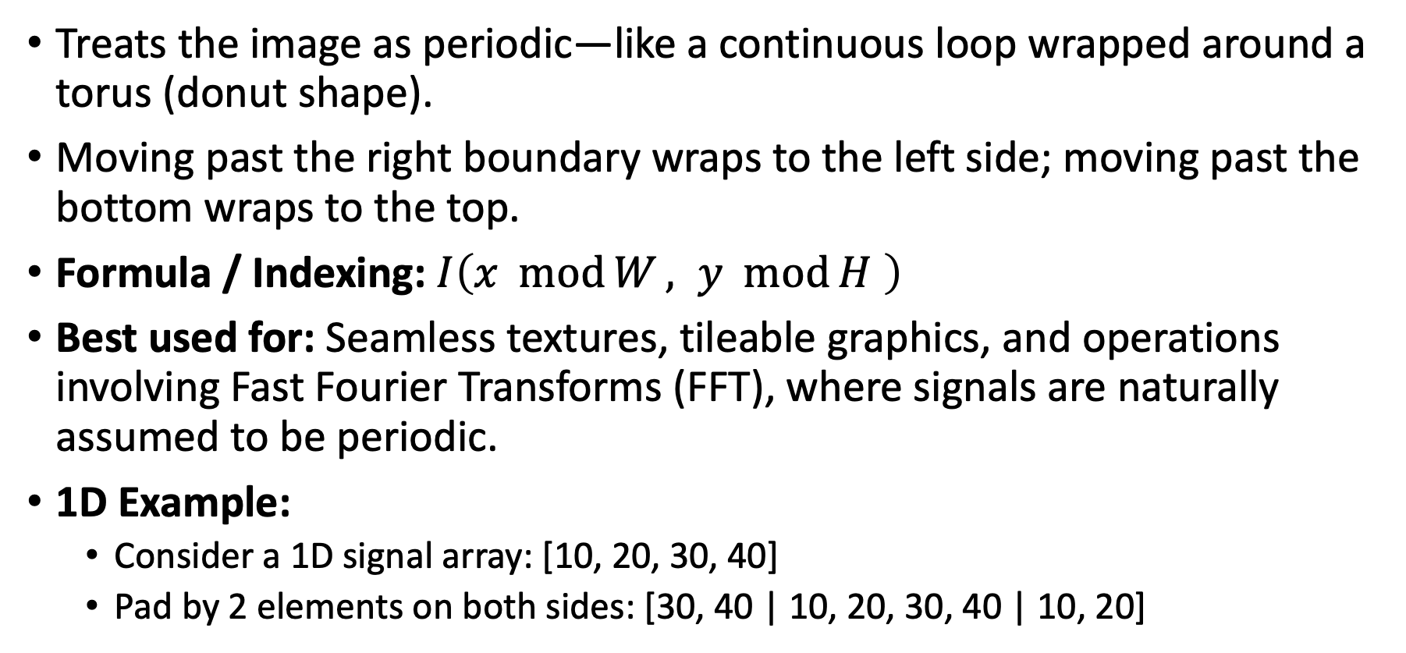
Cyclic / Wrap (Repeat or Tile)
Treats the image as periodic—like a continuous loop wrapped around a torus (donut shape).
Moving past the right boundary wraps to the left side; moving past the bottom wraps to the top.
Formula / Indexing: $I\left(x \operatorname{mod}{W}, y \operatorname{mod}{H} \right)$
Best used for: Seamless textures, tileable graphics, and operations involving Fast Fourier Transforms (FFT), where signals are naturally assumed to be periodic.
1D Example:
  Consider a 1D signal array: [10, 20, 30, 40]
  Pad by 2 elements on both sides: [30, 40 | 10, 20, 30, 40 | 10, 20]

Slide 7
Mirror (Reflection)
Reflects pixels across the image boundary as if placing a mirror at the edge.
This eliminates sharp intensity jumps at borders by maintaining local continuity.
Example: Pad by 2 elements on both sides:
  [20, 10 | 10, 20, 30, 40 | 40, 30]
Best used for: General image filtering, blurring, and edge detection where introducing artificial boundary artifacts must be avoided.

Slide 8
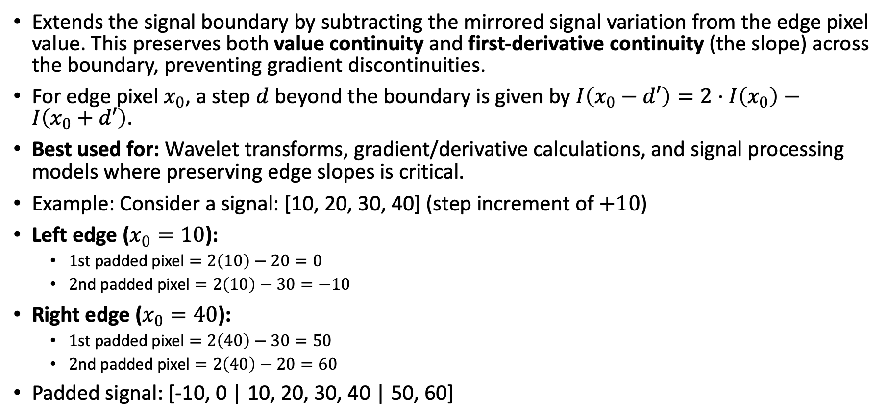
Extend (Linear Extrapolation)
Extends the signal boundary by subtracting the mirrored signal variation from the edge pixel value. This preserves both value continuity and first-derivative continuity (the slope) across the boundary, preventing gradient discontinuities.
For edge pixel $x_{0}$, a step $d$beyond the boundary is given by $I\left(x_{0}−d′\right)=2⋅I\left(x_{0}\right)−I\left(x_{0}+d′\right)$.
Best used for: Wavelet transforms, gradient/derivative calculations, and signal processing models where preserving edge slopes is critical.
Example: Consider a signal: [10, 20, 30, 40] (step increment of $+10$)
Left edge ($x_{0}=10$):
  $1\text{st padded pixel}=2\left(10\right)−20=0$
  $2\text{nd padded pixel}=2\left(10\right)−30=−10$
Right edge ($x_{0}=40$):
  $1\text{st padded pixel}=2\left(40\right)−30=50$
  $2\text{nd padded pixel}=2\left(40\right)−20=60$
Padded signal: [-10, 0 | 10, 20, 30, 40 | 50, 60]

Slide 9
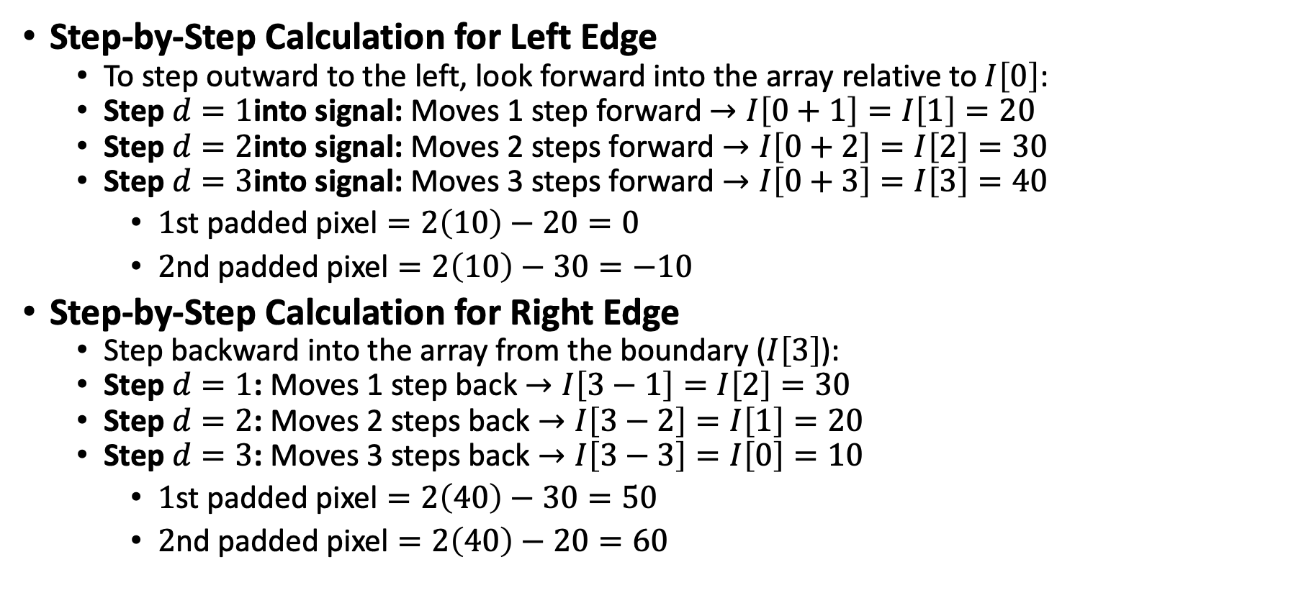

Linear Extrapolation
0 | 1 | 2 | 3
10 | 20 | 30 | 40
$$\text{Padded Pixel}=2⋅I\left[0\right]−I\left[d\right]$$
Step-by-Step Calculation for Left Edge
  To step outward to the left, look forward into the array relative to $I\left[0\right]$:
  Step $d=1$into signal: Moves 1 step forward $→I\left[0+1\right]=I\left[1\right]=20$
  Step $d=2$into signal: Moves 2 steps forward $→I\left[0+2\right]=I\left[2\right]=30$
  Step $d=3$into signal: Moves 3 steps forward $→I\left[0+3\right]=I\left[3\right]=40$
    $1\text{st padded pixel}=2\left(10\right)−20=0$
    $2\text{nd padded pixel}=2\left(10\right)−30=−10$
Step-by-Step Calculation for Right Edge
  Step backward into the array from the boundary ($I\left[3\right]$):
  Step $d=1$: Moves 1 step back $→I\left[3−1\right]=I\left[2\right]=30$
  Step $d=2$: Moves 2 steps back $→I\left[3−2\right]=I\left[1\right]=20$
  Step $d=3$: Moves 3 steps back $→I\left[3−3\right]=I\left[0\right]=10$
    $1\text{st padded pixel}=2\left(40\right)−30=50$
    $2\text{nd padded pixel}=2\left(40\right)−20=60$

Slide 10

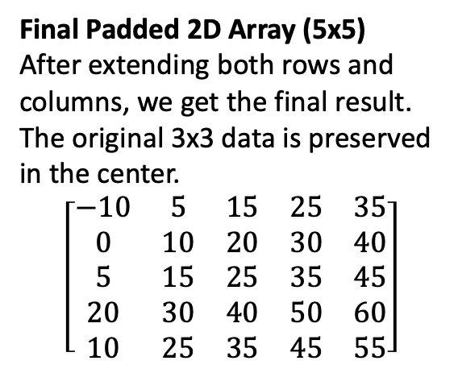
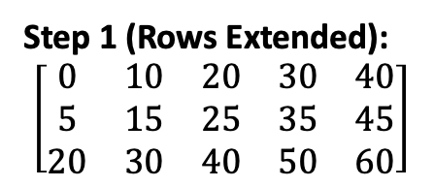
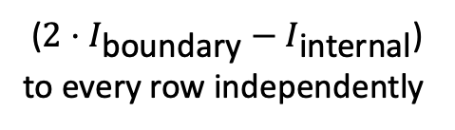
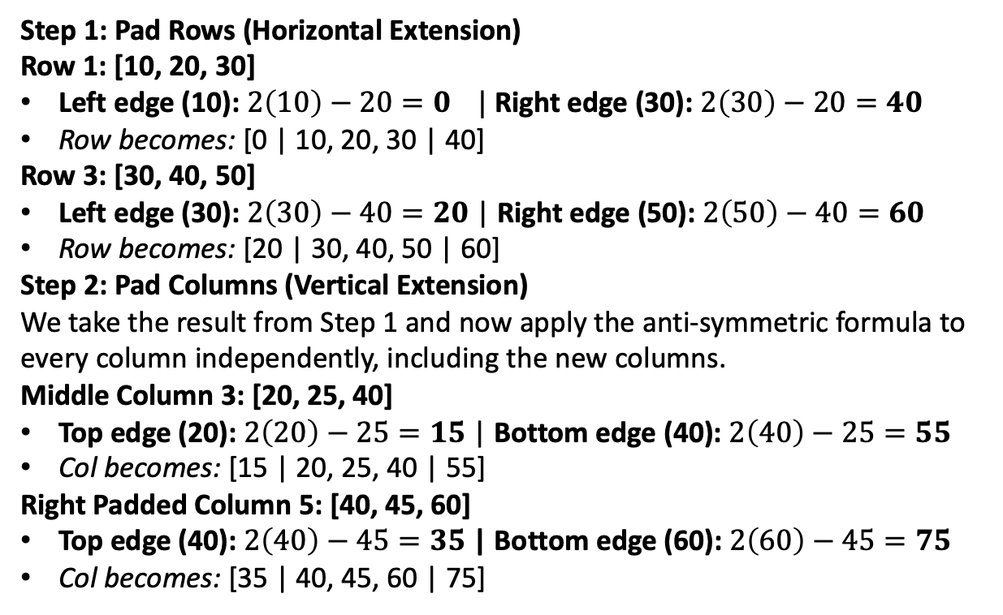
2D Example
($2⋅I_{\text{boundary}}−I_{\text{internal}}$)
to every row independently
Step 1: Pad Rows (Horizontal Extension)
Row 1: [10, 20, 30]
Left edge (10): $2\left(10\right)−20=0 |$ Right edge (30): $2\left(30\right)−20=40$
Row becomes: [0 | 10, 20, 30 | 40]
Row 3: [30, 40, 50]
Left edge (30): $2\left(30\right)−40=20$ | Right edge (50): $2\left(50\right)−40=60$
Row becomes: [20 | 30, 40, 50 | 60]
Step 2: Pad Columns (Vertical Extension)
We take the result from Step 1 and now apply the anti-symmetric formula to every column independently, including the new columns.
Middle Column 3: [20, 25, 40]
Top edge (20): $2\left(20\right)−25=15$ | Bottom edge (40): $2\left(40\right)−25=55$
Col becomes: [15 | 20, 25, 40 | 55]
Right Padded Column 5: [40, 45, 60]
Top edge (40): $2\left(40\right)−45=35$ | Bottom edge (60): $2\left(60\right)−45=75$
Col becomes: [35 | 40, 45, 60 | 75]
Step 1 (Rows Extended):
$$\left[\begin{matrix}0 & 10 & 20 & 30 & 40 \\ 5 & 15 & 25 & 35 & 45 \\ 20 & 30 & 40 & 50 & 60\end{matrix}\right]$$
Final Padded 2D Array (5x5)
After extending both rows and
columns, we get the final result.
The original 3x3 data is preserved
in the center.
$$\left[\begin{matrix}−10 & 5 & 15 & 25 & 35 \\ 0 & 10 & 20 & 30 & 40 \\ 5 & 15 & 25 & 35 & 45 \\ 20 & 30 & 40 & 50 & 60 \\ 10 & 25 & 35 & 45 & 55\end{matrix}\right]$$

Slide 11
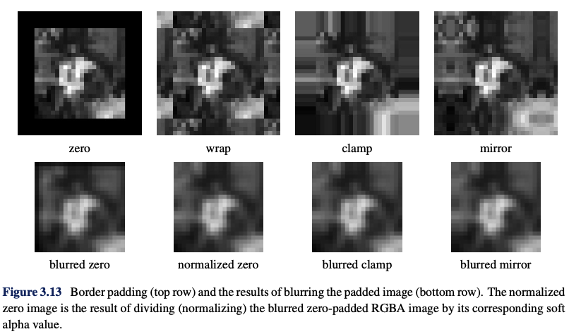

Slide 12
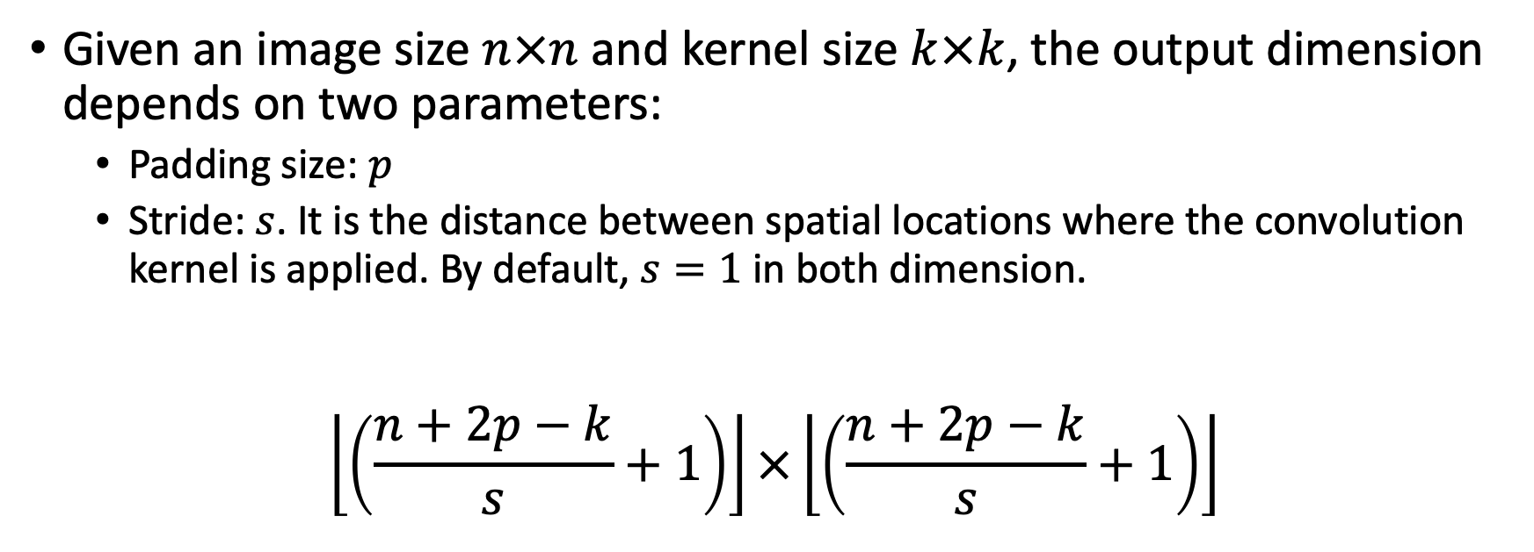
Output dimension
Given an image size $n×n$ and kernel size $k×k$, the output dimension depends on two parameters:
  Padding size: $p$
  Stride: $s$. It is the distance between spatial locations where the convolution kernel is applied. By default, $s=1$ in both dimension.
$$\left\lfloor \left(\frac{n+2p−k}{s}+1\right)\right\rfloor ×\left\lfloor \left(\frac{n+2p−k}{s}+1\right)\right\rfloor$$

Slide 13
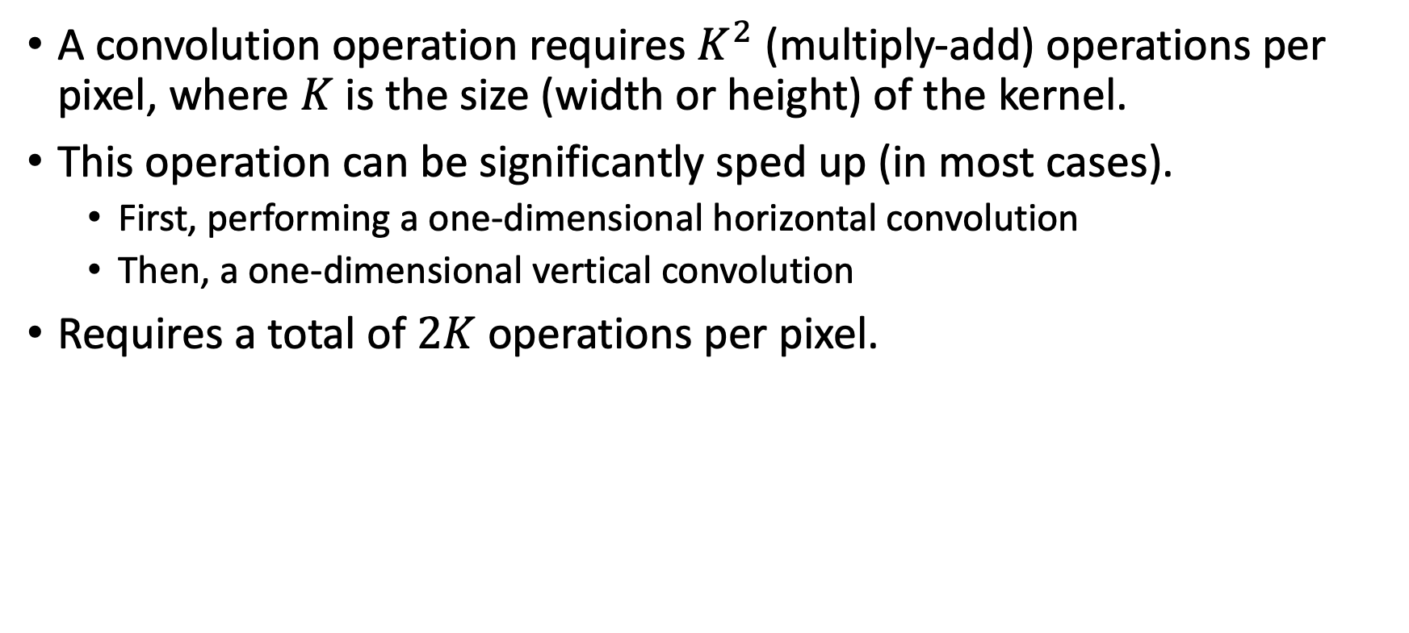
Why do we care about the Associative property?
A convolution operation requires $K^{2}$ (multiply-add) operations per pixel, where $K$ is the size (width or height) of the kernel.
This operation can be significantly sped up (in most cases).
  First, performing a one-dimensional horizontal convolution
  Then, a one-dimensional vertical convolution
Requires a total of $2K$ operations per pixel.

Slide 14

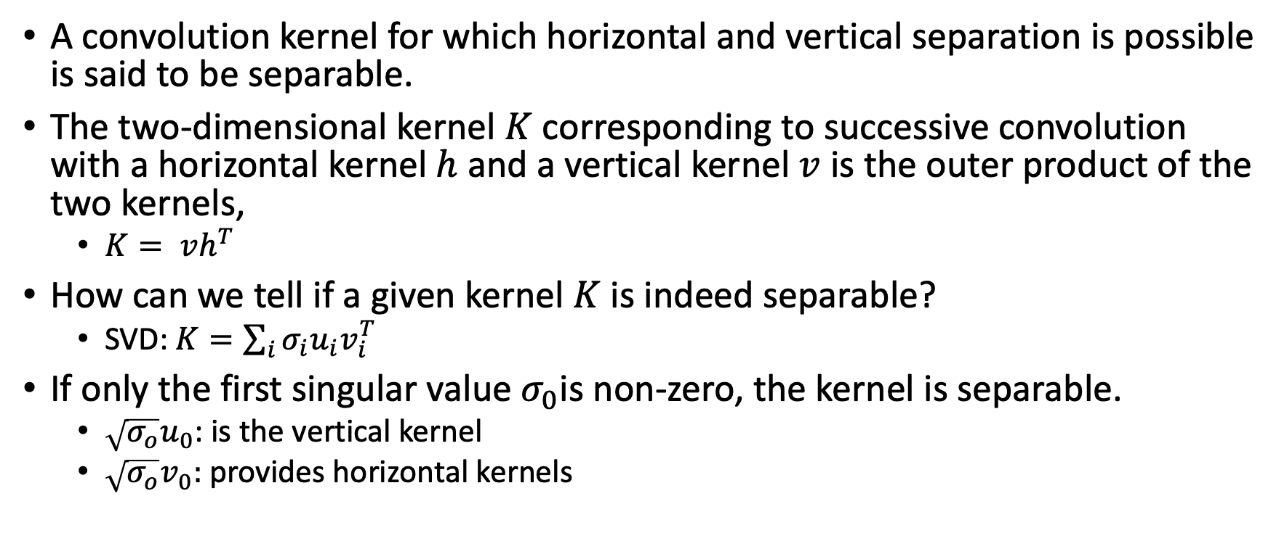
Separable kernel
A convolution kernel for which horizontal and vertical separation is possible is said to be separable.
The two-dimensional kernel $K$ corresponding to successive convolution with a horizontal kernel $h$ and a vertical kernel $v$ is the outer product of the two kernels,
  $K= vh^{T}$
How can we tell if a given kernel $K$ is indeed separable?
  SVD: $K=\sum_{i}{σ_{i}u_{i}v_{i}^{T}}$
If only the first singular value $σ_{0}$is non-zero, the kernel is separable.
  $\sqrt{σ_{o}}u_{0}$: is the vertical kernel
  $\sqrt{σ_{o}}v_{0}:$ provides horizontal kernels

Slide 15
Kernel weights
A kernel, convolution matrix, or mask is a small (weight) matrix.
It is used for :
  blurring,
  sharpening,
  embossing,
  edge detection,
Above mentioned tasks are accomplished by doing a convolution between a kernel and an image.

Slide 16
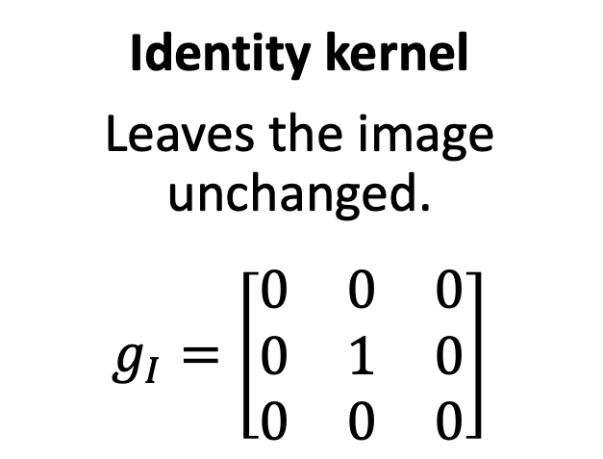
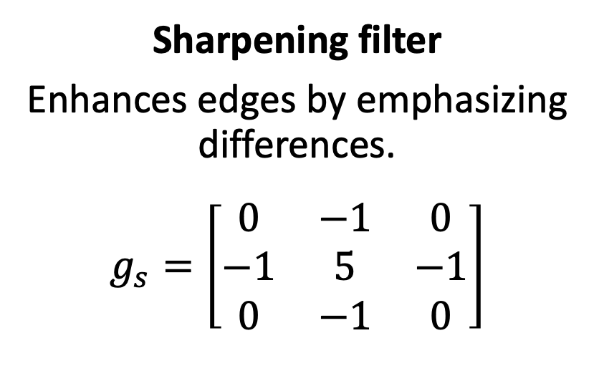
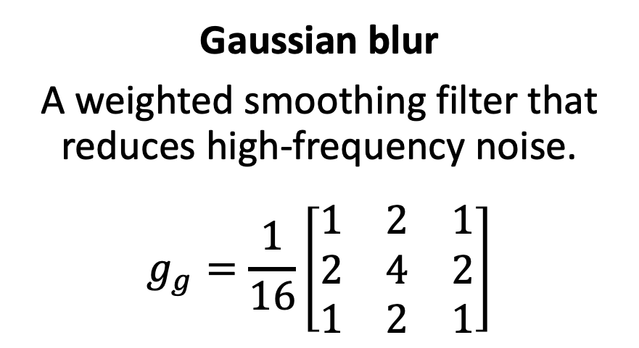
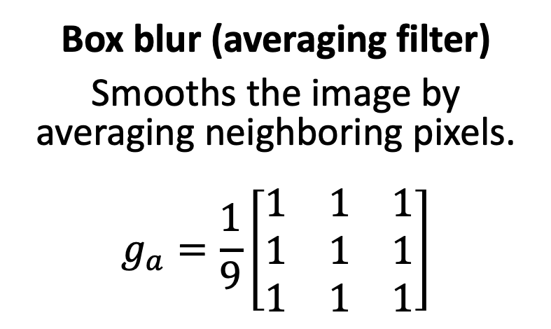
Identity kernel
Leaves the image unchanged.
$$g_{I}=\left[\begin{matrix}0 & 0 & 0 \\ 0 & 1 & 0 \\ 0 & 0 & 0\end{matrix}\right]$$
Box blur (averaging filter)
Smooths the image by averaging neighboring pixels.
$$g_{a}=\frac{1}{9}\left[\begin{matrix}1 & 1 & 1 \\ 1 & 1 & 1 \\ 1 & 1 & 1\end{matrix}\right]$$
Gaussian blur
A weighted smoothing filter that reduces high-frequency noise.
$$g_{g}=\frac{1}{16}\left[\begin{matrix}1 & 2 & 1 \\ 2 & 4 & 2 \\ 1 & 2 & 1\end{matrix}\right]$$
Sharpening filter
Enhances edges by emphasizing differences.
$$g_{s}=\left[\begin{matrix}0 & −1 & 0 \\ −1 & 5 & −1 \\ 0 & −1 & 0\end{matrix}\right]$$

Slide 17
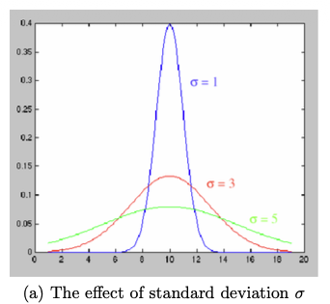
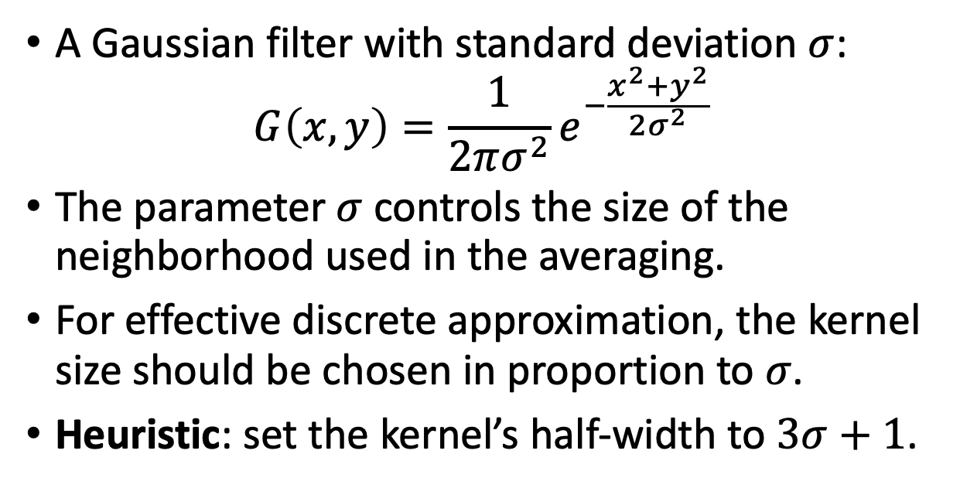
Gaussian Filter
A Gaussian filter with standard deviation $σ$:
$$G\left(x,y\right)=\frac{1}{2πσ^{2}}e^{−\frac{x^{2}+y^{2}}{2σ^{2}}}$$
The parameter $σ$controls the size of the neighborhood used in the averaging.
For effective discrete approximation, the kernel size should be chosen in proportion to $σ$.
Heuristic: set the kernel’s half-width to $3σ+1$.

Slide 18
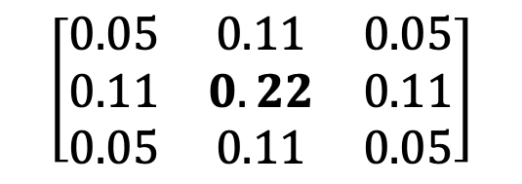


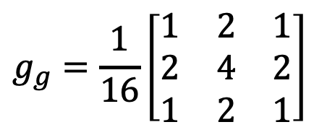
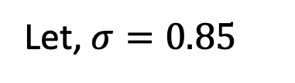
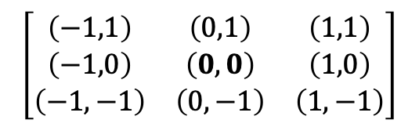

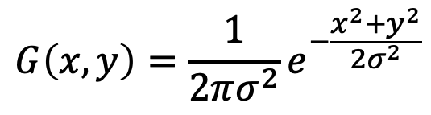
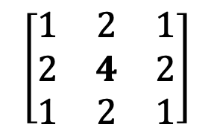
The Math Behind the Numbers
$$G\left(x,y\right)=\frac{1}{2πσ^{2}}e^{−\frac{x^{2}+y^{2}}{2σ^{2}}}$$
Let, $σ=0.85$
$$g_{g}=\frac{1}{16}\left[\begin{matrix}1 & 2 & 1 \\ 2 & 4 & 2 \\ 1 & 2 & 1\end{matrix}\right]$$
How $x,y$maps to matrix location??
$$\left[\begin{matrix}\left(−1,1\right) & \left(0,1\right) & \left(1,1\right) \\ \left(−1,0\right) & \left(0,0\right) & \left(1,0\right) \\ \left(−1,−1\right) & \left(0,−1\right) & \left(1,−1\right)\end{matrix}\right]$$
$$\left[\begin{matrix}0.05 & 0.11 & 0.05 \\ 0.11 & 0.22 & 0.11 \\ 0.05 & 0.11 & 0.05\end{matrix}\right]$$
Where is $σ$in $g_{g}$??
Integer Kernel Matrix: Multiplying the entire matrix by 20 (why 20?) converts the matrix to
standard integer values
$$\left[\begin{matrix}1 & 2 & 1 \\ 2 & 4 & 2 \\ 1 & 2 & 1\end{matrix}\right]$$
Where the$\frac{1}{16}$ comes from?
The sum of the matrix elements = 16
To ensure the filter doesn't artificially brighten the image during convolution, we divide by that total sum.

Slide 19
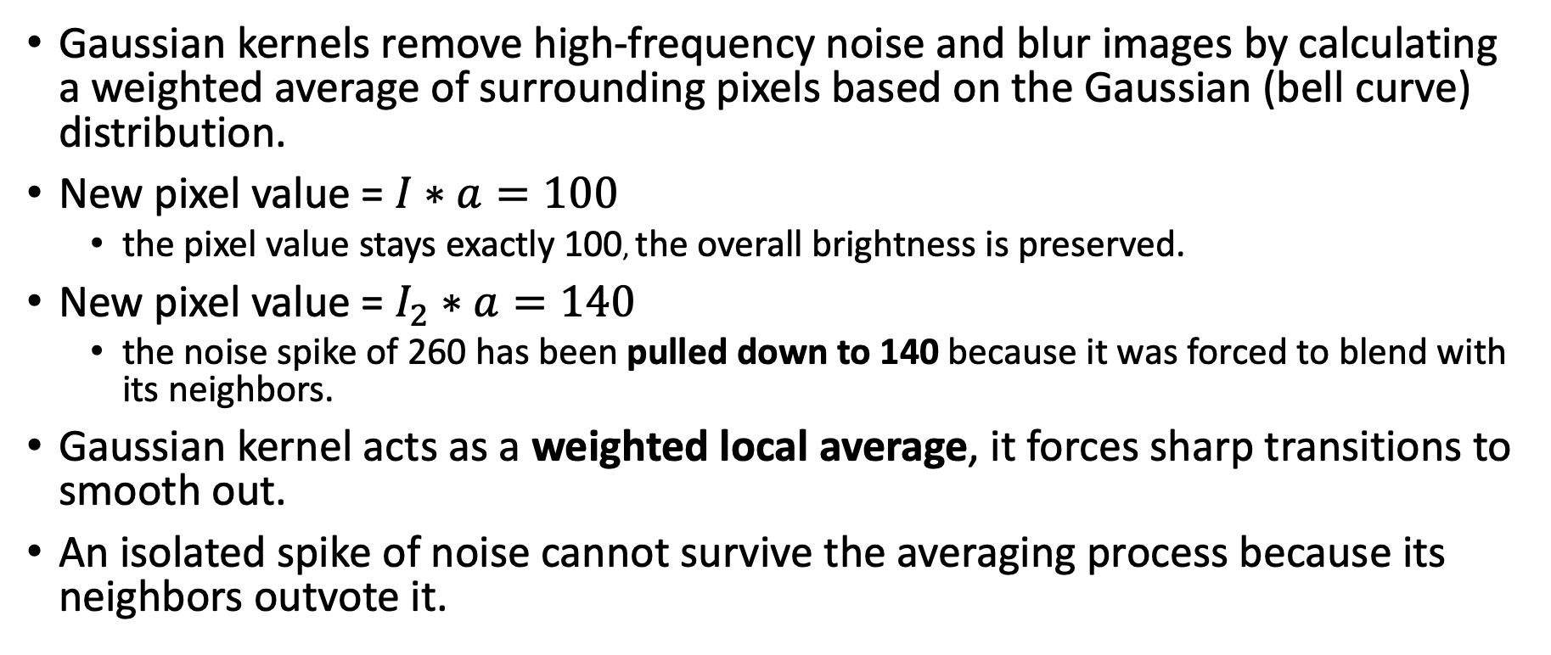
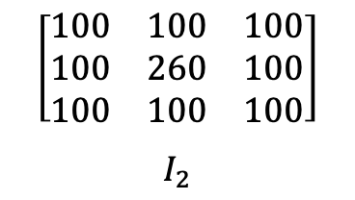
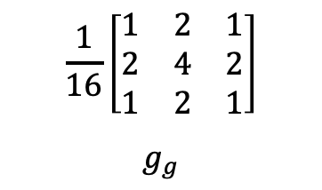
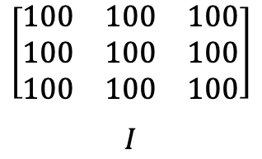
Gaussian Filter
$$\left[\begin{matrix}100 & 100 & 100 \\ 100 & 100 & 100 \\ 100 & 100 & 100\end{matrix}\right]$$
$$I$$
$$\frac{1}{16}\left[\begin{matrix}1 & 2 & 1 \\ 2 & 4 & 2 \\ 1 & 2 & 1\end{matrix}\right]$$
$$g_{g}$$
$$\left[\begin{matrix}100 & 100 & 100 \\ 100 & 260 & 100 \\ 100 & 100 & 100\end{matrix}\right]$$
$$I_{2}$$
Gaussian kernels remove high-frequency noise and blur images by calculating a weighted average of surrounding pixels based on the Gaussian (bell curve) distribution.
New pixel value = $I∗a=100$
  the pixel value stays exactly 100, the overall brightness is preserved.
New pixel value = $I_{2}∗a=140$
  the noise spike of 260 has been pulled down to 140 because it was forced to blend with its neighbors.
Gaussian kernel acts as a weighted local average, it forces sharp transitions to smooth out.
An isolated spike of noise cannot survive the averaging process because its neighbors outvote it.

Slide 20
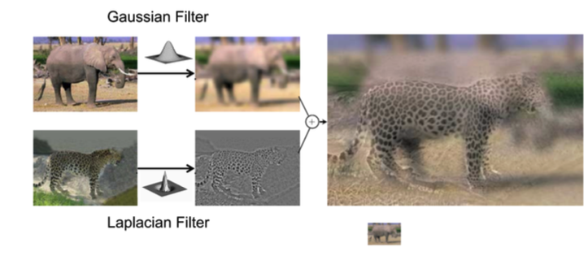
Hybrid Images

Slide 21
Hybrid Images
A single image that combines details from two different images:
  At a close distance, the image appears as one object.
  From a far distance, the image appears as another object.
This effect is achieved by blending the low-frequency components of one image with the high-frequency components of another image.
Human visual system perceives high frequencies better up close and low frequencies better at a distance:
  the image appears different depending on the viewing

Slide 22
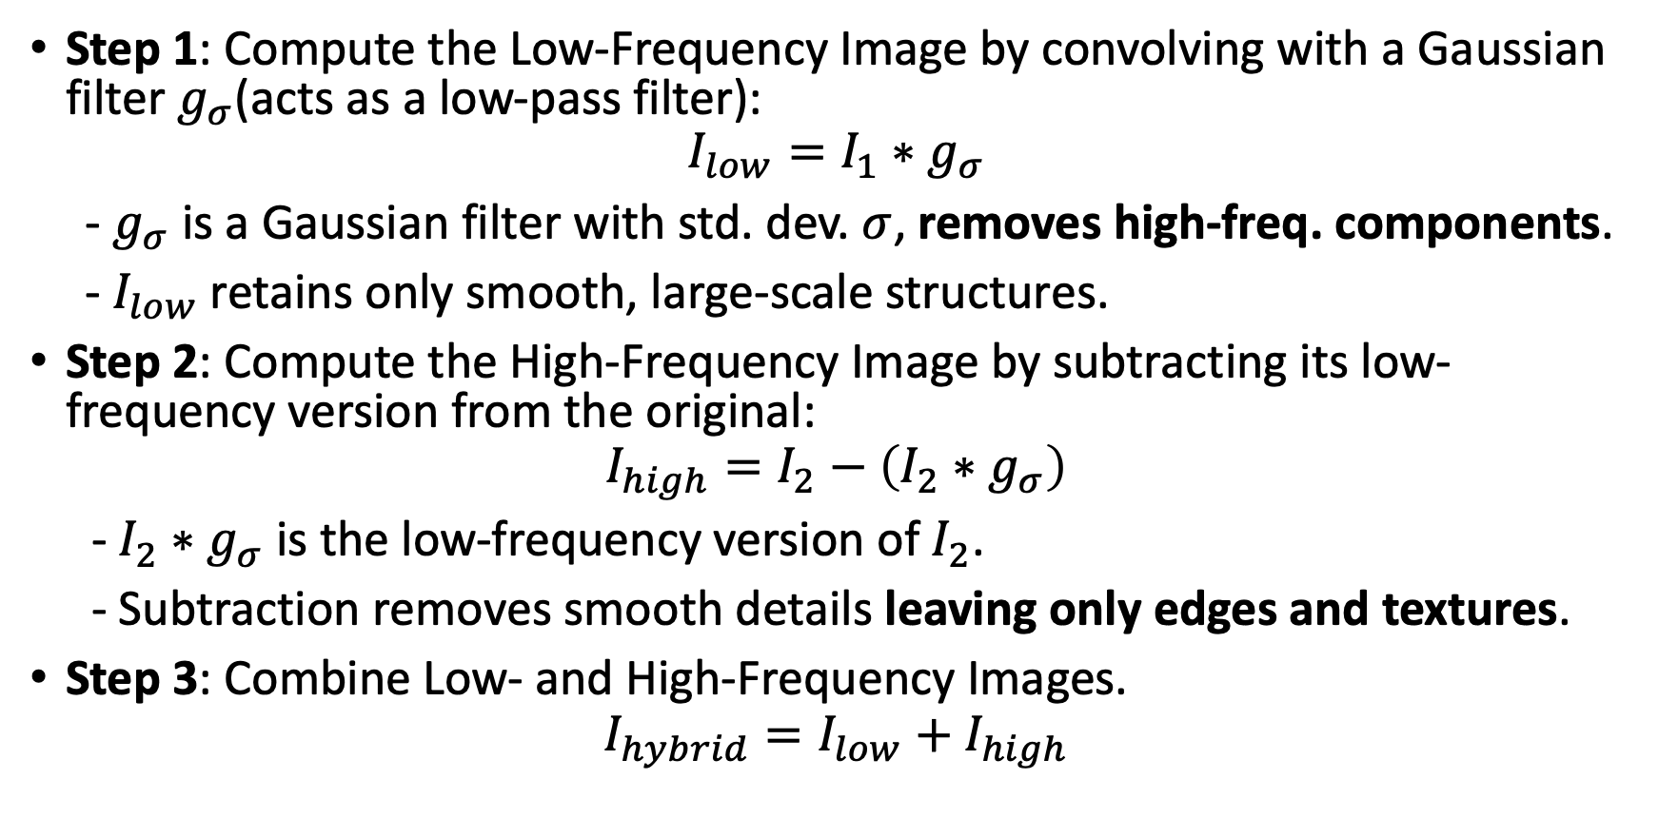
Mathematics - Hybrid Images
Step 1: Compute the Low-Frequency Image by convolving with a Gaussian filter $g_{σ}$(acts as a low-pass filter):
$$I_{low}=I_{1}∗g_{σ}$$
- $g_{σ}$ is a Gaussian filter with std. dev. $σ$, removes high-freq. components.
- $I_{low}$ retains only smooth, large-scale structures.
Step 2: Compute the High-Frequency Image by subtracting its low-frequency version from the original:
$$I_{high}=I_{2}−\left(I_{2}∗g_{σ}\right)$$
- $I_{2}∗g_{σ}$ is the low-frequency version of $I_{2}$.
- Subtraction removes smooth details leaving only edges and textures.
Step 3: Combine Low- and High-Frequency Images.
$$I_{hybrid}=I_{low}{+ I}_{high}$$

Slide 23
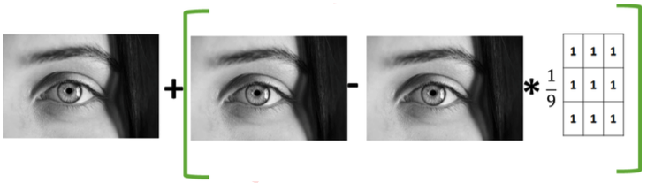
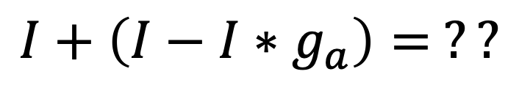
Linear filtering in practice
$$I+\left(I−I∗g_{a}\right)= ??$$

Slide 24
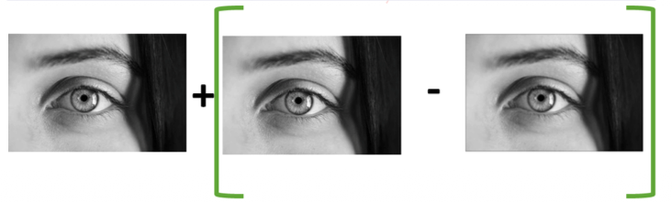

Linear filtering in practice
$$I∗A$$

Slide 25
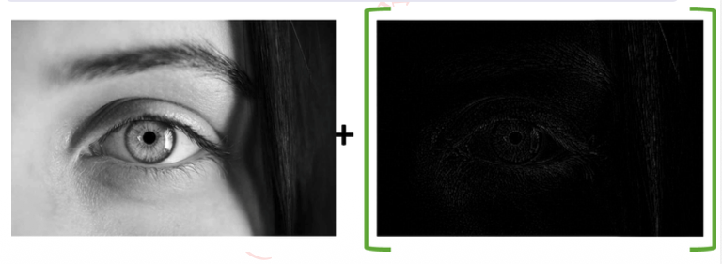
Linear filtering in practice

Slide 26
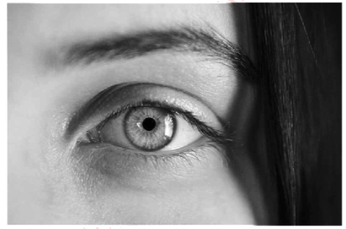
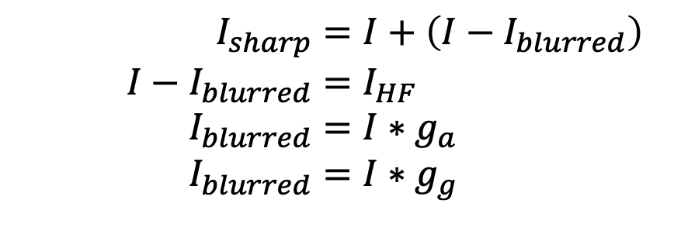
$$I_{sharp}=I+\left(I−I_{blurred}\right) \\ I−I_{blurred}=I_{HF} \\ I_{blurred}=I∗g_{a} \\ I_{blurred}=I∗g_{g}$$
This method is called “Unsharp” masking / filtering. It sharpens an image.
The unsharp filter is a versatile sharpening tool that improves the definition of fine detail by enhancing edges (and other high frequency components) in the original image.
The name derives from the fact that the technique uses a blurred, or “unsharp”, negative image to create a mask of the original image.

Slide 27
Edges
Edge detection is one of the most important pre-processing step for various computer vision tasks i.e.
  object detection
  object recognition
  shape analysis etc.
To isolate an object from its background and neighboring object pixels, first step is to recognize its edges.
An edge is a contour across which the image’s brightness or hue changes abruptly.
Notes:
Contour: A path or line separating two distinct regions in an image.

Slide 28
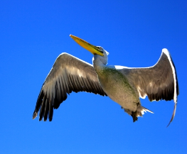
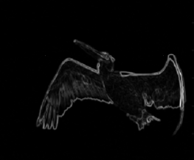
Edge detector
The goal of edge detection is to identify sudden changes (discontinuities) in an image.
We want edge operator / detector that produces :
  Edge position: exact location in an image
  Edge magnitude (strength): to threshold to decide whether its an edge.
  Edge orientation (direction)

Slide 29
Edge detection methods
Two methods of edge detection:
  Thresholding
  Convolution
Question is now how to figure out that pixel on location x,y is an edge pixel?
These are two representation of same signal (one is image and other is height map).
Edge are clearly visible in height map as where there is an edge, there is “steep cliff” in intensity.

Slide 30
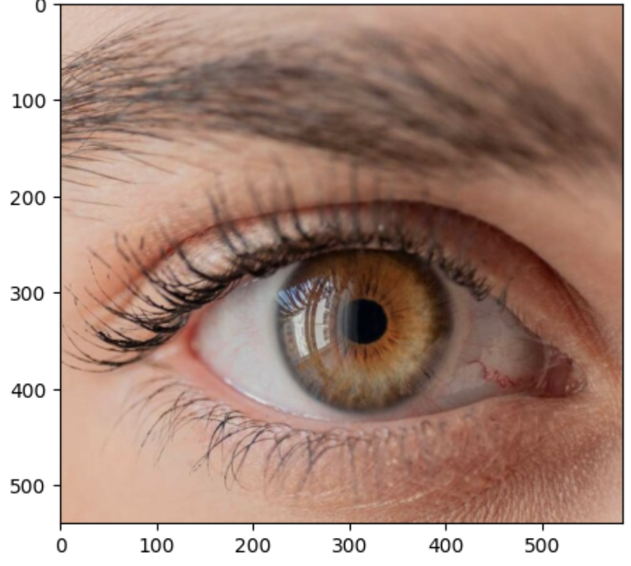
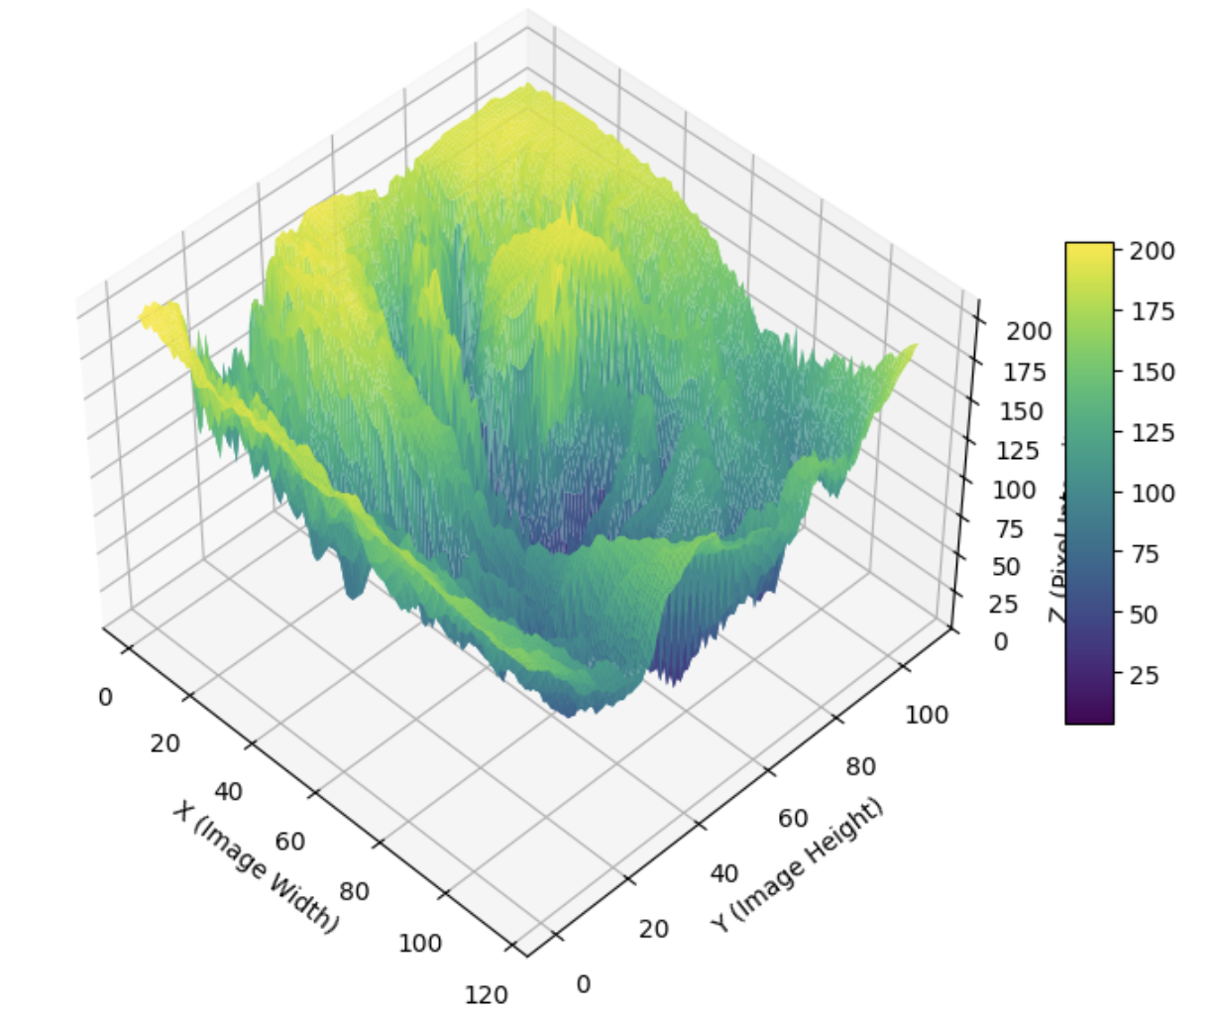

Slide 31
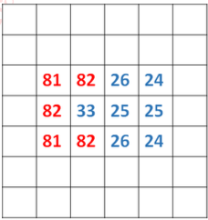
Edge detection
Basic idea: Look for a neighborhood with strong sign of change.
Problems:
  Neighborhood size
  How to detect change (how big ∆ should be called it a change?
There is a change in intensities i.e. 80’s are
on the one side, while the 20’s are on the
other side.

Slide 32
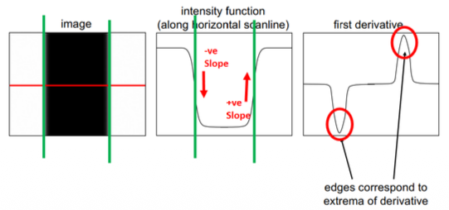
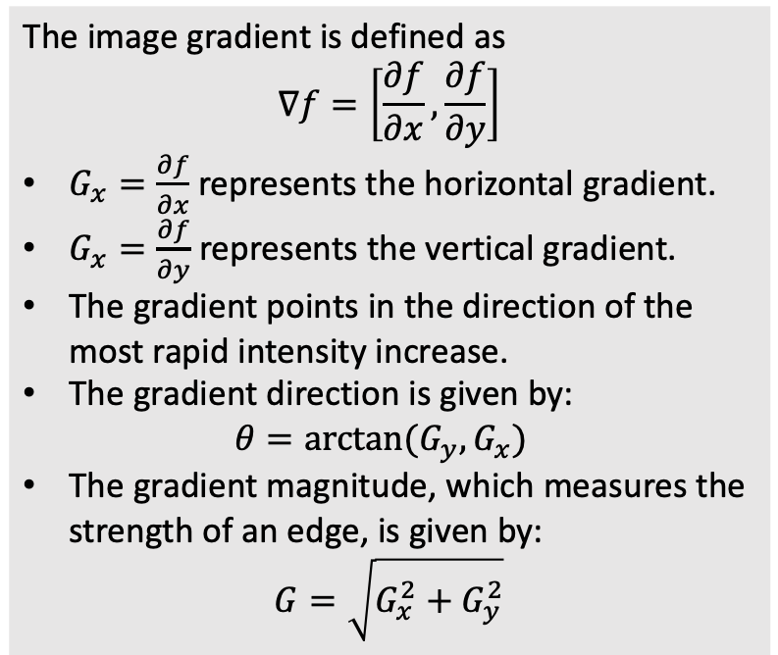
Edge detection
An edge is a place of rapid change in the image intensity function.
Change in function is detected from derivatives.
Finding edges → finding peaks in derivatives.
The image gradient is defined as
$$∇f=\left[\frac{∂f}{∂x},\frac{∂f}{∂y}\right]$$
$G_{x}=\frac{∂f}{∂x}$represents the horizontal gradient.
$G_{x}=\frac{∂f}{∂y}$ represents the vertical gradient.
The gradient points in the direction of the most rapid intensity increase.
The gradient direction is given by:
$$θ=arctan(G_{y}, G_{x})$$
The gradient magnitude, which measures the strength of an edge, is given by:
$$G=\sqrt{G_{x}^{2}+G_{y}^{2}}$$

Slide 33
Image derivative
How to find image derivatives?
  The same way as we did to remove noise i.e. run some filters.
  We need filter or differential operator (in this case).
  Differential operators when applied to an image returns derivatives / gradient.
  These operators can be modeled as filter / masks / kernels.
  In the last, some thresholding is applied to “gradients” to select the edge pixels.

Slide 34
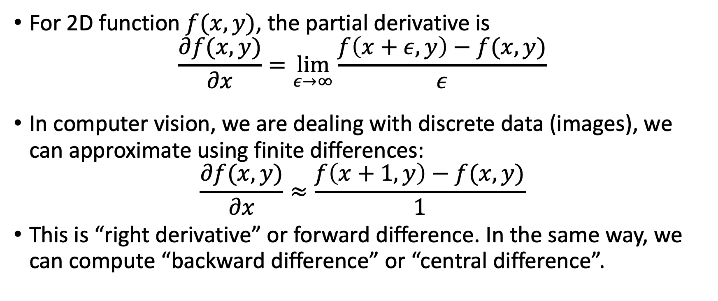
Image derivative
For 2D function $f(x,y)$, the partial derivative is
$$\frac{∂f(x,y)}{∂x}=\lim_{ε→∞}{\frac{f\left(x+ε,y\right)−f(x,y)}{ε}}$$
In computer vision, we are dealing with discrete data (images), we can approximate using finite differences:
$$\frac{∂f(x,y)}{∂x}≈\frac{f\left(x+1,y\right)−f(x,y)}{1}$$
This is “right derivative” or forward difference. In the same way, we can compute “backward difference” or “central difference”.

Slide 35
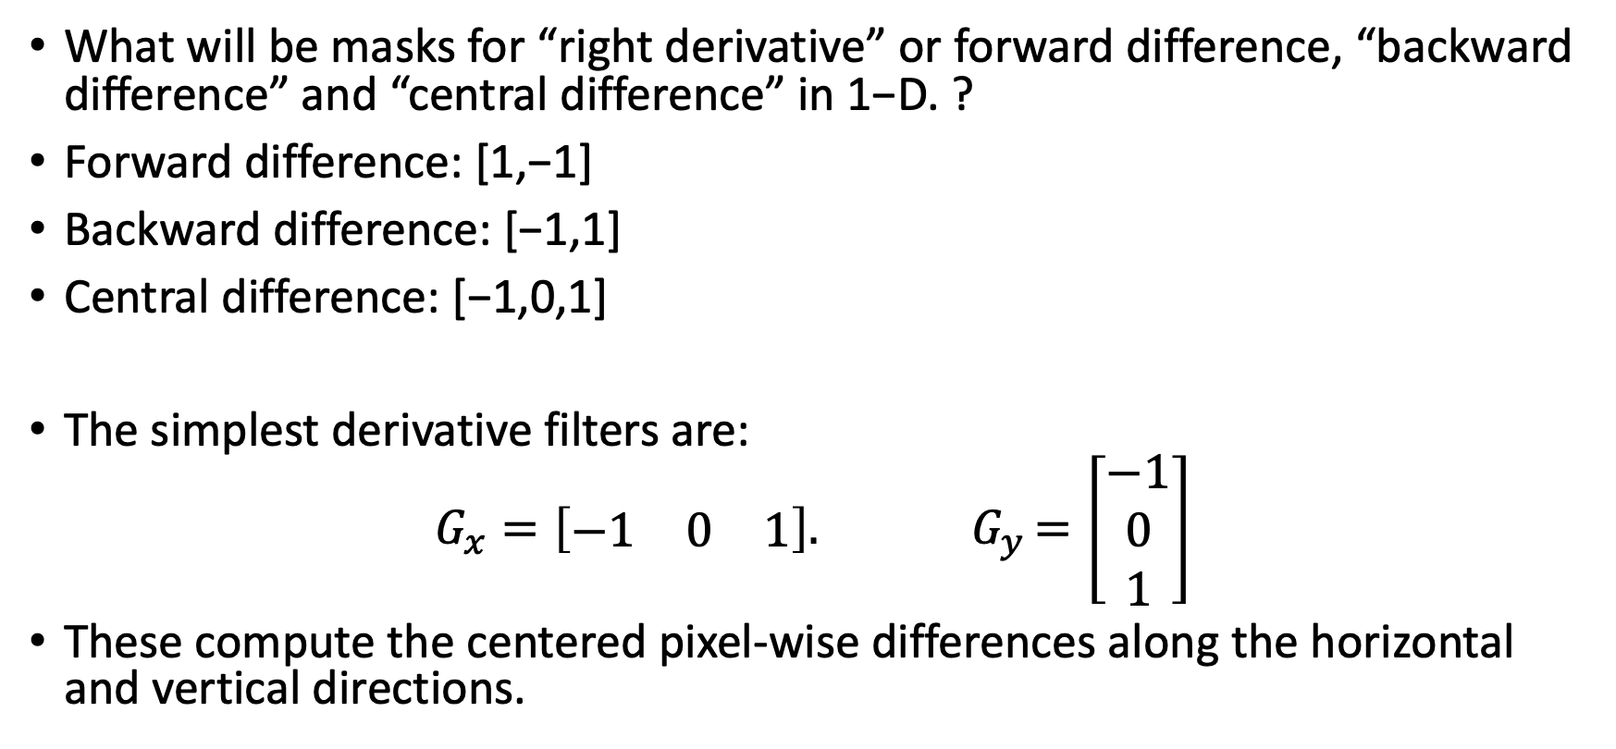
Image derivative
What will be masks for “right derivative” or forward difference, “backward difference” and “central difference” in 1−D. ?
Forward difference: [1,−1]
Backward difference: [−1,1]
Central difference: [−1,0,1]
The simplest derivative filters are:
$$G_{x}=\left[\begin{matrix}−1 & 0 & 1\end{matrix}\right]{. G}_{y}=\left[\begin{matrix}−1 \\ 0 \\ 1\end{matrix}\right]$$
These compute the centered pixel-wise differences along the horizontal and vertical directions.

Slide 36
Noise and Smoothing Before Edge Detection
Derivative filters are highly sensitive to image noise.
  To mitigate noise, first smooth the image using a Gaussian filter before applying the derivative filter
Since convolution is associative, applying a Gaussian filter followed by a derivative filter is equivalent to convolving the image with a single filter that is the convolution of the Gaussian filter with the derivative filter.
These derivatives of Gaussian filters simultaneously smooth the image and compute derivatives

Slide 37
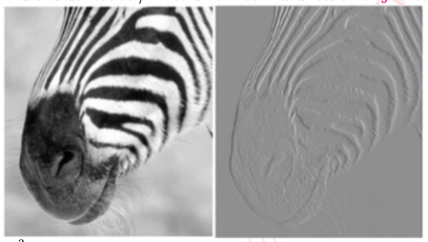

Slide 38
Readings
Szeliski book – Chap 3: Image processing
  Sections: 3.2
https://cvl-umass.github.io/intro-cv-spring-2025/assets/notes/imageprocessing.pdf
  Sections: 4, 5, 7 and 8
Computer Vision - A Modern Approach - D. Forsyth, J. Ponce
  Chap 5: Local Image Features.
    Sections: 5.1
Notebooks:
  https://www.kaggle.com/code/zahidbd/lecture9-nb1-kernel

