Slide 1


OffenseOrbit
Lost&Found?
Bridging Justice and Community with Trust and Technology
Crime Track
Presented By:
Mst. Sangida Afrin Niha - 21225103201
Md. Zahid Hasan - 21225103407
Md. Samiullah Mahmud - 21225103247
Md. Ebrahim Hossain - 21225103424

Slide 2
Table of contents
Vision & Mission
Objectives
Key Features of OffenseOrbit
Probleam Statement
Probleam Solution
Business Model
Market Analysis
Revenue Generation
Challenges
StartUp Plan
Technologies
User Experience
Conclusion

Slide 3
Vision & Mission
Vision:
To create a safer society through innovative technology, enhancing transparency and trust between citizens and law enforcement.
Mission:
To empower users with tools to report crimes, access safety information, and interact with law enforcement seamlessly.

Slide 4
Objectives
To offer a user-friendly and efficient platform for crime reporting and data management.
To ensure public access to real-time area safety information and case updates.
To enhance collaboration between law enforcement and citizens through technology.
To use data-driven insights for proactive crime prevention strategies.

Slide 5
Key Features of OffenseOrbit
Public Features:
Report crimes, search case records, provide feedback, and access area safety insights.
Law Enforcement Tools:
Case status updates, case management, and helpline tracking.
Real-Time Systems:
Live chat between users and police, danger zone mapping with three safety levels, and police station locator.
Information Hub:
Blog/news section with safety tips, crime prevention updates, and user engagement tools.

Slide 6
Problem Statement
Citizens face challenges reporting crimes and accessing real-time updates.
Crime data is fragmented, leading to inefficiencies in law enforcement operations.
Limited public access to danger zone information and safety insights.
Communication gaps between law enforcement and the public.

Slide 7
Problem Solution
Centralized platform for seamless crime data management.
Real-time tools for citizens, such as live chat and danger zone mapping.
Transparency in law enforcement through public access to case updates.
Data-driven analytics for identifying crime hotspots and safety concerns.

Slide 8
Business Model
Key Partners
- Law enforcement agencies
- Government organizations
- Technology investors
- NGOs and safety advocates
Key Activities
- Crime data collection and centralized management
- Development of danger zone mapping technology
- Integration of live chat systems for real-time communication
- Regular updates and maintenance of the platform
Value Propositions
- Building public trust through transparency
- Streamlining crime reporting and case management
- Proactive crime prevention through data-driven insights
- Enhancing collaboration between law enforcement and citizens
Customer Relationship
- Direct interaction with law enforcement via live chat
- Personalized assistance through user accounts
- Automated and real-time safety alerts for users
Customer Segments
- Bangladeshi citizens (urban and rural populations)
- Law enforcement agencies aiming for efficiency
- NGOs working in public safety and advocacy
Key Resources
- Web and mobile platform infrastructure
- Geographic Information System (GIS) and NLP technologies
- Secure databases for crime and user data
- Skilled personnel for development and support
Cost Structure
- Platform development and maintenance costs
- Training programs for law enforcement officers
- Marketing and public awareness campaigns
- Investment in cybersecurity for user data protection
Revenue Stream
- Subscription fees for premium features (e.g., advanced safety alerts)
- Contracts with government and law enforcement agencies
- Grants and donations from safety organizations
- Partnerships and sponsorships with NGOs and safety-related brands

Slide 9
Market Analysis
Target Audience:
Citizens (urban and rural) seeking safer communities.
Law enforcement agencies aiming to improve efficiency.
Market Need:
High demand for real-time crime data and safety insights.
Limited existing platforms offering integrated public-law enforcement tools.
Competitive Edge:
Unique features like live chat, real-time danger zone mapping, and police station locator.
Tailored for Bangladesh’s infrastructure and societal needs.
Market Trends:
Growing public reliance on digital tools for safety.
Increased government spending on smart city initiatives and safety tech.

Slide 10
Revenue Generation
Subscription Plans:
Basic Plan (Free): Access to basic features like crime reporting and area safety maps.
Premium Plan:
Advanced features, including real-time alerts and detailed danger zone insights.
Government Contracts:
Partnership with local law enforcement agencies for custom integrations.
Advertisements and Sponsorships:
Collaborations with NGOs and safety product companies for in-platform ads.
Donations and Grants:
Support from public safety organizations and international donors.

Slide 11
Challenges
Overcoming resistance to new technology in law enforcement.
Ensuring platform accessibility for rural users with limited internet access.
Protecting user data and maintaining privacy.
Keeping crime data updated in real-time.

Slide 12
StartUp Plan
Beta launch, onboarding law enforcement agencies, and public awareness.
Full-scale rollout with advanced features and data analytics.
National expansion, integrating AI-based safety predictions, and multilingual support.
Explore international opportunities and partnerships.

Slide 13
Technologies
Front-End :
HTML,CSS.
Back-End :
JAVA SCRIPT,PHP,MY-SQL.

Slide 14
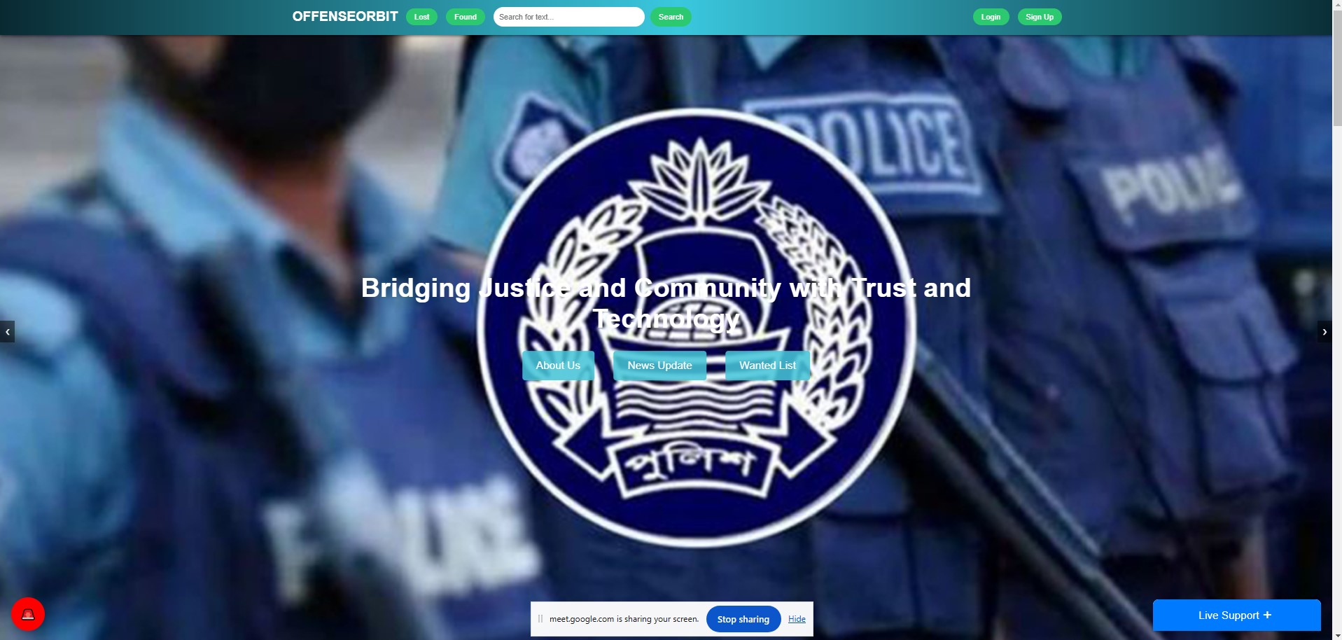
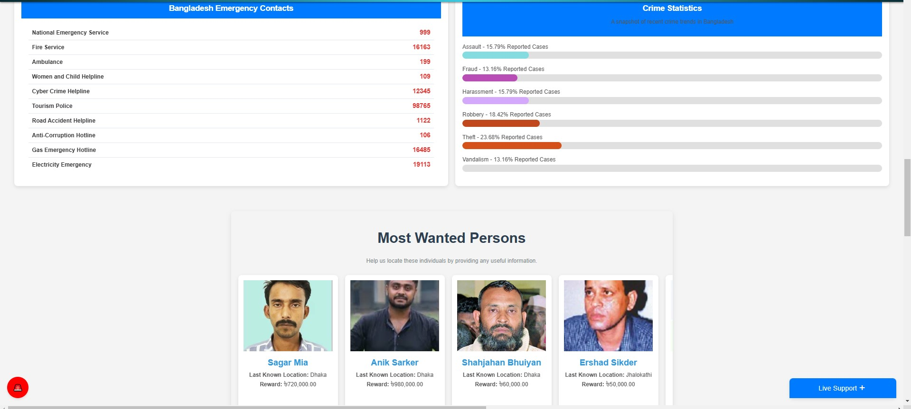
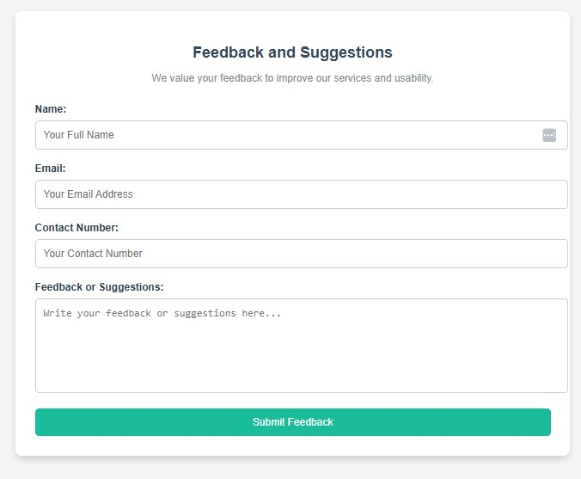
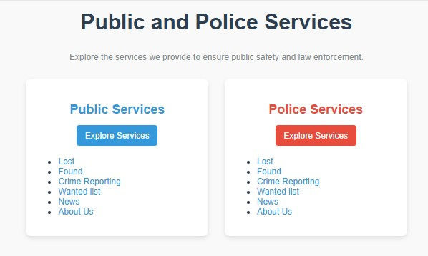
Homepage Dashboard

Slide 15
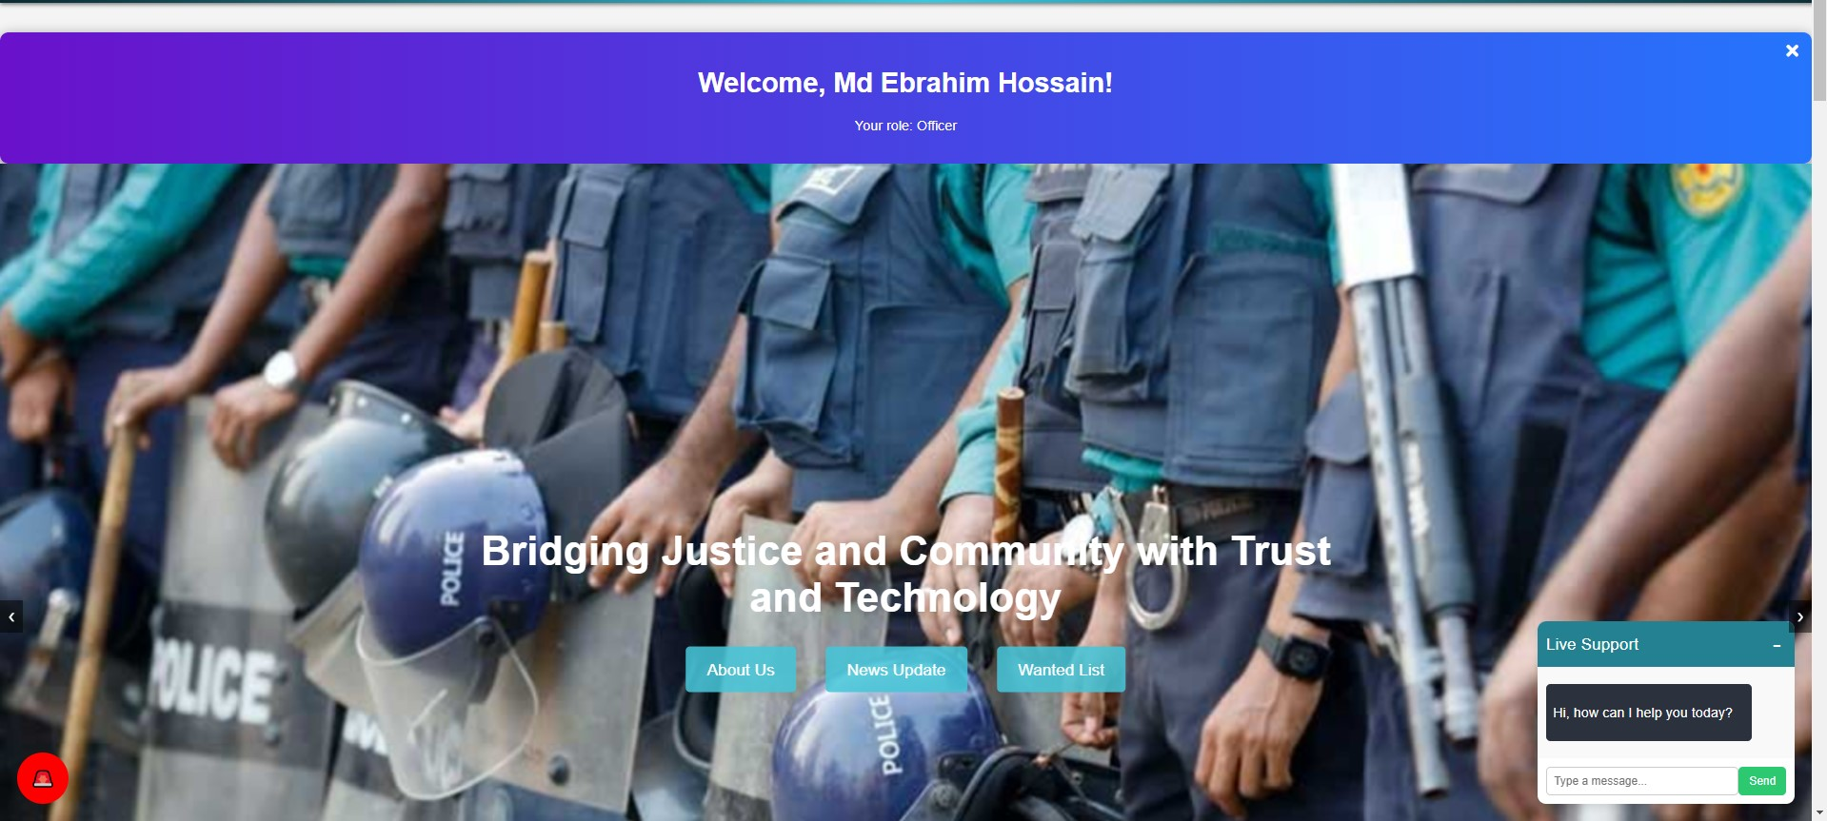
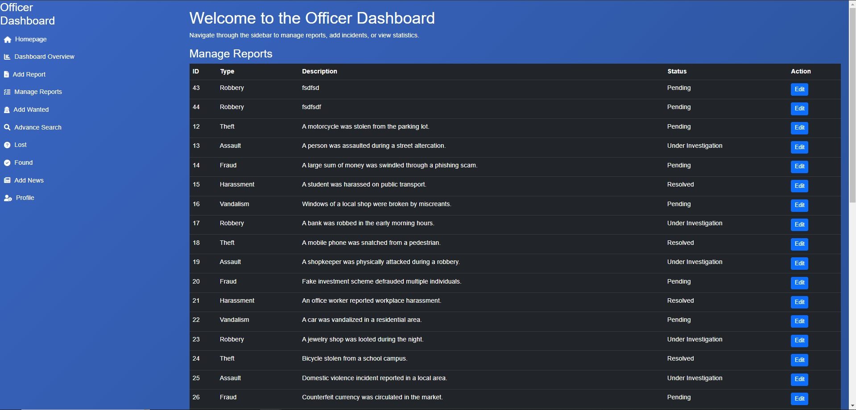
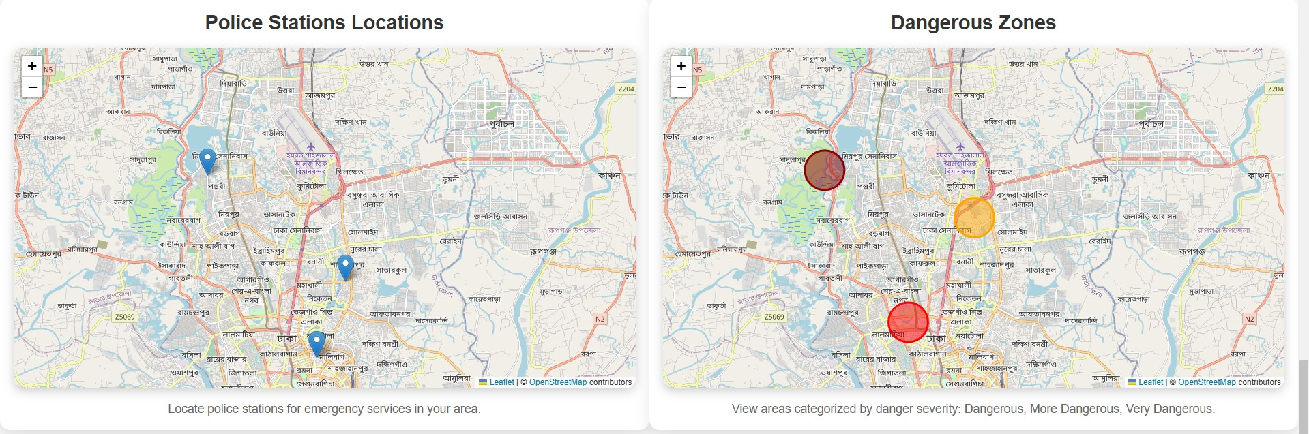
Officer Dashboard

Slide 16
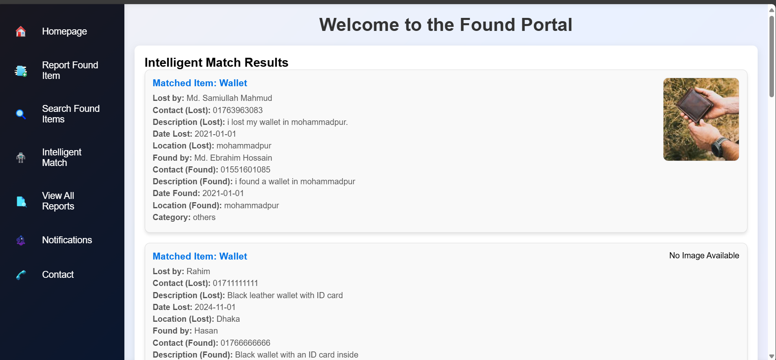
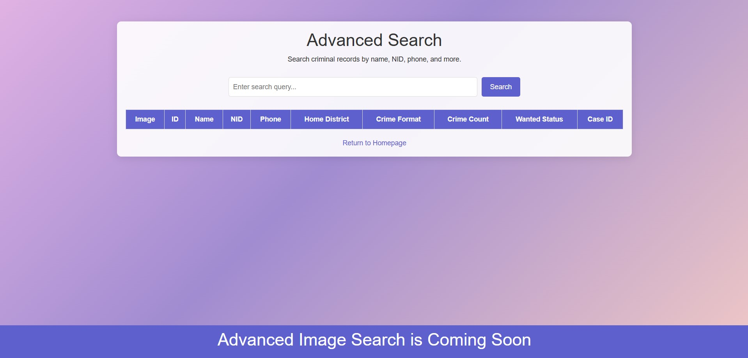
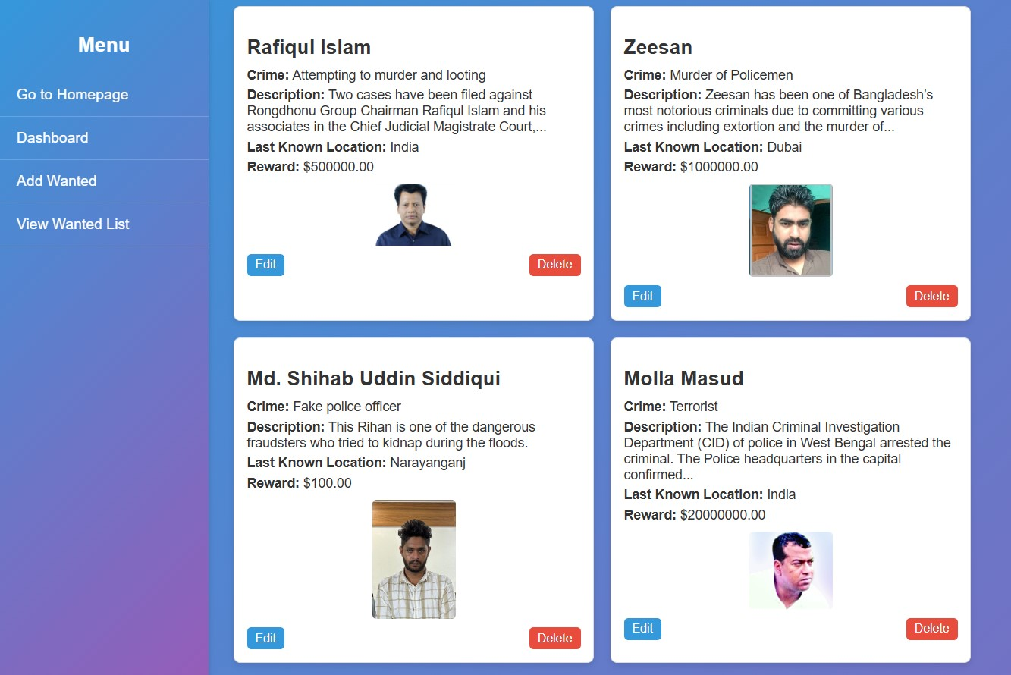
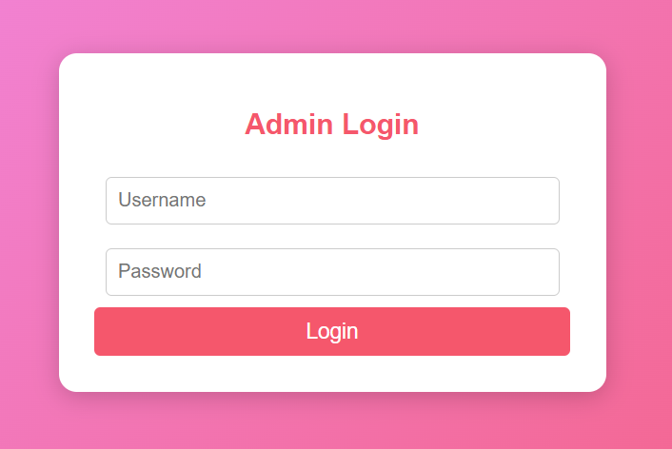
Interfaces

Slide 17
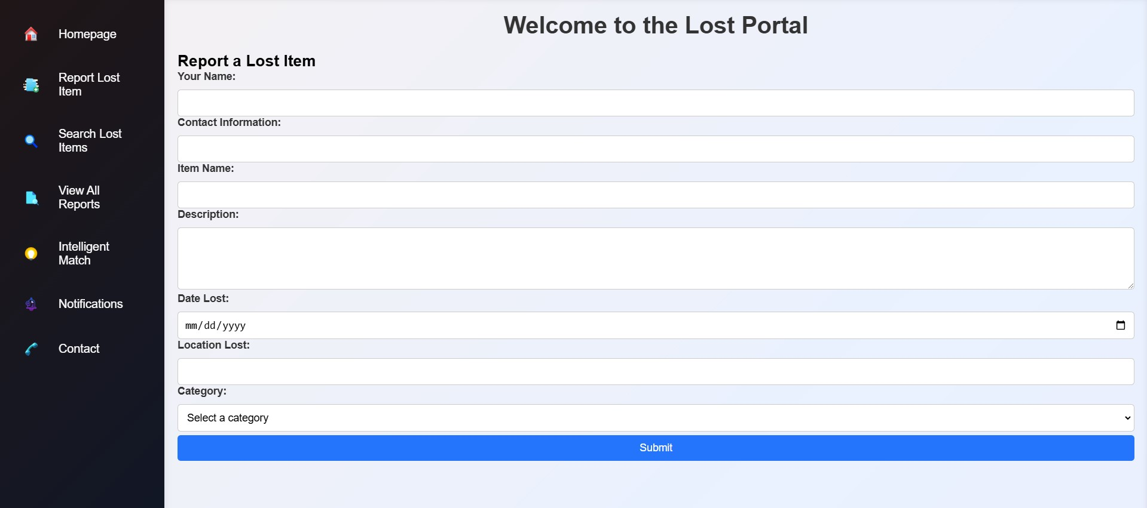
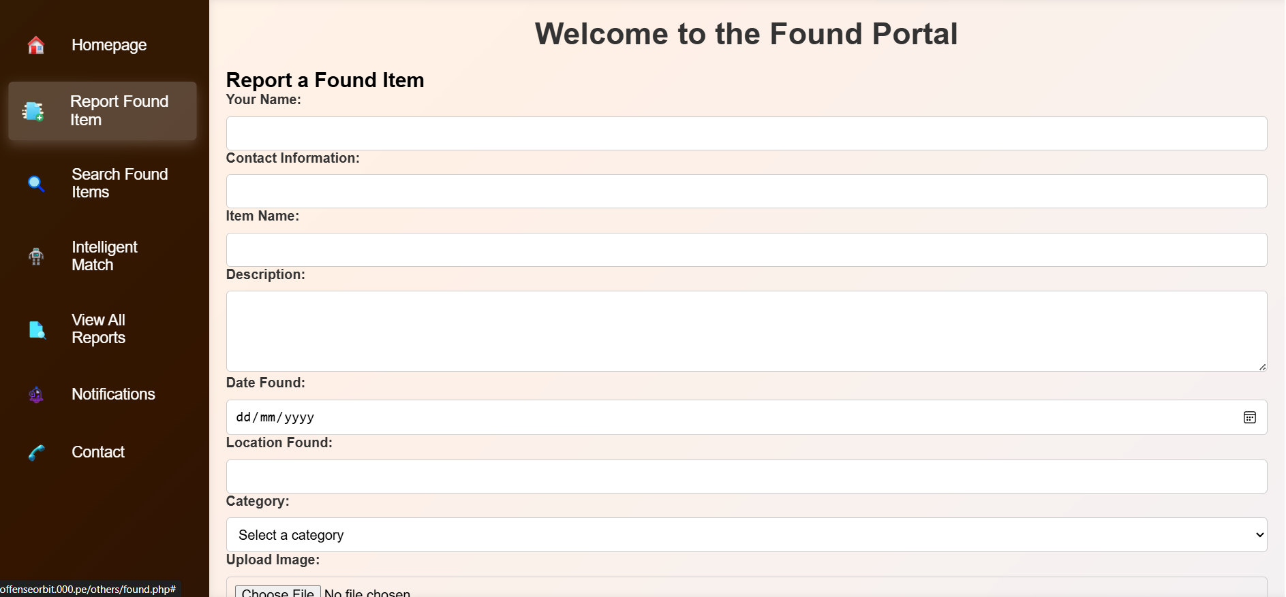
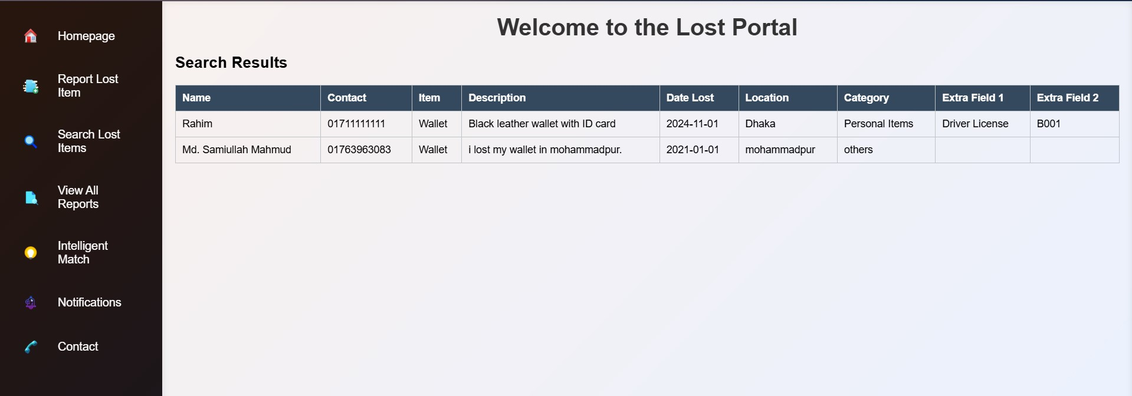
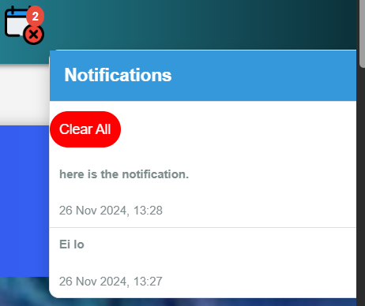
Lost & Found

Slide 18
User Experience
Responsive design for accessibility on all devices.
Intuitive navigation for easy reporting and data retrieval.
Multilingual support for inclusivity.
Interactive tools like live chat, mapping, and blog engagement.

Slide 19
Conclusion
OffenseOrbit bridges the gap between law enforcement and public safety.
Aims to revolutionize crime reporting and management in Bangladesh.
Encourages public trust and proactive crime prevention.

Slide 20
Thank You
Have questions? Let’s connect!
Website: [offenseorbit.000.pe](http://offenseorbit.000.pe)

