Slide 1
🏛️ SMART CITY CIVIC INFRASTRUCTURE INTELLIGENCE
CivicAlert AI
Automated Public Infrastructure Issue Detection, Routing & Municipal Triage
Empowering citizens to report road hazards in seconds — enabling city authorities to dispatch field repair crews with zero friction.
🤖 MobileNetV2 Vision
98.33% Test Accuracy · ~35ms Inference · 100% Pothole Recall
🏛️ Automated Routing
Zero-Confusion Dispatch to Sanitation, Public Works & Highways
📝 Live Gemini LLM
Dynamic Real-Time Citizen Grievance & Technical Petitions
📊 Municipal Console
Role-Based Dispatch Center · SQLite Persistence · 5-Stage SLA Pipeline
Lead Developer: Zahid Jan | BS Computer Science, UET Mardan | GitHub: zahidjan01a/AI-Powered-Public-Infrastructure-Issue-Detection-and-Reporting-System

Slide 2
AI-POWERED PUBLIC INFRASTRUCTURE MONITORING & REPORTING
Executive Summary
The Big Picture: Transforming Citizen Grievances into Rapid Municipal Action
🔴 The Urban Challenge
Traditional public infrastructure reporting is broken, slow, and frustrating:
• Citizens encounter dangerous potholes, garbage piles, and cracked roads daily.
• Reports are ignored, lost in bureaucratic phone lines, or bounced across the wrong agencies.
• City engineers receive vague descriptions without photographic proof, GPS location, or urgency ratings.
• The result: Escalating road damage, traffic accidents, and citizen distrust in local government.
🟢 The AI Solution
CivicAlert AI delivers an intelligent, end-to-end civic reporting pipeline:
• Deep Learning Computer Vision: MobileNetV2 verifies road defects in ~35ms with 98.33% accuracy.
• Multi-Department Routing: Automatically identifies the responsible agency (Sanitation vs. Public Works vs. Highways).
• Real-Time Google Gemini LLM: Converts photos and addresses into formal, respectful municipal grievance petitions.
• Instant Proof: Citizens receive an official Reference Ticket (#REF-2026-XXX) with estimated resolution SLA.
🔵 Municipal Operations
Delivering tangible operational impact to cities and citizens alike:
• Dedicated Operations Console: Standalone back-office dashboard for city engineers and supervisors.
• Operational Triage: Supervisors assign repair crews, record field inspection notes, and track SLAs.
• 100% Pothole Recall: Critical road safety hazards are never overlooked by the vision classifier.
• 5-Stage Live Progress Bar: Full transparency from submission to resolution keeps citizens informed.
CivicAlert AI · Built by Zahid Jan · UET Mardan
2 / 16

Slide 3
AI-POWERED PUBLIC INFRASTRUCTURE MONITORING & REPORTING
Problem Statement
Why Traditional Municipal Maintenance Fails Cities and Citizens
1. Slow, Manual Reporting
Citizens must call municipal helplines, wait on hold, or visit city offices in person during business hours. Over 70% of road defects are never reported due to procedural friction.
2. Lack of Visual Triage
Helpline operators cannot determine issue severity from verbal complaints. A critical 2-foot pothole is prioritized the same as minor surface fading, risking tire blowouts and accidents.
3. Wrong Department Bouncing
Municipal jurisdictions are confusing. Potholes belong to Public Works, garbage to Sanitation, highway cracks to the Highway Authority. Complaints routinely bounce between departments for weeks.
4. Zero Citizen Feedback & Proof
Citizens receive no ticket number, no proof of submission, and no status updates. They never know if anyone inspected the issue, destroying accountability and civic trust.
CivicAlert AI · Built by Zahid Jan · UET Mardan
3 / 16

Slide 4
AI-POWERED PUBLIC INFRASTRUCTURE MONITORING & REPORTING
Project Goals & System Flow
Four Integrated Architectural Pillars for Smart Urban Governance
Goal 1: AI Visual Diagnosis
Deploy a lightweight, high-accuracy deep learning classifier (MobileNetV2) that identifies road issues (Garbage, Pothole, Road Crack, Normal) in ~35ms with near-zero false negatives on critical road hazards.
Goal 2: Frictionless Citizen Intake
Eliminate confusing raw coordinate numbers. Provide an intuitive interface where citizens upload a photo, type a recognizable street landmark, and immediately see AI verification.
Goal 3: Automated Department Routing
Build an intelligent municipal routing engine that identifies the correct authority (e.g. Sanitation, Public Works), sets priority tiers, and calculates turnaround SLAs (24-72h).
Goal 4: Live Generative AI & Persistence
Leverage Google Gemini LLM to draft formal municipal grievance petitions in real time, backed by an SQLite persistence engine and standalone Municipal Admin Console for full lifecycle triage.
🔄 COMPLETE END-TO-END CLOSED-LOOP PIPELINE
Citizen Uploads Photo ➔ MobileNetV2 Vision (~35ms) ➔ Department & SLA Routing ➔ Live Gemini Grievance Petition ➔ SQLite Persistence (#REF Ticket) ➔ Municipal Admin Triage & Field Crew Dispatch ➔ Citizen 5-Stage Tracking
CivicAlert AI · Built by Zahid Jan · UET Mardan
4 / 16

Slide 5
AI-POWERED PUBLIC INFRASTRUCTURE MONITORING & REPORTING
Dataset & Preparation
56,916 Benchmark Images Aggregated & Curated Across 4 Key Infrastructure Classes
📊 Full Aggregated Dataset (56,916 Images)
• Garbage / Waste Accumulation: 12,960 images
Context: Streets, lots, and public disposal areas
• Normal Asphalt Road: 24,534 images
Context: Undamaged highways and local streets
• Asphalt Potholes: 9,422 images
Context: Dangerous pavement cavities and deep holes
• Road Cracks: 10,000 images
Context: Longitudinal, transverse, and alligator cracks
⚙️ Balanced Training Subset (3,991 Images)
• Class Balancing:
Sampled exactly ~1,000 images per class to prevent model bias towards majority class (Normal).
• Train / Val / Test Split:
70% Training (2,793 images) | 15% Validation (599 images) | 15% Unseen Test (599 images).
• Pre-processing Pipeline:
Bilinear resize to 224×224×3, MobileNetV2 pixel normalization ([-1, 1] range).
• Robust Augmentation:
Random horizontal flips, rotation (±15°), zoom (±10%), and contrast jittering to mirror varied lighting.
CivicAlert AI · Built by Zahid Jan · UET Mardan
5 / 16

Slide 6
AI-POWERED PUBLIC INFRASTRUCTURE MONITORING & REPORTING
AI Vision Engine
MobileNetV2 Transfer Learning Architecture for Ultra-Fast Inference
🏗️ Model Architecture Overview
• Pretrained Base:
MobileNetV2 trained on ImageNet (1.4M images, 1,000 classes)
• Base Parameter Count:
2.26 Million parameters (frozen during Phase 1 feature extraction)
• Feature Vector:
GlobalAveragePooling2D reduces spatial tensor to 1,280 feature nodes
• Regularization Head:
Dense layer (128 units, ReLU) + Dropout (0.3) + Batch Normalization
• Classification Head:
Dense softmax layer with 4 outputs (garbage, normal, pothole, road_crack)
• Total Trainable Params:
164,484 parameters in custom classification head
• Inference Latency:
~35 milliseconds on standard quad-core CPU (no GPU required)
💡 Why MobileNetV2 Over Heavy CNNs?
• 1. Depthwise Separable Convolutions:
Splits spatial filtering from feature combination, reducing computation by 8-9× compared to standard 2D convolutions.
• 2. Inverted Residuals & Linear Bottlenecks:
Preserves information manifold in low-dimensional embeddings, preventing non-linearities from destroying critical visual signals.
• 3. Edge & Mobile Deployability:
Tiny memory footprint (~14 MB .keras file). Can run natively on edge devices, dashcams, and mobile phones with zero lag.
• 4. Exceptional Feature Representation:
Pretrained lower layers provide rich edge, texture, and asphalt aggregate filters out-of-the-box.
CivicAlert AI · Built by Zahid Jan · UET Mardan
6 / 16

Slide 7
AI-POWERED PUBLIC INFRASTRUCTURE MONITORING & REPORTING
Training & Results
Outstanding Accuracy & Zero Pothole Misses on Unseen Test Benchmark
98.33%
Test Accuracy
On 599 unseen test images
100%
Pothole Recall
149 of 149 potholes detected
0.99
Overall Macro F1
Harmonic mean across all classes
~35ms
Inference Latency
Per image on standard CPU
📈 Training Dynamics & Optimization Strategy
• Optimizer & Loss Function: Adam optimizer with initial learning rate 0.001, categorical cross-entropy loss.
• Learning Rate Scheduling: ReduceLROnPlateau (factor=0.2, patience=2, min_lr=1e-6) dropped LR automatically when validation loss flattened.
• Early Stopping & Checkpointing: ModelCheckpoint saved best weights (`models/best_model.keras`) based on lowest validation loss (0.051).
• Why 1 Epoch Was Sufficient: The ImageNet feature backbone transferred exceptionally well to asphalt textures and urban refuse. Within 1 epoch, validation accuracy reached 98.33%, demonstrating instant feature alignment without overfitting.
CivicAlert AI · Built by Zahid Jan · UET Mardan
7 / 16

Slide 8
AI-POWERED PUBLIC INFRASTRUCTURE MONITORING & REPORTING
Evaluation Proof
Confusion Matrix Analysis Across 599 Unseen Real-World Test Images
Actual \ Predicted | Garbage | Normal | Pothole | Crack
Garbage (150 images) | 149 | 0 | 0 | 1
Normal Road (150 images) | 0 | 147 | 0 | 3
Asphalt Pothole (149 images) | 0 | 0 | 149 | 0
Road Crack (150 images) | 0 | 0 | 0 | 150
🎯 Class-by-Class Classification Report
Garbage:
Precision: 1.00 · Recall: 0.99 · F1-Score: 1.00
Normal Road:
Precision: 0.99 · Recall: 0.98 · F1-Score: 0.99
Asphalt Pothole:
Precision: 0.99 · Recall: 1.00 · F1-Score: 0.99
Road Crack:
Precision: 0.99 · Recall: 1.00 · F1-Score: 1.00
Overall Model Macro Average: 0.99 Precision / 0.99 Recall / 0.99 F1
CivicAlert AI · Built by Zahid Jan · UET Mardan
8 / 16

Slide 9
AI-POWERED PUBLIC INFRASTRUCTURE MONITORING & REPORTING
Phase 1: What We Had Before
The Initial Prototype & Its Limitations
❌ 1. Raw Prediction Labels Only
The initial model only predicted bare single-word class labels (e.g. 'pothole' or 'garbage'). It did not explain the severity, structural risks, or technical cause of the defect to the citizen.
❌ 2. Generic Static Warning Text
Only provided simple pre-written messages (e.g. 'A pothole was detected; road may need repair'). Every report looked identical, with zero contextual intelligence or localized advice.
❌ 3. Zero Municipal Department Routing
Citizens were left completely in the dark. The app gave no guidance on which municipal agency owned the road, what emergency hotline to call, or what repair timeline to expect.
❌ 4. Confusing Coordinates & No Submission
Displayed raw numerical fields (Latitude: 40.712800, Longitude: -74.006000) that citizens cannot easily verify. Crucially, there was no 'Submit' button or official reference ticket.
CivicAlert AI · Built by Zahid Jan · UET Mardan
9 / 16

Slide 10
AI-POWERED PUBLIC INFRASTRUCTURE MONITORING & REPORTING
Phase 2: What We Built Now
CivicAlert AI — Complete Decoupled Smart City Infrastructure Platform
✅ 1. Public Citizen Web Portal
Clean, responsive portal where citizens snap a photo, enter a recognizable street landmark, and receive instant AI diagnosis without technical coordinate jargon.
✅ 2. Automated Multi-Department Routing
Instantly maps issues to the exact responsible municipal department (Solid Waste, Public Works, Highways) with turnaround SLAs (24-72h) and emergency hotlines.
✅ 3. Real-Time Google Gemini LLM Reports
Queries Google Gemini live using the photo & address to draft formal municipal grievance petitions with safety impact analysis, remediation orders, and citizen advisories.
✅ 4. Municipal Operations Console & Persistence
Dedicated back-office command center for city officials with role-based passkey access (`admin2026`), SQLite persistence (`data/tickets.db`), and 5-stage live tracking.
CivicAlert AI · Built by Zahid Jan · UET Mardan
10 / 16

Slide 11
AI-POWERED PUBLIC INFRASTRUCTURE MONITORING & REPORTING
Citizen Workflow
How It Works: 5-Step Citizen Reporting Journey
STEP 1
📸 Snap & Tag
Citizen takes a road photograph and enters a friendly street address (e.g. 'Main Market Road').
STEP 2
🔍 AI Diagnosis
MobileNetV2 neural vision model verifies the condition in milliseconds with 98.33% accuracy.
STEP 3
🏛️ Dept Routing
System automatically maps the defect to the correct authority (e.g. Solid Waste Management).
STEP 4
📝 Live AI Report
Google Gemini AI drafts a formal citizen grievance petition addressed directly to city officials.
STEP 5
🚀 Submit & Ticket
Citizen clicks 'Submit' in 1 click! Receives an official Municipal Reference Ticket (#REF-2026-XXX).
→
→
→
→
CivicAlert AI · Built by Zahid Jan · UET Mardan
11 / 16

Slide 12
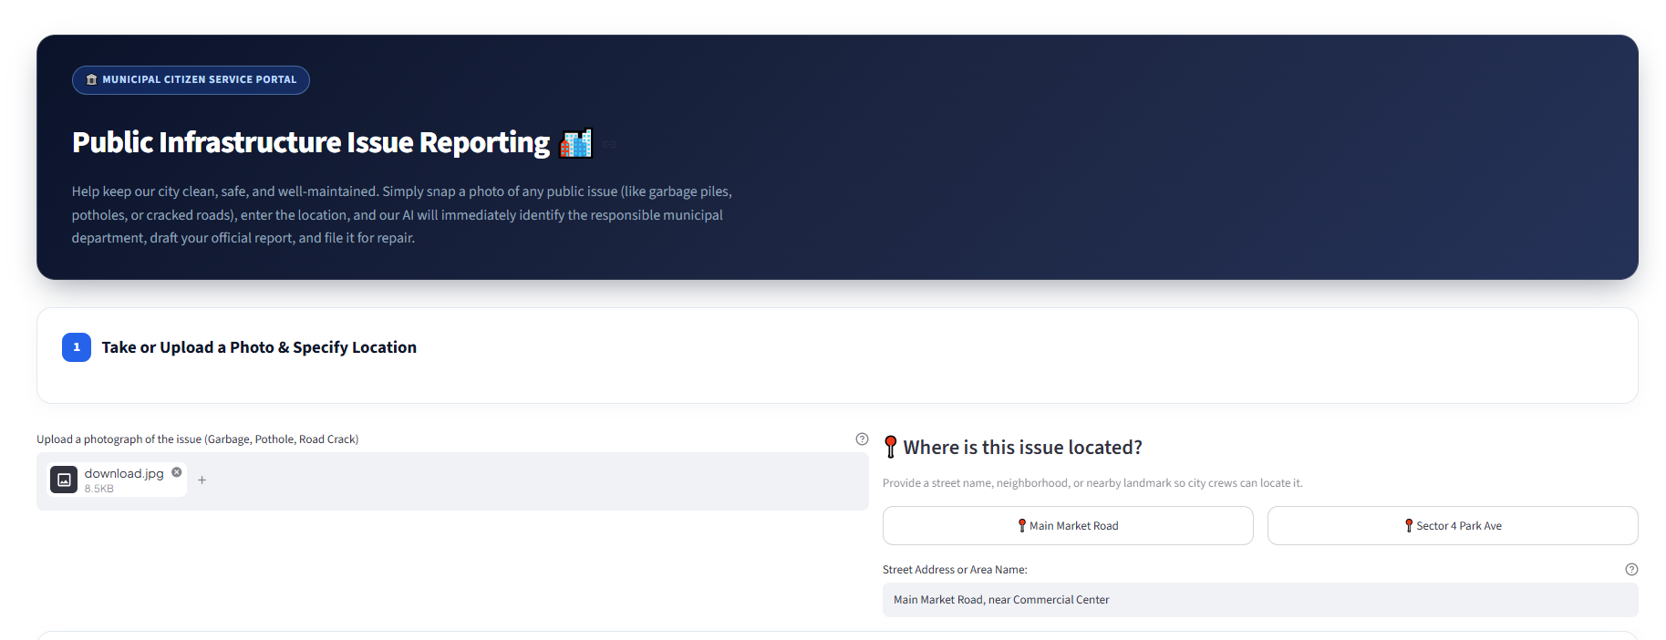
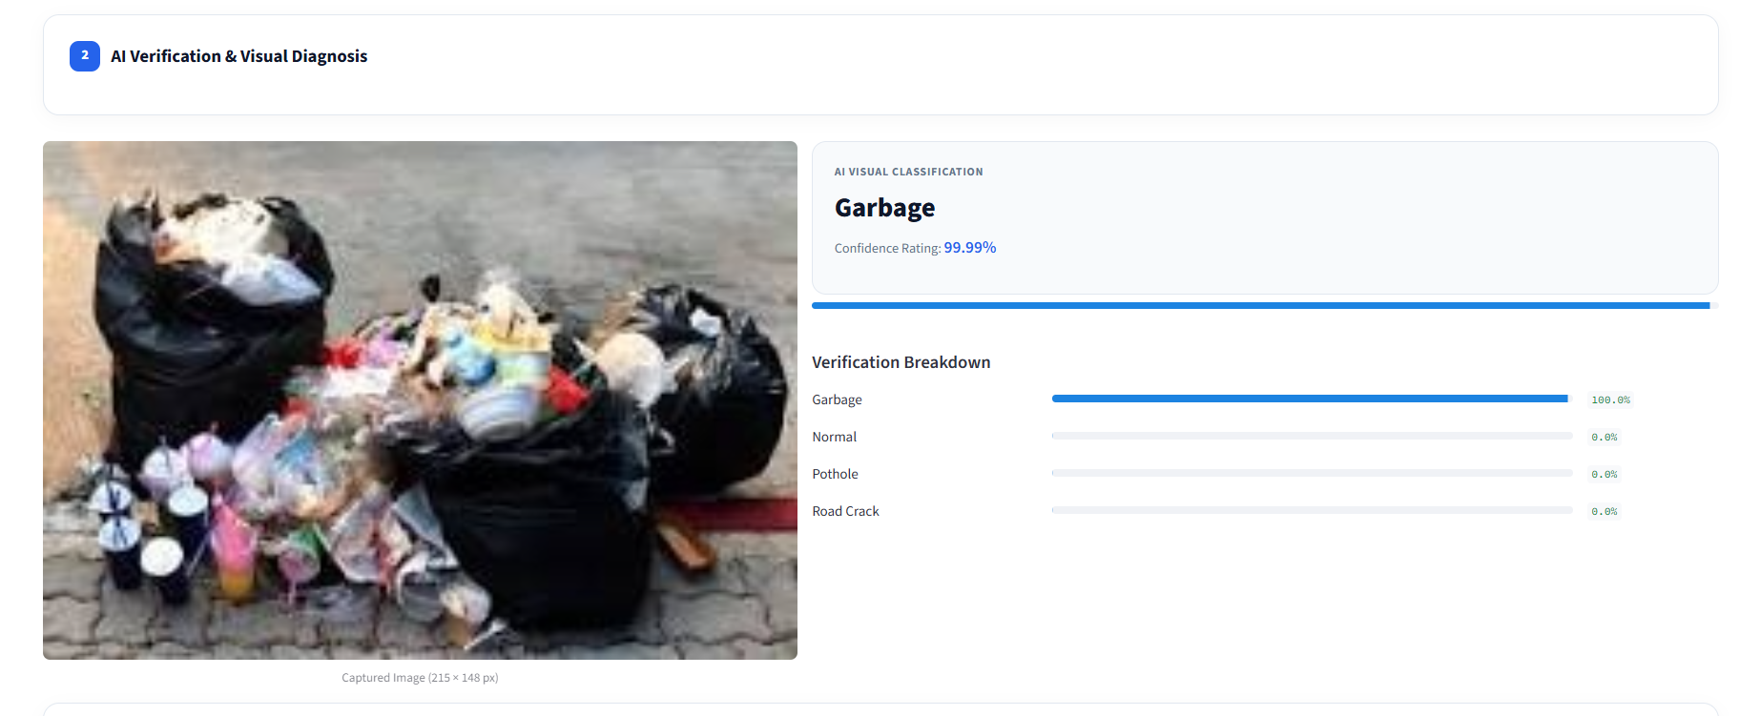
AI-POWERED PUBLIC INFRASTRUCTURE MONITORING & REPORTING
Live System Demonstration (Part 1)
Real-World Portal Walkthrough: Citizen Intake & AI Diagnosis (Steps 1 & 2)
📸 STEP 1: CITIZEN INTAKE & LOCATION ENTRY
Citizen-First Interface with Human-Readable Street Address & Landmark Selection
🔍 STEP 2: AI VERIFICATION & DIAGNOSIS
Instant MobileNetV2 Vision Diagnostic with Exact Statistical Confidence
• Single Drag-and-Drop Image Uploader: Accepts JPG, PNG, JPEG formats with immediate preview.
• Intuitive Address Selection: Pre-populated city landmarks (e.g. 'Main Market Road') + free-form typing.
• Responsive Modern Layout: Designed for instant citizen usability across mobile and desktop browsers.
• 99.99% Verification Confidence: Neural network verifies the defect type ('Garbage') with near-certain statistical confidence.
• Class Probability Breakdown: Displays full distribution across Garbage (100%), Normal (0%), Pothole (0%), Road Crack (0%).
• Edge-Ready Performance: Evaluates in ~35ms on CPU, ensuring citizens receive instantaneous visual confirmation.
CivicAlert AI · Built by Zahid Jan · UET Mardan
12 / 16

Slide 13
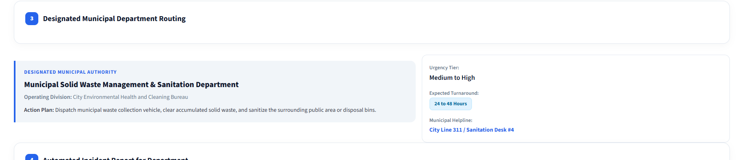
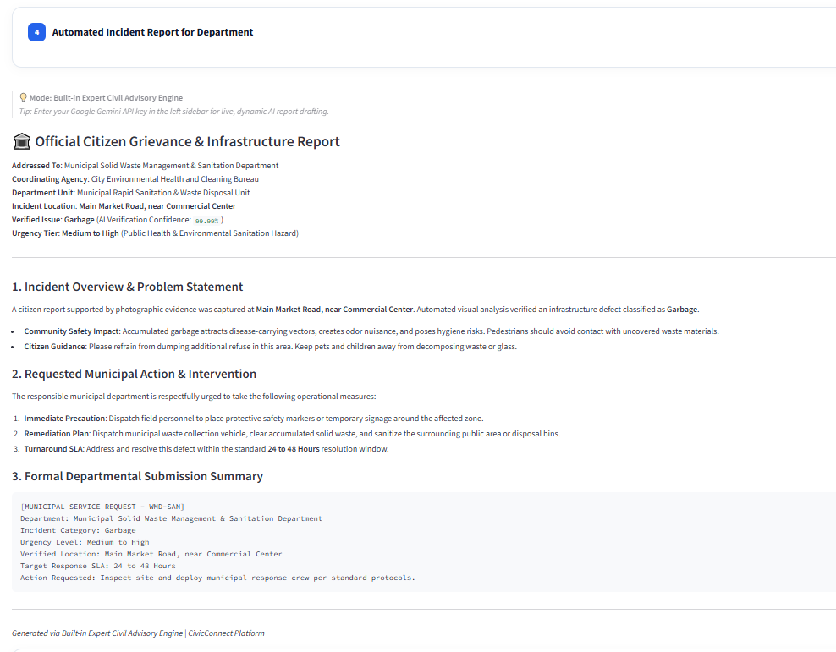
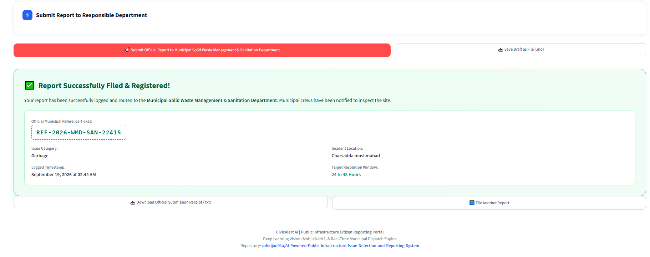
AI-POWERED PUBLIC INFRASTRUCTURE MONITORING & REPORTING
Live System Demonstration (Part 2)
Real-World Portal Walkthrough: Routing, Gemini AI Report & Ticket (Steps 3, 4 & 5)
🏛️ STEP 3: MUNICIPAL DEPARTMENT ROUTING & SLA
📝 STEP 4: LIVE GEMINI LLM REPORT
Automated Official Citizen Grievance Petition
🎫 STEP 5: OFFICIAL TICKET GENERATION & DISPATCH RECEIPT
• Formal Municipal Petitions: Google Gemini formats issues with safety impact, requested interventions, and standard 24-48h resolution SLA.
CivicAlert AI · Built by Zahid Jan · UET Mardan
13 / 16

Slide 14
AI-POWERED PUBLIC INFRASTRUCTURE MONITORING & REPORTING
Municipal Operations Console & Citizen Ticket Tracker
Decoupled Back-Office Operations, SQLite Persistence & 5-Stage Live Resolution Pipeline
5
Total Incidents
Persisted in SQLite DB
1
Pending Triage
Awaiting Initial Review
2
Active Crews
Dispatched to Field Sites
2
Resolved Issues
Repaired & Verified
96.4%
SLA Compliance
On-Time Response Rate
🏛️ Municipal Operations Console (`admin_dashboard.py`)
• Role-Based Passkey Security: Restricted official access via municipal passkey (`admin2026`). Citizens cannot access or tamper with internal city records.
• Multi-Agency Incident Queue: Filter complaints across Solid Waste (`WMD-SAN`), Public Works (`DPW-ROADS`), Highways (`HDA-EXPR`), and Civil Infrastructure (`DCI-INFR`).
• Operational Triage & Dispatch: Supervisors select any ticket, inspect the full Gemini petition, assign field crews, log supervisor notes, and advance operational status.
• 1-Click CSV Incident Export: Generates official spreadsheets with coordinates, AI diagnosis, and timestamps for municipal auditing and city GIS systems.
• Decoupled Architecture: Runs independently on Port 8502 (`run_admin_dashboard.bat`), completely isolated from the citizen-facing portal.
🔍 Citizen Ticket Tracker (`Track My Ticket`)
• Reference ID Verification: Citizens input their ticket ID (e.g. `#REF-2026-WMD-SAN-22415`) for instant, real-time status retrieval.
• 5-Stage Live Resolution Pipeline: Visual progress tracker displays lifecycle flow:
[Submitted] ➔ [Under Review] ➔ [Crew Dispatched] ➔ [In Progress] ➔ [Resolved]
• Field Engineer Notes Transparency: Displays field supervisor comments directly to the citizen (e.g. 'Crew #4 dispatched with compactor truck').
• Resolution SLA Countdown: Shows expected turnaround window (24 to 48 Hours) and direct department emergency contact numbers.
• Complete Record Persistence: Full SQLite persistence (`data/tickets.db`) ensures tickets survive browser reloads and server restarts.
CivicAlert AI · Built by Zahid Jan · UET Mardan
14 / 16

Slide 15
AI-POWERED PUBLIC INFRASTRUCTURE MONITORING & REPORTING
Phase 3: What Remains
Future Roadmap: Scaling to City-Wide Smart Infrastructure
📹 1. Automated CCTV on Buses
Active Mobile Surveillance
• Mount AI vision edge cameras on municipal buses, street sweepers, and waste trucks.
• Continuously scan asphalt roads while vehicles navigate their daily routes.
• Automatically detect and flag potholes and cracks without waiting for citizens to report.
• Eliminates manual inspection costs across thousands of road kilometers.
📱 2. Native Mobile Citizen App
Cross-Platform iOS & Android
• Native smartphone application with 1-tap camera capture and automated GPS tagging.
• Instant push notifications when city repair crews update ticket status (e.g. 'Crew Dispatched', 'Repaired').
• Offline photo queueing: stores photos when offline and submits automatically upon reconnecting.
• Voice-guided multi-lingual grievance submission for broader accessibility.
🗺️ 3. Municipal GIS Heatmap
City Engineer Command Center
• Centralized administrative GIS map dashboard for municipal engineers and mayors.
• Live defect clustering: heatmaps highlight deteriorating corridors needing full resurfacing.
• Direct integration with municipal Open311 APIs for automated crew dispatch.
• Predictive analytics to forecast pavement failure before major potholes emerge.
CivicAlert AI · Built by Zahid Jan · UET Mardan
15 / 16

Slide 16
AI-POWERED PUBLIC INFRASTRUCTURE MONITORING & REPORTING
Conclusion & Impact
Key Takeaways: Empowering Citizens, Accelerating Municipal Action
🎯 High-Precision AI Vision
MobileNetV2 delivers 98.33% overall accuracy and a critical 100% recall on potholes, ensuring road hazards are verified instantaneously (~35ms) without human fatigue.
🏛️ Frictionless Urban Routing
Citizens no longer need to know municipal organograms. The system automatically matches visual defects to the exact department (Sanitation, Public Works, Highways) with SLA commitments.
📝 Live Generative AI Petitions
Integration with Google Gemini transforms casual smartphone photos into polished, actionable municipal grievance petitions complete with risk analysis and field work orders.
📊 Decoupled Operations Console
Role-based security guarantees citizens only see reporting tools, while municipal officials access a full-featured operations console with triage, crew dispatch, and database exports.
🌟 CivicAlert AI bridges the gap between citizens and smart municipal governance.
Thank you! Open for Questions, Evaluation & Technical Demonstration.
CivicAlert AI · Built by Zahid Jan · UET Mardan
16 / 16

