Slide 1
AI / COMPUTER VISION ·
AI-Powered Public Infrastructure Issue Detection and Reporting System
AI-Based Detection of Garbage, Potholes, and Road Cracks
Garbage
Normal
Pothole
Road Crack
Zahid Jan
BS Computer Science · University of Engineering and Technology, Mardan
AI-Powered Public Infrastructure Issue Detection and Reporting System
1

Slide 2
WHY THIS MATTERS
Problem Statement
G
Garbage Accumulation
P
Potholes
Uncollected waste affects public spaces, hygiene, and city appearance.
Create road-safety hazards and add to vehicle and maintenance costs.
R
Road Cracks
M
Manual Inspection
Often an early sign of deeper infrastructure deterioration.
Checking infrastructure by hand is slow and resource-intensive.
This project focuses on classification support for inspection — not a replacement for engineering judgment.
AI-Powered Public Infrastructure Issue Detection and Reporting System
2
Notes:
Public infrastructure needs regular checking. Garbage buildup, potholes, and road cracks are three common problems that inspectors look for. Doing this by hand, walking or driving around a city, is slow and takes a lot of people and time. This project explores whether a simple AI image classifier can help support that inspection process — it's a support tool, not a full replacement for human inspectors.

Slide 3
GOALS
Project Objectives
1
Build an AI-based image classification system
2
Combine multiple infrastructure-related datasets
3
Detect four categories: garbage, normal, pothole, road crack
4
Apply transfer learning using MobileNetV2
5
Develop a usable Streamlit interface
AI-Powered Public Infrastructure Issue Detection and Reporting System
3
Notes:
These are the five goals of the project: build an image classifier, bring together several public datasets into one, detect four categories, use MobileNetV2 through transfer learning instead of training from scratch, and finally wrap everything in a Streamlit app so it's actually usable.

Slide 4
SOURCES & FINAL DISTRIBUTION
Dataset
Source Dataset | Original Images | Mapped To
Garbage Classification (12 sub-classes) | 15,515 | Garbage
Pothole Dataset | 1,401 | Normal / Pothole
Road Crack Dataset (Negative / Positive) | 40,000 | Normal / Road Crack
Final dataset: 56,916 images across 4 unified classes
Split: 39,841 train · 8,537 validation · 8,538 test
Class imbalance: Pothole has only 991 images vs 15,000–20,000+ for the others.
AI-Powered Public Infrastructure Issue Detection and Reporting System
4
Notes:
Three public datasets were combined. The garbage dataset had about fifteen and a half thousand images across twelve waste sub-classes, all grouped into one 'garbage' category. The pothole dataset had around fourteen hundred images labeled normal or pothole. The road-crack dataset had forty thousand images, negative and positive, mapped to normal and road-crack. After combining and splitting, the final dataset has almost fifty-seven thousand images. You can see on the chart that pothole is much smaller than the other three classes — that imbalance matters later when we talk about limitations.

Slide 5
FROM RAW DOWNLOADS TO ONE DATASET
Data Preparation
1
2
3
4
5
6
Extract ZIP files
→
Inspect folder
structures
→
Map labels to
unified classes
→
Combine into one
dataframe
→
Verify & assign
final labels
→
Split: train /
val / test
Unified output classes
Garbage
Normal
Pothole
Road Crack
AI-Powered Public Infrastructure Issue Detection and Reporting System
5
Notes:
Before training, the three datasets had to be unified. The zip files were extracted, their folder structures inspected, and each dataset's own labels were mapped onto our four shared classes. Everything was then combined into one dataframe, verified, and split into training, validation, and test sets. The end result is four consistent classes: garbage, normal, pothole, and road crack.

Slide 6
TRANSFER LEARNING ARCHITECTURE
Model: MobileNetV2
Input Image
224 × 224 × 3
Model Parameters
2,422,468
164,484
↓
MobileNetV2
pretrained on ImageNet
Total
Trainable
↓
Frozen Feature
Extractor
base_model.trainable = False
Configuration
↓
weights = "imagenet"
include_top = False
input_shape = (224, 224, 3)
base_model.trainable = False
Non-trainable parameters: 2,257,984
Global Average
Pooling 2D
↓
Dropout (0.3) +
Dense 128 (ReLU)
↓
Dropout (0.3) +
Dense 4 (Softmax)
4-class output
AI-Powered Public Infrastructure Issue Detection and Reporting System
6
Notes:
The model uses transfer learning with MobileNetV2, pretrained on ImageNet. Images are resized to 224 by 224 and passed through the frozen MobileNetV2 base, which acts as a feature extractor — its weights are not updated during training. On top of that we added Global Average Pooling, a dropout layer, a dense layer of 128 units with ReLU, another dropout layer, and finally a dense softmax layer with 4 outputs. In total the model has about 2.42 million parameters, but only about 164 thousand of them — the layers we added — are actually trainable.

Slide 7
PERFORMANCE SUMMARY
Training & Results
1
99.00%
98.33%
0.0412
Epoch Trained
Validation Accuracy
Test Accuracy
Test Loss
Why only 1 epoch?
Training was limited to 1 epoch because of a limited project timeframe and CPU-only training (TensorFlow 2.21.0, native Windows, no GPU support available). This kept high accuracy achievable within the time available, but it is not presented as an ideal training setup.
Classification report (per class)
Class | Precision | Recall | F1
Garbage | 1.00 | 0.97 | 0.98
Normal | 0.99 | 0.98 | 0.98
Pothole | 0.96 | 1.00 | 0.98
Road Crack | 0.99 | 0.99 | 0.99
AI-Powered Public Infrastructure Issue Detection and Reporting System
7
Notes:
Because of time and CPU-only training, the model was trained for just 1 epoch, using TensorFlow 2.21.0 on native Windows without GPU support. Even so, validation accuracy reached 99 percent and test accuracy reached 98.33 percent, with a test loss of about 0.04. The per-class report shows strong precision and recall across all four categories, with pothole recall reaching 1.00 despite having the fewest images. I want to be clear that one epoch is not an ideal training setup — it was a practical choice given the constraints, not a claim that this is the best way to train the model.

Slide 8
599 TEST SAMPLES EVALUATED
Confusion Matrix
PREDICTED →
TRUE ↓
Garbage
Normal
Pothole
Road Crack
Garbage
145
0
4
1
Normal
0
147
2
1
Pothole
0
0
149
0
Road Crack
0
2
0
148
Diagonal cells (dark teal) = correct predictions. Off-diagonal cells = misclassifications, e.g. 4 garbage images predicted as pothole, 2 normal images predicted as pothole.
AI-Powered Public Infrastructure Issue Detection and Reporting System
8
Notes:
This confusion matrix comes from evaluating 599 test samples. Each row is the true class and each column is what the model predicted. The teal diagonal cells are correct predictions — for example, 149 out of 149 pothole test images were correctly classified. The orange cells show the few mistakes: for instance, 4 garbage images were predicted as pothole, and 2 normal images were predicted as pothole. Overall, the vast majority of predictions land on the diagonal, meaning most predictions were correct.

Slide 9
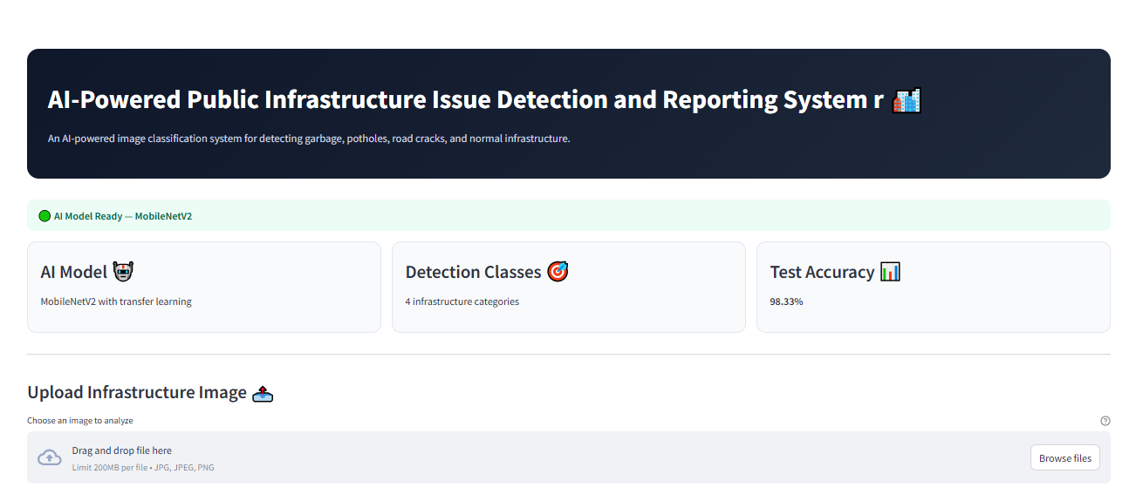
FROM UPLOAD TO RECOMMENDATION
Streamlit Application
Upload
Image
→
Image
Preprocessing
→
AI Model
(MobileNetV2)
→
Prediction
→
Confidence
Score
→
Recommended
Action
AI Public Infrastructure Detector
AI-Powered Public Infrastructure Issue Detection and Reporting System
9
Notes:
A Streamlit web application was built around the trained model. The user uploads an image, the app preprocesses it, sends it to the saved MobileNetV2 model — best_model.keras — and displays the predicted category, a confidence score, and a recommended action. The layout on this slide is illustrative rather than an actual screenshot, just to show how the pieces fit together.

Slide 10

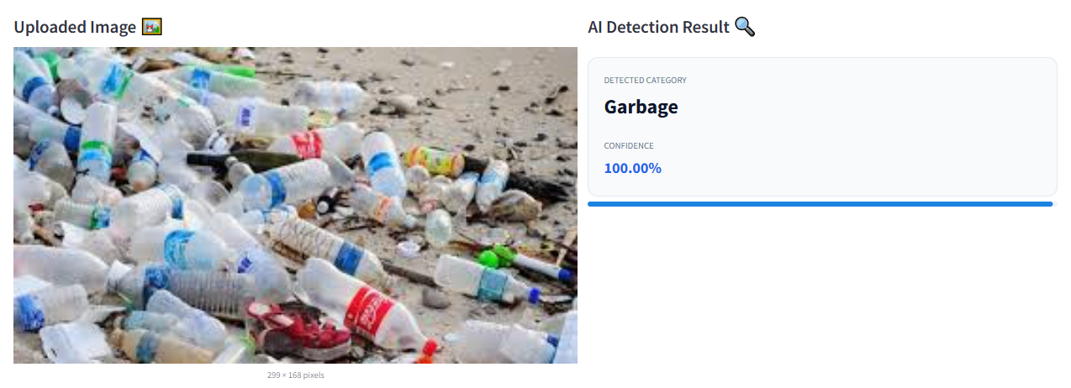

EXAMPLE PREDICTIONS BY CATEGORY
Demonstration
Image
Example Prediction
Normal
Predicted category shown by the app for this class
AI-Powered Public Infrastructure Issue Detection and Reporting System
10
Notes:
Here I'd show four example predictions, one for each class — garbage, normal, pothole, and road crack — using real screenshots from the application, clearly labeled as example predictions. I'm not going to state specific confidence numbers unless they come directly from an actual run of the app.

Slide 11
HONEST ASSESSMENT
Limitations & Future Work
Limitations
Future Work
Class imbalance (pothole = 991 images)
Limited training time
CPU-based training only
Some individual images misclassified
Source datasets differ in visual style
From AI Classification to Smart Infrastructure Monitoring:
GPS-Based Location Detection
Responsible Department Assignment
One-Click Complaint Submission
Municipal Authority Dashboard
Automatic Complaint Tracking
Mobile Application
Real-Time CCTV Monitoring
Note: during manual testing, at least one known pothole image was predicted as road crack with high confidence — showing that individual predictions can still be wrong even with high overall accuracy.
AI-Powered Public Infrastructure Issue Detection and Reporting System
11
Notes:
I want to be upfront about the limitations. The pothole class has far fewer images than the others, which is a real imbalance. Training happened for a limited time on CPU only. And even though overall accuracy is high, individual images can still be misclassified — for example, one known pothole image was predicted as road crack with high confidence during manual testing. Looking forward, the plan is to grow and balance the pothole dataset, use data augmentation, train for more epochs, fine-tune MobileNetV2 further, try other architectures, collect more real-world images, and eventually move toward a deployable monitoring tool.

Slide 12
CONCLUSION
What We Built
Built an end-to-end AI computer vision system
Combined multiple public datasets into one
Used MobileNetV2 transfer learning
Achieved 98.33% test accuracy
Developed a working Streamlit application
Demonstrated potential for automated infrastructure inspection
98.33%
Test Accuracy
Thank You
Questions?
AI-Powered Public Infrastructure Issue Detection and Reporting System
12
Notes:
To summarize: this project built an end-to-end AI computer vision pipeline, combining several public datasets, using MobileNetV2 transfer learning, and reaching 98.33 percent test accuracy, wrapped in a working Streamlit application. It shows real potential for supporting automated infrastructure inspection, while leaving clear room for future improvement. Thank you — I'm happy to take questions.

