Slide 1
Paddy leaf disease recognition using machine learning approaches.

Slide 2
Team Member:
Name: Sampa Akter
ID: 2019000000025
Batch: 51
Name: Shree Dab Shingha
ID: 2019100000026
Batch: 52
Name: Zahid Hasan
ID: 2019100000015
Batch: 52

Slide 3
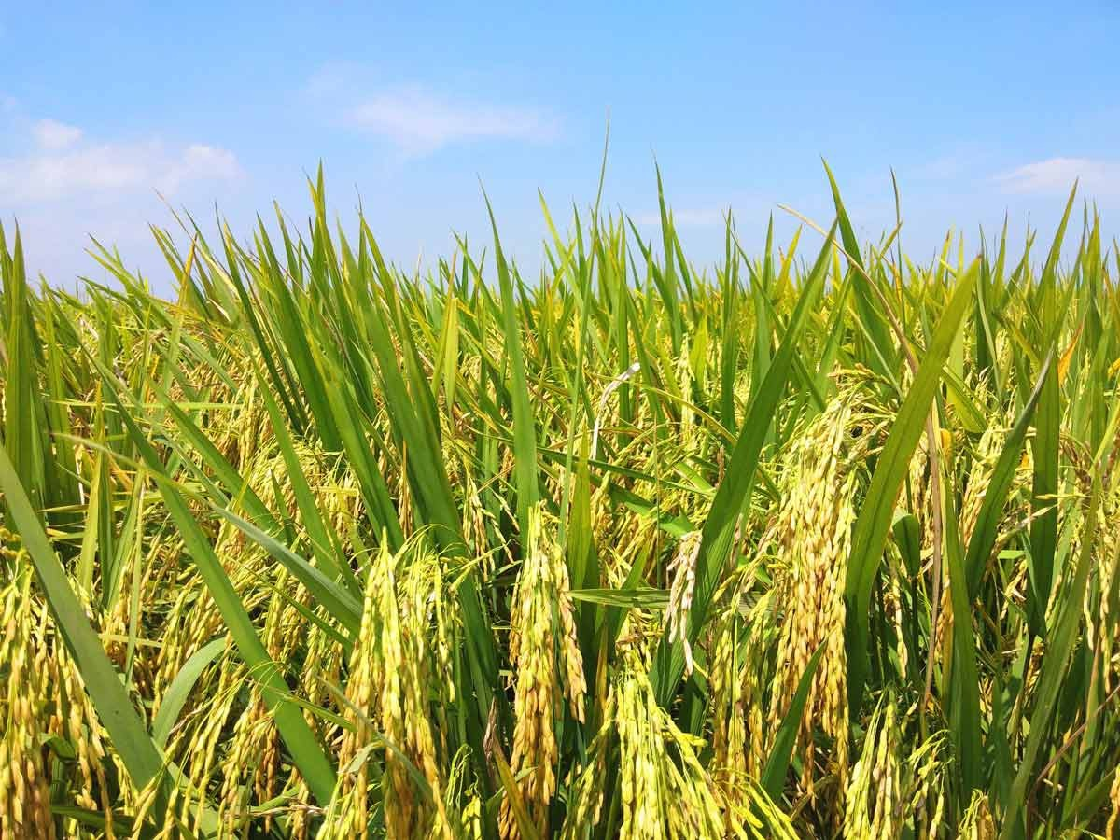
Introduction:
The agricultural industry contributed to Bangladesh's
highest GDP, BDT 11.54 billion in 2022. Paddy production
accounts for half of the agricultural GDP. Consequently,
this also accounts for about half of rural employment.
Paddy has a significant economic significance for
the nation while also providing the majority of the populace
with a staple food and two-thirds of their daily calorie needs.
Natural view of paddy.

Slide 4
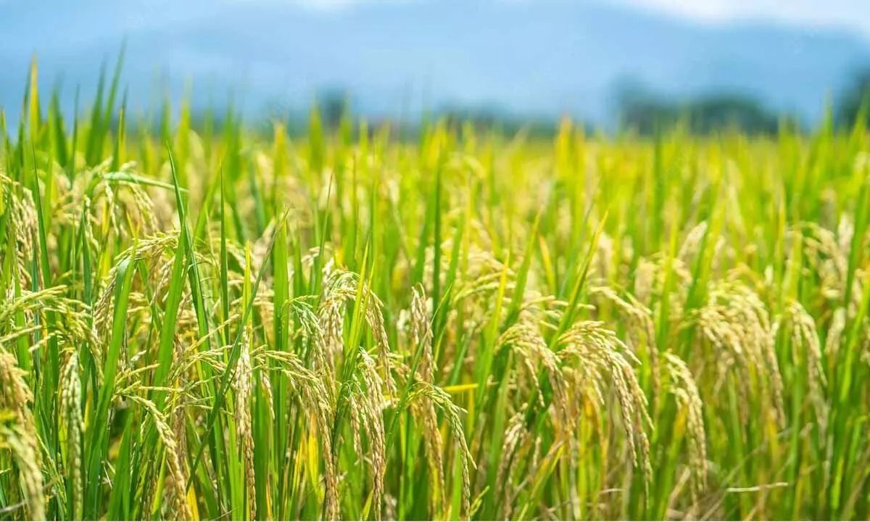
.
These economic results demonstrate
unequivocally that Bangladesh places a
high priority on proper paddy cultivation.
The production of disease-free paddy
would be crucial to guaranteeing steady
economic growth and maintaining the
desired goals.
Additionally, Bangladesh needs to
concentrate on its industrial innovations,
which will feature smart systems that can make
choices without human intervention, in order
to stay up with the upcoming fourth industrial revolution.
Natural view of paddy.

Slide 5
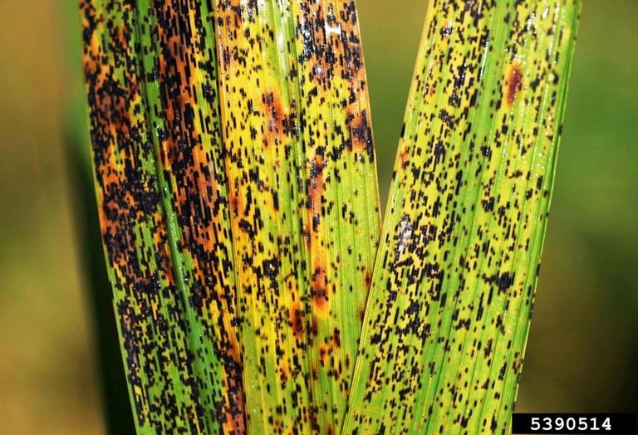
Classification of paddy disease:
A survey conducted in Bangladesh from
1979 to 1981 identified 20 paddy diseases .
13 diseases were found to be serious ones.
The most common and serious paddy
diseases today are thought to be Leaf smut,
Bacterial blight, and Brown spot.
Leaf smut: small black linear lesions on leaf
blades, leaf tips may turn grey and dry.
Leaf smut.

Slide 6
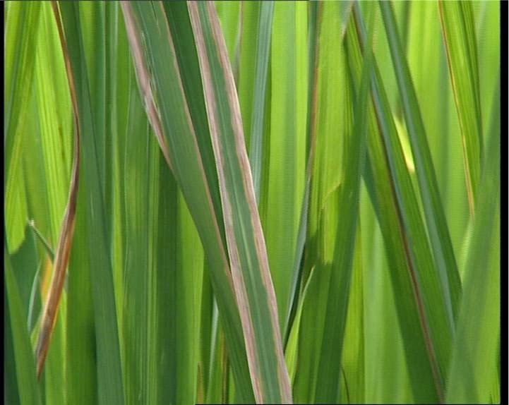
Bacterial blight: elongated lesions
near the leaf tips and margins, and turns
white to yellow and then grey due to
fungal attack.
Bacterial blight.

Slide 7
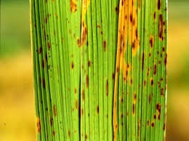
Brown spot: dark brown colored
and round to oval shaped lesions
on rice leaves.
Brown spot.

Slide 8
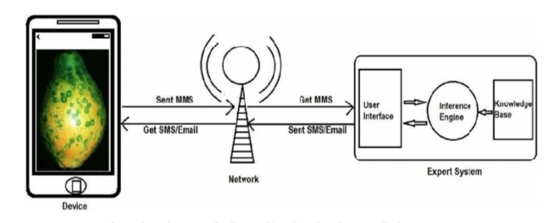
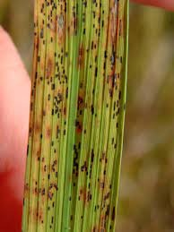
Proposed system architecture:
The design of an online machine vision-based agro-medical expert system for diagnosing paddy leaf disease. It begins with the supposition that someone, a farmer or a user will take a picture of a paddy leaf that has been infected by a disease using a mobile phone or other portable device on which the proposed mobile app is already installed. Then, by using the app, he or she will send the image to our suggested expert system. The back-end server, where our agro-medical expert system is located, receives the image after obtaining it via the Internet at front-end software. Using the input image as a basis, the system will provide feedback. Through the front-end program, the feedback will be sent as an SMS to the user's mobile device.

Slide 9
Block Diagram:
Inputting of captured image.
Resizing into a fixed-sized image.
Dataset.
Output.
Testing.
Training.

Slide 10
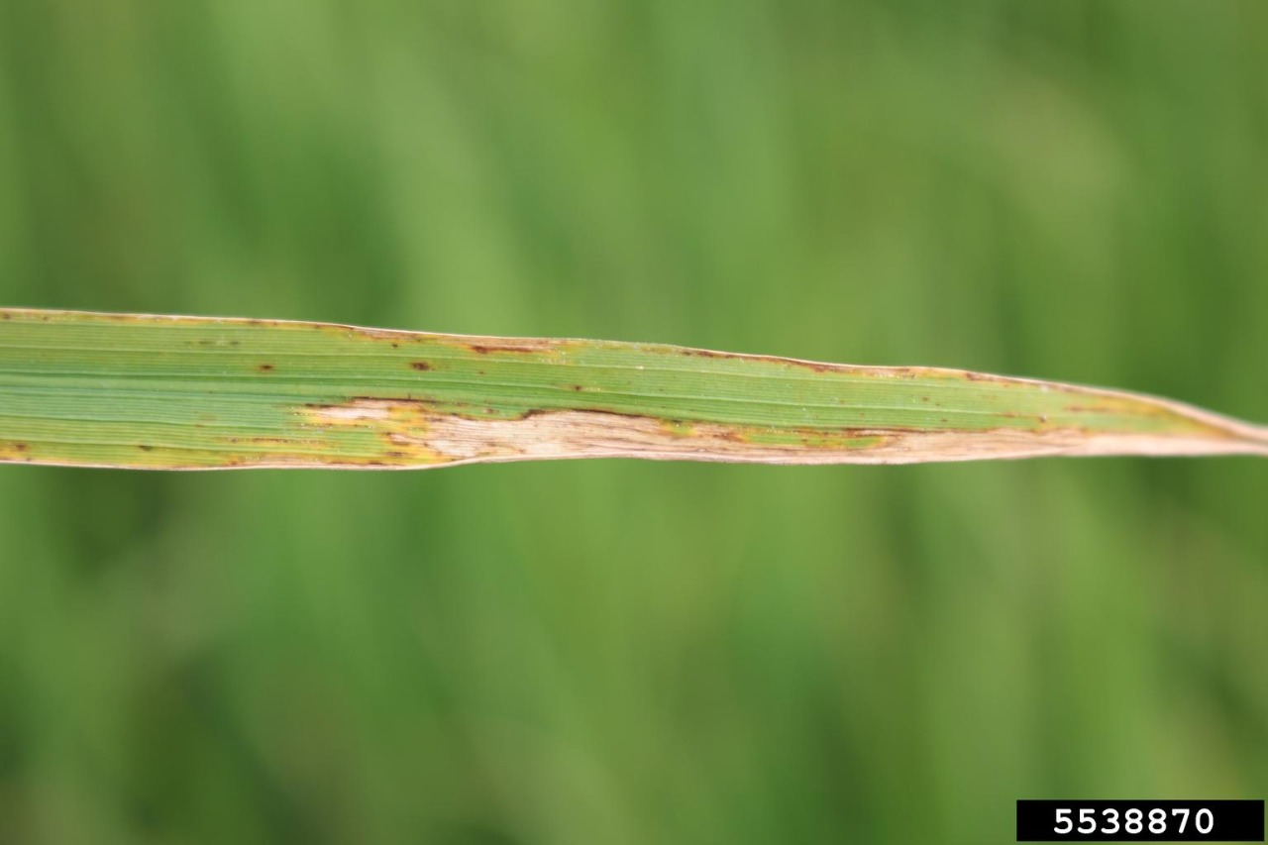
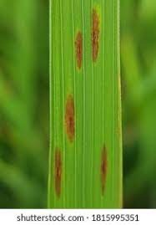
Sample of dataset:

Slide 11
Some algorithm used for ML:
Logistic Regression: Only categorical values for the target class are acceptable for use in logistic regression. Logistic regression was an appropriate model to train our dataset using because the goal was to predict and categorize the disease of the afflicted paddy leaf.
K-Nearest Neighbour: KNN functions well for discrete target classes, just like logistic regression does. It calculates the distances between each instance and the query point and finds the K minimum distances, or the K closest neighbors for the query point, from which it can infer the query point's class.
Decision Tree: One of the most popular classifiers for machine learning is the decision tree. This approach divides the dataset into partitions by starting with the most suited attribute as the root. Unmixing the dataset is the aim of the partition. The partitioning continues iteratively until the data are finally grouped into homogeneous groups. The decision tree's main algorithm is the iterative dichotomiser, which takes a greedy approach. In this method, the tree is built using the information theory concepts of entropy and information gain. Entropy quantifies the impureness of any given attribute; a value of 0 denotes that all instances are members of the same class. The examples get more and more heterogeneous as the entropy increases. The instances' diversity keeps increasing.

Slide 12
Reference:
https://scholar.google.com/citations?view_op=view_citation&hl=en&user=m7sMqQQAAAAJ&citation_for_view=m7sMqQQAAAAJ:qjMakFHDy7sC
https://scholar.google.com/citations?view_op=view_citation&hl=en&user=m7sMqQQAAAAJ&citation_for_view=m7sMqQQAAAAJ:d1gkVwhDpl0C
https://scholar.google.com/citations?view_op=view_citation&hl=en&user=m7sMqQQAAAAJ&citation_for_view=m7sMqQQAAAAJ:Zph67rFs4hoC
https://scholar.google.com/citations?view_op=view_citation&hl=en&user=m7sMqQQAAAAJ&citation_for_view=m7sMqQQAAAAJ:YOwf2qJgpHMC
https://scholar.google.com/citations?view_op=view_citation&hl=en&user=m7sMqQQAAAAJ&citation_for_view=m7sMqQQAAAAJ:4TOpqqG69KYC
https://scholar.google.com/citations?view_op=view_citation&hl=en&user=m7sMqQQAAAAJ&citation_for_view=m7sMqQQAAAAJ:kNdYIx-mwKoC
https://scholar.google.com/citations?view_op=view_citation&hl=en&user=m7sMqQQAAAAJ&citation_for_view=m7sMqQQAAAAJ:W7OEmFMy1HYC
https://scholar.google.com/scholar?hl=en&as_sdt=0%2C5&q=rice+disease+using+machine+learning+&oq=#d=gs_qabs&t=1659630637994&u=%23p%3D3I8b65rnrlkJ
https://scholar.google.com/citations?view_op=view_citation&hl=en&user=m7sMqQQAAAAJ&citation_for_view=m7sMqQQAAAAJ:u5HHmVD_uO8C

