Slide 1
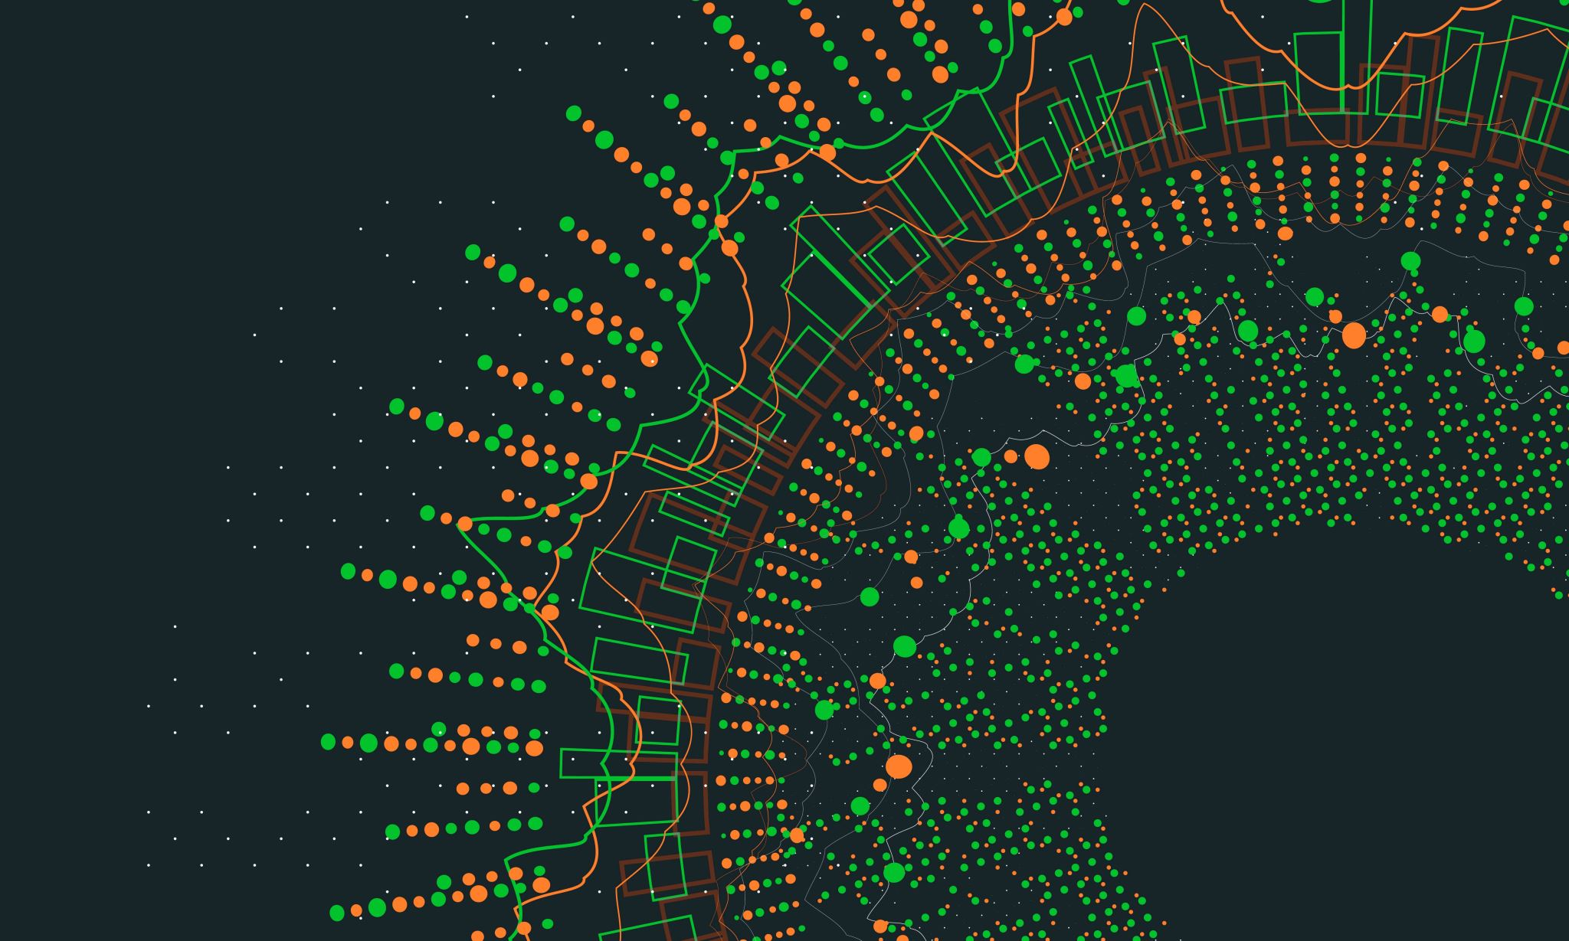
Chat with the Maintainers

Slide 2
Group members & work division
Zahidullah (038): Problem and Solution
Usama Khalid (037): Trade offs
Habib ur rehman (049): Example
Shahab Mughal (024): Rationale
Hammad Ali (011): Known users
Hamza Asif (012): Related patterns

Slide 3
Chat with the Maintainers
Intent
Learn about the historical and political context of your project through discussions with the people maintaining the system.
Problem
Documentation, if present, typically records decisions about the solution, not about the factors which have influenced that solution.
The system is valuable, yet management has lost control.
Persons working with the system might mislead you.

Slide 4
Solution
Discuss with the system maintainers
Technical people who have been intimately involved with the legacy system
Well aware of the system’s history
Treat the maintainers as “brothers in arms”

Slide 5
Hints & Questions
Hints
Best to ask these questions during an informal meeting
Make notes after the meeting to record your main conclusions, assumptions and concerns.
Ask questions like.
What was the easiest bug you had to fix during the last month?
How does the maintenance team collect bug reports and feature requests?
Who was part of the development/maintenance team during the course of years?
Who was part of the development/maintenance team during the course of years?
Why is this reengineering project started?

Slide 6
Trade offs
The known Pros, Cons and Difficulties of performing the activity of “Chat with Maintainers”.
Pros.
Obtains the information effectively, which is not available from documentation.
Getting acquainted with the new teammates.
Cons
You can only get limited information from people. People don’t remember everything and the details about them.

Slide 7

Difficulties
People protect their own jobs. They may try to hide their own faults.
Instability of teams. The teams for maintenance are unstable and keep changing because maintenance is considered second class work and people don’t like it.

Slide 8
Example
Communication with original developer is best solution to know the system from ground reality.
Why Dave?
Good Point: Dave knows how to implement ICP and handle transection with health insurance and his colleagues are experienced in object oriented
Bad point: Dave was left out of design phase, so he has a less understanding from System design perspective.
Points to note in finalizing the meeting.
Mental note
Functionality comparison of two product that are to be merged.
Motivate team member.

Slide 9
Rationale
Factor | Reason
Know how Development team was organized. | Through this we get to know the structure of source code.
Know Capabilities of Team member. | Through this we can formulate a plan to assign tasks to maintainers.
Being good in terms of sociological perspective has higher precedence then being good at technology.
Conway’s law is often paraphrased as: “If you have 4 groups working on a compiler; you’ll get a 4-pass compiler”
Factors to be considered to Plan for Reengineering project.
Maintenance is considered as “Second Class work”

Slide 10
Known uses
Meetings with the maintenance teams
Why?
Attitude in meeting
The RT-100 by Nortel
Early assessment of the historical and political context
DESEL Project
Design for evolution

Slide 11
Related patterns
Patterns languages
Why should we know relates patterns?

Slide 12

What’s next?
Outcomes verification against other sources
Sources?
Verification benefits
Effect on work plan
Plan aim
Team communication

Slide 13

Conclusions

