Slide 1

Android Application Development
Before Getting Started

Slide 2

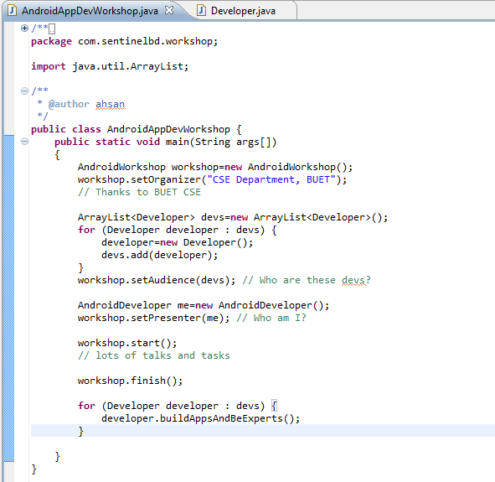
Before Proceeding Any Further
Prerequisite:
Working knowledge in
Java Programming language
* Object Oriented Programming:
* What are the advantages?
Why Java knowledge is the prerequisite?
Why Google chose Java for Android?

Slide 3
So Today…
Get Basic Idea on Mobile and Smartphone Applications
Get Basic Idea on Mobile, Smartphone & Tablet Platforms
Identify the Position of Android Platform
Background and History of Android
Get the Idea: Why Should We Learn Android Platform
Opportunities
Some App Demos
System Architecture
Environment Setup to Kick-start
Development Environment
Application Structure

Slide 4
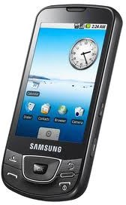
Mobile and Smartphone Applications
Smart Phones
A smartphone is a mobile phone that offers more advanced computing ability, Features and connectivity than a contemporary cell phones.
Smartphones may be thought of as handheld computers integrated with a mobile telephone.
They also provide their own Operating System with Application Development Framework
To learn about smart phones in details:
https://www.theguardian.com/technology/2012/jan/24/smartphones-timeline
You’ll get detailed history about how this technology evolved over the years

Slide 5
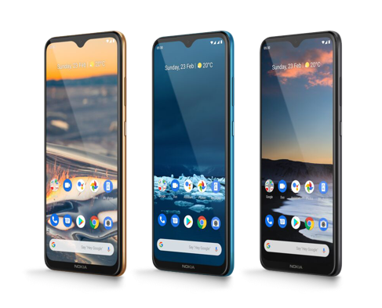
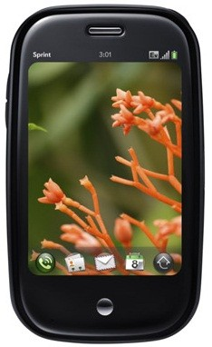
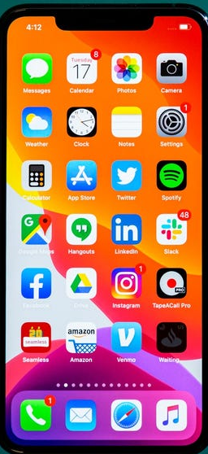
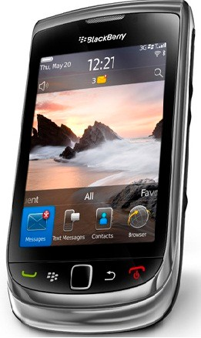
Mobile and Smartphone Applications
Smart Phones Platforms
Android iPhone BlackBerry
Palm Pre

Slide 6
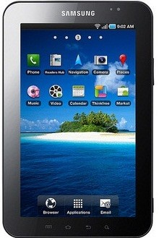
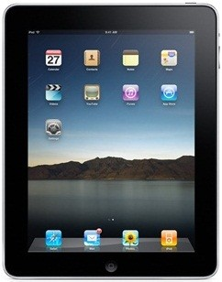
Mobile and Smartphone Applications
Tablet Platforms
Android: Galaxy Tab
Apple: iPad

Slide 7
Overview of Application Platforms (alphabetically)
Platform | Language (s) | Remarks
Android | Java, C, C++ | Open Source OS (Based on Linux) http://developer.android.com
bada | C, C++ | Samsung’s mobile platform running on Linux or RealTime OS http://developer.bada.com
BlackBerry | Java, Web Apps | Java, Web Apps, Java ME compatible, extensions enable tighter integration http://na.blackberry.com/eng/developers
iOS | Objective-C, C | Requires Apple Developer Account http://developer.apple.com/iphone
MeeGo | Qt, C++, others | Intel and Nokia guided open source OS (based on Linux) http://meego.com/developers
Symbian | C, C++, Java, Qt, Web Apps, others | OS built from the ground up for mobile devices http://www.forum.nokia.com/symbian

Slide 8
Overview of Application Platforms (Cont.)
Platform | Language (s) | Remarks
webOS | HTML, CSS, JavaScript, C | Supports widget style programming (based on Linux) http://developer.palm.com
Windows Mobile | C#, C | .NET CF or Windows Mobile API, most devices ship with Java ME compatible JVM http://developer.windowsmobile.com
Windows Phone | C#, VB.NET | Silverlight, XNA Frameworks http://create.msdn.com
Source: http://mobileplatforms.wikidot.com/

Slide 9






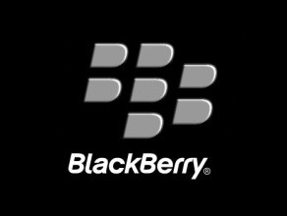
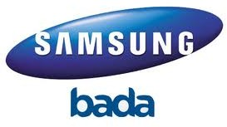
Application Platforms

Slide 10
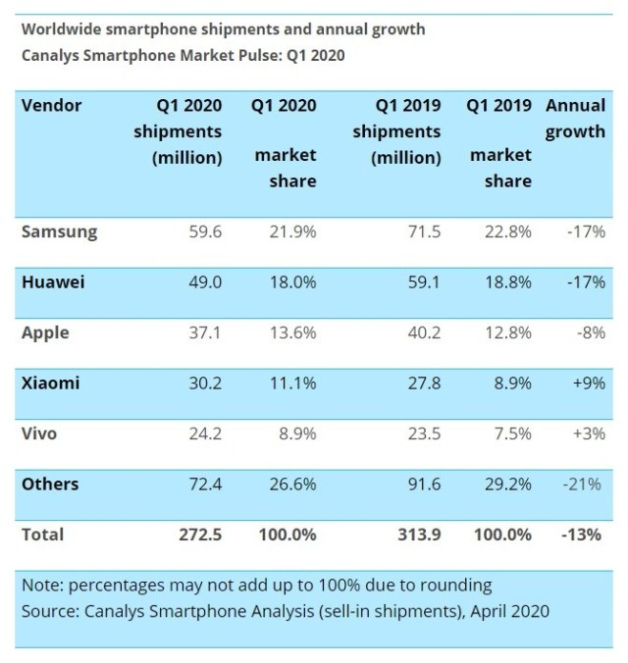
Why Android

Slide 11
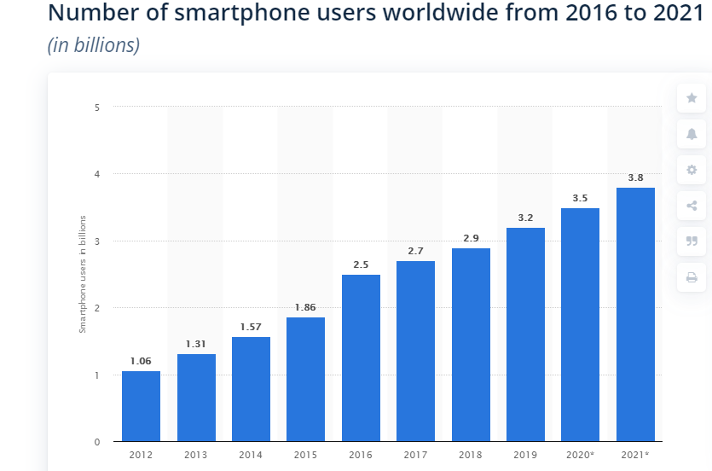
Why Android (Cont.)

Slide 12
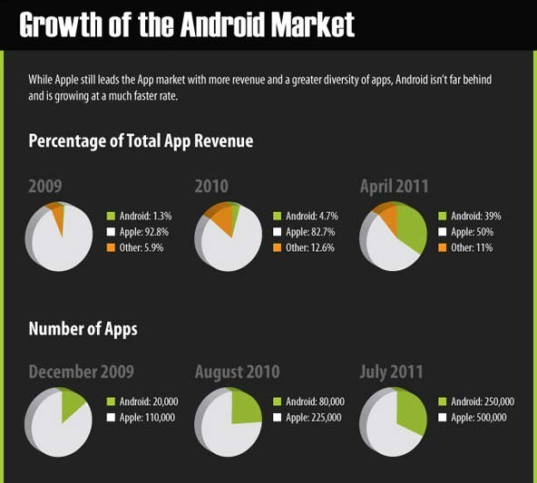
Why Android (Cont.)

Slide 13
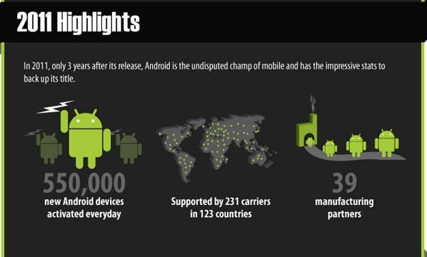
Why Android (Cont.)

Slide 14
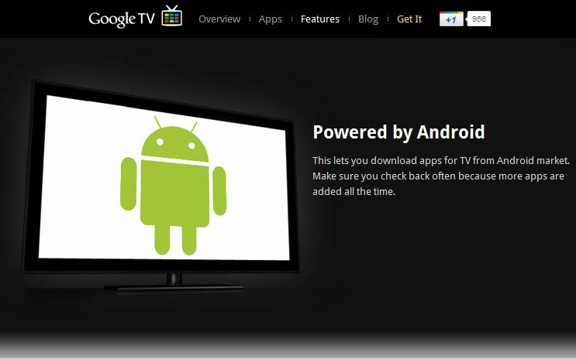
Why Android: Google TV

Slide 15
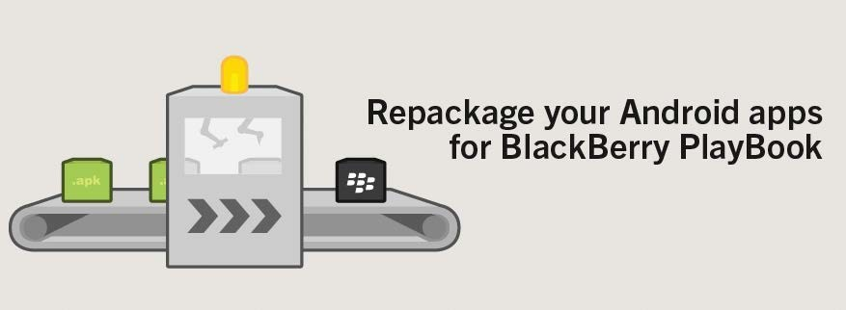
Why Android: Finally BlackBerry Gives In

Slide 16











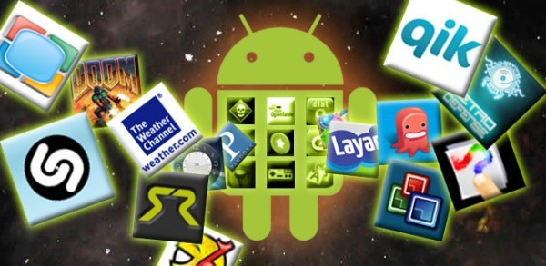



Open Handset Alliance
Manufacturers: Designing the Android Handsets
Content Providers: Developing Apps
Mobile Operators
Markets: Distribution

Slide 17


Why Android (Cont.)
Technical Advantages
No need to pay for any developer’s program to develop and test apps in real devices
Open source platform with scope of more innovation (Less proprietary restrictions)
Java programming language
Rich and easy to integrate feature sets
Easy, effective and cost-effective prototyping for research and business Development Environment Support in Windows, Mac & Linux (Ubuntu)
Imagination is the Limit

Slide 18
Why Android (Cont.)
Business Advantages
Google Play:
Integrated market app
One time low registration fee
Many Distribution Channels:
(We’ll see next)
Low Barrier to Market:
No approval process
Less restrictions with copyright issues

Slide 19
Why Android (Cont.)
Opportunities
Google Play: (http://market.android.com)
Integrated Android Market Application in phones can ensure your reach to
millions of users without any approval process.
Amazon Appstore for Android:
http://www.amazon.com/mobile-apps/b?ie=UTF8&node=2350149011
Enterprise Market:
https://marketplace.cisco.com/
3rd Party Distribution Channels :
1. | Andspot 2. Handango 3. GetJar 4. SlideMe | 5.AndAppStore
6. | AndroLib 7. AppBrain and many more…

Slide 20
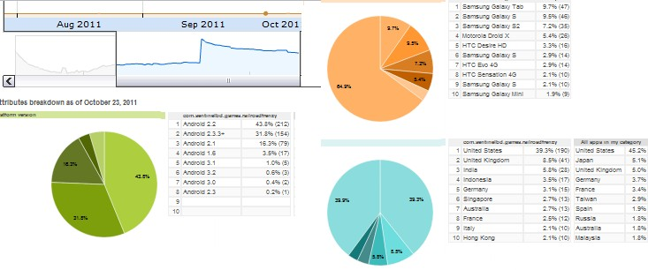
Why Android (Cont.)
Opportunities
Android Market: (1) Analytics to help decision making

Slide 21
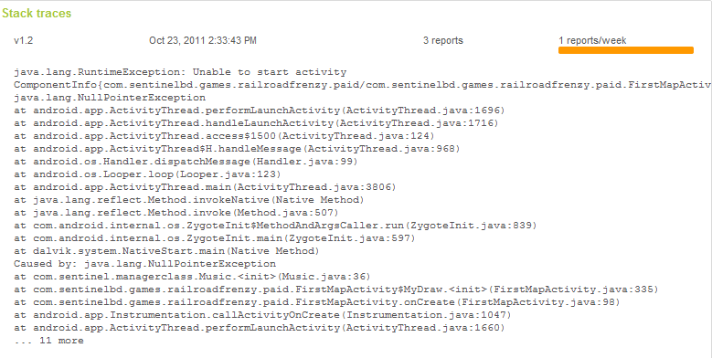
Why Android (Cont.)
Opportunities
Google Play: (2) Crash log to support bug fixes

Slide 22
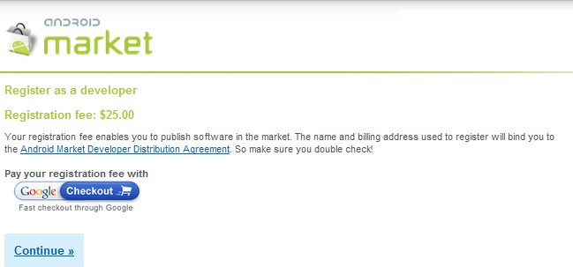
Why Android (Cont.)
Opportunities
Google Play: (3) Requirements

Slide 23
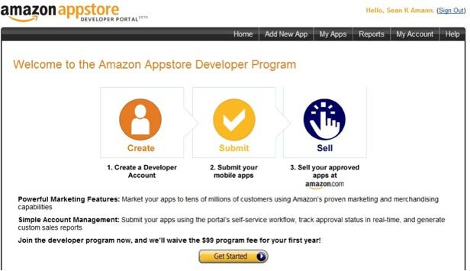
Why Android (Cont.)
Opportunities
Amazon Appstore for Android:

Slide 24
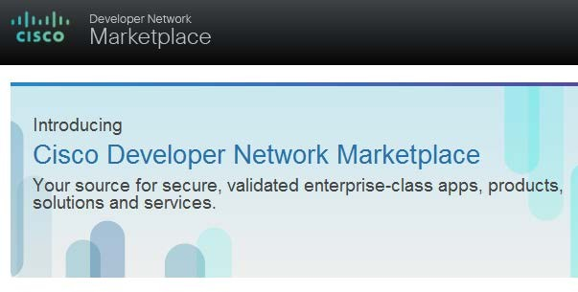
Why Android (Cont.)
Opportunities
Enterprise Market:
$ $ $ $ $ $ $

Slide 25
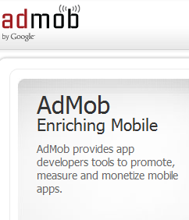


Why Android (Cont.)
Monetization Opportunities
Paid Apps $ $ $ $ $ $ $ In-App Billing
Free Apps with Ads
AdMob AdWhirl
Mobclix and many more

Slide 26
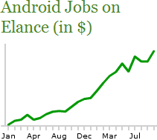
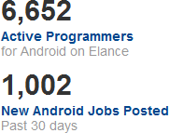
Why Android (Cont.)
Freelancing Opportunities
Statistics
Source: http://www.elance.com/android-programmers-freelancers/230
Similar trend is seen in other freelancing sites
Can be a good source of income to support your own
product development or research

Slide 27

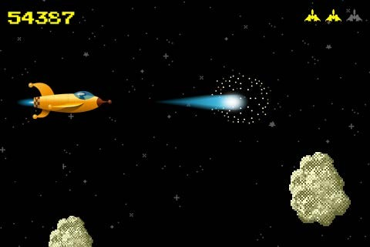
Why Android (Cont.)
Game Development Opportunities
Case Study: AhhhPah http://ahhhpah.com/
Development Time: 8 hours Downloads: millions
Simplified Game frameworks
Libgdx:
AndEngine:
Unity3d:
http://code.google.com/p/libgdx/ http://www.andengine.org/ http://unity3d.com/

Slide 28

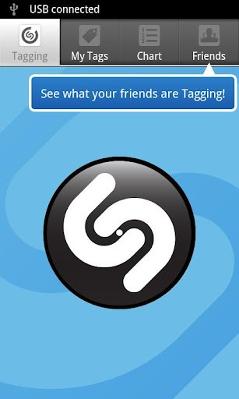
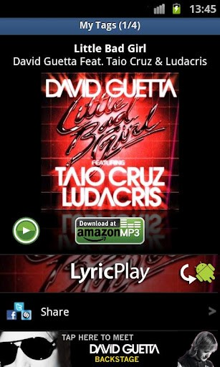
Why Android (Cont.)
Some Interesting Apps
Shazam
Hear a song you don't know? Shazam identifies it instantly.
INSTALLS:10,000,000 - 50,000,000

Slide 29

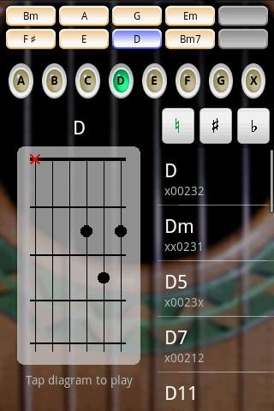
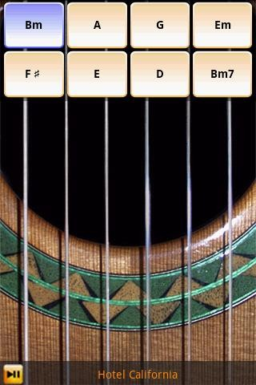
Why Android (Cont.)
Some Interesting Apps
Guitar : Solo Lite
INSTALLS:10,000,000 - 50,000,000

Slide 30

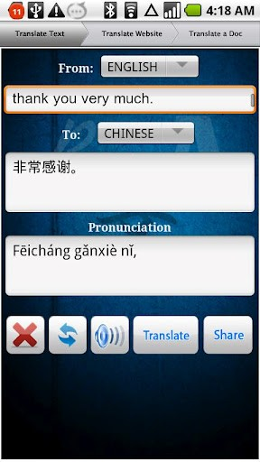
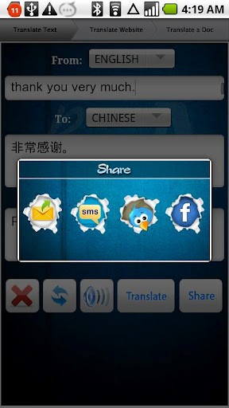
Why Android (Cont.)
My Story
ProTranslate
INSTALLS: 50,000 - 100,000
It gave us Google’s Device Seeding Program Award
Features:
Support for wide range of languages
Share translated text (Email,SMS,twitter,facebook) Pronounciation and speech output
Website translation Document translation and share via email
Auto-prompt to translate SMS received
Optimized for all Android devices

Slide 31
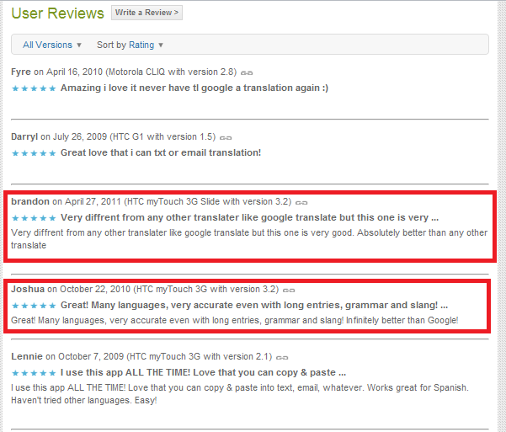
Why Android (Cont.)
My Story
ProTranslate

Slide 32
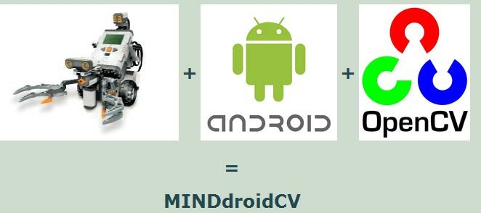
Why Android (Cont.)
Research Opportunities
Easy Prototyping of any idea is possible in Android. Some of the advanced research based projects are prototyped in Android.
Computer Vision
MINDdroidCV(http://www.jataka.hu/rics/nxt_android_opencv/index.html)

Slide 33
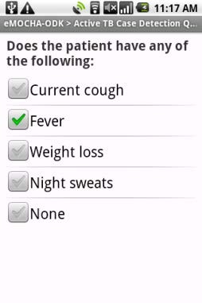
Why Android (Cont.)
Research Opportunities
Easy Prototyping of any idea is possible in Android. Some of the advanced research based projects are prototyped in Android.
mHealth
eMOCA (www.emocha.org)
Developed by the Johns Hopkins Center for Clinical Global Health Education,
eMOCHA uses video, audio, touchscreen quizzes, GPS and SMS to collect and analyze large amounts of data.

Slide 34
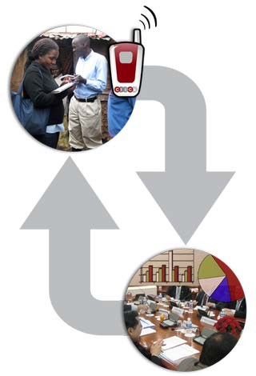
Why Android (Cont.)
Research Opportunities
Easy Prototyping of any idea is possible in Android. Some of the advanced research based projects are prototyped in Android.
mHealth
ClickDiagnostics
http://clickdiagnostics.com/
Developed by ClickDiagnostics, uses video, audio, touchscreen Quizzes to upload data to server to reach the consultants.

Slide 35
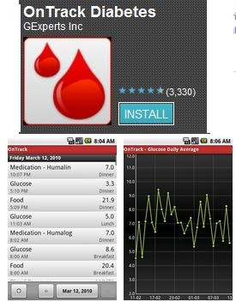
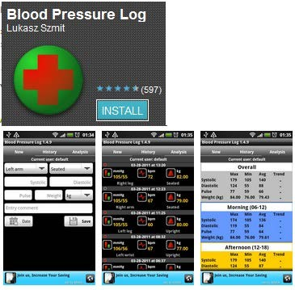
Why Android (Cont.)
Research Opportunities mHealth
Clinical diagnosis + Data acquisition

Slide 36
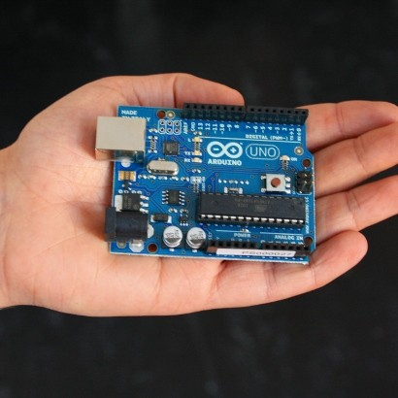
Why Android (Cont.)
Research Opportunities
Android + Arduino = Innovation Unlimited Arduino (http://www.arduino.cc/)
Arduino is an open-source electronics prototyping platform
can sense the environment by receiving input from a variety of sensors and can affect its surroundings by controlling lights, motors, and other actuators.
http://arduino.cc/blog/2011/10/12/androi d-open-2011-massimo-banzi-arduino- android-infinite-possibilities/

Slide 37
Why Android (Cont.)
Research Opportunities
Android in Disaster Management
A Mobile Disaster Management System Using the Android Technology
http://www.naun.org/journals/communications/19-280.pdf
Implementation of an Android based disaster management system
http://www.bcdph.com/download/android.pdf
Android Incident Reporting for SAHANA Disaster Management System
http://code.google.com/p/sahana-incident-reporter/
Case Study: Bangladesh Army
Custom sensor device to accumulate weather data
Create forecast
Use data feeds to plan strategies for recovery
Integrated solar cell for self sufficient power

Slide 38
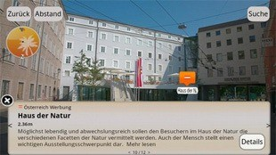
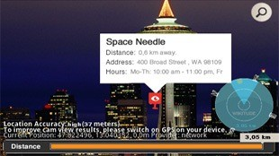
Why Android (Cont.)
Application Development Opportunities Augmented Reality
Some more: http://techsplurge.com/3214/mega-list-33-awesome-augmented-reality-apps-games-android/
Real World Environment+ Sound, Video, Graphics data generated by systems= AR

Slide 39
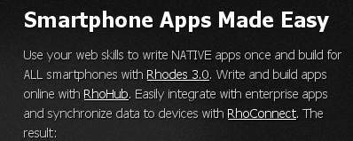
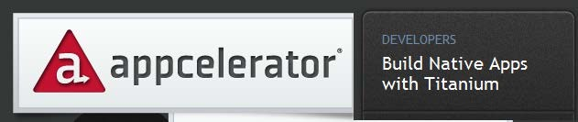
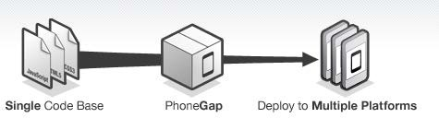
Cross-platform Development
1. RhoMobile
http://rhomobile.com/
2. Appcelerator
http://www.appcelerator.com/
3. PhoneGap
http://www.phonegap.com/

Slide 40
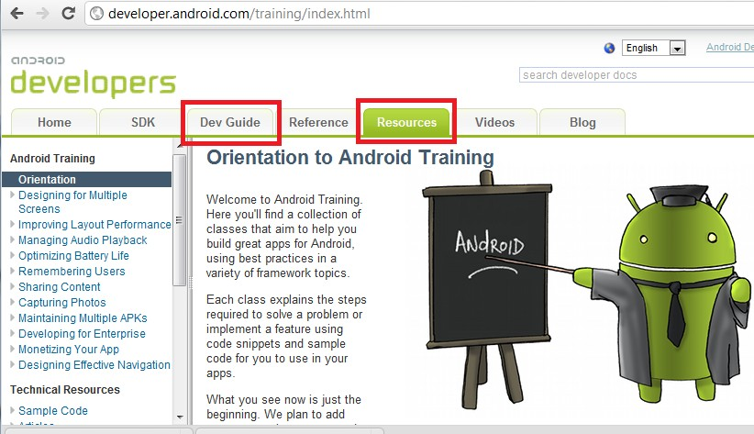
Resources: Android Developers’ Site
http://developer.android.com
Tutorials & Design Guidelines
SDK References
Articles on Pragmatic & Good Practices
& anything you’ll need including Google IO Videos

Slide 41

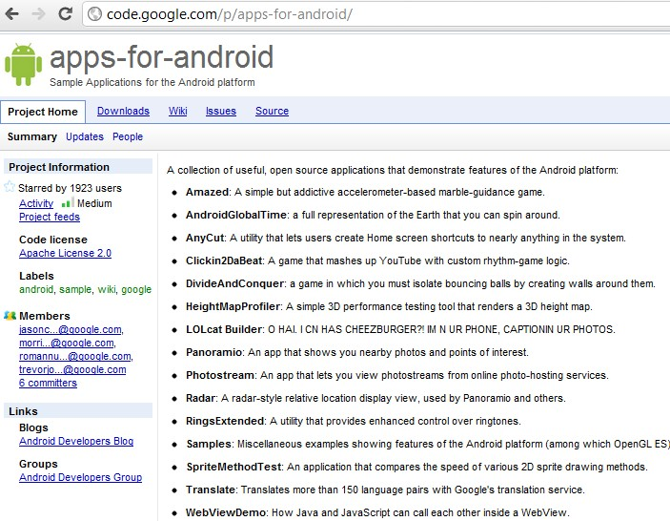
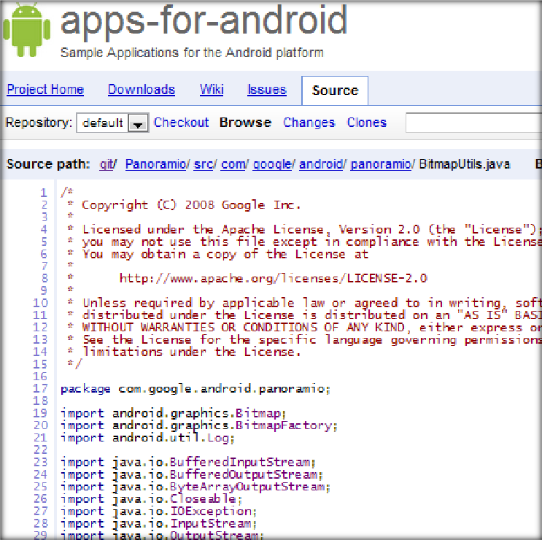
Resources: Open Source Projects
http://code.google.com/p/apps-for-android/
http://en.wikipedia.org/wiki/List_of_open_source_Android_applications

Slide 42
Android Features
Application Framework
Dalvik virtual machine
Integrated (webkit) browser
2D and 3D graphics APIs with HW
SQLite
Video and audio codecs
Bluetooth, EDGE, 3G, and WiFi
Camera, GPS, compass, and accelerometer

Slide 44

Questions?

