Slide 1
Final Story of Influenza Data
K M Abdullah Zahid Niloy

Slide 2
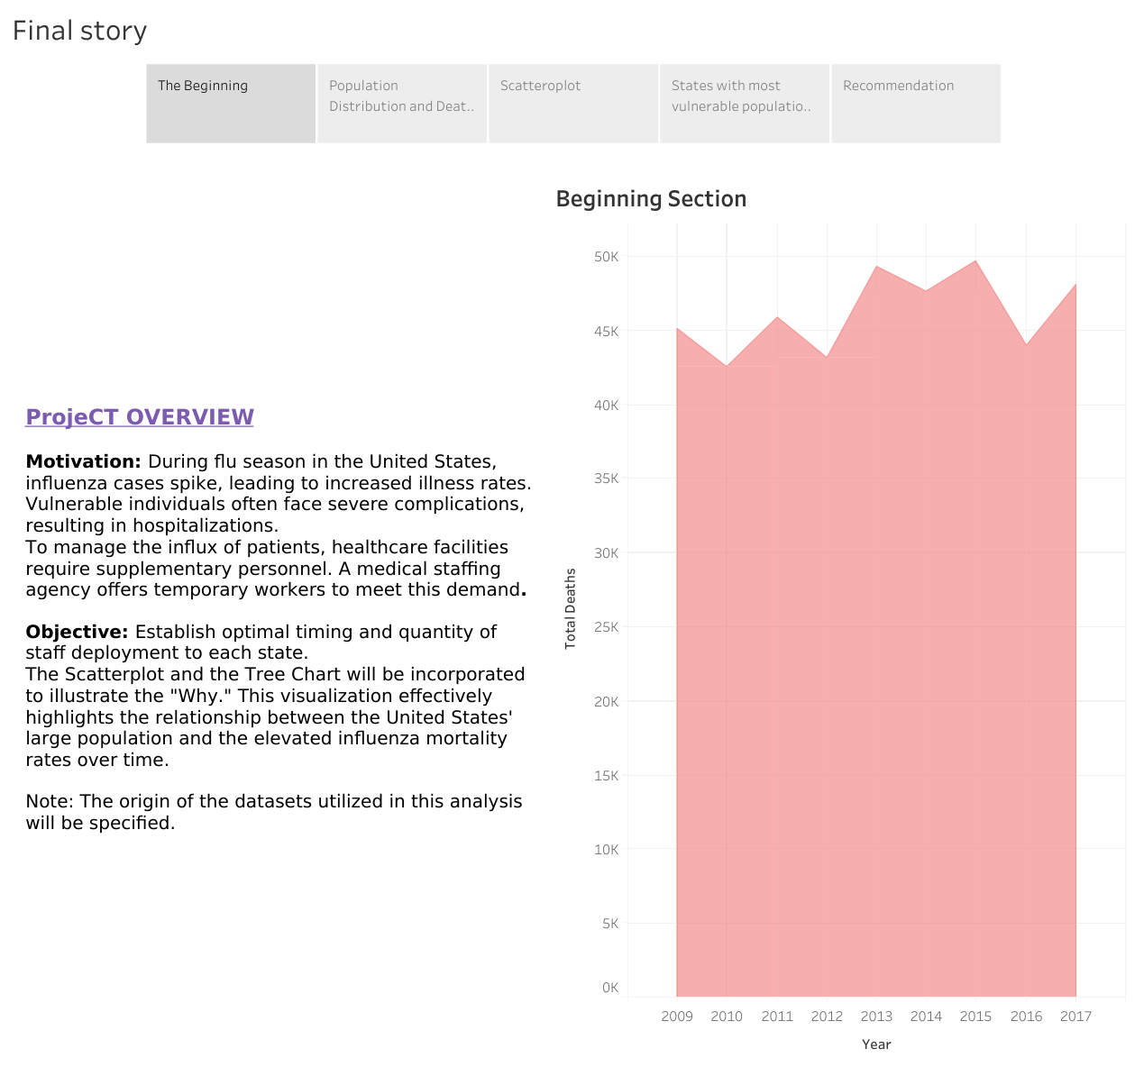

Slide 3
Key Factors to Consider
Age Group: 65 years and older
Mortality Rate: 70-85% of flu-related deaths
Hospitalizations: 51,686 to 129,497 annually

Slide 4
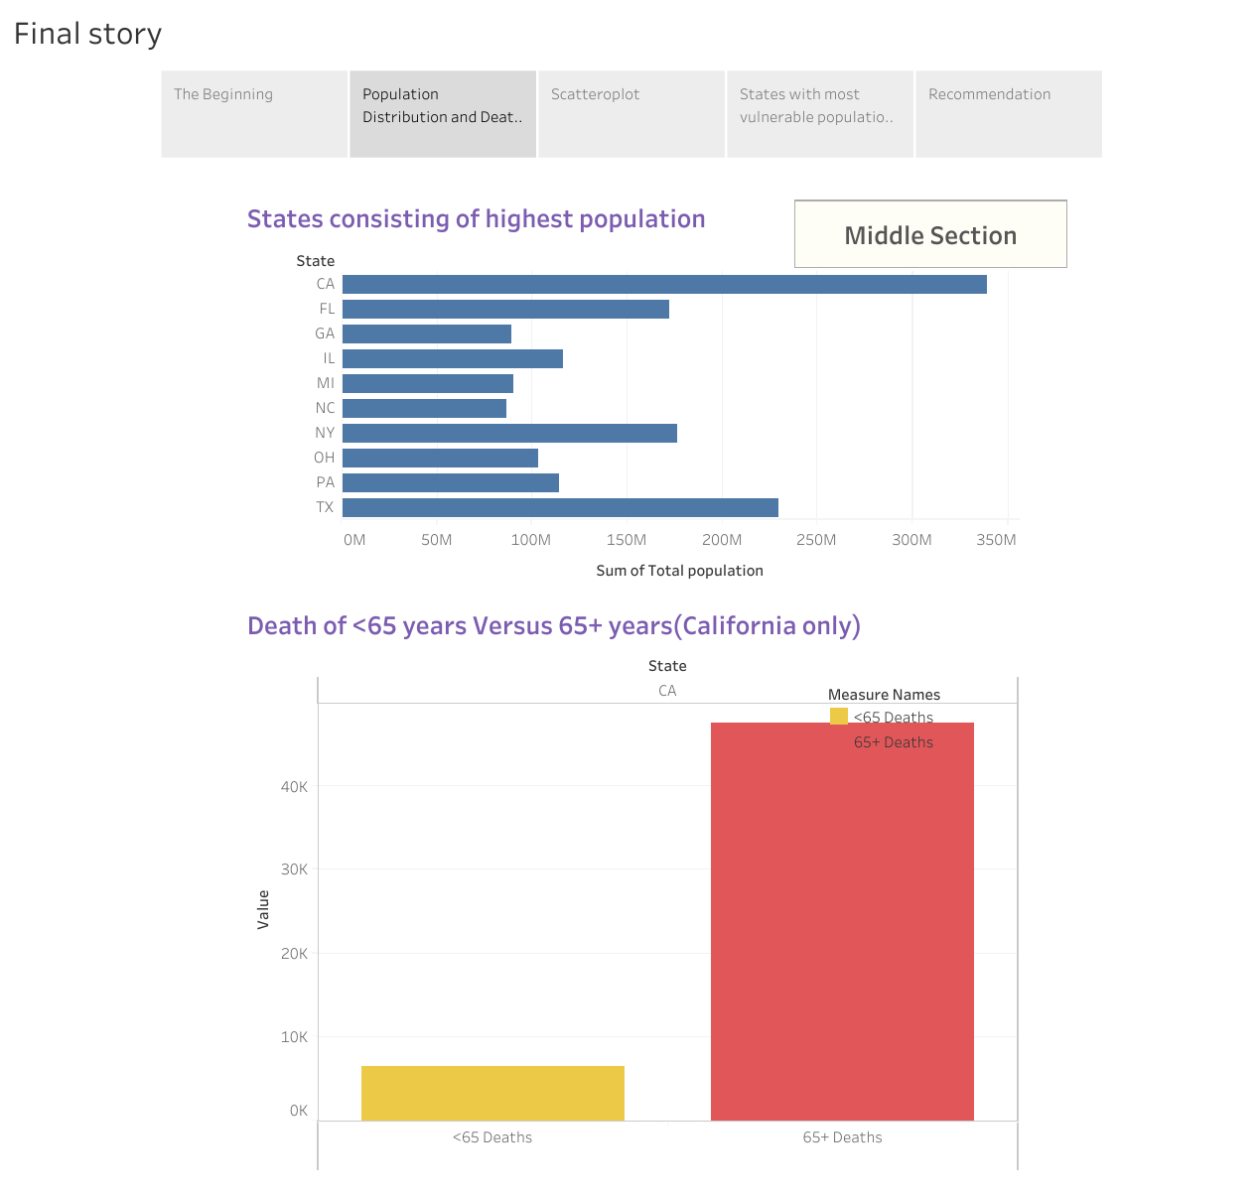

Slide 5
Recommendation
Higher Mortality Rates: 65+ age group vulnerable
Contributing Factors: Immune decline, chronic conditions
Need for Interventions: Targeted preventive measures

Slide 6
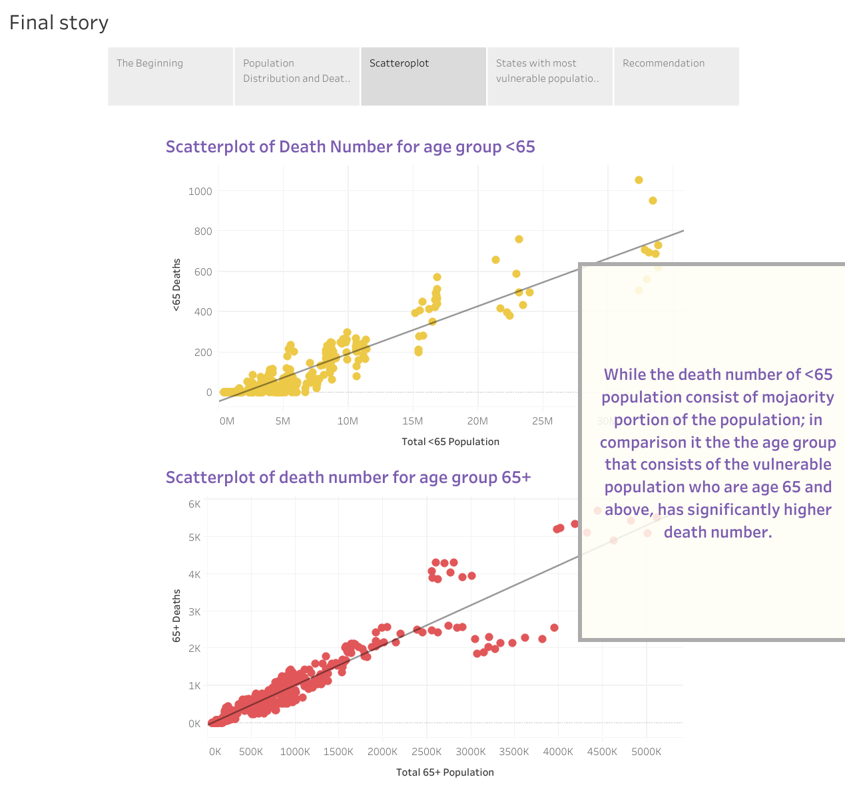

Slide 7
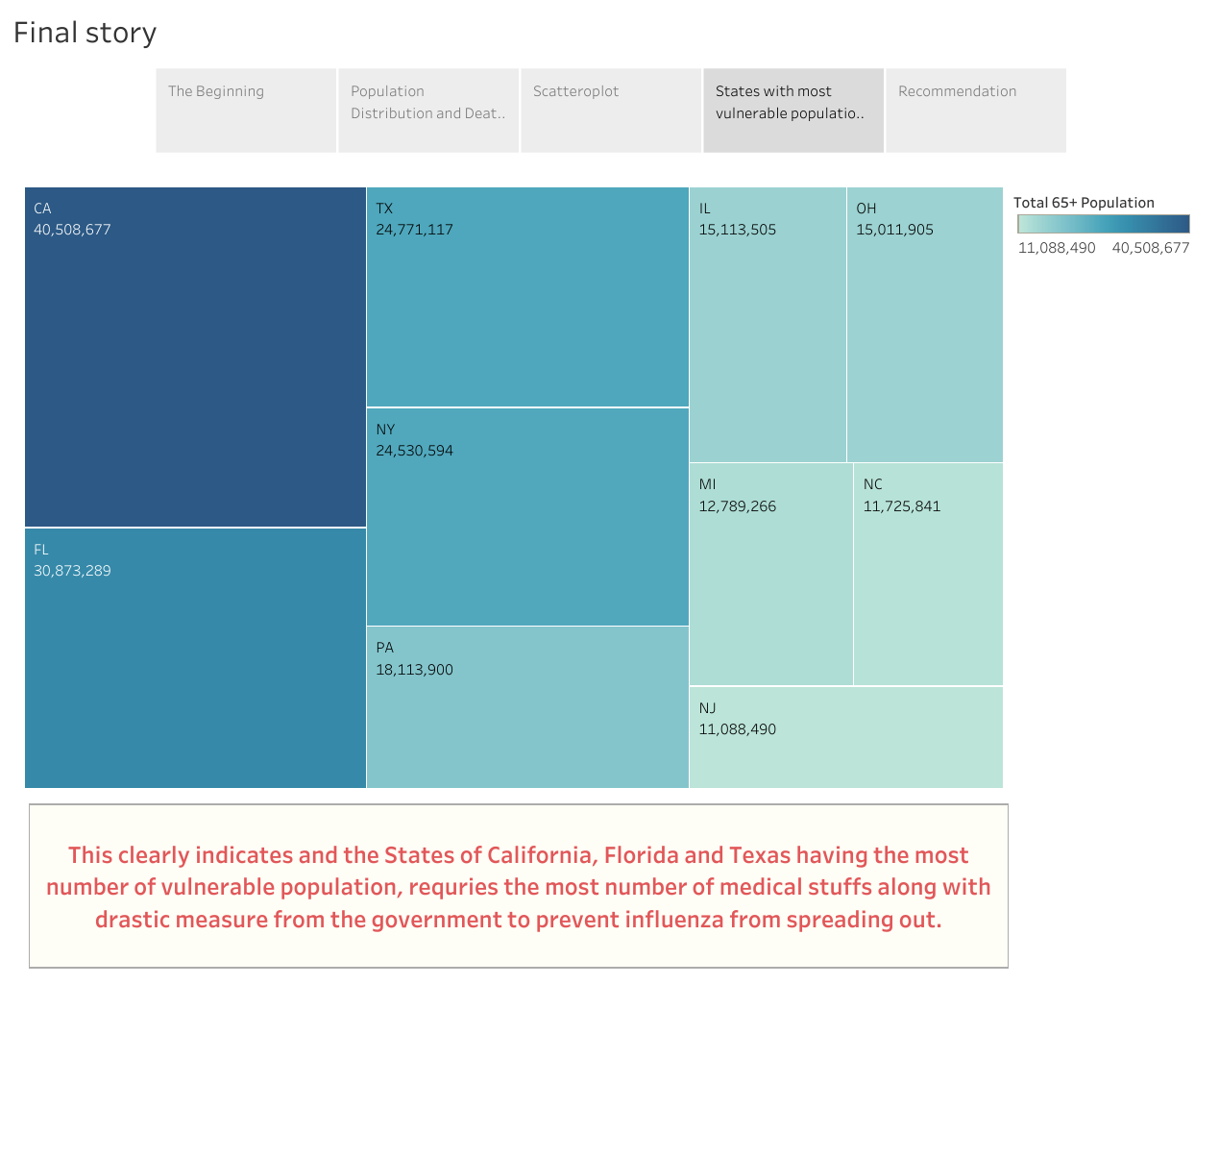

Slide 8
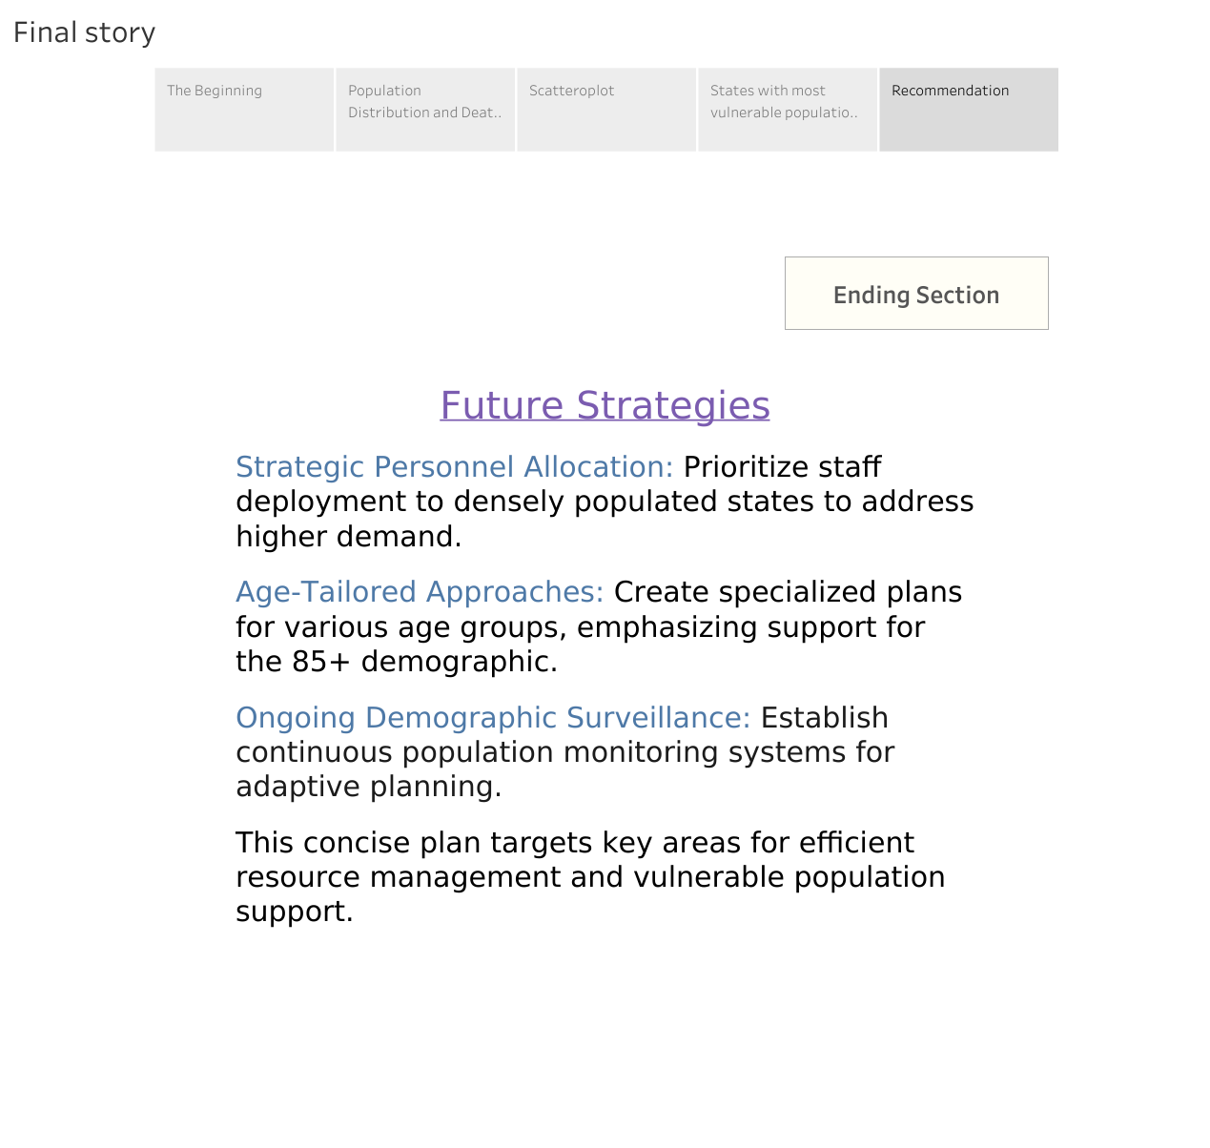

Slide 9
Further areas of Improvement
Vaccination Campaigns: Focus on 65+ population
Early Detection: Improve treatment protocols
Public Education: Raise awareness of risks

Slide 10
Limitations Preventing Analysis
Data Access: Limited individual-level patient data
Historical Data: Insufficient long-term trend analysis

Slide 11
Data Limitations Affecting Results
Underreporting: Misclassification of influenza deaths
Testing Inconsistency: Lack of standardized protocols

Slide 12
Monitoring Impact of Staffing Changes
Vaccination Tracking: Monthly rates for 65+
Treatment Timing: Monitor onset to antiviral initiation

Slide 13
Metrics for Monitoring Impact
Hospitalization Rates: Per 100,000 for 65+
Years of Life Lost (YLL): Due to influenza mortality

