Slide 1
CURSO
construir software moderno

Slide 2
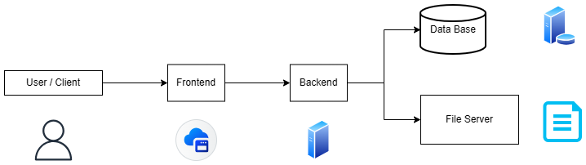
BASIC APP

Slide 3
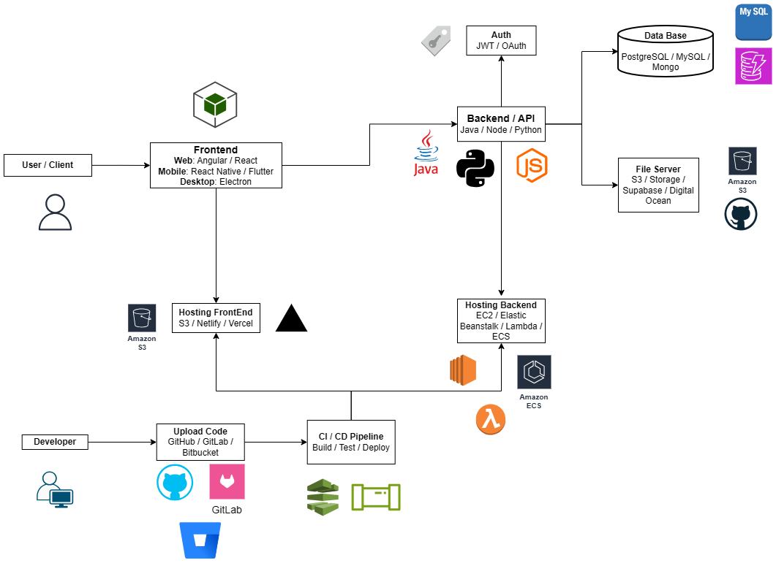
REAL APP

Slide 4
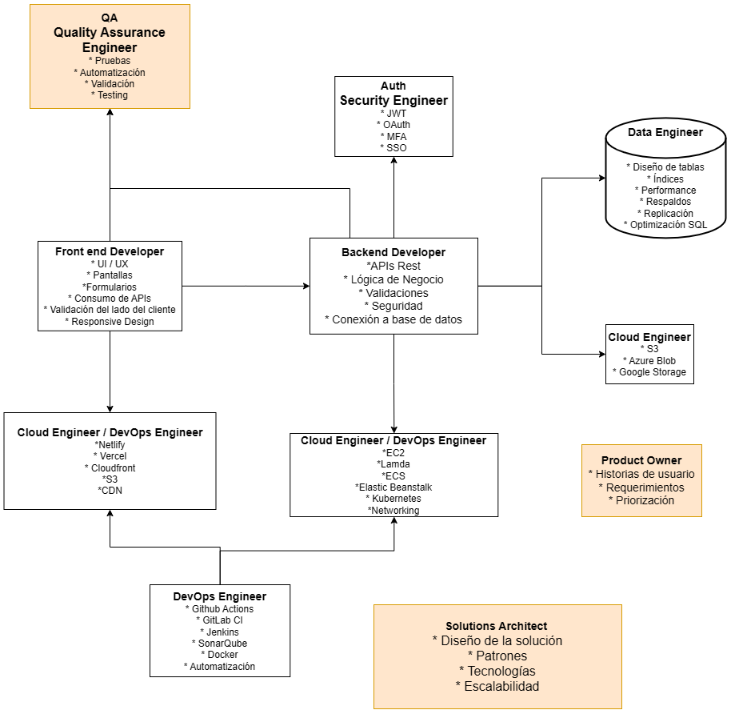
ROLES

Slide 5
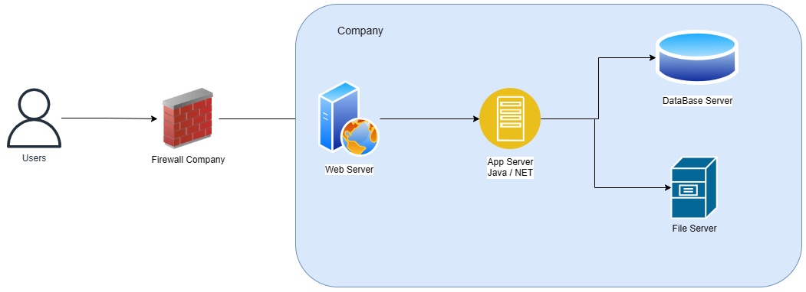
ON-PREM

Slide 6
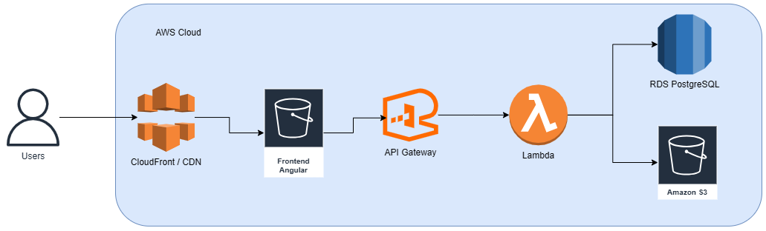
AWS CLOUD

