Slide 1
Welcome to
Idb-bisew
It scholarship project

Slide 2
MAGENTO WORK PRESENTION
Name: Zahidul
ID:1243346
Round-37
WDPF

Slide 3
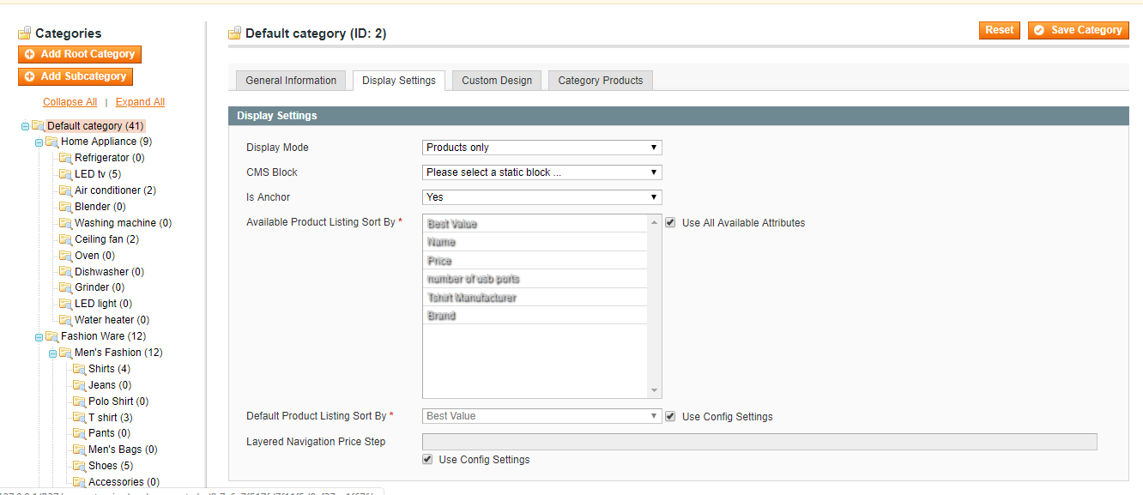
create default and subcategory for show product

Slide 4
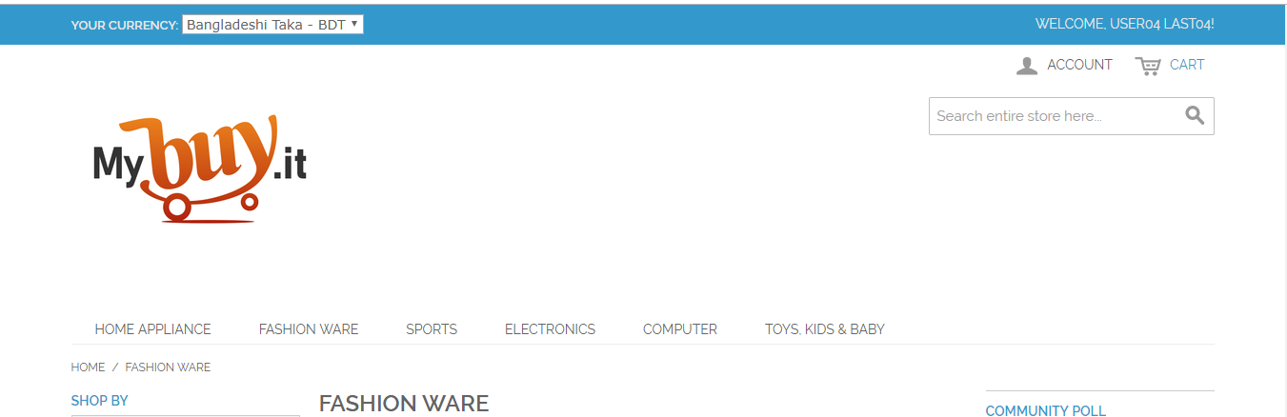
Add new Logo
on font page

Slide 5
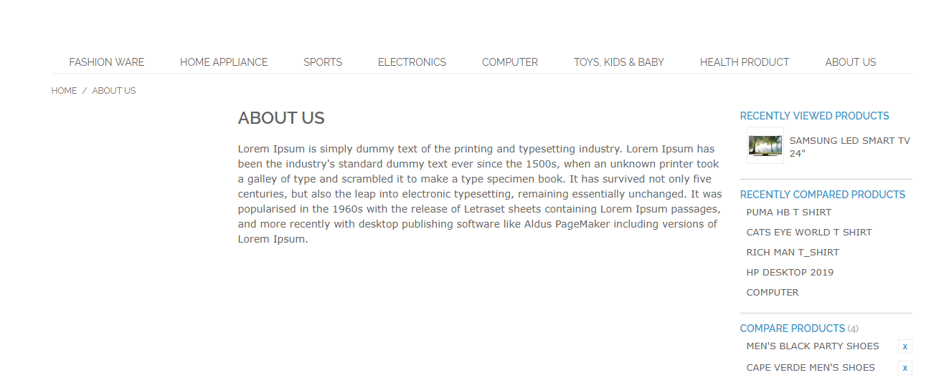
block page example

Slide 6
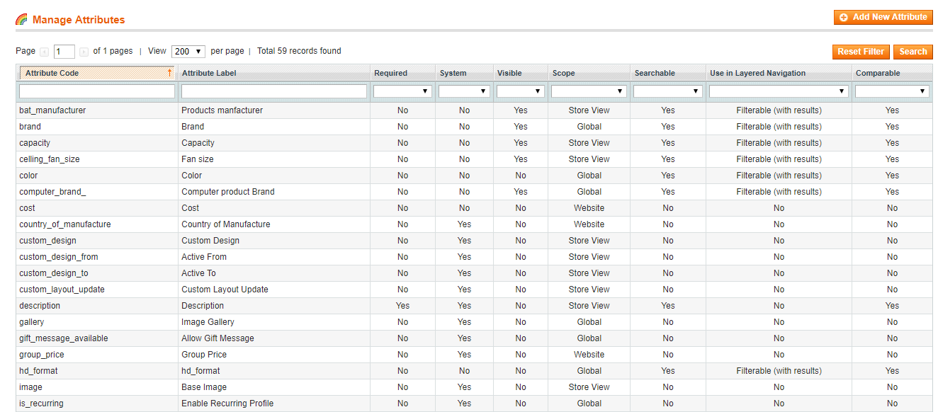
New create Attributes

Slide 7
new attribute Set

Slide 8
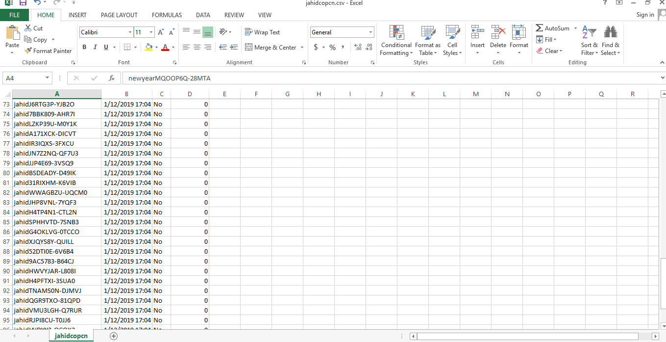
Cuppon List on csv file

Slide 9
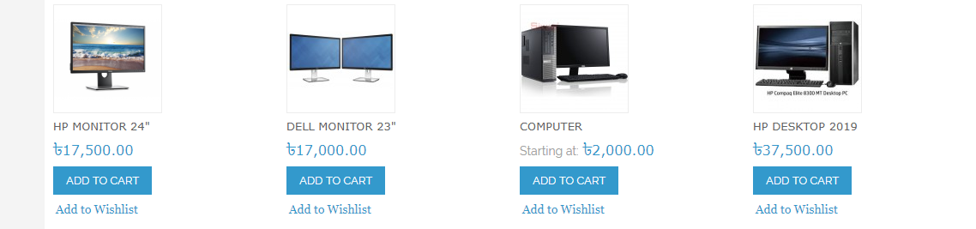
Product on
font page

Slide 10
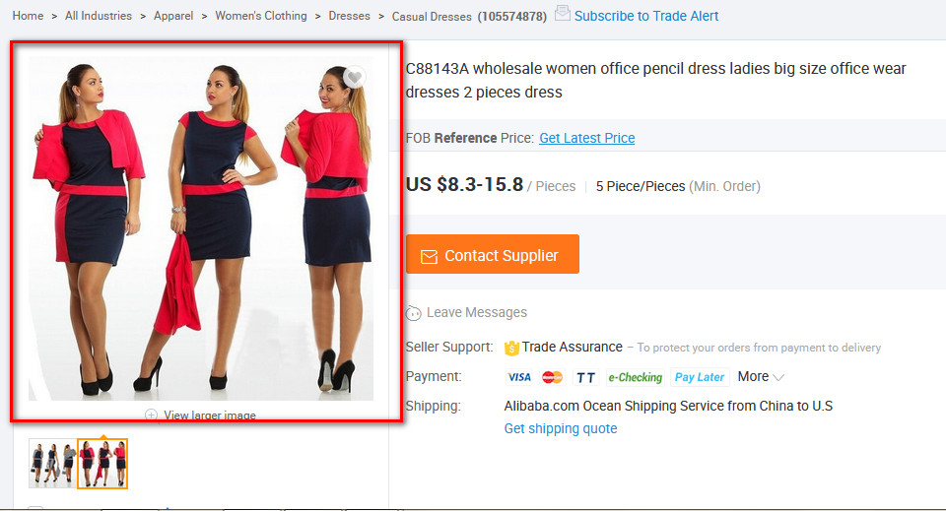
Show product
on single page

Slide 11
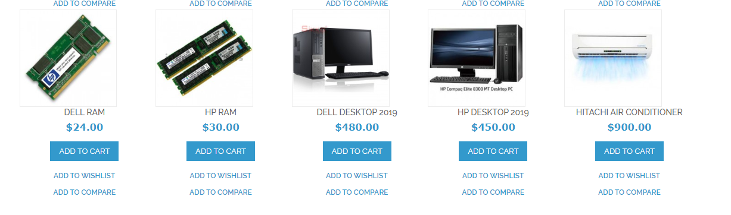
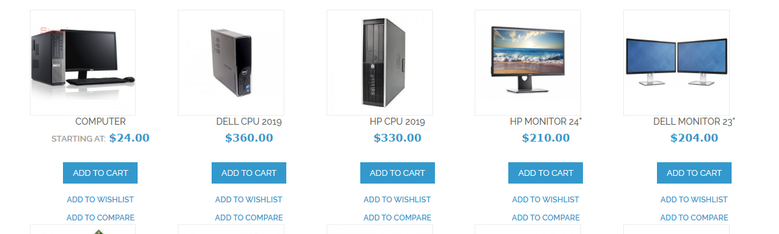
Related Product

Slide 12
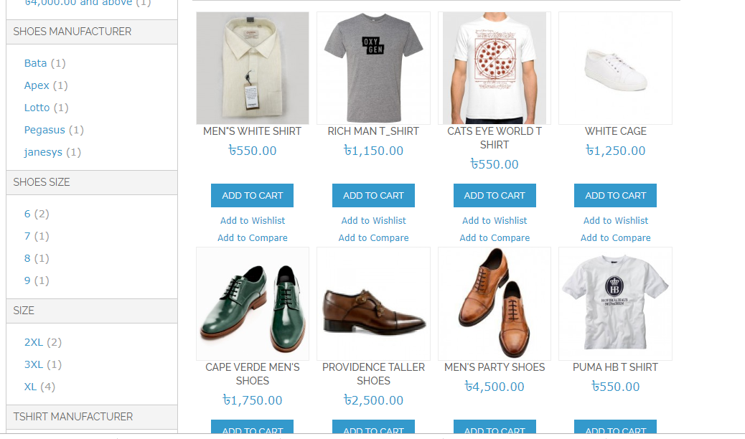
Layer and Navigations

Slide 13
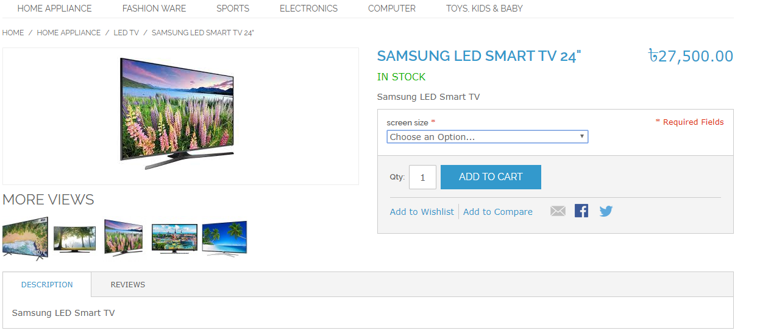
Configarible Product

Slide 14
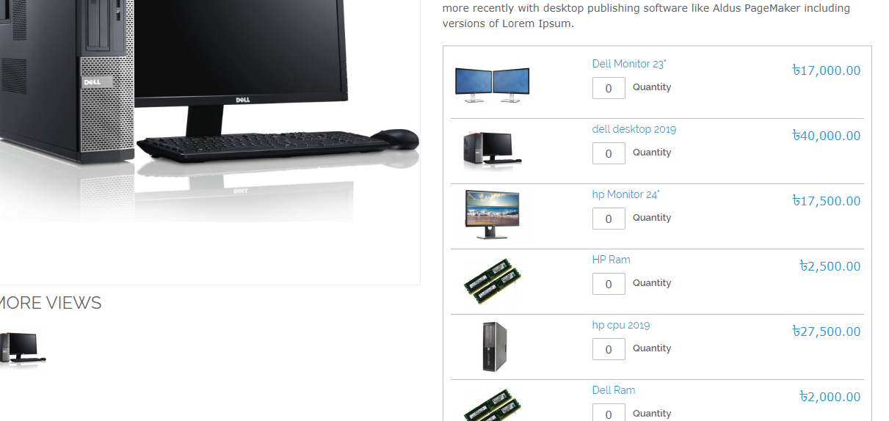
Group Prodect

Slide 15
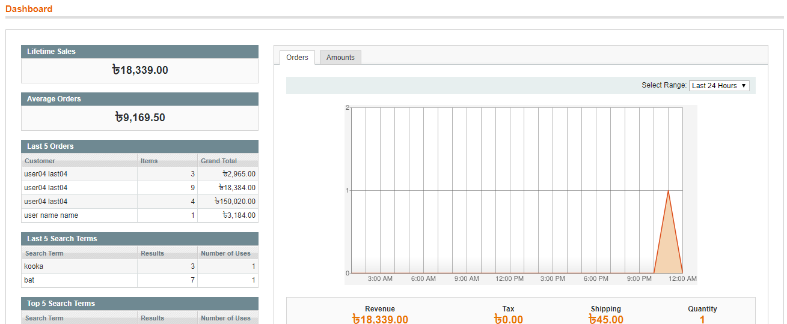
Show sales
Show sale today repots

Slide 16
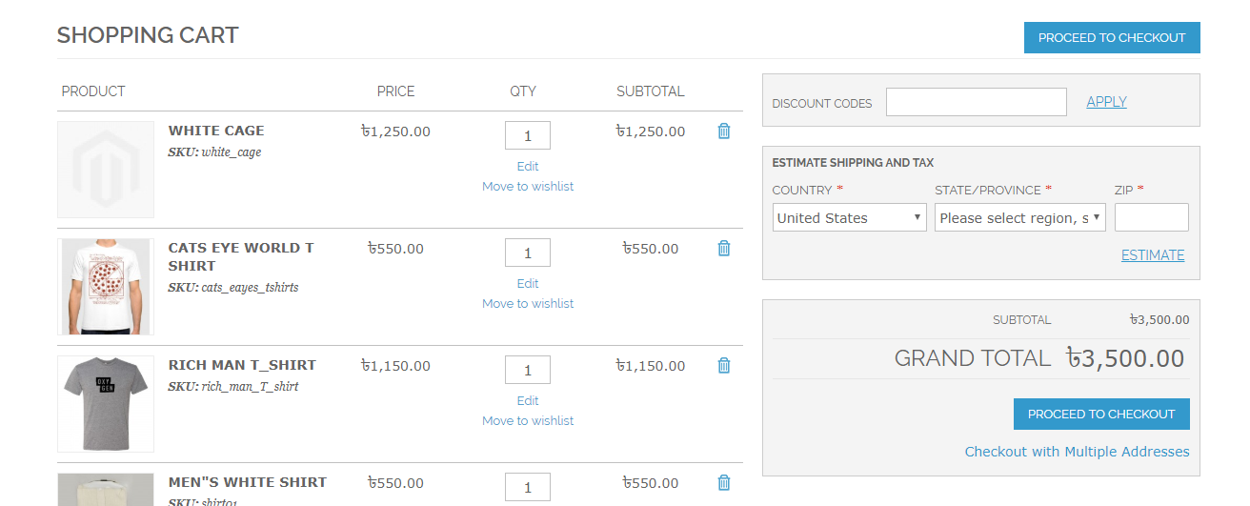
show Add to cart

Slide 17
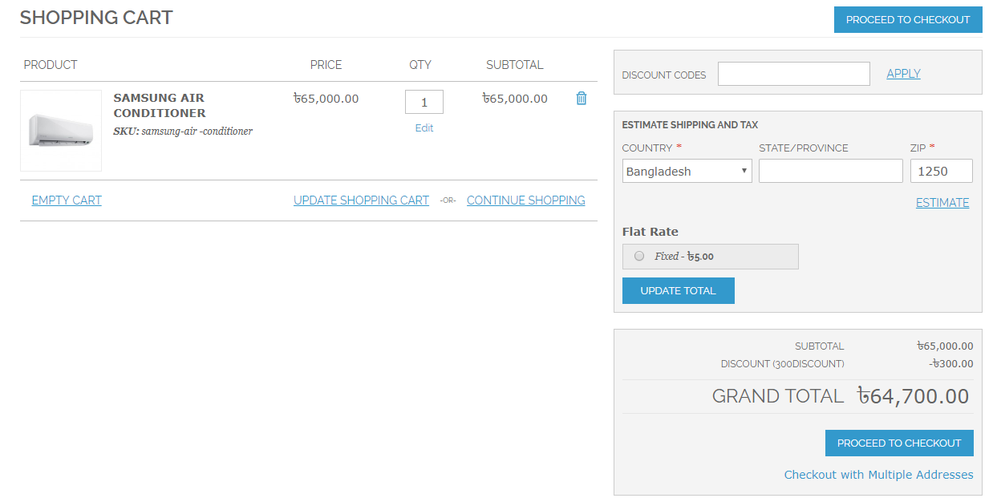
Show total Amount
affter catt

Slide 18
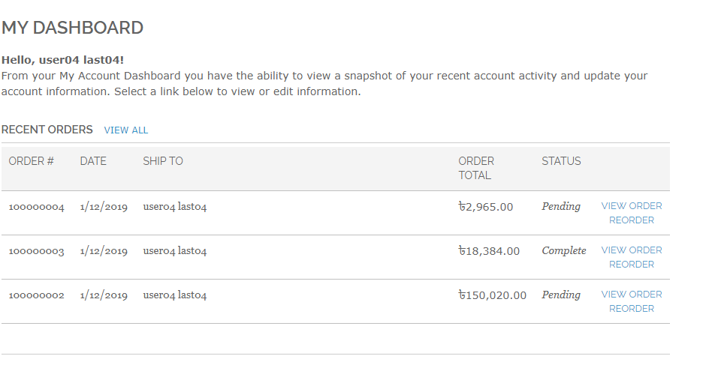
Show pending orders

Slide 19
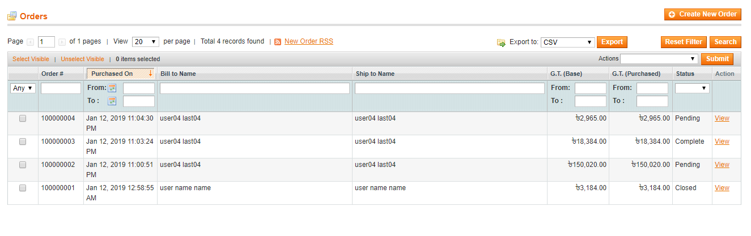
Show orders List
Show orders List

Slide 20
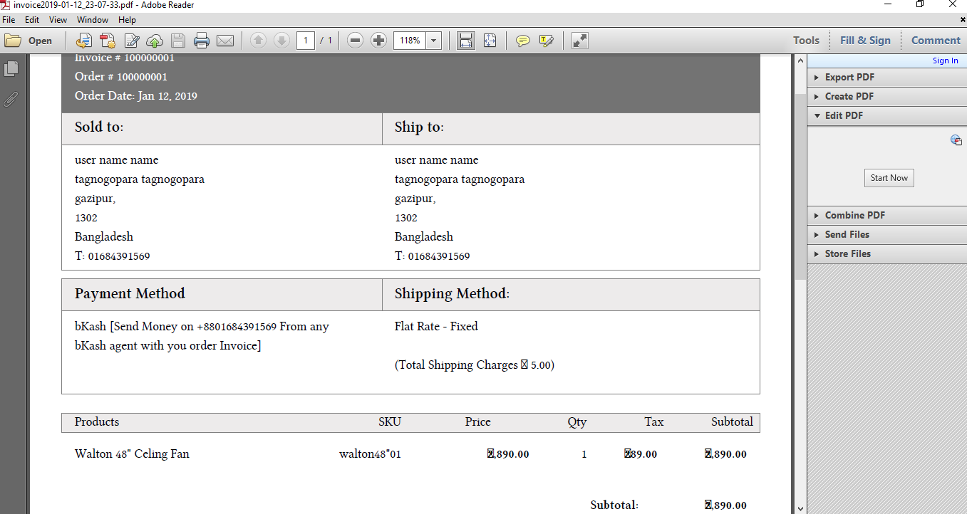
order invoice

Slide 21
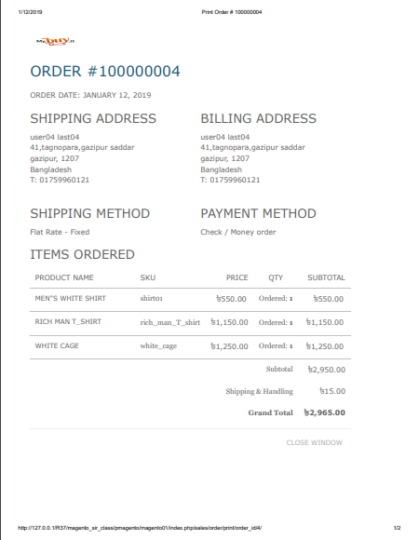
prientinvoice
prientinvoice

Slide 22
The end
Thank you

