Slide 1
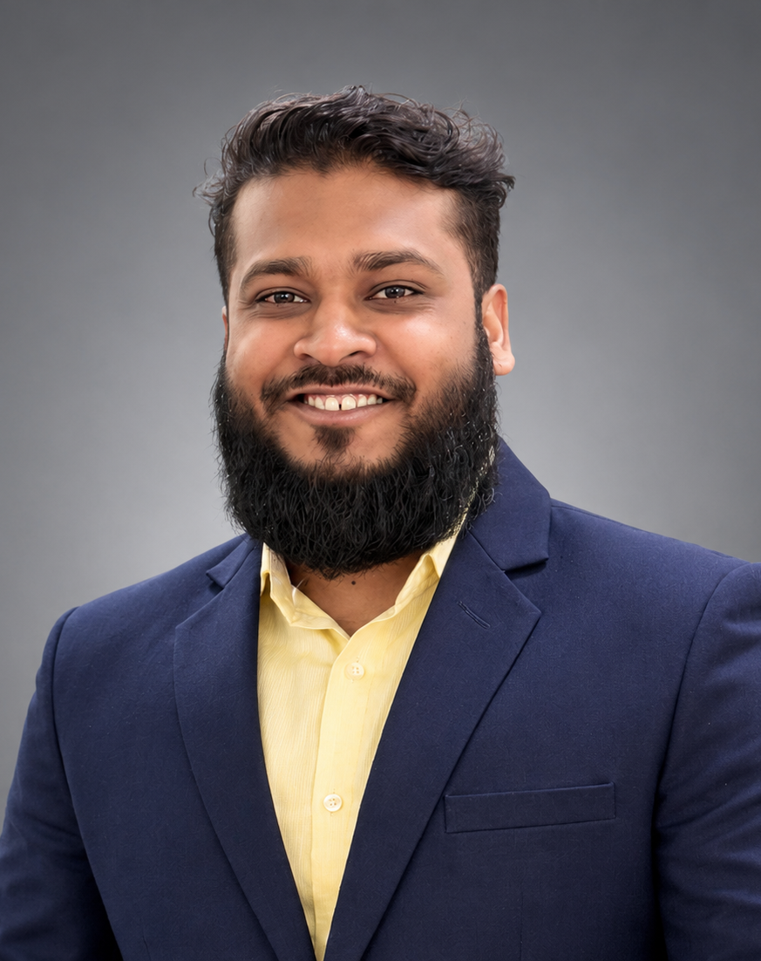
MARKETING PORTFOLIO
Zahidul
Islam
BBA in Marketing
Jahangirnagar University
Brand Management / Trade Marketing
Consumer Insights / Business Development
Zahidul Islam
01

Slide 2
Profile
Marketing graduate, Jahangirnagar University
I am passionate about understanding consumers, building brands, and turning ideas into market impact.
I completed my BBA in Marketing and developed my experience through academic projects, student leadership, and a Sales Internship in Reckitt’s Trade Marketing Department.
As I begin my professional career, I aim to keep learning, contribute meaningfully, and grow into a well-rounded marketing professional. I welcome meaningful conversations, new challenges, and opportunities to learn.
Zahidul Islam
02

Slide 3
Reckitt sales internship
Reckitt Benckiser (Bangladesh) PLC, Dhaka / 16 April–15 July 2026
Market execution
Visited distribution houses and retail outlets to observe sales operations, target execution, and retailer relationships.
Competitor pricing
Updated online competitor prices twice weekly to support pricing and market positioning analysis.
Add internship photo or approved work sample
Effective Trade Price
Calculated outlet purchase prices after discounts and trade offers to support trade marketing evaluation.
Zahidul Islam
03

Slide 4
Internship contributions
Sales Intern, Trade Marketing Department
90 to 45
219
19
Zero-sales DSR count over 21 days
Contributed through follow-up
Follow-up calls on DSR incentive
awareness and achievement
Merchandisers monitored
through the CM Tracker
SKU mapping
Updated Eco SKU mapping by brand, variant, and pack size.
Demographic analysis
Analyzed population, household, income, and expenditure data using BBS Census and HIES datasets.
Zahidul Islam
04

Slide 5
Selected projects
01 Frame-e Bondi
Online sunglasses brand / Strategic Brand Management (MKT-408) / January 2026
02 Ornabites
One-day marketing activation / Marketing Management (MKT-401) / September 2025
03 Mental health awareness advertisement
Advertising and Public Relations (MKT-402) / Team video project
04 BSCIC tannery estate documentary
Project Management (309) / Talk show and documentary / October 2025
Zahidul Islam
05

Slide 6
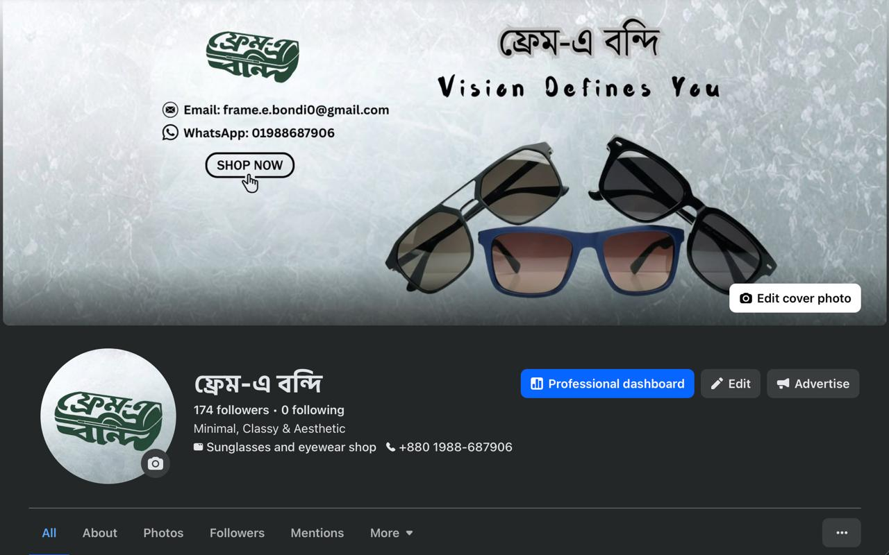
Frame-e Bondi
Online sunglasses brand / Strategic Brand Management (MKT-408) / January 2026
Our team developed an online brand using STP, SWOT, and a brand mantra, then tested our decisions through day-to-day operations.
My responsibilities
Set up the social media page, maintained consistent posts, and handled customer DMs.
Business operations
Sourced quality products at low cost, supported fair pricing, and kept online availability aligned with inventory.
Brand page supplied with this portfolio
Zahidul Islam
06

Slide 7
Brand decisions in practice
Frame-e Bondi / Project reflection
Good branding and sound business decisions need to work together.
The project showed me how customer communication, product availability, sourcing costs, and margins shape the brand experience.
Add product photography
or presentation photos
We presented to Professor Md. Kashedul Wahab Tuhin and Assistant Professor Sabakun Naher Shetu. Auvik Jamil, owner of J-The Story of Handloom Jamdani, provided feedback on scaling branding decisions.
Zahidul Islam
07

Slide 8
Ornabites
Team Syncforce / New Product Fair / 7 September 2025
“If you bite it, you write it.”
For MKT-401, our team executed a one-day marketing plan offering food items and ornaments. All products sold out ahead of schedule.
Add stall photo, menu,
or event highlights
I handled brand promotion, visual identity, menu design, stall and banner design, logistics coordination, and sales of my self-developed product.
I also hosted the special session with faculty members and industry professionals.
Zahidul Islam
08

Slide 9
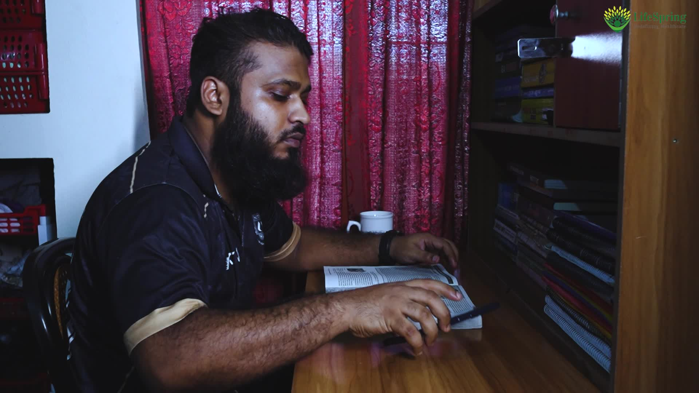
Mental health awareness advertisement
Advertising and Public Relations (MKT-402) / Academic project, not a paid promotion
Our first video advertisement explored unseen struggles, including PTSD, ADHD, and OCD, and the value of steady support.
I helped turn the idea into a video and acted in it. The project developed my teamwork, empathy, and understanding of responsible storytelling.
Video still from the supplied advertisement
Teacher: Mamtaj Akter
Team: Rafi Islam, Sabrina Khan, Md. Aminul Islam, and Mozammel Haque Tanvir
Add the video in Canva
Zahidul Islam
09

Slide 10
BSCIC tannery estate documentary
Savar / Project Management (309) / October 2025
Our team produced a talk show and documentary based on a visit to the BSCIC Tannery Industrial Estate.
We spoke with industry professionals and documented the estate’s challenges and successes, including its environmental and economic impact.
Add documentary video
or field visit photos
The assignment strengthened my understanding of project management and teamwork through fieldwork, planning, filming, and editing.
Faculty: Md. Muzahidul Islam
Team: Md. Aminul Islam and Md. Mozammel Haque Tanvir
Zahidul Islam
10

Slide 11
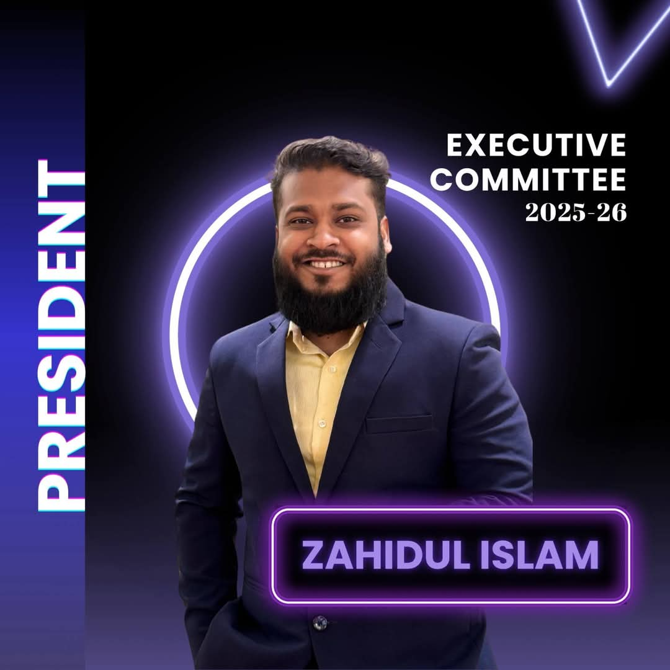
Student leadership
President, Forum of Entrepreneurship & Business (FEB-JU) / July 2025–June 2026
Food Carnival
Organized stalls where 30+ students prepared and sold food to explore entrepreneurship.
BRAC Bank Career Talk
Coordinated an event for 350+ participants, including 45+ on-campus interviewees. Many advanced to the next stage.
FUTUREMAKERS Roadshow
Organized the Grameenphone roadshow at Jahangirnagar University with 230+ participants.
Zahidul Islam
11

Slide 12
FEB-JU event coordination
Leadership through planning, teamwork, and ownership
Business & Mental Wellness Seminar
Collaborated with Grameen Digital Healthcare Solutions on a seminar engaging 80+ students.
Add seminar or roadshow photos
FEBx Edge
Co-convened a five-day flagship event with 60+ participants per session, including the finale and prize-giving.
Add FEBx Edge event photos
Zahidul Islam
12

Slide 13
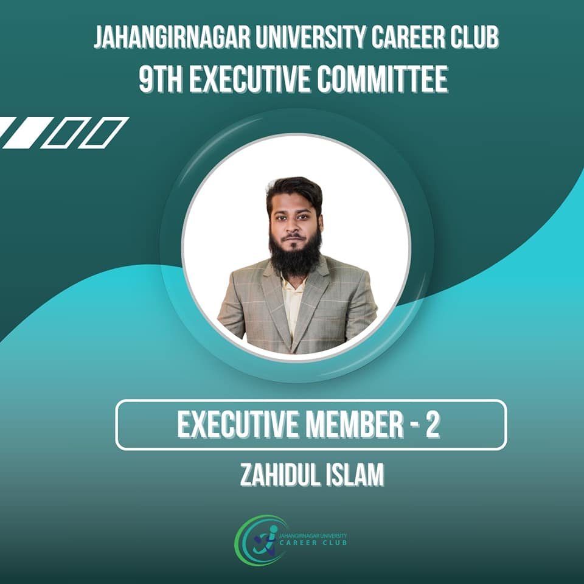
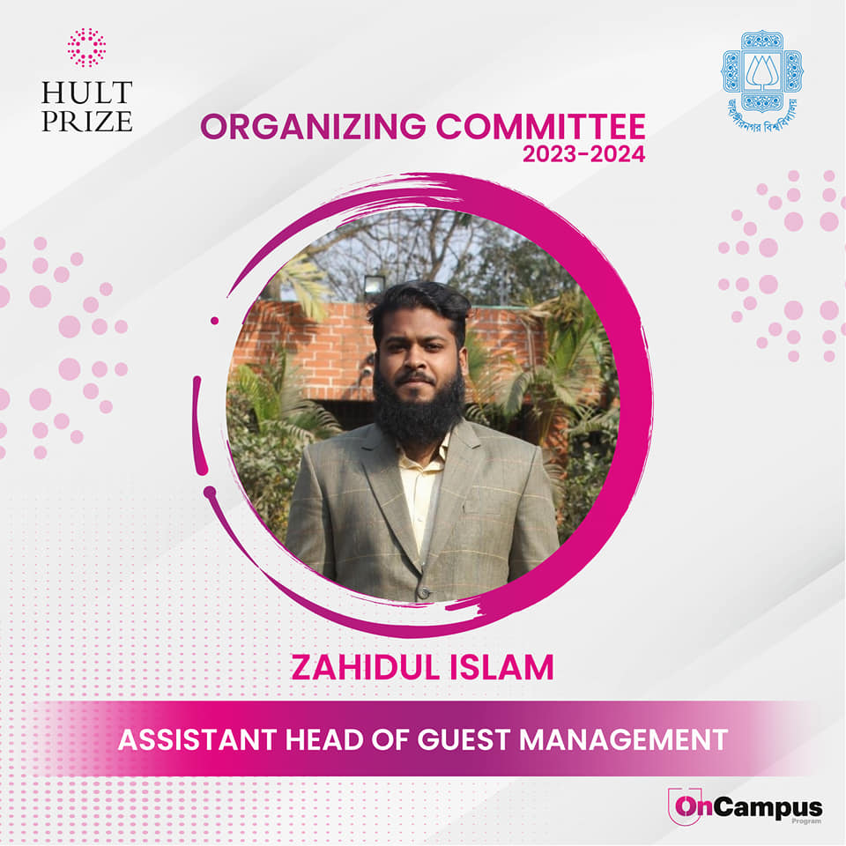
Campus engagement
Jahangirnagar University Career Club and Hult Prize
JUCC Executive Member-2 / 2023–2025
Recruited 1,200+ new general members in a single tenure. Supported logistics for Breakthrough Beginnings, a fresher’s reception featuring Sadman Sadik with 200+ attendees.
Hult Prize Guest Management / 2023–2024
As Assistant Head of Guest Management, managed guest coordination and on-site support for campus events with 150 participating teams.
Club appointment graphics
Zahidul Islam
13

Slide 14
Professional capabilities
Trade marketing & analysis
Competitor price tracking, Effective Trade Price analysis, SKU mapping, merchandiser monitoring, and demographic analysis.
Brand execution
Social media setup, customer communication, visual identity, menu and banner design, sourcing, pricing, and inventory coordination.
Leadership & delivery
Event coordination, stakeholder engagement, guest management, field team communication, sales follow-up, and teamwork.
Zahidul Islam
14

Slide 15
Certificates & professional learning
Aspire Institute
Engage Test Pilot, Aspire Leaders Program. Recognition for early LMS testing and feedback.
keeron
MS Excel for Professionals
Add certificate scans
Duplicate this page for more
Nestlé Bangladesh
NestGen Running an Efficient Supply Chain
Empowering a Sustainable Future through YOUth
Reckitt
Sales internship completion certificate
Zahidul Islam
15

Slide 16
Achievements
Four consecutive years
Jahangirnagar University Merit Scholarship
Outstanding academic performance in 2023, 2024, 2025, and 2026
Champion / 2019
Business Fest, Wall Magazine, Notre Dame College, Dhaka
2nd place / 2019
Business Fest, Olympiad Management, Notre Dame College, Dhaka
Zahidul Islam
16

Slide 17
Let’s connect
Zahidul Islam
Interested in Brand Management, Trade Marketing,
Consumer Insights, and Business Development.
zahidul.faysal02@gmail.com
linkedin.com/in/zahidul-islam1766
Zahidul Islam
17

