Slide 1
Verification services
To get a cleaner chip in shorter time

Slide 2
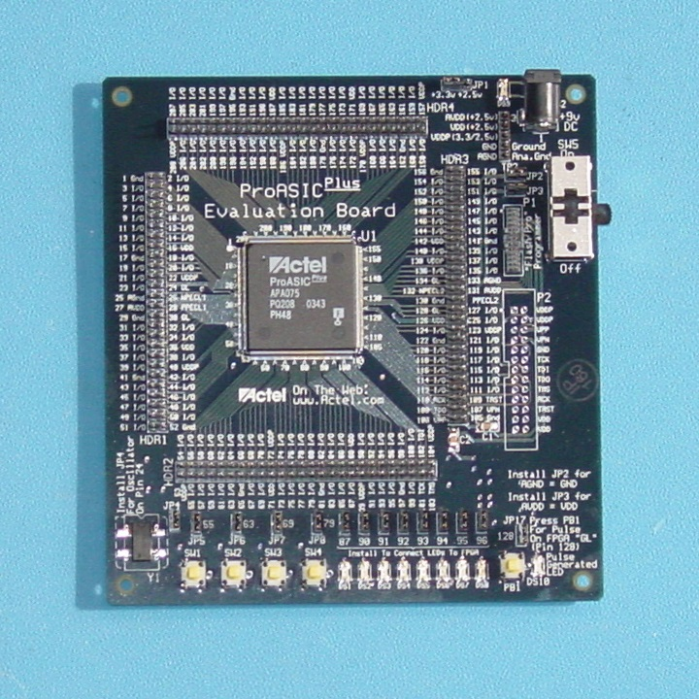
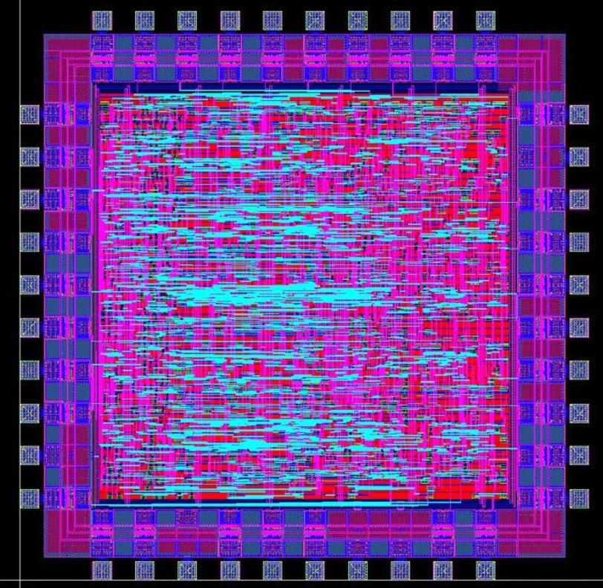
Application Specific Integrated Circuit - ASIC
ASIC today are very complex electronic parts that perform complex tasks.
Manufacturing an ASIC chip is a major time and money consuming task. So it has to be faultless on first attempt.
Respin cost a lot of money and delay time to market.

Slide 3
Stages in making a product
Characterization (with or without a client)
Architectural
Design + basic functional testing.
Producing first version (prototype).
Testing and corrections (using test plan).
Making beta version (to use with client).
Field testing & final fixes (with client).
Final version.

Slide 4
Changes for chip design
Characterization (with or without a client)
Architectural
Design + module testing.
Full chip integration & verification.
Random testing.
RTL freeze -> Synthesize
Gate level (without/with timing)
Final version (tapeout).

Slide 5
ASIC general structure
ASIC is usually designed as Hardware blocks connected together.
Each block has input & output pins.
Some blocks inputs are been driven by other blocks outputs.
Most ASIC has many operations modes which can be configured from the outside.
ASIC block diagram
Full chip
outputs
Full chip
inputs
Configuration
inputs
DUT2.v
DUT1.v
DUT0.v

Slide 6
Hardware modules – Design & verification
PASS/FAIL
Message to log file
Test bench.v
(simulate board)
The Data must be preraperd manually
DUT.v
Design Under Test
OUTPUTS CHECKER
Checks the DUT outputs against the DUT expected outputs
SIGNAL DRIVER
Simulate the full system inputs to our DUT
Module DUT (
Input …,
Output …
);
Always @ (posedge clk or negedge rstb)
if (!rstb) …
else ….
Assign ….
.
.
endmodule
outputs
inputs
Test_in.txt
32’h12345678
32’h34567890
32’h567890ab
.
.
.
test_out.txt
32’h87654321
32’h09876543
32’hba098765
.
.
.
We had to prepare the expected outcome
The machines are relative

Slide 7
Automatic hardware verification environment
Active/Passive
The Checker (score board). Prepare form the input signals, the expected output signals. Compare them and give a pass/fail massage.
The sequence driver. Send the scenarios to the design.
The monitors (inputs & outputs). Read back the input/output signals and generate back a data structure to be transfer to the checker.
SEQUENCE DRIVER
Message to log file
SEQUENCE
LIBRARY
OUTPUT
MONITOR
CHECKER
(S/B)
INPUT
MONITOR
SIGNAL DRIVER
Generate the input signals to our DUT
DUT.v
Design Under Test
Signal Driver. Translate the high level scenarios (sequences) to low level signal, to be driven to the DUT.
outputs
inputs

Slide 8
Full chip integration
The chip integrator integrate all the chip’s modules into the chip’s top level file.
Full chip
outputs
Full chip
inputs
Configuration
inputs
DUT2.v
DUT1.v
DUT0.v

Slide 9
Full chip verification environment
Having an environment for each module means that the full chip integrator only have to combine those environments.
Drivers for internal modules are no more needed. (passive mode)
And we can have high level sequences controlling the low level
VIRTUAL
SEQUENCE DRIVER
Passive
Active
Full chip
outputs
Configure driver
Cnf
SEQ
Full chip
inputs
SEQ
SEQ
SEQ
MON
SB
MON
MON
SB
MON
MON
SB
MON
DUT2.v
Driver
DUT1.v
Driver
DUT0.v
Driver

Slide 10
Random testing
At this stage we have a pretty big system and we let it go.
The system can now run scenarios on its own (Random).
At this point most of our test should PASS and we declare :
RTL Freeze
We keep building it to get cleaner and more readable results
VIRTUAL
SEQUENCE DRIVER
Top level score board
Full chip
outputs
Configure driver
Cnf
SEQ
Full chip
inputs
SEQ
SEQ
SEQ
MON
SB
MON
MON
SB
MON
MON
SB
MON
DUT2.v
Driver
DUT1.v
Driver
DUT0.v
Driver

Slide 11
Synthesize & Gate level verification
After the code is checked (for some stability) we do synthesis. This turn the code lines into electronic gates & flip-flops
Some of the inner signals will be lost in the process.
Full chip
outputs
Full chip
inputs
DUT2.v
Q
D
Q
D
DUT0.v
DUT1.v
CLK
CLK
rst
rst

Slide 12
Gate level testing
When we lost some of the inner signals we can’t use the monitors & score boards.
But we now knew that those tests had passed in logic so if they fail now it is an electrical problem.
VIRTUAL
SEQUENCE DRIVER
Top level score board
Full chip
outputs
Configure driver
Cnf
SEQ
Full chip
inputs
SEQ
SEQ
SEQ
MON
SB
MON
MON
SB
MON
MON
SB
MON
Driver
DUT1.v
Driver
DUT0.v
Driver
Q
D
Q
D
CLK
CLK
rst
rst

Slide 13
Gate level with timing
Up till now we looked at the signals as rising & falling in 0 time. In the real would they don’t.
clock
input
output
clock
In real life it takes the gates & flip-flops to change their values.
input
output
Q
D
Q
D
DUT1.v
CLK
CLK
rst
rst

Slide 14
Gate level with timing
Setup time
Hold time
We define the flip-flop’s ‘clock to Q’ & ‘delay time’ for the logic.
We define ‘setup time’ & ‘hold time’ that inputs must stand in .
clock
input
output
Clock to Q &
delay time
Q
D
Q
D
DUT1.v
CLK
CLK
rst
rst

Slide 15
Gate level with timing testing
We run all the tests again. All the test that passed without timing HAVE to pass with timing.
This is the last check before production, any bug found later will force us to re-spin.
VIRTUAL
SEQUENCE DRIVER
Top level score board
Full chip
outputs
Configure driver
Cnf
SEQ
Full chip
inputs
SEQ
MON
MON
Driver
DUT1.v
Driver
DUT0.v
Driver
Q
D
Q
D
CLK
CLK
rst
rst

Slide 16
And …
Tape out
We send the design to production and hope for the best ☺

