Slide 1
Prediction of antibiotic resistance in E. coli
CSE465
Section-1
Faculty: Mohammad Ashrafuzzaman Khan (AzK)

Slide 2
Group Members
ID Name
1711020042 Zahin Ahmed
1721498042 Mahmud Elahi Akhter
1510939042 Mst. Kamruna Jahan Konica
1520412042 Tamanna Islam Sushoma

Slide 3
Process:
To predict if a strain of E.coli is resistant to a certain antibiotic or not, we have to analyze its genetic sequence.
All parts of the genetic sequence are not responsible for resistance, some specific parts are
All strains of E.Coli have a “core genome sequence”
Same series of genes in all strains
But position within the sequence can differ
Finding the population structure from the core genome sequence answers the question: Does the position of the core genome affect Resistance?
Each strain have accessory genomes as well
Genomes that might be unique to the strain, or same for a subset of the strains
How does accessory genomes affect resistance?

Slide 4
Process (Cont.)
What we have: Raw sequences of each strain
What we need: Core genomes and Accessory genomes, their positions in the strains.
Genomes (Core and Accessory) of strains are not present in sampling, they have to be constructed.
Constructed using the following tools:
Velvet
Prokka
Roary

Slide 5
Velvet:
Takes the Sequences (in FASTA file format) as inputs
Gives the paired-end reads of the sequences as outputs
Paired-end reads basically gives the HEAD and TAIL of the sequences
Makes the sequences shorter and easier to use
Makes alignments and finding genetic differences easier
Runs on Linux
Requires at least 12GB of RAM

Slide 6
Prokka
Takes the output files of Velvet (known as assemblies) as input
Annotates the genetic sequence
Whole genome annotation is the process of identifying features of interest in a set of genomic DNA sequences, and labelling them with useful information.
Roary
Takes the output files of Prokka (annotated assemblies) as input
Produces the pan genome data as the output
The pangenome is the entire gene set of all strains of a species. It includes genes present in all strains (core genome) and genes present only in some strains of a species (variable or accessory genome).
Both are Linux based and require large RAM.

Slide 7
Progress Overview:
Preparing for Preprocessing took longer than expected due to:
HUGE size of data, bigger than estimated
Each raw sequence file (in FASTA format) are about 800MB
1936 *800MB= 1,548,800‬ MB= 1548.8 GB !!
Each sequence has to be downloaded individually
Usage of multiple tools in processing
Understanding the data and how the tools modify them
Arranging the required resources

Slide 8
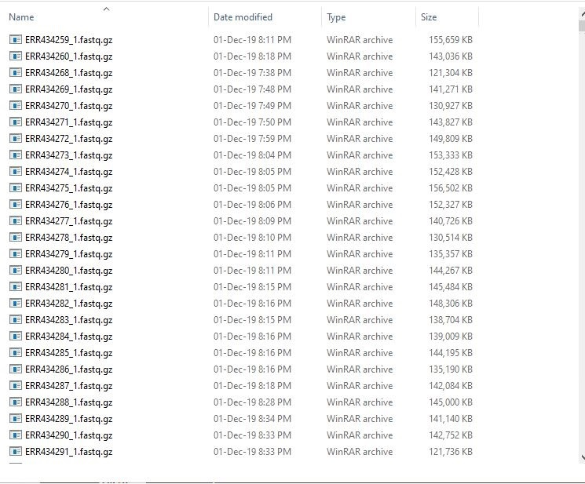
A small sample of the entire dataset:

Slide 9
Progress Overview (Cont.)
Currently, working on a smaller scale using smaller and fewer sequences to understand how the tools work
Setting the parameters of the tools can affect the overall modelling severely
Hence, very important to be learnt properly.

