Slide 1
Prediction of antibiotic resistance in E. coli
CSE465
Section-1
Faculty: Mohammad Ashrafuzzaman Khan (AzK)

Slide 2
Group Members
ID Name
1711020042 Zahin Ahmed
1721498042 Mahmud Elahi Akhter
1510876042 Syeda Saiara Lubaba
1510939042 Mst. Kamruna Jahan Konica
1520412042 Tamanna Islam Sushoma

Slide 3
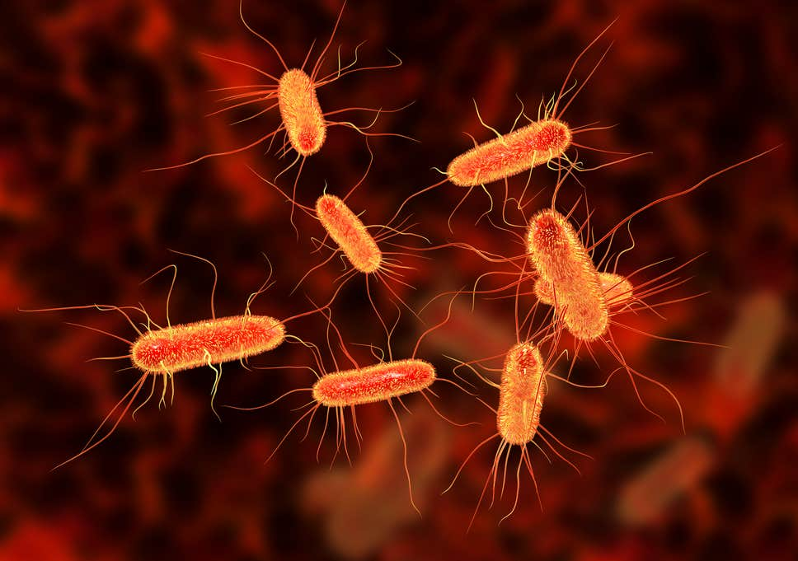
Motivation:
Currently, one of the main causes of death in Bangladesh is “Diarrheal Diseases”. Such diseases, alongside other diseases such as Urinary Tract Infections(UTI), are caused by Escherichia coli (E. Coli).
However, day by day strains of E. Coli are becoming resistant to anti-biotics, which is a major global health concern.
The key to controlling spread of resistant strains is accurate and rapid detection

Slide 4
Problem:
Traditional culture-based methods are time consuming
They involve human error
Efficiency is drastically reduced if a large outbreak occurs and there are too many patients testing in the lab
Trained personnel are needed to perform the cultures as medical background is mandatory

Slide 5
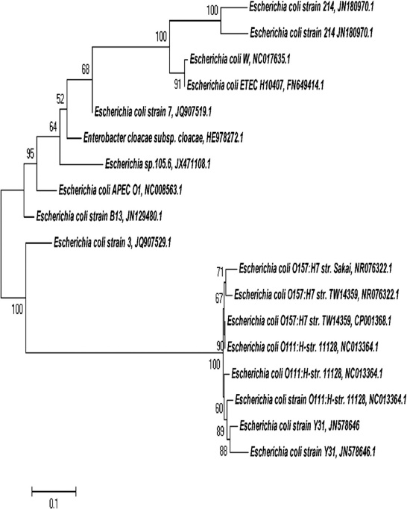
Proposed solution:
Prediction of antibiotic resistance in Escherichia coli from large-scale pan-genome data
Detecting which mutation caused resistance, and at which generation the mutation occurred (using phylogenetic analysis)
Why?
Will greatly increase efficiency
Reduce human error (Possible error will depend on model used and accuracy)
No in-depth medical background required
Fig: Sample phylogenetic tree of E. Coli

Slide 6
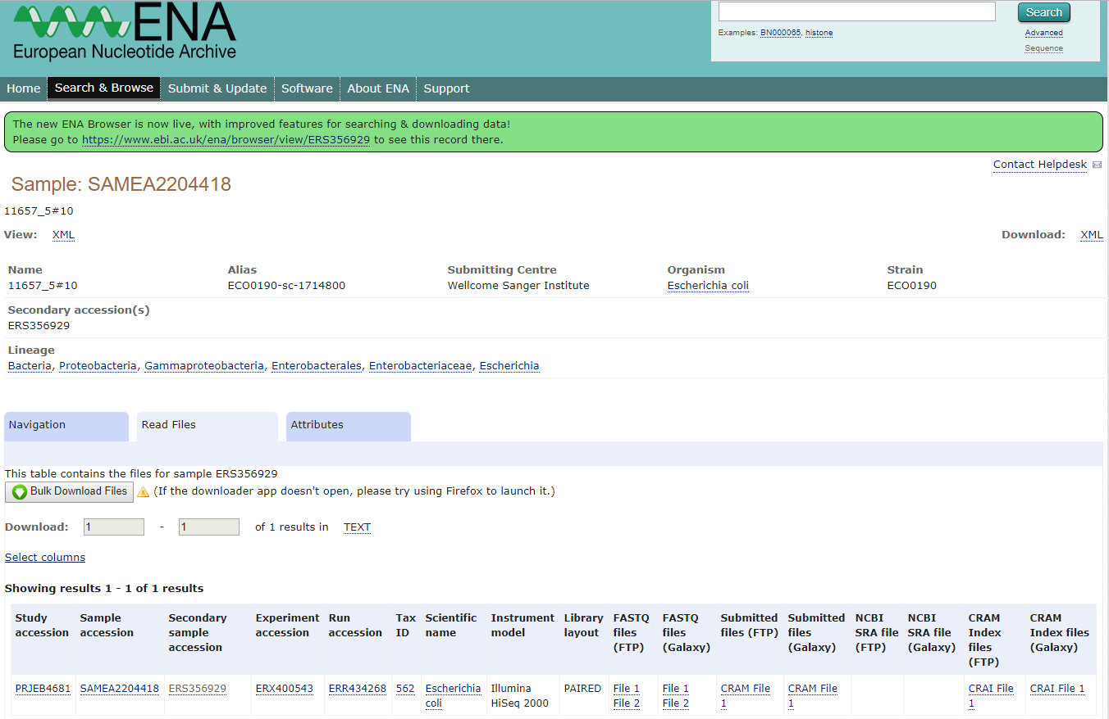
Dataset:
Existing and novel whole genome sequences of 1936 E. coli strains from European Nucleotide Archive (ENA)
European Nucleotide Archive Website

Slide 7
Timeline:
Week 1 | Week 2 | Week 3 | Week 4 | Week 5 | Week 6 | Week 7 | Week 8
Data Collection
 | Pre-Processing
 |  | Exploratory Statistics
 |  |  | Feature Engineering
 |  |  |  | Model Selection and Implementation
 |  |  |  | Training and Testing
 |  |  |  |  | Hyperparameter Optimization
 |  |  |  |  |  |  | Finalizing Model

