Slide 1
Architecture design overview
STRIVE product -- software as a service -- multi tenancy

Slide 2
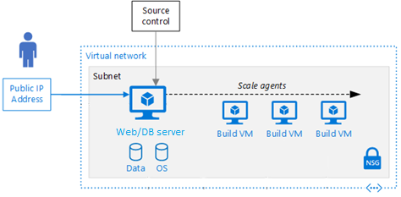
Micro websites architecture in Virtual machine

Slide 3
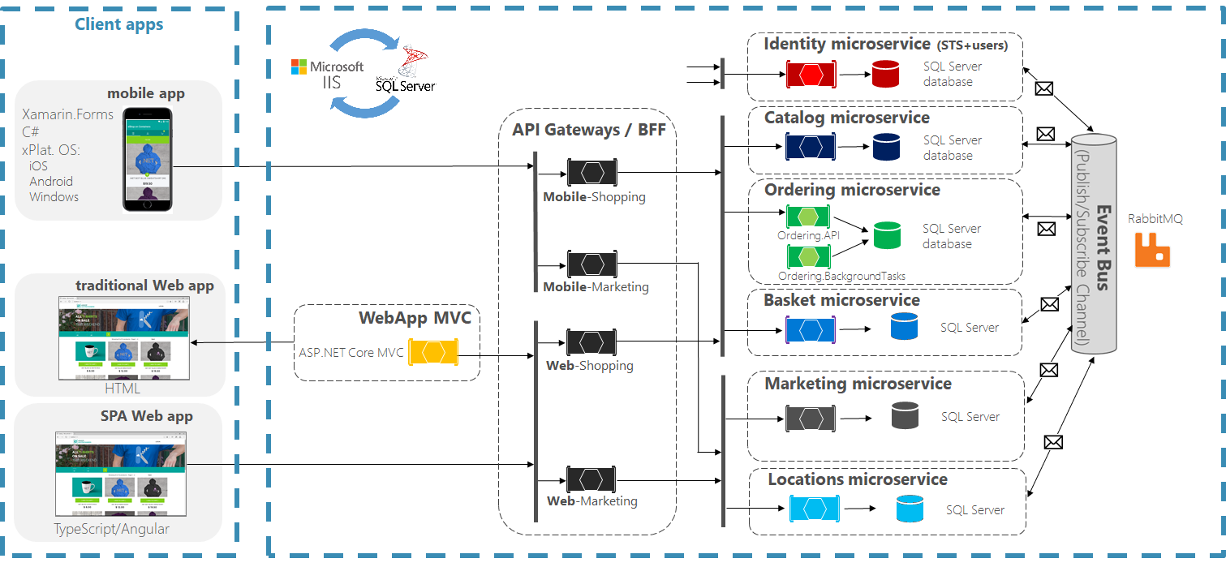
Micro websites development architecture

Slide 4
services overview
SSL, HTTPS
Custom Domain
Custom Sub Domain
Google Analytics
Google Page Speed
Google FCM
Virtual Machine
Security Center
Network Security
Azure Monitor
Static IP Reservation
Microsoft IIS
Microsoft SQL Server

Slide 5
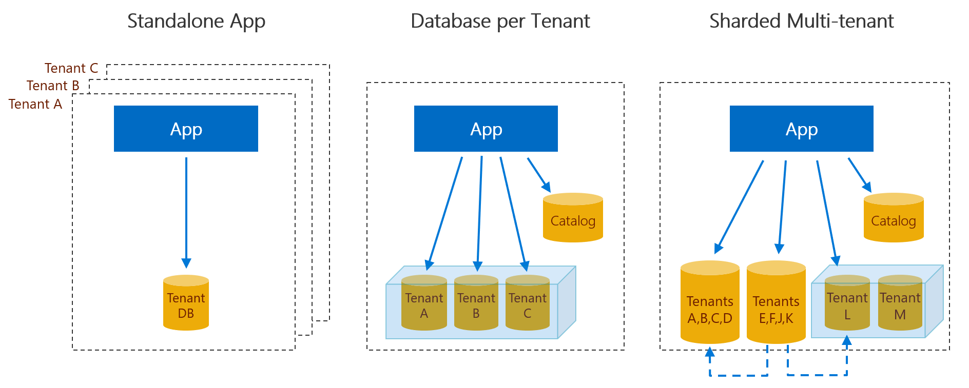
Multi tenant Database architecture

Slide 6
Azure Databases overview
Common Database
Licenses
Trails/Expiry, etc.,
Auth Database
oAuth2
Password Hash, etc.,
Lead Database
Marketing
Lead Generation, etc.,
Tenant Database(s)
Tenant Schema Tables
Instead of Row Level Security (Tenant Id column in each Table)
Control the Data Violation by each Tenant SQL User Login
Azure Virtual Machine with SQL Server
5 to 10 Databases with Shared CPU/Memory
Start with Minimum 4 CPU/32 GB Ram

Slide 7
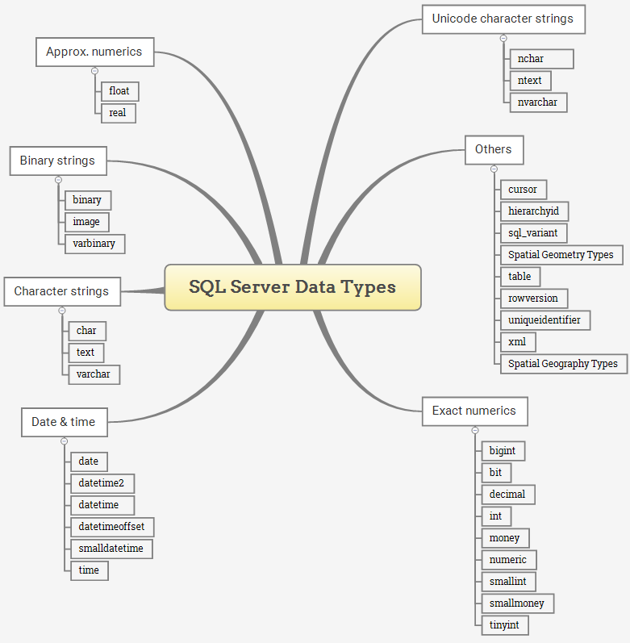
Sql data types overview

Slide 8
Sql data types memory storage
Data type | Lower limit | Upper limit | Memory bytes | 2^N
bigint | −2^63 | 2^63−1 | 8 | Yes
int | −2^31 | 2^31−1 | 4 | Yes
smallint | −2^15 | 2^15 | 2 | Yes
tinyint | 0 | 255 | 1 | No
bit | 0 | 1 | 1 | No
decimal | −10^38+1 | 10^38−1 | 17 | No
numeric | −10^38+1 | 10^38−1 | 17 | No
money | −10^20+1 | 10^20−1 | 8 | Yes
smallmoney | −214,478.36 | 2,14,478.36 | 4 | Yes
datetime | 1753-01-01 | 9999-12-31 | 8 | Yes
smalldatetime | 1900-01-01 | 2079-06-06 | 4 | Yes
date | 0001-01-01 | 9999-12-31 | 3 | No
datetime2 | 0001-01-01 | 9999-12-31 | 6 | No
char | 0 chars | 8000 chars | N | Yes, 2^N
varchar | 0 chars | 8000 chars | N+2 | Yes, 2^N

Slide 9
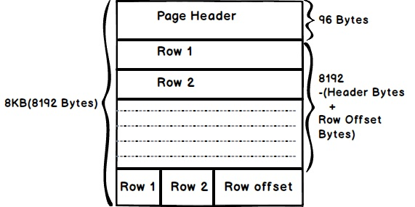
Table design overview
8k Page Size Table Design
2^N bytes data types to be used
Small Int, Int, Big Int, Money, Date Time
To fit max number of Rows per Page
Odd bytes data type to avoid
Bit, Tiny Int, Date, etc.,
Varchar(2^N)
Varchar(128), not Varchar(100)
2, 4, 8, 16, 32, 64, 128, 256, 512 sizes
1024, 2048, 4096, 8000 – to avoid
Char(2^N)
Char(2), not Char(1), not Bit, not Tiny Int
Small Int is better than these
1970 Unix Timestamp with Big Int
Created Date, Modified Date as Big Int
Not Date of Birth, < 1970 Dates
Read Heavy DB Design
One to Many Relationship Tables
Master Table w/o Varchar, Varchar in Detail Table

Slide 10
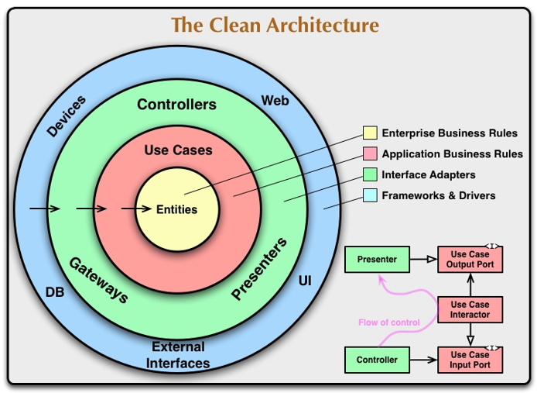
The Clean architecture

Slide 11
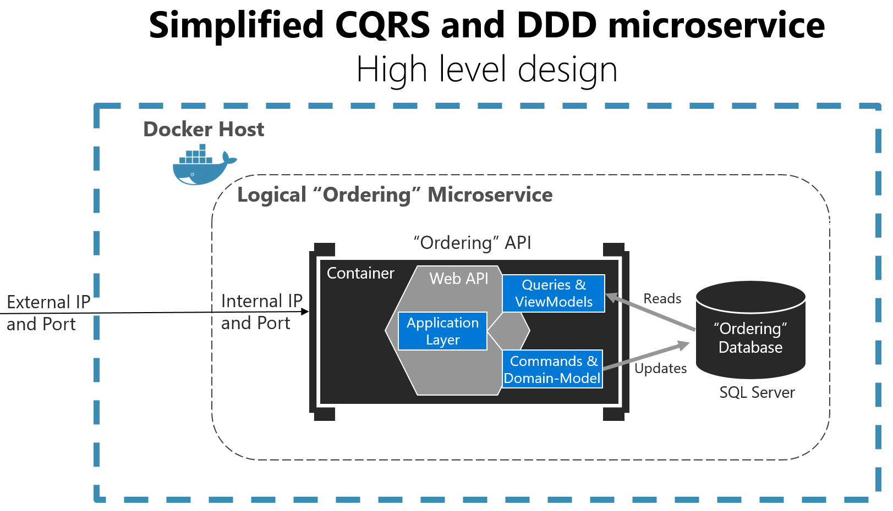
Cqrs + Ddd design pattern overview

Slide 12
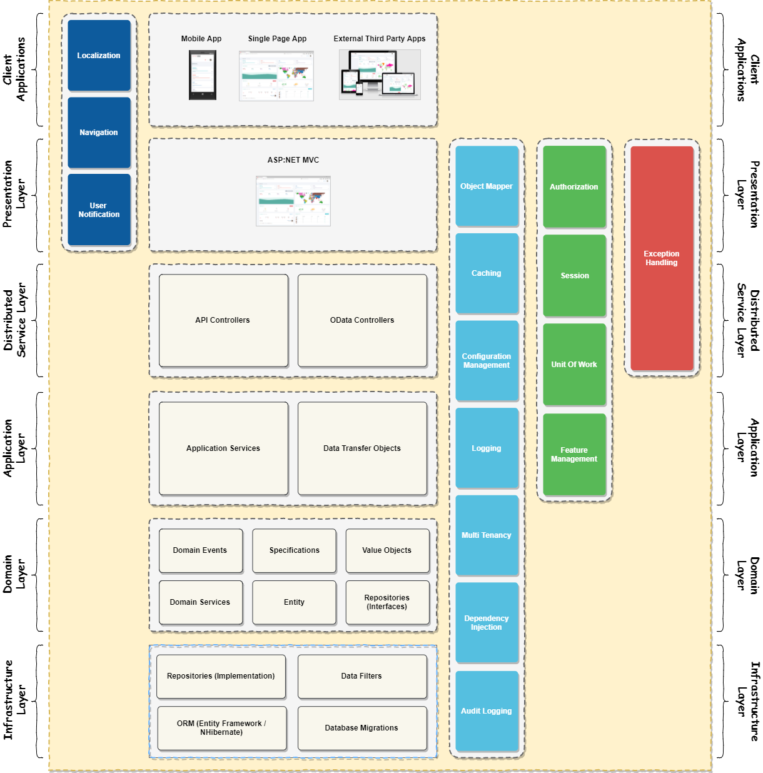
multi Layer N-tier architecture

Slide 13
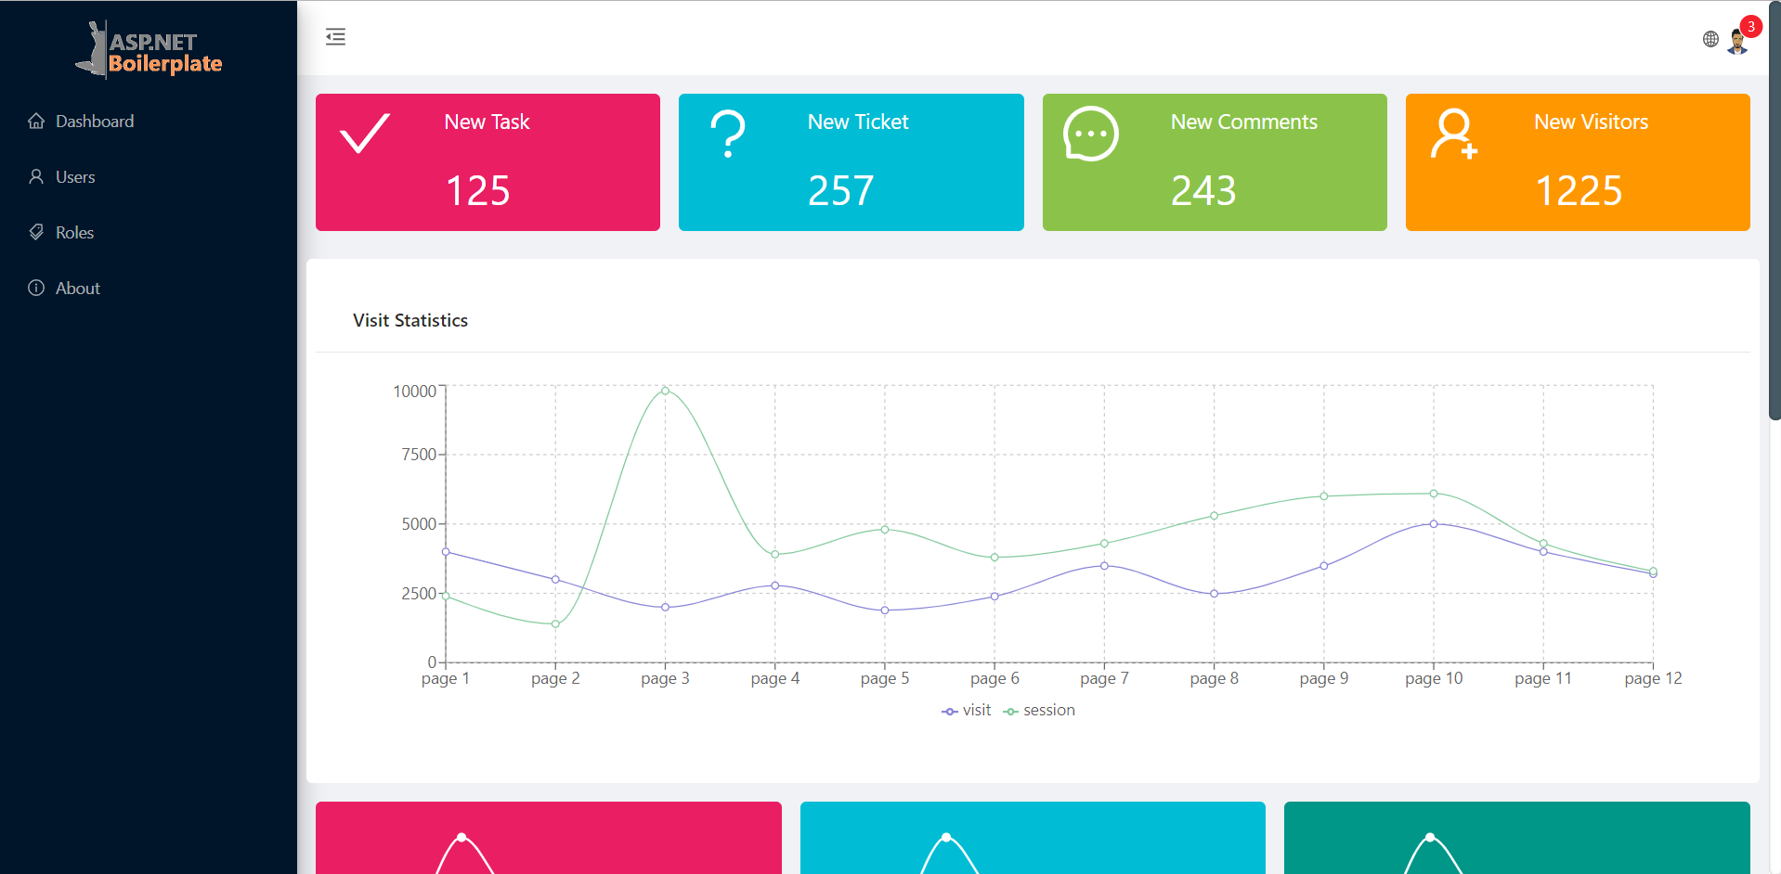
Asp.net core Boiler plates overview

Slide 14
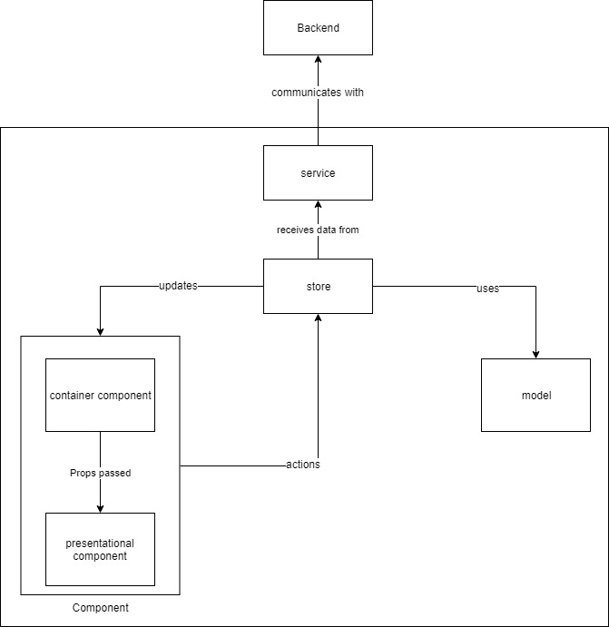
Asp.net core Boiler plates components

Slide 15
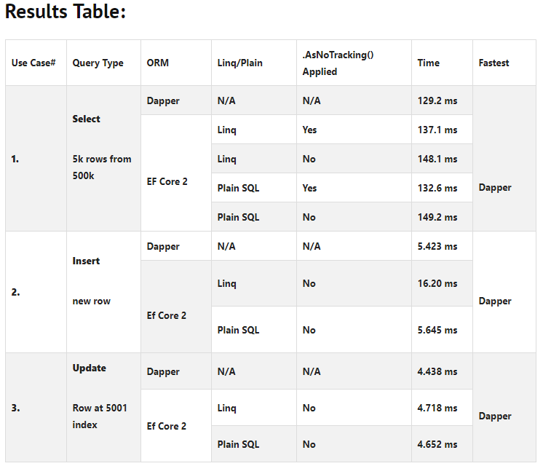
ORM dapper vs entity framework

Slide 16
Overall Architecture overview
Multi Tenant Design Approach
Database First Approach
Schema Level Tenant Databases
Command Query Responsibility Segregation (CQRS)
Domain Driven Development (DDD)
Test Driven Development (TDD)
Dependency Injection (DI)
Separation of Concerns (SoC)
Inversion of Control (IoC)
Multi Layer N-Tier Architecture
Event Driven Architecture
ASP. Net Boiler Plate Templates
Component Design Approach
ORM Dapper instead of Entity Framework
ASP. Net Core Framework
AngularJS UI Framework

Slide 17
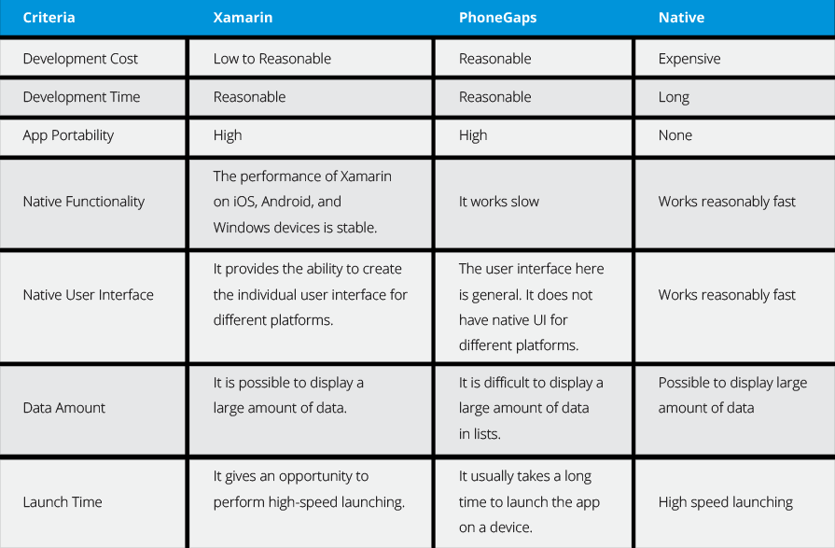
Hybrid mobile platform comparison

Slide 18
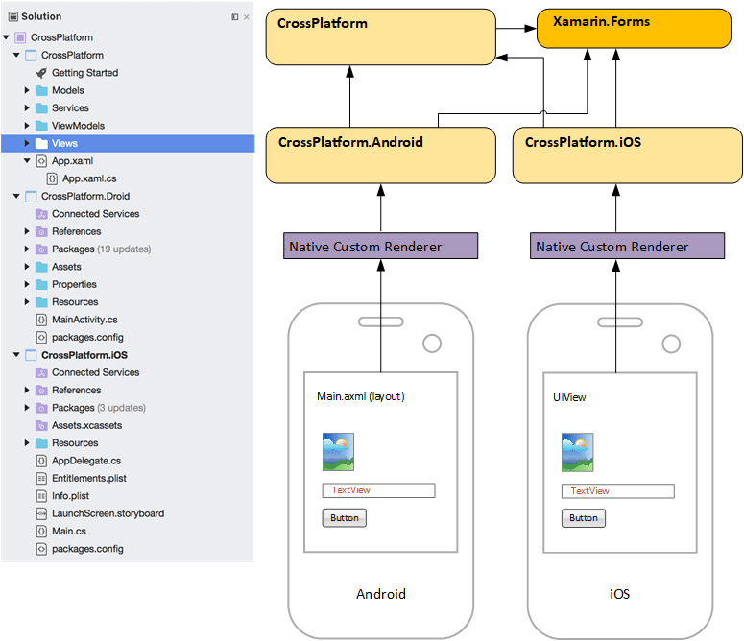
mobile platform Xamarin forms overview

Slide 19
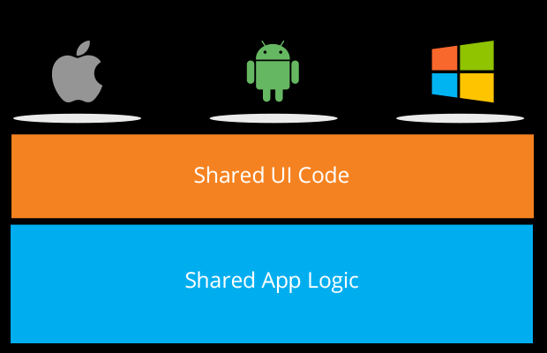
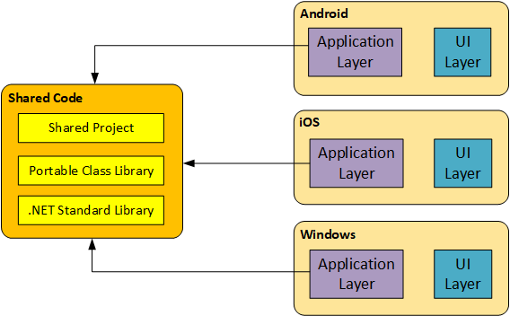
Xamarin forms MVVM OVERVIEW

Slide 20
Strategic Features
First feature
Database Design
Second feature
Architecture Development
Third feature
Backend/Frontend Development

Slide 21
Up Next
Database skeleton design
Table design and development
Architecture skeleton development
Backend development
Frontend development
DevOps deployment (Azure or Jenkins)
User acceptance testing
Staging environment
Production environment

Slide 22
Thank you
Mahadevan Alagar
+91 99625 11023
Mahadevan.a@telliant.net

