Slide 1
AIDA Week 12 Exam : PCA of Stocks
Mohammed Zahir Ali

Slide 2
Objectives
Selecting stocks that might potentially affect NIFTY
Calculating returns for stocks and NIFTY
Using Principal Component Analysis using the stocks as predictor variables
Identifying PCs of interest
Running a regression analysis using the Principal Components to predict NIFTY
Identifying potential correlations between stocks and NIFTY

Slide 3
Stock Selection
8 stocks were selected for analysis.
Stocks were a mix of NIFTY and non-compliance stocks, and were also assessed in terms of recent performance - some stocks have shown considerable growth lately while others have dipped.
For non-compliance stocks, only companies that had a market capitalization of 300 billion or more were considered.

Slide 4
Stock Selection
NIFTY Stocks
TATA Steel
Infosys
State Bank of India
Non Compliance Stocks
Ashok Leyland
Bharat Heavy Electricals Ltd.
Bluedart
Edelweiss
Gas Authority of India Ltd.

Slide 5
Calculating Returns
Only the closing price was considered. Historical data of each stock, and NIFTY for the past year was sourced from Yahoo Finance.
Returns were calculated for each stock. Returns is defined as the relative growth or decline in closing value compared to the previous day.
The final dataset with only the Returns, was used for the model.

Slide 6
Final Dataset
Date | TataSteel_Returns | Infosys_Returns | SBI_Returns | AshokLeyland_Returns | BHEL_Returns | Bluedart_Returns | Edelweiss_Returns | GAIL_Returns | NIFTY_Returns
07-12-2021 | 0.036075037 | 0.010982184 | 0.024500375 | 0.026834356 | 0.019704367 | -0.00426262 | 0.020378473 | 0.02871556 | 0.015636549
08-12-2021 | 0.021065512 | 0.023740706 | 0.031151617 | 0.030216456 | 0.00805153 | 0.012082749 | 0.010699002 | 0.00867592 | 0.017060949
09-12-2021 | 0.00328214 | 0.005590694 | -0.005899693 | 0.010305152 | 0.024760448 | 0.003417542 | 0.079745973 | 0.00411371 | 0.002696067
10-12-2021 | 0.002676654 | -0.00229757 | 0.012381087 | 0.003530836 | 0.006235401 | -0.011760394 | -0.012418261 | 0.00893858 | -0.000316771

Slide 7
Principal Component Analysis
Principal Component Analysis is an unsupervised machine learning algorithm used for dimension reduction, by finding a sequence of linear combinations of variables.
The Principal Components are a straight line that captures most of the variance of the data. Since they are orthogonal to each other, multi-collinearity in the dataset does not present a problem when running the regression analysis.
The objective is to heuristically arrive at an optimal number of Principal Components that capture the variance beyond the threshold, and reject the components that could potentially result in overfitting.

Slide 8
Model
The stocks for the 10 companies were considered as predictor variables (X), and NIFTY as the dependent variable (Y).
Eigenvalues and eigenvector pairs were computed to assess what percentage of variance in the dataset was explained by the Principal Components.
The loadings for each variable were calculated for each Principal Component, which were then fed as the coefficients for the regression model.
The regression model outputs the confidence levels for the Principal Components, which in tandem with the adjusted R-squared values will help us identify the Principal Components to reject to avoid overfitting.

Slide 9
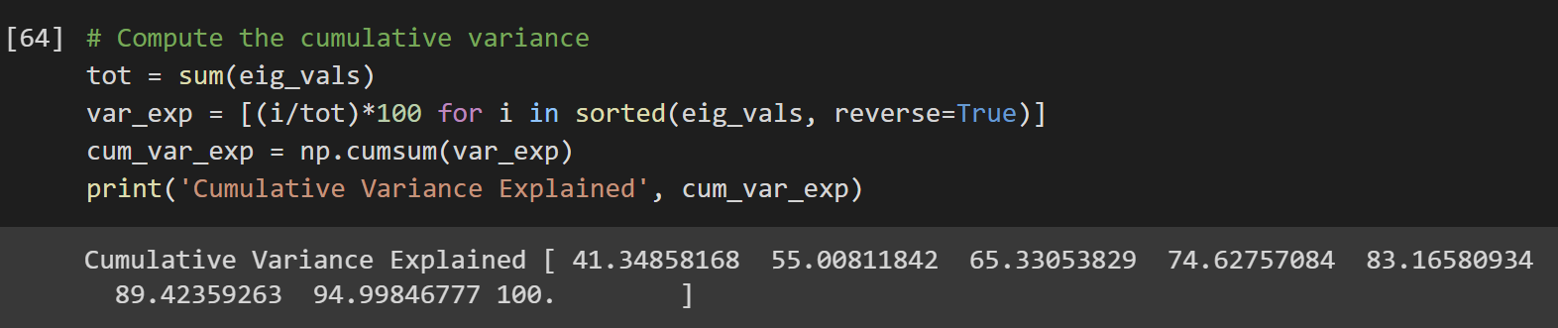
Cumulative Variance Explained
Upon computing the eigenvalues and eigenvector pairs, it was found that 6 Principal Components were able to explain over 89% of the cumulative variance in the dataset.

Slide 10
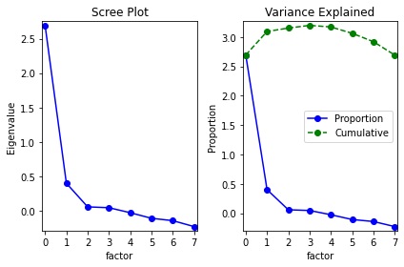
Scree Plot
A scree plot was made to visually understand the variance explained by the components. We can see that the plot flattens after the 5th factor.

Slide 11
Loadings
 | TataSteel_Returns | Infosys_Returns | SBI_Returns | AshokaLeyland_Returns | BHEL_Returns | Bluedart_Returns | Edelweiss_Returns | GAIL_Returns
comp_0 | -0.3853 | -0.28323 | -0.4163 | -0.38413 | -0.41869 | -0.26822 | -0.31134 | -0.32602
comp_1 | 0.418963 | -0.17712 | -0.07744 | -0.31306 | 0.202783 | -0.4352 | -0.36357 | 0.571303
comp_2 | -0.01484 | -0.83489 | -0.11639 | 0.11217 | 0.074107 | 0.47732 | 0.085715 | 0.189587
comp_3 | 0.24571 | 0.334228 | -0.16424 | -0.24095 | -0.26824 | 0.685209 | -0.43529 | 0.109311
comp_4 | -0.13055 | -0.12545 | 0.410411 | 0.435422 | 0.124145 | -0.0344 | -0.74512 | -0.19337
comp_5 | 0.451816 | -0.21673 | 0.433063 | -0.48442 | 0.094824 | 0.048208 | 0.070925 | -0.55708
comp_6 | -0.09805 | 0.11615 | -0.47285 | -0.0944 | 0.799664 | 0.11483 | -0.11762 | -0.27913
comp_7 | 0.62018 | -0.05886 | -0.44789 | 0.500632 | -0.20558 | -0.1569 | -0.00043 | -0.30626

Slide 12
Regression Model
 | coef | std err | t | P>|t| | [0.025 | 0.975]
const | 0.0005 | 0 | 1.535 | 0.126 | 0 | 0.001
comp_0 | -0.1449 | 0.005 | -30.277 | 0 | -0.154 | -0.135
comp_1 | -0.0265 | 0.005 | -5.548 | 0 | -0.036 | -0.017
comp_2 | -0.0498 | 0.005 | -10.404 | 0 | -0.059 | -0.04
comp_3 | 0.009 | 0.005 | 1.872 | 0.062 | 0 | 0.018
comp_4 | 0.0131 | 0.005 | 2.729 | 0.007 | 0.004 | 0.022
comp_5 | 0.01 | 0.005 | 2.081 | 0.038 | 0.001 | 0.019
comp_6 | -0.0098 | 0.005 | -2.044 | 0.042 | -0.019 | 0
comp_7 | 0.0082 | 0.005 | 1.722 | 0.086 | -0.001 | 0.018

Slide 13
Identifying PCs of Interest
Principal Components | Adjusted R-Squared
1 | 0.695
2 | 0.718
3 | 0.8
4 | 0.802
5 | 0.807
6 | 0.809
7 | 0.812
8 | 0.813
Based on the cumulative variance explained by the Principal Components, we know that we only need 6 PCs.
The adjusted R-squared values also plateau around 6 PCs.
From the results of the Regression Analysis, we identify that comp_3 and comp_7 have to be rejected for the final analysis - they present a p-value > α (0.05), and also their confidence intervals span across 0.

Slide 14
Viability of PCA
Advantages
Since PCA reduces the number of features in the dataset, there is little scope for overfitting.
PCA provides higher efficiency for large datasets, avoiding inaccuracy that generally results from the same.
Disadvantages
PCA can lead to loss in information, since variables are being transformed in PC loadings (coefficients).
After Independent Variables are transformed to PCs, their readability is reduced.

