Slide 1

CSTP1303 INTRO TO CLIENT-SERVER COMPUTING IN JAVA
OPEN THE SLIDES IN THE EDITTING MODE, THERE ARE SOME USEFULL INFO AND SOLUTION IN NOTES
Tatyana Mozgacheva
tmozgacheva@vcc.ca
Notes:
https://excalidraw.com/

Slide 2
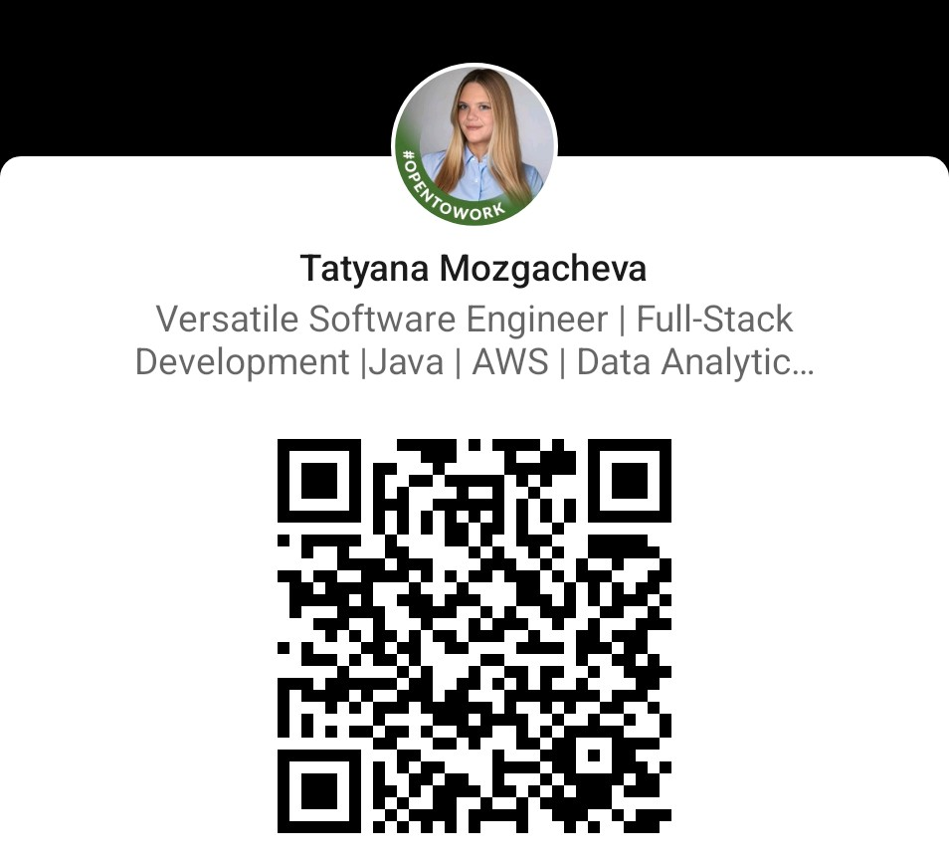
Completed a Master degree in Computer Science at Simon Fraser University (SFU);
Internships: Oracle, BC Cancer Agency, Kardium;
Worked as a Software Development Engineer at Amazon for 3.5 years.

Slide 3

Course Syllabus
Class Meetings: Room 145, Monday 12:30pm-3pm, Wednesday 2pm-4pm.
Instructor: Tatyana Mozgacheva
Email Address: tmozgacheva@vcc.ca
Instructor Availability: Checking above email weekdays
Course Length: 15 weeks
Teaching Hours: 60 hours
Credit Value: 3 credits

Slide 4
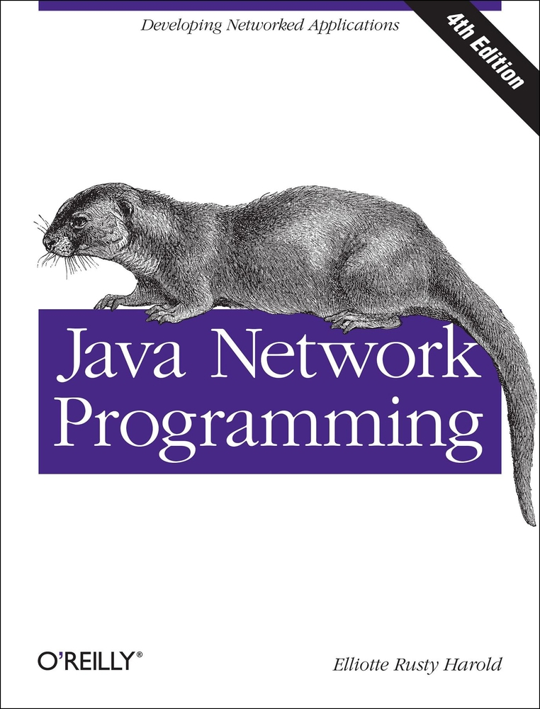
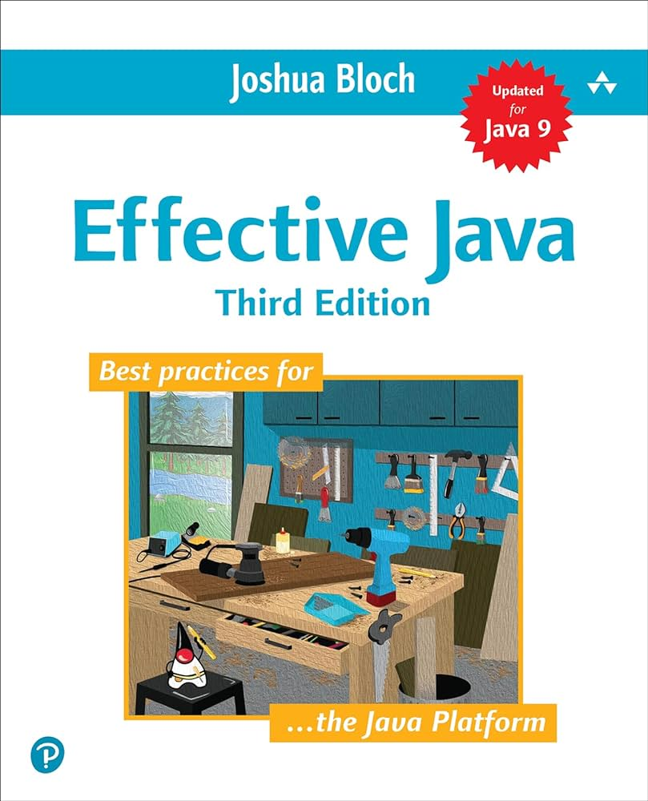
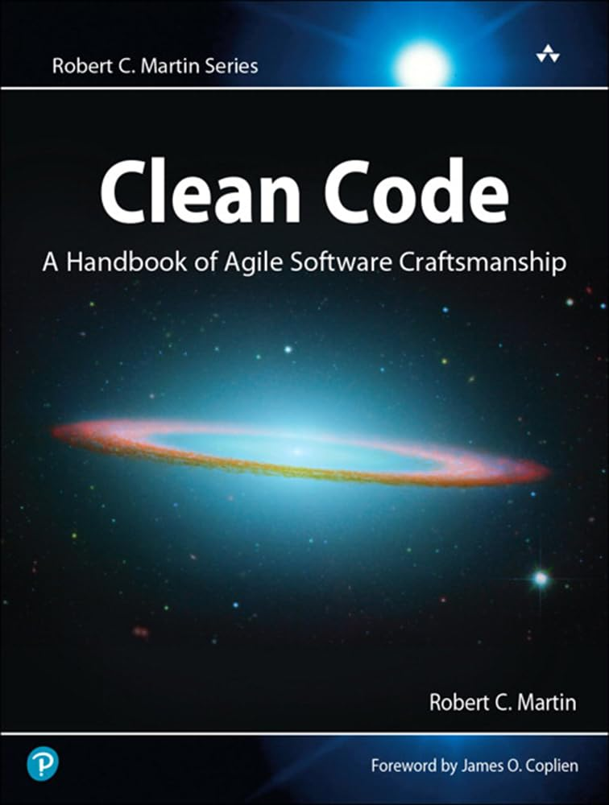
Technology Needed: A computer with installed Windows, Linux, macOS, Software: Java JDK 8 or later, Java IDE tool. Recommended: Eclipse
Required Textbook(s): Java Network Programming, 4th Edition, by Elliotte Rusty Harold, Released October 2013, Publisher(s): O'Reilly Media, Inc., ISBN: 9781449365950
Suggested Reading:
1) Effective Java, 3rd Edition by Joshua Bloch, Released December 2017, Publisher(s): Addison- Wesley Professional, ISBN: 9780134686097
2) Clean Code: A Handbook of Agile Software Craftsmanship by Robert C. Martin, Released August 2008, Publisher(s): Pearson, ISBN: 9780136083238

Slide 5
Evaluation and Grading: ​
Assignments | 45 %
Lab Work(Quizzes, presentation) | 15 %
Midterm | 15 %
Final | 25%
Total Mark | 100 %
Grading System: Letter Grade (A-F)
Passing Grade: C (61%)
Course Completion: In order to successfully complete the course, a student must earn the passing grade for the course. A student who does not pass the course may be required to take the course again in order to meet the requirements for their program of study.

Slide 6
DATE | TOPIC | EXAMPLES AND ASSIGNMENTS
Week 1 | Basic Java Programming | Basic Java Problems
Week 2 | Basic Java Programming, Code review, The best practice, Time and Space Complexity | Basic Java Problems + Code review + Time and Space Complexity
Week 3 | Main concept of networking, Stream, URI, URL | Networking Java Problems I
Week 4 | NIO classes, InetAddress | Networking Java Problems II
Week 5 | UDP | Chat application
Week 6 | TCP | Extend TCP application
Week 7 | Multithreading, TCP with multiple threads | Java Multithreading problems
Week 8 | Midterm
Week 9 | HTTP protocol programming | Extend HTTP application
Week 10 | Mail protocol programming | Extend Mail application
Week 11 | FTP protocol programming | Extend FTP application
Week 12 | Secure Socket (TLS/SSL) | Project proposal
Week 13 | Group Project (+ AI APIs)
Week 14 | Group Project (+ AI APIs) | Project/Presentation
Week 15 | Review and Final Exam

Slide 7
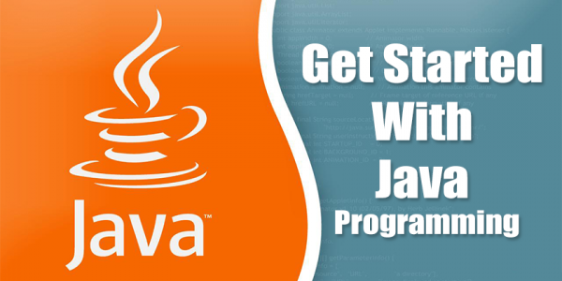
Java Crash course
Data Types
Variables
Arrays
Operators and Conditional Statements
Loops
Classes
Interface
Abstraction
Exception Handling
Garbage collection

Slide 8
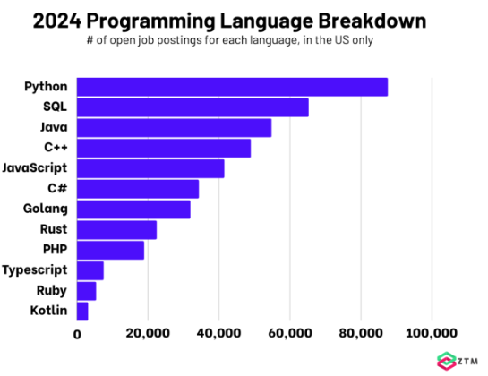
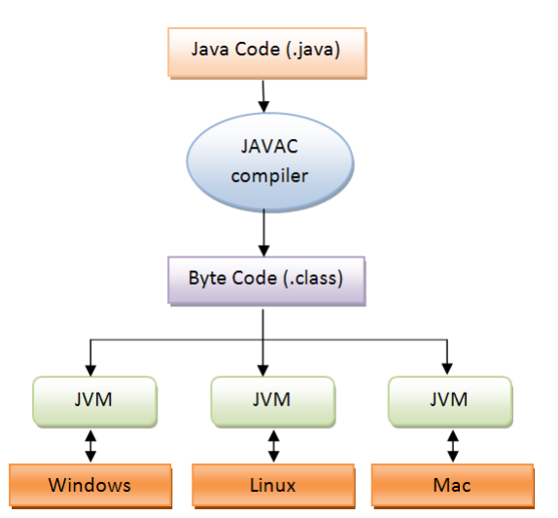
INTRO to Java
Notes:
High-level programming languages, such as Java, are akin to human language and are mostly independent of the machine they run on. Java's compatibility with a range of machines is facilitated by the Java Virtual Machine (JVM), fulfilling the "write once, run everywhere" promise. Below high-level languages lie assembly language, with machine language at the bottom, directly interpretable by hardware. High-level languages aim to communicate with hardware effectively. Aside from Java, other notable high-level languages include Fortran, C, Pascal, C++, PHP, Python, and Dart.
This is the completion of our code, which is also called Java byte code. This byte code of Java is completely platform-independent. It can run on Linux, Windows, and macOS if that computer system has Java Runtime Environment (JRE).
JRE, released by Oracle, is a freely available software for personal use. This JRE contains the standalone Java Virtual Machine (JVM). JVM is a virtual machine that enables a computer to run any Java programs as well as other programs written in other languages, which are compiled to Java Byte Code.
Java source code is compiled to a byte code (Main.class). This byte code goes to a JVM, which is also called an interpreter. It actually interprets the Byte Code into the Native Code that can be run in any operating system.
Type source code, compile by javac, no error get the class made up of byte code. Run the program by starting the Java Virtual Machine (optimize). The JVM translate into something the underlying platform understands. And run your program.

Slide 9
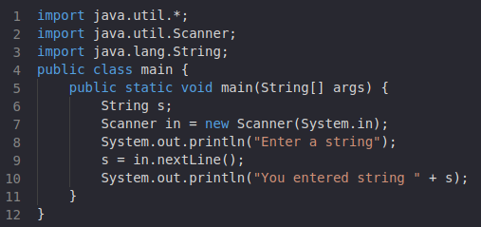
"Hello world" =)

Slide 10
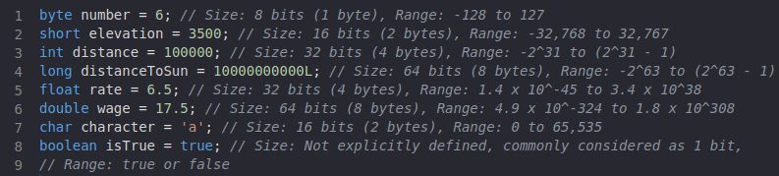
Data TYPES

Slide 11
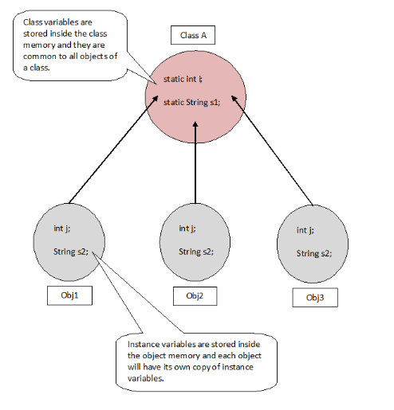
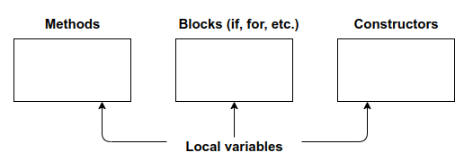
Variables
Notes:
Reference variable
Local variable
Instance variable
we have to initialize local variables.
- It is not mandatory that we should initialize the instance variable. Its default value is 0. Objects store their states inside the fields or variables and that value is unique to each instance or object.
The word static means you can access the variable directly through the class name. You don’t have to create an object to do that anymore. It also tells the compiler that there is exactly one copy of this variable in existence.

Slide 12
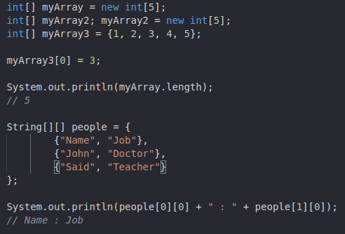
ARRAY

Slide 13
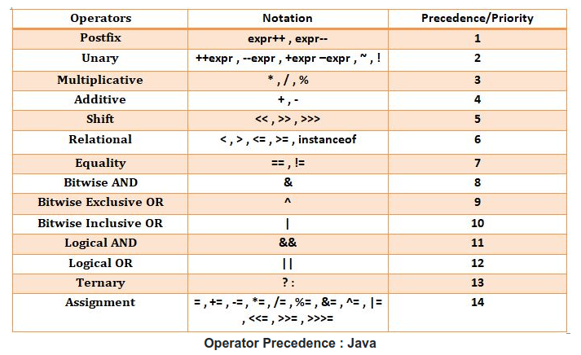
OPERATORS

Slide 14
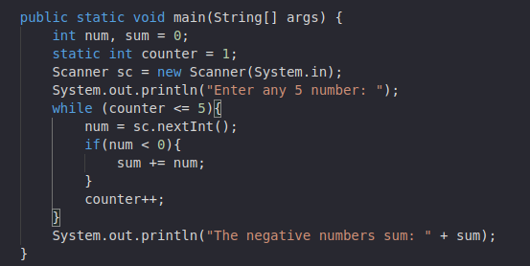
Loop, COnditional statement

Slide 15
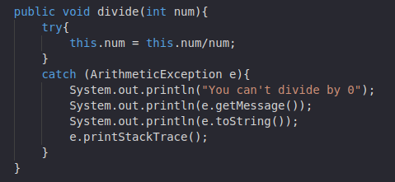
EXCEPTION HANDLING

Slide 16
Protected VS PUBLIC VS PRIVATED VS PACKAGE
Public (+ in the class diagram): When a member (method, field, class, etc.) is declared as public, it means it can be accessed from anywhere, by any other class.
Protected (# in the class diagram): When a member is declared as protected, it can be accessed within its own class, by subclasses, and by classes in the same package.
Private(- in the class diagram): When a member is declared as private, it can only be accessed within its own class.
Package-private (default, empty in the class diagram): In Java, if no access modifier is specified, it defaults to package-private. It means the member is accessible only within the same package.

Slide 17
Class, INHERETENCE, ABSTRACT and INTERFACE
Class:
A blueprint for creating objects in object-oriented programming. It defines the attributes and behaviors that objects of the class will possess.
Inheritance:
A mechanism in object-oriented programming that allows a new class to inherit properties and behaviors (methods) from an existing class. This promotes code reuse and supports the concept of hierarchical classification.
Abstract:
An abstract class in Java is a class that cannot be instantiated on its own and may contain one or more abstract methods. Abstract classes are meant to be subclassed, providing a common interface for a group of related classes.
Interface:
In Java, an interface is a reference type that defines a set of abstract methods. It provides a contract for classes to adhere to, specifying what methods they must implement. Interfaces facilitate multiple inheritances, allowing a class to implement multiple interfaces.

Slide 18
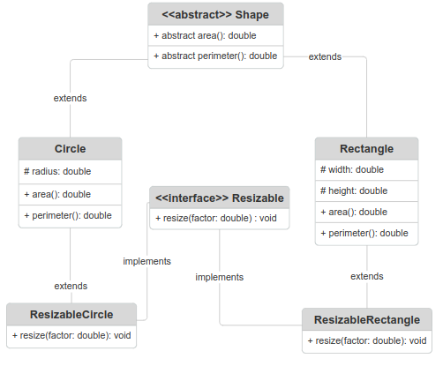
Class DIAGRAM
Task: Create the Circle and Rectangle classes and calculate their area and perimeter. In the addition to this, the shapes can be resized by the factor.
Using abstract classes and interfaces promotes cleaner, reusable, and more flexible code. They encapsulate common behavior, encourage code reusability, allow for flexible extension, and promote standardized and maintainable designs.
Java doesn't allow multiple inheritance of classes to avoid ambiguity and complexity, like the diamond problem (next slide). However, it supports multiple inheritance through interfaces, allowing a class to implement multiple interfaces to inherit behavior.
Notes:
Software objects are often used to model the real-life objects that we see around us every day.
// Shape.java
abstract class Shape {
abstract double area();
abstract double perimeter();
}
// Circle.java
class Circle extends Shape {
private double radius;
Circle(double radius) {
this.radius = radius;
}
@Override
double area() {
return Math.PI * radius * radius;
}
@Override
double perimeter() {
return 2 * Math.PI * radius;
}
}
// Rectangle.java
class Rectangle extends Shape {
private double width;
private double height;
Rectangle(double width, double height) {
this.width = width;
this.height = height;
}
@Override
double area() {
return width * height;
}
@Override
double perimeter() {
return 2 * (width + height);
}
}
// Resizable.java
interface Resizable {
void resize(double factor);
}
// ResizableCircle.java
class ResizableCircle extends Circle implements Resizable {
ResizableCircle(double radius) {
super(radius);
}
@Override
public void resize(double factor) {
this.radius *= factor;
}
}
// ResizableRectangle.java
class ResizableRectangle extends Rectangle implements Resizable {
ResizableRectangle(double width, double height) {
super(width, height);
}
@Override
public void resize(double factor) {
this.width *= factor;
this.height *= factor;
}
}
// Main.java
public class Main {
public static void main(String[] args) {
Circle circle = new Circle(5);
System.out.println("Circle Area: " + circle.area());
System.out.println("Circle Perimeter: " + circle.perimeter());
Rectangle rectangle = new Rectangle(4, 6);
System.out.println("Rectangle Area: " + rectangle.area());
System.out.println("Rectangle Perimeter: " + rectangle.perimeter());
ResizableCircle resizableCircle = new ResizableCircle(5);
resizableCircle.resize(2);
System.out.println("Resizable Circle Area after resizing: " + resizableCircle.area());
System.out.println("Resizable Circle Perimeter after resizing: " + resizableCircle.perimeter());
ResizableRectangle resizableRectangle = new ResizableRectangle(4, 6);
resizableRectangle.resize(1.5);
System.out.println("Resizable Rectangle Area after resizing: " + resizableRectangle.area());
System.out.println("Resizable Rectangle Perimeter after resizing: " + resizableRectangle.perimeter());
}
}
Tasks:
Create Additional Shapes: Ask students to create additional shape classes such as Triangle, Square, or any other geometric shape they prefer. These classes should extend the abstract class Shape and implement its abstract methods area() and perimeter().
Implement Interface: Create a new interface called Scalable with a method scale(double factor). Ask students to implement this interface in the existing shape classes (Circle, Rectangle, etc.) to allow scaling the shape by a certain factor.
Finalize Methods: Choose certain methods in the Circle, Rectangle, or other shape classes and make them final, preventing them from being overridden in subclasses. For example, you might make the area() method final to ensure that all subclasses use the same formula for calculating the area.
Override Methods: In the ResizableCircle and ResizableRectangle classes, override the resize(double factor) method inherited from the Resizable interface to provide custom resizing behavior.
Additional Functionality: Add additional functionality to the Main class. For example, create an array or list of Shape objects and demonstrate polymorphism by iterating over them and calling the area() and perimeter() methods.
Test Cases: Encourage students to write test cases to verify that their implementations work correctly. This could involve testing different shapes, scaling factors, and edge cases.
By completing these tasks, students will gain a deeper understanding of inheritance, abstract classes, interfaces, and the use of final methods in Java. They will also get practice with object-oriented design principles and writing testable code.

Slide 19
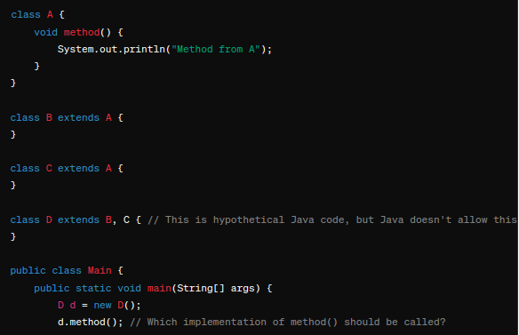
diamond problem
In this example, both classes B and C inherit from class A. Now, class D tries to inherit from both B and C. If D doesn't override the method() from A, there's ambiguity about whether method() from B or C should be used when calling d.method(). This ambiguity is the diamond problem.

Slide 20
interface Resizable {
void resize(double factor);
}
class ResizableCircle extends Circle implements Resizable {
ResizableCircle(double radius) {
super(radius);
}
@Override
public void resize(double factor) {
this.radius *= factor;
}
}
class ResizableRectangle extends Rectangle implements Resizable {
ResizableRectangle(double width, double height) {
super(width, height);
}
@Override
public void resize(double factor) {
this.width *= factor;
this.height *= factor;
}
}
public class Main {
public static void main(String[] args) {
Circle circle = new Circle(5);
System.out.println("Circle Area: " + circle.area());
System.out.println("Circle Perimeter: " + circle.perimeter());
Rectangle rectangle = new Rectangle(4, 6);
System.out.println("Rectangle Area: " + rectangle.area());
System.out.println("Rectangle Perimeter: " + rectangle.perimeter());
ResizableCircle resizableCircle = new ResizableCircle(5);
resizableCircle.resize(2);
System.out.println("Resizable Circle Area after resizing: " + resizableCircle.area());
System.out.println("Resizable Circle Perimeter after resizing: " + resizableCircle.perimeter());
ResizableRectangle resizableRectangle = new ResizableRectangle(4, 6);
resizableRectangle.resize(1.5);
System.out.println("Resizable Rectangle Area after resizing: " + resizableRectangle.area());
System.out.println("Resizable Rectangle Perimeter after resizing: " + resizableRectangle.perimeter());
}
}
Import java.lang.Math;
abstract class Shape {
abstract double area();
abstract double perimeter();
}
class Circle extends Shape {
protected double radius;
Circle(double radius) {
this.radius = radius;
}
@Override
double area() {
return Math.PI * radius * radius;
}
@Override
double perimeter() {
return 2 * Math.PI * radius;
}
}
class Rectangle extends Shape {
protected double width;
protected double height;
Rectangle(double width, double height) {
this.width = width;
this.height = height;
}
@Override
double area() {
return width * height;
}
@Override
double perimeter() {
return 2 * (width + height);
}
}

Slide 21
Best Practices for cleaner code
Why important?:
Readability and Maintenance, Bug Fixing
Heuristics:
Comments should say things that the code cannot say for itself;
No duplication -> DRY ("Do not repeat yourself");
Function Names Should Say What They Do;
Function should do one thing;
Etc...
Notes:
Readability and Maintenance: Studies have shown that developers spend a significant portion of their time understanding and modifying existing code rather than writing new code from scratch. For example, a study by Lutz Prechelt found that developers spend about 50% to 80% of their time on maintenance activities. Clean code practices, such as clear naming conventions and modular design, can significantly reduce the time required for these tasks.
Bug Fixing: According to a study by Cambridge University, developers spend approximately 50% of their time debugging code. Clean code can streamline the debugging process by making it easier to identify the root cause of issues and apply fixes. This leads to faster resolution of bugs and ultimately improves software reliability.

Slide 22
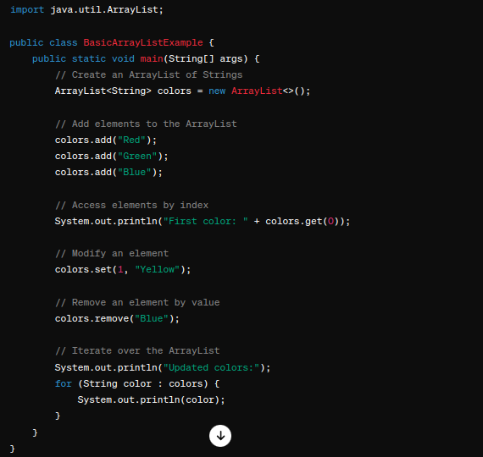
Java library: Array LIST

Slide 23
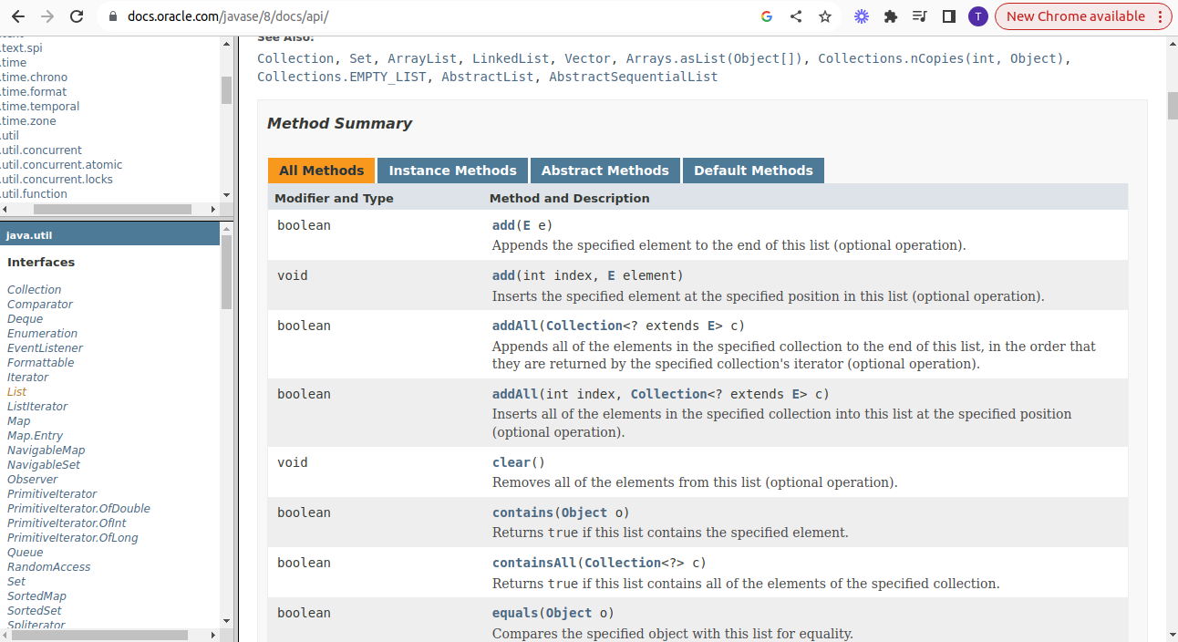
JAVA API: discover the classes!
https://docs.oracle.com/javase/8/docs/api/

Slide 24
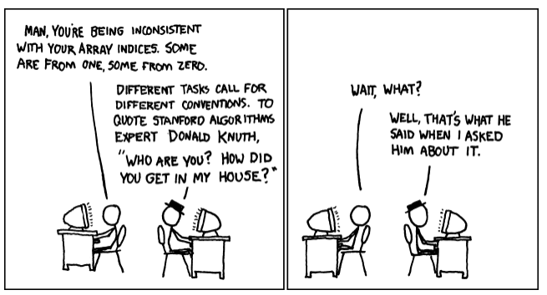
EXERCISE (Array LIST):
Create class Employee with name, age, country;
Create the Array List and add couple of Employees:
Function #1: Find employees aged over 50
Function #2: Find employees from the USA
Function #3: Sort employees by country
The solution in the Notes of the PowerPoint!!!
Notes:
package lecture1;
import java.util.ArrayList;
import java.util.List;
import java.util.stream.*;
import java.util.Collections;
import java.util.LinkedList;
class Employee {
private String name;
private int age;
private String country;
public Employee(String name, int age, String country) {
this.name = name;
this.age = age;
this.country = country;
}
public int getAge() {
return this.age;
}
public String getName() {
return this.name;
}
public String getCountry() {
return this.country;
}
public void setName(String name) {
this.name = name;
}
}
public class MainEmployee {
public static void main(String[] args)
{
List<Employee> list = new ArrayList<>(); // LinkedList
list.add(new Employee("Alex", 23, "USA"));
list.add(new Employee("Dave", 34, "India"));
list.add(new Employee("Carl", 21, "USA"));
list.add(new Employee("Joe", 56, "Russia"));
list.add(new Employee("Amit", 64, "China"));
list.add(new Employee("Ryan", 19, "Brazil"));
// 1 Find employees aged over 50
List<Employee> listOver50 = findEmployees(list);
for (Employee emp : listOver50) {
System.out.println("Employee Name: " + emp.getName() + ", Employee Age: " + emp.getAge());
}
// Another way to implement findEmployees using stream
list.stream().filter(emp -> emp.getAge() > 50).map(emp -> emp.getName() ).forEach(System.out::println);
System.out.println("________");
//2 Find employees from the USA
List<Employee> listUSA = findEmployeesByCountry(list, "USA");
for (Employee emp : listUSA) {
System.out.println("Employee Name: " + emp.getName() + ", Employee Age: " + emp.getAge());
}
//3 Sort employees by country
Collections.sort(list, (e1, e2) -> e1.getCountry().compareTo(e2.getCountry()));
System.out.println("Hello World !!");
}
public static List<Employee> findEmployees(List<Employee> employees) {
List<Employee> result = new ArrayList<>();
for(Employee emp: employees) {
if(emp.getAge() > 50) {
result.add(emp);
}
}
return result;
}
public static List<Employee> findEmployeesByCountry(List<Employee> employees, String country) {
List<Employee> result = new ArrayList<>();
for(Employee emp: employees) {
if(emp.getCountry().equals(country)) {
result.add(emp);
}
}
return result;
}
}

Slide 25
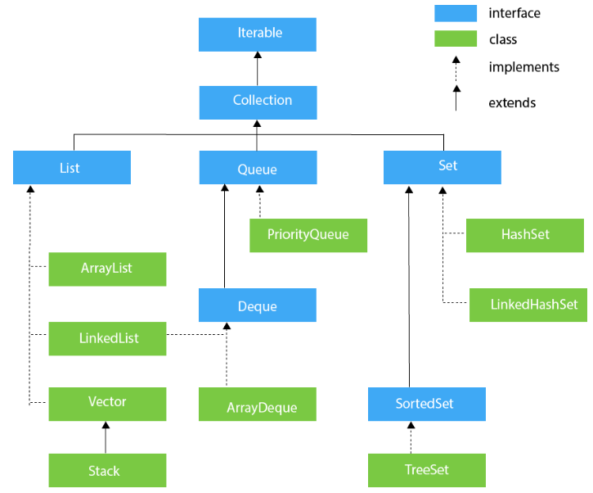
COLLECTION IN JAVA
Notes:
The Collection in Java is a framework that provides an architecture to store and manipulate the group of objects.
Java Collections can achieve all the operations that you perform on a data such as searching, sorting, insertion, manipulation, and deletion.

Slide 26
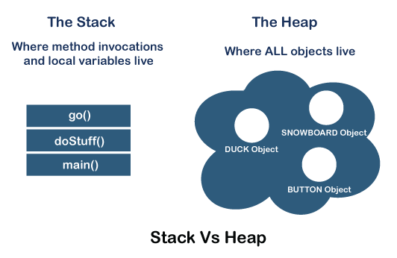
Where DOES everything live?
Notes:
nderstanding memory management, threads, and exception handling in Java is crucial for developing efficient and robust applications. Let's break down why we learn each of these concepts:
Memory Management: When the Java Virtual Machine (JVM) starts up, it allocates memory from the operating system. Understanding memory management helps us comprehend how Java handles memory allocation for different types of variables and objects. For instance, instance variables and fields within a class are stored in the heap memory, while local variables within a method are stored in the stack memory. Visualizing this process with an example code snippet, such as Student st = new Student();, helps illustrate how references and objects are stored in memory: the reference variable st resides in the stack, while the Student object is allocated in the heap.
Threads: In Java, multithreading allows programs to perform multiple tasks concurrently, enhancing performance and responsiveness. Thread management is vital for developing applications that can execute tasks simultaneously, improving overall efficiency. Understanding threads helps us design applications that can handle complex operations concurrently, optimizing resource utilization and enhancing user experience.
Exception Handling: Exception handling is essential for writing robust and reliable code. In Java, exceptions represent unexpected conditions that disrupt the normal flow of a program. By learning exception handling mechanisms, such as try-catch blocks, we can gracefully handle errors and failures, ensuring that our applications remain stable and resilient. Effective exception handling improves the overall quality of software by anticipating and addressing potential issues before they lead to program crashes or unexpected behavior.
In summary, mastering memory management, threads, and exception handling in Java equips developers with the necessary skills to build high-performance, scalable, and robust applications that can efficiently manage resources, handle concurrent tasks, and gracefully recover from errors. These concepts form the foundation of Java programming and are essential for creating reliable software solutions.

Slide 27
How long does it live?
The local variable lives within the method where it was declared.
The Instance variable lives if an object does.
The object is alive if there are references to it. It becomes eligible for the garbage collection.
Notes:
GB will destroy some objects if low on memory. You can not control it. Make sure you can make them eligible.

Slide 28
Static vs non-static methods
Math ob = new Math(); -> because the constructor is private
int min = Math.min(3,1);
The method min never uses instance variable values!
The keyword static lets a method run without the instance of the class. No object!
public static int min(int a, int b){
}
The static methods can't use non-static methods!
Static variables are shared and initialized when a class is loaded.
Notes:
For the utility class there is no need to have an instance of the class. E.g Math. No point to create the object on the Heap.

Slide 29
Final
Variable: Once initialized it can never change. Constant variable names are usually in all caps!
e.g. Math.PI
public static final double PI = 3.141592;
Method: stopping from overriding.
The child class which extends Student won't be able to override (a subclass provides a specific implementation for a method that is already defined in its superclass.) this method.
class Student {
final void generateID() {
}
}
class Alien extends Student {
void generateID() {
}
}
Class: cannot extends the class.
The library String declared as the final.
class myString extends String {
}

Slide 30
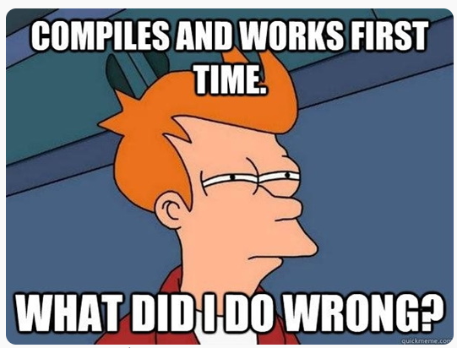
Will it compile?
public class myClass1 {
static int myVar;
public void myFunc() {
System.out.println(myVar)
}
}
public class myClass2 {​
int myVar2;
​
public static void myFunc2() {​
System.out.println(myVar2)​
}​
}​
public class myClass3 {​​
final int myVar3;​​
public void myFunc3() {​​
System.out.println(myVar3)​​
}​​
}​​
Notes:
Answer:
1 – yes,
2 – no, static method references a non-static instance variable
3 – instance variable is final and hasn't been initialized.

Slide 31
ASSIGNMENT #1
Grade: 2%
Deadline: May 13th, 12:30 PM
Please ensure timely submission (no late submission) as the solution will be covered on that day.
Submission: Moodle
Note: Please adhere to the best practices (heuristics) in coding as discussed during the lecture, and consider edge cases.
Write and test a function within the main() method that removes duplicates from an array.
Input:
int[] array = {1, 2, 3, 1, 2};
Output:
{1, 2, 3}
2) Create a class named Cat which includes attributes such as name and weight. Add various cats to the collection and remove any cats weighing less than 5 pounds.

Slide 32
Develop the foundational classes including constructors and implement getters and setters.
Create a function to add specialists into the veterinary clinic.
Display details about both the pet and the specialist.
Create a function to schedule appointments: randomly select a specialist, confirm the booking, mark the specialist as unavailable, and record the pet's appointment.
Display details of all pets with scheduled appointments.
Test the functionality of your methods by creating a Driver class. Initialize your classes and call the functions within the public static void main(String args[]) method.
Create the class diagram using a tool of your choice such as Lucidchart, draw.io, https://app.smartdraw.com/ or any preferred diagramming software.
3) Title: Orchestrating Veterinary Care: Streamlining Clinic Operations
Introduction: The doors of a veterinary clinic stand wide open, welcoming pets of all shapes and sizes to receive the care they deserve. Within its walls, a dedicated team stands ready, equipped to handle any challenge that comes their way. From routine vaccinations to complex surgeries, the veterinary staff collaborates seamlessly to ensure the health and happiness of every animal in their care.
Structure of the Project: Within the dynamic environment of a veterinary clinic, two primary entities interact:
Pet: The beloved companion of pet owners seeking medical attention or preventive care.
Veterinarian: The skilled professionals dedicated to diagnosing and treating animals, specializing in various fields.
For this project, we'll consider three specialized veterinarians:
Canine Specialist
Feline Specialist
Avian Specialist
Pets are brought to the clinic by their owners, often following a pre-scheduled appointment.

