Slide 1
Analysis of Algorithms
Dilemma: you have two (or more) methods to solve problem, how to choose the BEST?
One approach: implement each algorithm in C, test how long each takes to run.
Problems:
  Different implementations may cause an algorithm to run faster/slower
  Some algorithms run faster on some computers
  Algorithms may perform differently depending on data (e.g., sorting often depends on what is being sorted)

Slide 2
Outline
Analysis
  Concept of "best"
    What to measure
  Types of "best”
    best-, average-, worst-case
  Comparison methods
    Big-O analysis
  Examples
    Searching, sorted array: sequential vs. binary
    Sorting: selection, insertion, merge

Slide 3
Analysis: A Better Approach
Idea: characterize performance in terms of key operation(s)
  Sorting:
    count number of times two values compared
    count number of times two values swapped
  Search:
    count number of times value being searched for is compared to values in array
  Recursive function:
    count number of recursive calls

Slide 4
Analysis in General
Want to comment on the “general” performance of the algorithm
  Measure for several examples, but what does this tell us in general?
Instead, assess performance in an abstract manner
Idea: analyze performance as size of problem grows
Examples:
  Sorting: how many comparisons for array of size N?
  Searching: #comparisons for array of size N
May be difficult to discover a reasonable formula

Slide 5
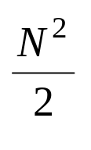
Analysis where Results Vary
Example: for some sorting algorithms, a sorting routine may require as few as N-1 comparisons and as many as
Types of analyses:
  Best-case: what is the fastest an algorithm can run for a problem of size N?
  Average-case: on average how fast does an algorithm run for a problem of size N?
  Worst-case: what is the longest an algorithm can run for a problem of size N?
Computer scientists mostly use worst-case analysis

Slide 6


How to Compare Formulas?
Which is better: or
Answer depends on value of N:
N
1 120 37
2 511 71
3 1374 159
4 2895 397
5 5260 1073
6 8655 3051
7 13266 8923
8 19279 26465
9 26880 79005
10 36255 236527

Slide 7


What Happened?
N
1 37 12 32.4
2 71 36 50.7
3 159 108 67.9
4 397 324 81.6
5 1073 972 90.6
6 3051 2916 95.6
7 8923 8748 98.0
8 26465 26244 99.2
9 79005 78732 99.7
10 236527 236196 99.9
  One term dominated the sum

Slide 8
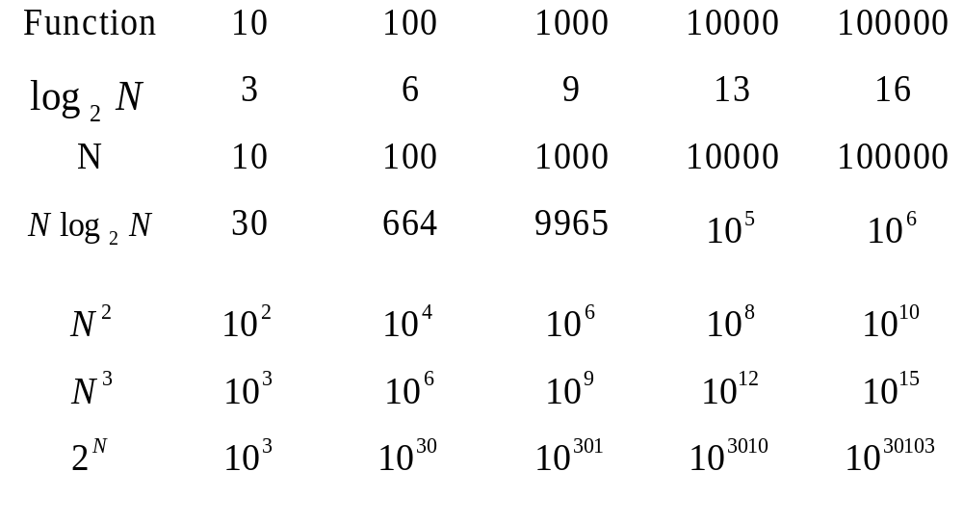
As N Grows, Some Terms Dominate

Slide 9
Order of Magnitude Analysis
Measure speed with respect to the part of the sum that grows quickest
Ordering:

Slide 10

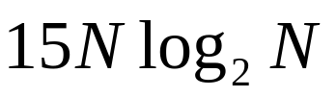


Order of Magnitude Analysis (cont)
Furthermore, simply ignore any constants in front of term and simply report general class of the term:
grows proportionally to
grows proportionally to
When comparing algorithms, determine formulas to count operation(s) of interest, then compare dominant terms of formulas

Slide 11
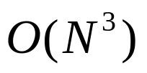
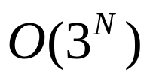
Big O Notation
Algorithm A requires time proportional to f(N) - algorithm is said to be of order f(N) or O(f(N))
Definition: an algorithm is said to take time proportional to O(f(N)) if there is some constant C such that for all but a finite number of values of N, the time taken by the algorithm is less than C*f(N)
Examples:
is
is
If an algorithm is O(f(N)), f(N) is said to be the growth-rate function of the algorithm

Slide 12
Example: Searching Sorted Array
Algorithm 1: Sequential Search
int search(int A[], int N, int Num) {
int index = 0;
while ((index < N) && (A[index] < Num))
index++;
if ((index < N) && (A[index] == Num))
return index;
else
return -1;
}

Slide 13
Analyzing Search Algorithm 1
Operations to count: how many times Num is compared to member of array
  One after the loop each time plus ...
  Best-case: find the number we are looking for at the first position in the array (1 + 1 = 2 comparisons) O(1)
  Average-case: find the number on average half-way down the array (sometimes longer, sometimes shorter)
  (N/2+1 comparisons) O(N)
  Worst-case: have to compare Num to very element in the array (N + 1 comparisons) O(N)

Slide 14
Search Algorithm 2: Binary Search
int search(int A[], int N, int Num) {
int first = 0;
int last = N - 1;
int mid = (first + last) / 2;
while ((A[mid] != Num) && (first <= last)) {
if (A[mid] > Num)
last = mid - 1;
else
first = mid + 1;
mid = (first + last) / 2;
}
if (A[mid] == Num)
return mid;
else
return -1;
}

Slide 15
Analyzing Binary Search
One comparison after loop
First time through loop, toss half of array (2 comps)
Second time, half remainder (1/4 original) 2 comps
Third time, half remainder (1/8 original) 2 comps
…
Loop Iteration Remaining Elements
1 N/2
2 N/4
3 N/8
4 N/16
…
?? 1
How long to get to 1?

Slide 16
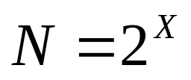
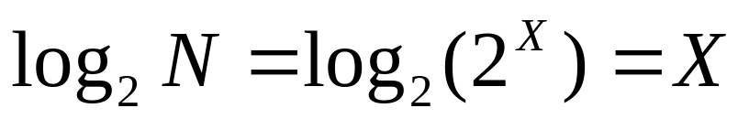
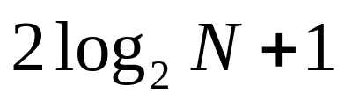
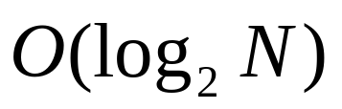
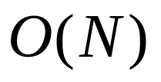
Analyzing Binary Search (cont)
Looking at the problem in reverse, how long to double the number 1 until we get to N?
and solve for X
two comparisons for each iteration, plus one comparison at the end -- binary search takes
in the worst case
Binary search is worst-case
Sequential search is worst-case

Slide 17
Analyzing Sorting Algorithms
Algorithm 1: Selection Sort
void sort(int A[], int N) {
int J, K, SmallAt, Temp;
for (J = 0; J < N-1; J++) {
SmallAt = J;
for (K = J+1; K < N; K++)
if (A[K] < A[SmallAt])
SmallAt = K;
Temp = A[J];
A[J] = A[SmallAt];
A[SmallAt] = Temp;
}
}

Slide 18
Sorting Operations of Interest
Number of times elements in array compared
Number of times element copied (moved)
Selection sort
  J=0: set min as 0, compare min to each value in A[1..N-1]
  swap (3 copies)
  J=1: set min as 1, compare min to each value in A[2..N-1]
  swap (3 copies)
  J=2: set min as 2, compare min to each value in A[3..N-1]
  swap (3 copies)
  ...

Slide 19
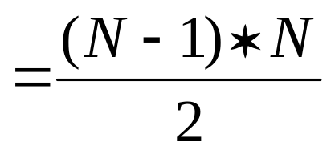
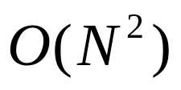

Analyzing Selection Sort
Comparisons:
Copies: (for this version)

Slide 20
Insertion Sort
void sort(int A[], int N) {
int J, K, temp;
for (J = 1; J < N; J++) {
temp = A[J];
for (K = J; (K > 0) && (A[K-1] > temp); K--)
A[K] = A[K-1];
A[K] = temp;
}
}
Both compares and copies done during inner loop

Slide 21
Insertion Sort Analysis
J=1 may have to shift val at A[0] to right (at most 1 comp)
at most three copies (one to pick up val at position 1, one
to shift val at 0 to 1, one to put val down)
J=2 may have to shift vals at A[0..1] to right (at most 2 comps)
at most four copies (pick up val at A[2], shift A[1] to A[2],
A[0] to A[1], put val from A[2] down at A[0])
J=3 may have to shift vals at A[0..2] to right (at most 3 comps)
at most five copies (pick up val at A[3], shift A[2] to A[3],
A[1] to A[2], A[0] to A[1], put val from A[3] at A[0])
...

Slide 22

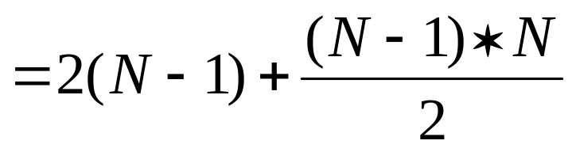
Insertion Sort Analysis (cont)
Comparisons (worst case):
Copies: (for this version)

Slide 23


Insertion Sort - Best Case
Comparisons (best case):
Copies:
When? Sorted array (still O(N) when almost sorted)

Slide 24
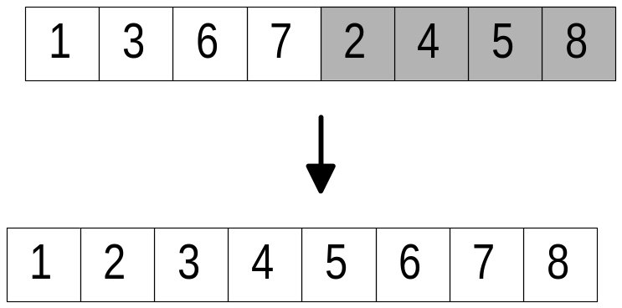
Merge Sort
Idea: divide the array in half, sort the two halves (somehow), then “merge” the two sorted halves into a complete sorted array

Slide 25
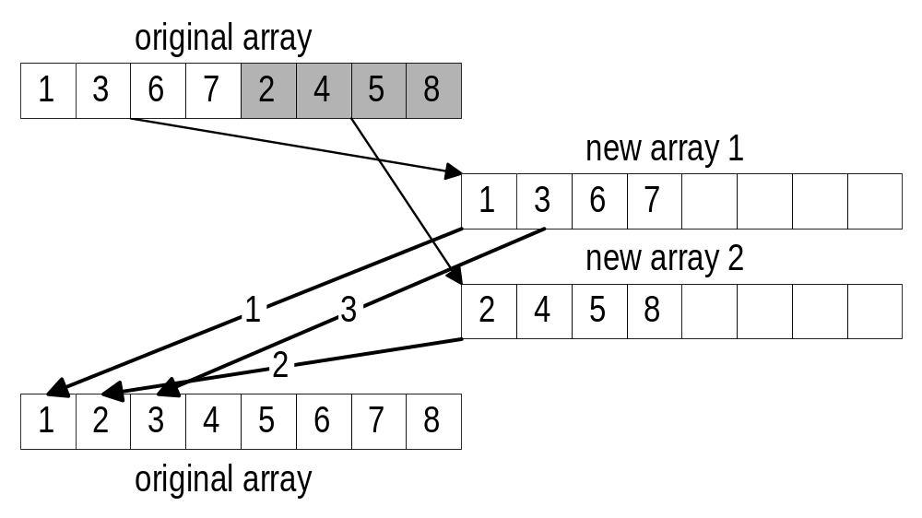
How to Merge
Copy the two segments into two other arrays
Copy the smaller of the two elements from the front of the two arrays back to the original array

Slide 26
Merging Two Array Segments
void merge(int A[], int s1low, int s1high,
int s2low, int s2high) {
int n1 = s1high - s1low + 1;
int n2 = s2high - s2low + 1;
int temp1[ASIZE];
int temp2[ASIZE];
int dst, src1, src2;
/* Copy A[s1low..s1high] to temp1[0..n1-1] */
copy_to_array(A,temp1,s1low,s1high,0);
/* Copy A[s2low..s2high] to temp2[0..n2-1] */
copy_to_array(A,temp2,s2low,s2high,0);

Slide 27
Copying Array Segment
void copy_to_array(int srcarray[], int dstarray[], int slow, int shigh, int dst) {
int src;
/* Copy elements from srcarray[slow..shigh] to
dstarray starting at position dst */
for (src = slow; src <= shigh; src++) {
dstarray[dst] = srcarray[src];
dst++;
}
}

Slide 28
Merge (continued)
dst = seg1low; /* Move elements to A starting at
position seg1low */
src1 = 0; src2 = 0;
/* While there are elements left in temp1, temp2 */
while ((src1 < n1) && (src2 < n2)) {
/* Move the smallest to A */
if (temp1[src1] < temp2[src2]) {
A[dst] = temp1[src1];
src1++;
}
else {
A[dst] = temp2[src2];
src2++;
}
dst++;
}

Slide 29
Merge (continued)
/* Once there are no elements left in either
temp1 or temp2, move the remaining elements
in the non-empty segment back to A */
if (src1 < n1)
copy_to_array(temp1,A,src1,n1-1,dst);
else
copy_to_array(temp2,A,src2,n2-1,dst);
}

Slide 30
Merge Sorting
To merge, we need two halves of array to be sorted, how to achieve this:
  recursively call merge sort on each half
  base case for recursion: segment of array is so small it is already sorted (has 0 or 1 elements)
  need to call merge sort with segment to be sorted (0 to N-1)
void sort(int A[], int N) {
do_merge_sort(A,0,N-1);
}

Slide 31
Merge Sort Recursive Function
void do_merge_sort(int A[], int low, int high) {
int mid;
/* Base case low >= high, we simply do not do
anything, no need to sort */
if (low < high) {
mid = (low + high) / 2;
do_merge_sort(A,low,mid);
do_merge_sort(A,mid+1,high);
merge(A,low,mid,mid+1,high);
}
}

Slide 32
Merge Sort Analysis
Comparisons to merge two partitions of size X is 2X at most (each comparison causes us to put one elment in place)
Copies is 4X (similar reasoning, but we have to move elements to temp arrays and back)
Partitions of Size # Partitions #Comparisons
N/2 2 N
N/4 4 N
N/8 8 N
…
1 N N

Slide 33
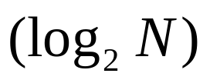
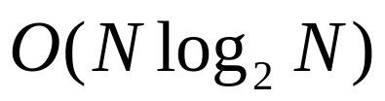
Merge Sort Analysis (cont)
Comparison cost is N * how many different partition sizes
# of partition sizes related to how long to go from 1 to N by doubling each time
Cost: Comparisons
Copies

