Slide 1
Design and Analysis of Programming Platform for Accelerated GPU-Like Architectures
Houssam-Eddine Zahaf and Giuseppe Lipari

Slide 2


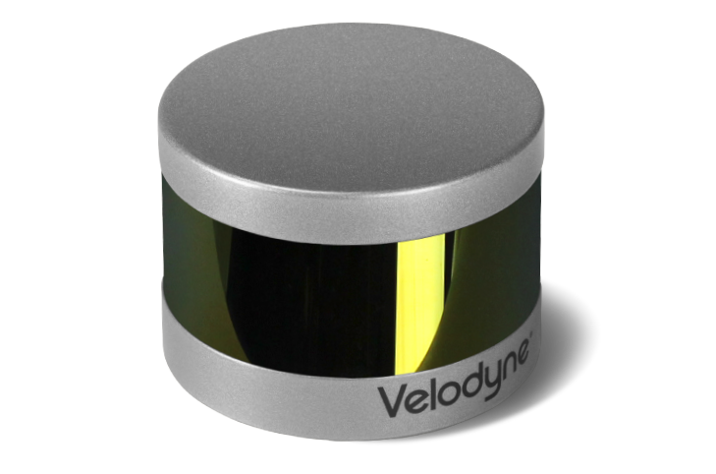
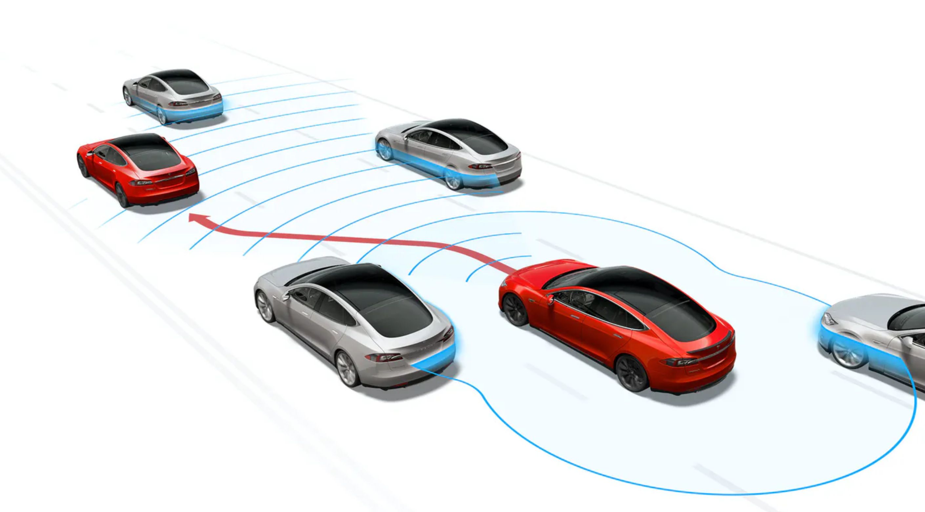
Autonomous Driving
A car must understand the surrounding environment and react to its evolution

Slide 3
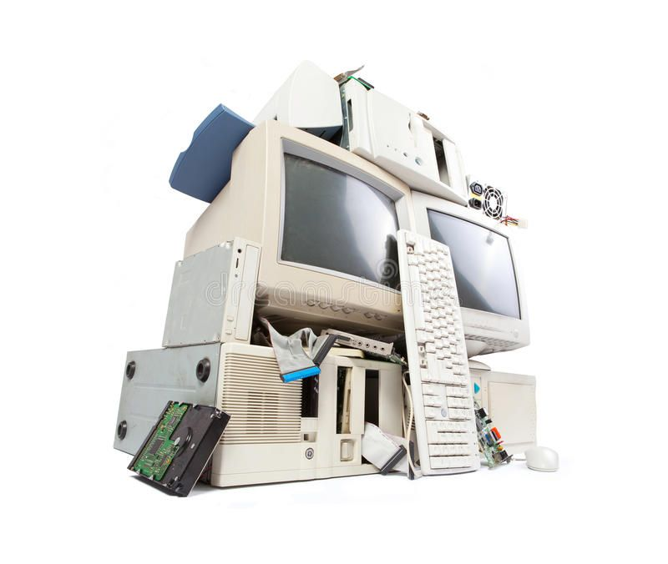
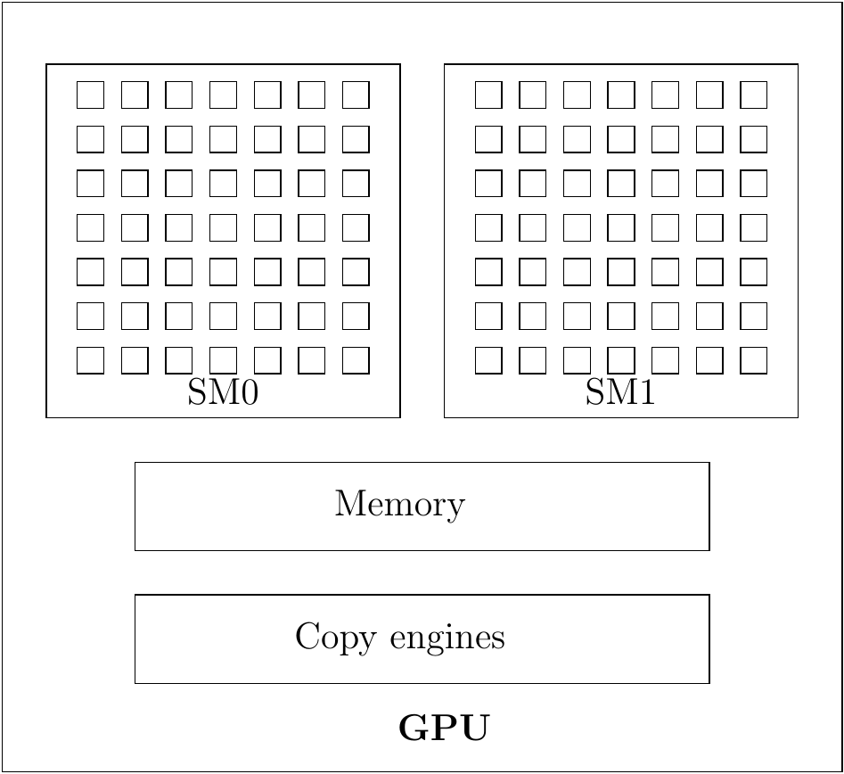
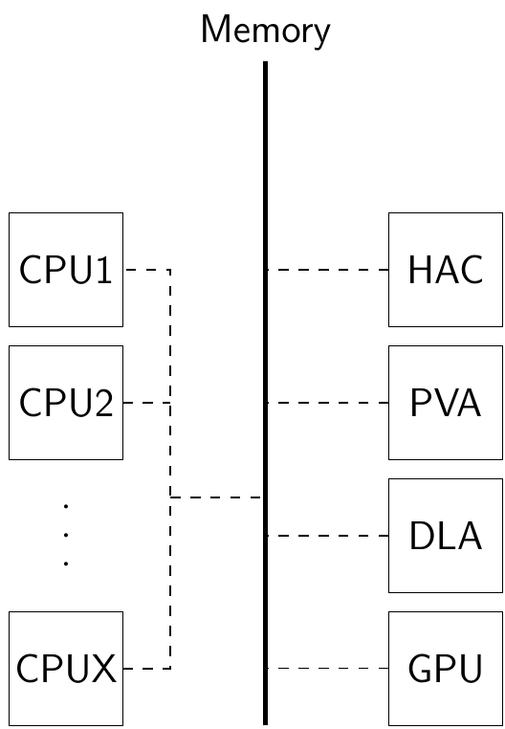
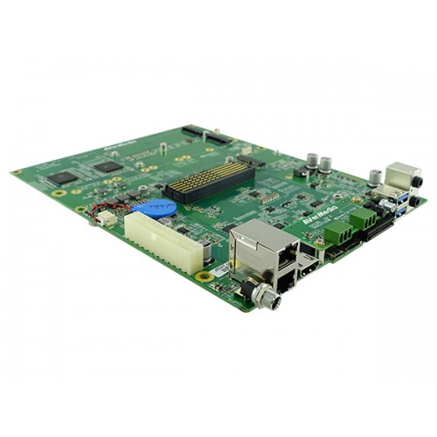
ADAS Heterogeneous computing requirement
Tasks may process a very large amount of data
Classical CPU-based architectures can not satisfy the real-time requirements of such architecture.
Heterogeneous architectures, use dedicated fast processor are a good candidate to meet real-time constraints
Accelerators are black-boxes, allocation and scheduling internals are hidden

Slide 4

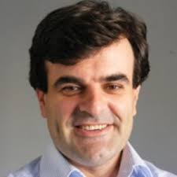

This work
Allow parallel execution within the same accelerator
Mostly used as single core platform.
Several scheduling policies
Implements and allows to implement easily different scheduling policies.
Control of allocation
Provides functions to allocate a task to a subset of resources
Provide a proof of concept library

Slide 5
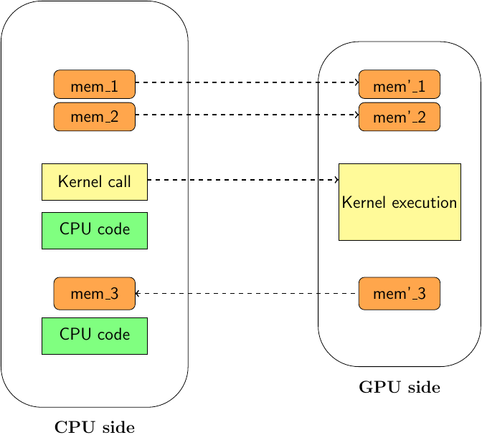
GPU Programming model
cudaMemcpy(ptr_ad,ptr_ah,cudaMemcpyHostToDevice);
cudaMemcpy(ptr_bd,ptr_bh,cudaMemcpyHostToDevice);
kernel<<<nb_block, nb_thread,shared_mem, str>>>(ptr_ad,… );
cudaMemcpy(ptr_cd,ptr_ch,cudaMemcpyDeviceToHost);

Slide 6

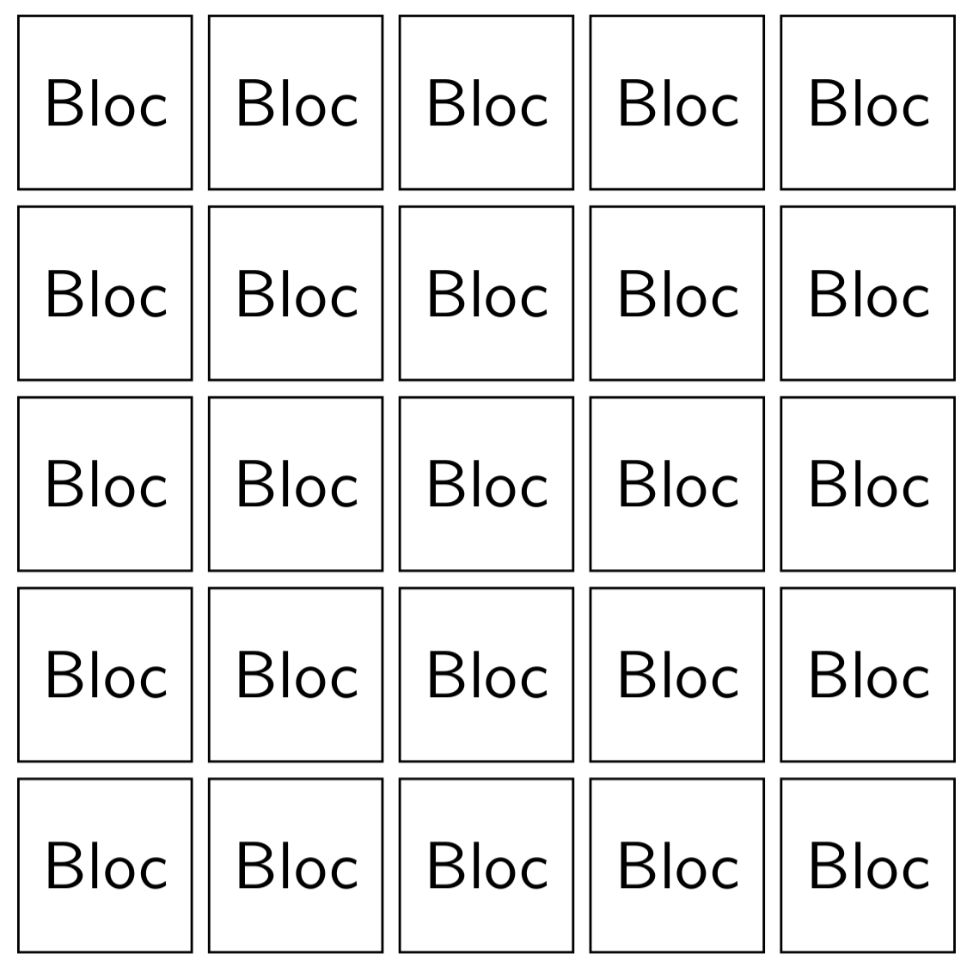




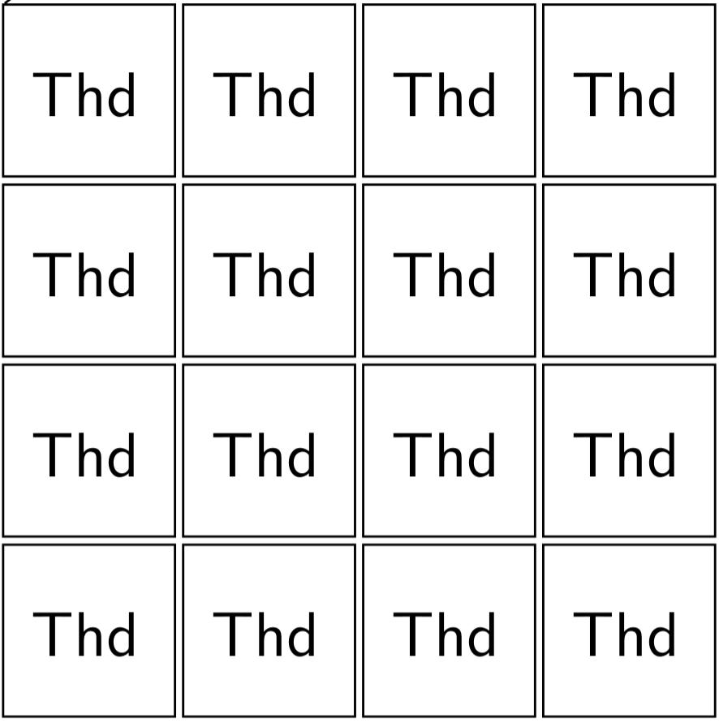
GPU Programming model
kernel1<<<nb_block, nb_thread,shared_mem, str>>>(ptr_ad,… );
kernel2<<<nb_block, nb_thread,shared_mem, str>>>(ptr_ad,… );
Kernels within the same stream are run in FIFO.
Streams can be prioritized, but to only a limited number of priorities.
Threads of the same block executes within the same SM.
Assembly code can be invoked to check Sms,to exit a thread, ...
Amert et al. ``GPU scheduling on the NVIDIA TX2: Hidden details revealed.'' RTSS'17
Capodieci et al. “Deadline-Based Scheduling for GPU with Preemption Support”. RTSS’18.
Sanudo et al. ``Dissecting the CUDA scheduling hierarchy: a Performance and Predictability Perspective'',RTAS'20.

Slide 7
Design a programming
library to handle scheduling for
accelerators (e.g. GPU)
Non preemptive single resource policy
Preemptive single resource policy
Multiple resources preemptive policy

Slide 8

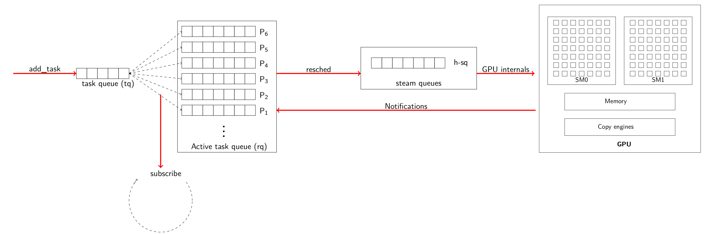


Strategy 1: Single CUDA stream
Only non-preemptive scheduling policies can be implemented using this strategy
Inherits from non-preemptive drawbacks such as priority inversion

Slide 9
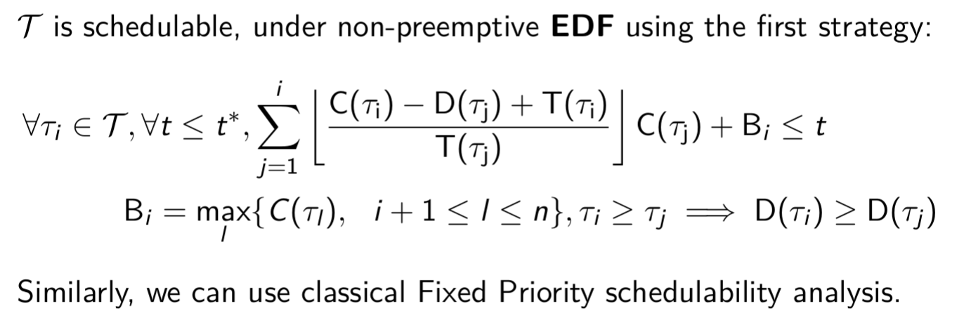
Strategy 1 : Classical non preemptive schedulability analysis

Slide 10
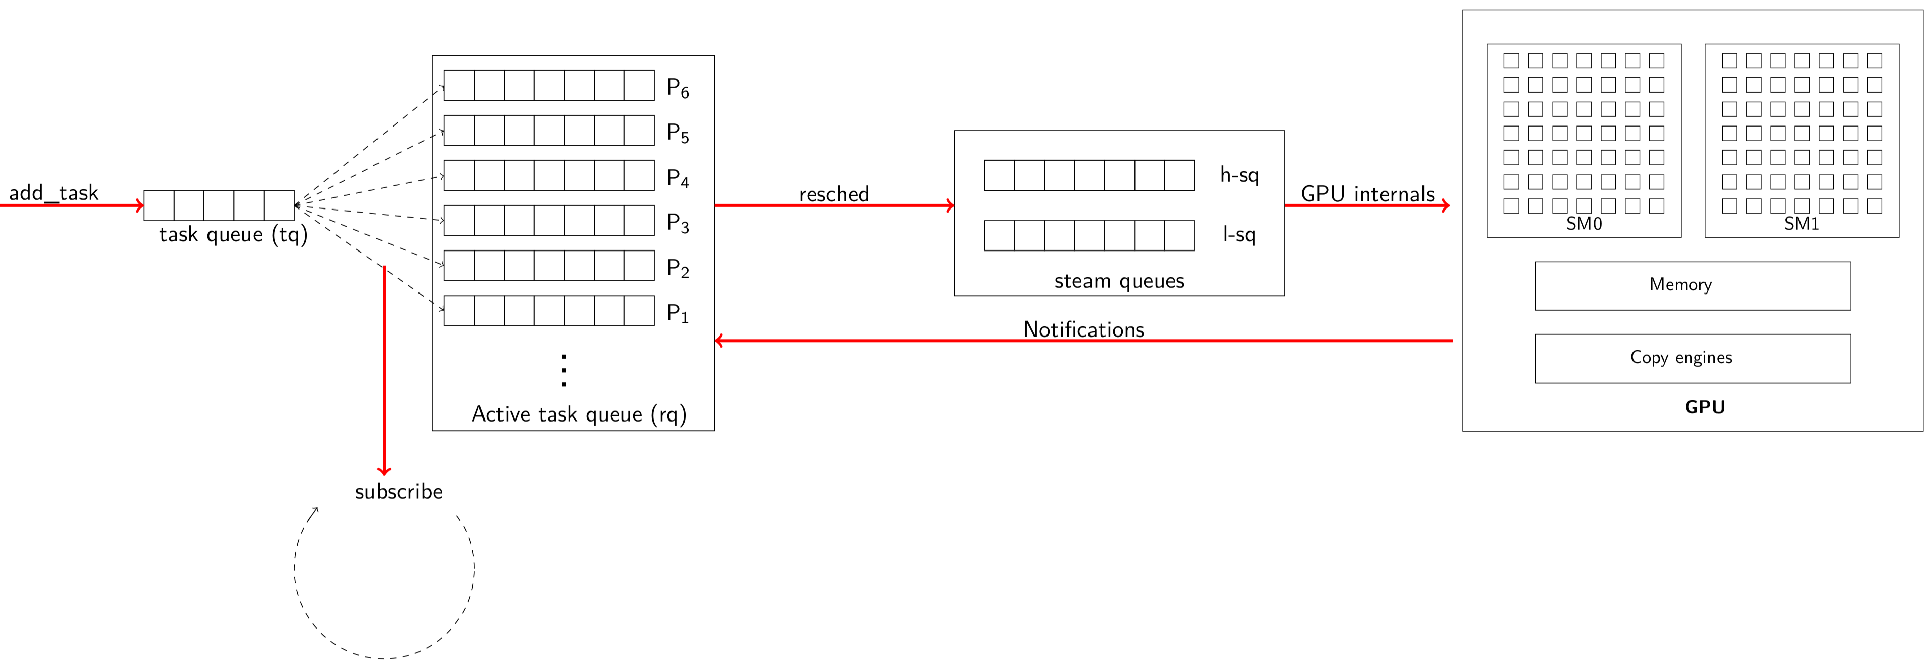
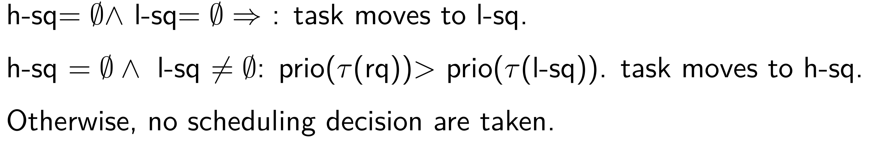
Strategy 2 : Enabling preemption
Limited-preemption scheduling policies can be implemented
Uses the accelerator (GPU) as a single resource

Slide 11
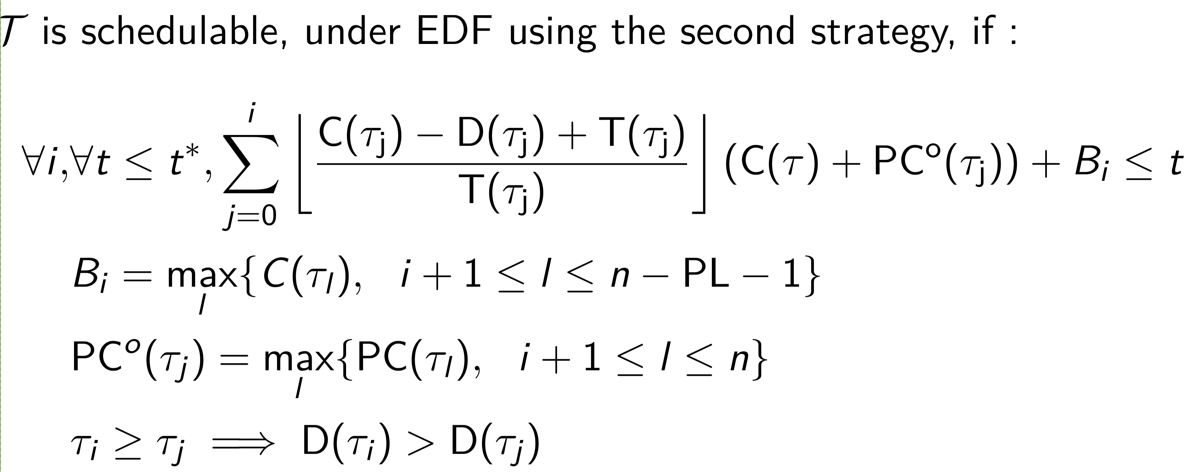
Strategy 2:Limited preemption-level analysis

Slide 12


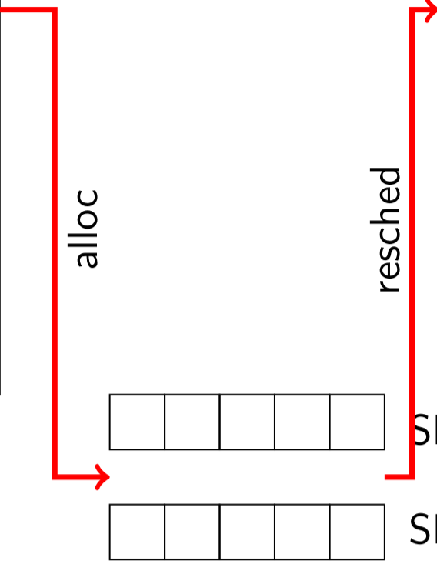
Strategy 3: The GPU as a multicore
Tasks are big or little : Allocated to one or two SMs
Scheduling : two reservations + Event based scheduler

Slide 13
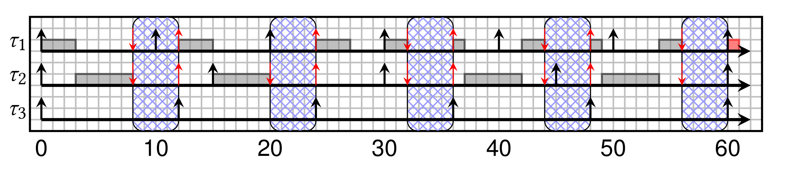
Strategy 3: Gang-EV’ Schedulability analysis
- We use two time triggered reservations : R^L and R^B such that they do not overlap
- We schedule :
- Big tasks are scheduled as single core within R^B reservation
- Little tasks are scheduled in their cores within R^L reservation
- Example : tau_1 and tau_2 are little tasks allocated on the same SM, tau_3 is a big task

Slide 14
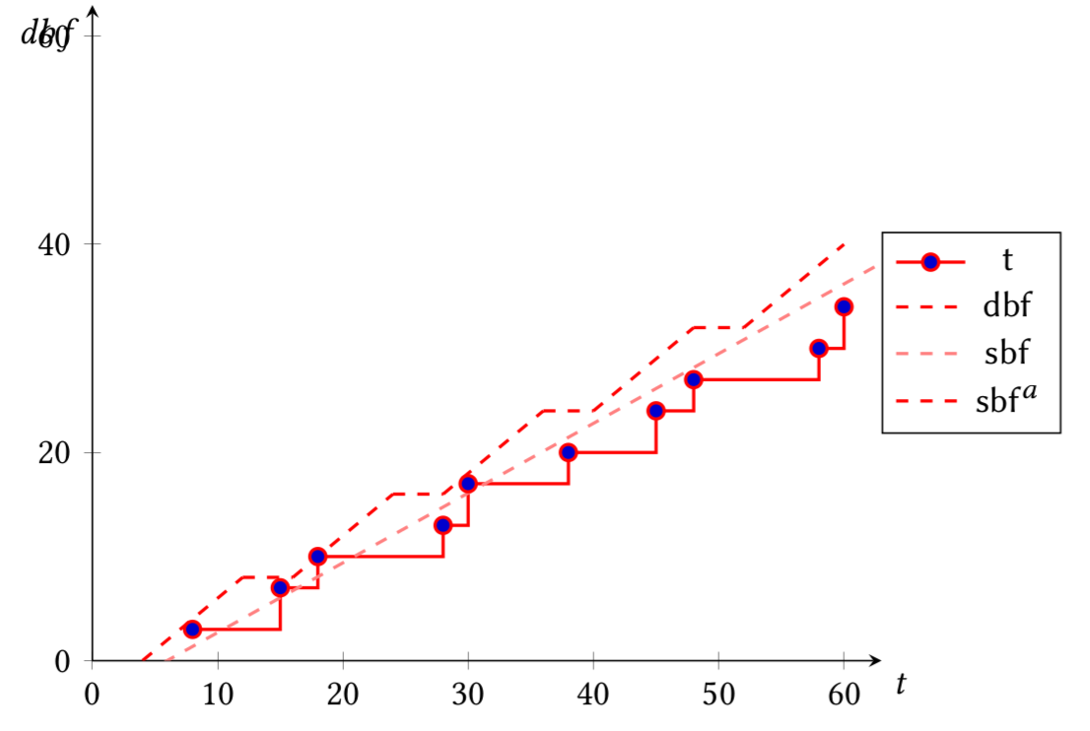
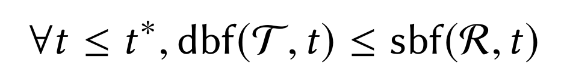
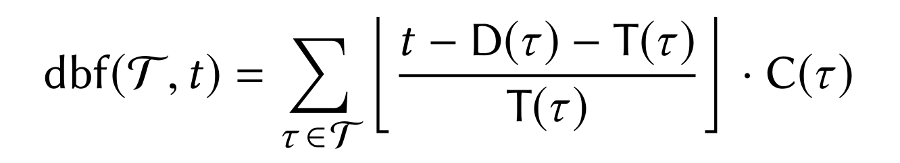
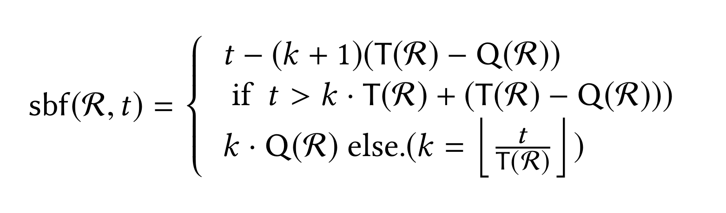
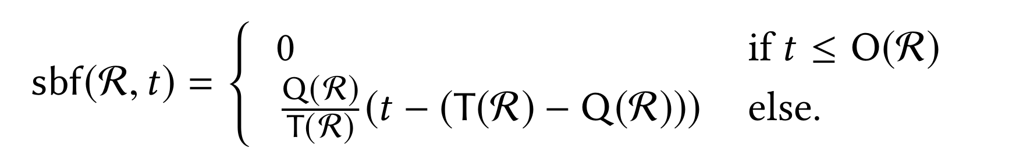
Strategy 3 : Schedulability analysis using supply bound function

Slide 15
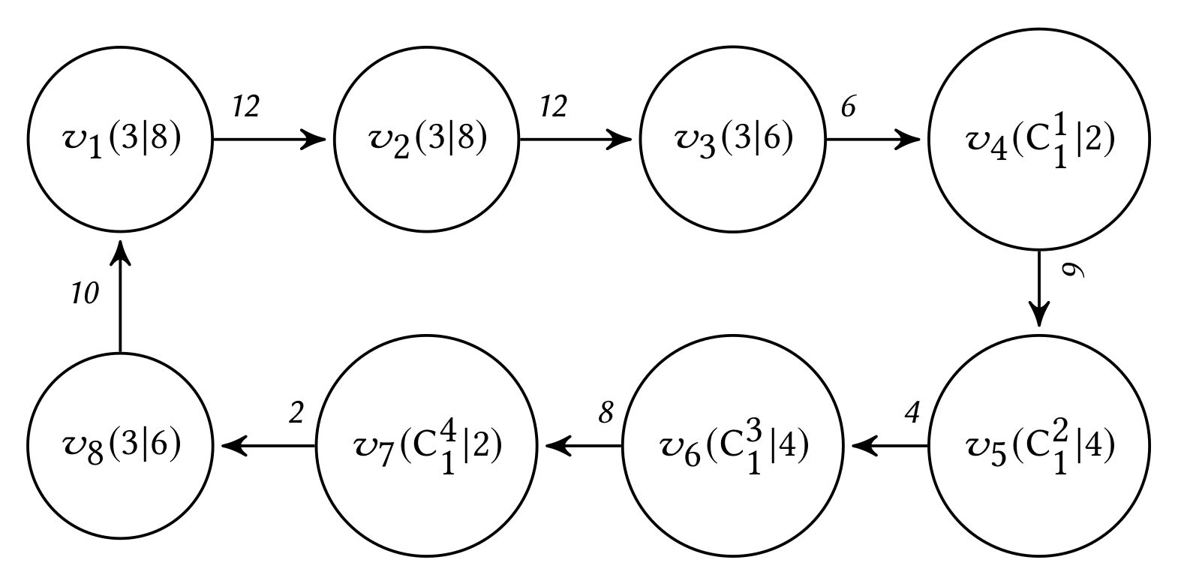
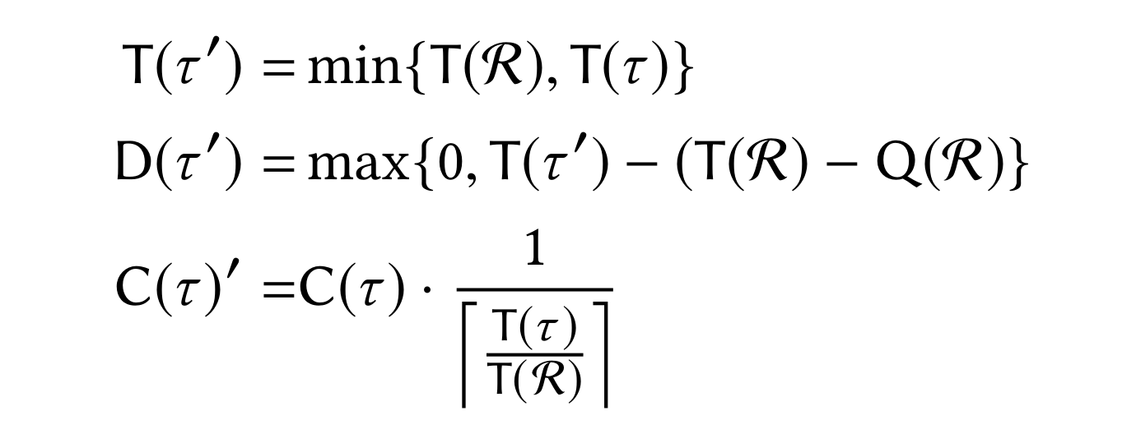
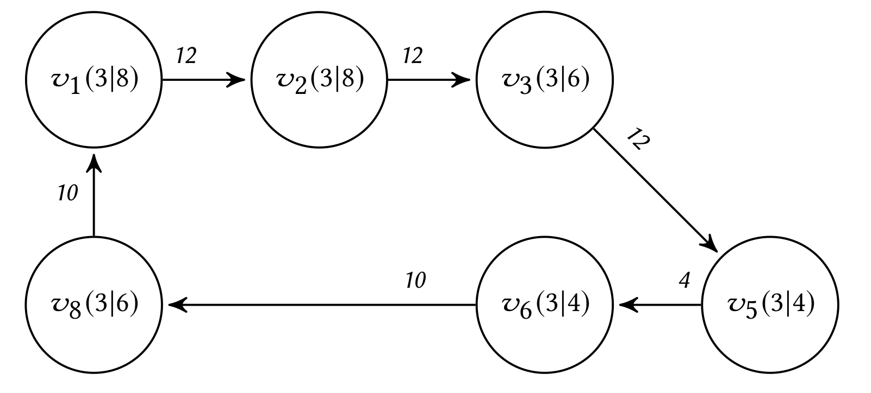
Strategy 3: Analysis using transformations

Slide 16

4. Results
Schedulability rates of the third strategy
Using synthetic experiments
Performances of the library
Using a subset of Autoware tasks

Slide 17
Schedulability rates using synthetic tasksets
Fixed utilization of big tasks 0.2 and 0.5 on both SMs.

Slide 18
Schedulability rates using synthetic tasksets
Fixed utilization of big tasks 0.2 and 0.5 on both SMs.

Slide 19
Schedulability rates using synthetic tasksets
Fixed utilization of big tasks 0.2 and 0.5 on both SMs.

Slide 20
Schedulability rates for harmonic periods
Task periods are either dividers or multipliers of the reservation periods

Slide 21
Schedulability rates for harmonic periods
Task periods are either dividers or multipliers of the reservation periods

Slide 22
Schedulability rates for harmonic periods
Task periods are either dividers or multipliers of the reservation periods

Slide 23
Predictible response times using our library
- Evaluation using NVIDIA Jetson TX2 , Ubuntu 18.04
- 3 Compute_Hessian tasks from NDT package in Autoware framework

Slide 24
Predictible response times using our library
- Evaluation using NVIDIA Jetson TX2 , Ubuntu 18.04
- 3 Compute_Hessian tasks from NDT package in Autoware framework

Slide 25
4. Closing
Design of Accelerator scheduling API
Supports preemption and parallel execution
Evaluated on synthetic and realistic experiments

Slide 26
4. What’s Next
Incorporate task allocation and time slot definition in the schedulability analysis
Efficient support to memory transfers
Scheduling mechanisms: Big tasks run in fully GANG model (Sanudo et al. RTAS’2020)

