Slide 1
Do Students Who Reflect
Learn More Deeply?
Statistical Investigation Using Descriptive, Inferential & Predictive Analysis
Group: The Learning Loop
IT23708280 – J.H.F. Zahra
IT23686588 – K.S. Hettiarachchi
IT23684430 – Nuhaz Ahameth M.R
IT23663268 – E.A.D.K.C. Gunasekara
Problem Statement • Objectives • Data • Descriptive • Inferential • Predictive • Results • Conclusion

Slide 2
Problem Statement
"Students who reflect on their learning demonstrate deeper understanding."
1
Can we prove using real student data and statistical methods that students who show reflective behaviours actually perform better academically?
2
Reflection cannot be measured directly from the dataset, so we use 5 behavioural indicators (reflection proxies) as indirect measures.
3
Academic understanding is measured using 2 outcome variables (understanding proxies) — Exam Score and Final Grade.
H₀: Reflection does NOT significantly affect deeper understanding | H₁: Reflection DOES significantly affect deeper understanding α = 0.05

Slide 3
Objectives
01
Identify Proxies
02
Descriptive Analysis
03
Inferential Analysis
Select 5 reflection proxies (StudyHours, Attendance, Discussions, Motivation, AssignmentCompletion) and 2 understanding proxies (ExamScore, FinalGrade) from the dataset.
Summarise and visualise the data using summary statistics, histograms, bar charts, box plots, and correlation tables to spot early patterns.
Statistically test whether the reflection proxies have a significant relationship with understanding proxies using Pearson, Spearman, T-test, and ANOVA.
04
Predictive Analysis
05
Justify with Literature
06
Draw Conclusion
Build Linear and Logistic regression models to assess whether reflection proxies can predict ExamScore and Pass/Fail outcomes.
Use findings from Lew & Schmidt (2011) and Dahlgren (2020) to support or contextualise our statistical results.
Accept or reject H₀ based on combined evidence from all three stages of analysis.

Slide 4
Data Collection
14,003
16
7,813
7
Raw rows
Columns
Cleaned rows
Selected columns
Reflection Proxies (Input Variables)
Understanding Proxies (Output Variables)
StudyHours — hours spent studying
Attendance — attendance percentage (0–100)
Discussions — participated or not (0 or 1)
Motivation — motivation level (0, 1, or 2)
AssignmentCompletion — % of work completed
ExamScore — score on the exam (40 to 100)
FinalGrade — overall grade category (0, 1, 2, or 3)
Grade 0 = highest (85–100)
Grade 1 = (70–84)
Grade 2 = (55–69)
Grade 3 = lowest (40–54)
Dataset: student_performance.csv | Source: Kaggle | Tool: R Studio

Slide 5
Data Preprocessing
Raw Dataset
Cleaned Dataset
Steps Performed
14,003 rows
16 columns
→
7,813 rows
7 columns
Checked dimensions, missing values,
impossible values, duplicates (2 rounds)
Converted FinalGrade to factor (4 levels)
Check | Finding | Action Taken
Missing values | None found | No action needed
Impossible values | None found | No action needed
Duplicate rows | Found — removed in 2 rounds | Removed using distinct()
FinalGrade column | Stored as integer | Converted to factor (4 levels) — CSV doesn't preserve data type
Dataset size | 14,003 rows, 16 cols → 7,813 rows, 7 cols | Subset + deduplicated

Slide 6
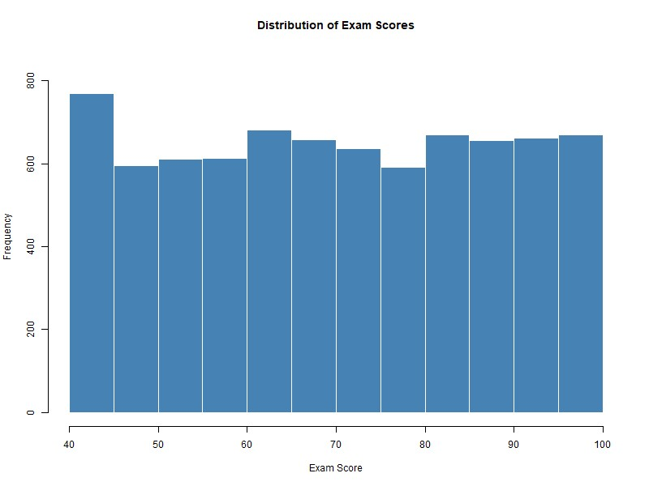
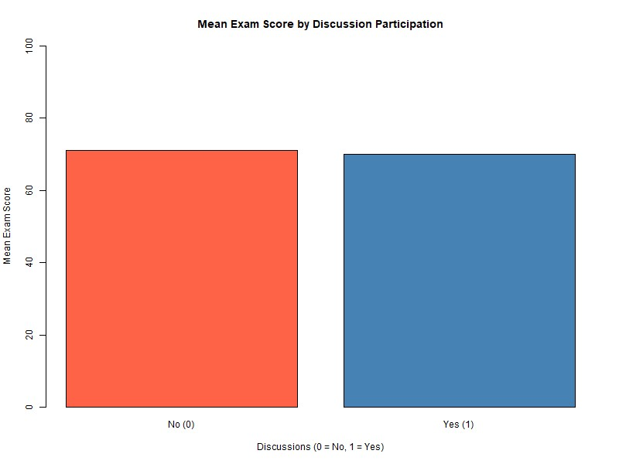
Descriptive Analysis
Summary stats: StudyHours mean 20.03 | Attendance mean 80.11 | AssignmentCompletion mean 74.55 | ExamScore mean 70.37
Histogram — ExamScore
Bar Chart — Mean Score by Discussions
Scores spread evenly from 40–100. No clustering. Approximately uniform distribution across all students.
No participation: 70.96 avg. Participated: 69.99 avg.
Difference < 1 mark — no meaningful impact.
Shows how the scores are spread
Shows comparison between 2 groups

Slide 7
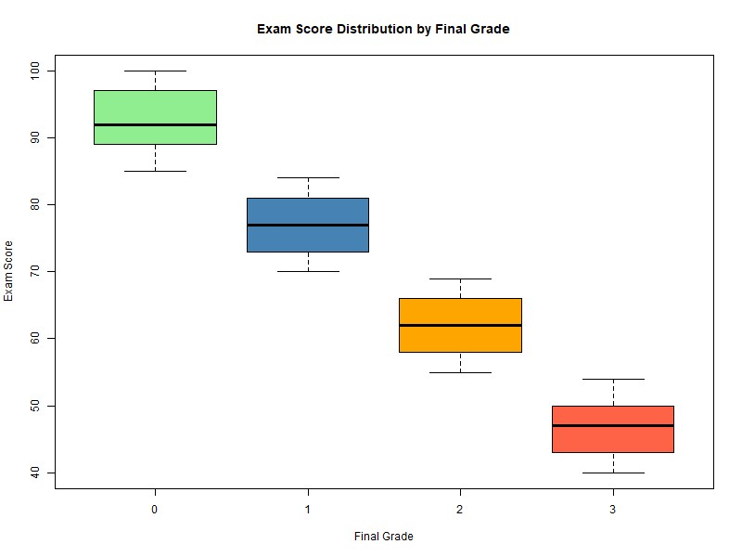
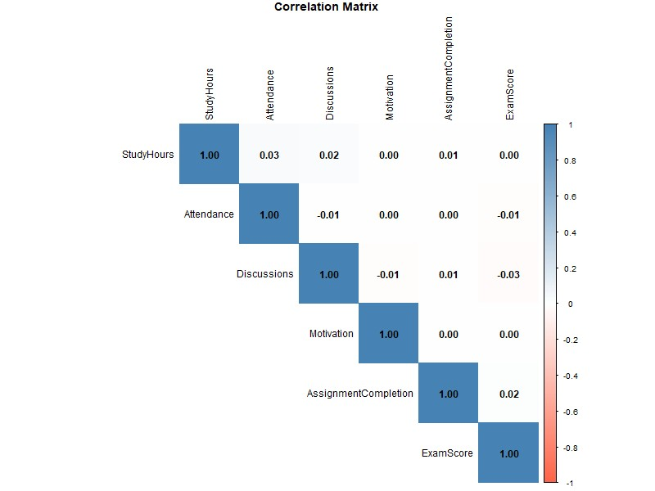
Descriptive Analysis
Summary stats: StudyHours mean 20.03 | Attendance mean 80.11 | AssignmentCompletion mean 74.55 | ExamScore mean 70.37
Box Plot — ExamScore by FinalGrade
Correlation Table
Clear separation:
Grade 0 median 92, Grade 1: 77, Grade 2: 62, Grade 3: 47.
~15 mark gap each level.
All correlations near 0.
Strongest: Attendance & StudyHours (0.034).
No strong linear relationships.
Shows whether grade categories score differently on exams
Shows relationships between all variable pairs

Slide 8
Inferential Analysis | α = 0.05 → Reject H₀ if p-value < 0.05
Pearson Correlation vs ExamScore
Spearman Correlation vs FinalGrade (ordinal — Pearson invalid)
Proxy | r value | p-value | Decision
StudyHours | 0.0015 | 0.894 | Do not reject H₀
Attendance | -0.0127 | 0.261 | Do not reject H₀
Discussions | -0.0268 | 0.018 ✓ | Reject H₀
Motivation | -0.0055 | 0.628 | Do not reject H₀
AssignCompl | 0.0183 | 0.107 | Do not reject H₀
Proxy | rho | p-value | Decision
StudyHours | -0.0051 | 0.649 | Do not reject H₀
Attendance | 0.0105 | 0.355 | Do not reject H₀
Discussions | 0.0343 | 0.002 ✓ | Reject H₀
Motivation | 0.0056 | 0.619 | Do not reject H₀
AssignCompl | -0.0201 | 0.075 | Do not reject H₀
T-Test — ExamScore by Discussions (only binary proxy)
One-Way ANOVA + Post-Hoc — ExamScore by FinalGrade (4 groups)
Group | Mean | t / p-value | Decision
Discussions = 0 (No) | 70.96 | t=2.365 / p=0.018 | Reject H₀
Discussions = 1 (Yes) | 69.99 | t=2.365 / p=0.018 | Reject H₀
Source | df | F value | p-value
FinalGrade (Between) | 3 | 38,843 | < 0.001 ***
Residuals (Within) | 7,809 | — | —
Grade 1 vs 0: −15.4
Grade 2 vs 0: −30.6
Significant (p=0.018 < 0.05) but difference < 1 mark — statistically real, practically meaningless.
Grade 3 vs 0: −45.8
All pairs: p = 0

Slide 9
Predictive Analysis — Regression Models
Model 1 — Linear Regression | Predicts: ExamScore
Model 2 — Logistic Regression | Predicts: Pass / Fail
Proxy | Coefficient | p-value
StudyHours | 0.006 | 0.836
Attendance | -0.020 | 0.250
Discussions | -0.982 | 0.017 ✓
Motivation | -0.136 | 0.609
AssignCompl | 0.022 | 0.103
Confusion Matrix:
 | Actual 0 (Pass) | Actual 1 (Fail)
Predicted 0 | 2,875 ✓ | 2,690 ✗
Predicted 1 | 1,123 ✗ | 1,125 ✓
A total of 4,000 correct out of 7,813
51.2%
R² = 0.0013
Model accuracy — barely above random guessing (50%)
Only 0.13% of ExamScore variation explained
All odds ratios near 1.0 — none of the proxies meaningfully change a student's chances of passing or failing.
Only Discussions at 1.118 shows a slight effect (+12% odds of failing), but practically negligible.
Overall model p = 0.079 — not significant.
Reflection proxies cannot predict ExamScore.
Exam performance is driven by factors not in this dataset.

Slide 10
Assumptions Made Throughout the Analysis
Data Cleaning
Descriptive
7,813 rows accurately represent the student population. The 7 selected columns are sufficient to represent reflection and understanding.
Summary statistics (mean, median, SD) meaningfully represent the data. Charts accurately visualise the distributions.
Pearson Correlation
Spearman Correlation
ExamScore is normally distributed. Both variables are continuous and numeric.
FinalGrade is ordinal with a meaningful order (0 is best, 3 is worst).
T-Test
ANOVA
The two discussion groups (0 and 1) are independent of each other. ExamScore values are roughly normally distributed within each group.
Exam scores within each grade group are roughly normally distributed. Variances across the four groups are similar (homogeneity of variance).
Regression
The relationship between reflection proxies and the outcome variable is approximately linear.
In short: We assumed the data is representative, variables are suitable, and statistical assumptions like normality and independence are reasonably satisfied.

Slide 11
Results — Summary Across All Three Analysis Stages
Descriptive
Exam scores distributed evenly - no clustering
Discussion participants vs non-participants: < 1 mark difference
Box plot - clear grade separation (~15 marks between each level)
All correlations near zero - no meaningful linear relationships
Inferential
4 out of 5 proxies show NO significant relationship (Pearson & Spearman)
Discussions - only significant proxy in all tests (p < 0.05)
Effect sizes negligible: r = -0.027, rho = 0.034
ANOVA: F = 38,843, p < 0.001 - strongest result, confirms grade separation
Predictive
Linear regression: R² = 0.0013 - proxies explain only 0.13% of ExamScore
Overall model not significant (p = 0.079)
Logistic regression: 51.2% accuracy - barely better than random guessing
Odds ratios all near 1.0 - proxies have no predictive power on Pass/Fail
Consistent pattern across all 3 stages: Only Discussions shows any significance, but with negligible effect sizes.

Slide 12
Final Decision
H₀ CANNOT be fully rejected — data provides only LIMITED and PARTIAL support for H₁
Only 1 of 5 proxies significant
Models failed to predict
Discussions showed significance in Pearson, Spearman, and T-test but effect sizes were r = -0.027 and rho = 0.034, which are negligibly small.
Linear regression R² = 0.0013.
Logistic regression accuracy = 51.2%.
Both confirm the proxies carry almost no predictive information.
Aligned with literature
Proxy limitation
Lew & Schmidt (2011): weak correlations between reflection and academic grades — 'subtle impact.’
Dahlgren (2020): reflection not equally effective for all students.
Our proxies measure what students DO, not how deeply they THINK.
A student can attend every class without actually reflecting. This gap limits our findings.
The statement may hold true in principle, but the behavioural proxy variables are insufficient to statistically demonstrate it.

Slide 13
Conclusion
Dataset
Inferential
Predictive
7,813 student records, 5 reflection proxies, 2 understanding proxies analysed across 3 stages.
Only Discussions showed significance. All other proxies showed no significant relationship with ExamScore or FinalGrade.
R² = 0.0013, Accuracy = 51.2%. Reflection proxies have virtually no predictive power.
Literature
Limitation
Future Work
Consistent with Lew & Schmidt (2011) and Dahlgren (2020) — reflection's effect on measurable outcomes is subtle.
Proxies measure behaviour, not depth of thinking. Direct reflection measures would give stronger results.
Use datasets with journal scores, self-assessments, or structured reflection ratings for more meaningful analysis.
Our data provides only limited and partial support for H₁ — reflection behaviours alone are insufficient to statistically demonstrate deeper understanding.
Thank You | The Learning Loop | IT3011 – TPSM | SLIIT

