Slide 1
Churnx
File created on: 2021-02-20 10:00:59 PM CST

Slide 2
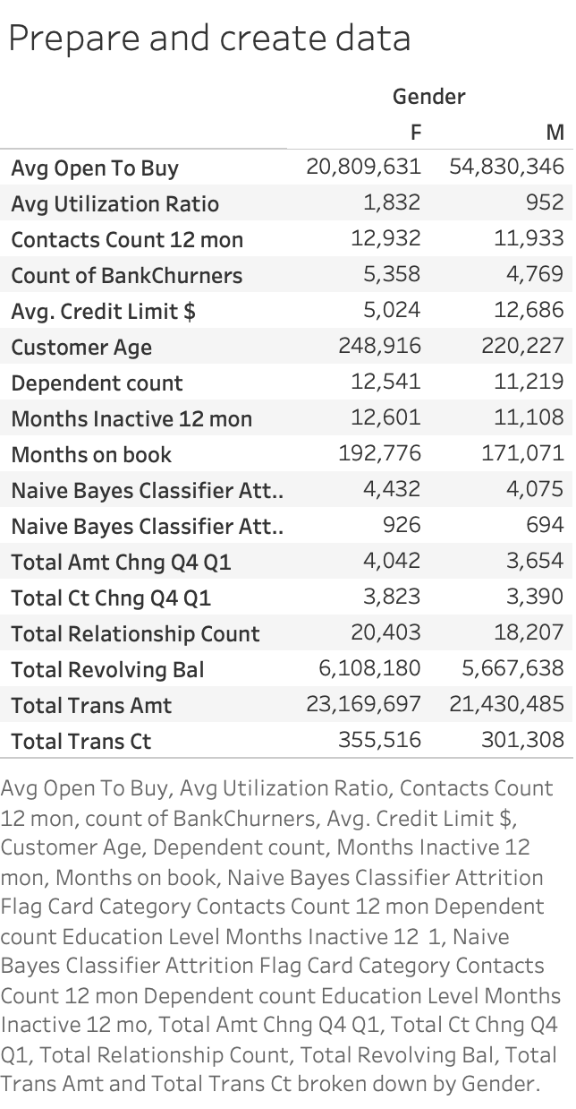

Slide 3


Slide 4


Slide 5


Slide 6


Slide 7


Slide 8


Slide 9
