Slide 1

Zπ
Zπ MATHS HUB
Pearson Edexcel IGCSE (9–1) · Higher Tier
y = ?
Rearranging Formulae
Changing the Subject — Linear · Powers · Completing the Square · Algebraic Fractions
Zahra Sheikh Ali
IGCSE Mathematics Teacher · M.Sc. Differential Geometry & Geometric Control
☎ 66613748 ✉ zahraa.sheikhali@outlook.com

Slide 2

Zπ
THE BIG IDEA
Changing the Subject
GOLDEN RULE
Use inverse operations to get the new subject on its own — doing the same to both sides every time.
THE CASES WE'LL MEET
Linear — inverse operations
Subject appears twice — factorise
Powers & roots
1
2
3
Completing the square
Algebraic fractions
Fractions with powers / roots
4
5
6

Slide 3


Zπ
CASE 1 · LINEAR
Inverse Operations
Make t the subject: m = 6p + t
Make y the subject: Dy – 3e = 2g + 5
1
subtract 6p from both sides
1
add 3e: Dy = 2g + 3e + 5
2
divide by D

Slide 4
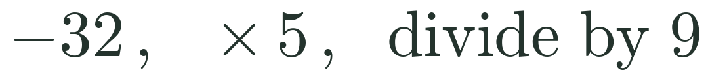


Zπ
CASE 1 · LINEAR
With Brackets & Fractions
9C
Make S the subject: a(y + S) = F
Make C the subject: F =
+ 32
1
expand: ay + aS = F
1
2
subtract ay, then divide by a

Slide 5
Zπ
CASE 1 · PRACTICE
Make the Given Letter the Subject
1
y = x + 5 (x)
4
V = u + at (t)
2
b = 3a (a)
5
m = 5(n + s) (s)
3
y = 2x + 7 (x)
6
a = b + 2 (b)
Notes:
Answers — 1: x=y–5. 2: a=b/3. 3: x=(y–7)/2. 4: t=(V–u)/a. 5: s=(m–5n)/5 = m/5 – n. 6: b=a–2.

Slide 6


Zπ
CASE 2 · SUBJECT APPEARS TWICE
Collect, then Factorise
Collect every term with the subject on one side, factorise it out, then divide.
Make x the subject:
ax – m = bx + y
Make w the subject:
S = 2lw + 2lh + 2hw
1
ax – bx = m + y
1
2lw + 2hw = S – 2lh
2
factorise: x(a – b) = m + y
2
w(2l + 2h) = S – 2lh

Slide 7


Zπ
CASE 3 · POWERS & ROOTS
Square → √ , Cube → ∛
Isolate the power, then take the matching root — the inverse of squaring is √, of cubing is ∛.
Make q the subject:
5(p + q²) = 4V
Make r the subject:
V =
4
πr³
1
5p + 5q² = 4V → 5q² = 4V – 5p
3
1
3V = 4πr³ → cube-root
2

Slide 8
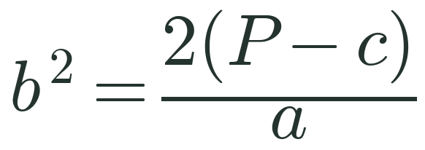




Zπ
CASE 3 · POWERS & ROOTS
More Worked Examples
Make n the subject: y = 5√(mn)
Make b the subject (b > 0):
P = ½ ab² + c
1
square both sides: y² = 25mn
1
Worded: A cylinder has volume V = πr²h . Make r the subject.
1

Slide 9
Zπ
CASE 4 · COMPLETING THE SQUARE
When the Subject is Squared AND Linear
If the subject appears as both x² and x, complete the square, then square-root both sides.
Make x the subject: y = x² + 8x
Make x the subject: y = x² – 6x + 1
1
complete the square: y = (x + 4)² – 16
1
y = (x – 3)² – 9 + 1 = (x – 3)² – 8
2
(x + 4)² = y + 16 → √ both sides
2
(x – 3)² = y + 8 → √ both sides
x = –4 ± √(y + 16)
x = 3 ± √(y + 8)

Slide 10
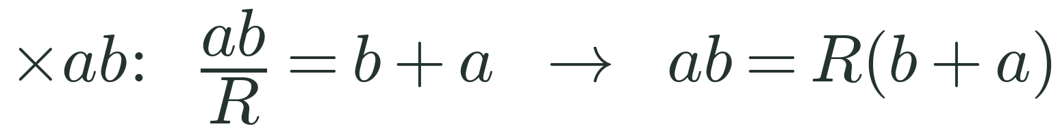

Zπ
CASE 5 · ALGEBRAIC FRACTIONS
Clear the Denominators First
Multiply through to clear fractions, collect the subject, factorise, then divide.
1
1
1
Make R the subject:
=
+
R
a
b
1
2
divide both sides by (a + b)

Slide 11
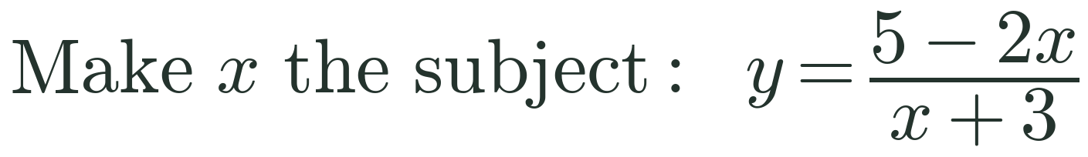
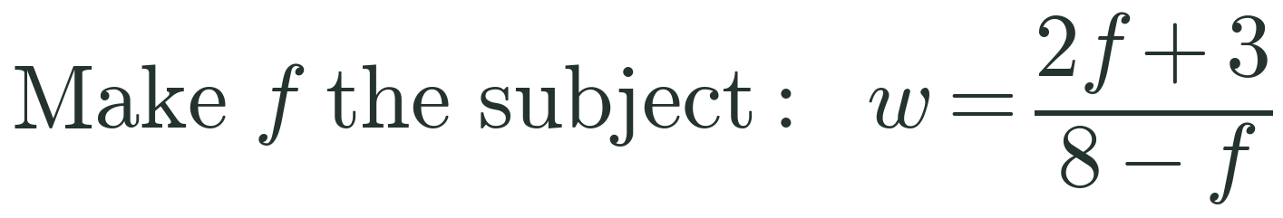


Zπ
CASE 5 · ALGEBRAIC FRACTIONS
Subject in the Numerator AND Denominator
1
y(x + 3) = 5 – 2x
1
w(8 – f) = 2f + 3
2
yx + 2x = 5 – 3y
2
8w – 3 = 2f + wf
3
x(y + 2) = 5 – 3y
3
8w – 3 = f(2 + w)

Slide 12
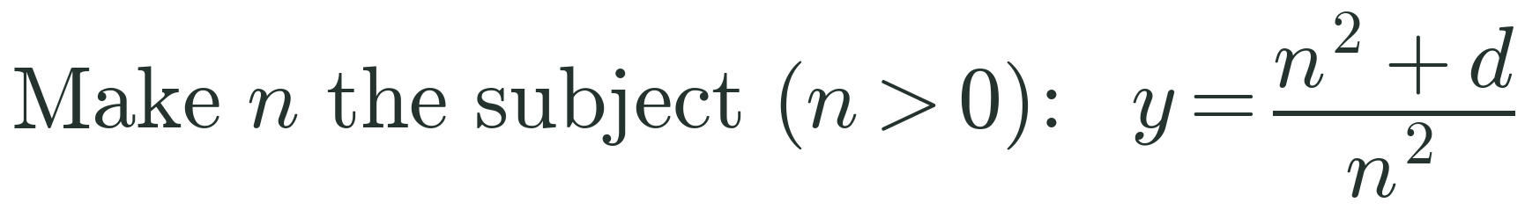
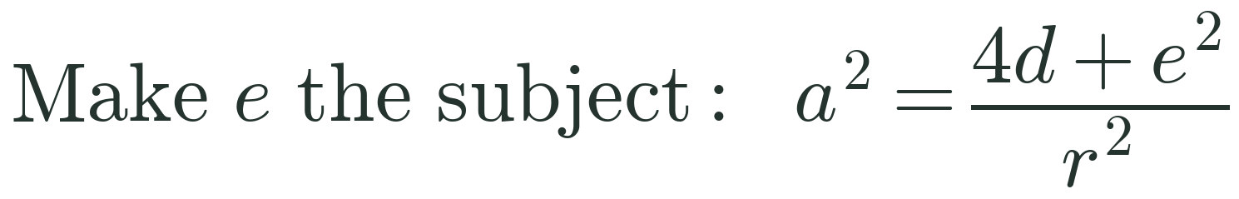


Zπ
CASE 6 · FRACTIONS WITH POWERS
Powers Inside an Algebraic Fraction
1
yn² = n² + d
1
a²r² = 4d + e²
2
n²(y – 1) = d
2
e² = a²r² – 4d → √

Slide 13
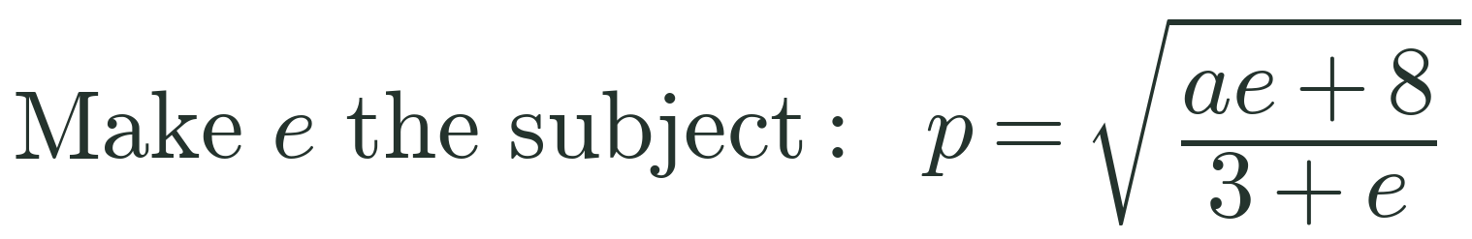
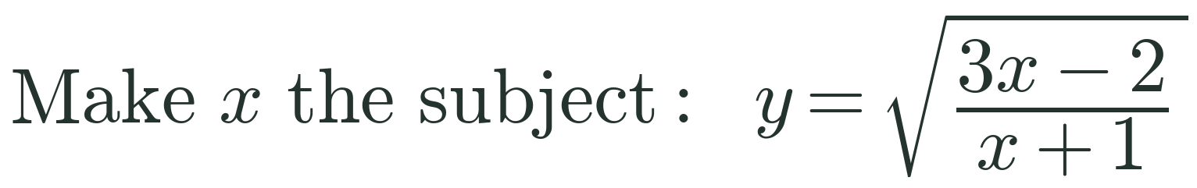


Zπ
CASE 6 · FRACTIONS WITH ROOTS
Square Both Sides First
1
square: p²(3 + e) = ae + 8
1
square: y²(x + 1) = 3x – 2
2
3p² – 8 = ae – ep² = e(a – p²)
2
x(y² – 3) = – 2 – y²

Slide 14
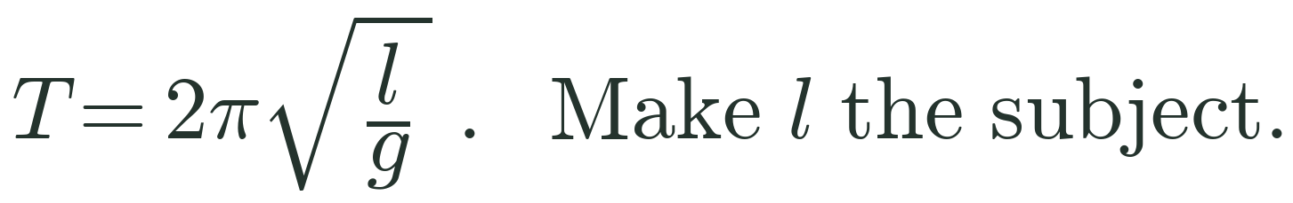
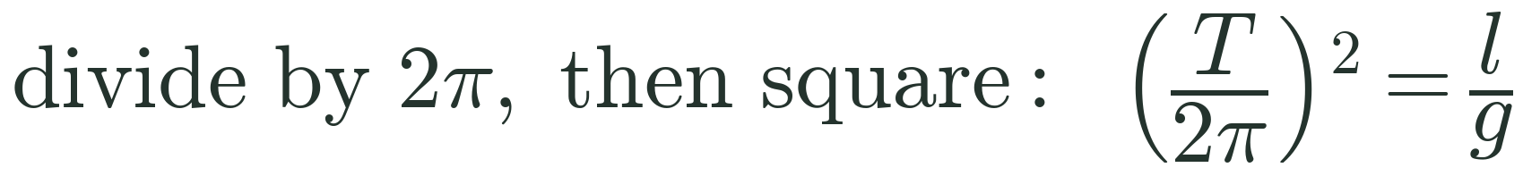


Zπ
WORDED FORMULAE
Real-World Rearranging
Pythagoras
Pendulum
c = √(a² + b²) . Make a the subject.
1
square: c² = a² + b²
1
2
a² = c² – b² → square-root
2
multiply by g

Slide 15
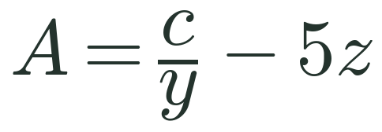
Zπ
PAST PAPER
Linear, Powers & Roots
MAKE a
MAKE a
MAKE c
d = g + 2ac
M = ac – bd
MAKE t
MAKE b (b > 0)
MAKE f
c = t³ – 8v
P = ½ ab² + c
m = √(⅓ ef)
Notes:
Answers — d=g+2ac: a=(d–g)/(2c). M=ac–bd: a=(M+bd)/c. A=c/y–5z: c=y(A+5z). c=t³–8v: t=∛(c+8v). P=½ab²+c: b=√(2(P–c)/a). m=√(⅓ef): f=3m²/e.

Slide 16
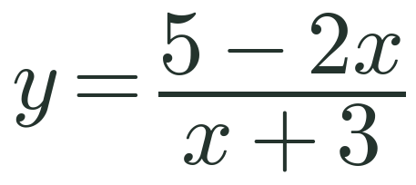
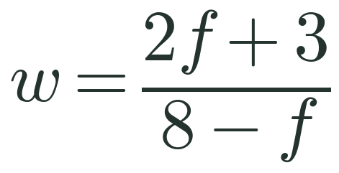
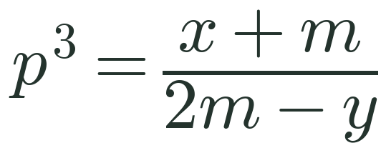
Zπ
PAST PAPER
Algebraic Fractions
MAKE x
MAKE f
MAKE m
x + 3
8 – f
2m – y
Notes:
Answers — y=(5–2x)/(x+3): x=(5–3y)/(y+2). w=(2f+3)/(8–f): f=(8w–3)/(w+2). p³=(x+m)/(2m–y): m=(x+yp³)/(2p³–1).

Slide 17
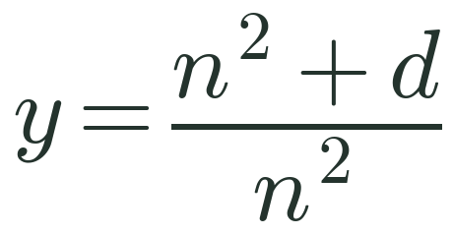
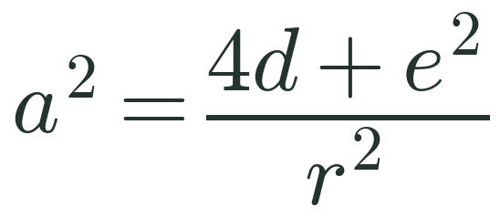
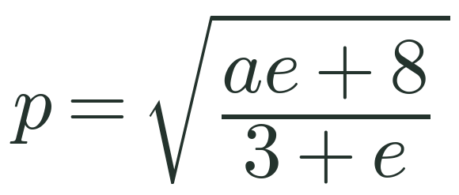
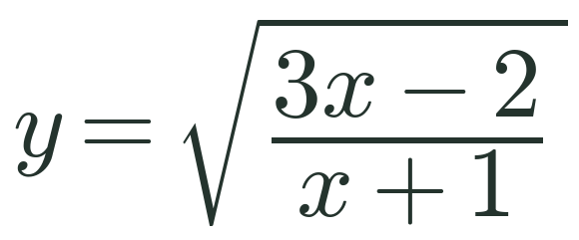
Zπ
PAST PAPER
Fractions with Powers & Roots
MAKE n (n > 0)
MAKE e
MAKE e
MAKE x
Notes:
Answers — y=(n²+d)/n²: n=√(d/(y–1)). a²=(4d+e²)/r²: e=√(a²r²–4d). p=√((ae+8)/(3+e)): e=(8–3p²)/(p²–a). y=√((3x–2)/(x+1)): x=(2+y²)/(3–y²).

Slide 18
Zπ
Zπ MATHS HUB
Recap & Resources
Linear
Subject twice
inverse operations, both sides
collect · factorise · divide
Powers & roots
y = ?
Completing the square
isolate the power, take the root
when x
Algebraic fractions
Fractions with powers
clear denominators, then factorise
square / root, then rearrange
Practice: wordwall.net — rearranging formulae ✉ zahraa.sheikhali@outlook.com · ☎ 66613748
Ms. Zahra Sheikh Ali · Pearson Edexcel IGCSE (9–1) Mathematics A · Higher Tier

