Slide 1
Zπ
Zπ MATHS HUB
Pearson Edexcel IGCSE (9–1) · Higher Tier
y
x
Graphing Inequalities
Regions on a Graph · Boundary Lines · Dashed or Solid · Shading · Describing a Region
Zahra Sheikh Ali
IGCSE Mathematics Teacher · M.Sc. Differential Geometry & Geometric Control
☎ 66613748 ✉ zahraa.sheikhali@outlook.com

Slide 2
Zπ
LESSON OVERVIEW
Inequalities in Two Variables
An inequality like y ≤ 2x + 1 is satisfied by a whole REGION of the graph, not just a line. Draw the boundary line, decide dashed or solid, then shade the correct side.
Inequalities in two variables
The boundary line
Dashed or solid?
1
2
3
Which side to shade
Several regions together
Past-paper questions
4
5
6
Key words: region · boundary line · dashed · solid · test point · half-plane · satisfy · shade

Slide 3
Zπ
THE KEY IDEA
An Inequality Describes a REGION
x + 2y ≤ 8 is a linear inequality in two variables. A point (x, y) is a solution if it makes the inequality true — all such points form a region.
Testing a point
The three steps
Is (1, 3) a solution of x + 2y ≤ 8?
1 + 2(3) = 7, and 7 ≤ 8 ✓
So (1, 3) lies inside the region.
1. Draw the BOUNDARY line.
2. Dashed for < >, solid for ≤ ≥.
3. Test a point to see which side to shade.
The graph of an inequality is a HALF-PLANE — everything on one side of the boundary.

Slide 4
Zπ
THE BOUNDARY LINE
Dashed or Solid?
The type of inequality sign decides the type of line.
DASHED line: < or >
SOLID line: ≤ or ≥
y
y
x
x
x < 2 — the line is NOT included
y ≥ 3 — the line IS included
Strict (< >) → DASHED (not included). ‘Or equal to’ (≤ ≥) → SOLID (included).

Slide 5
Zπ
WHICH SIDE TO SHADE
Use a Test Point — Usually (0, 0)
1
Graph y ≥ 3. Boundary: the horizontal line y = 3 (SOLID).
Method
Pick any point not on the line — (0, 0) is easiest.
Substitute it into the inequality.
TRUE → shade that side. FALSE → shade the other side.
Horizontal line = y = k; vertical line = x = k.
2
Test (0, 0): is 0 ≥ 3 ? FALSE.
3
So (0, 0) is NOT in the region — shade the OTHER side (above the line).
4
For x < 2: test (0,0) → 0 < 2 TRUE, so shade the side containing the origin.
Test (0,0): TRUE → shade that side; FALSE → shade the opposite side
If the line passes through the origin, test another easy point such as (1, 0).

Slide 6
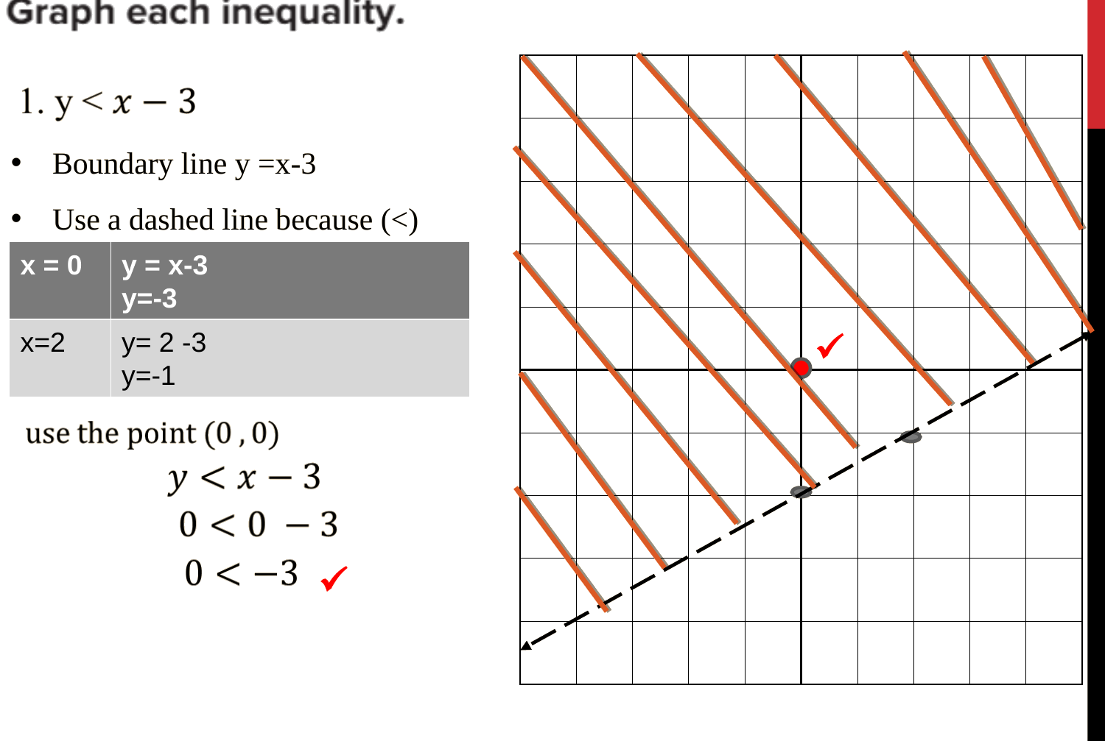
Zπ
SLOPING BOUNDARIES
Draw the Line from a Table of Values
For a line like y = x − 3, work out two or three points first, join them, then shade.
Steps
Boundary line: y = x − 3.
DASHED, because the sign is <.
x = 0 → y = −3 (0, −3)
x = 2 → y = −1 (2, −1)
Join the points, then test (0, 0):
0 < −3 is FALSE → shade the other side.
Substitute easy x-values to get points → join → test a point to decide the side.

Slide 7
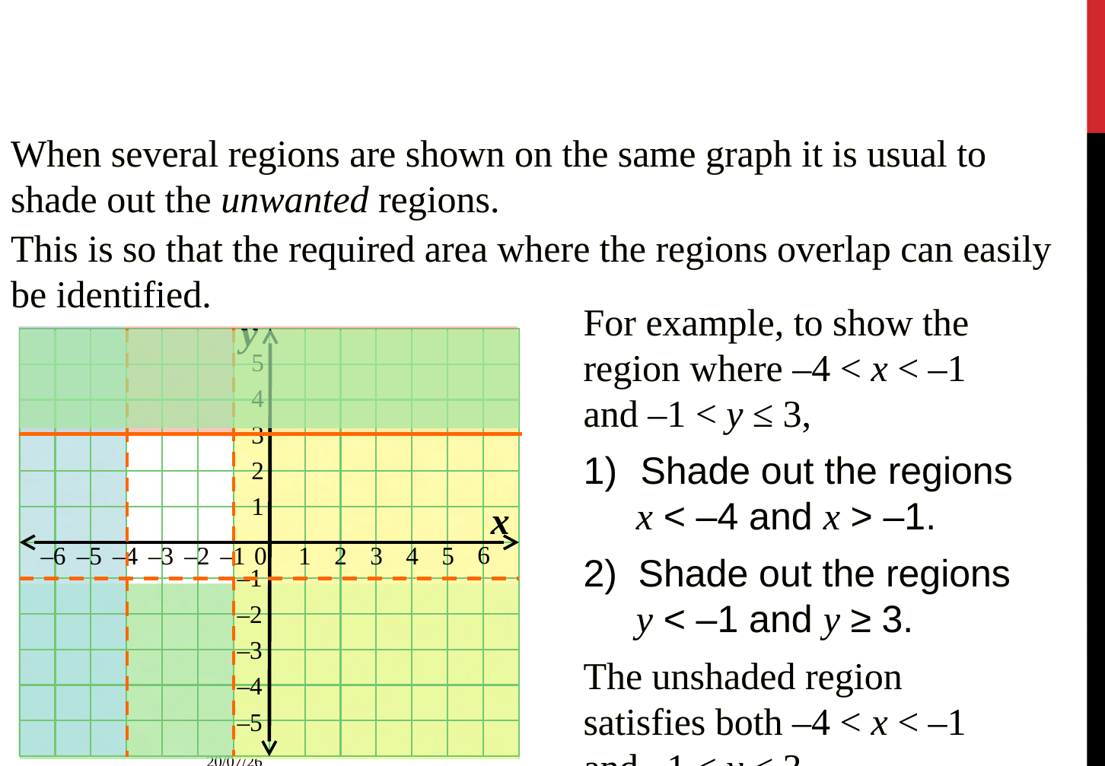
Zπ
SEVERAL INEQUALITIES
Shade OUT the Unwanted Regions
With more than one inequality, the answer is where the regions OVERLAP.
Method
Draw every boundary line.
Dashed for < > , solid for ≤ ≥.
Take one inequality at a time.
Shade OUT what you do not want.
The clear area left is region R.
Check a point inside fits ALL.
Shading out the unwanted parts makes the required overlap easy to see — label it R.

Slide 8
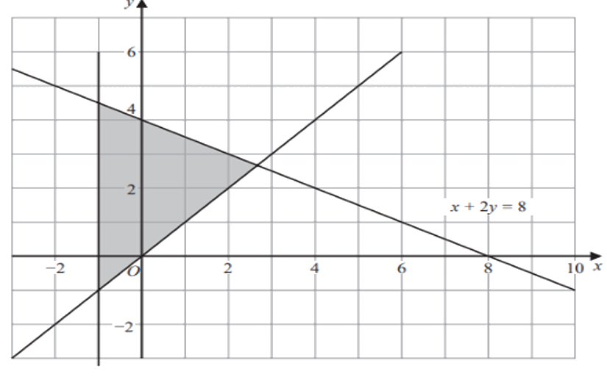
Zπ
DESCRIBING A REGION
Three Lines — Find the Three Inequalities
The shaded region is bounded by three lines. Only x + 2y = 8 is given — find the other two.
Working
1. The left edge is the y-axis:
x = 0 → x ≥ 0
2. The lower line passes through
(0,0) and (2,2): y = x
region is above it → y ≥ x
3. The given line: x + 2y = 8
region is below it → x + 2y ≤ 8
All three lines are SOLID, so use ≤ and ≥.
Answer: x ≥ 0, y ≥ x, x + 2y ≤ 8 (check a point inside, e.g. (1, 2)).

Slide 9
Zπ
DESCRIBING A REGION
The Method in Three Steps
Work through one boundary line at a time. Equation → sign → direction.
Find the EQUATION of each boundary line (y = k, x = k, or y = mx + c).
1
Choose the SIGN: dashed line → < or > ; solid line → ≤ or ≥.
2
Choose the DIRECTION: test a point inside the region in each inequality.
3
A region bounded by three lines needs THREE inequalities.
4
Horizontal boundary → y = k; vertical → x = k; sloping → find the gradient and intercept.

Slide 10
Zπ
PART 2
Past-Paper Questions
Draw each boundary, dashed or solid, shade out the unwanted side, label R.
1
Boundary line first
2
Dashed (< >) or solid (≤ ≥)
3
Test (0,0) to pick the side
4
Describing? → equation + sign + test

Slide 11
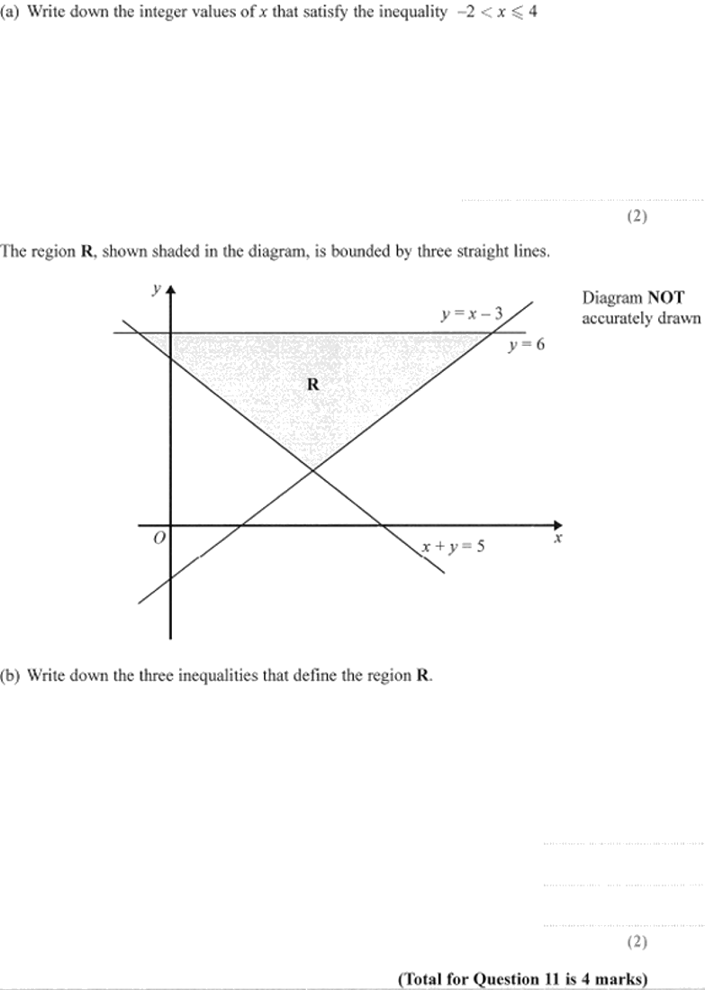
Zπ
PAST-PAPER QUESTION
Question 1

Slide 12
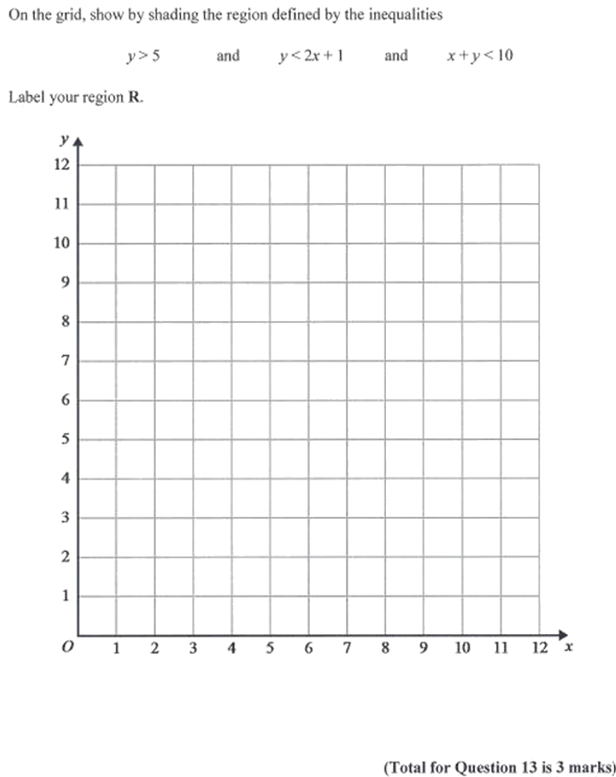
Zπ
PAST-PAPER QUESTION
Question 2

Slide 13
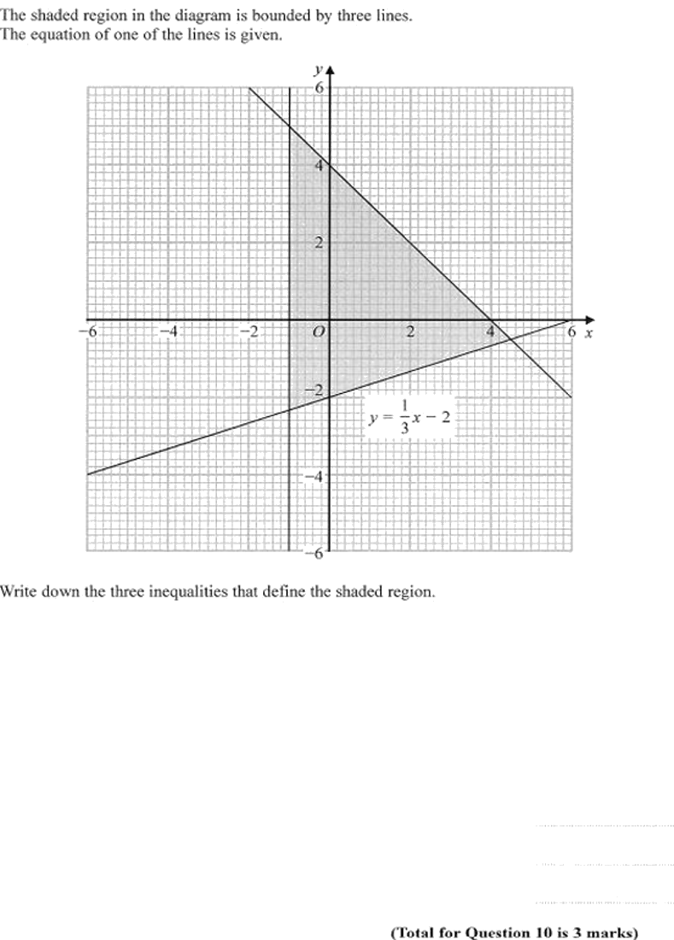
Zπ
PAST-PAPER QUESTION
Question 3

Slide 14
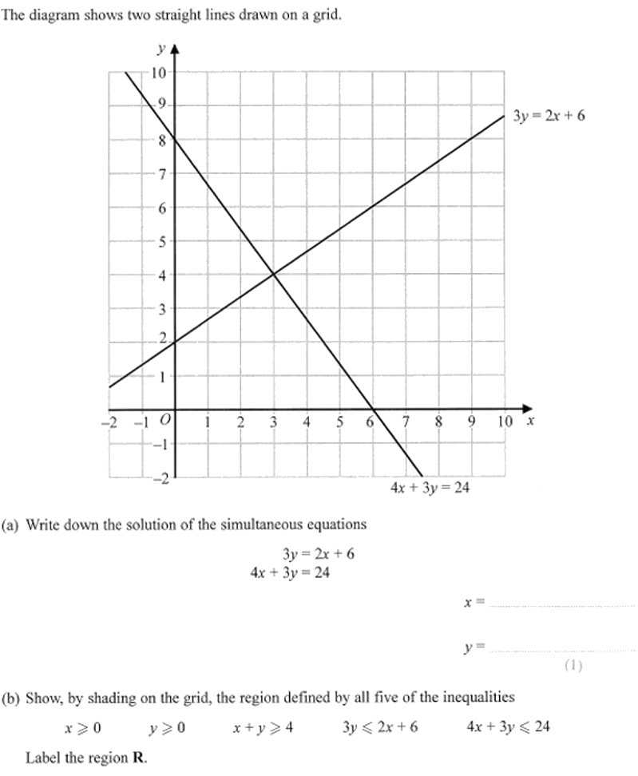
Zπ
PAST-PAPER QUESTION
Question 4

Slide 15
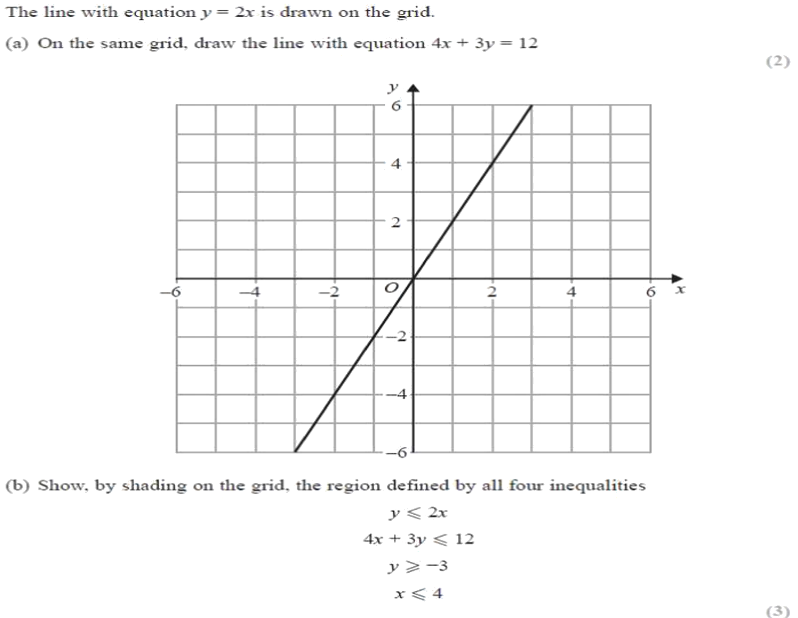
Zπ
PAST-PAPER QUESTION
Question 5

Slide 16
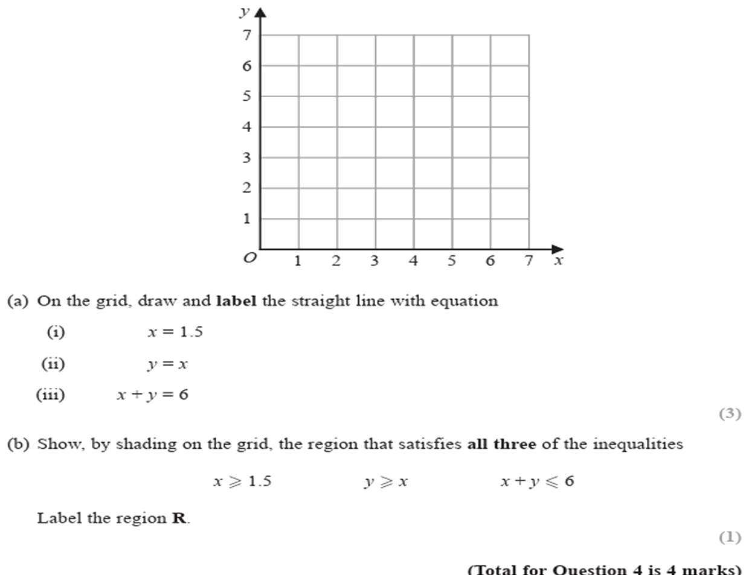
Zπ
PAST-PAPER QUESTION
Question 6

Slide 17
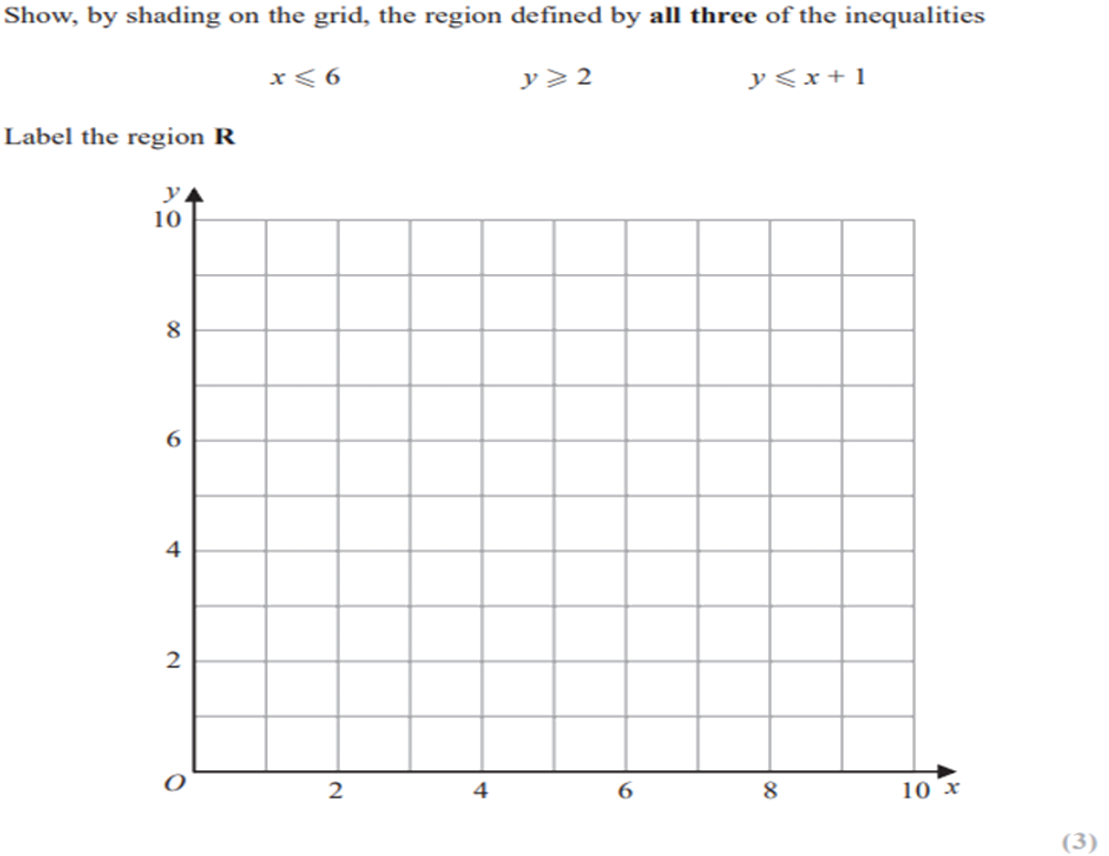
Zπ
PAST-PAPER QUESTION
Question 7

Slide 18
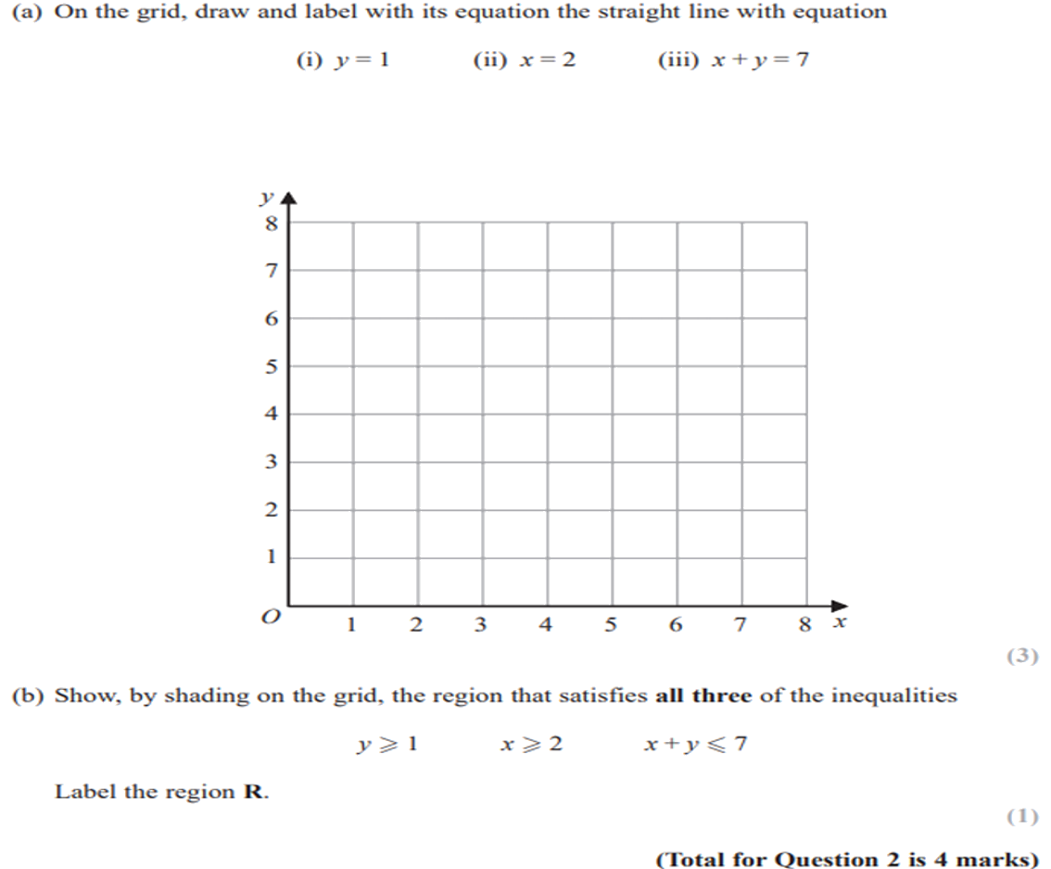
Zπ
PAST-PAPER QUESTION
Question 8

Slide 19
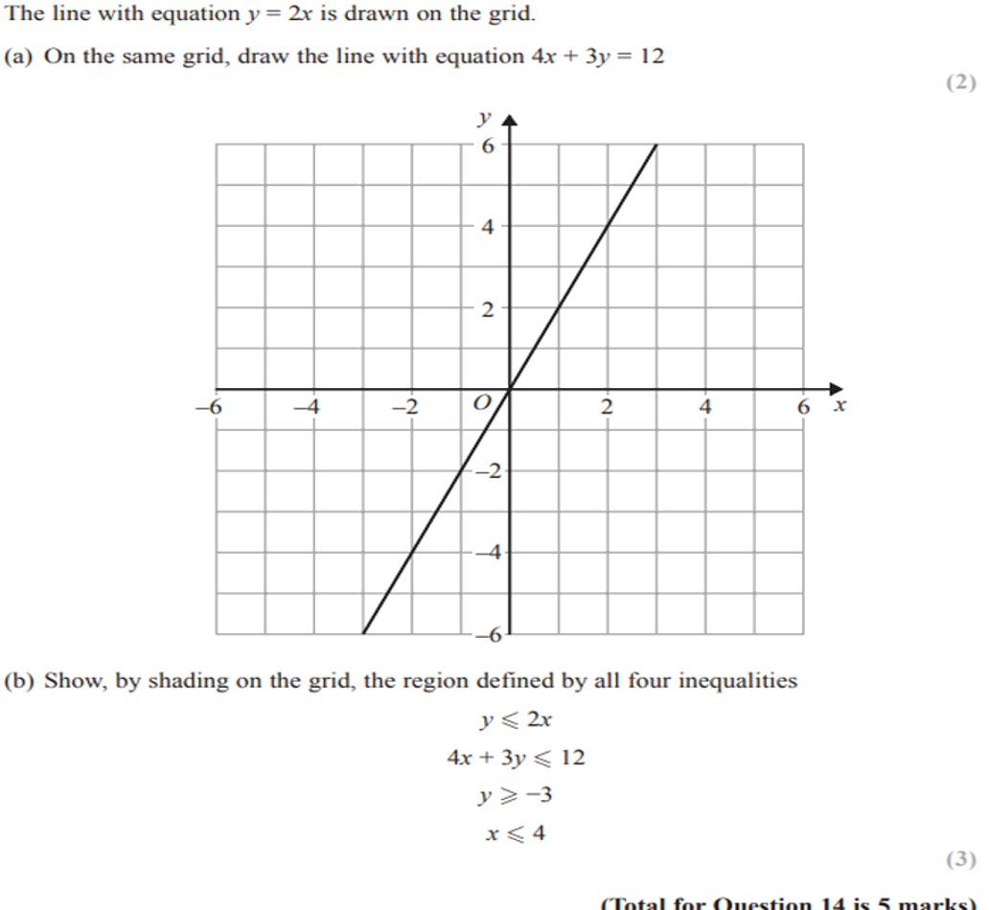
Zπ
PAST-PAPER QUESTION
Question 9

Slide 20
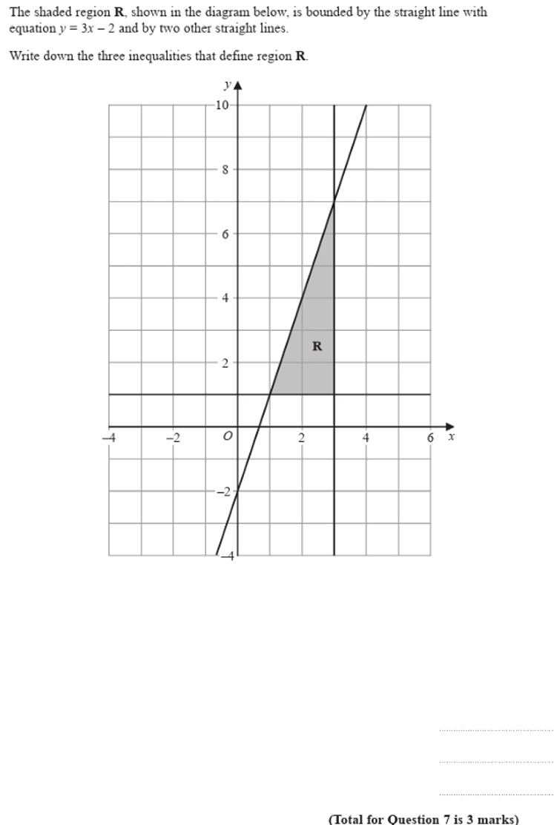
Zπ
PAST-PAPER QUESTION
Question 10

Slide 21
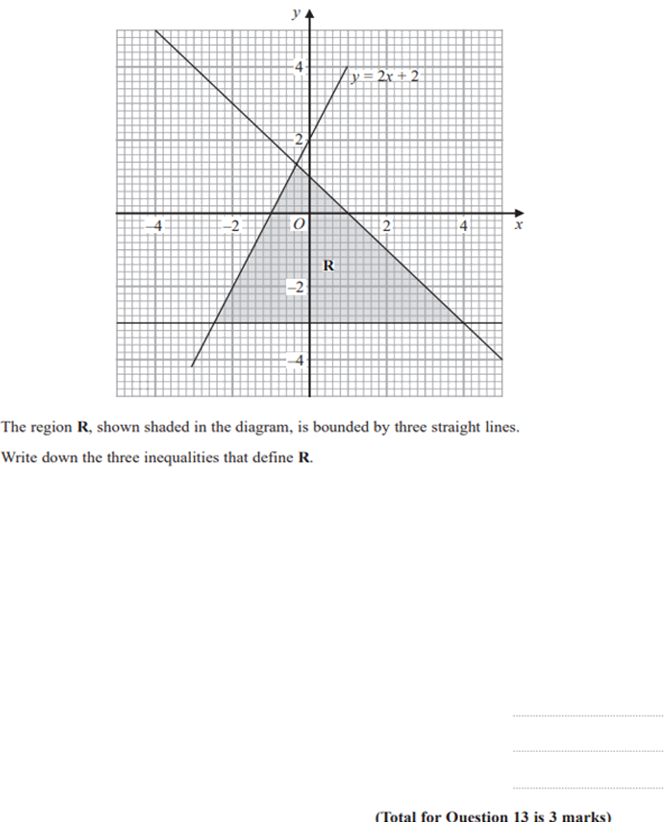
Zπ
PAST-PAPER QUESTION
Question 11

Slide 22
Zπ
RECAP
Key Takeaways
An inequality in two variables describes a REGION (half-plane), not just a line.
Draw the boundary line first: dashed for < >, solid for ≤ ≥.
Test a point (usually the origin): TRUE → shade that side, FALSE → shade the other.
Several inequalities: the answer is the overlap — shade out what you don’t want and label R.
To DESCRIBE a region: find each line’s equation, choose the sign from dashed/solid, then test a point.
Golden rule: boundary line → dashed or solid → test a point to decide which side to shade.

