Slide 1

Zπ
Zπ MATHS HUB
Pearson Edexcel IGCSE (9–1) · Higher Tier
10
n
Standard Form
Ordinary ↔ Standard Form · Add · Subtract · Multiply · Divide
Zahra Sheikh Ali
IGCSE Mathematics Teacher · M.Sc. Differential Geometry & Geometric Control
☎ 66613748 ✉ zahraa.sheikhali@outlook.com

Slide 2
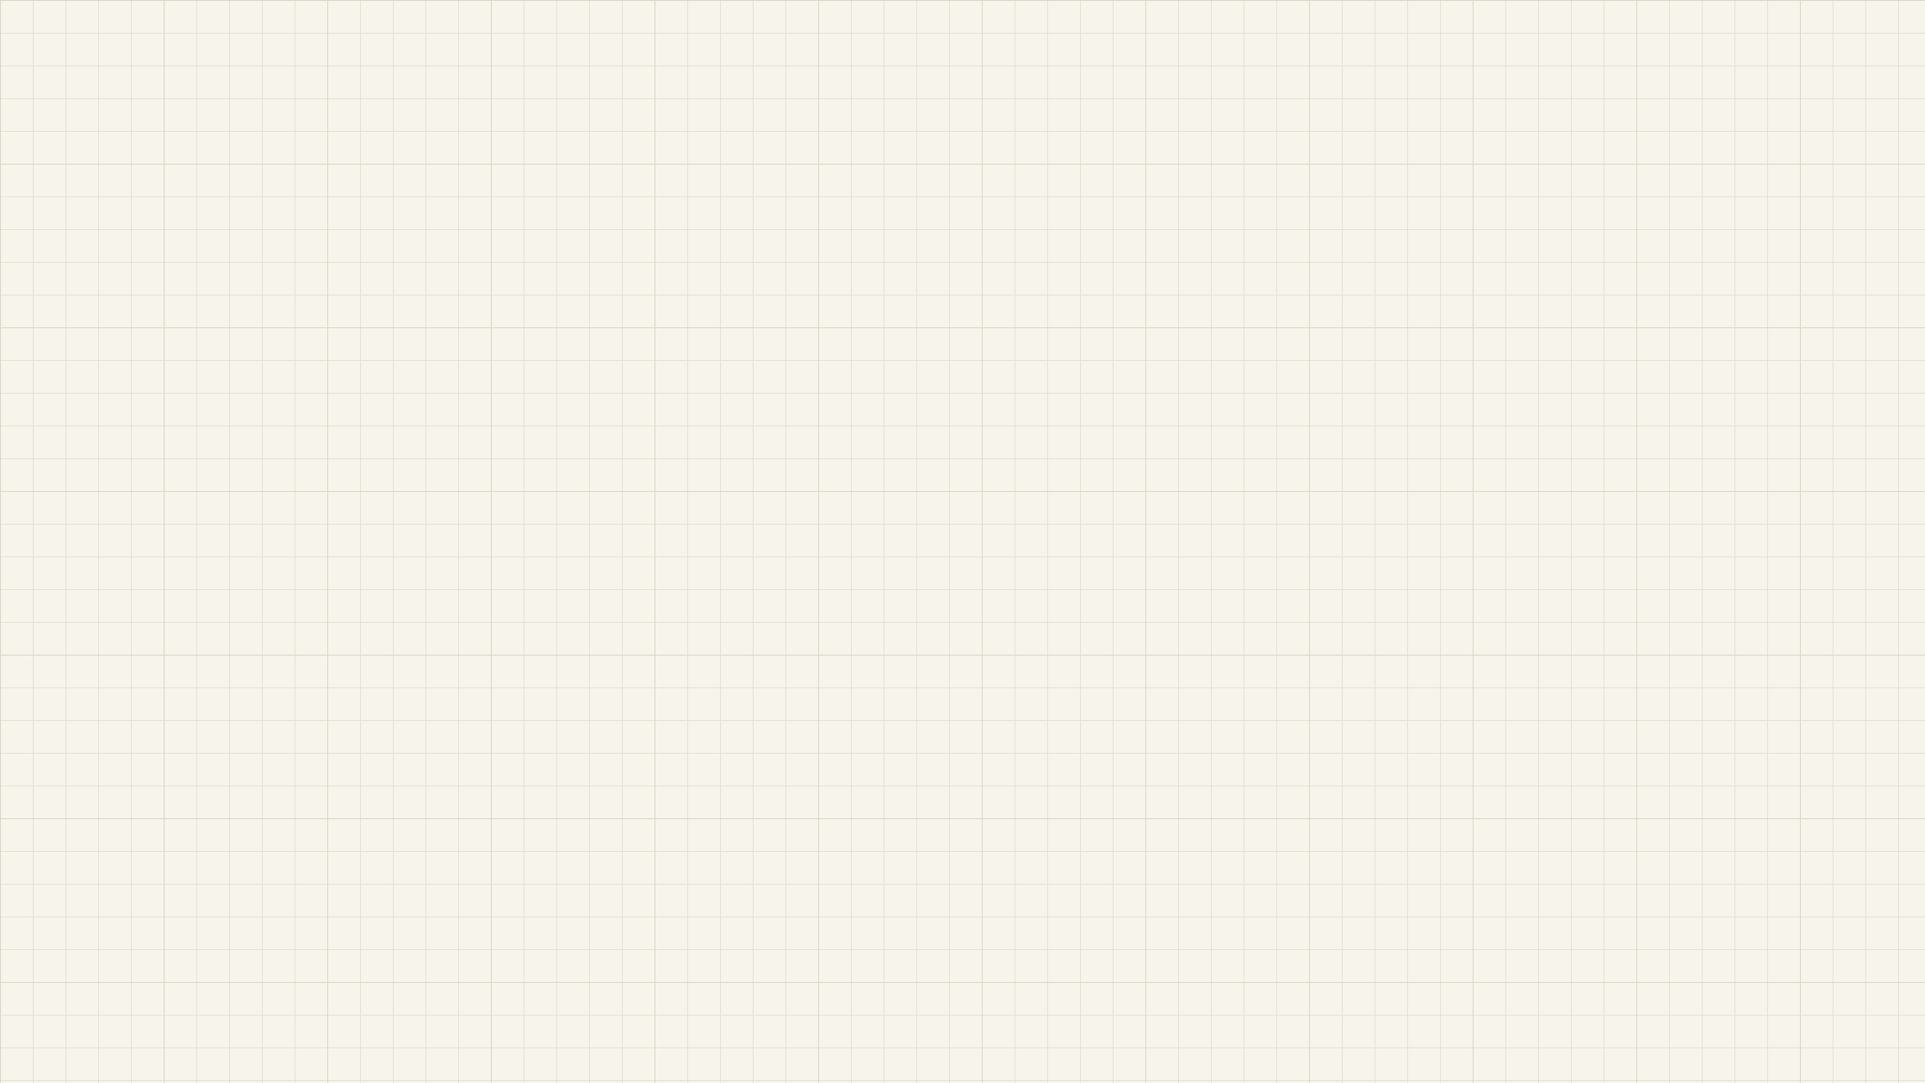
Zπ
THE BIG IDEA
What is Standard Form?
a × 10^{n}
a is between 1 and 10 (1 ≤ a < 10) n is any whole number (can be negative)
WHY USE IT?
1
Write very big or very small numbers concisely
2
Compare big and small numbers easily
234 000 000 000 000 = 2.34 × 10¹⁴
2.34 × 10¹⁴ > 2.34 × 10¹³

Slide 3
Zπ
QUICK CHECK
Standard Form — or Not?
✓ STANDARD FORM
✗ NOT STANDARD FORM
6 × 10³
680000 it isn't written as a × 10ⁿ
3.5 × 10^{–6}
45 × 10² 45 is not between 1 and 10
5.0 × 10⁷
4 × 10 × 10 not a single power of 10
–3.45 × 10⁸
0.0004 not written as a × 10ⁿ
–4.32 × 10^{–3}
3 × 4² the base is 4, not 10

Slide 4
Zπ
REAL NUMBERS
Very Big & Very Small
BIG — positive power
SMALL — negative power
Mass of the Earth ≈
Width of a shelled amoeba =
5 970 000 000 000 000 000 000 000 kg
0.000 13 m
= 5.97 × 10²⁴ kg
= 1.3 × 10^{–4} m
24 places from where the decimal sits.
Small number → the power is negative.

Slide 5
Zπ
CONVERTING · FROM STANDARD FORM
Standard Form → Ordinary Number
Positive power n: move the decimal point n places to the right (fill with zeros).
8 × 10⁷
5.273 × 10⁸
1
move the point 7 places right
1
move the point 8 places right
= 80 000 000
= 527 300 000

Slide 6
Zπ
CONVERTING · FROM STANDARD FORM
Negative Powers → Small Numbers
Negative power: move the decimal point that many places to the LEFT.
2.35 × 10^{–4} → 4 places left
4 × 10^{–3} → 3 places left
= 0.000235
= 0.004
NOW TRY — write as an ordinary number
3 × 10⁴
1.24 × 10⁵
6 × 10^{–3}
1.01 × 10^{–1}
1
2
3
4
Notes:
Answers — 1: 30 000. 2: 124 000. 3: 0.006. 4: 0.101.

Slide 7
Zπ
CONVERTING · TO STANDARD FORM
Ordinary Number → Standard Form
Put the decimal point after the first non-zero digit, then count how many places it moved — that's n.
Write 675 400 000 000 000 000 in standard form
1
First digits give the number between 1 and 10: 6.754
2
Count the places back to the decimal point: 17
= 6.754 × 10¹⁷
Big number → positive power.

Slide 8
Zπ
CONVERTING · TO STANDARD FORM
Small Numbers → Negative Powers
Write 0.000 000 000 000 004 26 in standard form
1
Number between 1 and 10: 4.26 · decimal moves 15 places right → power –15
= 4.26 × 10^{–15}
NOW TRY — write in standard form
20 000
0.0043
931 000 000
0.000001001
1
2
3
4
Tip: the first non-zero digit always sits just before the × sign.
Notes:
Answers — 1: 2×10⁴. 2: 4.3×10⁻³. 3: 9.31×10⁸. 4: 1.001×10⁻⁶.

Slide 9
Zπ
PAST PAPER
Converting — Exam Questions
STANDARD FORM
STANDARD FORM
ORDINARY
Write 1 300 000 in standard form
Write 0.005 in standard form
Write 8 × 10⁴ as an ordinary number
STANDARD FORM
STANDARD FORM
ORDINARY
Write 2 940 000 000 in standard form
Volume of the South China Sea is 9 880 000 km³ . Write 9 880 000 in standard form
Write 6.25 × 10^{–3} as an ordinary number
Notes:
Answers — 1 300 000 = 1.3×10⁶. 0.005 = 5×10⁻³. 8×10⁴ = 80 000. 2 940 000 000 = 2.94×10⁹. 9 880 000 = 9.88×10⁶. 6.25×10⁻³ = 0.00625.

Slide 10
Zπ
MULTIPLYING
Multiply in Standard Form
Multiply the number parts, add the powers (10^{m} × 10^{n} = 10^{m+n} ) — then fix to standard form.
Work out 2 × 10⁵ × 7.2 × 10³
1
Numbers: 2 × 7.2 = 14.4 Powers: 10⁵ × 10³ = 10⁸
2
= 14.4 × 10⁸ — not standard form (14.4 > 10)
3
14.4 = 1.44 × 10, so 14.4 × 10⁸ = 1.44 × 10⁹
= 1.44 × 10⁹

Slide 11
Zπ
MULTIPLYING
Worked Examples & Practice
(2 × 10³)(4 × 10⁴)
(7 × 10⁵)(6 × 10⁶)
= 8 × 10⁷
= 42 × 10¹¹ = 4.2 × 10¹²
NOW TRY — give each answer in standard form
(3 × 10⁴)(2 × 10⁵)
(5 × 10⁶)(7 × 10⁷)
(2.5 × 10⁵)²
1
2
3
Notes:
Now try — 1: 6×10⁹. 2: 35×10¹³ = 3.5×10¹⁴. 3: (2.5)²×10¹⁰ = 6.25×10¹⁰.

Slide 12
Zπ
DIVIDING
Divide in Standard Form
Divide the number parts, subtract the powers (10^{m} ÷ 10^{n} = 10^{m–n} ) — then fix to standard form.
Work out 1.2 × 10^{–6} ÷ 4.8 × 10⁷
1
Numbers: 1.2 ÷ 4.8 = 0.25 Powers: 10^{–6} ÷ 10⁷ = 10^{–13}
2
= 0.25 × 10^{–13} — not standard form (0.25 < 1)
3
0.25 = 2.5 × 10^{–1} , so = 2.5 × 10^{–14}
= 2.5 × 10^{–14}

Slide 13
Zπ
DIVIDING
Worked Examples & Practice
8 × 10⁷ ÷ 2 × 10³
3.6 × 10⁹ ÷ 9 × 10⁵
= 4 × 10⁴
= 0.4 × 10⁴ = 4 × 10³
NOW TRY — give each answer in standard form
4.5 × 10⁵ ÷ 9 × 10⁵
(6.4 × 10⁸) ÷ (1.6 × 10³)
9 × 10^{–2} ÷ 3 × 10⁴
1
2
3
Notes:
Now try — 1: 0.5×10⁰ = 5×10⁻¹. 2: 4×10⁵. 3: 3×10⁻⁶.

Slide 14
Zπ
PAST PAPER
Multiply & Divide — Exam Questions
STANDARD FORM
STANDARD FORM
Work out (3.5 × 10³) ÷ (7 × 10⁶)
Work out (2.4 × 10²) ÷ (9.6 × 10⁵)
STANDARD FORM
CHALLENGE
Work out
(9.6 × 10¹⁶ + 6.4 × 10¹⁶) ÷ (3.2 × 10¹⁰)
a = 25 × 10^{4n} , n is an integer.
Find an expression for a² in standard form.
Notes:
Answers — (3.5×10³)÷(7×10⁶) = 0.5×10⁻³ = 5×10⁻⁴. (2.4×10²)÷(9.6×10⁵) = 0.25×10⁻³ = 2.5×10⁻⁴. (9.6+6.4)×10¹⁶ ÷ 3.2×10¹⁰ = 16×10¹⁶ ÷ 3.2×10¹⁰ = 5×10⁶. a² = 625×10⁸ⁿ = 6.25×10^(8n+2).

Slide 15
Zπ
ADDING & SUBTRACTING
You Need the Same Power of 10
Make the powers equal (or convert to ordinary numbers), then add / subtract — and fix to standard form.
Work out 2 × 10⁴ + 3 × 10⁵
1
Match the powers: 2 × 10⁴ = 0.2 × 10⁵
2
0.2 × 10⁵ + 3 × 10⁵ = 3.2 × 10⁵
= 3.2 × 10⁵
Or convert both to ordinary numbers (20 000 + 300 000 = 320 000), then back to standard form.

Slide 16
Zπ
ADDING & SUBTRACTING
Worked Examples & Practice
(1.1 × 10⁵) + (2 × 10⁴)
(5 × 10⁷) + (2 × 10⁵)
(3.2 × 10^{–4}) – (5 × 10^{–5})
= 1.3 × 10⁵
= 5.02 × 10⁷
= 2.7 × 10⁻⁴
NOW TRY — give each answer in standard form
(1.1 × 10⁵) – (2 × 10⁴)
(9 × 10¹⁰) + (2 × 10¹²)
(6.2 × 10^{–2}) + (3 × 10^{–3})
1
2
3
Notes:
Examples — 1.1×10⁵+2×10⁴=1.3×10⁵; 5×10⁷+2×10⁵=5.02×10⁷; 3.2×10⁻⁴–5×10⁻⁵=2.7×10⁻⁴. Now try — 1: 9×10⁴. 2: 2.09×10¹². 3: 6.5×10⁻².

Slide 17
Zπ
PAST PAPER
Real Data — Mixed Exam Questions
City populations (2018, 3 s.f.)
Ocean volumes (km³)
Ahmedabad
7.70 × 10⁶
Two oceans hold 9.6 × 10¹⁶ and 6.4 × 10¹⁶ km³ .
Barcelona
5.50 × 10⁶
Chicago
8.60 × 10⁶
(a) Write 7.18 × 10⁷ as an ordinary number. (b) Work out the total volume of the two oceans, giving your answer in standard form.
Lagos
1.50 × 10⁷
Tokyo
3.70 × 10⁷
(a) Write 8.60 × 10⁶ as an ordinary number. (b) Which city had the least population? (c) Work out Tokyo − Ahmedabad, in standard form.
Notes:
Cities — (a) 8.60×10⁶ = 8 600 000. (b) Barcelona (5.50×10⁶). (c) 3.70×10⁷ − 7.70×10⁶ = 2.93×10⁷. Ocean — (a) 7.18×10⁷ = 71 800 000. (b) 9.6×10¹⁶ + 6.4×10¹⁶ = 1.6×10¹⁷ km³.

Slide 18
Zπ
Zπ MATHS HUB
Recap & Resources
Standard form
From standard form
a × 10ⁿ, with 1 ≤ a < 10
move the point n places (right if +, left if –)
To standard form
10
Multiply / divide
n
count the moves back to 1–10
× or ÷ numbers, add or subtract powers
Add / subtract
Always finish
match the powers first, then ±
check 1 ≤ a < 10 — fix if not
Practice: wordwall.net — standard form match-up ✉ zahraa.sheikhali@outlook.com · ☎ 66613748
Ms. Zahra Sheikh Ali · Pearson Edexcel IGCSE (9–1) Mathematics A · Higher Tier

