Slide 1
Zπ
Zπ MATHS HUB
Pearson Edexcel IGCSE (9–1) · Higher Tier
× 1.2
× 0.85
Percentages
% of an Amount · Increase & Decrease · The Multiplier · Percentage Change · Profit & Loss · Reverse
Zahra Sheikh Ali
IGCSE Mathematics Teacher · M.Sc. Differential Geometry & Geometric Control
☎ 66613748 ✉ zahraa.sheikhali@outlook.com

Slide 2
Zπ
LESSON OVERVIEW
Everything Runs on the Multiplier
One idea ties it all together: the multiplier. Turn a percentage into a decimal, then multiply. It handles ‘% of’, increase, decrease, change, profit, loss, and even working backwards.
Finding a % of an amount
Increase & decrease
The multiplier method
1
2
3
Percentage change
Profit & loss
Reverse percentages
4
5
6
Key words: increase · decrease · multiplier · discount · VAT · profit · loss · original amount

Slide 3
Zπ
STARTER
Increase or Decrease?
Spot the key words. Which of these mean the amount goes UP, and which mean it goes DOWN?
INCREASE (goes up)
DECREASE (goes down)
“15% pay increase”
“20% off all marked prices!”
“Fares set to rise by 30%”
“House prices to fall by 2%”
“25% extra free!”
“SALE — now only £568”
“Plus 17½% VAT”
“30% discount today”
VAT, pay rises and ‘extra free’ add on; sales, discounts and ‘off’ take away.

Slide 4
Zπ
PART 1 · % OF AN AMOUNT
Finding a Percentage of an Amount
1
Find 20% of £150
Two ways
Multiplier: turn the % into a decimal, then multiply.
Non-calculator: find 10% (÷ 10), then scale up.
20% is just double 10%.
2
Multiplier: 20% = 20 ÷ 100 = 0.2
3
0.2 × £150 = £30
4
Non-calc check: 10% = £15, so 20% = £30
20% of £150 = £30
The multiplier for ‘% of’ is 0.__ — the percentage written as a decimal.

Slide 5
Zπ
THE KEY IDEA
The Multiplier
Every percentage question is a multiplication. Decide the multiplier first, then multiply the amount by it.
To …
Multiply by
Example
find a % of an amount
0.__ (% ÷ 100)
20% → × 0.20
increase by a %
1.__ (100 + %)
+20% → × 1.20
decrease by a %
0.__ (100 − %)
−30% → × 0.70
Increase adds onto 100%; decrease takes away from 100%.

Slide 6
Zπ
PART 2 · INCREASE
Increasing by a Percentage
1
Frank’s house (£150,000) rises by 20%.
Why 1.2?
The original is 100% of itself.
Adding 20% gives 120% = 1.2.
One multiplication does it in a single step.
2
100% + 20% = 120%
3
Multiplier = 1.2
4
1.2 × £150,000 = £180,000
New value = £180,000
Increase by p% → multiply by (1 + p/100).

Slide 7
Zπ
PART 2 · DECREASE
Decreasing by a Percentage
1
A £75 CD player is reduced by 30% in a sale.
Why 0.7?
The original is 100%.
Taking 30% away leaves 70% = 0.7.
No need to find 30% then subtract — one step.
2
100% − 30% = 70%
3
Multiplier = 0.7
4
0.7 × £75 = £52.50
Sale price = £52.50
Decrease by p% → multiply by (1 − p/100).

Slide 8
Zπ
YOUR TURN · PRACTICE
Increase & Decrease
Choose the multiplier, then multiply. Watch the units.
1
Increase QAR50 by 15%
= 57.50
6
Decrease QAR1700 by 13%
= 1479
2
Decrease QAR50 by 15%
= 42.50
7
Increase QAR240 by 45%
= 348
3
Increase 160 m by 25%
= 200 m
8
Decrease 240 m by 36%
= 153.6 m
4
Decrease 360° by 10%
= 324°
9
Increase 150 g by 12%
= 168 g
5
Increase 60 kg by 5%
= 63 kg
10
Decrease QAR300 by 43%
= 171
Answers shown — cover the right column and work each one out first.

Slide 9
Zπ
IN CONTEXT
Sales, Discounts & VAT
Discount: 10% off QAR400
Add 20% VAT to QAR320
Multiplier = 0.90
0.9 × 400 = QAR360 (or 400 − 40)
Multiplier = 1.20
1.2 × 320 = QAR384 (or 320 + 64)
Now try (10% off): iPad QAR350, Nissan QAR15000, Mini QAR13000. (50% off): Holiday QAR3640, Kindle QAR69.
Answers:
iPad → QAR315 Nissan → QAR13,500 Mini → QAR11,700 Holiday → QAR1,820 Kindle → QAR34.50
Extension: reduce each by 20%, then add 20% VAT — do the two multipliers 0.8 then 1.2.

Slide 10
Zπ
PART 3
Percentage Change, Profit & Loss
When you are GIVEN the old and new amounts and must find the percentage.
1
Find the actual change (new − old)
2
Divide by the ORIGINAL amount
3
Multiply by 100
4
Profit / loss uses the same steps

Slide 11
Zπ
PERCENTAGE CHANGE
Finding the Percentage Change
1
A printer’s price rises from £80 to £100.
The rule
Always divide by the ORIGINAL (the starting amount).
× 100 turns the fraction into a percentage.
Increase → rise; decrease → fall.
2
Change = 100 − 80 = £20
3
% change = (change ÷ original) × 100
4
= (20 ÷ 80) × 100 = 25%
25% increase
Dividing by the original (not the new) amount is the most common exam slip.

Slide 12
Zπ
YOUR TURN · PERCENTAGE CHANGE
Find the Percentage Change
Change ÷ original × 100. Give decimals to 1 d.p. where needed.
Temperature rises 20°C → 30°C. Find the % increase.
50% increase
1
A car falls from £3950 to £3300. Find the % decrease.
16.5% decrease
2
A house rises from £250,000 to £280,000. % increase?
12% increase
3
A coat drops from £60 to £45. Find the % decrease.
25% decrease
4

Slide 13
Zπ
PROFIT & LOSS
Same Idea, Different Words
% profit or loss = (actual profit or loss ÷ original cost) × 100. The ‘original’ is the buying (cost) price.
Profit — an antique chair
Loss — a used guitar
Buy £250, sell £300
Profit = 300 − 250 = £50
% profit = (50 ÷ 250) × 100
= 20% profit
Buy £140, sell £100
Loss = 140 − 100 = £40
% loss = (40 ÷ 140) × 100
= 28.6% loss (1 d.p.)
Try: the Robinsons buy a house for £180,000 and sell for £230,000 — find the % profit. (Answer: 27.8%)

Slide 14
Zπ
PART 4
Reverse Percentages
You are given the NEW amount and must find the ORIGINAL — work backwards.
1
Write ORIGINAL × multiplier = NEW
2
Rearrange: ORIGINAL = NEW ÷ multiplier
3
Use the SAME multiplier as a forward change
4
Never just take the % off the new amount

Slide 15
Zπ
REVERSE PERCENTAGES
Finding the Original Amount
The forward rule is ORIGINAL × multiplier = NEW. So to go back, DIVIDE by the multiplier.
ORIGINAL = NEW ÷ multiplier
After a 20% increase
After a 30% decrease
multiplier = 1.20
original = new ÷ 1.2
multiplier = 0.70
original = new ÷ 0.7

Slide 16
Zπ
REVERSE · WORKED
Working Backwards
1
A camcorder’s price rose 10%. It now costs £600.
Common trap
Do NOT take 10% off £600 — that gives the wrong answer.
£600 is 110% of the original, not 100%.
Divide by 1.1 to undo the increase.
2
Increase 10% → multiplier = 1.1
3
ORIGINAL = NEW ÷ multiplier = 600 ÷ 1.1
4
= £545.45 (nearest penny)
Original price = £545.45
Also: a sideboard is £540 after a 23% rise → 540 ÷ 1.23 = £439.02.

Slide 17
Zπ
FROM THE EXAM
Past-Paper Questions
Original past-paper questions — apply the multiplier method to each; watch for reverse ones.
1
Read carefully: increase, decrease or reverse?
2
Choose the correct multiplier
3
For ‘original amount’ → divide
4
Show clear working

Slide 18
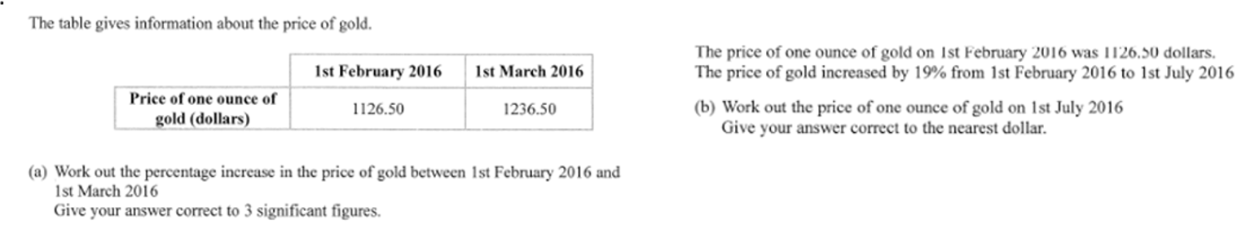
Zπ
PAST-PAPER QUESTION
Question 1

Slide 19
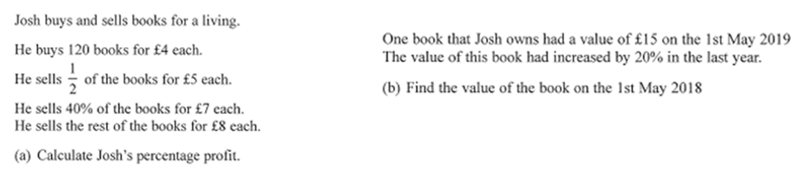
Zπ
PAST-PAPER QUESTION
Question 2

Slide 20
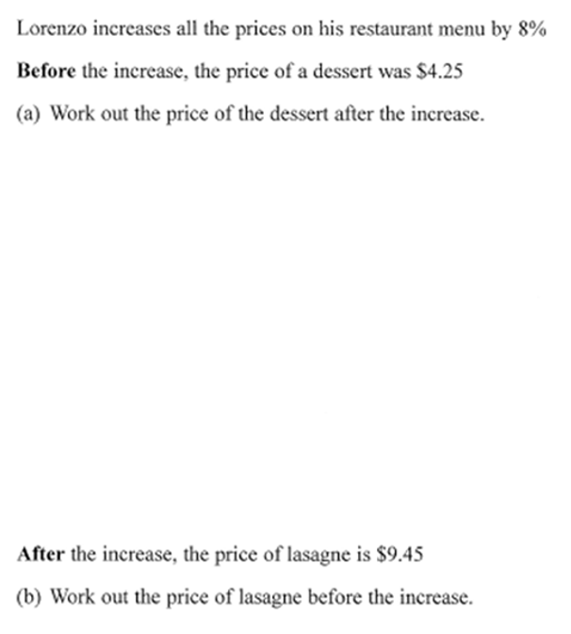
Zπ
PAST-PAPER QUESTION
Question 3

Slide 21
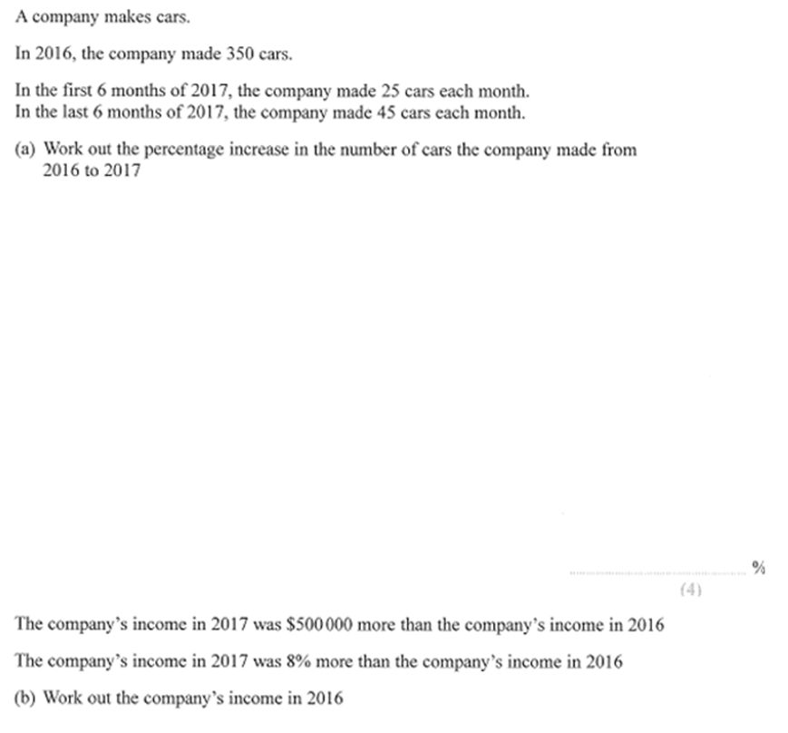
Zπ
PAST-PAPER QUESTION
Question 4

Slide 22
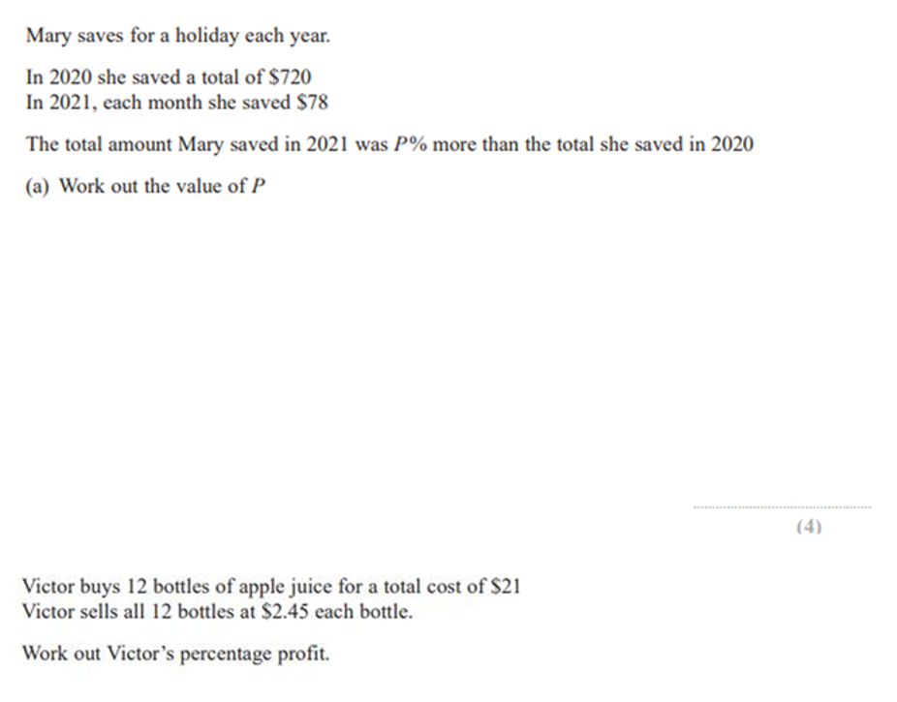
Zπ
PAST-PAPER QUESTION
Question 5

Slide 23
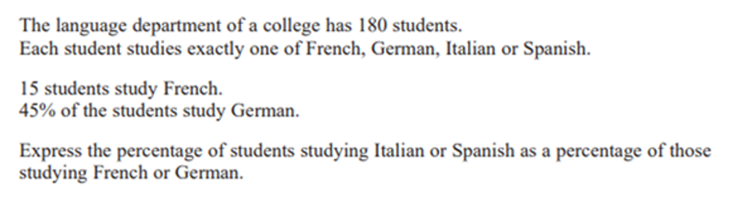
Zπ
PAST-PAPER QUESTION
Question 6

Slide 24
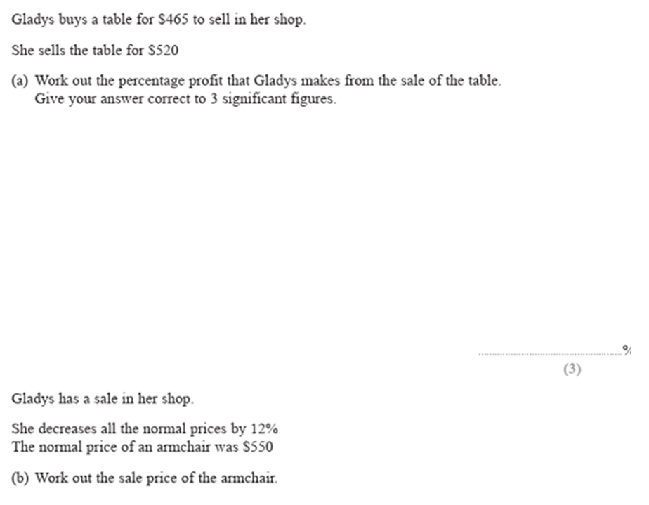
Zπ
PAST-PAPER QUESTION
Question 7

Slide 25
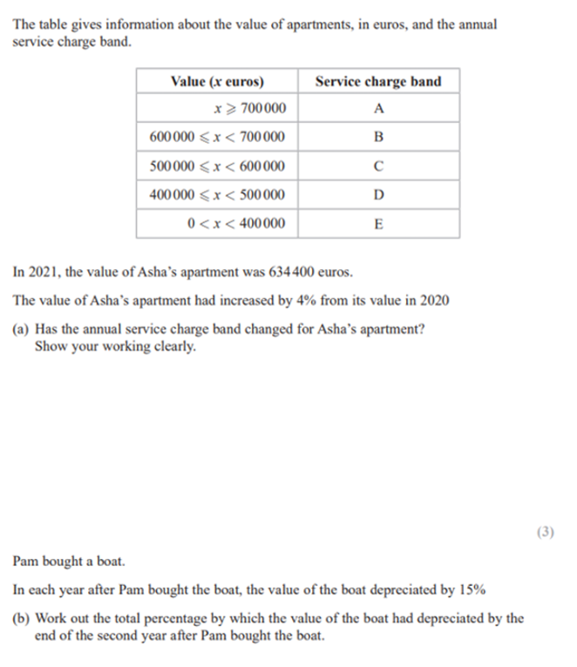
Zπ
PAST-PAPER QUESTION
Question 8

Slide 26
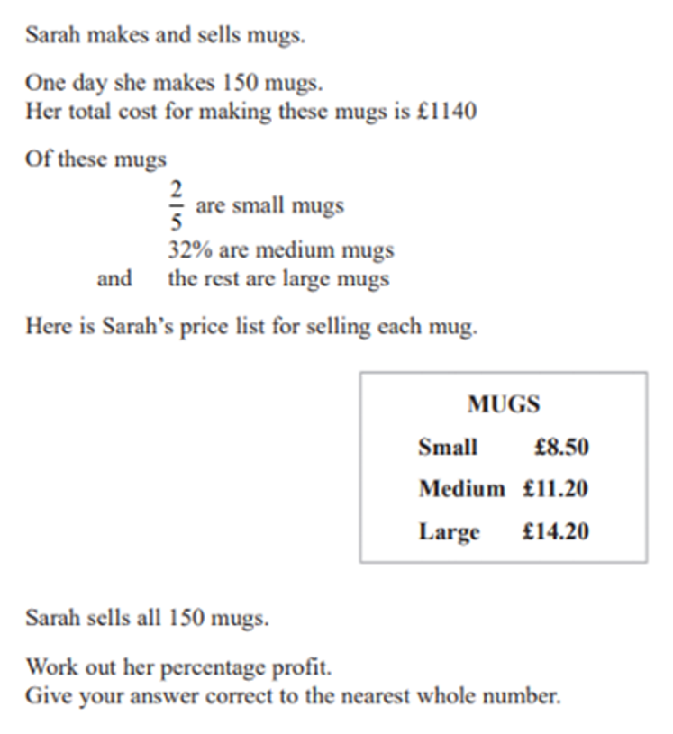
Zπ
PAST-PAPER QUESTION
Question 9

Slide 27
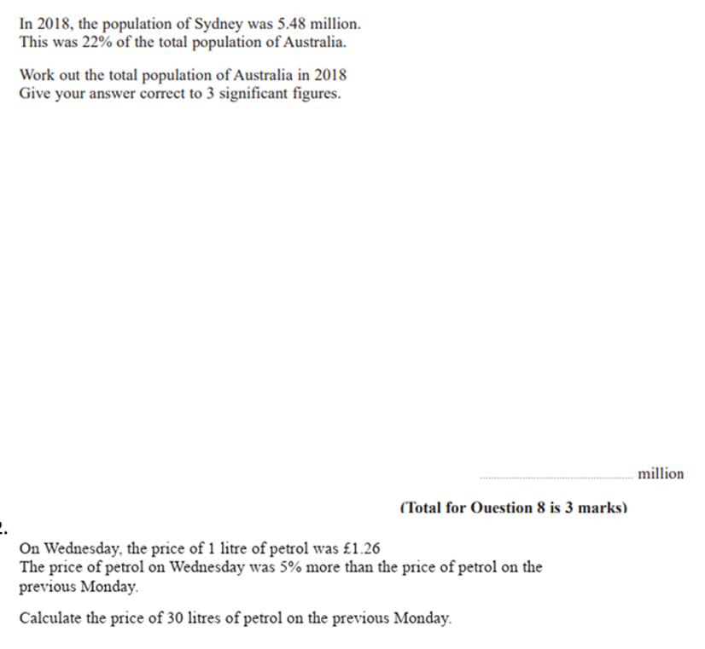
Zπ
PAST-PAPER QUESTION
Question 10

Slide 28
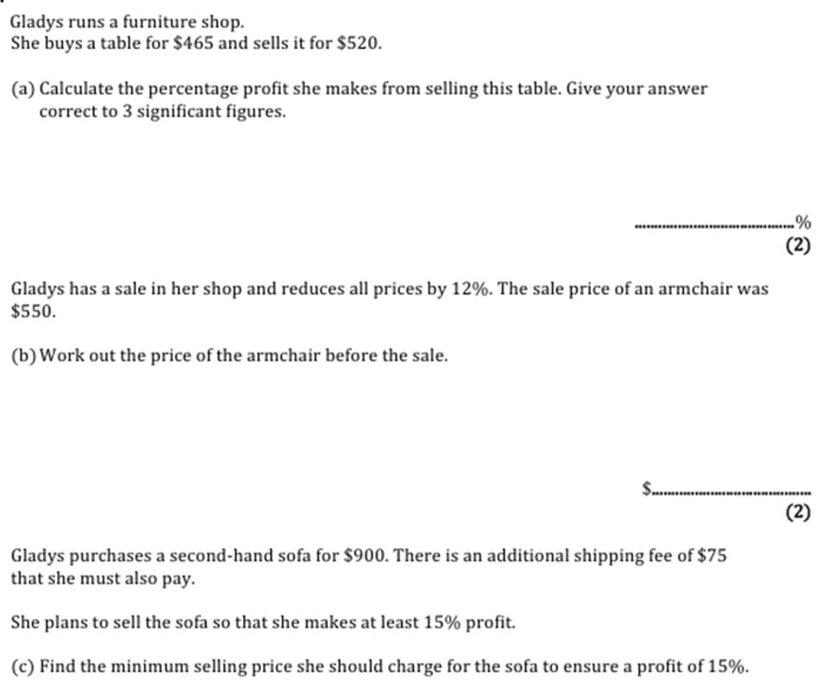
Zπ
PAST-PAPER QUESTION
Question 11

Slide 29
Zπ
RECAP
Key Takeaways
Turn the percentage into a MULTIPLIER, then multiply — one step.
% of an amount → ×0.__ ; increase → ×1.__ ; decrease → ×0.__ .
Percentage change = (change ÷ ORIGINAL) × 100.
Profit / loss % uses the buying price as the original.
Reverse: ORIGINAL = NEW ÷ multiplier — never just take the % off.
Golden rule: decide the multiplier first — it drives every percentage question.

