Slide 1
Zπ
Zπ MATHS HUB
Pearson Edexcel IGCSE (9–1) · Higher Tier
ⁿ
× 1.05
Simple & Compound Interest
Simple Interest · Compound Growth · The Multiplier over n Years · Repeated % Change · Reverse
Zahra Sheikh Ali
IGCSE Mathematics Teacher · M.Sc. Differential Geometry & Geometric Control
☎ 66613748 ✉ zahraa.sheikhali@outlook.com

Slide 2
Zπ
LESSON OVERVIEW
Interest Grows by Multiplying
Simple interest is the same each year; compound interest grows on the growing total. Both live on the multiplier — and repeated changes multiply, they do NOT add.
Simple interest (PRT/100)
Compound interest
Growth over n years
1
2
3
Repeated % change
+20% then −30% ≠ −10%
Past-paper questions
4
5
6
Key words: principal · rate · per annum · multiplier · depreciate · compound · repeated change

Slide 3
Zπ
PART 1 · SIMPLE INTEREST
Interest on the Original Amount
1
Simple interest is paid on the ORIGINAL amount only.
The formula
P = principal (amount invested).
R = rate as a percentage; T = time in years.
The interest is the SAME every year — it never grows.
2
Formula: I = (P × R × T) ÷ 100
3
£600 for 2 years at 4%: I = (600×4×2) ÷ 100
4
= £48
Interest earned = £48
Months → years first (e.g. 30 months = 2.5 years) before using the formula.

Slide 4
Zπ
YOUR TURN · SIMPLE INTEREST
Find the Simple Interest
Use I = PRT ÷ 100. Change months to years first. (nearest £)
1
£500, 3 yr, 6%
£90
4
£2400, 3½ yr, 4¾%
£400
2
£1500, 2½ yr, 4½%
£169
5
£2500, 42 mo, 3¼%
£284
3
£7500, 4½ yr, 5¼%
£1772
6
£6500, 15 mo, 5¾%
£470
Cover the answers first. Remember 42 months = 3.5 years, 15 months = 1.25 years.

Slide 5
Zπ
PART 2
Compound Interest
Interest is added to the total each year, so the next year earns interest too.
1
Write the rate as an increase multiplier (×1.__)
2
Raise it to the power of the number of years
3
Amount = P × (multiplier)ⁿ
4
Interest = final amount − principal

Slide 6
Zπ
COMPOUND INTEREST
Interest on the Growing Total
Each year the interest is added on, then the NEW total earns interest. So we multiply by the same multiplier once for every year.
Amount = Principal × (multiplier)^{number of years}
5% per year
Simple vs Compound
multiplier = 1.05
3 years → × 1.05 × 1.05 × 1.05 = ×1.05³
Simple: same interest each year.
Compound: each year earns a little more — it grows faster.

Slide 7
Zπ
COMPOUND · WORKED
Growth over Several Years
1
£500 at 5% per year for 2 years.
Key idea
One multiplier, raised to the number of years.
Interest earned = final amount − £500.
No need to work year by year — the power does it.
2
Multiplier = 1.05
3
500 × 1.05² = £551.25
4
Over 10 years: 500 × 1.05¹⁰ = £814.45
After 2 years = £551.25
£2000 at 12% for 3 years: 2000 × 1.12³ = £2809.86.

Slide 8
Zπ
YOUR TURN · COMPOUND INTEREST
Find the Final Amount
Amount = P × (multiplier)ⁿ. Give money to the nearest penny.
1
£240, 10%, 2 yr
£290.40
4
£7000, 15%, 3 yr
£10646.13
2
£800, 4%, 2 yr
£865.28
5
£8000, 7%, 6 yr
£12006
3
£15000, 8½%, 2 yr
£17658.38
6
Interest earned in Q5
£4006
Q6: interest = final amount − principal = 12006 − 8000.

Slide 9
Zπ
PART 3
Repeated Percentage Change
When changes follow one another, MULTIPLY the multipliers — never add the percentages.
1
Write each change as a multiplier
2
Multiply them together
3
An increase then a decrease is NOT their difference
4
Read the combined multiplier to get the overall change

Slide 10
Zπ
THE KEY IDEA
+20% then −30% is NOT −10%
1
Increase 20% → ×1.2; decrease 30% → ×0.7
Why not −10%?
The 30% decrease acts on the LARGER amount, not the original.
Adding ‘+20% −30%’ ignores that — wrong.
Always multiply the multipliers: 1.2 × 0.7 = 0.84.
2
Combined: 1.2 × 0.7 = 0.84
3
×0.84 means 84% of the original left
4
So the overall change is a 16% DECREASE (not 10%)
1.2 × 0.7 = 0.84 → 16% decrease
Check with £500: 500 × 1.2 = 600, then 600 × 0.7 = £420 = 84% of £500.

Slide 11
Zπ
REPEATED · SOURCE EXAMPLE
A Jacket: −20% then a Further −10%
1
A jacket is reduced 20%, then a further 10%.
Not 30%!
Two discounts do not simply add.
0.8 × 0.9 = 0.72, so 28% off in total.
The second discount is taken off the already-reduced price.
2
20% off → ×0.8; 10% off → ×0.9
3
Combined: 0.8 × 0.9 = 0.72
4
0.72 = 72% of the original → 28% discount
Total discount = 28% (not 30%)
The sale price is 72% of the original price.

Slide 12
Zπ
REVERSE · FIND THE UNKNOWN
Increase 20%, Decrease 30%, then Decrease x%
1
£500 → +20% → −30% → −x% = £252. Find x.
Method
Apply the known multipliers first (1.2 then 0.7).
Divide the final amount by the running total to get the last multiplier.
0.6 = a 40% decrease, so x = 40.
2
500 × 1.2 × 0.7 = 420
3
420 × (1 − x/100) = 252 → 1 − x/100 = 252 ÷ 420 = 0.6
4
1 − x/100 = 0.6 → x = 40
x = 40%
The last multiplier is new ÷ running total — then turn it back into a percentage.

Slide 13
Zπ
YOUR TURN · REPEATED CHANGE
Multiply the Multipliers
Write each change as a multiplier, multiply, then read the result.
1
+10% then −10%. Overall?
1% decrease
4
£300 → +20% → −x% = £288
x = 20
2
£800: +25% then −20%
£800 (no change)
5
−20% then −25%. Total discount?
40% discount
3
£12000 car, −15% for 2 yr
£8670
6
+50% then −x% back to start
x = 33.3%
Q6: 1.5 × (1−x/100) = 1 → 1−x/100 = 0.667 → x ≈ 33.3%.

Slide 14
Zπ
PART 4
Past-Paper Questions
Original past-paper questions on interest and repeated change — use the multiplier method.
1
Simple or compound? Read carefully
2
Write the multiplier(s)
3
Raise to a power for several years
4
Show clear working

Slide 15
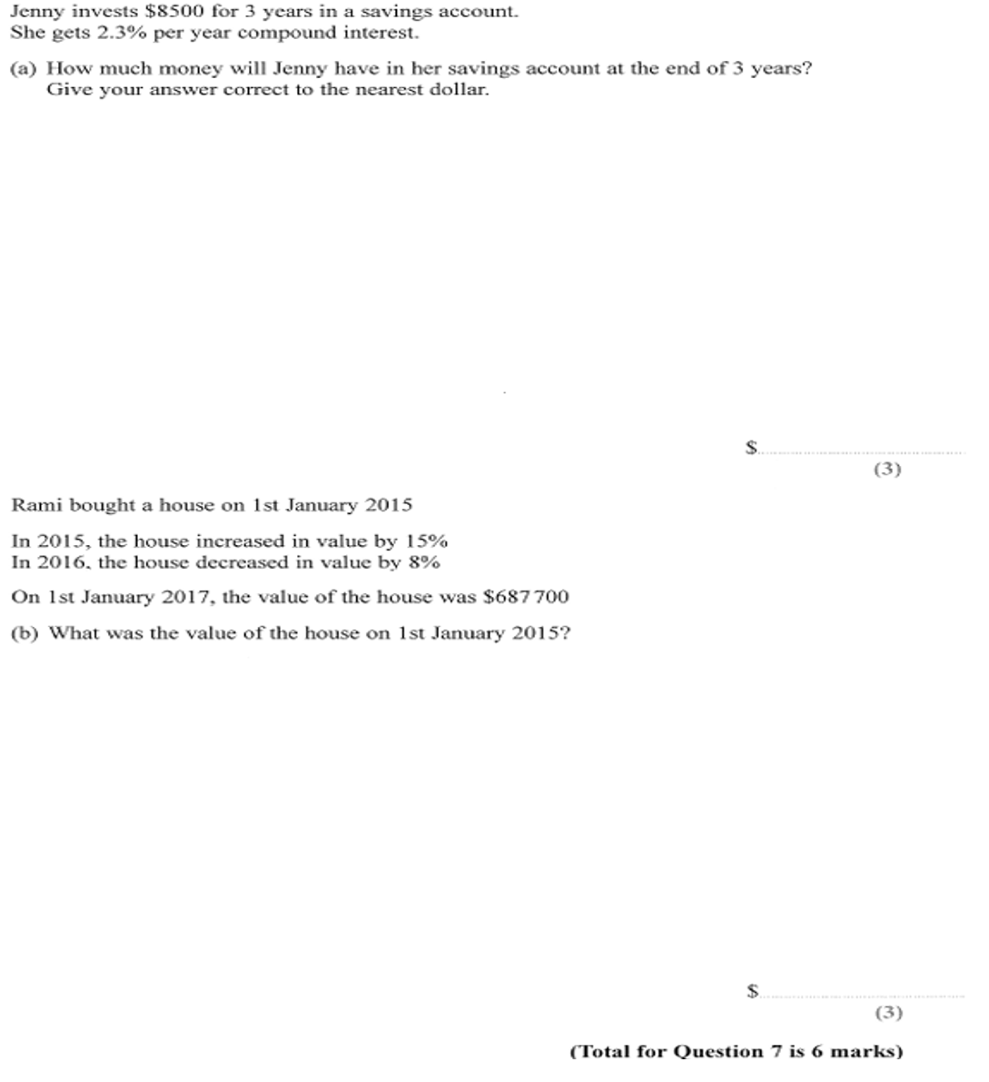
Zπ
PAST-PAPER QUESTION
Question 1

Slide 16
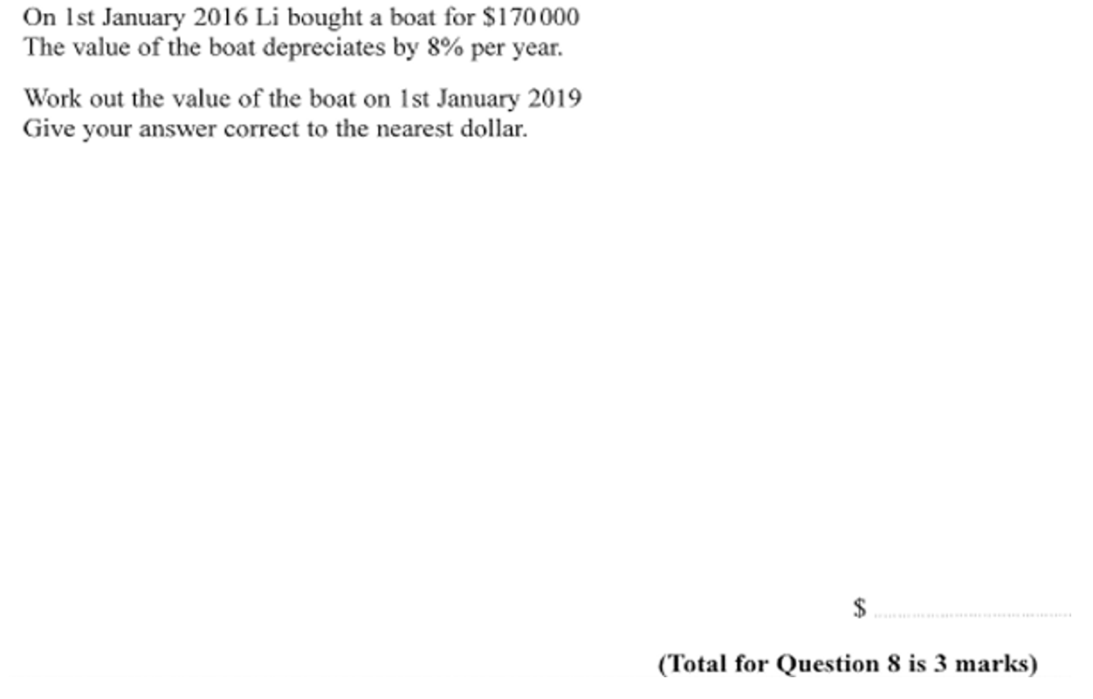
Zπ
PAST-PAPER QUESTION
Question 2

Slide 17
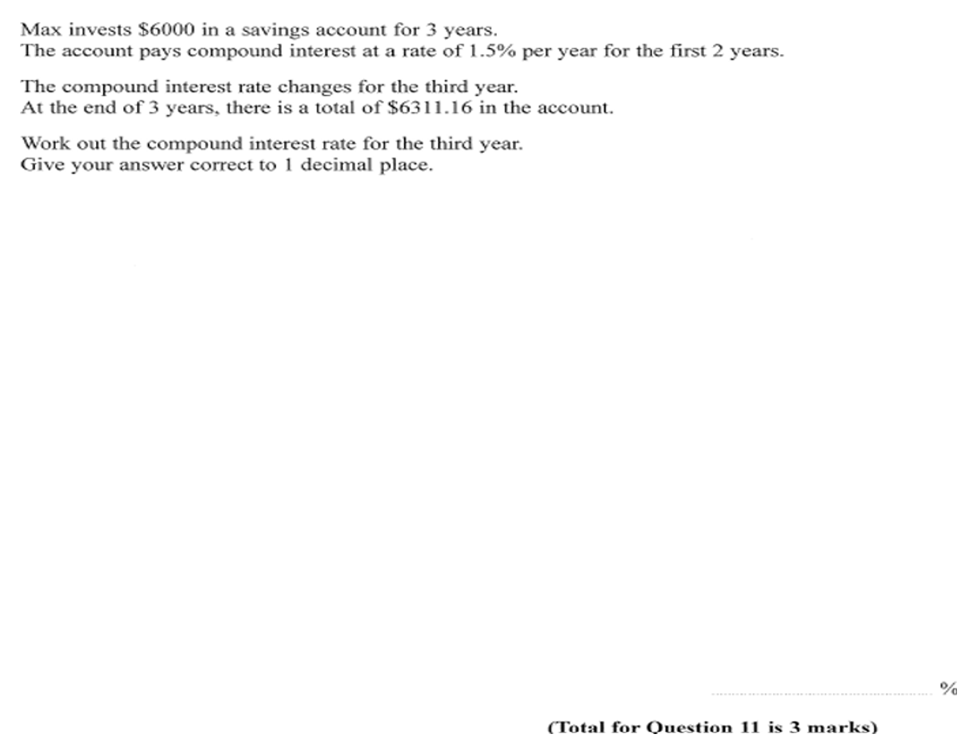
Zπ
PAST-PAPER QUESTION
Question 3

Slide 18
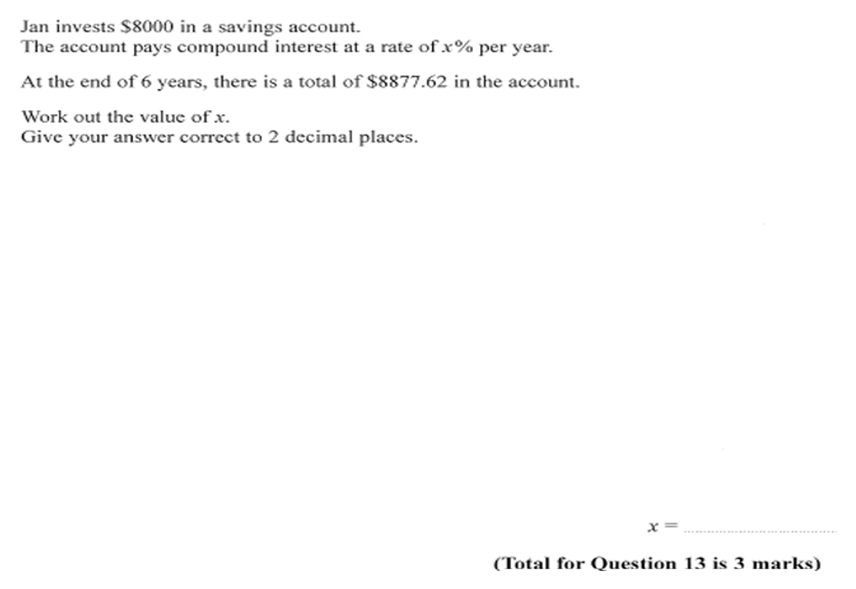
Zπ
PAST-PAPER QUESTION
Question 4

Slide 19
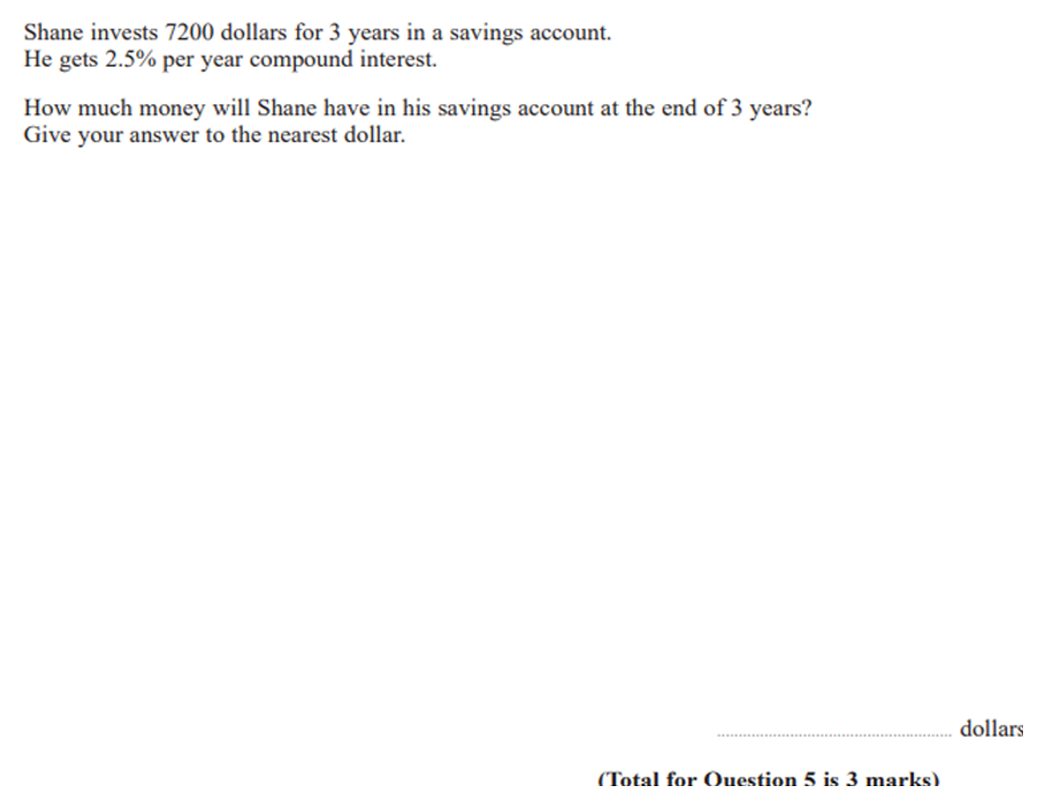
Zπ
PAST-PAPER QUESTION
Question 5

Slide 20
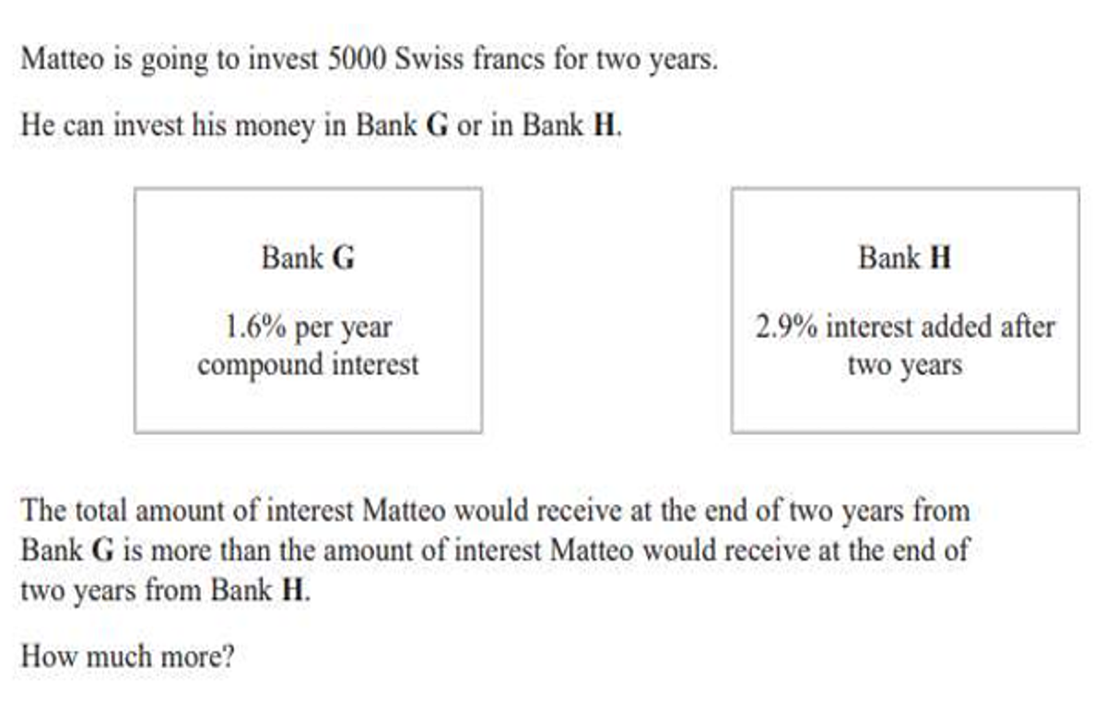
Zπ
PAST-PAPER QUESTION
Question 6

Slide 21
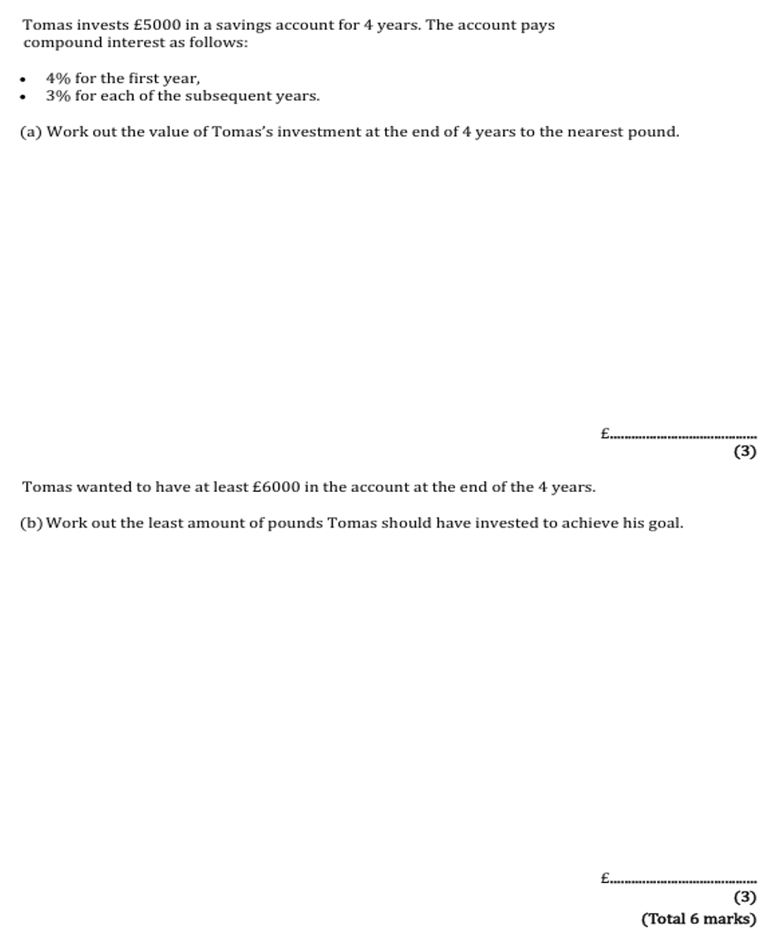
Zπ
PAST-PAPER QUESTION
Question 7

Slide 22
Zπ
RECAP
Key Takeaways
Simple interest: I = PRT ÷ 100 — the same amount every year.
Compound interest: Amount = P × (multiplier)ⁿ — it grows on the growing total.
Interest earned = final amount − principal.
Repeated changes MULTIPLY: +20% then −30% is ×1.2×0.7 = ×0.84 (16% down, not 10%).
To find an unknown change, divide the final amount by the running total.
Golden rule: never add or subtract percentages across steps — multiply the multipliers.

