Slide 1
Zπ
Zπ MATHS HUB
Pearson Edexcel IGCSE (9–1) · Higher Tier
x^{a+b}
Laws of Indices
Multiply · Divide · Power of a Power · Zero · Negative · Fractional Indices & Roots
Zahra Sheikh Ali
IGCSE Mathematics Teacher · M.Sc. Differential Geometry & Geometric Control
☎ 66613748 ✉ zahraa.sheikhali@outlook.com

Slide 2
Zπ
LESSON OVERVIEW
Six Rules for Powers
An index (power) tells you how many times to multiply. Six rules cover everything — including negative powers (fractions) and fractional powers (roots).
Multiplying powers
Dividing powers
Power of a power
1
2
3
Negative indices
Fractional indices
Past-paper questions
4
5
6
Key words: index · power · base · reciprocal · root · evaluate · simplify

Slide 3

Zπ
THE KEY IDEA
The Laws of Indices
Learn these six — every question uses one or more of them.
MULTIPLY — ADD POWERS
DIVIDE — SUBTRACT POWERS
xª × x^{b} = x^{a+b}
xª ÷ x^{b} = x^{a−b}
POWER OF A POWER — MULTIPLY
POWER OF ZERO
( xª )^{b} = x^{ab}
x⁰ = 1
NEGATIVE — RECIPROCAL
FRACTIONAL — ROOT
x^{−n} =
1
x^{1/n} =
x^{n}

Slide 4
Zπ
WORKED · SIMPLIFY
Multiplying & Dividing Powers
1
Multiply → ADD: a⁷ × a² = a⁹
Key idea
Same base: add powers to multiply, subtract to divide.
Deal with the numbers separately (9 ÷ 3 = 3).
x means x¹ (a hidden power of 1).
2
Divide → SUBTRACT: 9a⁴ ÷ 3a = 3a³
3
12w³y² ÷ 6w = 2w²y²
4
Numbers divide; letters follow the power rule.
a⁷ × a² = a⁹ , 9a⁴ ÷ 3a = 3a³
Only add or subtract powers when the BASE is the same.

Slide 5
Zπ
WORKED · SIMPLIFY
Power of a Power (and Zero)
1
Multiply the powers: ( x² )³ = x⁶
Watch the number
(2x³)²: square the 2 as well → 4.
Power of a power → MULTIPLY the powers.
x⁰ = 1 for any non-zero x.
2
Include the number: ( 2x³ )² = 4x⁶
3
( 3² )² × ( 3³ )³ = 3⁴ × 3⁹ = 3¹³
4
Anything to the power 0 is 1: 5⁰ = 1
( 2x³ )² = 4x⁶
( ab )ⁿ = aⁿ bⁿ : the power applies to everything in the bracket.

Slide 6
Zπ
NEGATIVE INDICES
A Negative Power Means ‘One Over’
A negative index gives the reciprocal: flip it to make the power positive.
2⁻³
=
1
=
1
2³
8
5⁻²
=
1
=
1
5²
25
x^{−n}
=
1
=
x^{n}
Flip to a fraction, turn the power positive, then evaluate. x⁻¹ = 1/x.

Slide 7



Zπ
FRACTIONAL INDICES
A Fraction Power Means a Root
The bottom of the fraction is the ROOT, the top is the POWER. Do the root first — the numbers stay small.
49^{½} =
= 7
8^{⅓} =
= 2
8^{⅔} = (
)² = 2² = 4
Root first, then power — e.g. the cube root of 8 is 2, then 2² = 4.

Slide 8

Zπ
PUTTING IT TOGETHER
Negative AND Fractional
Deal with the negative first (flip), then the fraction (root, then power).
Step 1 — flip the negative
Step 2 — root, then power
64^{−⅔} =
1
64^{⅔} = (
)² = 4² = 16
64^{⅔}
So 64^{−⅔} =
1
16
A negative fractional index: flip, take the root, then apply the power.

Slide 9
Zπ
PART 2
Past-Paper Questions
Original exam questions — shown as printed so every power and fraction is exact.
1
Which law(s) does it use?
2
Deal with numbers and letters separately
3
Negative → flip; fraction → root then power
4
Show clear working

Slide 10
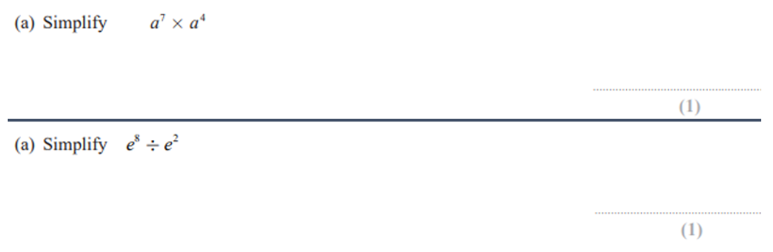
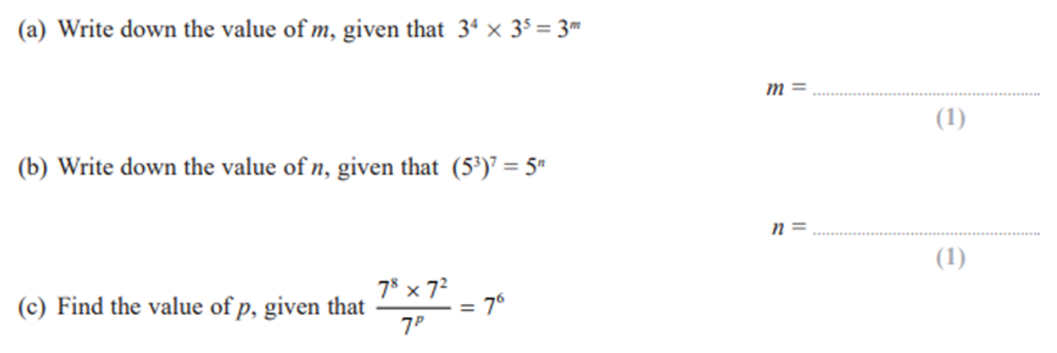
Zπ
PAST-PAPER QUESTIONS (1 of 11)
As Printed in the Exam
1
2

Slide 11
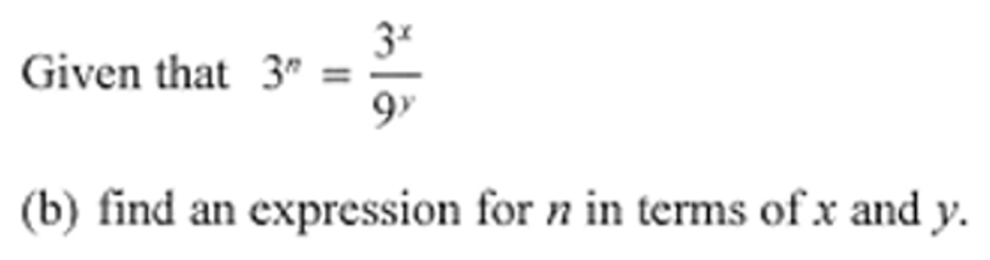
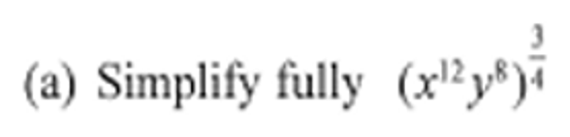
Zπ
PAST-PAPER QUESTIONS (2 of 11)
As Printed in the Exam
3
4

Slide 12
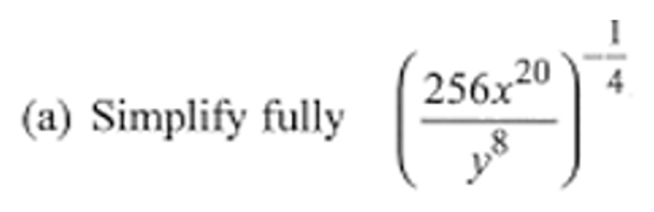
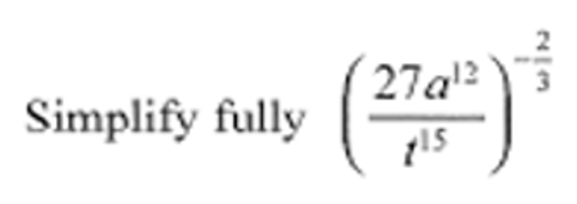
Zπ
PAST-PAPER QUESTIONS (3 of 11)
As Printed in the Exam
5
6

Slide 13
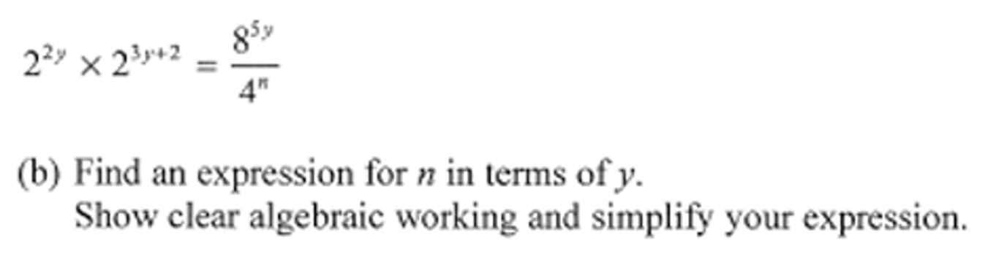
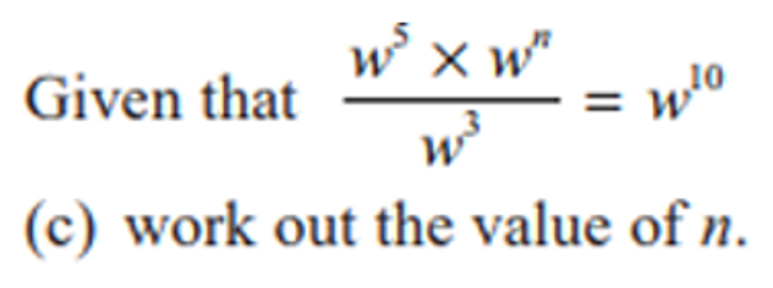
Zπ
PAST-PAPER QUESTIONS (4 of 11)
As Printed in the Exam
7
8

Slide 14
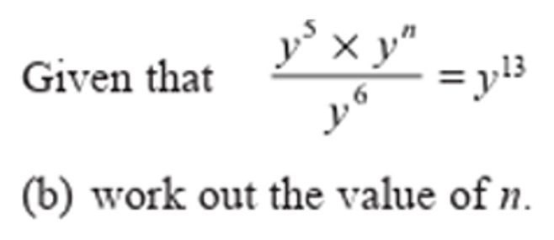
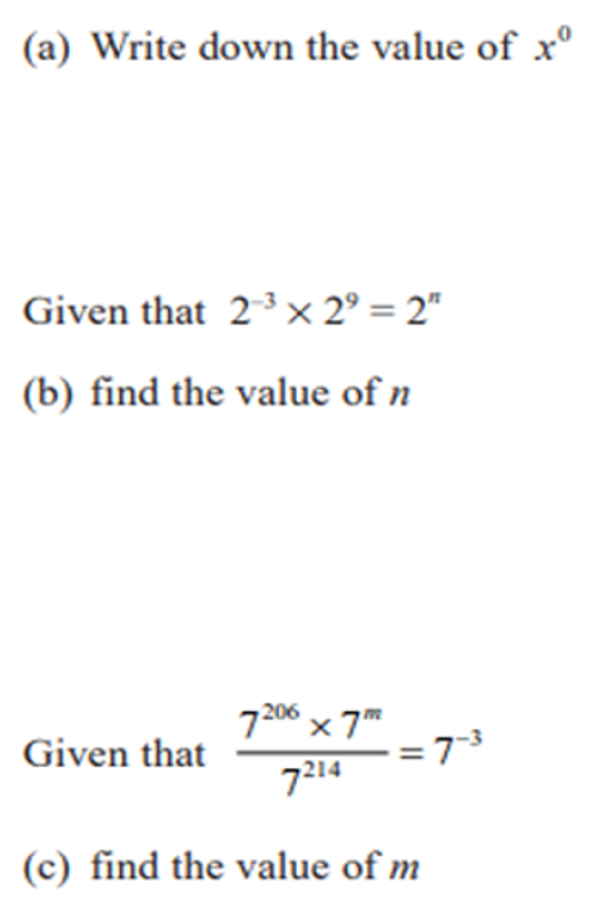
Zπ
PAST-PAPER QUESTIONS (5 of 11)
As Printed in the Exam
9
10

Slide 15
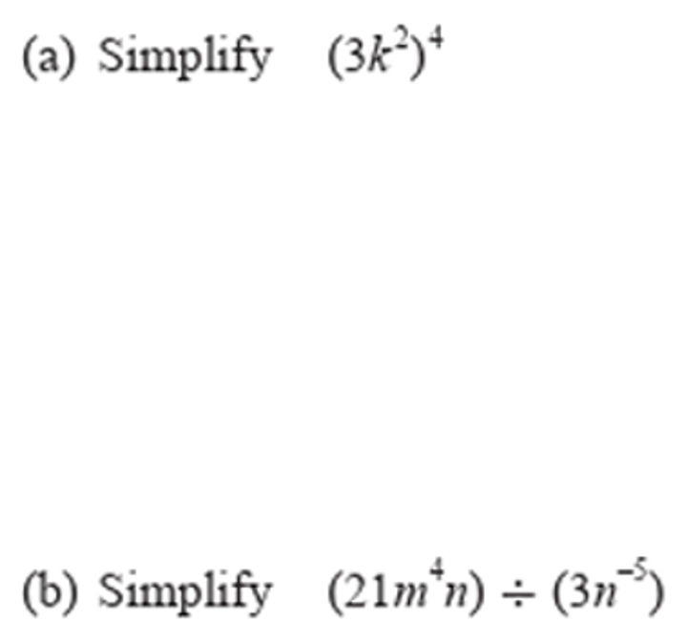
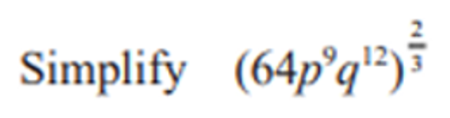
Zπ
PAST-PAPER QUESTIONS (6 of 11)
As Printed in the Exam
11
12

Slide 16
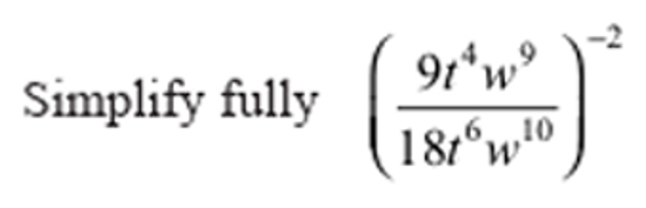
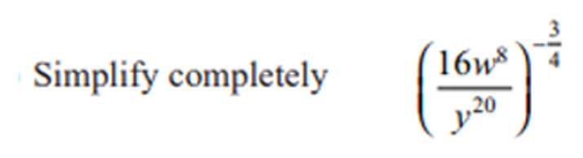
Zπ
PAST-PAPER QUESTIONS (7 of 11)
As Printed in the Exam
13
14

Slide 17
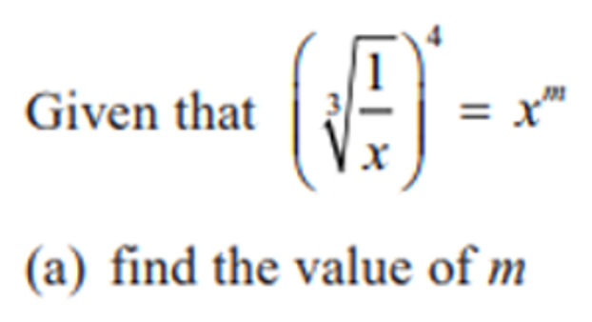
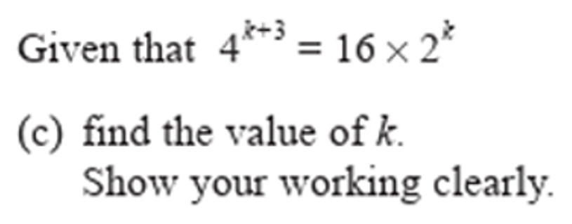
Zπ
PAST-PAPER QUESTIONS (8 of 11)
As Printed in the Exam
15
16

Slide 18
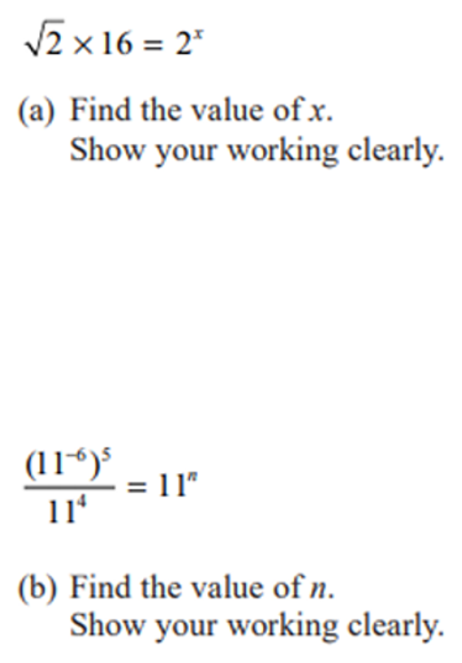
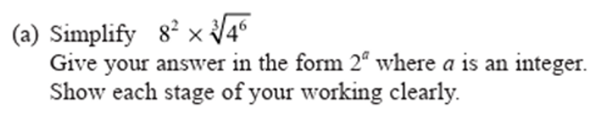
Zπ
PAST-PAPER QUESTIONS (9 of 11)
As Printed in the Exam
17
18

Slide 19
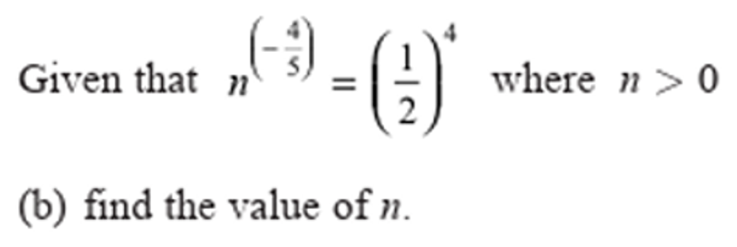
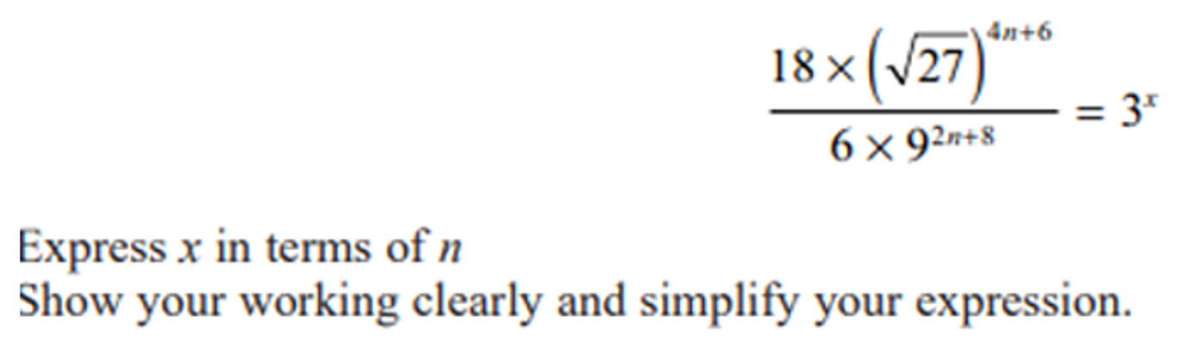
Zπ
PAST-PAPER QUESTIONS (10 of 11)
As Printed in the Exam
19
20

Slide 20
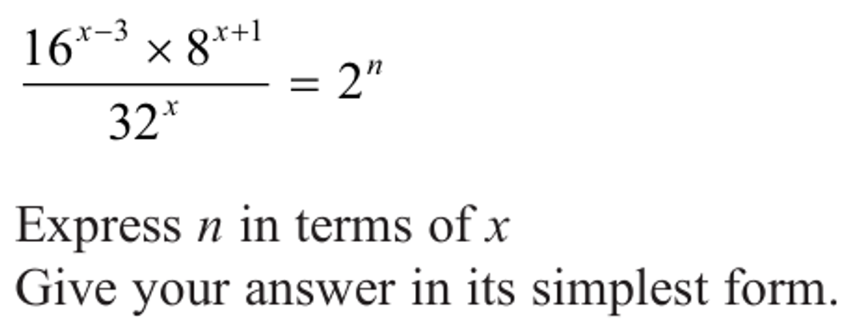
Zπ
PAST-PAPER QUESTIONS (11 of 11)
As Printed in the Exam
21

Slide 21
Zπ
RECAP
Key Takeaways
Multiply → add powers; divide → subtract powers (same base only).
Power of a power → multiply the powers; x⁰ = 1.
Negative index → reciprocal: x⁻ⁿ = 1 over xⁿ.
Fractional index → root: bottom is the root, top is the power.
Combine carefully: flip for the negative, then root and power for the fraction.
Golden rule: same base — add, subtract or multiply the powers; a fraction power is a root.

