Slide 1
Zπ
Zπ MATHS HUB
Pearson Edexcel IGCSE (9–1) · Higher Tier
2
Roots & Surds
Simplifying · Multiplying & Dividing · Adding Like Surds · Expanding · Rationalising
Zahra Sheikh Ali
IGCSE Mathematics Teacher · M.Sc. Differential Geometry & Geometric Control
☎ 66613748 ✉ zahraa.sheikhali@outlook.com

Slide 2
Zπ
LESSON OVERVIEW
Working with Exact Roots
A SURD is a root that cannot be worked out exactly, like √2 or √5. We leave it as a root so the answer stays exact — never round it.
Simplifying a surd
Multiplying & dividing
Adding like surds
1
2
3
Expanding brackets
Rationalising the denominator
Past-paper questions
4
5
6
Key words: surd · exact · simplify · square factor · like surds · rationalise · conjugate

Slide 3











Zπ
THE KEY IDEA
The Surd Rules
Learn these four — every question uses one of them.
Multiply the numbers inside one root.
×
=
Divide the numbers inside one root.
÷
=
Only LIKE surds (same number inside) can be added.
p
+
q
= (p + q)
The surd disappears — this is why the conjugate works.
( x +
) ( x −
²
) = x
− y
Keep answers EXACT — leave the surd in, never round it.

Slide 4
















Zπ
SIMPLIFYING A SURD
Take Out the Largest Square Factor
Look for the biggest square number (4, 9, 16, 25, 36 …) that divides into it.
= 6
Method
Find the largest SQUARE factor.
72 = 36 × 2, and 36 is a square.
Split the root into two roots.
3
√36 = 6, so the answer is 6√2.
Check: 6² × 2 = 72 ✓
√72 = 6√2

Slide 5



Zπ
EXAMPLE · MULTIPLY
Multiply the Numbers Inside One Root
√a × √b = √(ab)
=
=
Note
Here the answer is a whole number, because 36 is a perfect square.
If it is not a perfect square, simplify it instead — e.g. √2 × √10 = √20 = 2√5.
= 6
√3 × √12 = √36 = 6

Slide 6



Zπ
EXAMPLE · DIVIDE
Divide the Numbers Inside One Root
√a ÷ √b = √(a/b)
=
=
Method
Put both numbers under ONE root as a fraction.
72 ÷ 8 = 9, and √9 = 3.
Always divide first, then take the root.
= 3
√72 ÷ √8 = √9 = 3

Slide 7



Zπ
EXAMPLE · ADD LIKE SURDS
Only Add Surds with the SAME Number Inside
p√c + q√c = (p + q)√c
3
+
5
=
Careful
√2 + √3 does NOT simplify — different numbers inside.
Sometimes you must simplify FIRST:
√45 + √20 = 3√5 + 2√5 = 5√5
Think of √2 like a letter: 3x + 5x = 8x.
3√2 + 5√2 = 8√2. Simplify each surd first so the insides match.

Slide 8




Zπ
EXAMPLE · EXPANDING
(x + √y)(x − √y) = x² − y
Expand as normal — the middle terms cancel and the surd disappears.
( 3 +
) ( 3 −
)
Why it works
The two middle terms are −3√5 and +3√5 — they cancel.
√5 × √5 = 5, so no surd is left.
The answer is a whole number.
= 9 − 3
+ 3
− 5
= 9 − 5 = 4
(3 + √5)(3 − √5) = 3² − 5 = 4

Slide 9
Zπ
EXAMPLE · RATIONALISE
Clear the Surd from the Bottom
Multiply the top AND bottom by the surd on the bottom.
6
√3
6
√3
×
=
=
2
√3
√3
√3
3
Why it works
√3 × √3 = 3, so the bottom becomes a whole number. Then 6 ÷ 3 = 2, leaving 2√3.
Never leave a surd on the bottom — rationalise it.

Slide 10
Zπ
EXAMPLE · CONJUGATE
When the Bottom is a + √b
Multiply top and bottom by the CONJUGATE — the same expression with the sign flipped.
1
2 −
√3
2 −
√3
×
=
=
2 −
√3
2 +
√3
2 −
√3
4 − 3
The key step
(2 + √3)(2 − √3) = 2² − 3 = 4 − 3 = 1. The surd cancels, so the bottom is a whole number.
Conjugate of a + √b is a − √b. Multiplying them removes the surd.

Slide 11
Zπ
PART 2
Past-Paper Questions
Simplify first, then apply the rule — and never leave a surd on the bottom.
1
Take out the largest square factor
2
√a × √b = √(ab)
3
Like surds add
4
Rationalise with the conjugate

Slide 12
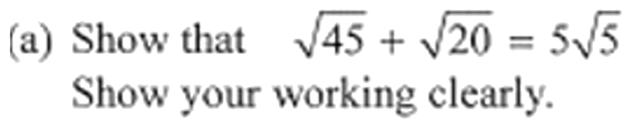
Zπ
PAST-PAPER QUESTION
Question 1

Slide 13
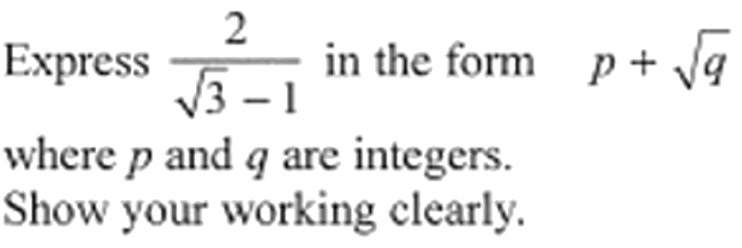
Zπ
PAST-PAPER QUESTION
Question 2

Slide 14
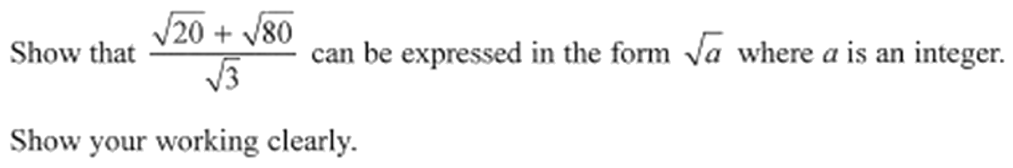
Zπ
PAST-PAPER QUESTION
Question 3

Slide 15
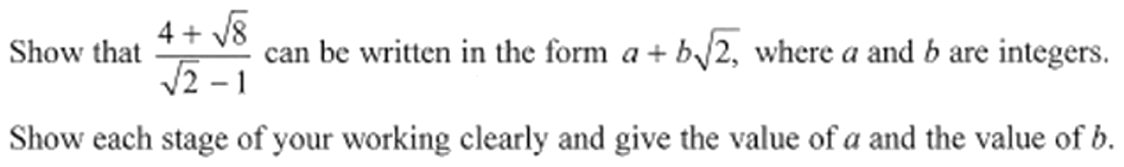
Zπ
PAST-PAPER QUESTION
Question 4

Slide 16
Zπ
PAST-PAPER QUESTION
Question 5

Slide 17
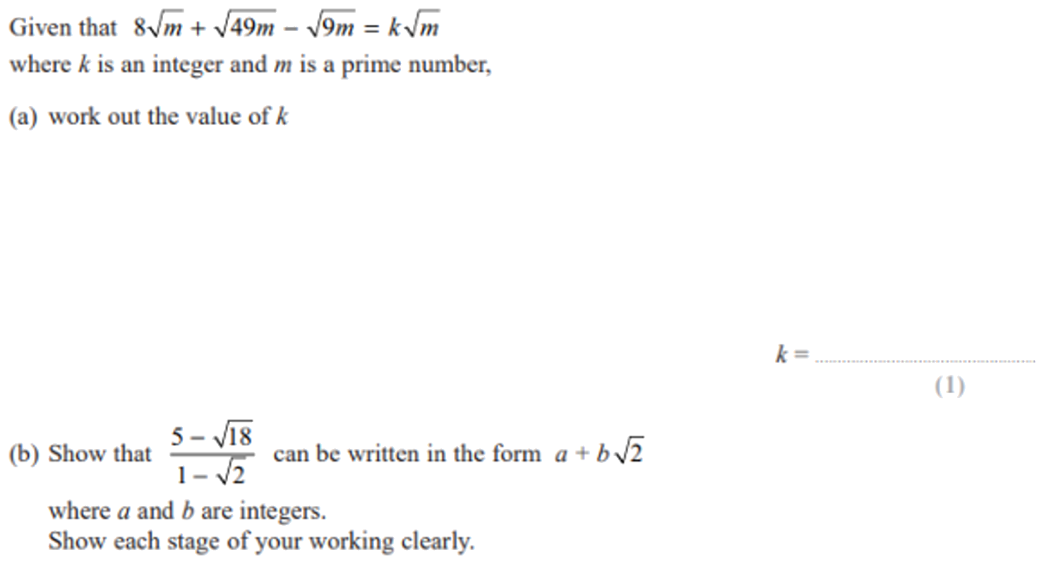
Zπ
PAST-PAPER QUESTION
Question 6

Slide 18
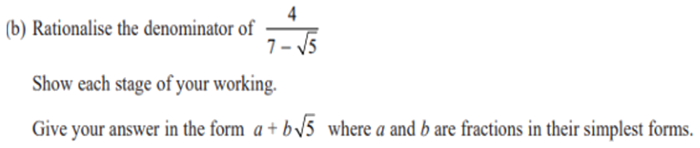
Zπ
PAST-PAPER QUESTION
Question 7

Slide 19
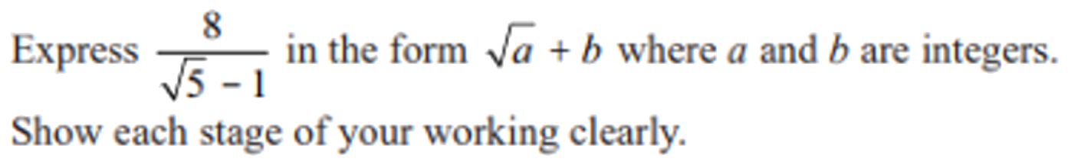
Zπ
PAST-PAPER QUESTION
Question 8

Slide 20
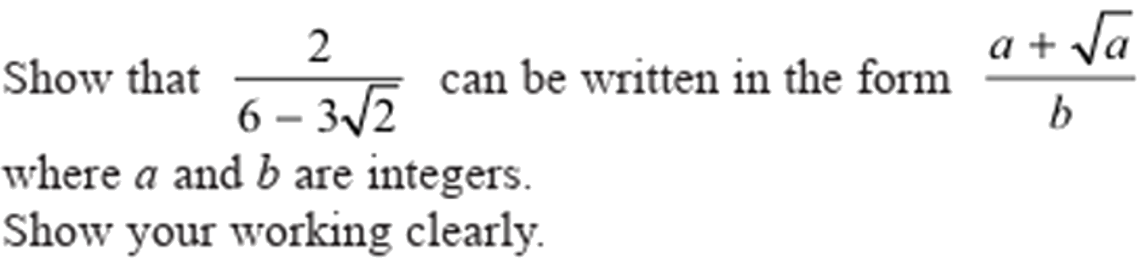
Zπ
PAST-PAPER QUESTION
Question 9

Slide 21
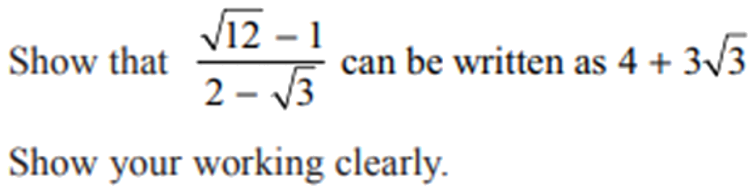
Zπ
PAST-PAPER QUESTION
Question 10

Slide 22
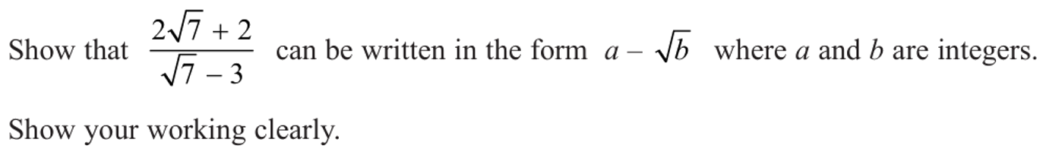
Zπ
PAST-PAPER QUESTION
Question 11

Slide 23
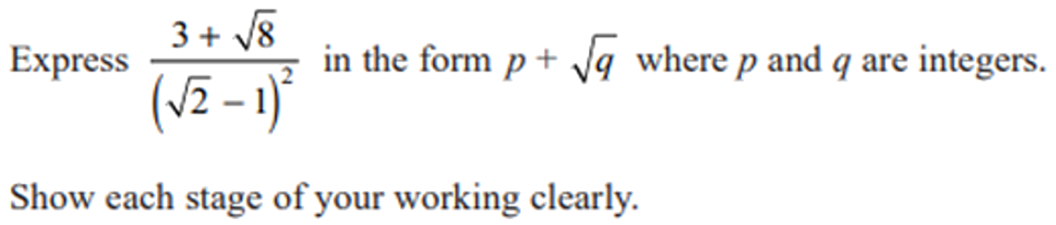
Zπ
PAST-PAPER QUESTION
Question 12

Slide 24
Zπ
RECAP
Key Takeaways
A surd is an exact root — leave it in, never round it.
Simplify by taking out the largest SQUARE factor: √72 = 6√2.
√a × √b = √(ab) and √a ÷ √b = √(a÷b).
Only LIKE surds can be added: 3√2 + 5√2 = 8√2.
Rationalise: multiply by the surd, or by the CONJUGATE if the bottom is a ± √b.
Golden rule: simplify first, then apply the rule — and clear every surd from the denominator.

