Slide 1
Zπ
Zπ MATHS HUB
Pearson Edexcel IGCSE (9–1) · Higher Tier
LB ≤ x < UB
Bounds
Upper & Lower Bounds · Error Intervals · Calculating with Bounds · Speed & Area
Zahra Sheikh Ali
IGCSE Mathematics Teacher · M.Sc. Differential Geometry & Geometric Control
☎ 66613748 ✉ zahraa.sheikhali@outlook.com

Slide 2
Zπ
LESSON OVERVIEW
How Far Could It Really Be?
A rounded measurement is never exact. Every value has a lower and an upper bound. Find them by halving the rounding unit, then use the right combination for a calculation.
What is a bound?
Finding bounds
Error intervals
1
2
3
Adding & subtracting
Multiplying & dividing
Past-paper questions
4
5
6
Key words: upper bound · lower bound · error interval · rounding unit · significant figures

Slide 3
Zπ
PART 1 · FINDING BOUNDS
Halve the Rounding Unit
1
A weight is 4.3 kg, correct to 1 decimal place.
The method
Decide what it was rounded to.
Cut that amount in half.
Add it on for the UPPER bound, take it off for the LOWER bound.
2
Rounding unit = 0.1 → half of it = 0.05
3
Lower bound = 4.3 − 0.05 = 4.25
4
Upper bound = 4.3 + 0.05 = 4.35
4.25 ≤ weight < 4.35
The upper bound is the value you never quite reach — use < there.

Slide 4
Zπ
ERROR INTERVALS
Writing the Range as an Inequality
Measurements are continuous, so we write an interval: LB ≤ x < UB. The lower bound is included; the upper bound is not.
Rounded value
Error interval
60, to the nearest 10
55 ≤ x < 65
4.3, to 1 decimal place
4.25 ≤ x < 4.35
250, to the nearest 10
245 ≤ x < 255
17, to the nearest integer
16.5 ≤ x < 17.5
Same idea whatever the rounding: nearest 10, decimal places, significant figures, or nearest 5.

Slide 5
Zπ
OTHER ROUNDINGS
Significant Figures & Nearest 5
1
4.8 to 2 s.f.: unit 0.1 → 4.75 ≤ x < 4.85
Watch the unit
The unit is the place value of the LAST significant figure.
‘Nearest 5’ → halve the 5 (use 2.5).
Always halve the rounding unit, then ±.
2
0.26 to 2 s.f.: unit 0.01 → 0.255 ≤ x < 0.265
3
15 to the nearest 5: half of 5 = 2.5 → 12.5 ≤ x < 17.5
4
20 to 2 s.f.: unit 1 → 19.5 ≤ x < 20.5
Rounding unit ÷ 2 gives the ± amount
For 2 s.f., 4.8 has unit 0.1 but 0.26 has unit 0.01 — look at the last figure.

Slide 6
Zπ
PART 2
Calculating with Bounds
To make a result as BIG or as SMALL as possible, pick the right bound of each value.
1
ADD: UB+UB for upper, LB+LB for lower
2
SUBTRACT: UB−LB for upper, LB−UB for lower
3
MULTIPLY: UB×UB for upper, LB×LB for lower
4
DIVIDE: UB÷LB for upper, LB÷UB for lower

Slide 7
Zπ
ADD & SUBTRACT
Same Sign or Opposite?
1
ADD: upper = UB + UB, lower = LB + LB
Why swap for subtract?
To make a difference BIGGEST, take the biggest minus the SMALLEST.
So upper of a − b uses UB(a) − LB(b).
Lower uses LB(a) − UB(b).
2
e.g. UB (33+49) to the nearest integer, 33.5 + 49.5 = 83 (both upper bounds)
3
SUBTRACT: upper = UB − LB, lower = LB − UB
4
e.g. UB (33+49) to the nearest integer, 33.5 − 48.5 = −15
Upper of a − b = UB(a) − LB(b)
Adding keeps the same bound; subtracting swaps to the opposite bound.

Slide 8
Zπ
MULTIPLY & DIVIDE
Biggest over Smallest
1
MULTIPLY: upper = UB × UB, lower = LB × LB
Why swap for divide?
To make a quotient BIGGEST, divide the biggest by the SMALLEST.
So upper of a ÷ b uses UB(a) ÷ LB(b).
Lower uses LB(a) ÷ UB(b).
2
e.g. UB (2 +5.3) correct to 1 d.p, 2.05 × 5.35 = 10.9675
3
DIVIDE: upper = UB ÷ LB, lower = LB ÷ UB
4
e.g. UB (2 +5.3) correct to 1 d.p, 1.95 ÷ 5.25 = 0.37142857
Upper of a ÷ b = UB(a) ÷ LB(b)
Multiplying keeps the same bound; dividing swaps to the opposite bound.

Slide 9
Zπ
WORKED · IN CONTEXT
Bounds for a Perimeter
1
Rectangle 12 cm by 15 cm, each to the nearest cm.
Key idea
Find the bounds of each measurement first.
For the largest perimeter, use the upper bounds.
Speed = distance ÷ time works the same way — biggest over smallest.
2
Length: 11.5–12.5, Width: 14.5–15.5
3
Perimeter = 2(L + W). Upper = 2(12.5 + 15.5) = 56 cm
4
Lower = 2(11.5 + 14.5) = 52 cm
52 cm ≤ perimeter ≤ 56 cm
For a maximum area or perimeter, combine the upper bounds; for a minimum, the lower bounds.

Slide 10
Zπ
PART 3
Past-Paper Questions
Substitute the right bound of each value; geometry questions are shown as they appear in the exam.
1
Find each value’s bounds
2
Choose UB or LB for the result you want
3
Substitute carefully
4
Round only at the end

Slide 11
Zπ
PAST-PAPER QUESTIONS (1 of 4)
Bounds of a Value & a Difference
The weight of a cat is 4.3 kg, correct to 2 significant figures. Write down the upper bound of the weight.
1
ANSWER
4.35 kg
G = e − f, where e = 17 (nearest integer) and f = 9.4 (1 d.p.). Work out the upper bound for G.
2
ANSWER
8.15
C = b − a, where a = 6 (nearest integer) and b = 15 (nearest 5). Work out the upper bound for C.
3
ANSWER
12

Slide 12
Zπ
PAST-PAPER QUESTIONS (2 of 4)
Products, Formulae & Speed
P = ef, where e = 4.8 and f = 0.26 (both 2 s.f.). Work out the lower bound for P (3 s.f.).
4
ANSWER
1.21
P =
2a − c
5
d
ANSWER
27.44
a = 58.4 (3 s.f.), c = 20 (2 s.f.), d = 3.6 (2 s.f.). Upper bound for P (2 d.p.).
A train travels 487 km (nearest km) in 3 hours (nearest minute). Find the average speed in km/min to a suitable accuracy.
6
ANSWER
2.7 km/min

Slide 13
Zπ
PAST-PAPER QUESTIONS (3 of 4)
Formulae with Division
a =
v − u
7
t
ANSWER
3.22
v = 9.6, u = 3.8 (1 d.p.), t = 1.84 (2 d.p.). Upper bound for a (2 d.p.).
y =
2a − b
8
f
ANSWER
7.79
a = 7.5 (1 d.p.), b = 3.42 (2 d.p.), f = 2 (nearest whole). Upper bound for y.
p =
t
9
a − h
ANSWER
3
t = 14, a = 7.8, h = 3.4 (all 2 s.f.). Work out the lower bound for p.

Slide 14
Zπ
PAST-PAPER QUESTIONS (4 of 4)
Harder Formulae
A = w −
x²
10
y
ANSWER
2.6
w = 3.45 (2 d.p.), x = 1.9 (1 d.p.), y = 5 (nearest whole). Lower bound for A.
G =
c
11
2f − 3h
ANSWER
0.765
c = 8 (nearest whole), f = 6.62 (2 d.p.), h = 1.2 (1 d.p.). Lower bound for G (3 d.p.).

Slide 15
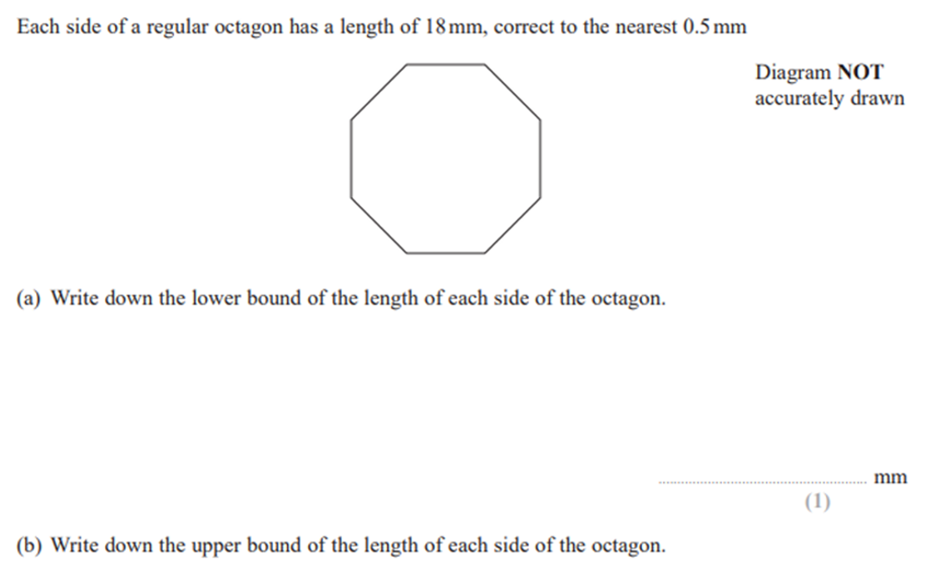
Zπ
PAST-PAPER · GEOMETRY
Question 12 — Regular Octagon

Slide 16
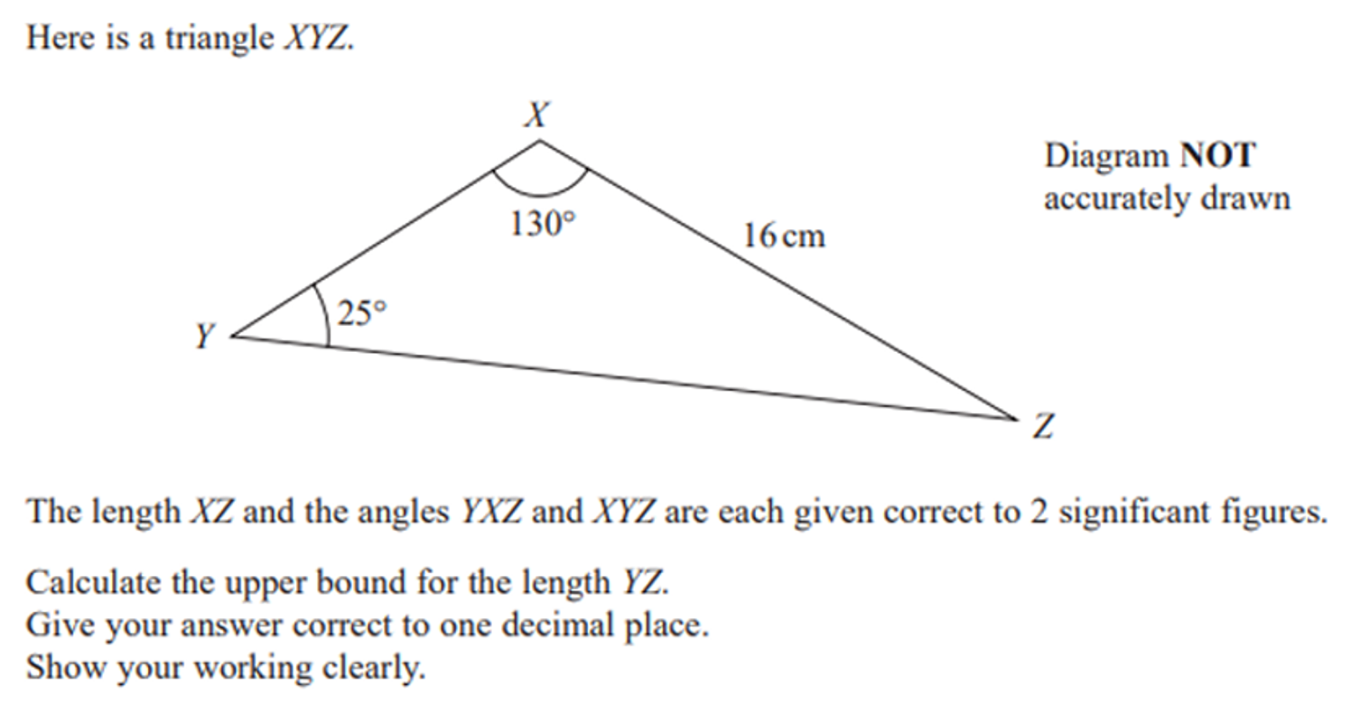
Zπ
PAST-PAPER · GEOMETRY
Question 13 — Triangle XYZ

Slide 17
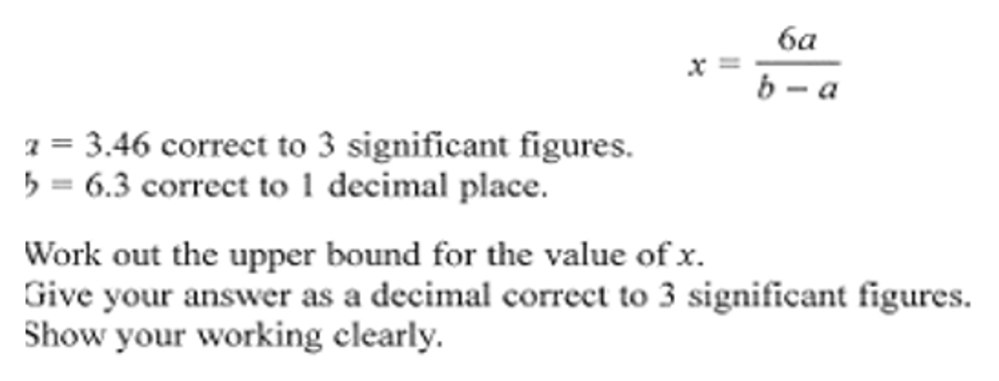
Zπ
PAST-PAPER · EXAM IMAGE
Question 14 — As Printed

Slide 18
Zπ
RECAP
Key Takeaways
A rounded value has bounds: halve the rounding unit, then ±.
Error interval: LB ≤ x < UB (lower included, upper not).
ADD / MULTIPLY keep the same bound; SUBTRACT / DIVIDE swap to the opposite.
For the biggest result: biggest ÷ smallest, biggest − smallest.
Watch the rounding: s.f., decimal places, nearest 5 — the unit changes.
Golden rule: to make a result as big as possible, make the top big and the bottom small.

