Slide 1
Zπ
Zπ MATHS HUB
Pearson Edexcel IGCSE (9–1) · Higher Tier
D
S
T
Compound Measures
Speed, Distance & Time · Density, Mass & Volume · Pressure, Force & Area · Unit Conversions
Zahra Sheikh Ali
IGCSE Mathematics Teacher · M.Sc. Differential Geometry & Geometric Control
☎ 66613748 ✉ zahraa.sheikhali@outlook.com

Slide 2
Zπ
LESSON OVERVIEW
One Triangle, Three Formulas
A COMPOUND MEASURE links two different quantities — you can hear it in the word ‘per’ (kilometres per hour, grams per cm³). ‘Per’ means DIVIDED BY, and each one has a formula triangle.
What ‘per’ means
Speed, distance & time
Density, mass & volume
1
2
3
Pressure, force & area
Matching the units
Past-paper questions
4
5
6
Key words: compound measure · per · formula triangle · density · speed · pressure · units

Slide 3
Zπ
THE KEY IDEA
‘Per’ Means Divided By
A compound measure tells you about a relationship between two quantities. Its unit always contains the word ‘per’ when you say it out loud.
Hear the word ‘per’
The three you need
kilometres PER hour → km ÷ h
Density
mass ÷ volume
g/cm³, kg/m³
grams PER cm³ → g ÷ cm³
Speed
distance ÷ time
m/s, km/h, mph
newtons PER m² → N ÷ m²
Pressure
force ÷ area
N/m², N/cm²
The slash / is just ‘divided by’.
Every compound measure is a DIVISION — and every one has a formula triangle.

Slide 4
Zπ
THE FORMULA TRIANGLE
Cover Up What You Want
Put the measure on top, the other two underneath. Cover the one you are looking for and read off what is left.
Reading the triangle
D
Cover D → D = S × T
Cover S → S = D ÷ T
Cover T → T = D ÷ S
S
T
The horizontal line means DIVIDE.
Check the units match first.
distance on top; speed × time underneath
Side by side (S × T) means multiply; one above the other means divide.

Slide 5
Zπ
SPEED · DISTANCE · TIME
Speed = Distance ÷ Time
Average speed = total distance ÷ total time.
Example 1
Example 2 · minutes!
D
A car travels 126 miles in 3 hours. Find its average speed.
A car travels 40 miles in 45 minutes. Find its average speed.
S
T
d
126
45 min = 0.75 hours
s =
=
t
3
s =
40
0.75
= 42 mph
= 53.3 mph (1 dp)
Time must be in HOURS for km/h or mph. Minutes ÷ 60 turns them into hours.

Slide 6
Zπ
FINDING THE TIME
And Turning Decimals Back into Minutes
Cover T in the triangle: time = distance ÷ speed.
Example
Decimal hours ↔ minutes
A train completes a 520 km journey at an average speed of 160 km/h. Find the time taken.
0.25 h = 15 min
0.5 h = 30 min
t =
d
=
520
0.75 h = 45 min
s
160
Decimal × 60 gives the minutes:
= 3.25 hours
3.25 h = 3 hours 15 minutes
Minutes → hours: ÷ 60. Hours → minutes: × 60. Never write 3.25 hours as 3 h 25 min.

Slide 7
Zπ
DENSITY · MASS · VOLUME
Density = Mass ÷ Volume
Mass on top; density × volume underneath.
Example 1
Example 2 · find the volume first
M
A block has a volume of 600 cm³ and a mass of 204 g. Find its density.
A cube of ice of side 2 cm has a mass of 7.36 g. Find the density of ice.
D
V
m
204
volume = 2³ = 8 cm³
d =
=
v
600
d =
7.36
8
= 0.34 g/cm³
= 0.92 g/cm³
If the shape is a cube, cuboid or cylinder, work out its VOLUME first.

Slide 8
Zπ
MATCHING THE UNITS
The Step Most Marks Are Lost On
Before you divide, make sure the units agree. A density in g/cm³ needs the mass in GRAMS and the volume in cm³.
Example
Conversions to know
A tyre made of rubber (density 1.2 g/cm³) has a mass of 3.6 kg. Find its volume.
1 kg = 1000 g
1 m = 100 cm
3.6 kg = 3600 g (× 1000)
1 m³ = 1 000 000 cm³
v =
m
=
3600
= 3000 cm³
d
1.2
1 litre = 1000 cm³
1 km = 1000 m, 1 hour = 3600 s
Convert FIRST, then use the formula — and give the answer in the unit the question asks for.

Slide 9
Zπ
PRESSURE · FORCE · AREA
Pressure = Force ÷ Area
Force on top; pressure × area underneath. Measured in N/m² or N/cm².
How it is used
F
Cover F → F = P × A
Cover P → P = F ÷ A
P
A
Cover A → A = F ÷ P
The AREA is the face in contact with the surface.
For a cuboid on a table: area = length × width.
For a cube of side 7 cm: area = 7 × 7 = 49 cm².
Read carefully which FACE is touching the table — that face gives the area.

Slide 10
Zπ
CONVERTING SPEEDS
km/h ↔ m/s
1 km = 1000 m and 1 hour = 3600 s. So to change km/h into m/s, multiply by 1000 and divide by 3600 — that is the same as dividing by 3.6.
km/h → m/s
m/s → km/h
÷ 3.6
× 3.6
e.g. 72 km/h
e.g. 15 m/s = 15 × 3.6 = 54 km/h
=
72 × 1000
= 20 m/s
3600
(× 3600 seconds, ÷ 1000 metres)
km/h → m/s: ÷ 3.6. m/s → km/h: × 3.6.

Slide 11
Zπ
PART 2
Past-Paper Questions
Pick the right triangle, match the units, then work one step at a time.
1
Which measure is it?
2
Cover what you want
3
Match the units first
4
Answer in the unit asked for

Slide 12
Zπ
PAST-PAPER QUESTION
Question 1
A plane takes 3 hours 36 minutes to fly from the Cayman Islands to New York.
The plane flies a distance of 2470 km.
Work out the average speed of the plane in km/h.
Give your answer correct to the nearest whole number.
km/h
(3 marks)

Slide 13
Zπ
PAST-PAPER QUESTION
Question 2
Change a speed of 630 kilometres per hour to a speed in metres per second.
m/s
(3)

Slide 14
Zπ
PAST-PAPER QUESTION
Question 3
A block of wood has a mass of 3.5 kg.
The wood has density 0.65 kg/m³
(a) Work out the volume of the block of wood.
Give your answer correct to 3 significant figures.
m³
(2)

Slide 15
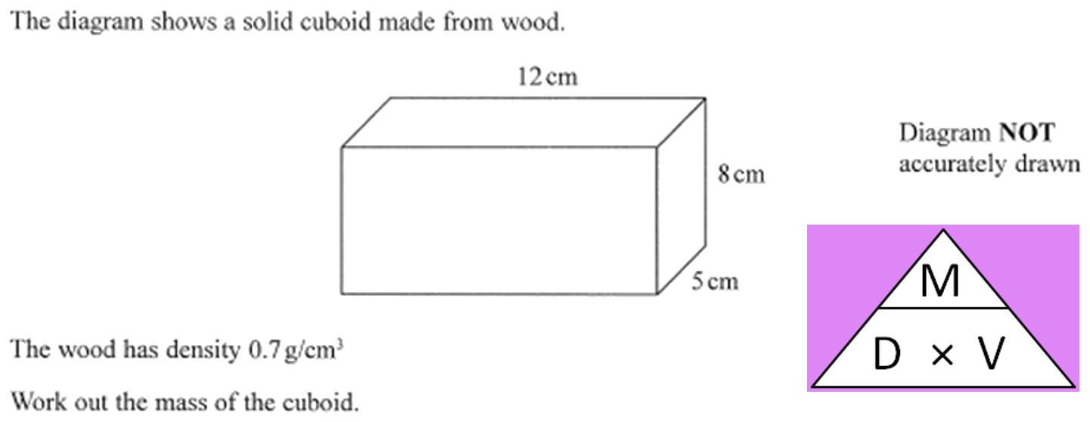
Zπ
PAST-PAPER QUESTION
Question 4

Slide 16
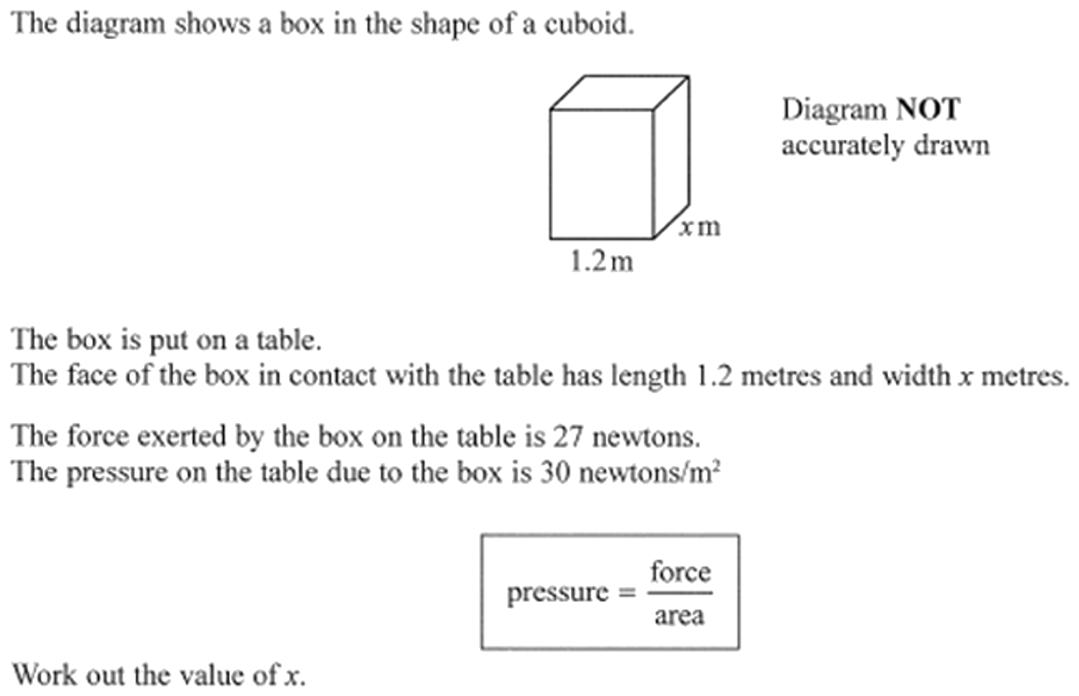
Zπ
PAST-PAPER QUESTION
Question 5

Slide 17
Zπ
PAST-PAPER QUESTION
Question 6
A train takes 6 hours 39 minutes to travel from New Delhi to Kanpur.
The train travels a distance of 429 km.
Work out the average speed of the train.
Give your answer in km/h correct to one decimal place.
km/h

Slide 18
Zπ
PAST-PAPER QUESTION
Question 7
Change a speed of 81 kilometres per hour to a speed in metres per second.
m/s

Slide 19
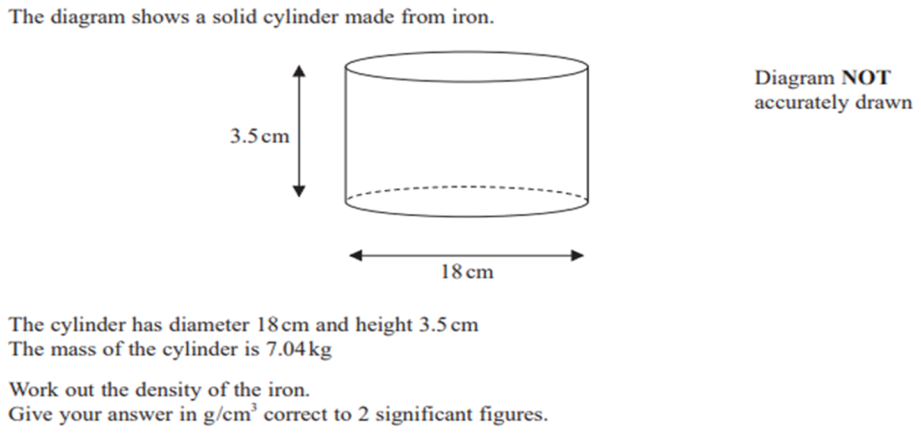
Zπ
PAST-PAPER QUESTION
Question 8

Slide 20
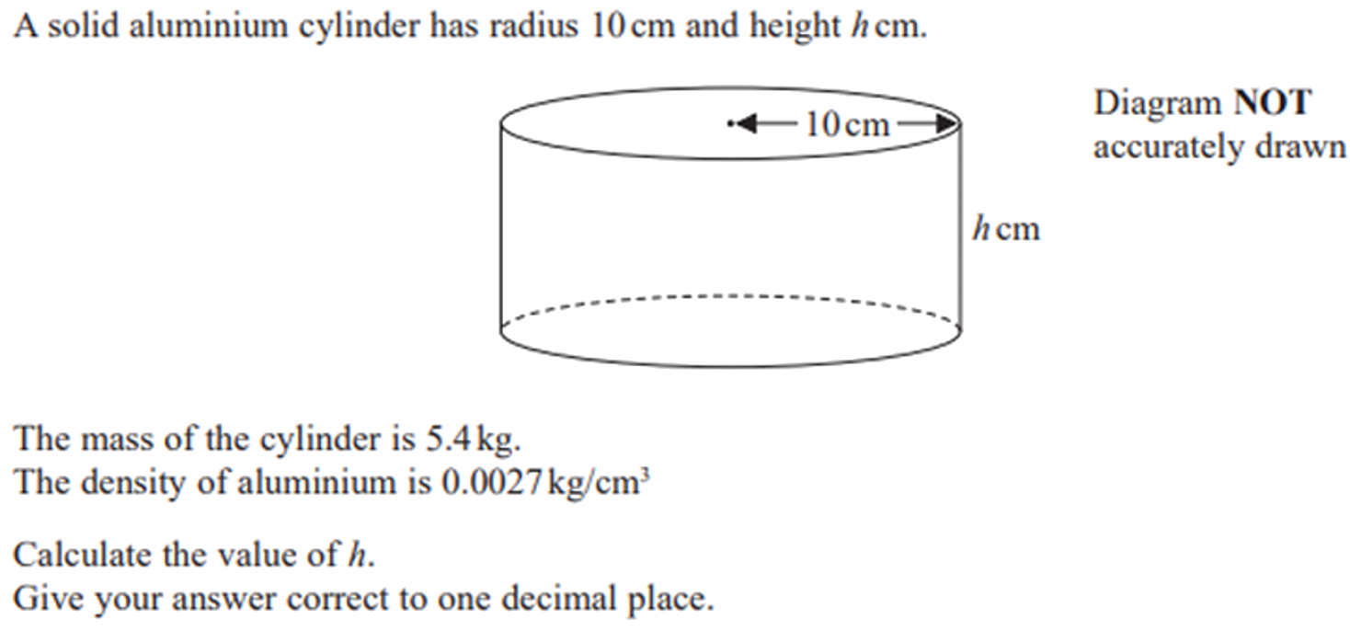
Zπ
PAST-PAPER QUESTION
Question 9

Slide 21
Zπ
PAST-PAPER QUESTION
Question 10
A parcel in the shape of a cube is placed on a table so that the whole of one face
of the parcel is in contact with the table.
The parcel has sides of length 7 cm
The pressure on the table due to the parcel is 62 newtons/cm²
pressure =
force
area
Work out the force exerted by the parcel on the table.
newtons

Slide 22
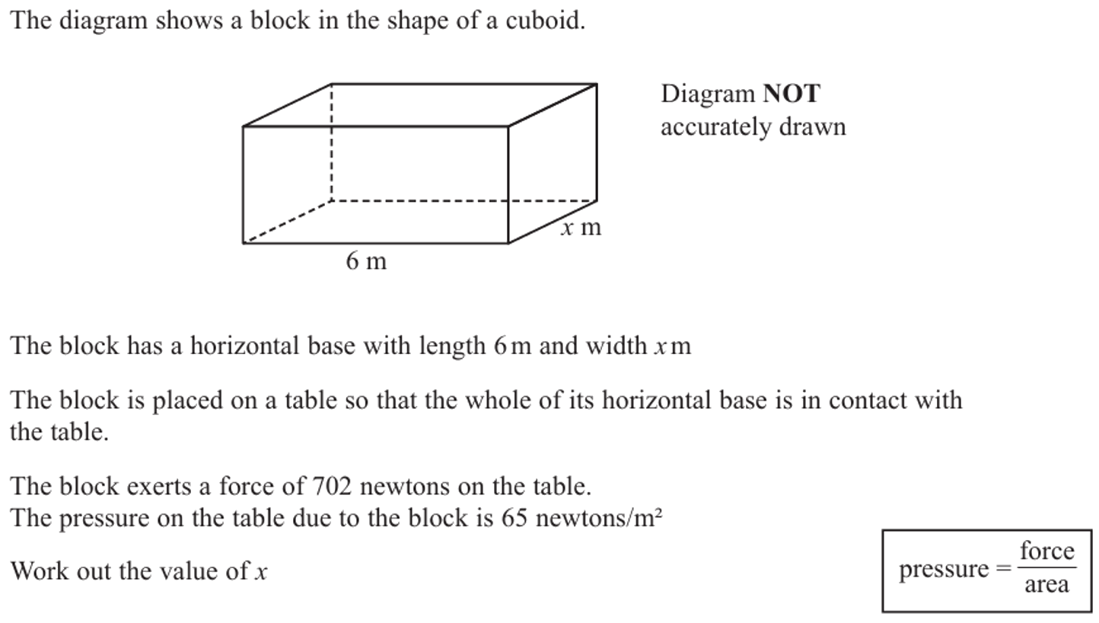
Zπ
PAST-PAPER QUESTION
Question 11

Slide 23
Zπ
RECAP
Key Takeaways
A compound measure links two quantities — ‘per’ means divided by.
Speed = distance ÷ time; density = mass ÷ volume; pressure = force ÷ area.
Use the formula triangle: cover what you want, the line means divide.
Match the units BEFORE calculating (kg → g, minutes → hours, m → cm).
km/h → m/s: divide by 3.6. m/s → km/h: multiply by 3.6.
Golden rule: choose the triangle, fix the units, then divide or multiply — and answer in the unit asked for.

