Slide 1
Zπ
Zπ MATHS HUB
Pearson Edexcel IGCSE (9–1) · Higher Tier
Angles & Polygons
Angle Rules · Parallel Lines · Triangles & Quadrilaterals · Interior & Exterior Angles of Polygons
Zahra Sheikh Ali
IGCSE Mathematics Teacher · M.Sc. Differential Geometry & Geometric Control
☎ 66613748 ✉ zahraa.sheikhali@outlook.com

Slide 2
Zπ
LESSON OVERVIEW
From Basic Angle Rules to Polygons
Part 1 covers the ANGLE RULES — straight lines, points, triangles and parallel lines. Part 2 applies them to POLYGONS, using the interior angle sum (n − 2) × 180° and the fact that exterior angles add up to 360°.
Straight line, point, opposite
Triangles & quadrilaterals
Parallel lines: F, Z, C
1
2
3
Interior angle sum
Exterior angles & regular polygons
Past-paper questions
4
5
6
Key words: straight line · vertically opposite · alternate · co-interior · isosceles · polygon · interior · exterior · regular

Slide 3
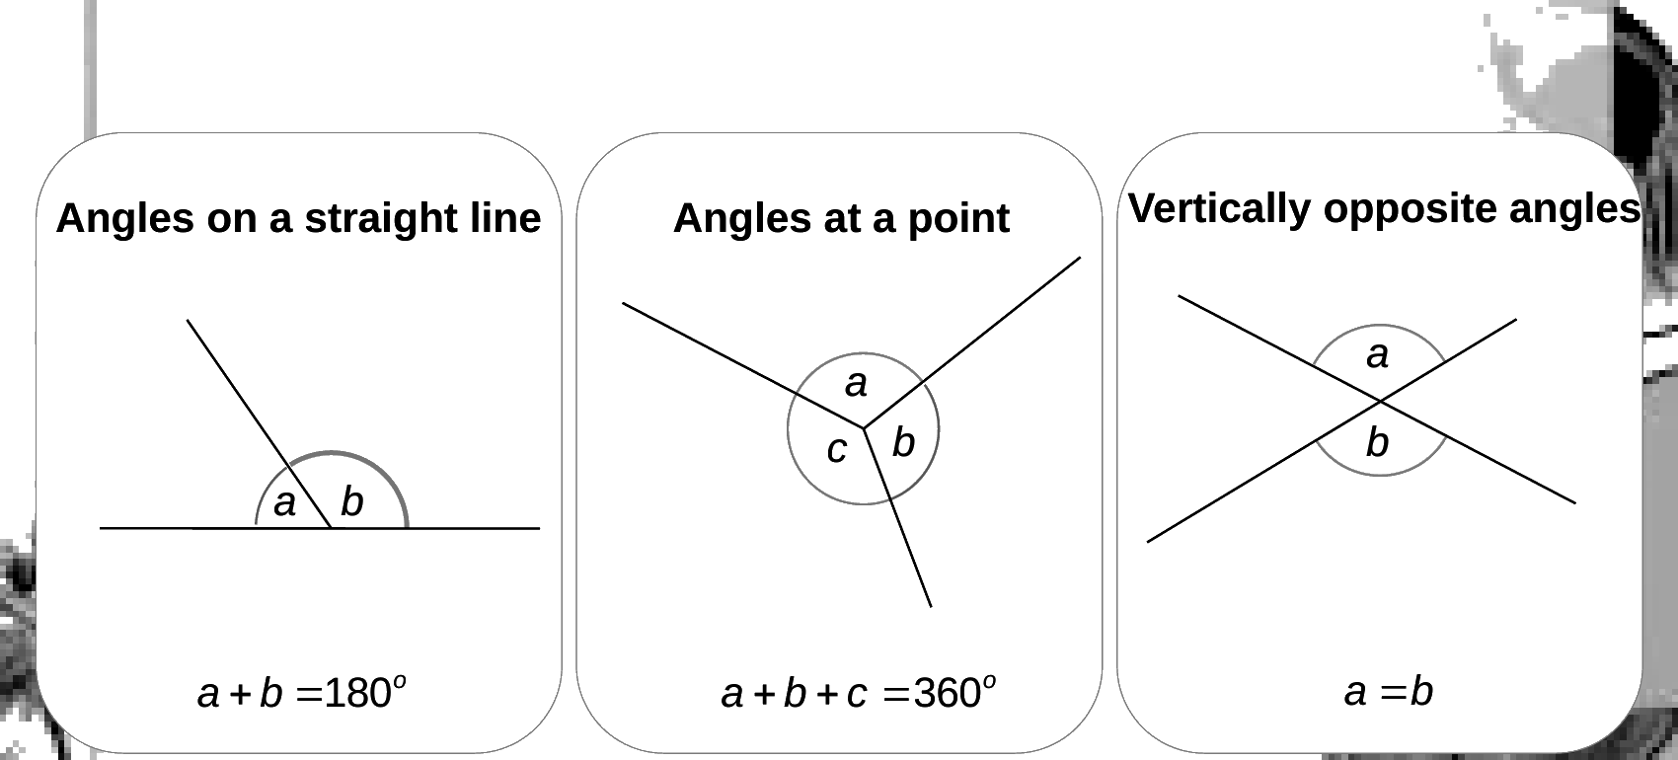
Zπ
THE BASIC RULES
Straight Line · Point · Vertically Opposite
Three rules that appear in almost every question.
Straight line = 180°. Full turn at a point = 360°. Vertically opposite angles are equal.

Slide 4
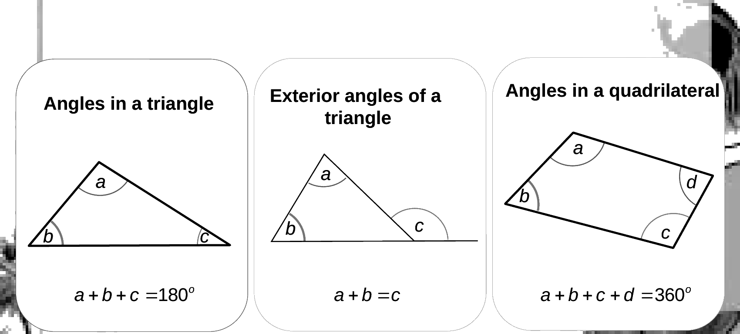
Zπ
TRIANGLES & QUADRILATERALS
Angle Sums
Add up the angles inside the shape — and learn the exterior-angle rule.
Triangle = 180°. Quadrilateral = 360°. Exterior angle of a triangle = the two opposite interior angles.

Slide 5
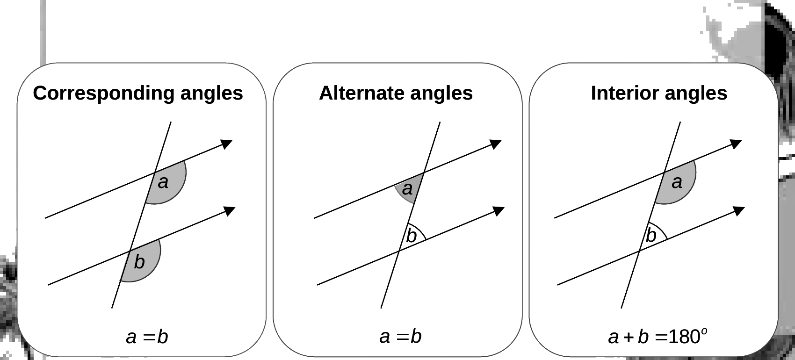
Zπ
PARALLEL LINES
Corresponding · Alternate · Interior
Look for the F, Z and C shapes. Arrows on the lines tell you they are parallel.
Corresponding and alternate angles are EQUAL; interior (co-interior) angles ADD UP TO 180°.

Slide 6
Zπ
ISOSCELES TRIANGLES
Two Equal Sides → Two Equal Angles
Exam questions very often hide an isosceles triangle. Equal sides (the dashes) mean the base angles are equal.
equal sides
How to use it
x
The two base angles are EQUAL (both y).
x + y + y = 180°, so x + 2y = 180°.
Given the apex x: y = (180° − x) ÷ 2.
Given a base angle y: x = 180° − 2y.
y
y
Equilateral triangle: every angle is 60°.
the two base angles are equal
Equal sides → equal base angles. Look for the dashes, or two matching sides / radii.

Slide 7
Zπ
EXAM TECHNIQUE
Give a Reason for Every Step
Marks are given for the REASON as well as the number. Use the proper wording.
What you used
How to write the reason
Straight line
angles on a straight line add up to 180°
Point
angles at a point add up to 360°
Crossing lines
vertically opposite angles are equal
Triangle
angles in a triangle add up to 180°
Parallel, F-shape
corresponding angles are equal
Parallel, Z-shape
alternate angles are equal
Parallel, C-shape
co-interior angles add up to 180°
Equal sides
base angles of an isosceles triangle are equal
Work one angle at a time, write it on the diagram, and state the reason — then use it to find the next.

Slide 8
Zπ
PART 2
Angles in Polygons
Every polygon question comes from two facts: the interior angle sum, and exterior angles = 360°.
1
Sum of interior = (n − 2) × 180°
2
Exterior angles add to 360°
3
Regular: exterior = 360 ÷ n
4
interior + exterior = 180°

Slide 9
Zπ
POLYGONS
Names and What ‘Regular’ Means
REGULAR means all sides equal AND all angles equal. If it is not regular, the angles can all be different.
Triangle
Quadrilateral
Pentagon
3 sides
4 sides
5 sides
Hexagon
Octagon
Decagon
6 sides
8 sides
10 sides
n = the number of sides. A regular polygon has n equal sides and n equal angles.

Slide 10
Zπ
INTERIOR ANGLE SUM
Split the Polygon into Triangles
From one corner, draw diagonals. A polygon with n sides splits into (n − 2) triangles, and each triangle is 180°.
sum of interior angles = (n − 2) × 180°
Triangle
3
(3−2)×180 = 180°
Quadrilateral
4
(4−2)×180 = 360°
Pentagon
5
(5−2)×180 = 540°
Hexagon
6
(6−2)×180 = 720°
Octagon
8
(8−2)×180 = 1080°
pentagon: 5 − 2 = 3 triangles
Sum of interior angles = (n − 2) × 180° — because the polygon splits into (n − 2) triangles.

Slide 11
Zπ
EXTERIOR ANGLES
They Always Add Up to 360°
An exterior angle is the angle you turn at each corner. Walking right round the shape is one full turn — 360°, whatever the number of sides.
sum of exterior angles = 360°
Interior + exterior at each corner
interior + exterior = 180°
They sit on a straight line at every corner.
each turn is an exterior angle
Exterior angles ALWAYS add to 360°; at each corner, interior + exterior = 180°.

Slide 12
Zπ
REGULAR POLYGONS
One Exterior Angle, One Interior Angle
In a REGULAR polygon every angle is the same, so just divide.
Each exterior angle
Each interior angle
=
360°
= 180° − exterior
n
(or sum ÷ n)
Regular polygon
Exterior
Interior
Pentagon (n=5)
360÷5 = 72°
180−72 = 108°
Hexagon (n=6)
360÷6 = 60°
180−60 = 120°
Octagon (n=8)
360÷8 = 45°
180−45 = 135°
Decagon (n=10)
360÷10 = 36°
180−36 = 144°

Slide 13
Zπ
FINDING THE NUMBER OF SIDES
Work Backwards from an Angle
1
A regular polygon has an exterior angle of 24°. How many sides?
Method
Always turn the interior angle into the EXTERIOR angle first.
exterior = 180° − interior.
n = 360° ÷ exterior angle.
Check: n must be a whole number.
2
n = 360° ÷ exterior = 360 ÷ 24 = 15 sides
3
If instead the INTERIOR angle is 150°: exterior = 180 − 150 = 30°
4
n = 360 ÷ 30 = 12 sides
n = 360° ÷ exterior angle (interior first → exterior = 180° − interior)
You can also use the sum: (n − 2) × 180 = n × interior, then solve for n.

Slide 14
Zπ
SHAPES MEETING AT A POINT
A Very Common Exam Question
When regular polygons meet at a point, their INTERIOR angles fit together. They must add up to 360°.
The idea
Example
Work out each polygon's INTERIOR angle.
A regular hexagon and a regular octagon meet at a point. Find the third angle.
hexagon interior = 120°
octagon interior = 135°
third = 360 − 120 − 135 = 105°
At a point they add up to 360°.
Round a straight line they add to 180°.
Inside a shape, use the angle sum.
Find each interior angle first, then use ‘angles at a point add to 360°’.

Slide 15
Zπ
PART 3
Past-Paper Questions
Angle-rule questions first, then the polygon questions.
1
One rule at a time — give the reason
2
Parallel → F, Z, C
3
Polygons → (n − 2) × 180°
4
Regular → exterior = 360 ÷ n

Slide 16
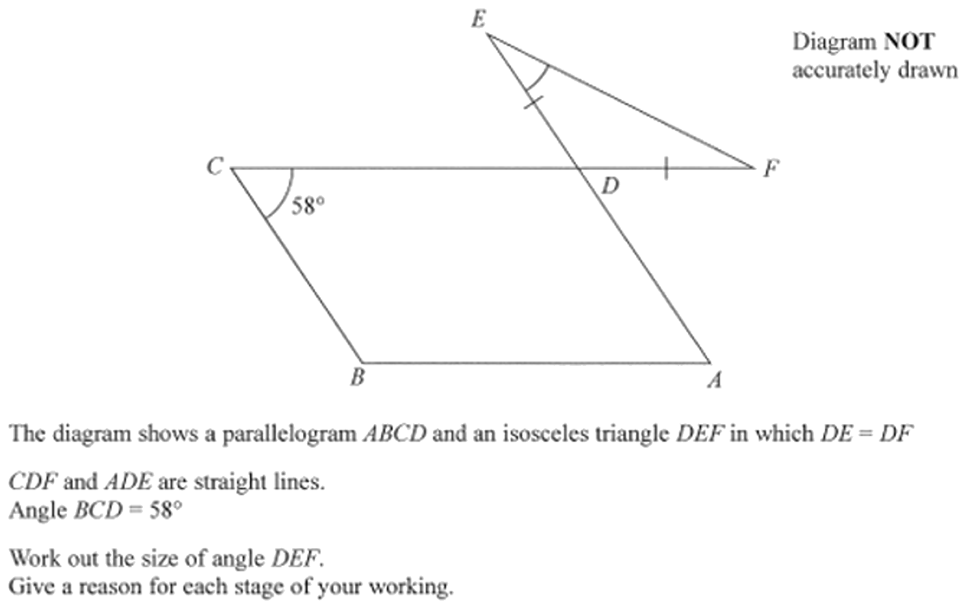
Zπ
PAST-PAPER QUESTION
Question 1

Slide 17
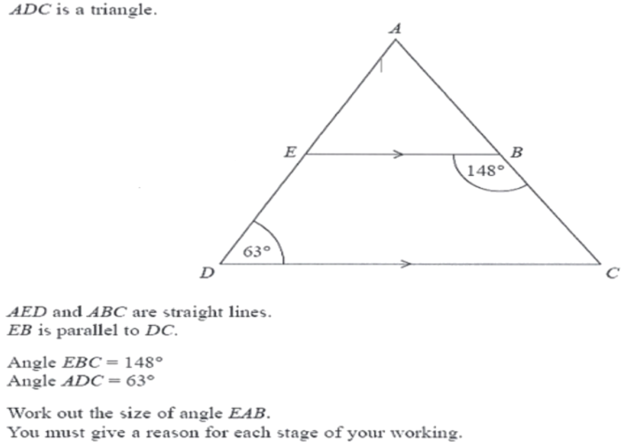
Zπ
PAST-PAPER QUESTION
Question 2

Slide 18
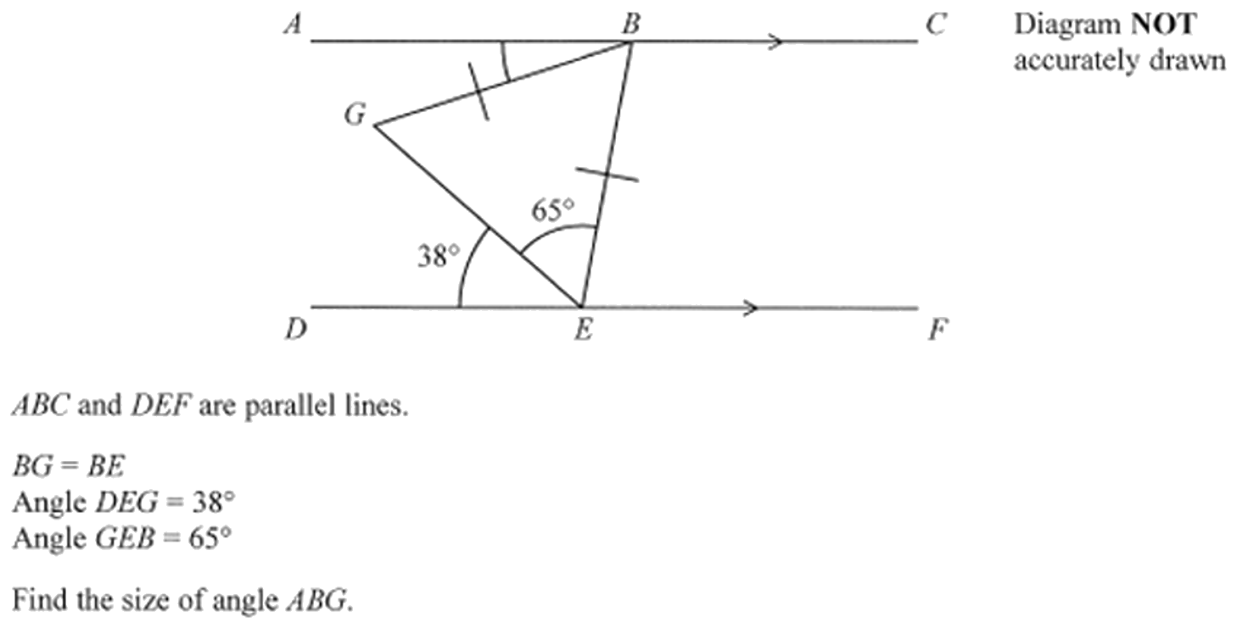
Zπ
PAST-PAPER QUESTION
Question 3

Slide 19
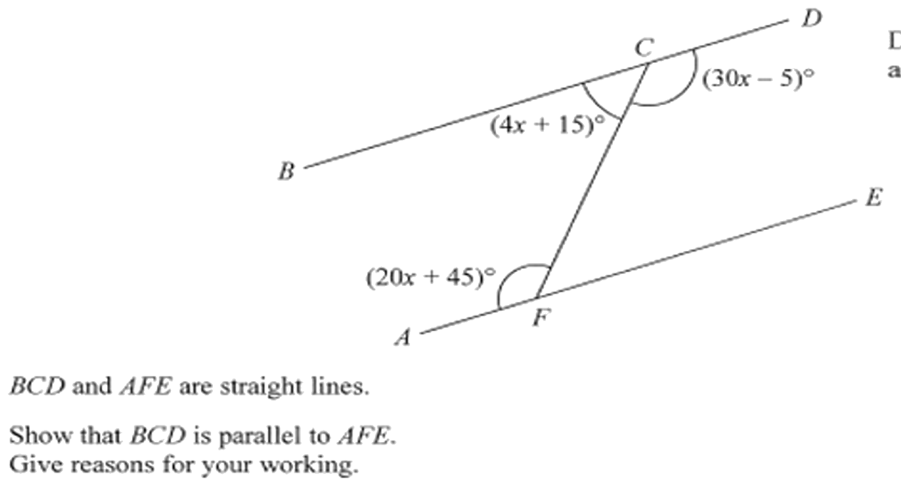
Zπ
PAST-PAPER QUESTION
Question 4

Slide 20
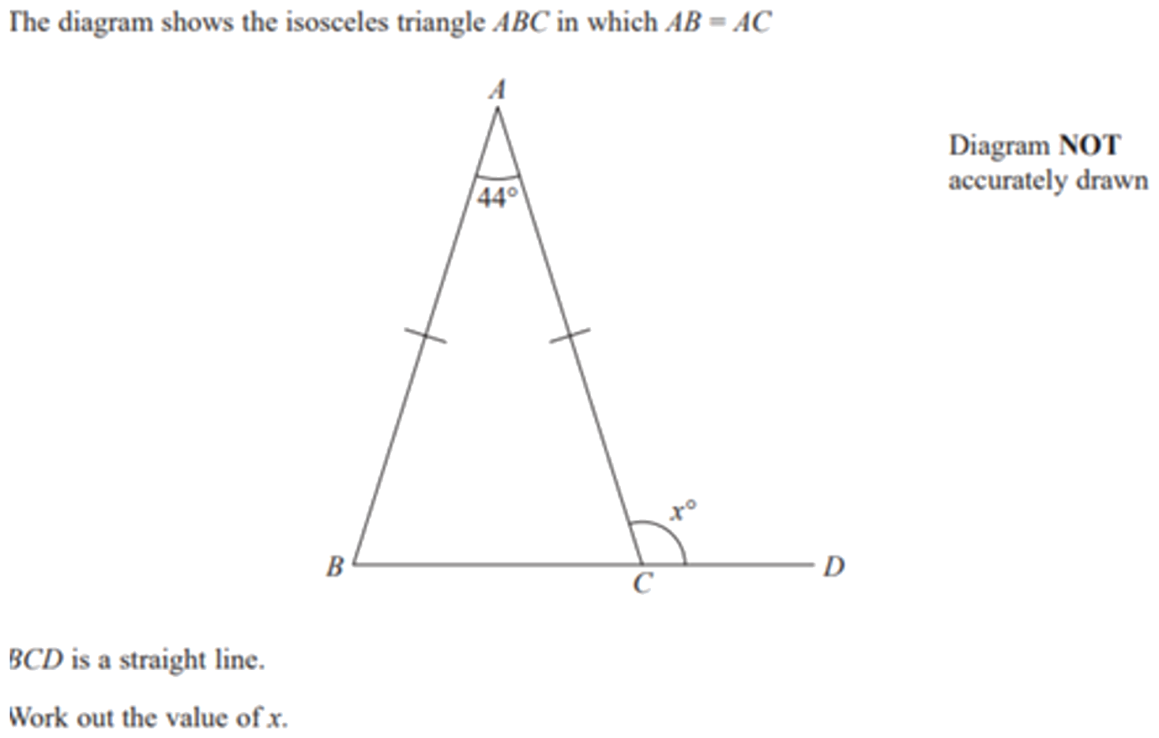
Zπ
PAST-PAPER QUESTION
Question 5

Slide 21
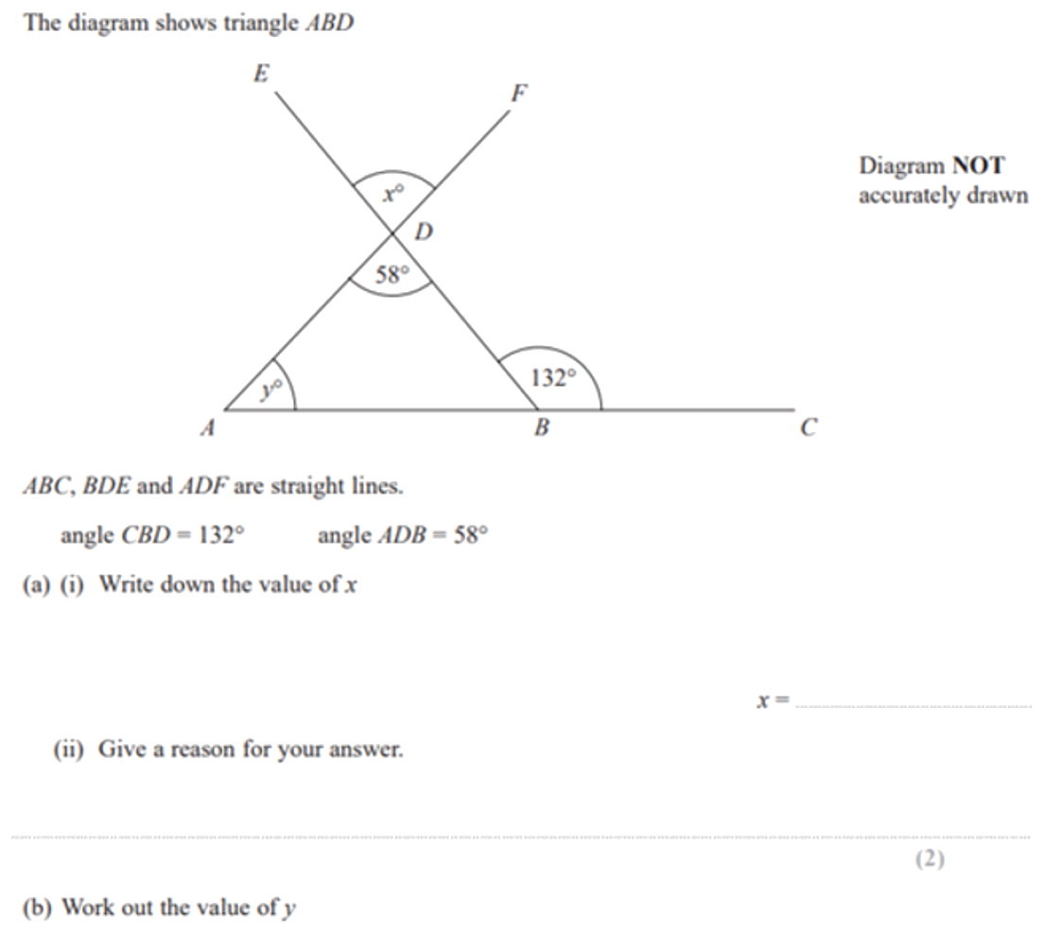
Zπ
PAST-PAPER QUESTION
Question 6

Slide 22
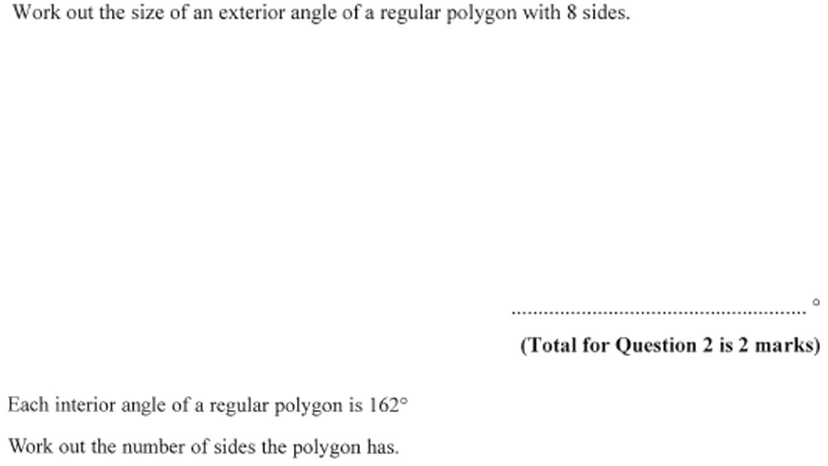
Zπ
PAST-PAPER QUESTION
Question 7

Slide 23
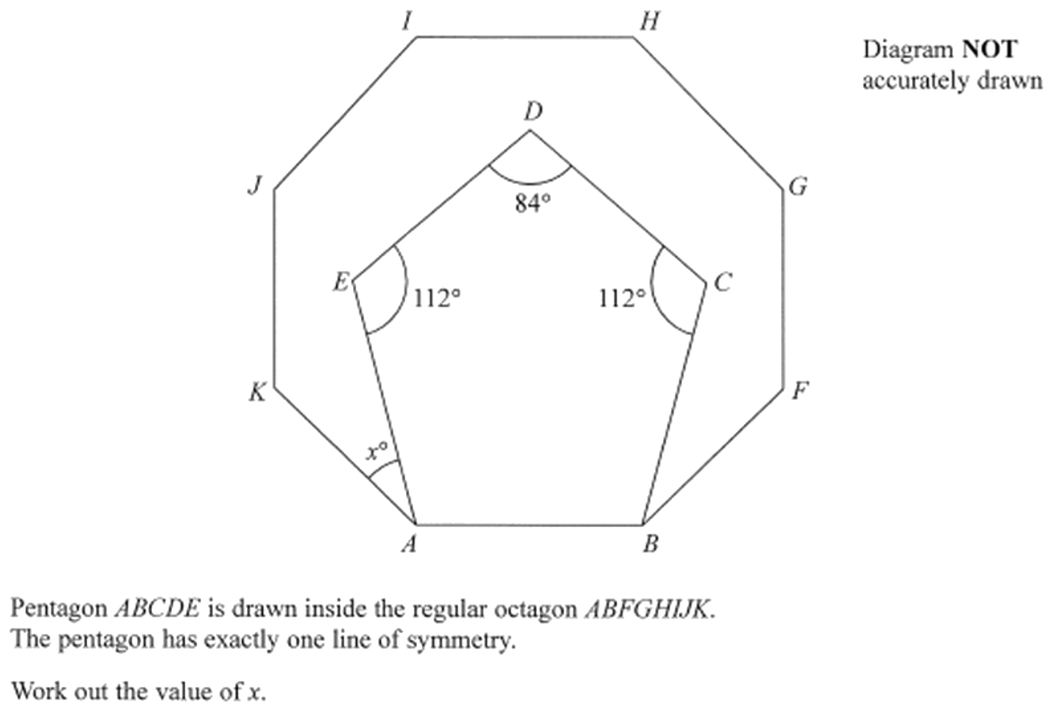
Zπ
PAST-PAPER QUESTION
Question 8

Slide 24
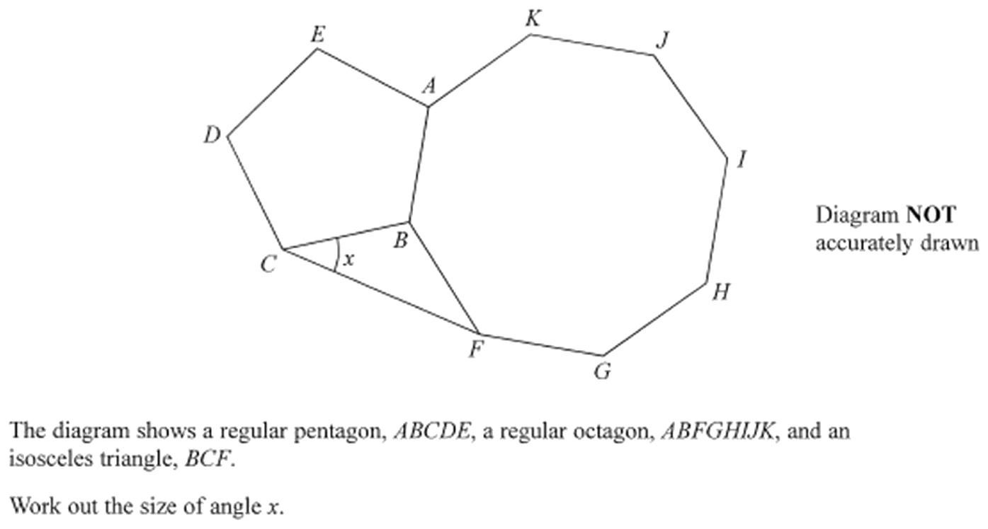
Zπ
PAST-PAPER QUESTION
Question 9

Slide 25
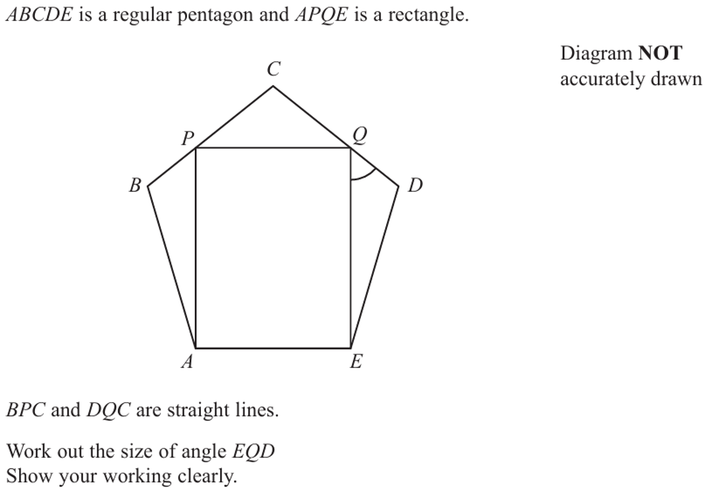
Zπ
PAST-PAPER QUESTION
Question 10

Slide 26
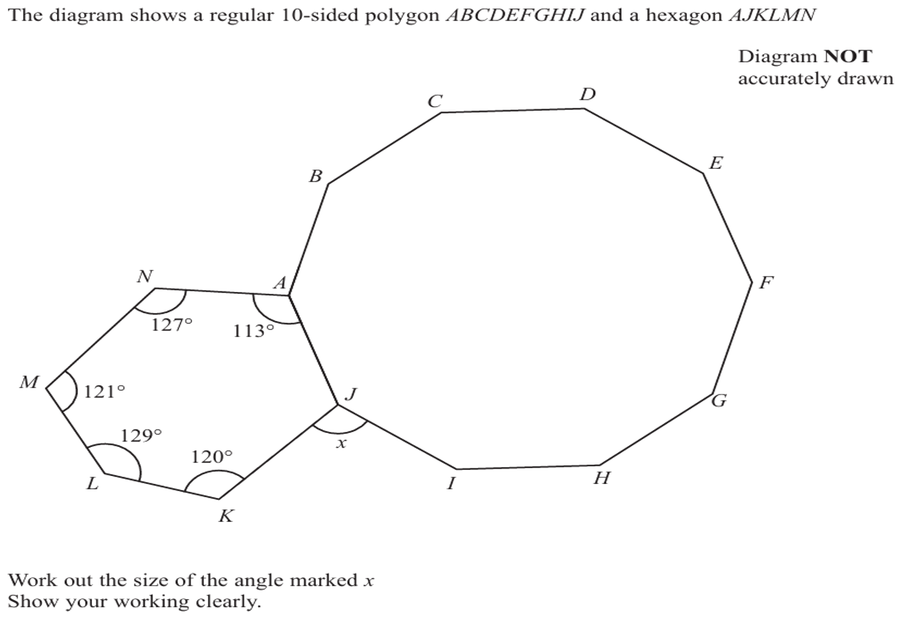
Zπ
PAST-PAPER QUESTION
Question 11

Slide 27
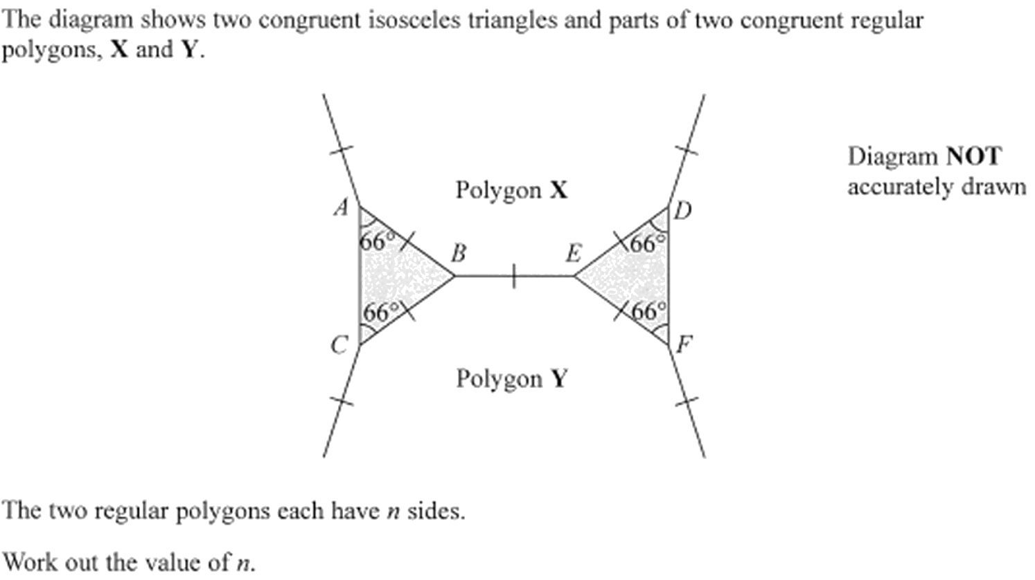
Zπ
PAST-PAPER QUESTION
Question 12

Slide 28
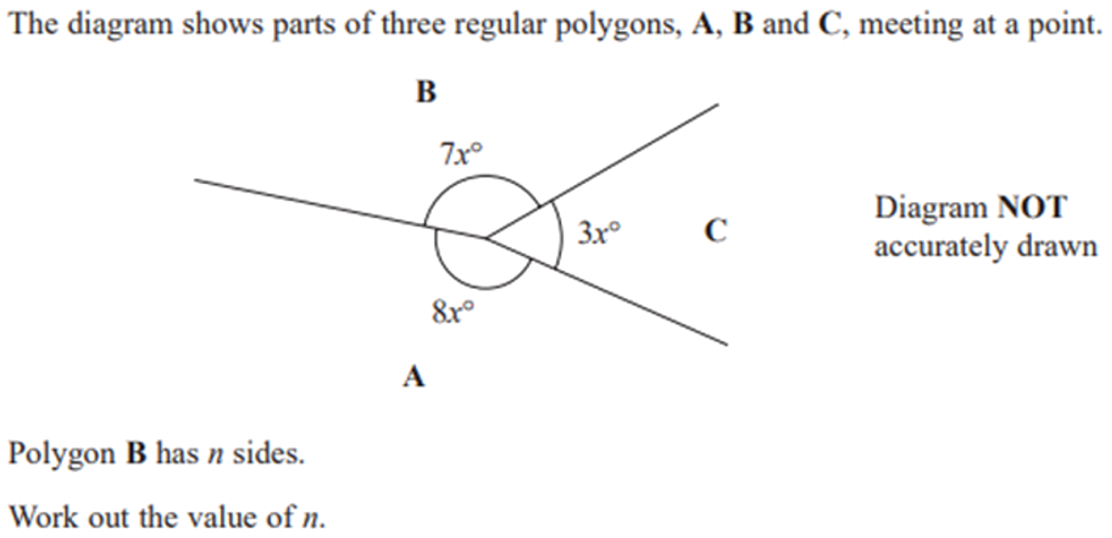
Zπ
PAST-PAPER QUESTION
Question 13

Slide 29
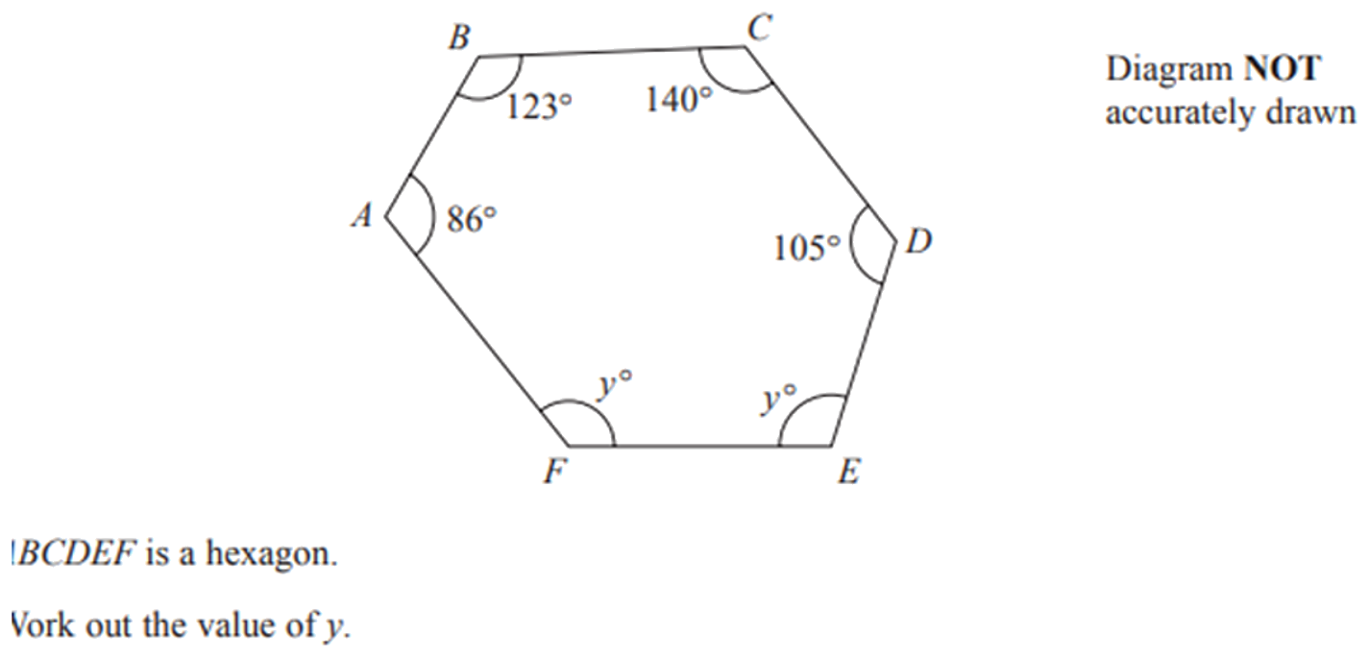
Zπ
PAST-PAPER QUESTION
Question 14

Slide 30
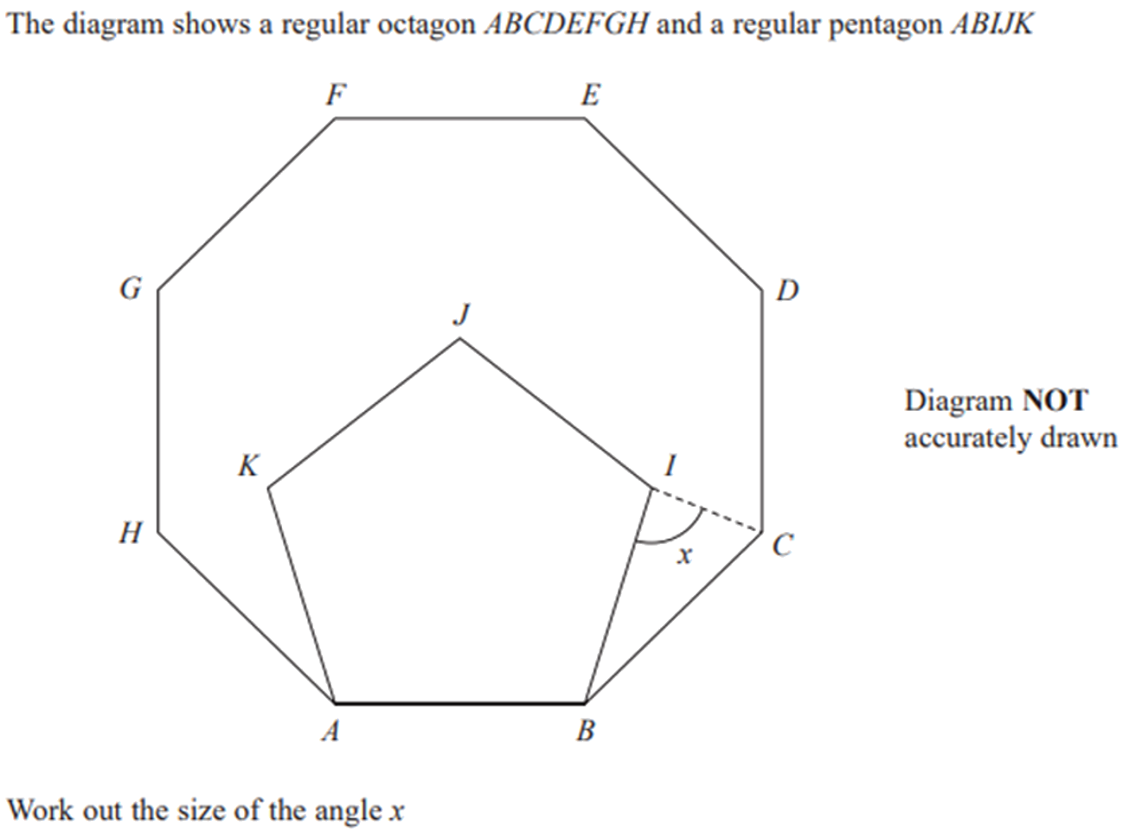
Zπ
PAST-PAPER QUESTION
Question 15

Slide 31
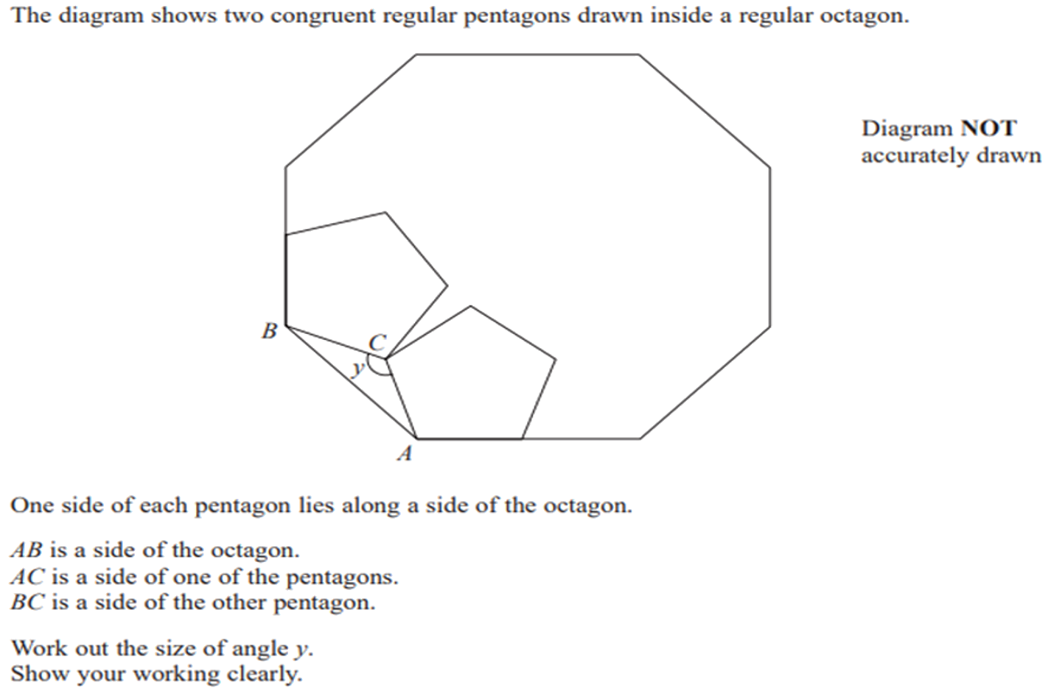
Zπ
PAST-PAPER QUESTION
Question 16

Slide 32
Zπ
RECAP
Key Takeaways
Straight line 180°, point 360°, vertically opposite angles equal.
Triangle 180°, quadrilateral 360°; exterior angle of a triangle = the two opposite interior angles.
Parallel lines: corresponding and alternate EQUAL; co-interior add to 180°.
Polygons: sum of interior angles = (n − 2) × 180°; exterior angles add to 360°.
Regular polygon: exterior = 360° ÷ n, interior = 180° − exterior, and n = 360° ÷ exterior.
Golden rule: one rule at a time with a reason — and for polygons, go through the exterior angle.

