Slide 1
Zπ
Zπ MATHS HUB
Pearson Edexcel IGCSE (9–1) · Higher Tier
y = mx + c
Straight Line Equations
y = mx + c · Gradient & Intercept · Drawing Lines · Finding the Equation · Midpoint & Distance
Zahra Sheikh Ali
IGCSE Mathematics Teacher · M.Sc. Differential Geometry & Geometric Control
☎ 66613748 ✉ zahraa.sheikhali@outlook.com

Slide 2
Zπ
LESSON OVERVIEW
Everything from y = mx + c
Every straight line has the form y = mx + c. m is the gradient (steepness), c is where it crosses the y-axis. Find those two and you have the equation.
Lines & linear equations
Vertical & horizontal lines
Drawing a line
1
2
3
Gradient and intercept
Finding the equation
Midpoint & distance
4
5
6
Key words: linear · gradient · y-intercept · substitute · rearrange · midpoint

Slide 3
Zπ
WHAT IS A STRAIGHT LINE?
Linear Equations
A linear equation has every variable to the power 1. No x², no x³, no 1/x — those curve. Linear equations always give a STRAIGHT line.
Straight (linear) ✓
NOT straight ✗
y = 2x + 3
y = x² + 1
y = 5 − x
y = x³
2y + 7x = 10
y = 1/x
x = 4 / y = −1
y = √x
A power of 1 on x and y → a straight line. Any other power → a curve.

Slide 4
Zπ
SPECIAL LINES
Vertical & Horizontal
Look at what the points have in common. If every x is the same → x = c. If every y is the same → y = c.
Vertical: x = c
Horizontal: y = c
(2, 3), (2, 1), (2, −2), (2, 4)
Every x-coordinate is 2.
Equation: x = 2
It cuts the x-axis at (2, 0).
Gradient is undefined (infinitely steep).
(0, 1), (3, 1), (−2, 1), (2, 1)
Every y-coordinate is 1.
Equation: y = 1
It cuts the y-axis at (0, 1).
Gradient = 0 (flat).
Remember: the x-axis is y = 0, and the y-axis is x = 0.

Slide 5
Zπ
SUBSTITUTING
Does the Point Lie on the Line?
1
Substitute the coordinates and check both sides match.
Method
Put the x-value into the equation.
Work out y.
If it matches the point's y-value, the point is on the line.
2
y = 2x − 6 and (3, 0): 2(3) − 6 = 0 ✓ lies on the line
3
y = 3x + 2 and (4, 11): 3(4) + 2 = 14, not 11
4
✗ does NOT lie on the line
Substitute x, then compare the y-values
Always give a reason in the exam: state the y-value you calculated.

Slide 6
Zπ
THE KEY IDEA
y = mx + c
y = mx + c
m = the GRADIENT
c = the y-INTERCEPT
How steep the line is.
The number in front of x.
Where the line crosses the y-axis.
The number on its own — the point (0, c).
y = 3x + 2 → gradient 3, crosses the y-axis at (0, 2)

Slide 7
Zπ
READING m AND c
Rearrange into y = mx + c First
1
y = 5x − 4 → m = 5, c = −4
Golden rule
You can only read m and c when y is ALONE on one side.
Rearrange first: get y = …
m is the number multiplying x (with its sign).
2
y = 3 − 2x → m = −2, c = 3 (watch the sign!)
3
5x + 2y = 7 → 2y = 7 − 5x → y = 3.5 − 2.5x
→ m = −2.5, c = 3.5
5x + 2y = 7 → gradient = −2.5
A common exam question: ‘find the gradient of 5x + 2y = 7’ — you must rearrange.

Slide 8
Zπ
GRADIENT
From Two Points
Gradient = rise ÷ run. Take the change in y over the change in x.
m =
y₂ − y₁
x₂ − x₁
Example: (2, 3) and (5, 12)
Example: (4, 5) and (2, −3)
m = (12 − 3) ÷ (5 − 2)
= 9 ÷ 3 = 3
m = (5 − (−3)) ÷ (4 − 2)
= 8 ÷ 2 = 4
Subtract in the SAME order on top and bottom.

Slide 9
Zπ
GRADIENT
Positive, Negative, Zero or Undefined
The sign of m tells you which way the line slopes.
POSITIVE m > 0
NEGATIVE m < 0
upward slope /
downward slope \
e.g. y = 2x + 1
e.g. y = 3 − 2x
ZERO m = 0
UNDEFINED
horizontal —
vertical |
e.g. y = 4
e.g. x = 2
Steeper line → bigger |m|. A gradient of ½ is gentle; a gradient of 5 is steep.

Slide 10
Zπ
FINDING THE EQUATION
Given the Gradient and a Point
1
The gradient is 3 and the line passes through (4, 5).
Method
Put m into y = mx + c.
Substitute the point's x and y to find c.
Write the full equation.
2
Start with y = 3x + c
3
Substitute the point: 5 = 3(4) + c → 5 = 12 + c
4
c = −7, so y = 3x − 7
y = 3x − 7
If the point is (0, 5), then c = 5 straight away — it IS the y-intercept.

Slide 11
Zπ
FINDING THE EQUATION
Given Two Points
1
The line passes through (3, 6) and (5, 12).
Two steps
FIRST find the gradient from the two points.
THEN substitute either point to find c.
Check with the other point: 5 × 3 − 3 = 12 ✓
2
Gradient: m = (12 − 6) ÷ (5 − 3) = 6 ÷ 2 = 3
3
y = 3x + c. Substitute (3, 6): 6 = 9 + c → c = −3
4
So y = 3x − 3
y = 3x − 3
Some exams want the answer as ax + by = c — rearrange at the end.

Slide 12
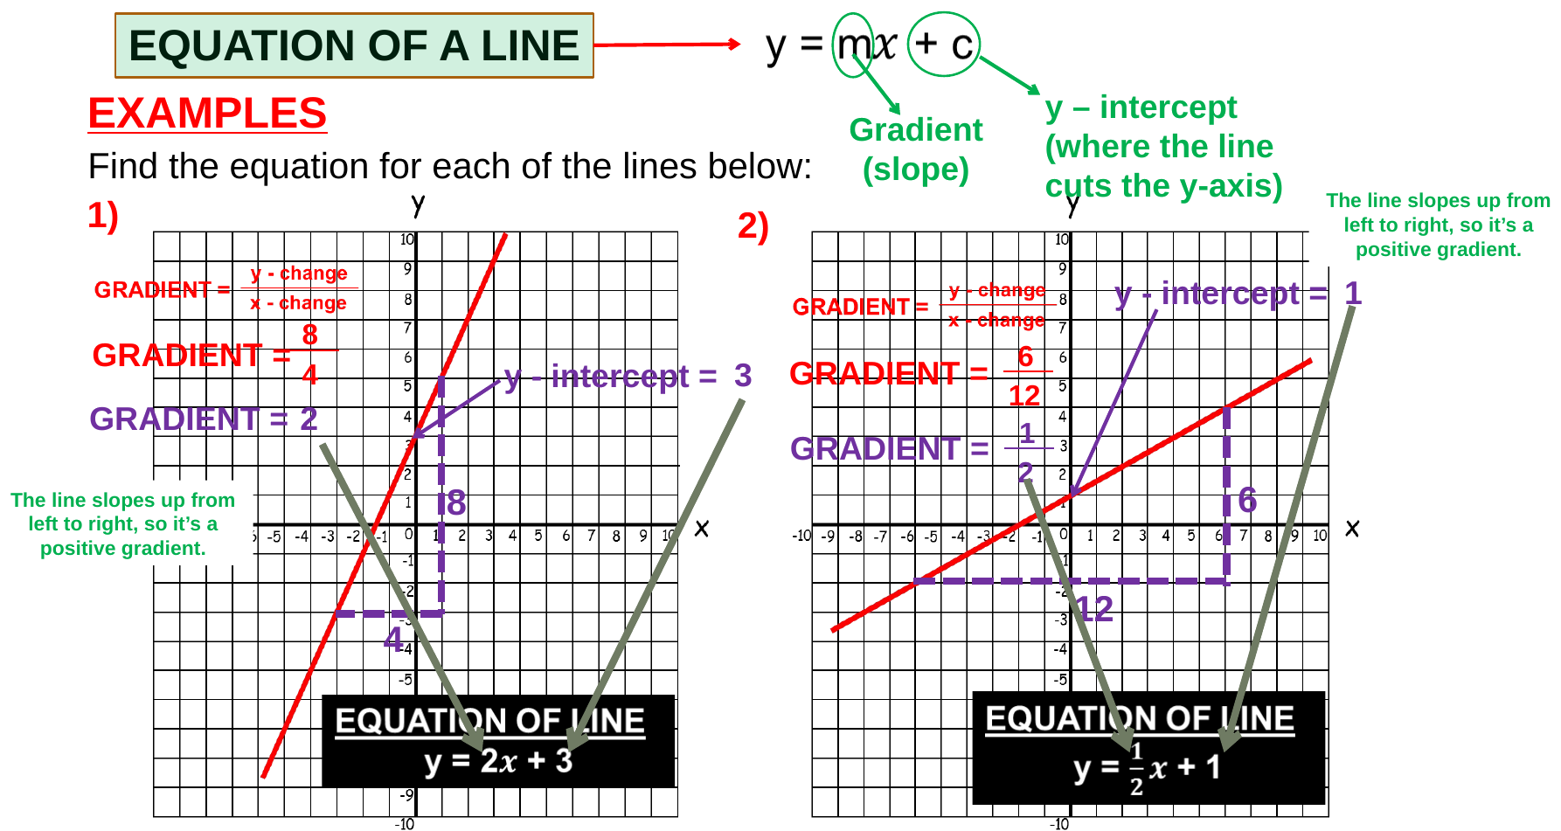
Zπ
FINDING THE EQUATION
From a Graph — Positive Gradients
Read c where the line crosses the y-axis, find m by rise ÷ run, then write y = mx + c.
Find c first (easy to read), then m — then put them into y = mx + c.

Slide 13
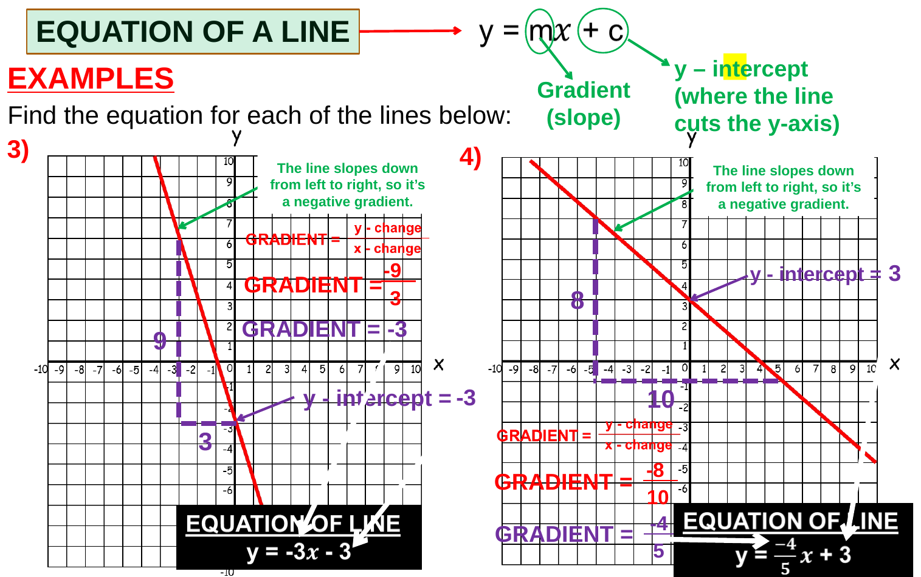
Zπ
FINDING THE EQUATION
From a Graph — Negative Gradients
If the line slopes DOWN from left to right, the gradient is negative.
A downward slope means m is NEGATIVE — do not forget the minus sign.

Slide 14
Zπ
TWO LAST THINGS
Midpoint & Distance
Midpoint — average the coordinates
Distance — Pythagoras
M =
( x₁ + x₂ , y₁ + y₂ ) ÷ 2
d = √( (x₂−x₁)² + (y₂−y₁)² )
e.g. (5, 4) and (13, 1) → (9, 2.5)
e.g. (0, 0) and (3, 4) → √(9 + 16) = 5
Midpoint: ADD and halve. Distance: SUBTRACT, square, add, square-root.
Exam example: A(−3, 11) and B(47, b). The midpoint of AB is (a, −19). Find a and b.
a = (−3 + 47) ÷ 2 = 22. (11 + b) ÷ 2 = −19 → 11 + b = −38 → b = −49.

Slide 15
Zπ
PART 2
Past-Paper Questions
Rearrange to y = mx + c, then read off m and c — or find them from points.
1
Rearrange first if y is not alone
2
Gradient from two points: rise ÷ run
3
Substitute a point to find c
4
Give the answer in the form asked for

Slide 16
Zπ
PAST-PAPER QUESTIONS (1 of 3)
Gradient, Intercept & Points
Line L has equation y = 2 − 3x. (a) Write down the gradient of L. (b) Does the point (100, −302) lie on L? Give a reason.
1
ANSWER
m = −3; No: y = −298
Find the gradient of the straight line with equation 5x + 2y = 7.
2
ANSWER
m = −2.5
The straight line L has equation 2y + 7x = 10. (a) Find the gradient of L. (b) Find where L crosses the y-axis.
3
ANSWER
m = −3.5; (0, 5)

Slide 17
Zπ
PAST-PAPER QUESTIONS (2 of 3)
Finding the Equation
Write down an equation of the straight line with gradient −3 that passes through (0, 5).
4
ANSWER
y = −3x + 5
Line L has gradient −2 and passes through (1, 3). Find an equation of L in the form ax + by = c.
5
ANSWER
2x + y = 5
The points (1, −1) and (4, 7) lie on line L. Find an equation for L in the form ax + by = c.
6
ANSWER
8x − 3y = 11

Slide 18
Zπ
PAST-PAPER QUESTIONS (3 of 3)
Equations, Midpoint & Coordinates
Find an equation of the line through (−3, 5) and (1, 2). Give your answer as ax + by = c.
7
ANSWER
3x + 4y = 11
A is (5, 4) and B is (13, 1). Work out the coordinates of the midpoint of AB.
8
ANSWER
(9, 2.5)
A is (−3, 11), B is (47, b). The midpoint of AB is (a, −19). Find a and b.
9
ANSWER
a = 22, b = −49

Slide 19
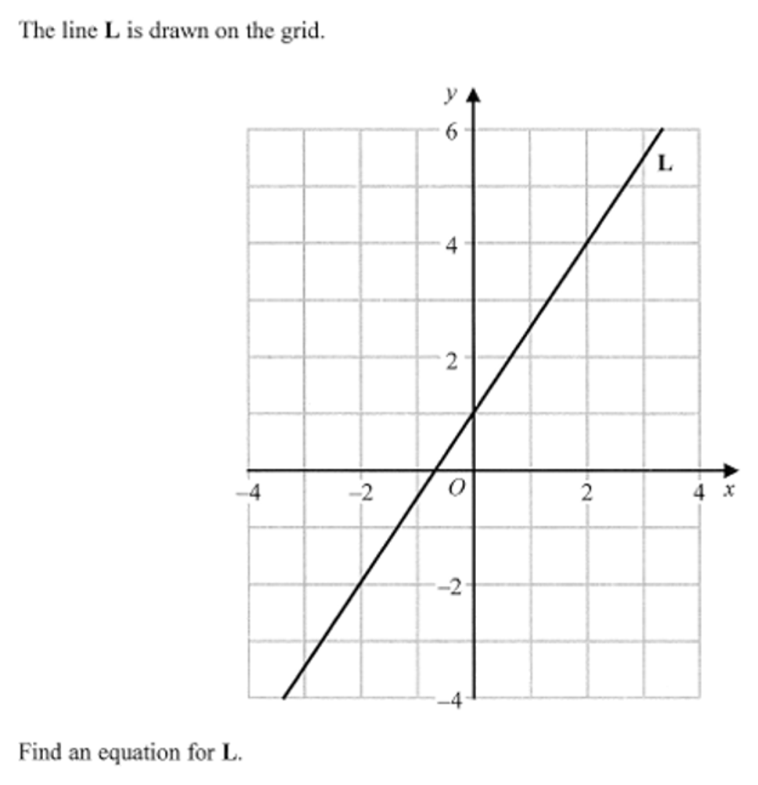
Zπ
PAST-PAPER · ON THE GRID
Question 10 — find an equation for L

Slide 20
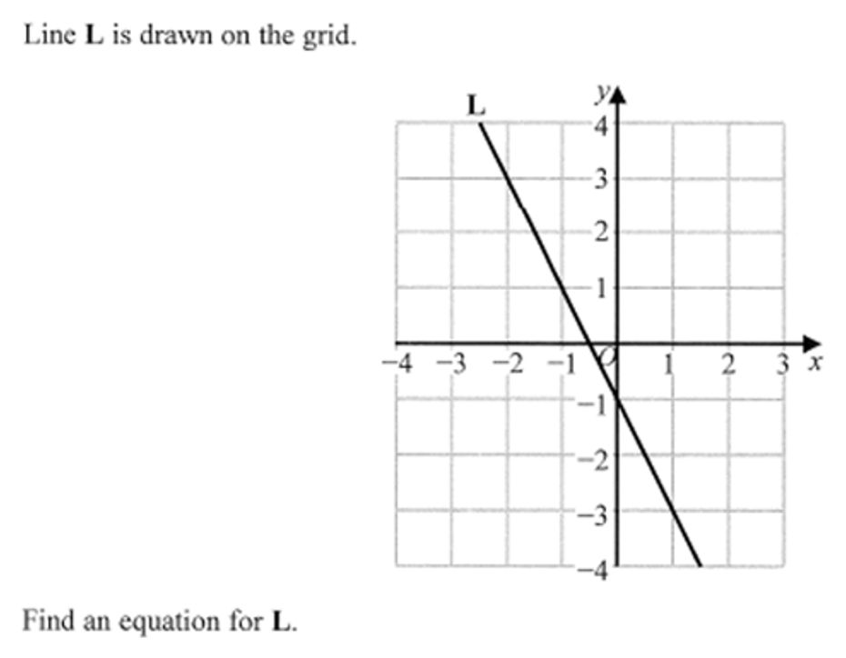
Zπ
PAST-PAPER · ON THE GRID
Question 11 — find an equation for L

Slide 21
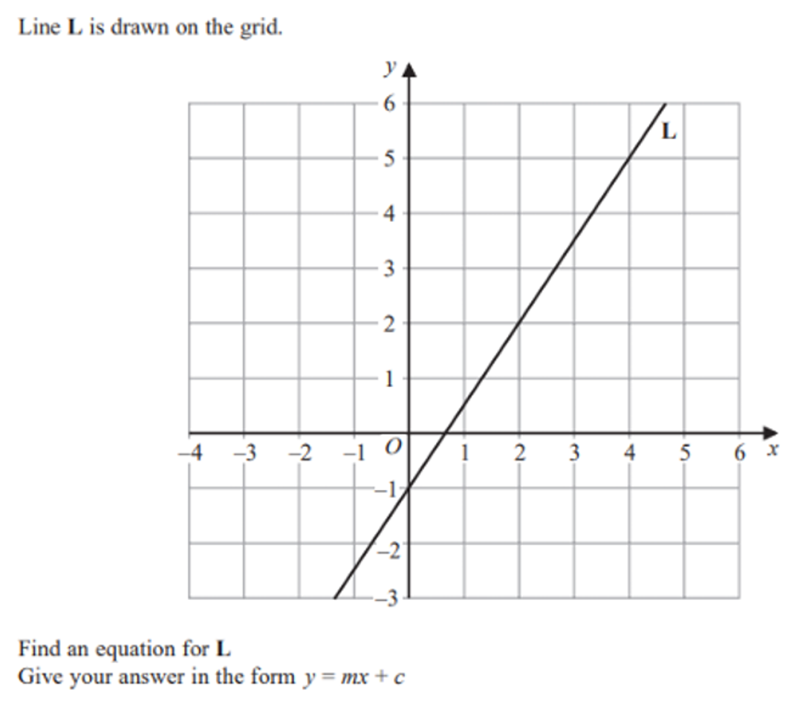
Zπ
PAST-PAPER · ON THE GRID
Question 12 — give your answer as y = mx + c

Slide 22
Zπ
RECAP
Key Takeaways
Every straight line is y = mx + c: m = gradient, c = y-intercept.
Rearrange to y = … BEFORE reading off m and c.
Gradient from two points = (y₂ − y₁) ÷ (x₂ − x₁).
Given m and a point: substitute to find c. Given two points: find m first.
Vertical lines are x = c; horizontal lines are y = c.
Golden rule: find the gradient and the y-intercept — those two numbers are the equation.

