Slide 1
Zπ
Zπ MATHS HUB
Pearson Edexcel IGCSE (9–1) · Higher Tier
Drawing a Straight Line
Table of Values · Gradient (Rise over Run) · Using the Intercepts · Horizontal & Vertical Lines
Zahra Sheikh Ali
IGCSE Mathematics Teacher · M.Sc. Differential Geometry & Geometric Control
☎ 66613748 ✉ zahraa.sheikhali@outlook.com

Slide 2
Zπ
LESSON OVERVIEW
Three Ways to Draw a Straight Line
Any equation like y = 2x + 1 can be drawn as a straight line. There are three methods — a table of values, the gradient (rise over run), or the two intercepts. All give the same line.
Linear equations
Horizontal & vertical lines
Method 1 · table of values
1
2
3
Method 2 · rise over run
Method 3 · the intercepts
Practice questions
4
5
6
Key words: linear · table of values · substitute · plot · gradient · rise · run · intercept · y = mx + c

Slide 3
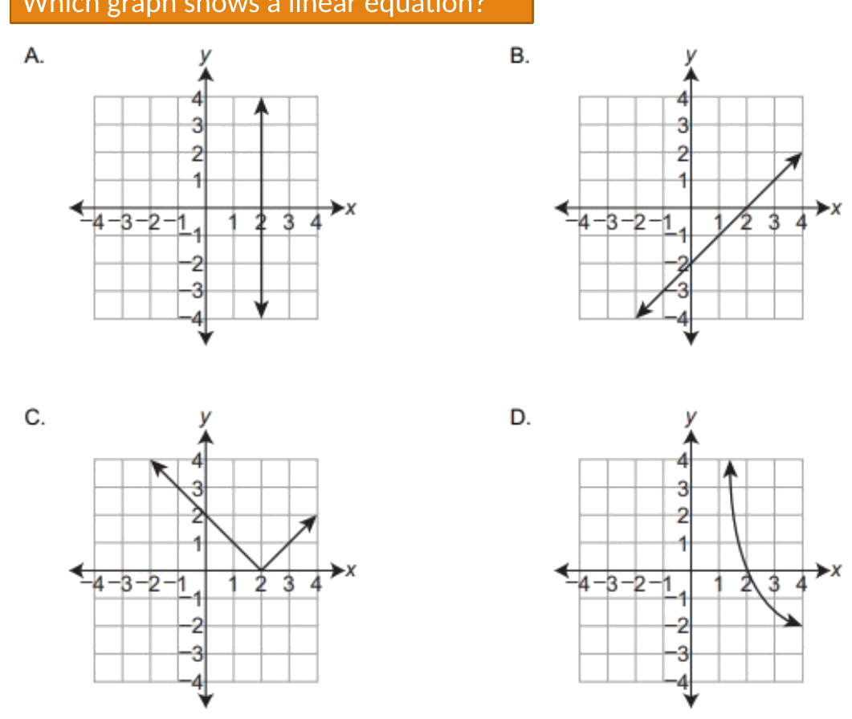
Zπ
LINEAR EQUATIONS
Which Graph is a Straight Line?
A linear equation has x and y to the power 1 only — its graph is always a straight line.
No x², no 1/x, no curves — a linear equation always gives a STRAIGHT line.

Slide 4
Zπ
VERTICAL LINES
x = a number
Every point has the SAME x-coordinate. Plot them and you get a vertical line.
4
y
What the points show
x = 2
3
(2, 3), (2, 1), (2, −2), (2, 0), (2, −3)
The x-coordinate is ALWAYS 2.
So the line is x = 2.
It is vertical, and it crosses the x-axis at 2.
Gradient: the run is 0, and you cannot divide by 0 — so the gradient is UNDEFINED.
2
1
x
-3
-2
-1
1
2
3
4
-1
-2
-3
-4
x = a number is always a VERTICAL line through that number on the x-axis.

Slide 5
Zπ
HORIZONTAL LINES
y = a number
Every point has the SAME y-coordinate. Plot them and you get a horizontal line.
4
y
What the points show
3
(0, 1), (3, 1), (−2, 1), (1, 1), (−3, 1)
The y-coordinate is ALWAYS 1.
So the line is y = 1.
It is horizontal, and it crosses the y-axis at 1.
Gradient: there is no rise at all, so the gradient is 0.
2
y = 1
1
x
-4
-3
-2
-1
1
2
3
4
-1
-2
-3
y = a number is always a HORIZONTAL line through that number on the y-axis.

Slide 6
Zπ
CHECKING A POINT
Does the Point Lie on the Line?
Substitute the x-value into the equation. If you get the y-value, the point is on the line.
Equation
Point
Substitute x
Check y
y = 2x − 6
(3, 0)
2(3) − 6 = 0
0 = 0 ✓ lies on the line
y = 3x + 2
(4, 11)
3(4) + 2 = 14
14 ≠ 11 ✗ does NOT
y = 4x − 5
(2, 3)
4(2) − 5 = 3
3 = 3 ✓ lies on the line
Put the x-value in. If the answer matches the y-value, the point is on the line.

Slide 7
Zπ
THREE METHODS
Ways to Draw the Same Line
All three give exactly the same straight line — choose whichever suits the question.
Always works — and it is what exam papers usually ask for.
TABLE OF VALUES
1
Substitute several x-values, work out y, plot the points.
Fastest when the equation is already y = mx + c.
RISE OVER RUN
2
Mark c on the y-axis, then step out the gradient to a second point.
Best when the equation looks like ax + by = c.
THE INTERCEPTS
3
Put x = 0 to get one point, y = 0 to get the other, then join.
Every method needs at least TWO points — a third is a useful check.

Slide 8
Zπ
METHOD 1 · TABLE OF VALUES
Substitute x to Find y
Choose some easy x-values, put each one into the equation, and work out y. Example: y = 2x + 1.
The working
The completed table
x = 0
y = 2(0) + 1 = 1
x
0
1
2
x = 1
y = 2(1) + 1 = 3
y
1
3
5
x = 2
y = 2(2) + 1 = 5
Each column is a coordinate:
(0, 1) (1, 3) (2, 5)
Always substitute the WHOLE x-value, including any minus sign.
Top row = the x you chose. Bottom row = the y you worked out.

Slide 9
Zπ
METHOD 1 · TABLE OF VALUES
Plot the Points, Then Join Them
Plot (0, 1), (1, 3) and (2, 5), then rule a straight line through them.
6
y
The four steps
y = 2x + 1
5
(2, 5)
Complete the table of values.
1
4
3
2
Plot every point from the table.
(1, 3)
2
3
Rule a straight line through them.
1
(0, 1)
x
4
Label the line with its equation.
-2
-1
1
2
3
4
-1
If a point does not line up, check that row of your table again.
-2
Three points is ideal — two to draw the line and one to check it.

Slide 10
Zπ
METHOD 1 · WORKED EXAMPLE
Draw the Graph of y = x − 2
Take x from −1 to 3. Subtract 2 from each x-value to get y.
3
y
Table of values
2
y = x − 2
x
-1
0
1
2
3
1
y
-3
-2
-1
0
1
x
-3
-2
-1
1
2
3
4
-1
x = −1 → y = −1 − 2 = −3
x = 2 → y = 2 − 2 = 0
Plot (−1, −3), (0, −2), (1, −1), (2, 0), (3, 1) and join them.
-2
-3
-4
Negative x-values are fine — just be careful with the signs.

Slide 11
Zπ
METHOD 2 · RISE OVER RUN
Always Write the Gradient as a Fraction
Start at the y-intercept, then step: rise (up/down) and run (right/left).
gradient m =
rise
= change in y ÷ change in x
run
5
y
Worked example
4
y =
2
x + 1
run 3 →
3
3
c = 1 → start at (0, 1)
2
rise 2 ↑
2
m =
→ rise = 2, run = 3
1
3
start (0, 1)
x
rise +2 → UP 2, run +3 → RIGHT 3
That lands on (3, 3) — join the two points.
-1
1
2
3
4
5
-1
rise = change in y (+ up, − down) · run = change in x (+ right, − left)

Slide 12
Zπ
METHOD 2 · RISE OVER RUN
Negative Gradients — and Whole Numbers as Fractions
A whole-number gradient is still a fraction: write it over 1.
6
y
Example: y = −2x + 4
5
m = −2 =
−2
down 2, right 1
start (0, 4)
4
1
rise −2 ↓
3
2
run 1 →
1
The sign rules
x
rise +
go UP
rise −
go DOWN
-2
-1
1
2
3
4
-1
run +
go RIGHT
run −
go LEFT
-2
−2/1 and 2/−1 give the SAME line — down-right, or up-left.

Slide 13
Zπ
METHOD 3 · THE INTERCEPTS
Where the Line Crosses Each Axis
Put x = 0 to find where it crosses the y-axis, and y = 0 for the x-axis. Two points is all you need.
4
y
Example: 3x + 4y = 12
(0, 3)
When x = 0:
4y = 12 → y = 3 gives (0, 3)
When y = 0:
3x = 12 → x = 4 gives (4, 0)
Plot the two points and rule a line through them.
A third point is a good check: x = 2 → y = 1.5.
3
2
1
x
-1
1
2
3
4
5
(4, 0)
-1
x = 0 gives the y-intercept; y = 0 gives the x-intercept — join them up.

Slide 14
Zπ
INTERCEPTS
Where the Line Crosses the Axes
1
y-axis: put x = 0. x-axis: put y = 0.
Drawing a line
The two intercepts are enough to draw any sloping line.
Or make a small table of values (x = 0, 1, 2).
Use a ruler and extend across the grid.
2
y = 2x − 6. x = 0 → y = −6, so (0, −6)
3
y = 0 → 0 = 2x − 6 → x = 3, so (3, 0)
4
Plot the two points and join them — that draws the line.
Crosses the axes at (0, −6) and (3, 0)
Set x = 0 for the y-intercept; set y = 0 for the x-intercept.

Slide 15
Zπ
PART 2
Practice Questions
Complete the table, plot the points, then rule and label the line.
1
Complete the table of values
2
Plot every point
3
Join with a ruler
4
Label the line

Slide 16
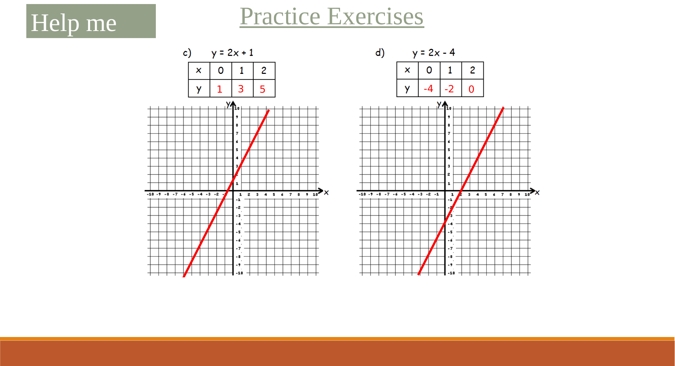
Zπ
PRACTICE · DRAWING GRAPHS
Question 1

Slide 17
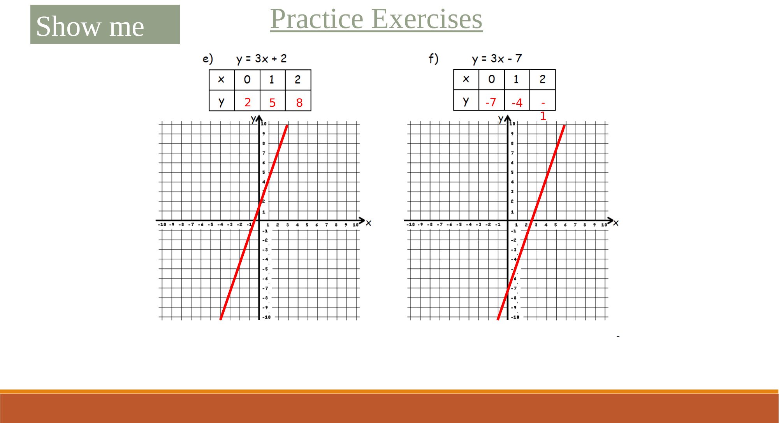
Zπ
PRACTICE · DRAWING GRAPHS
Question 2

Slide 18
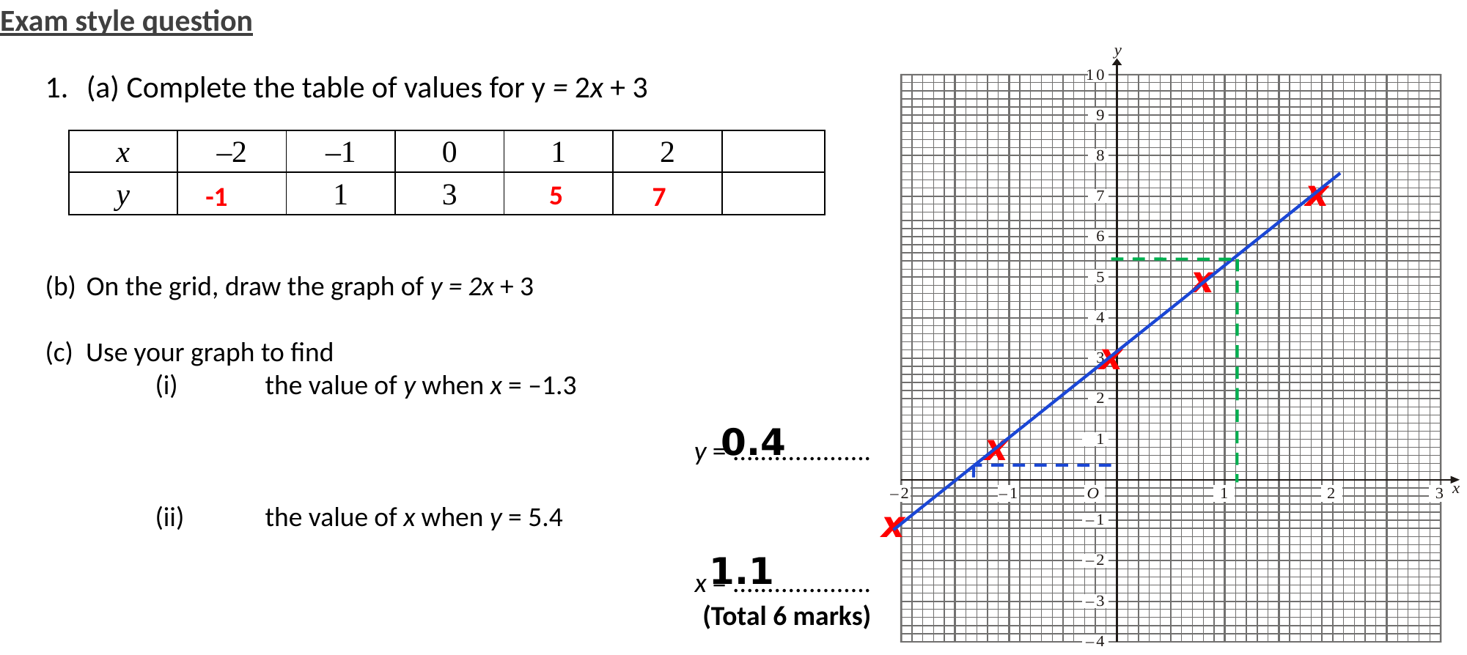
Zπ
PRACTICE · DRAWING GRAPHS
Question 3

Slide 19
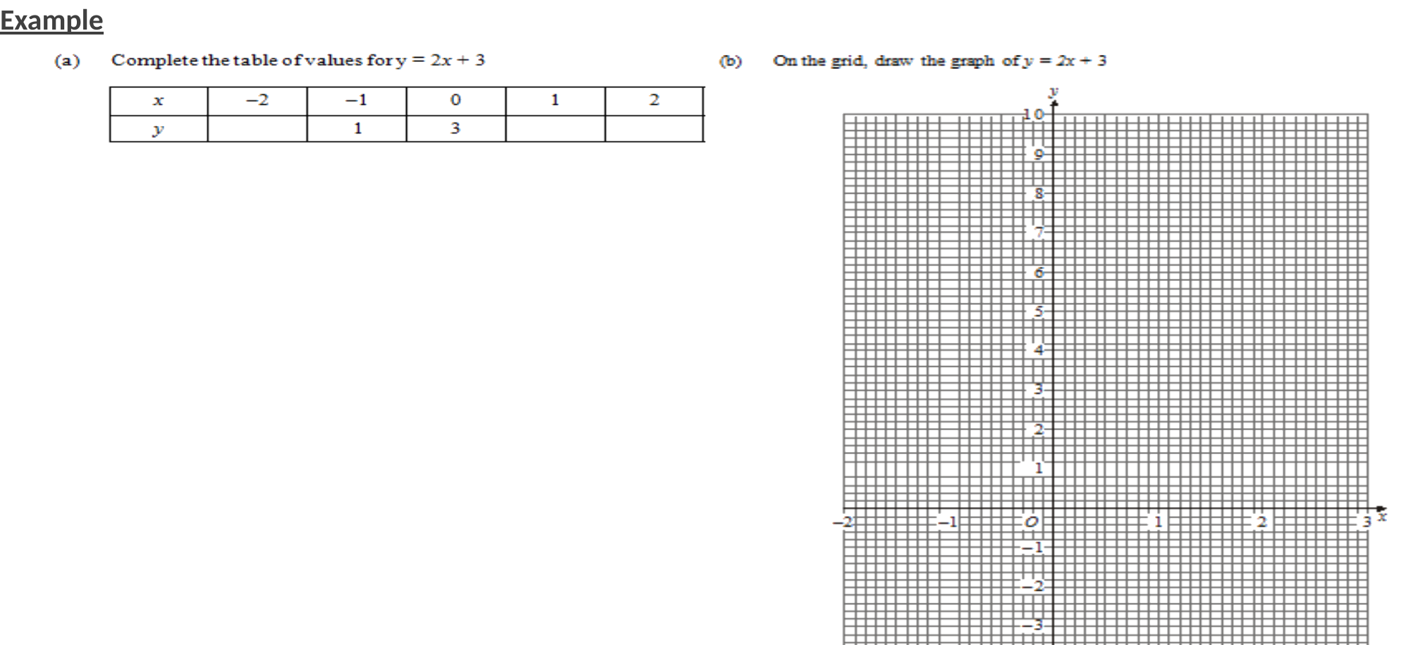
Zπ
PRACTICE · DRAWING GRAPHS
Question 4

Slide 20
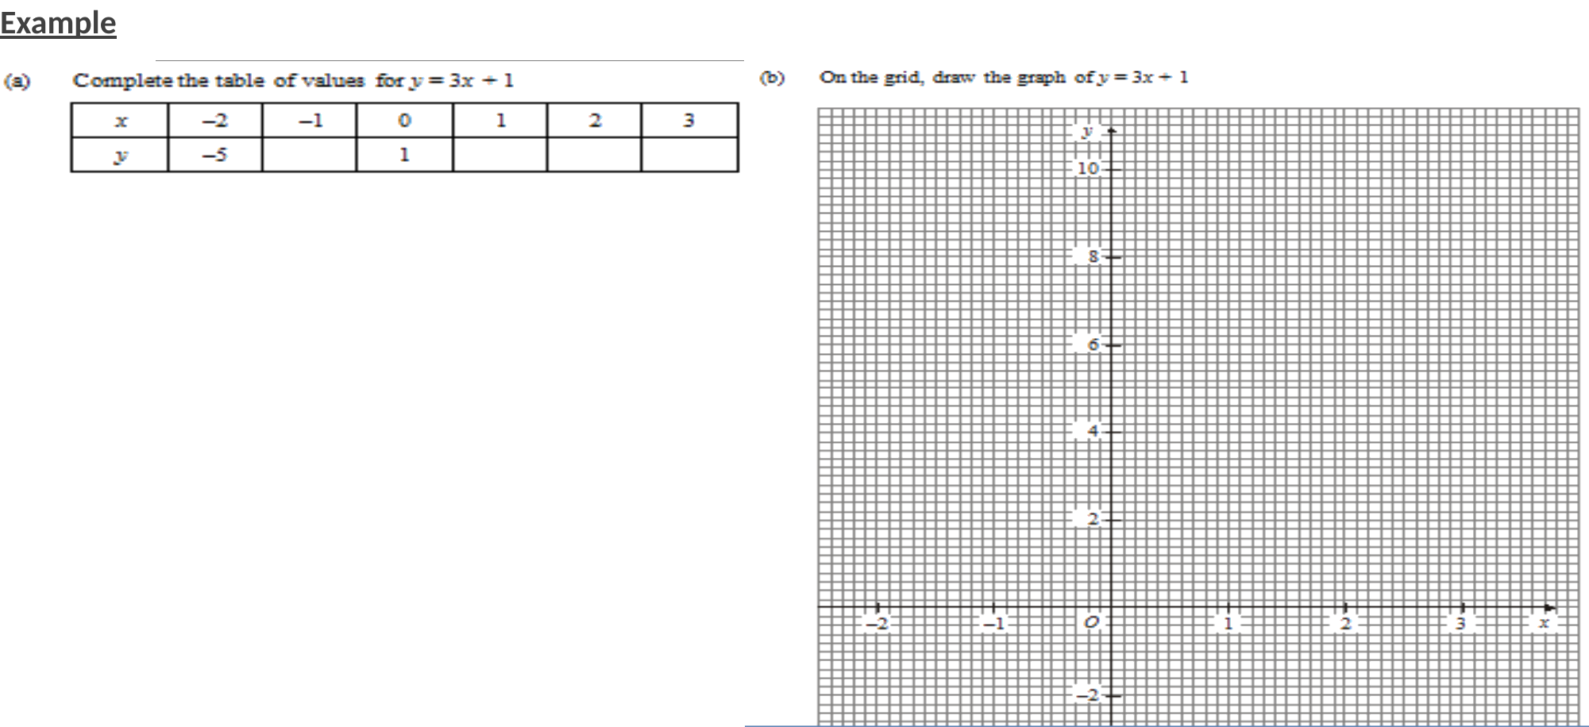
Zπ
PRACTICE · DRAWING GRAPHS
Question 5

Slide 21
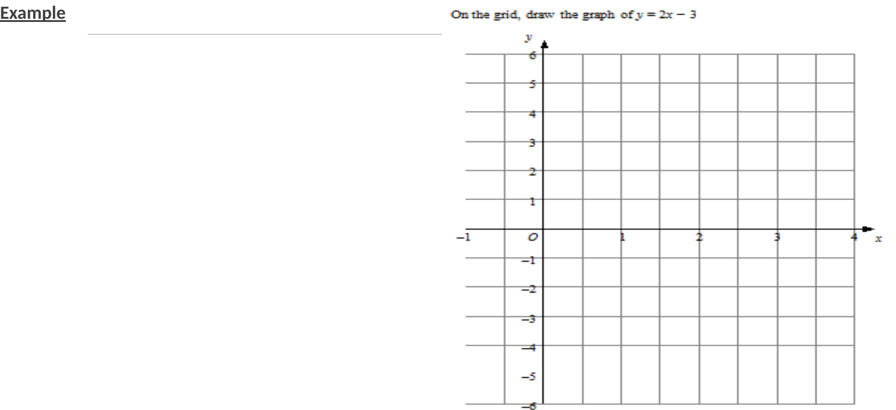
Zπ
PRACTICE · DRAWING GRAPHS
Question 6

Slide 22
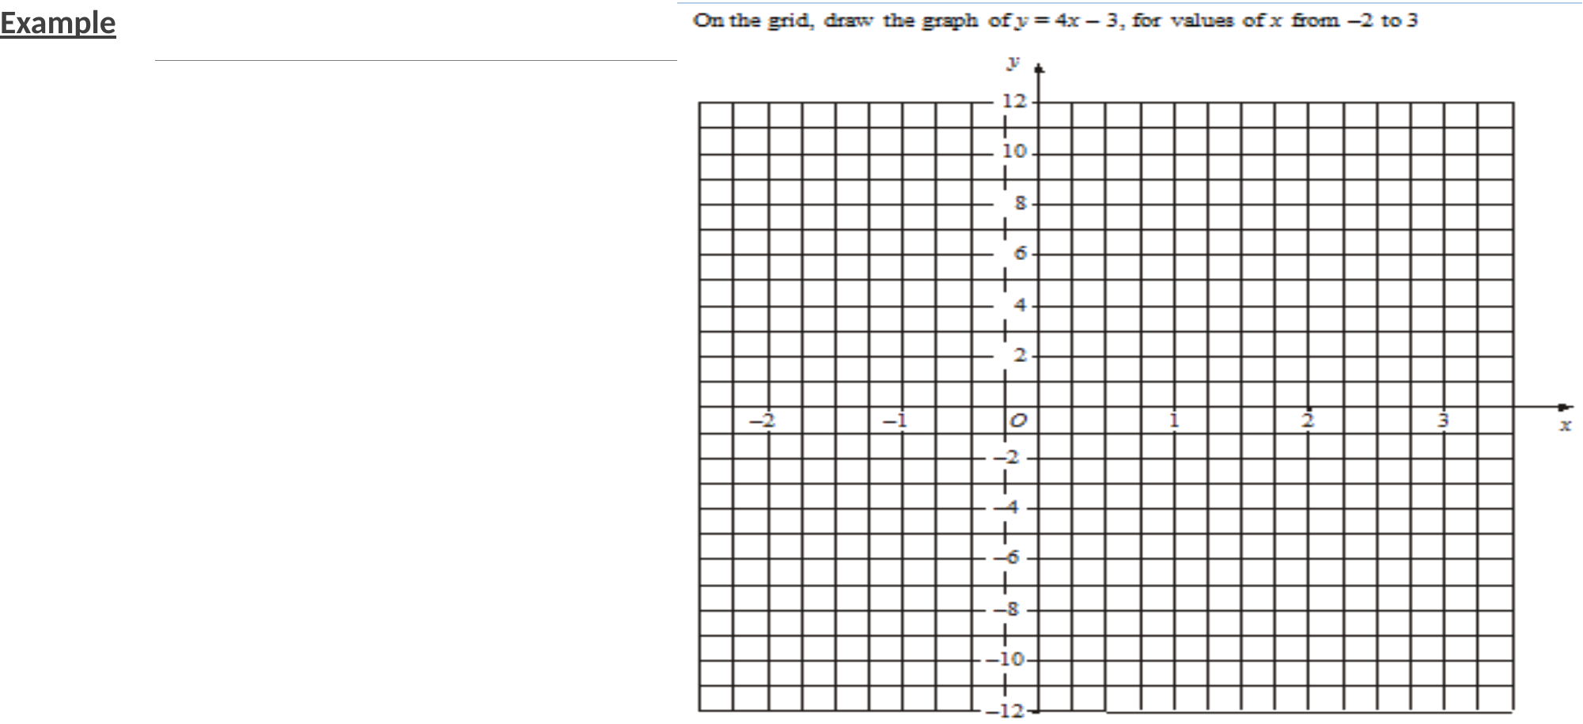
Zπ
PRACTICE · DRAWING GRAPHS
Question 7

Slide 23
Zπ
RECAP
Key Takeaways
A linear equation (x and y to the power 1) always graphs as a straight line.
x = a number is a vertical line; y = a number is a horizontal line.
Method 1 — table of values: substitute x, work out y, plot and join.
Method 2 — rise over run: plot c on the y-axis, then step out the gradient.
Method 3 — intercepts: x = 0 gives one point, y = 0 gives the other.
Golden rule: you only need TWO points to draw a straight line — a third one checks it.

