Slide 1
Zπ
Zπ MATHS HUB
Pearson Edexcel IGCSE (9–1) · Higher Tier
△ → △
Transformations
Translation · Rotation · Reflection · Enlargement · Performing & Describing
Zahra Sheikh Ali
IGCSE Mathematics Teacher · M.Sc. Differential Geometry & Geometric Control
☎ 66613748 ✉ zahraa.sheikhali@outlook.com

Slide 2
Zπ
LESSON OVERVIEW
Four Transformations
Two jobs in every exam: PERFORM the transformation (draw the image) or DESCRIBE it fully. Describing needs specific details — miss one and you lose the mark.
Translation — a slide
Rotation — a turn
Reflection — a flip
1
2
3
Enlargement — a resize
Describing fully
Past-paper questions
4
5
6
Key words: object · image · vector · centre · mirror line · scale factor · congruent · similar

Slide 3
Zπ
THE KEY IDEA
Describing: What You MUST State
Say the NAME, then every detail. One transformation only — never write ‘reflect then translate’ for a single mark.
Transformation
You must state…
Example
TRANSLATION
the column vector
by the vector (3, −2)
ROTATION
angle + direction + centre
90° clockwise about (0, 0)
REFLECTION
the mirror line (its equation)
in the line x = 2
ENLARGEMENT
scale factor + centre
SF 2, centre (1, 1)
Translation, rotation and reflection keep the shape the SAME size (congruent). Enlargement changes the size (similar).

Slide 4
Zπ
TRANSLATION · PERFORMING
Slide Every Corner the Same Way
Translate triangle A by the vector (2, 5): 2 right, 5 up. Move each vertex, then join them up.
6
y
5
The column vector
4
Top number = movement LEFT/RIGHT (+ right, − left).
3
2
B
Bottom number = movement UP/DOWN (+ up, − down).
1
x
Here the vector is 2 across and 5 up.
-6
-5
-4
-3
-2
-1
1
2
3
4
5
6
-1
-2
Every vertex moves by exactly the same amount.
-3
A
-4
The image B is the same size and shape — congruent.
-5
-6
Write the vector as a column: 2 on top, 5 underneath.

Slide 5
Zπ
TRANSLATION · DESCRIBING
Count from Object to Image
Describe the transformation that maps A onto B. Pick one corner and count across, then up or down.
6
y
5
How to describe it
4
Choose a corner of A and the MATCHING corner of B.
A
3
2
From (−5, 2) to (2, −4): 7 right, 6 down.
1
x
Answer: a TRANSLATION by the vector (7, −6).
-6
-5
-4
-3
-2
-1
1
2
3
4
5
6
-1
-2
Down and left are NEGATIVE.
-3
B
-4
Say ‘translation’ and give the vector — both are needed.
-5
-6
Never say ‘moved’ — the exam wants the word TRANSLATION and the vector.

Slide 6
Zπ
ROTATION · PERFORMING
Turn About a Centre
Rotate triangle A 90° clockwise about the origin (0, 0). Use tracing paper if it helps.
6
y
5
The three things you need
4
ANGLE: 90°, 180° or 270°.
3
A
2
DIRECTION: clockwise or anticlockwise.
1
centre (0,0)
x
CENTRE: the point it turns about.
-6
-5
-4
-3
-2
-1
1
2
3
4
5
6
-1
B
-2
Coordinate rule (90° clockwise about O): (x, y) → (y, −x).
-3
-4
180°: (x, y) → (−x, −y) — direction does not matter.
-5
-6
Tracing paper: trace the shape, put your pencil on the centre, and turn.

Slide 7
Zπ
ROTATION · DESCRIBING
Finding the Angle, Direction & Centre
All three details or no marks. Find the centre with tracing paper — the point that stays still.
Rules about the origin
Describing — the checklist
90° clockwise
(x, y) → (y, −x)
Say the word ROTATION.
State the ANGLE (90°, 180°…).
90° anticlockwise
(x, y) → (−y, x)
State the DIRECTION (clockwise / anticlockwise).
180° (either way)
(x, y) → (−x, −y)
State the CENTRE as coordinates.
270° clockwise = 90° anticlockwise.
180° needs no direction.
e.g. ‘Rotation of 90° clockwise about (0, 0)’

Slide 8
Zπ
REFLECTION · PERFORMING
Flip in the Mirror Line
Reflect triangle A in the y-axis (the line x = 0). Each point stays the same distance from the mirror, on the other side.
6
y
5
Mirror lines you must know
4
x-axis → the line y = 0 (x, y) → (x, −y)
3
B
2
A
y-axis → the line x = 0 (x, y) → (−x, y)
1
x
The line y = x (x, y) → (y, x)
-6
-5
-4
-3
-2
-1
1
2
3
4
5
6
-1
-2
The line y = −x (x, y) → (−y, −x)
-3
-4
Also x = 2, y = 3 and so on — count squares across.
-5
-6
Measure perpendicular to the mirror: same distance the other side.

Slide 9
Zπ
REFLECTION · DESCRIBING
Find the Mirror Line
Describe the transformation mapping A onto B. The mirror line sits exactly halfway between them.
6
y
5
How to find it
4
Join a point to its image; the mirror crosses the middle at 90°.
3
2
A
y = 1
Here every point is the same distance above/below y = 1.
1
B
Answer: a REFLECTION in the line y = 1.
-6
-5
-4
-3
-2
-1
1
2
3
4
5
x
6
-1
-2
Always give the EQUATION of the mirror line.
-3
-4
‘Reflected in a horizontal line’ is not enough.
-5
-6
Say REFLECTION and the equation of the mirror line — both are needed.

Slide 10
Zπ
ENLARGEMENT · PERFORMING
Scale Factor and Centre
Enlarge triangle A by scale factor 2, centre (0, 0). Distances from the centre are multiplied by 2.
6
y
5
How to do it
4
Draw rays from the CENTRE through each corner.
3
B
2
A
Multiply the distance from the centre by the SCALE FACTOR.
1
centre
x
SF 2: each corner goes TWICE as far from the centre.
-6
-5
-4
-3
-2
-1
1
2
3
4
5
6
-1
-2
Every length doubles; the angles stay the same.
-3
-4
Object and image are SIMILAR (same shape, different size).
-5
-6
Rule for centre (0,0): multiply both coordinates by the scale factor.

Slide 11
Zπ
ENLARGEMENT
Fractional & Negative Scale Factors
An ‘enlargement’ can make a shape SMALLER or flip it. The scale factor tells you which.
SF greater than 1
SF 3 → 3× as far from the centre
bigger
SF between 0 and 1 (a fraction)
SF ½ → half as far from the centre
SMALLER
NEGATIVE SF
SF −2 → twice as far, but through the centre
other side of the centre, upside down
The image is still called an enlargement — even when it gets smaller.

Slide 12
Zπ
ENLARGEMENT · DESCRIBING
Finding the Scale Factor & Centre
Two things to find: the scale factor (compare lengths) and the centre (draw rays).
1. The scale factor
2. The centre
SF = image length ÷ object length
e.g. object side 2, image side 6 → SF = 3
If the image is smaller, the SF is a fraction (e.g. ½).
Draw a RAY through each corner and its image.
The rays all meet at ONE point — that is the centre.
Give it as coordinates, e.g. (1, 2).
e.g. ‘Enlargement, scale factor 2, centre (1, 1)’

Slide 13
Zπ
REVISION
Congruent or Similar?
Three transformations keep the size; one changes it.
CONGRUENT (same size)
SIMILAR (different size)
Translation — a slide
Enlargement — a resize
Rotation — a turn
Angles stay the same
Reflection — a flip
Lengths are multiplied by the SF
Lengths and angles are unchanged.
Only the size changes — the shape is the same.
In the exam: describe ONE transformation only, with every detail.

Slide 14
Zπ
PART 2
Past-Paper Questions
These are grid questions — shown exactly as they appear in the exam.
1
Perform or describe?
2
If describing: name it, then give EVERY detail
3
Use tracing paper for rotations
4
Draw rays to find a centre

Slide 15
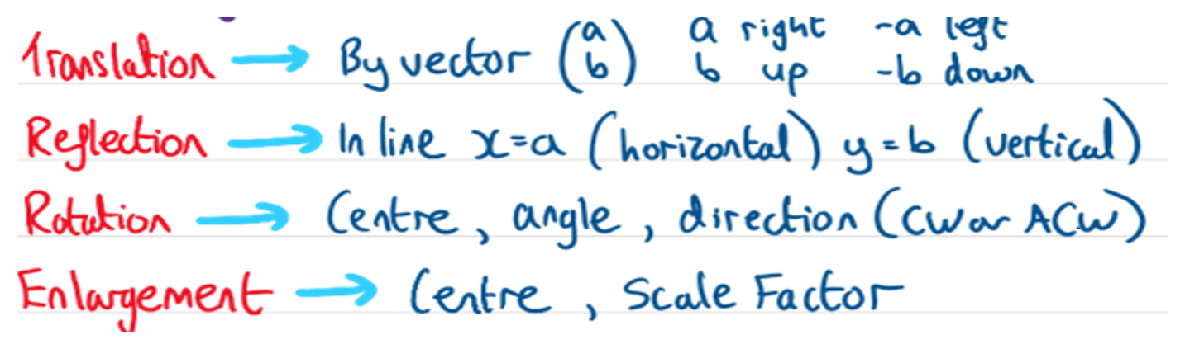
Zπ
PAST-PAPER QUESTION
Question 1

Slide 16
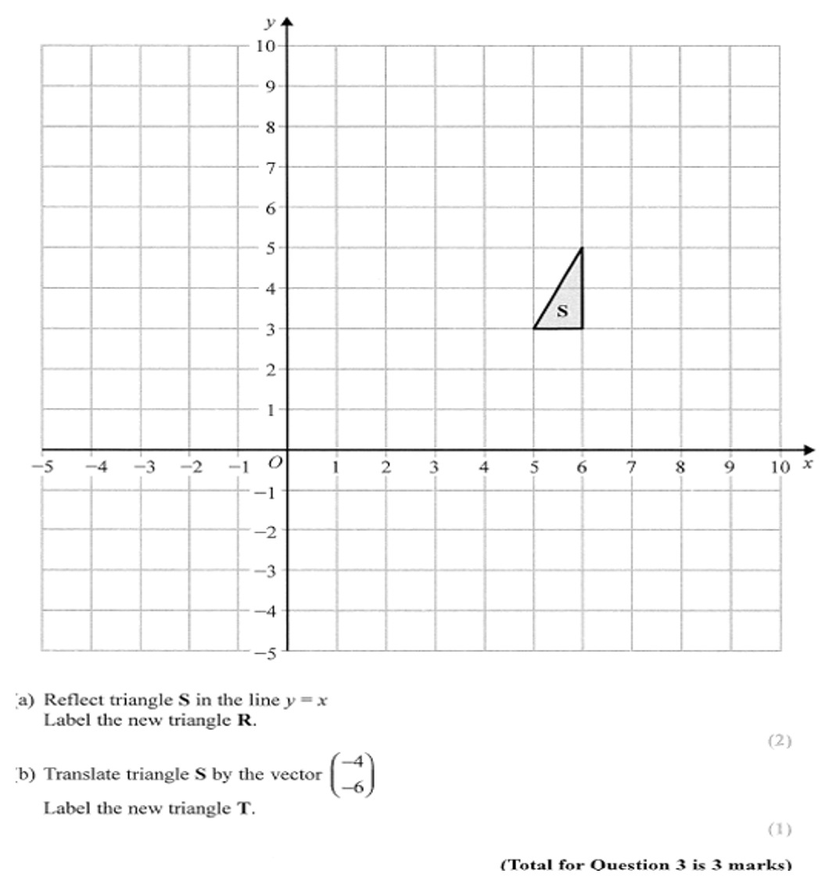
Zπ
PAST-PAPER QUESTION
Question 2

Slide 17
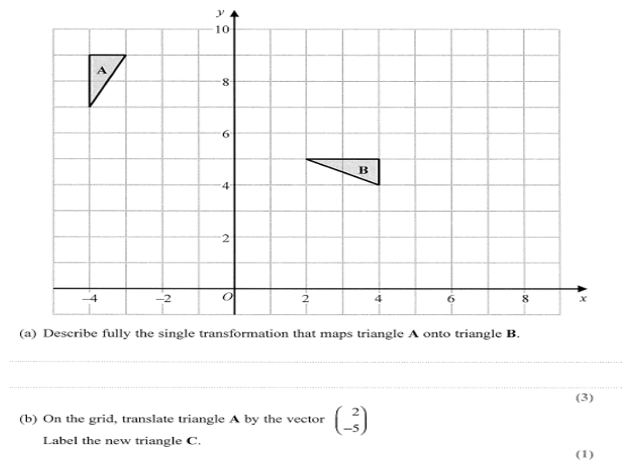
Zπ
PAST-PAPER QUESTION
Question 3

Slide 18
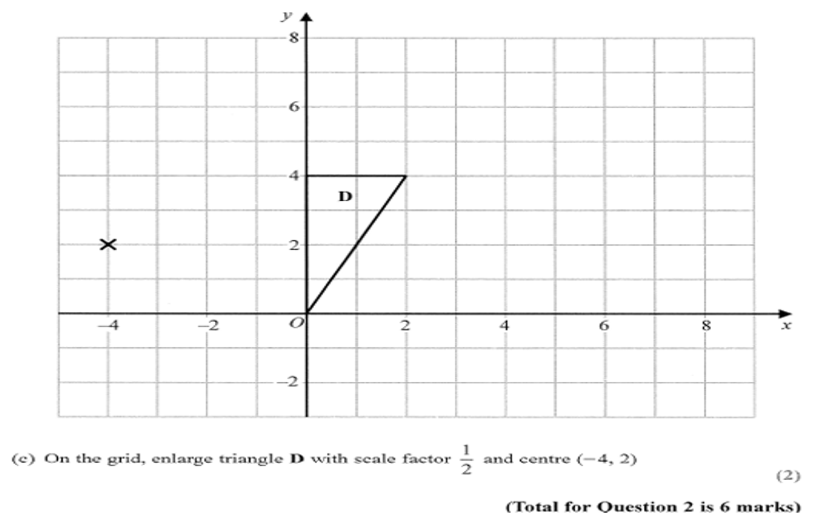
Zπ
PAST-PAPER QUESTION
Question 4

Slide 19
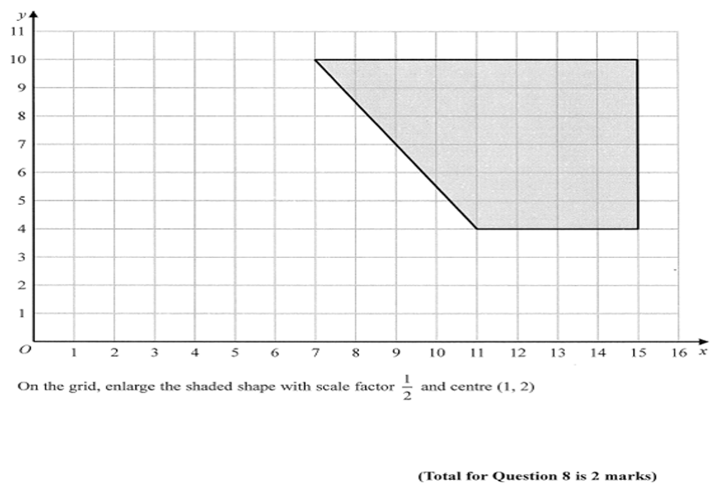
Zπ
PAST-PAPER QUESTION
Question 5

Slide 20
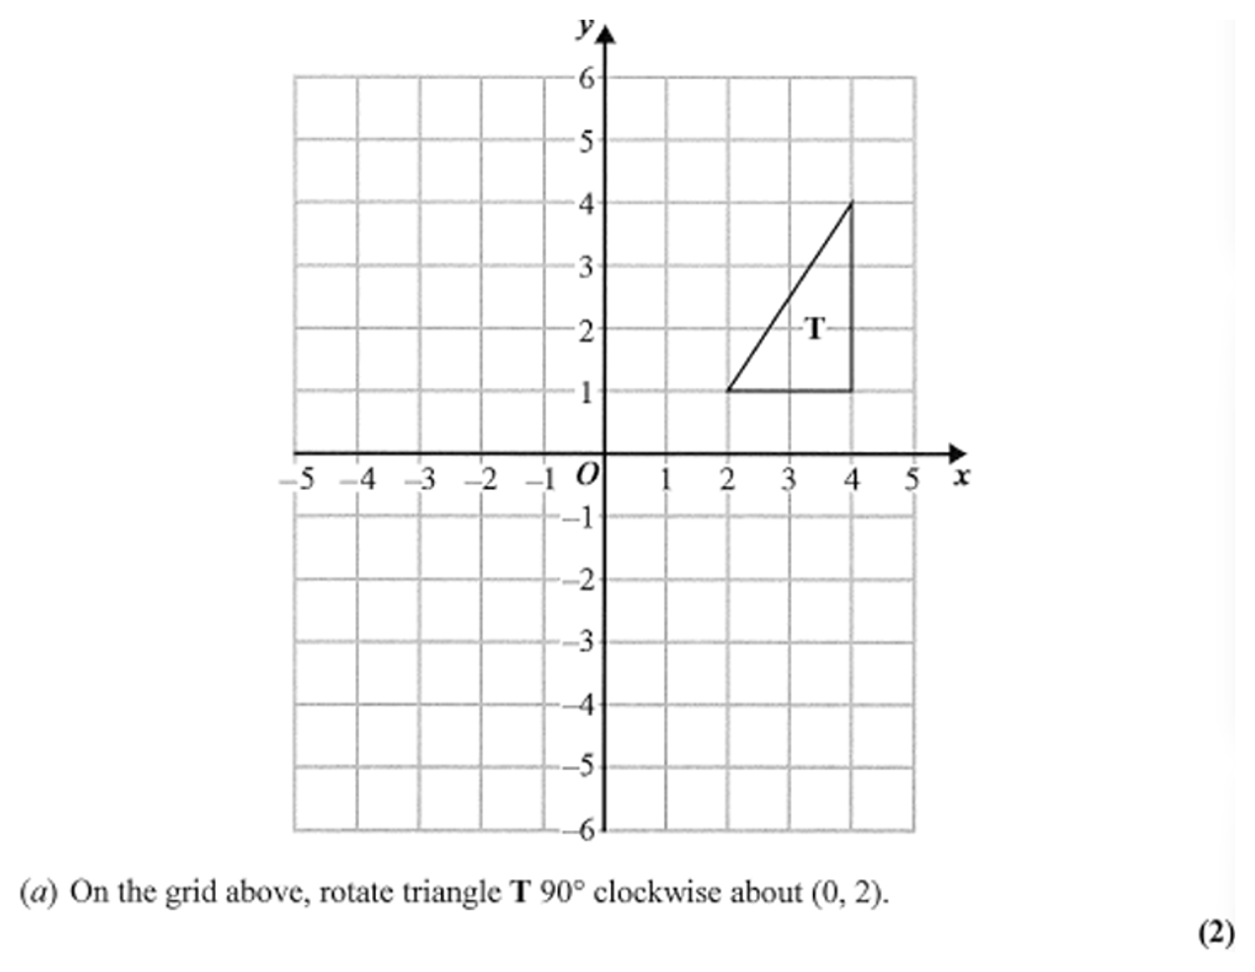
Zπ
PAST-PAPER QUESTION
Question 6

Slide 21
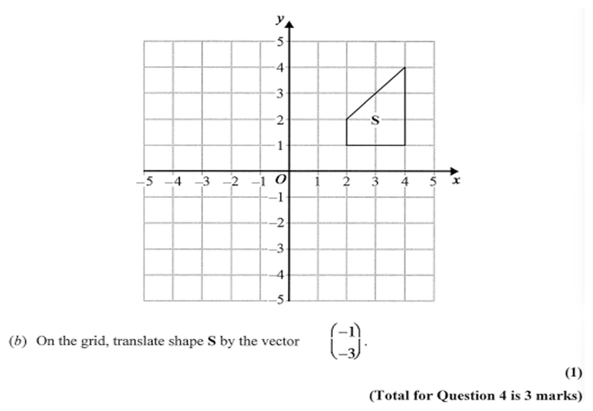
Zπ
PAST-PAPER QUESTION
Question 7

Slide 22
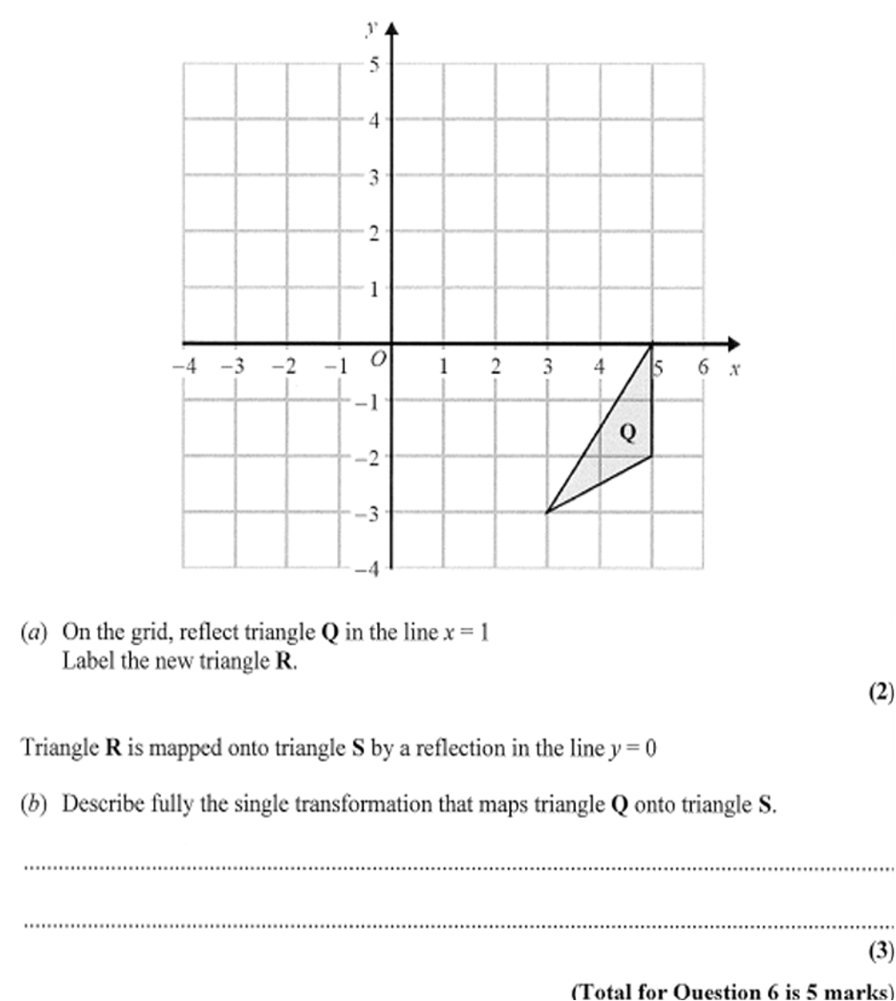
Zπ
PAST-PAPER QUESTION
Question 8

Slide 23
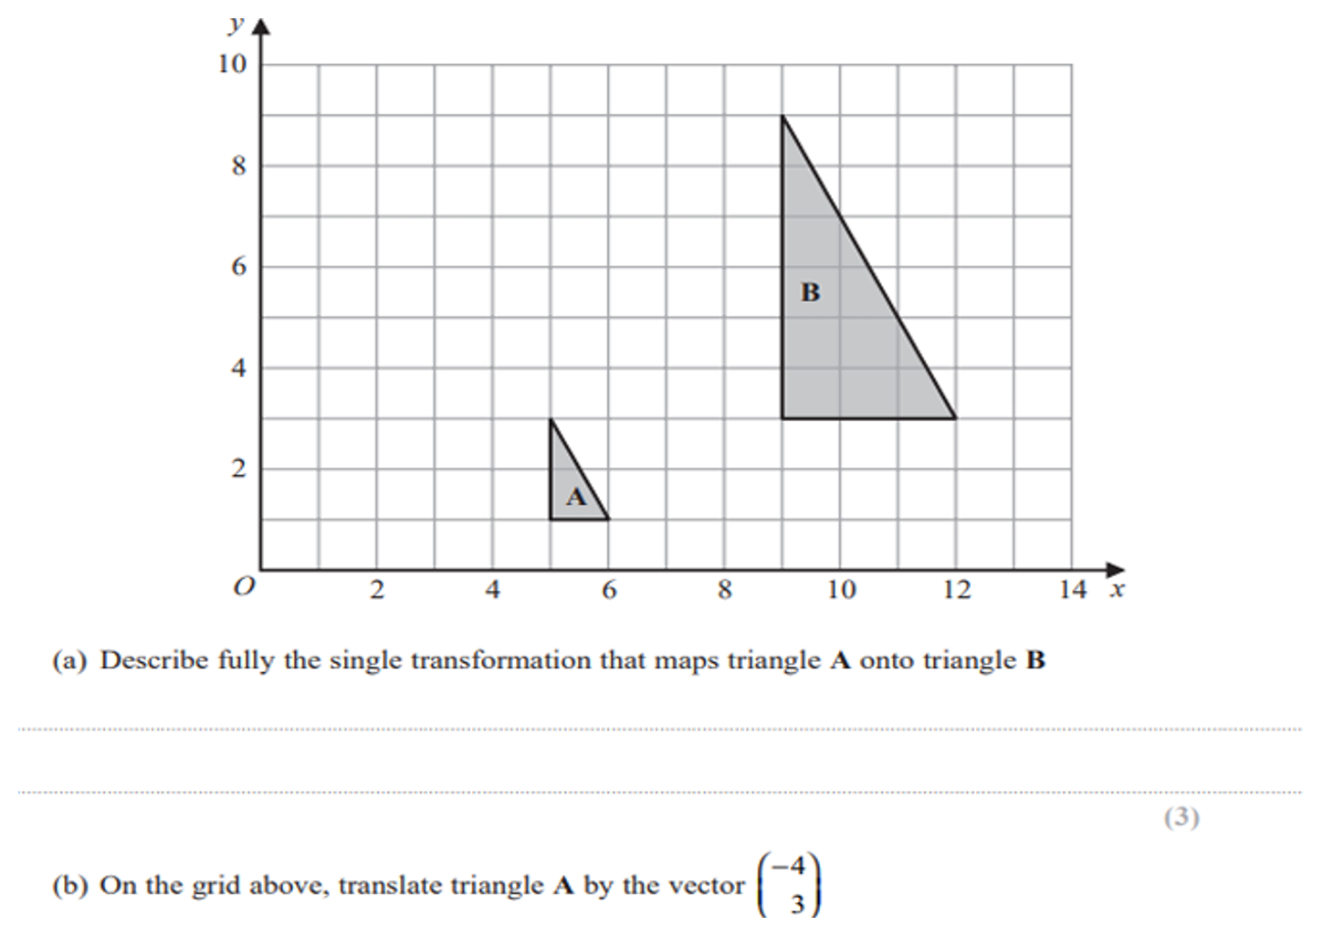
Zπ
PAST-PAPER QUESTION
Question 9

Slide 24
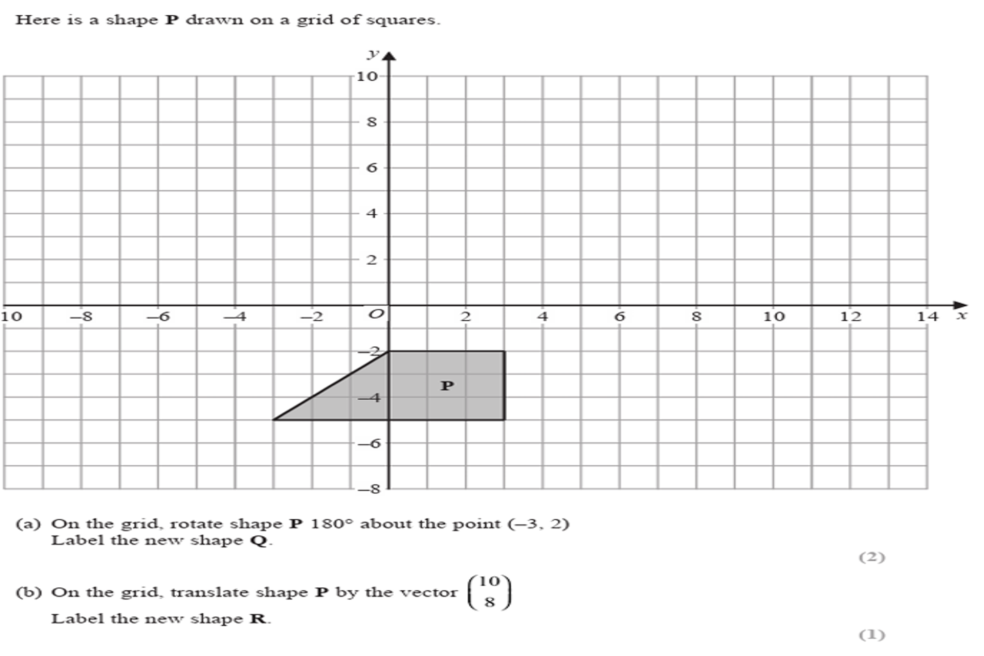
Zπ
PAST-PAPER QUESTION
Question 10

Slide 25
Zπ
RECAP
Key Takeaways
TRANSLATION → give the column vector (across, up).
ROTATION → give the angle, the direction AND the centre.
REFLECTION → give the EQUATION of the mirror line.
ENLARGEMENT → give the scale factor AND the centre.
Translation, rotation, reflection: congruent. Enlargement: similar.
Golden rule: name the transformation, then give every detail — one transformation only.

