Slide 1
Zπ
Zπ MATHS HUB
Pearson Edexcel IGCSE (9–1) · Higher Tier
y
x
Quadratic, Cubic & Reciprocal Graphs
Tables of Values · Plotting Curves · Roots & Turning Points · Recognising Shapes
Zahra Sheikh Ali
IGCSE Mathematics Teacher · M.Sc. Differential Geometry & Geometric Control
☎ 66613748 ✉ zahraa.sheikhali@outlook.com

Slide 2
Zπ
LESSON OVERVIEW
Curves, Not Straight Lines
The HIGHEST power decides the shape. x² gives a parabola, x³ gives an S-shape, and 1/x gives a hyperbola. Build a table of values, plot, and join with a smooth curve.
Quadratic graphs (x²)
Tables of values
Roots & turning points
1
2
3
Cubic graphs (x³)
Reciprocal graphs (1/x)
Past-paper questions
4
5
6
Key words: parabola · root · solution · turning point · line of symmetry · asymptote

Slide 3
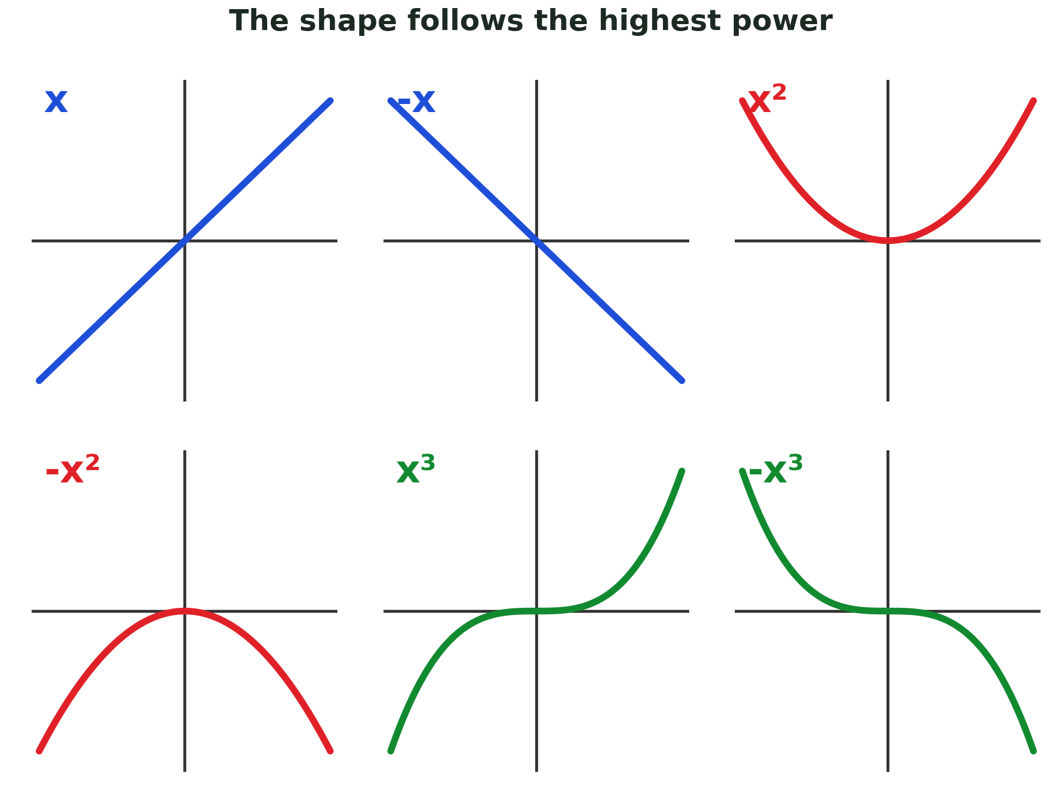
Zπ
THE KEY IDEA
The Highest Power Gives the Shape
The graph always takes the shape of the HIGHEST power. A minus in front flips it upside down.

Slide 4
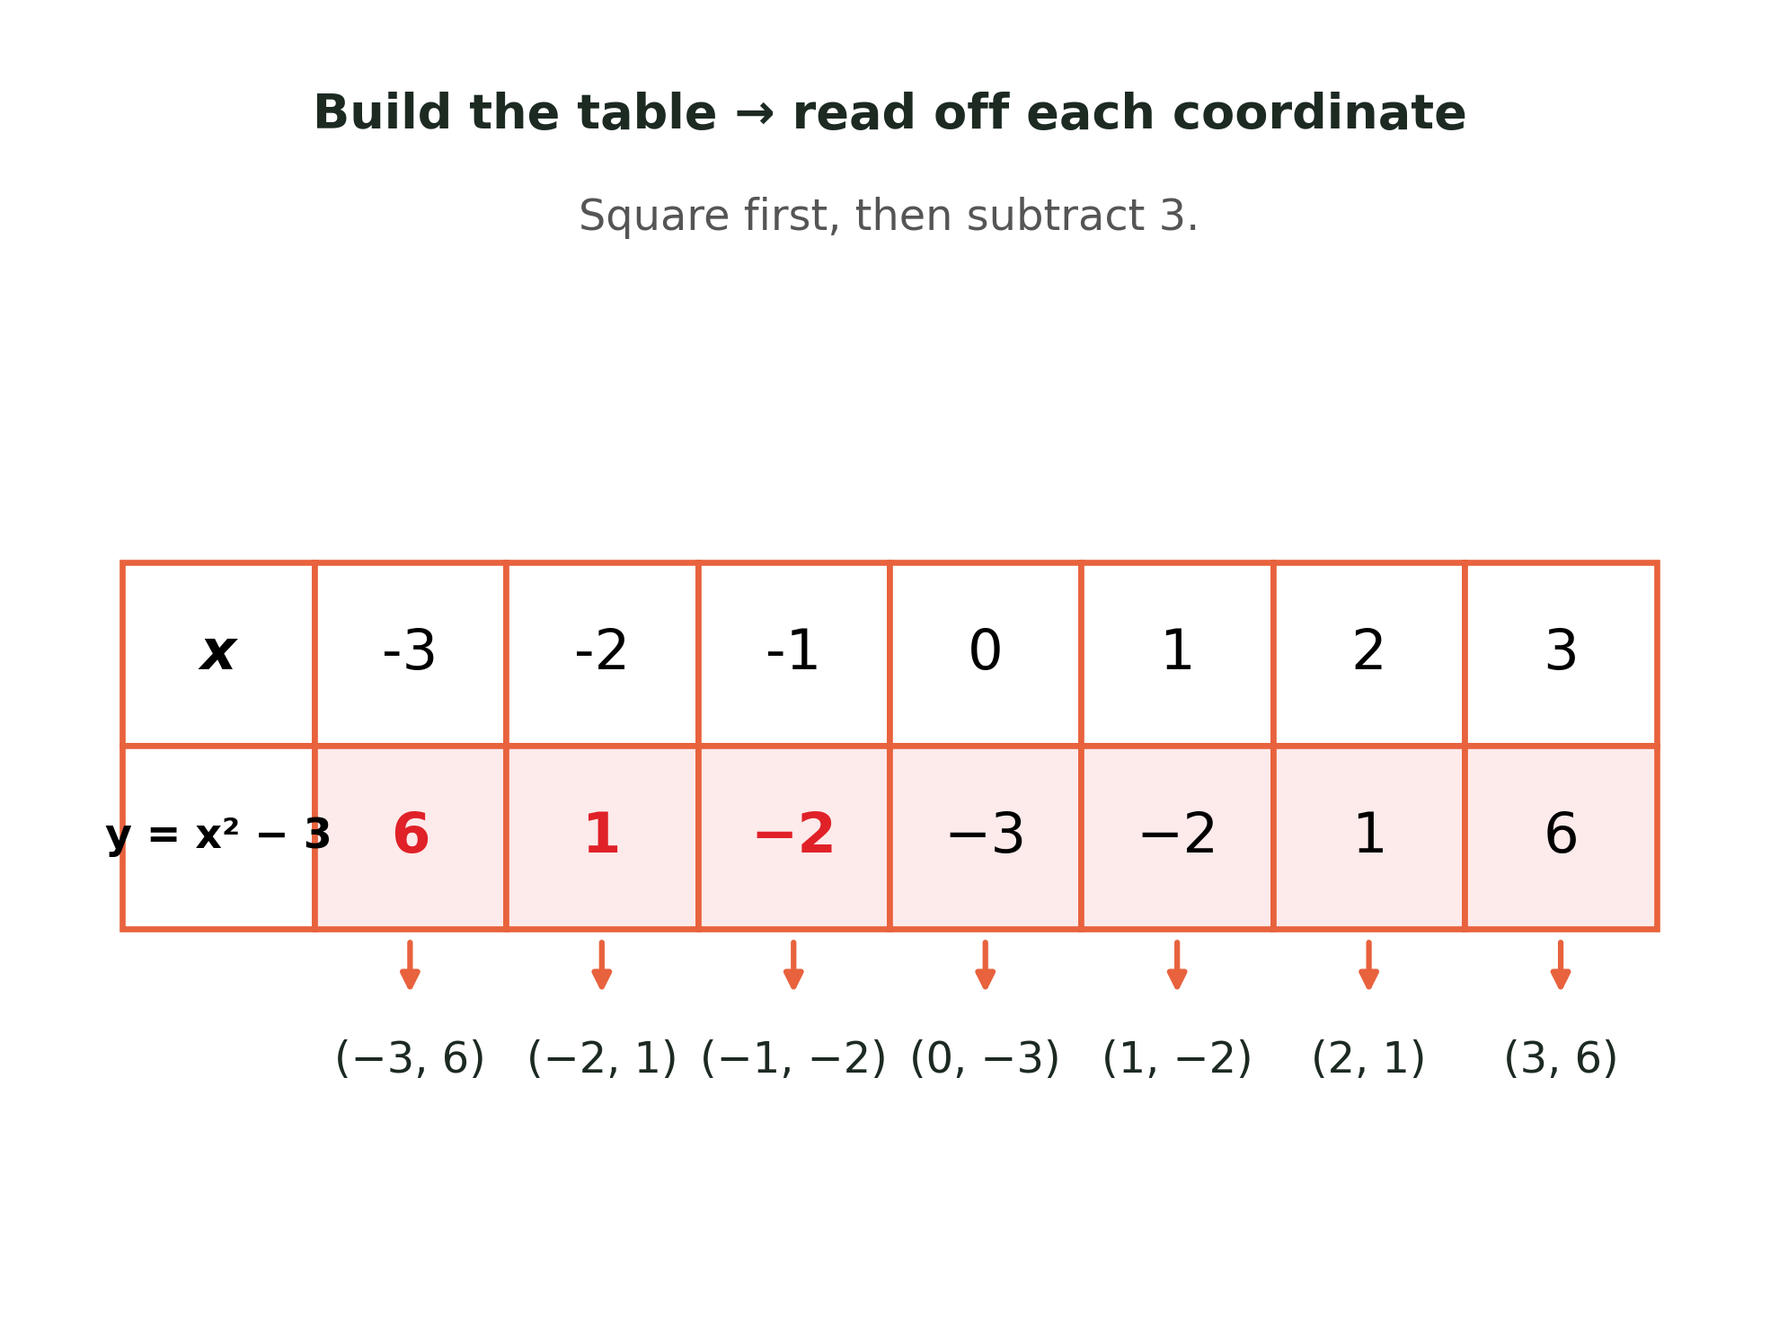
Zπ
PLOTTING · QUADRATIC
Table of Values: y = x² − 3
Substitute each x-value. Square FIRST: (−3)² = +9, so y = 6. Each pair gives a coordinate to plot.

Slide 5
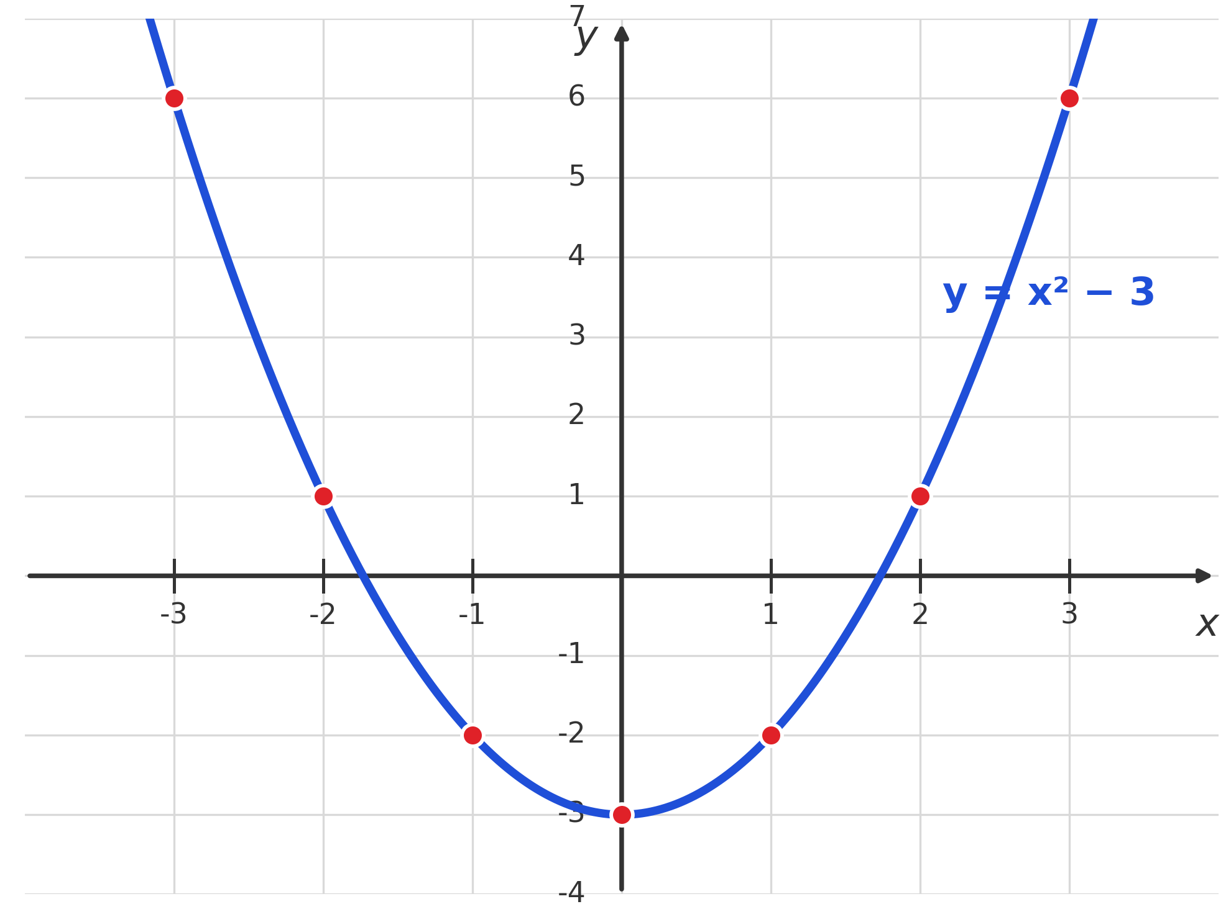
Zπ
PLOTTING · QUADRATIC
Plot the Points, Join with a Smooth Curve
Never join with straight lines. A quadratic gives a smooth, symmetrical parabola.

Slide 6
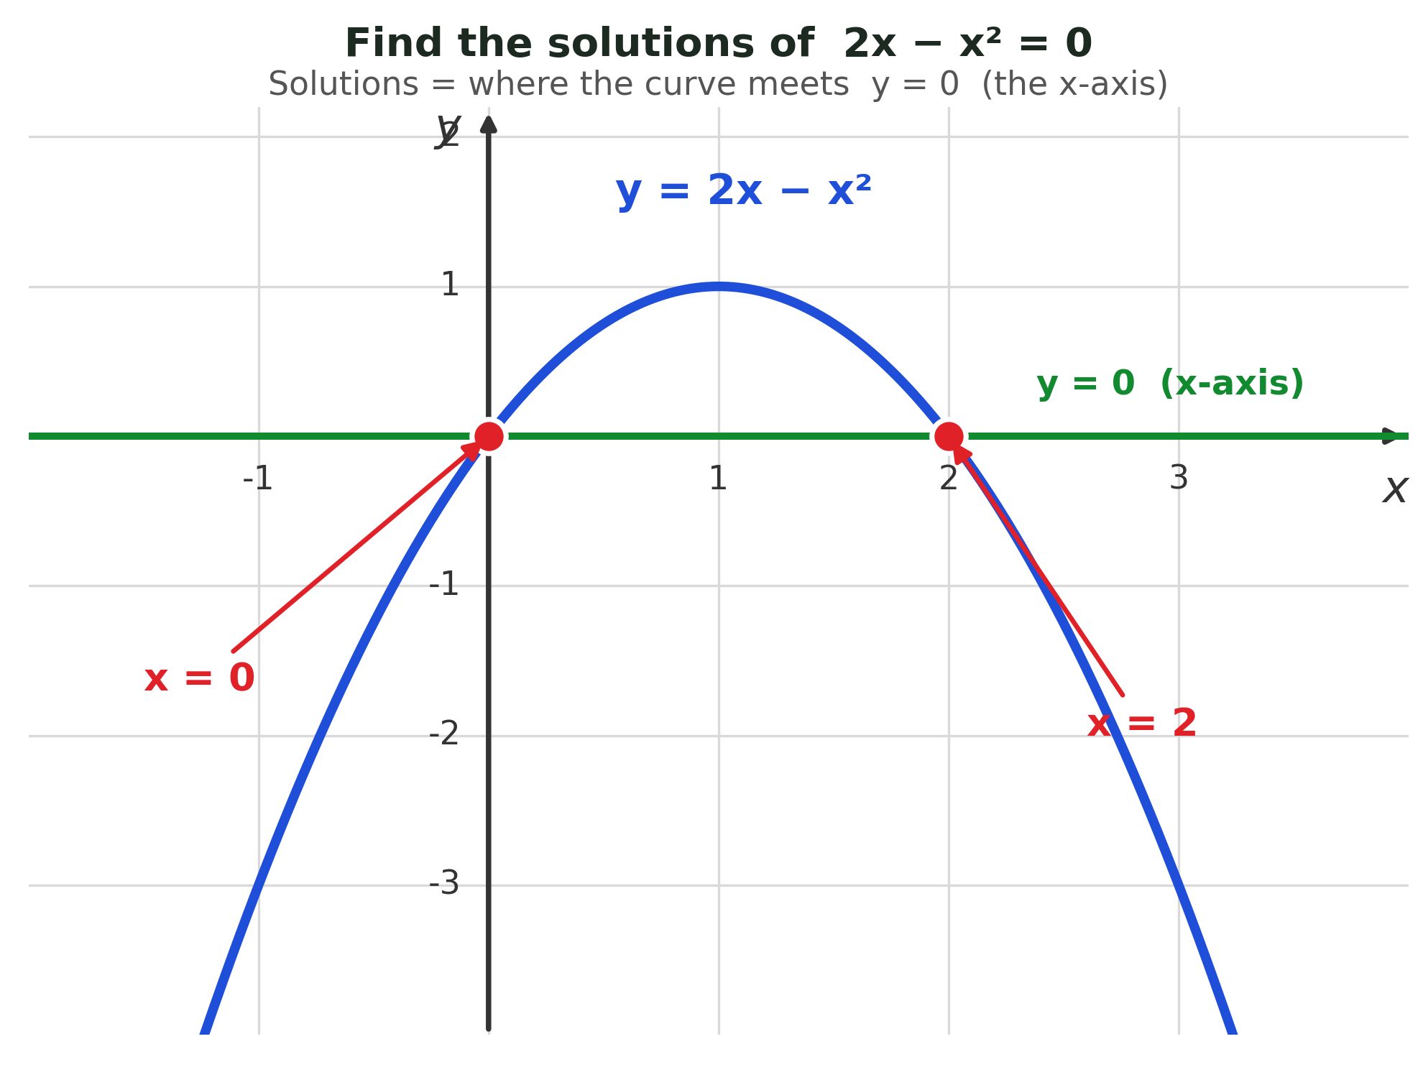
Zπ
KEY FEATURES
Roots — the Solutions of the Equation
Solving “= 0” means finding where the graph meets y = 0. That line is the x-axis, so read off the x-intercepts: x = 0 and x = 2.

Slide 7
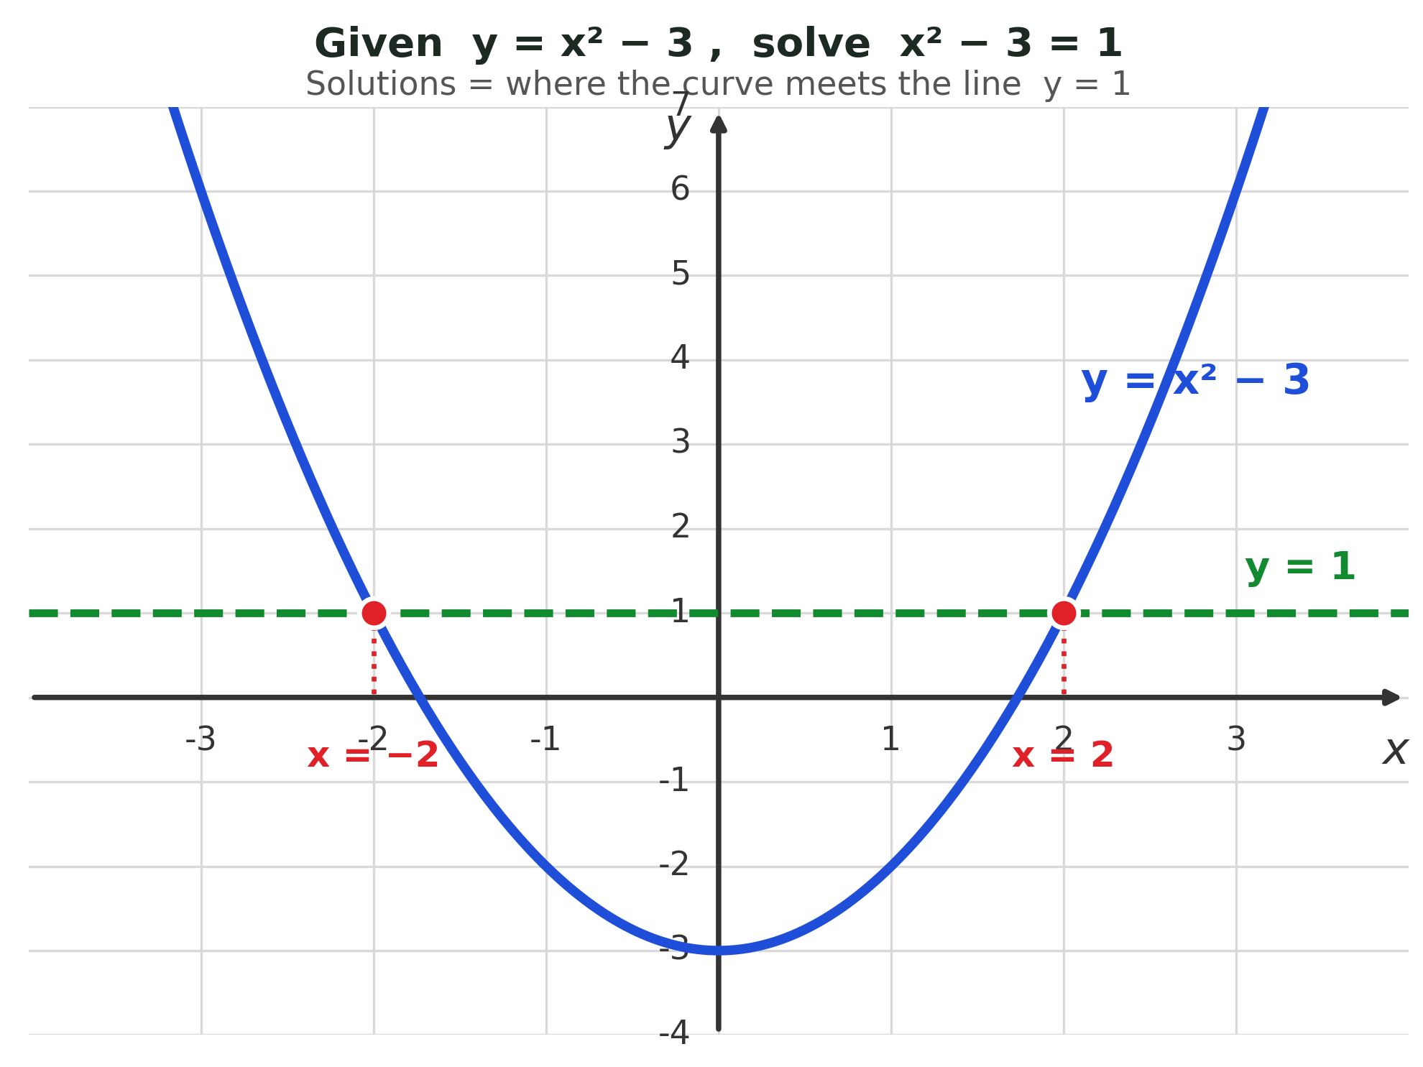
Zπ
USING THE GRAPH
Solving Equations from an Accurate Graph
Given y = x² − 3, to solve x² − 3 = 1 draw the line y = 1. The solutions are the x-values where the curve meets that line: x = ±2.

Slide 8
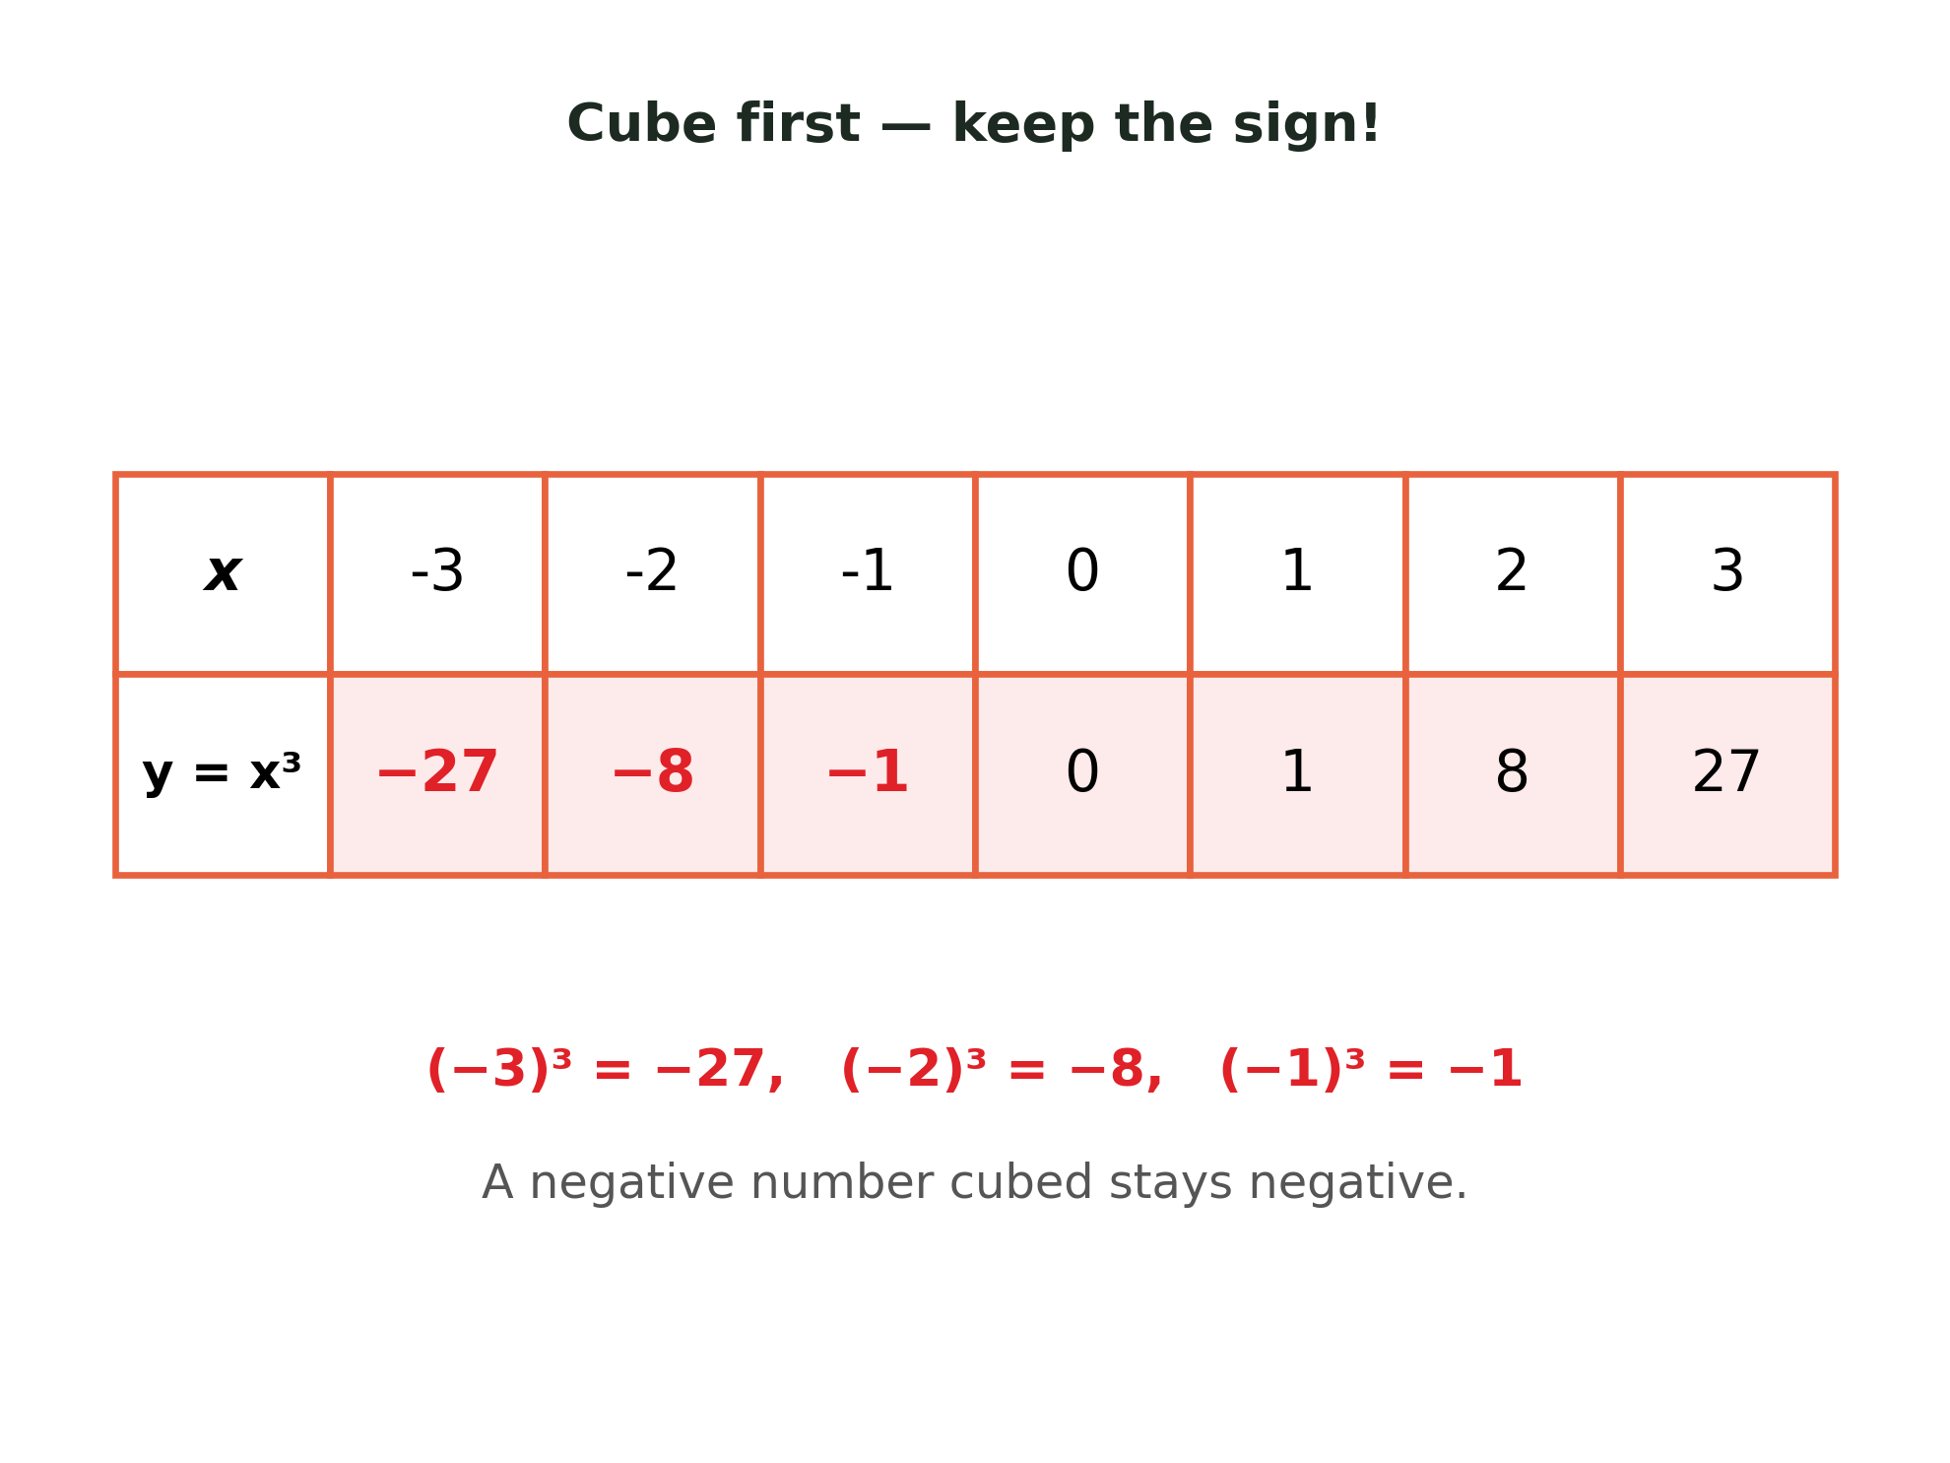
Zπ
CUBIC GRAPHS
Table of Values for a Cubic
A cubic always contains x³. Cube FIRST: (−3)³ = −27, not +27.

Slide 9
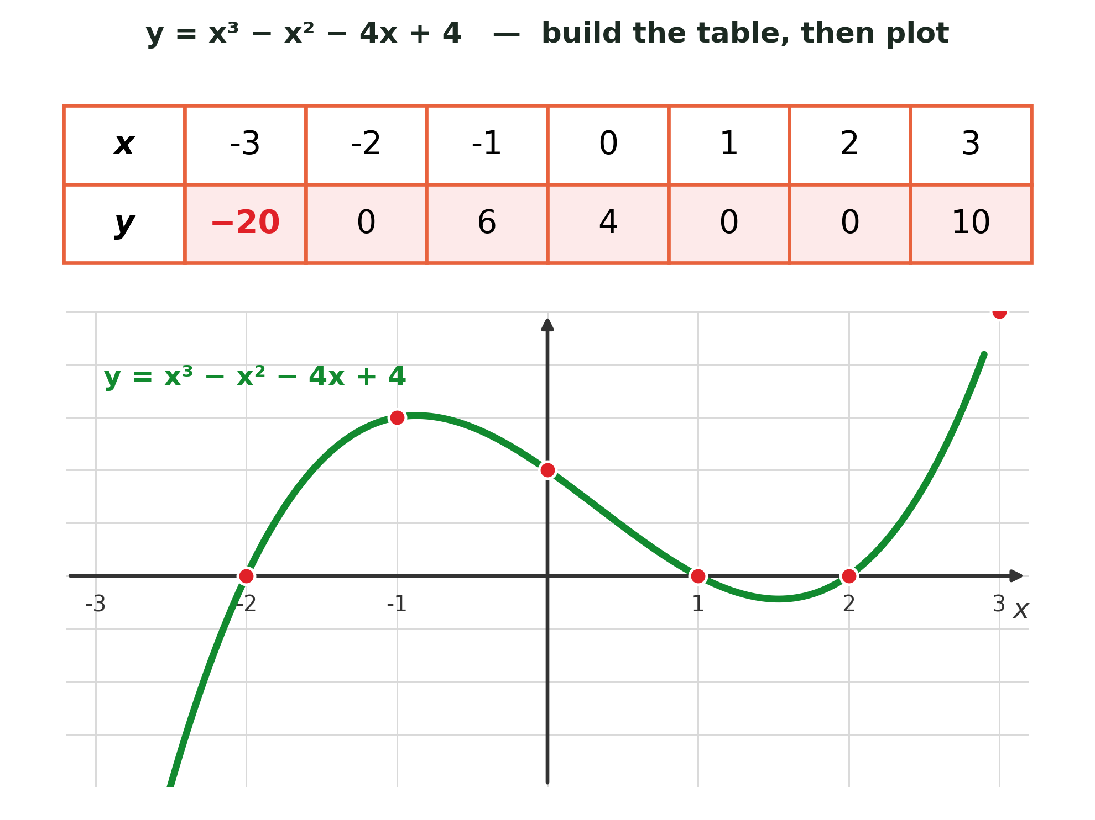
Zπ
CUBIC GRAPHS
Plotting y = x³ − x² − 4x + 4
A cubic gives an S-shape and can cross the x-axis up to THREE times.

Slide 10
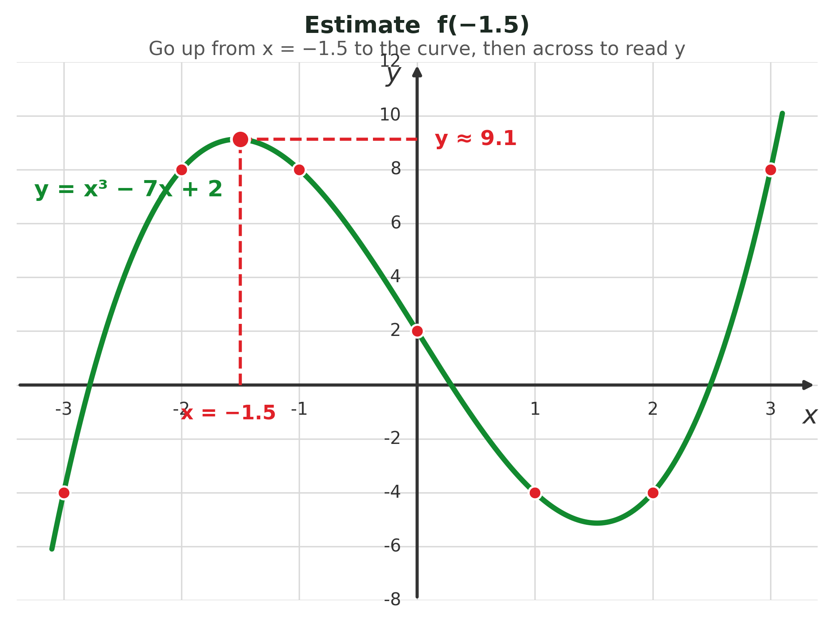
Zπ
CUBIC GRAPHS
Plotting y = x³ − 7x + 2
Same method every time: table of values → plot the points → join with a smooth curve.

Slide 11
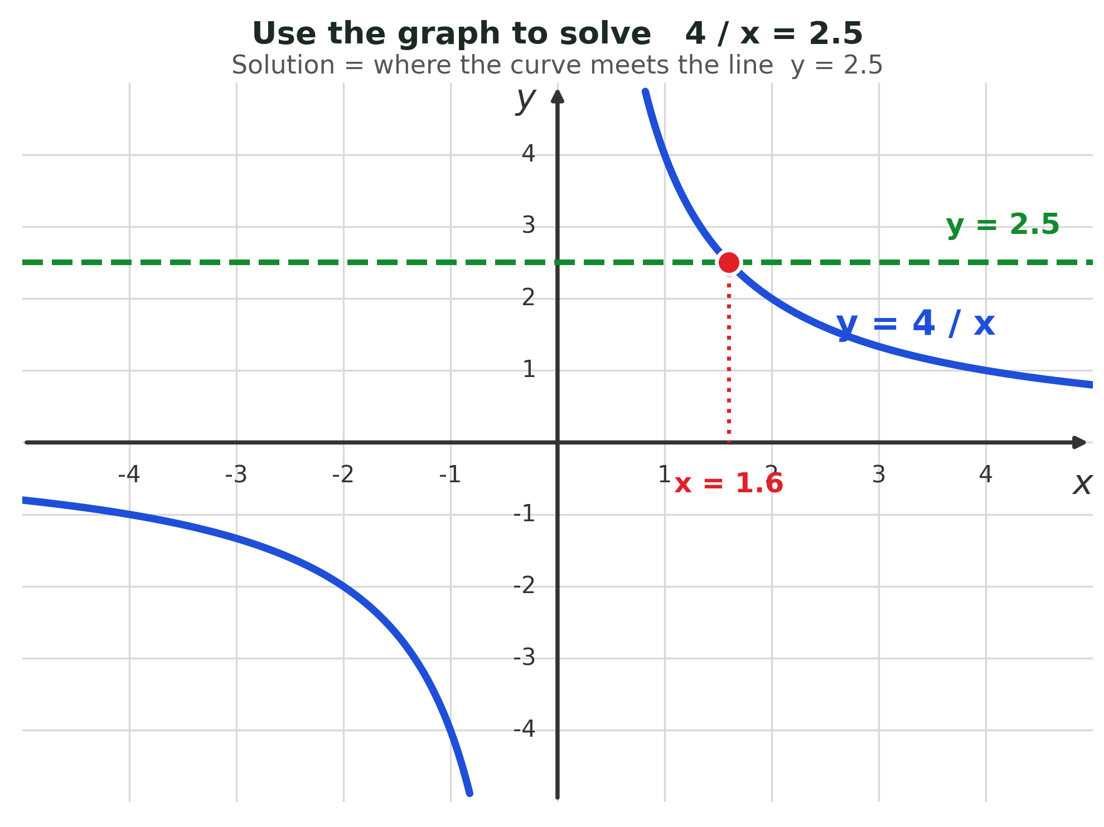
Zπ
RECIPROCAL GRAPHS
The Reciprocal Function y = k / x
x can NEVER be 0. The curve gets closer and closer to the axes but never touches them.

Slide 12
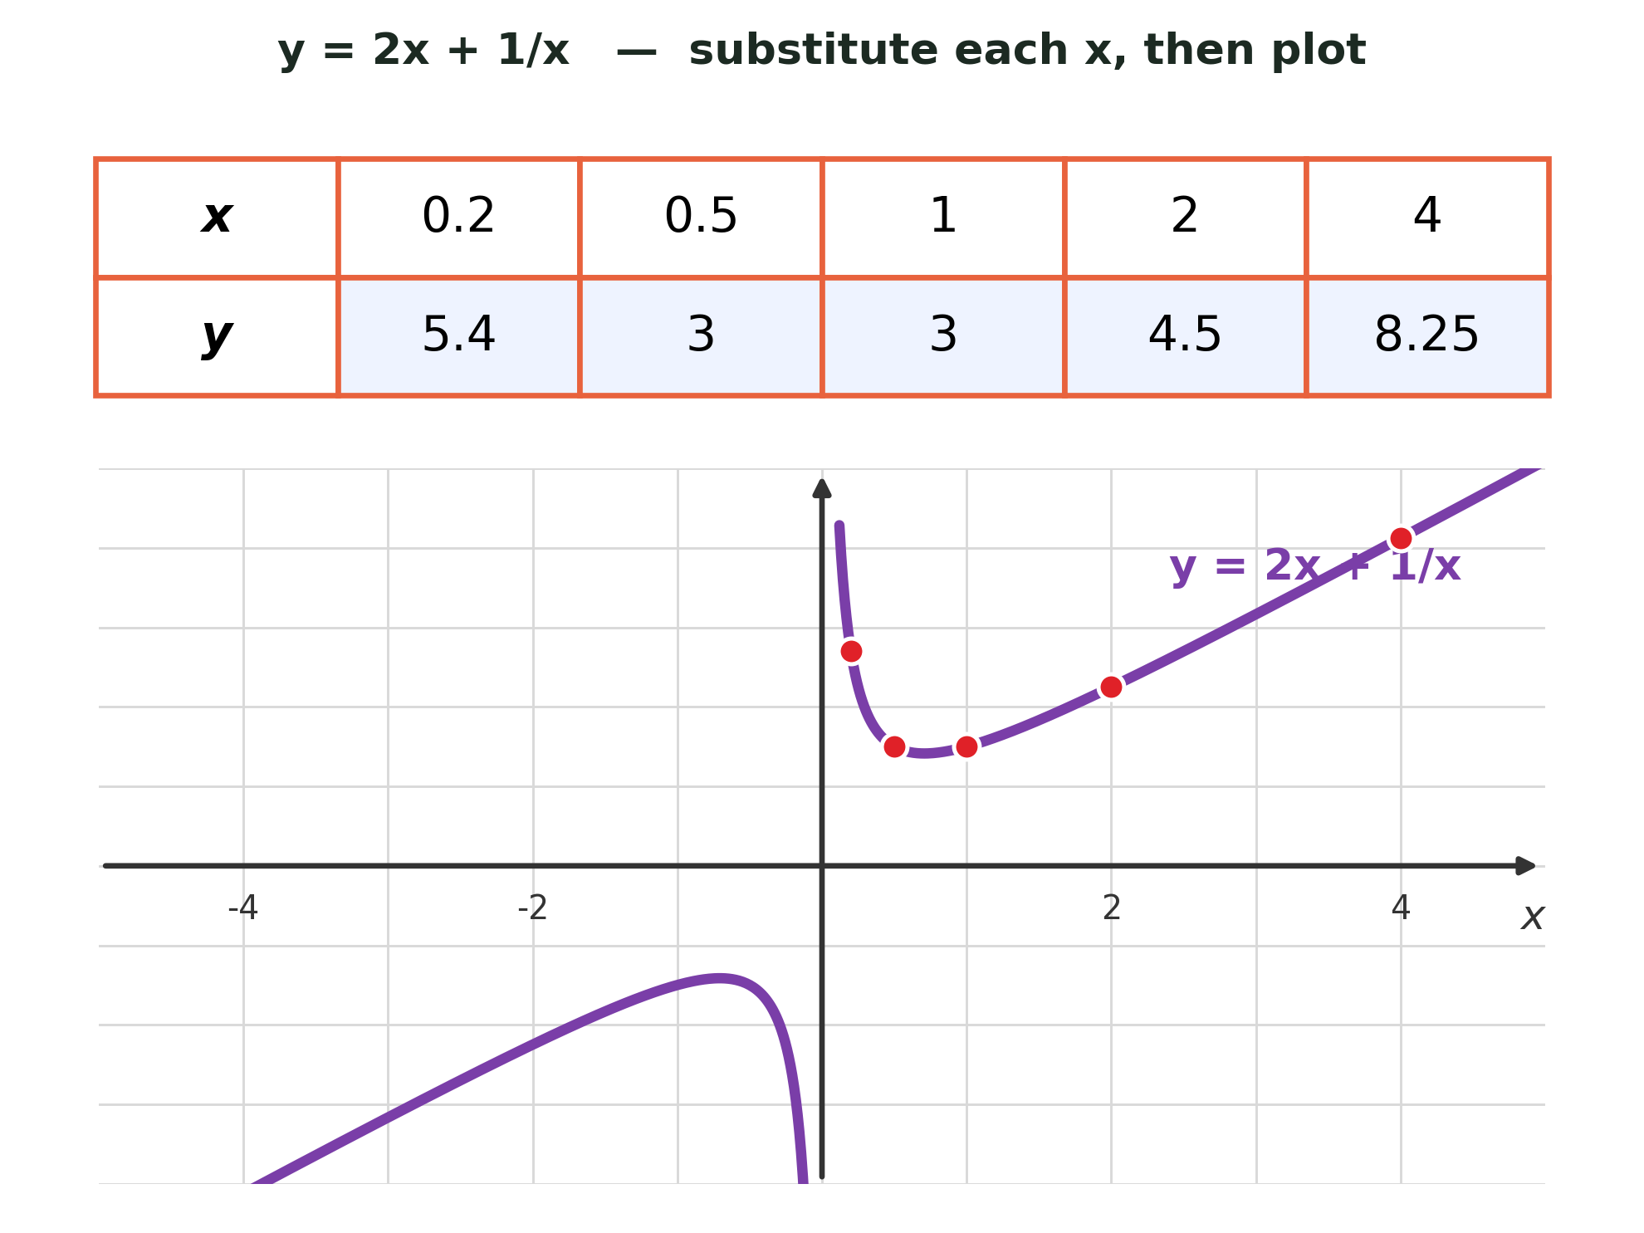
Zπ
RECIPROCAL GRAPHS
Two Separate Branches — Asymptotes
Leave a gap at x = 0. The x-axis and y-axis are ASYMPTOTES — do not join the two branches.

Slide 13
Zπ
TANGENT TO A CURVE
Finding the Equation of a Tangent
1
A tangent is a straight line that just touches the curve.
Example
Tangent at (−1, 3), also through (0, −2).
m = (−2 − 3) ÷ (0 − (−1)) = −5
y = −5x + c; at (0, −2): c = −2
So the tangent is y = −5x − 2.
2
Draw it at the point, then take TWO points on the line.
3
Gradient m = (change in y) ÷ (change in x)
4
Use y = mx + c and substitute the point to find c.
Tangent: y = −5x − 2
The gradient of the tangent = the gradient of the curve at that point.

Slide 14
Zπ
PART 2
Past-Paper Questions
Grid questions — shown exactly as printed in the exam.
1
Complete the table of values
2
Plot the points carefully
3
Join with a SMOOTH curve
4
Read off roots or solutions

Slide 15
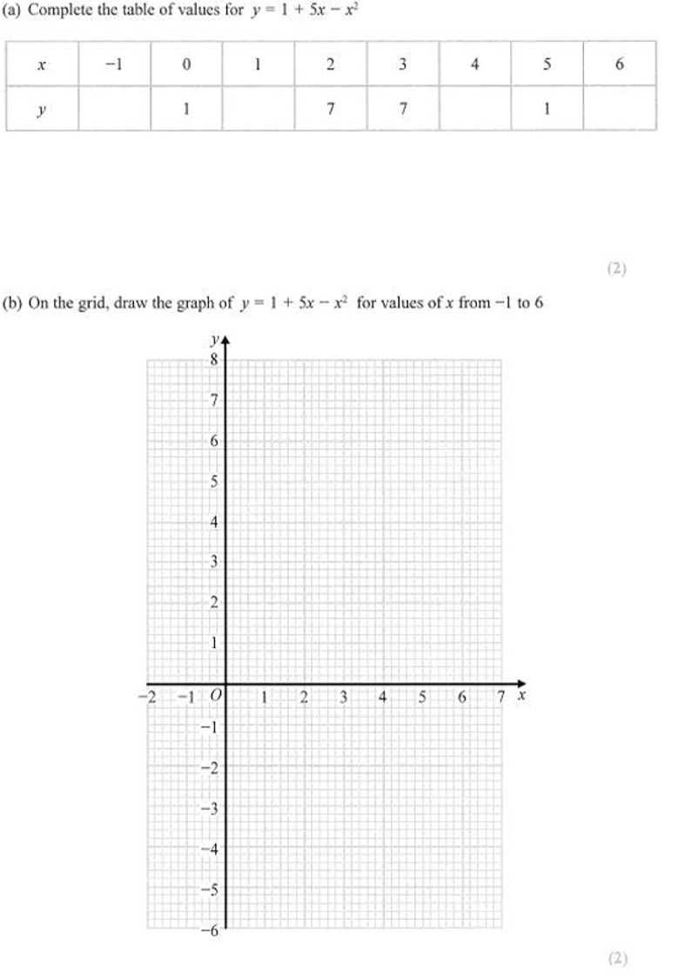
Zπ
PAST-PAPER QUESTION
Question 1

Slide 16
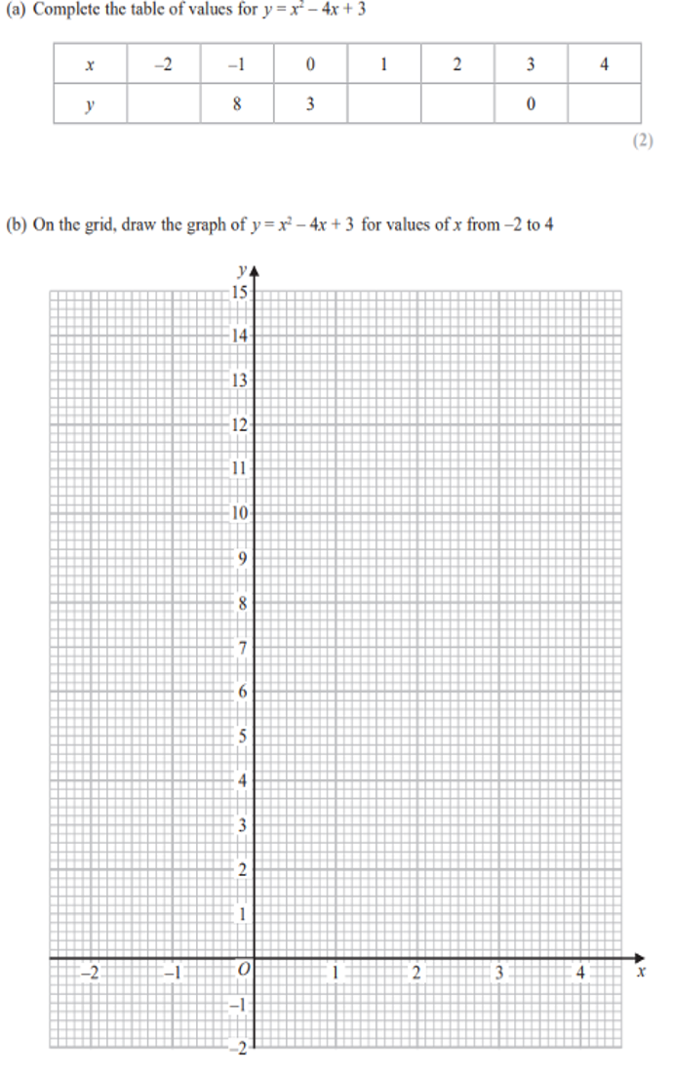
Zπ
PAST-PAPER QUESTION
Question 2

Slide 17
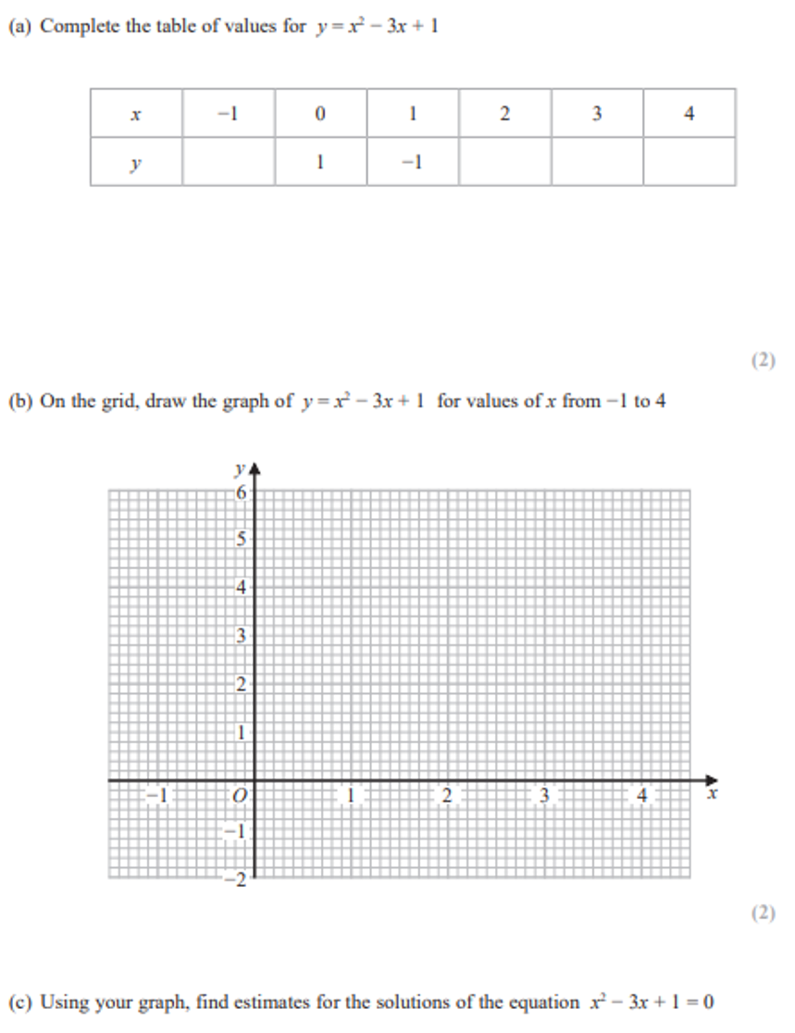
Zπ
PAST-PAPER QUESTION
Question 3

Slide 18
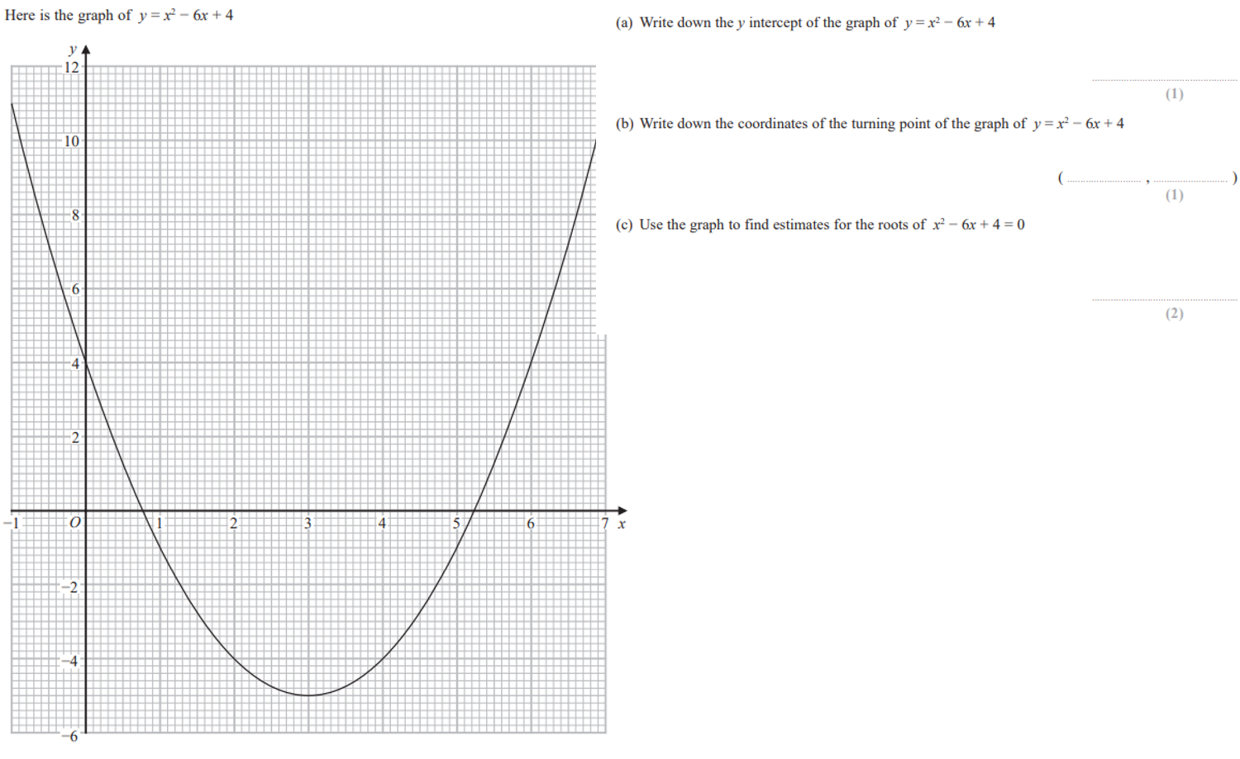
Zπ
PAST-PAPER QUESTION
Question 4

Slide 19
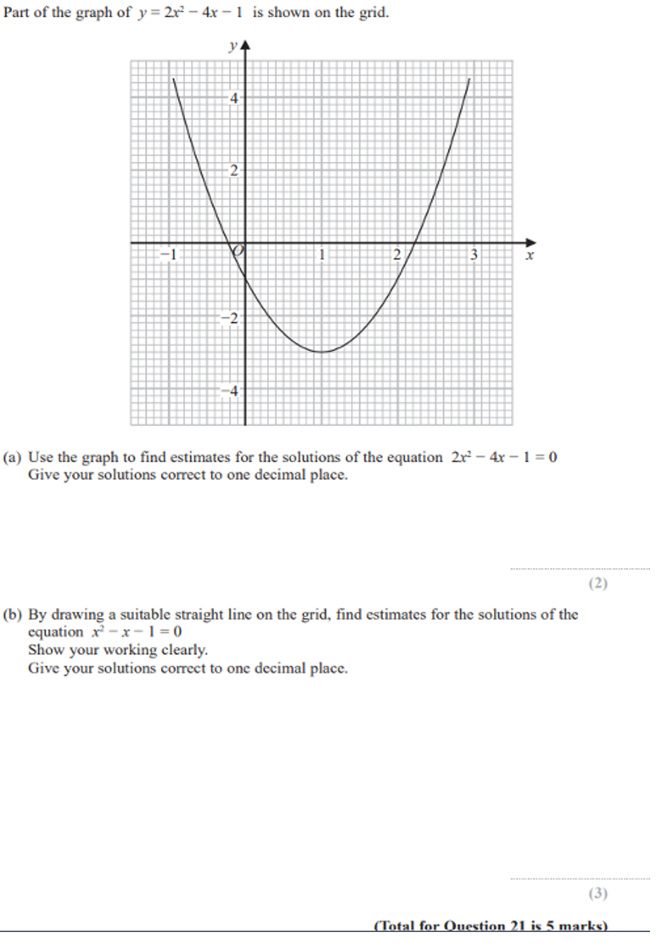
Zπ
PAST-PAPER QUESTION
Question 5

Slide 20
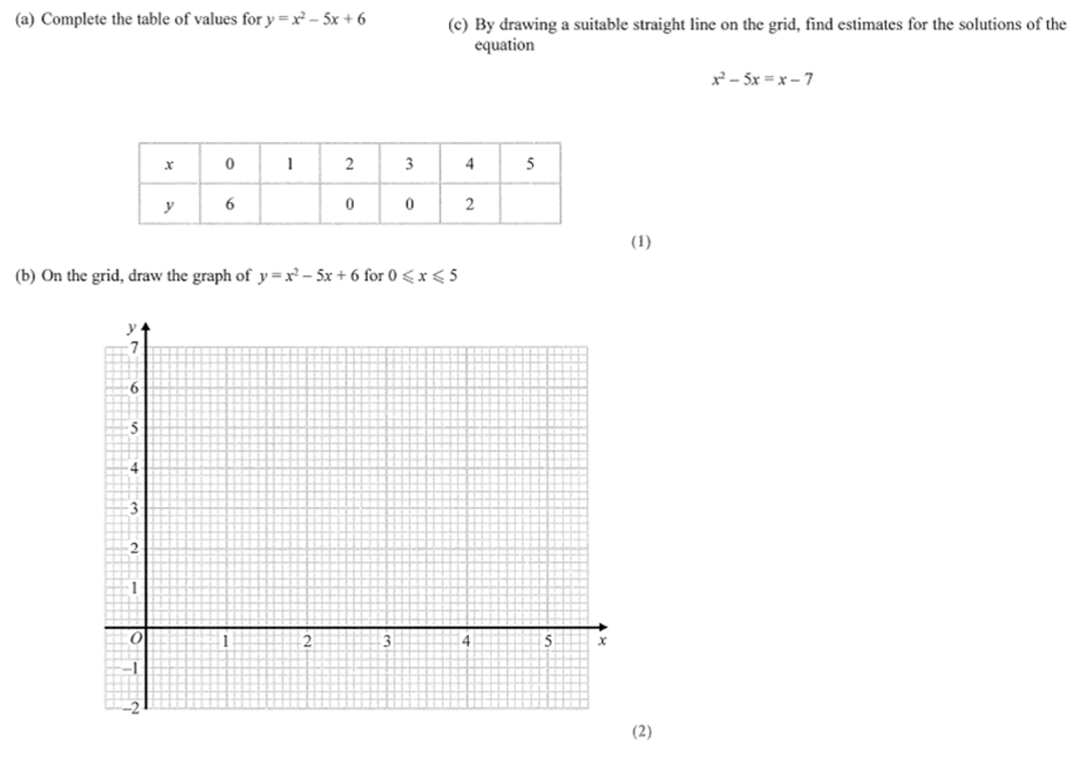
Zπ
PAST-PAPER QUESTION
Question 6

Slide 21
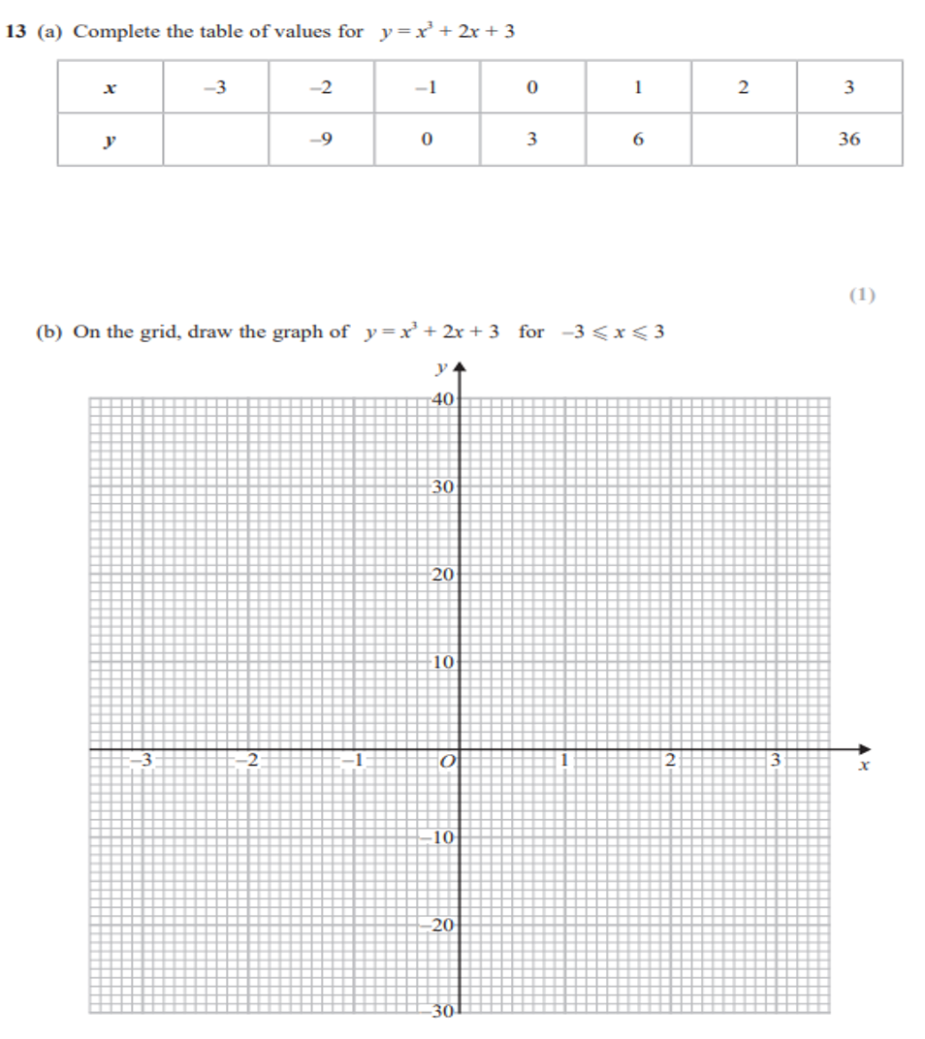
Zπ
PAST-PAPER QUESTION
Question 7

Slide 22
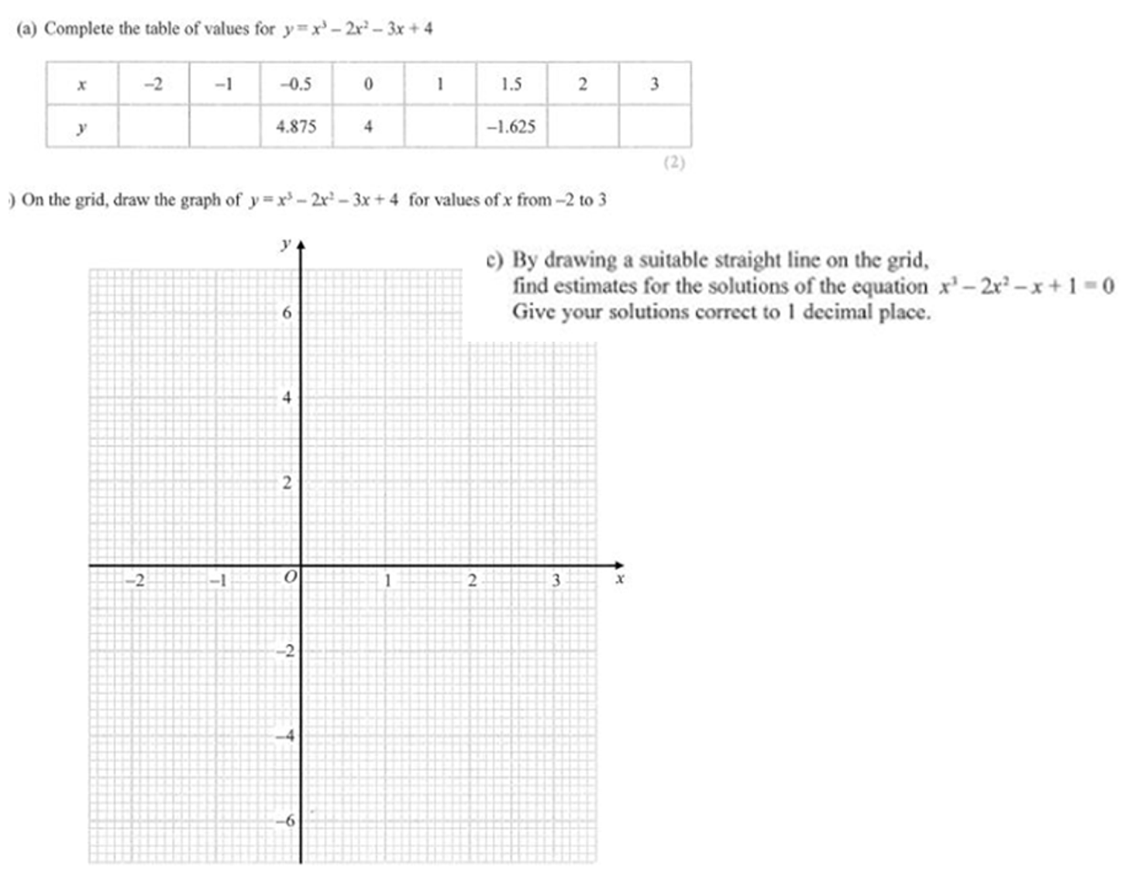
Zπ
PAST-PAPER QUESTION
Question 8

Slide 23
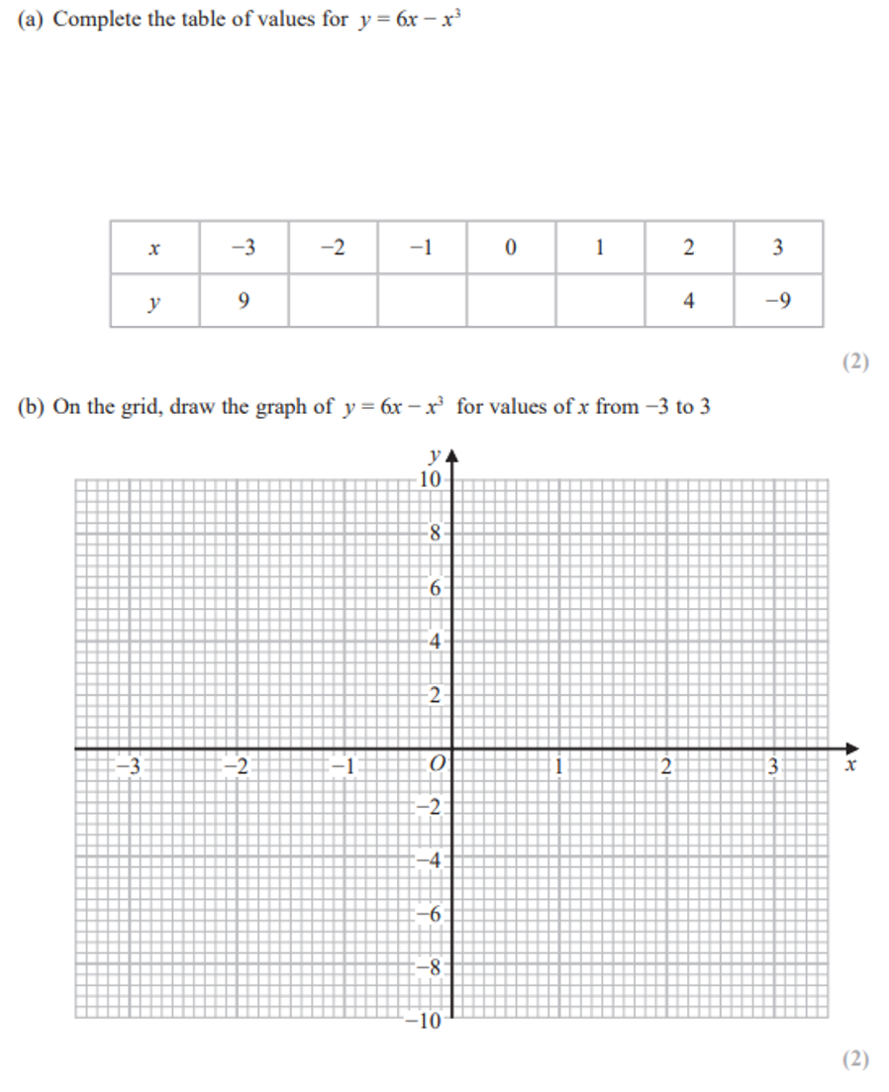
Zπ
PAST-PAPER QUESTION
Question 9

Slide 24
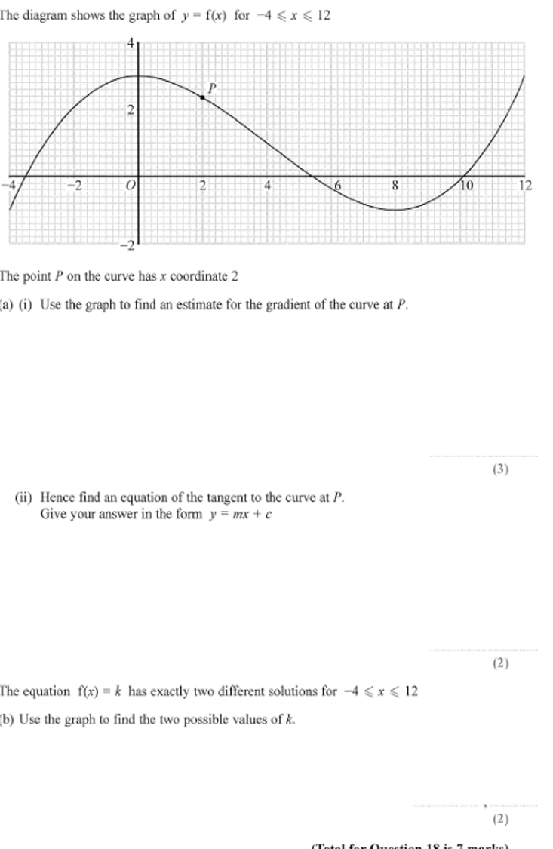
Zπ
PAST-PAPER QUESTION
Question 10

Slide 25
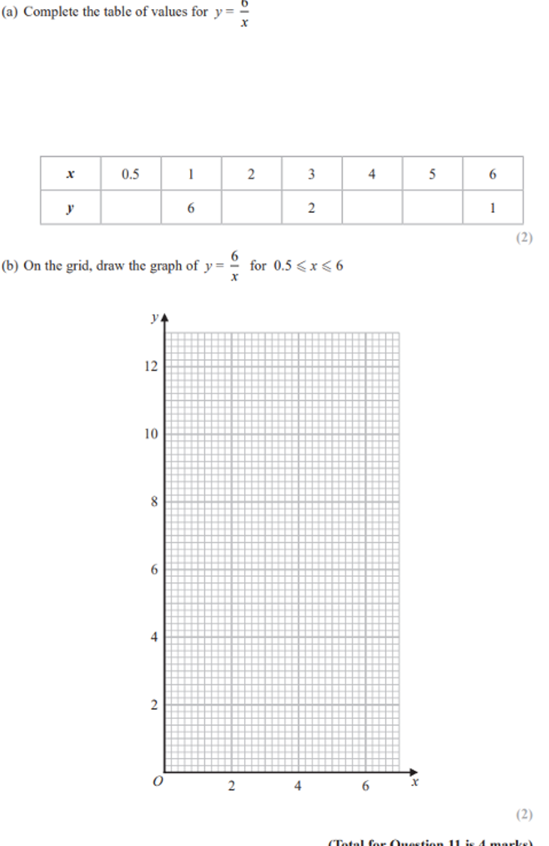
Zπ
PAST-PAPER QUESTION
Question 11

Slide 26
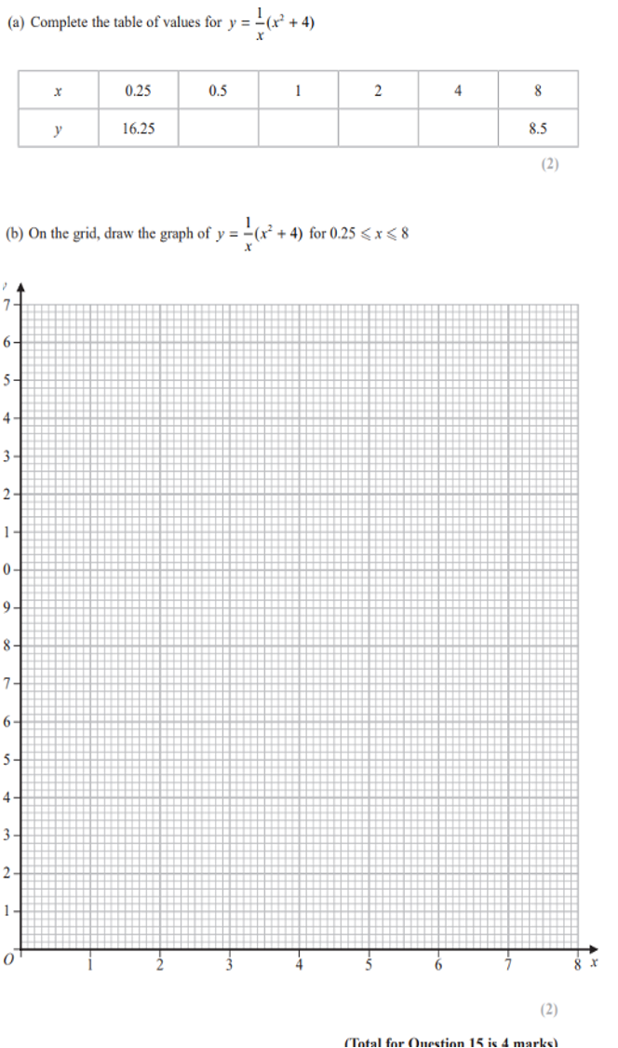
Zπ
PAST-PAPER QUESTION
Question 12

Slide 27
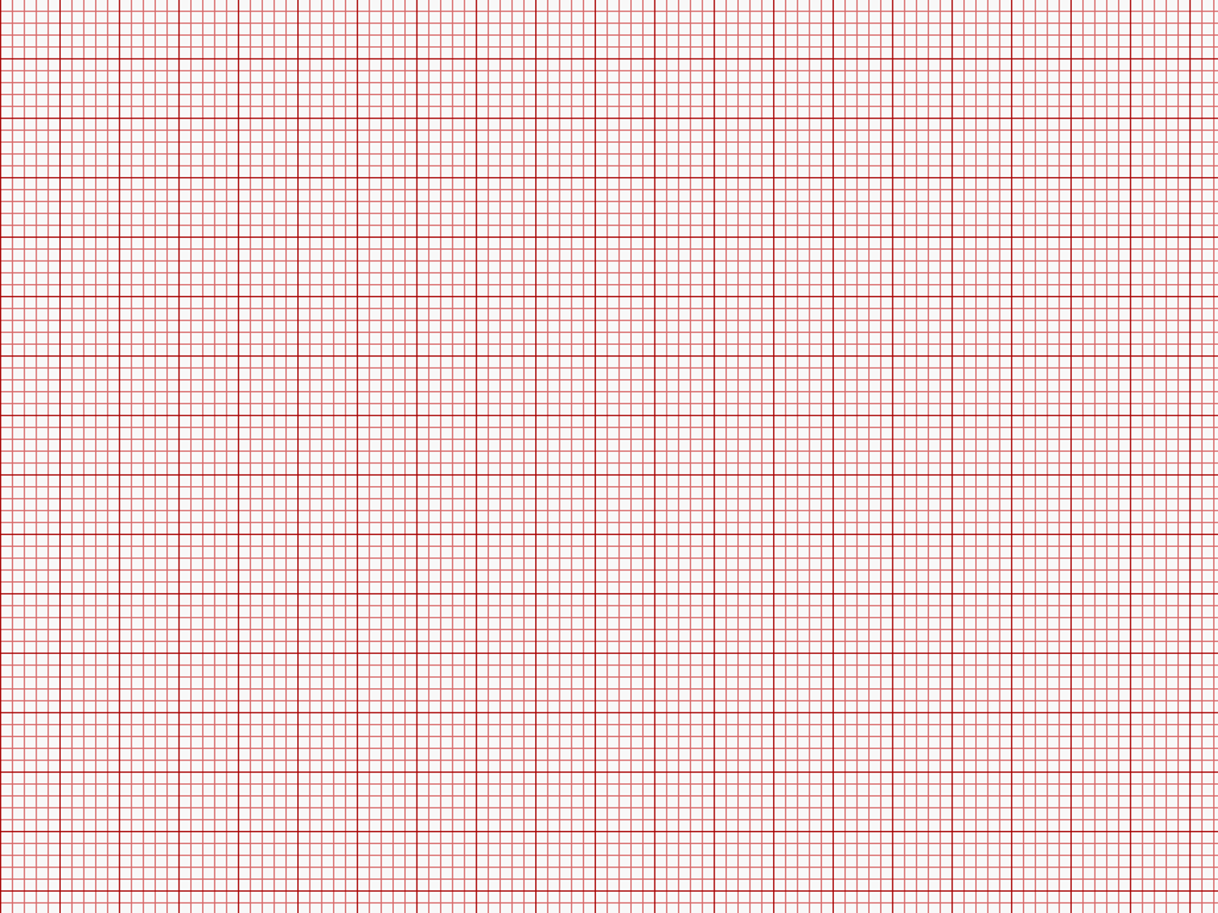
Zπ
PAST-PAPER QUESTION
Question 13

Slide 28
Zπ
RECAP
Key Takeaways
The HIGHEST power gives the shape: x² → parabola, x³ → S-shape, 1/x → two branches.
Make a table of values, plot the points, join with a SMOOTH curve (never straight lines).
Square or cube FIRST: (−3)² = 9 but (−3)³ = −27.
Roots = where the curve crosses the x-axis = the solutions of y = 0.
To solve = k, draw the line y = k and read off the x-values where it meets the curve.
Golden rule: a negative in front of the highest power flips the graph upside down.

