Slide 1
Zπ
Zπ MATHS HUB
Pearson Edexcel IGCSE (9–1) · Higher Tier
Circle Theorems
Angles in Circles · Right Angles · Same Segment · Angle at the Centre · Cyclic Quadrilaterals · Alternate Segment
Zahra Sheikh Ali
IGCSE Mathematics Teacher · M.Sc. Differential Geometry & Geometric Control
☎ 66613748 ✉ zahraa.sheikhali@outlook.com

Slide 2
Zπ
LESSON OVERVIEW
Laws of Angles in Circles
Circle theorems are laws about angles when circles are involved. Learn the wording in the boxes — the exam asks you to JUSTIFY each angle in words.
Parts of a circle
Right-angle theorems
Same segment & centre
1
2
3
Cyclic quadrilaterals
Alternate segment
Past-paper questions
4
5
6
Key words: radius · chord · tangent · arc · segment · subtended · cyclic quadrilateral

Slide 3
RECAP
Zπ
Parts of a Circle
(Minor) Arc
?
Sector
?
Chord
?
Radius
?
(Minor)
Segment
?
Diameter
?
Tangent
?
Circumference
?
Know the names first. Radius, diameter, chord, tangent, arc, sector and segment.

Slide 4
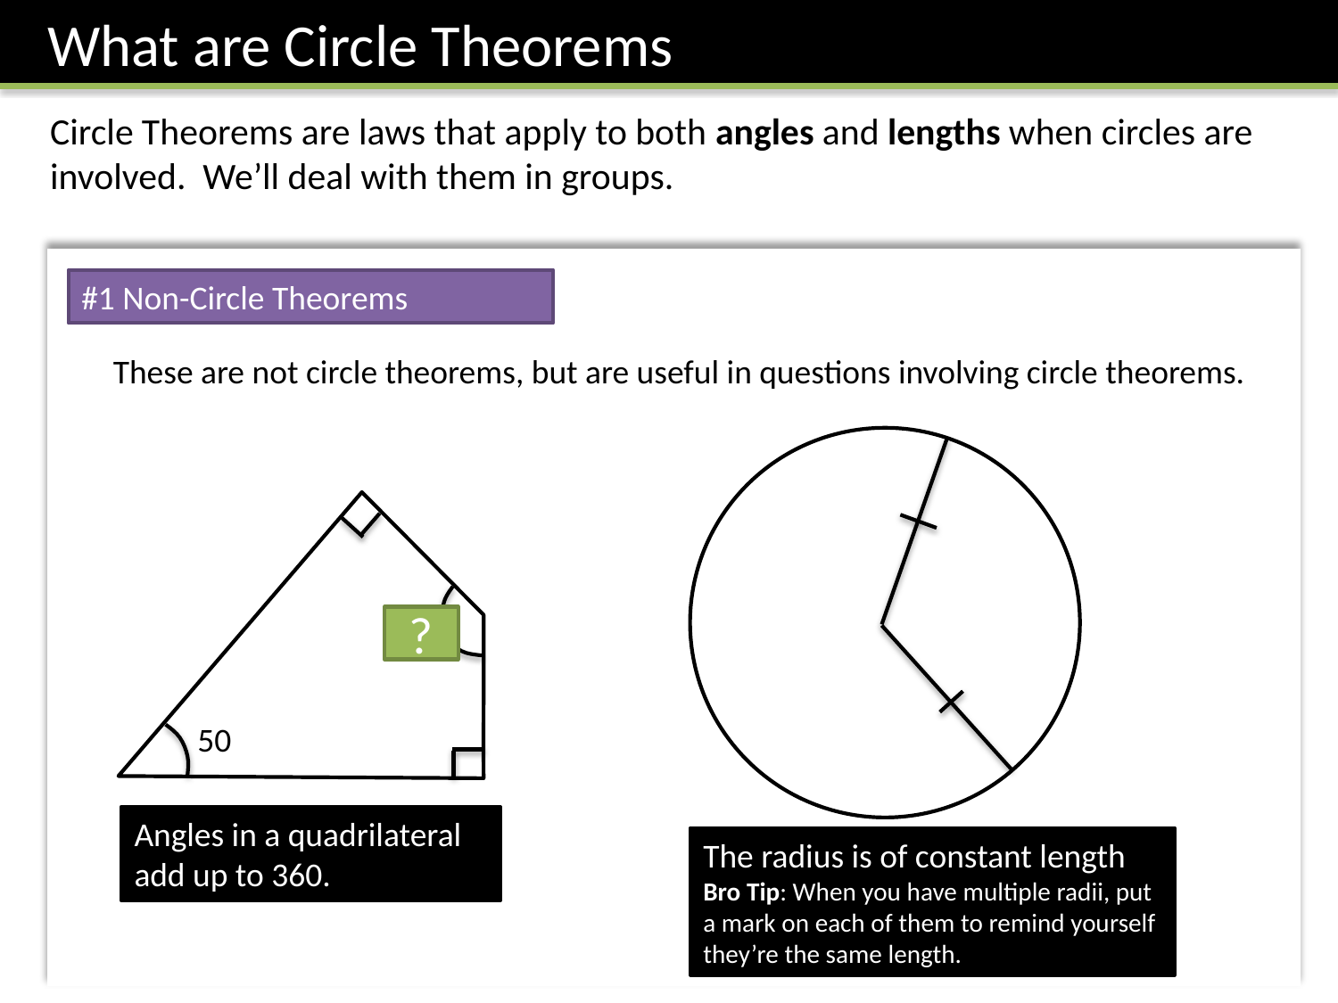
Zπ
BEFORE WE START
Useful Facts (Not Circle Theorems)
These are NOT circle theorems, but you need them: angles in a triangle/quadrilateral, and radii make ISOSCELES triangles.

Slide 5
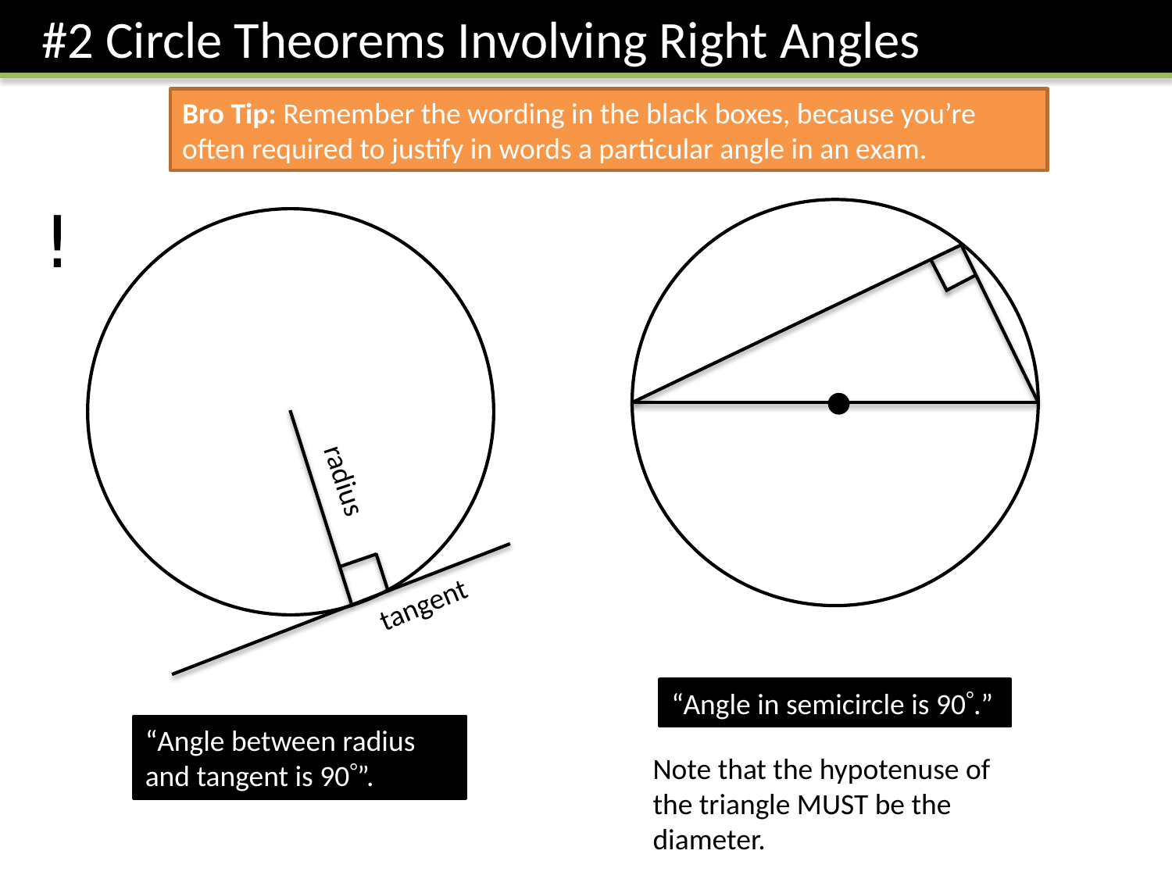
Zπ
THEOREM 1 · RIGHT ANGLES
Angle in a Semicircle & Radius–Tangent
“Angle in a semicircle is 90°.” “Angle between a radius and a tangent is 90°.” Learn this wording.

Slide 6
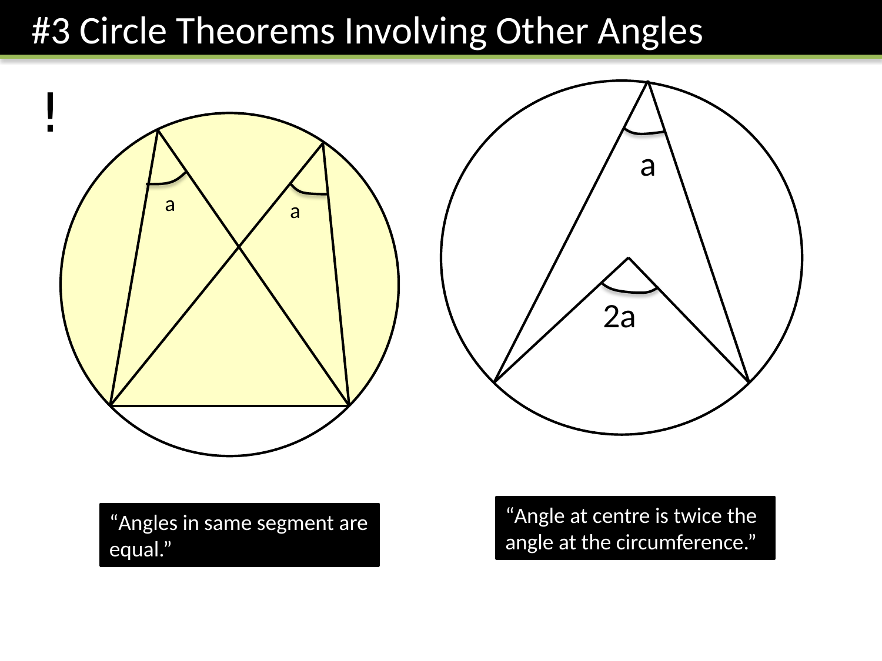
Zπ
THEOREM 2 · KEY ANGLES
Same Segment & Angle at the Centre
“Angles in the same segment are equal.” “The angle at the centre is TWICE the angle at the circumference.”

Slide 7
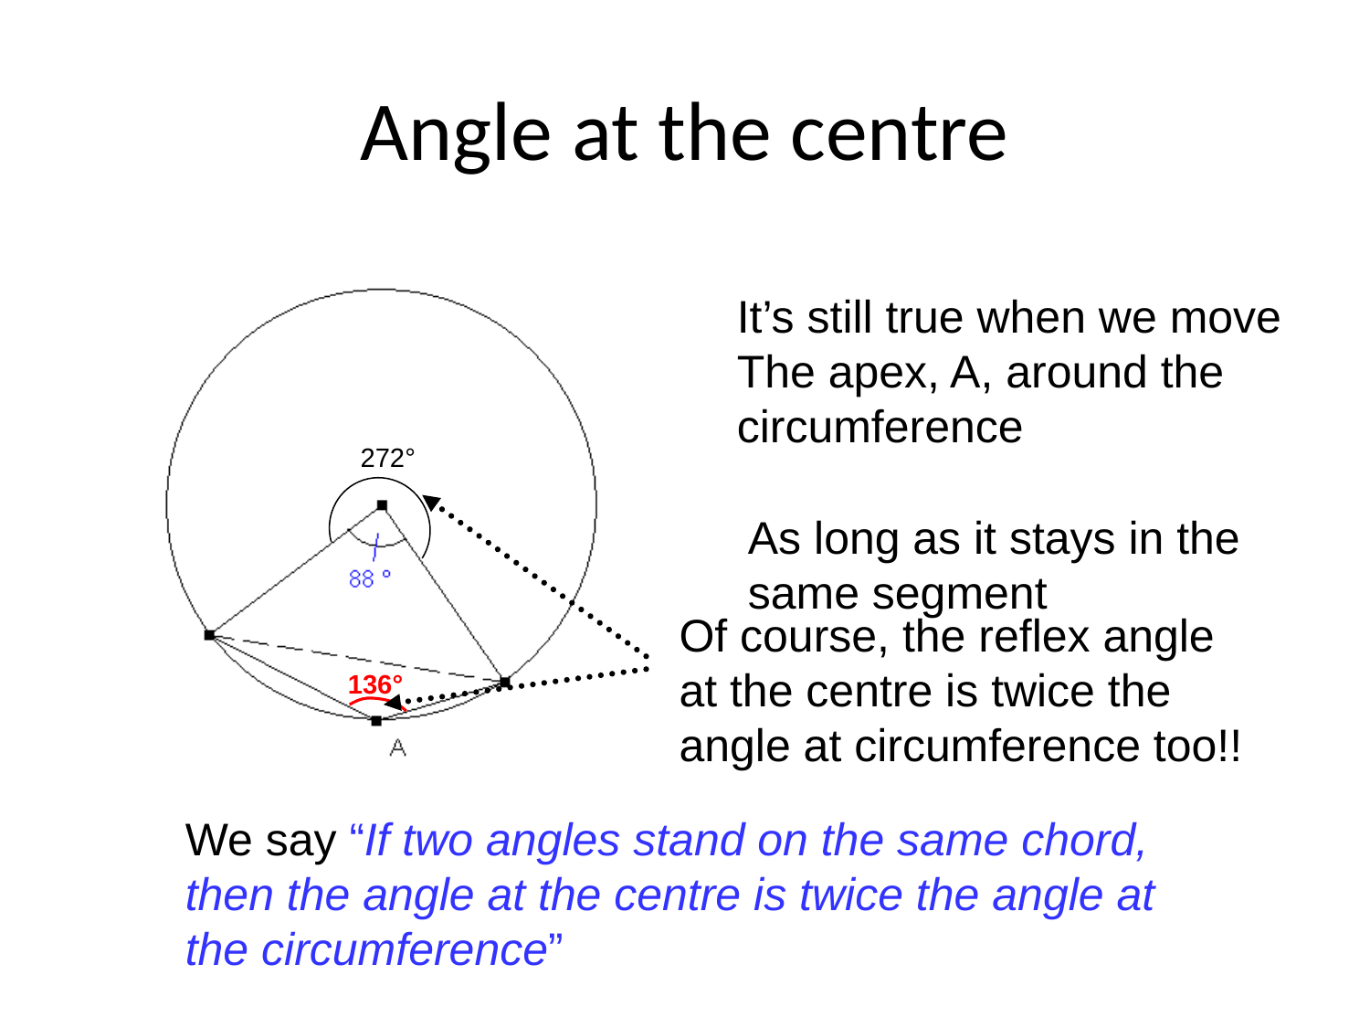
Zπ
ANGLE AT THE CENTRE
It Stays True Wherever the Apex Moves
Both angles stand on the same arc. Move the apex around the circumference — the angle at the centre is still double.

Slide 8
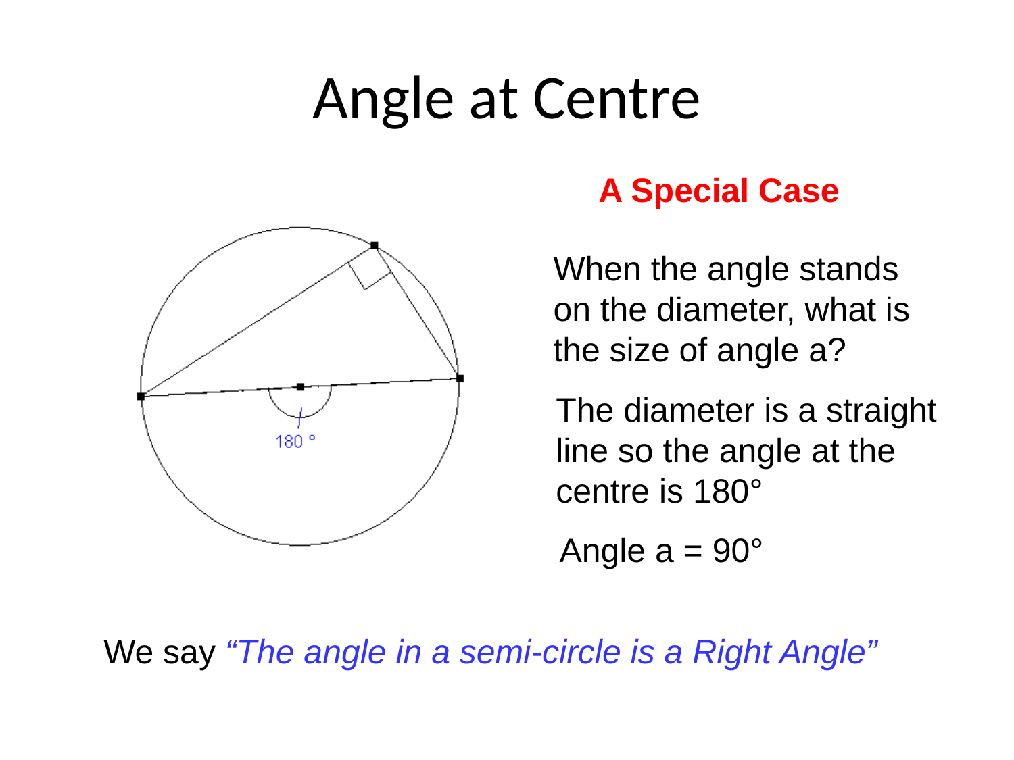
Zπ
ANGLE AT THE CENTRE
Special Case — Standing on the Diameter
On a diameter the centre angle is 180°, so the angle at the circumference is 90° — that is the semicircle theorem.

Slide 9
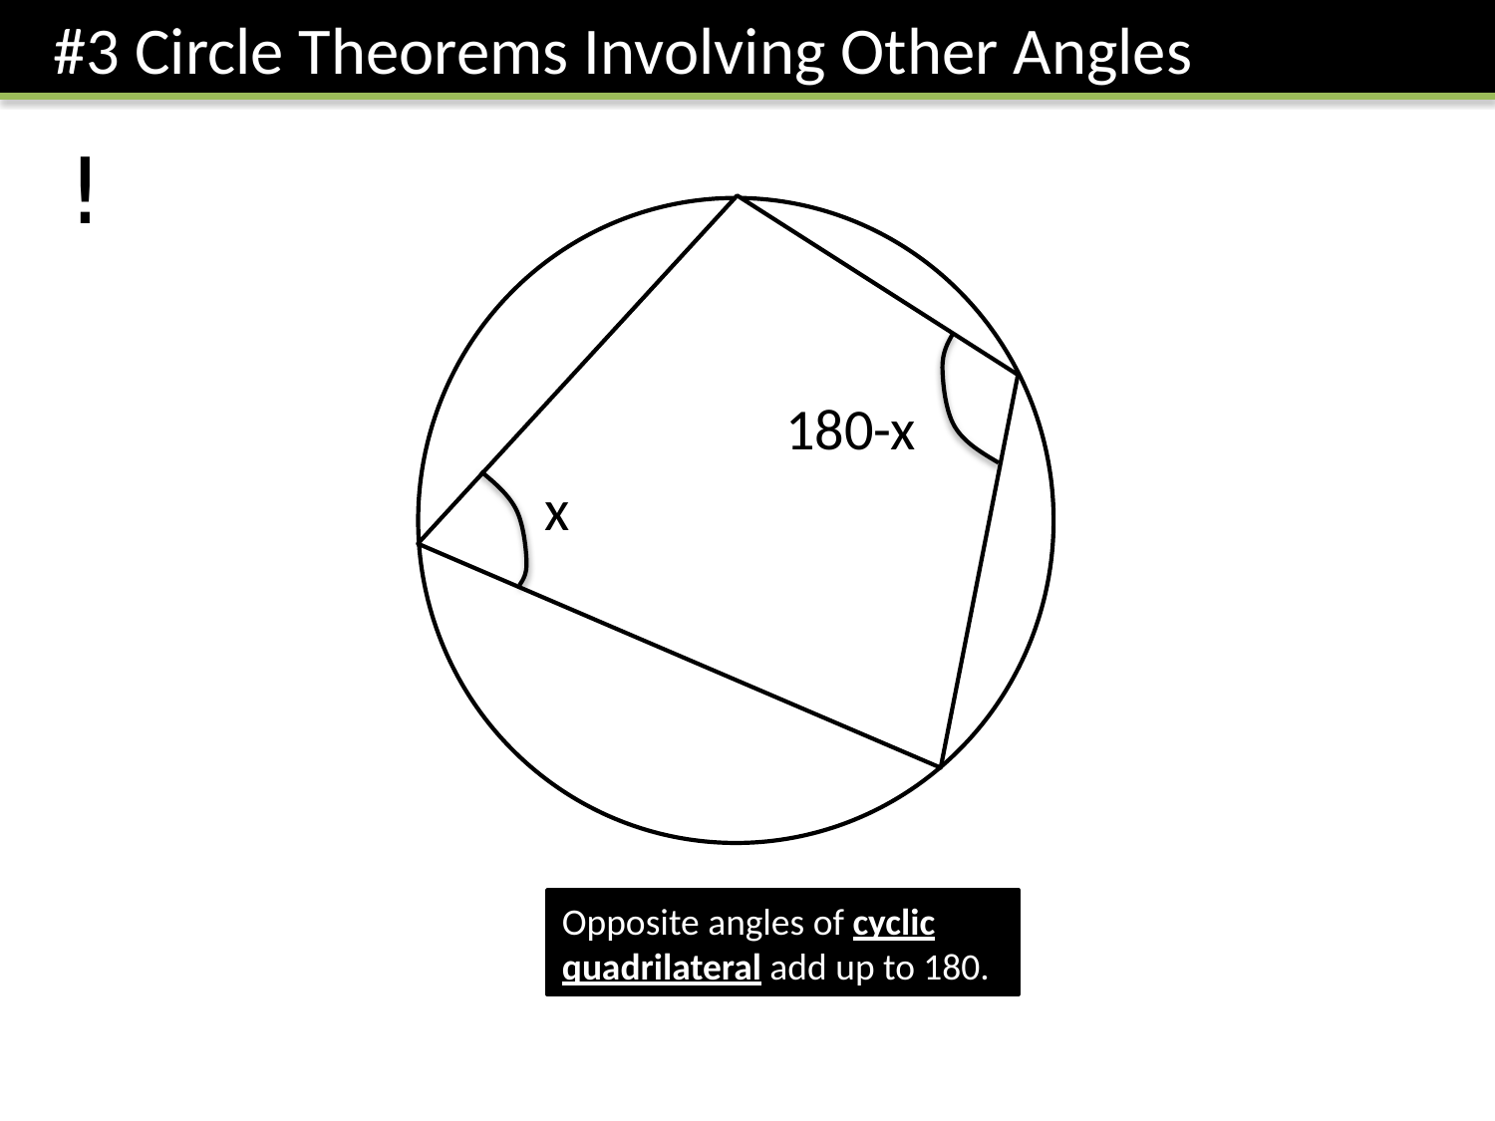
Zπ
THEOREM 3
Cyclic Quadrilaterals
“Opposite angles of a cyclic quadrilateral add up to 180°.” All four vertices lie on the circumference.

Slide 10
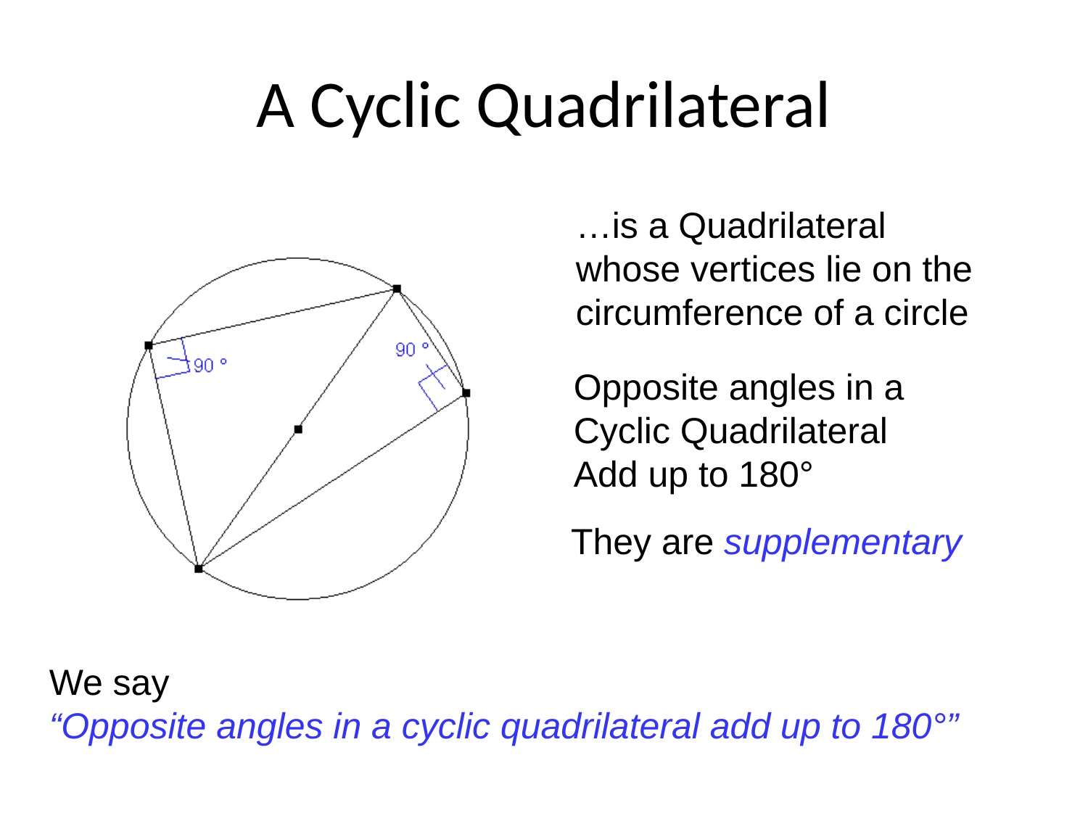
Zπ
CYCLIC QUADRILATERAL
What Counts as a Cyclic Quadrilateral?
Every vertex must be ON the circumference. If one is not, the theorem does not apply.

Slide 11
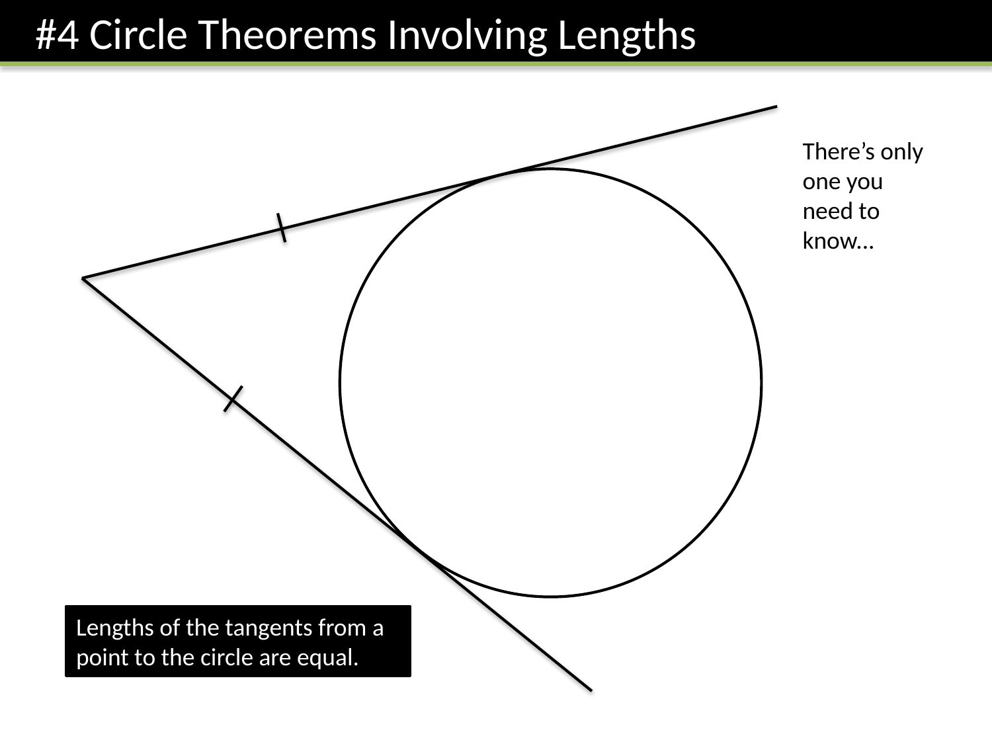
Zπ
THEOREM 4 · LENGTHS
Tangents from a Point Are Equal
“The two tangents from a point to a circle are equal in length.” This creates an isosceles triangle.

Slide 12
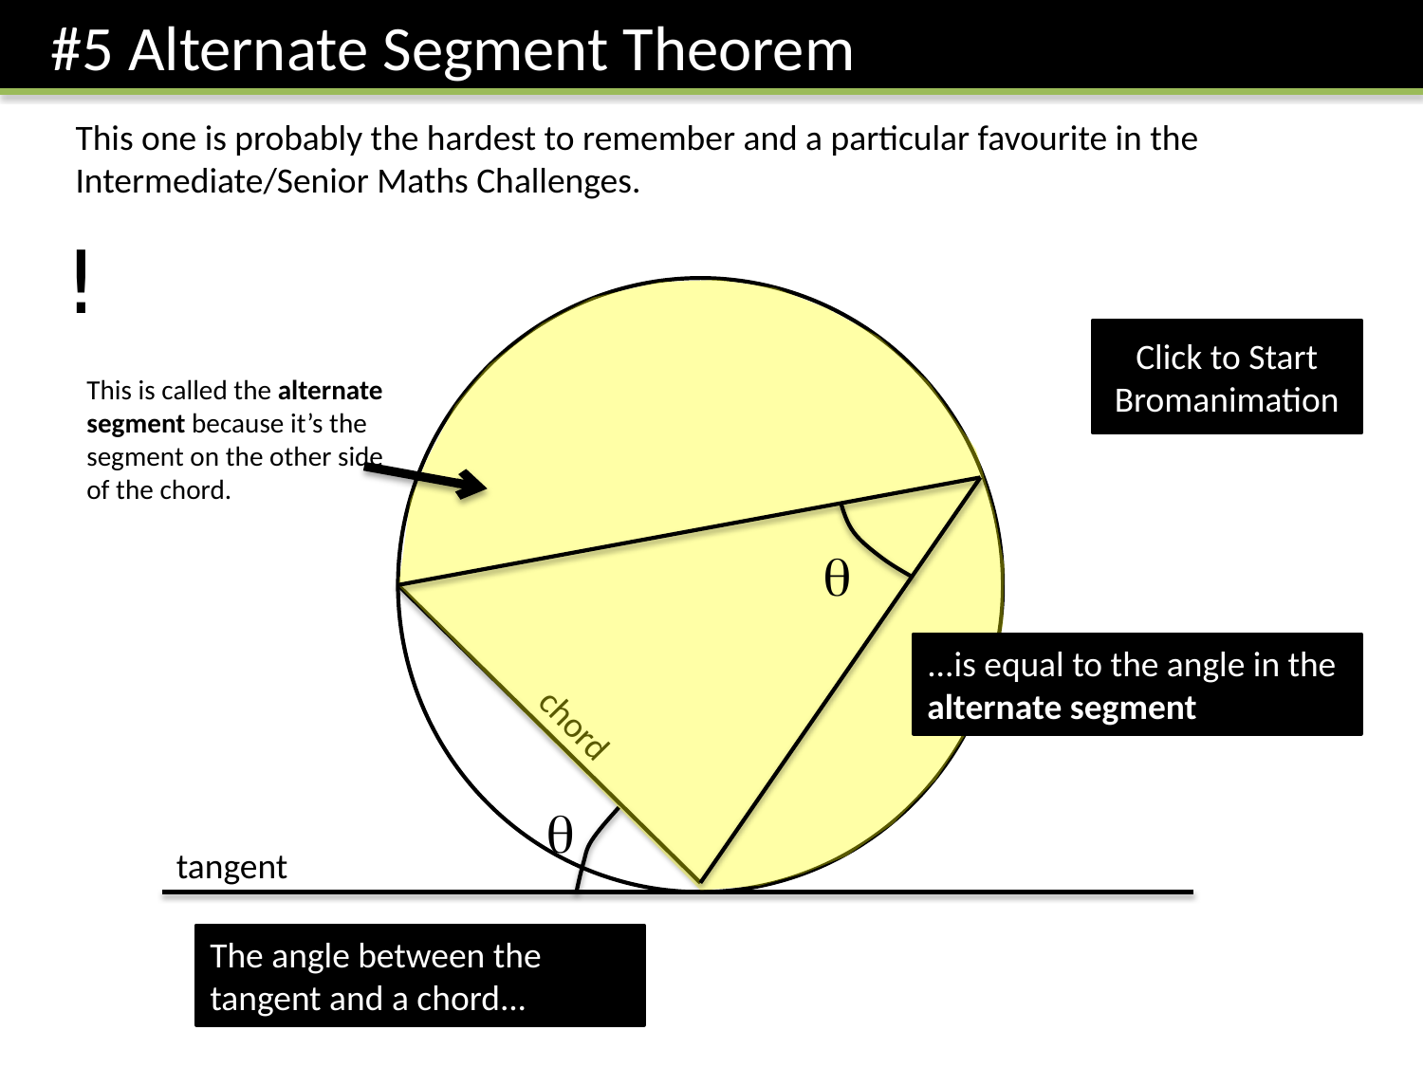
Zπ
THEOREM 5
The Alternate Segment Theorem
“The angle between a tangent and a chord equals the angle in the alternate segment.” The hardest one — learn it.

Slide 13
Zπ
SUMMARY
The Reasons You Must Write
In the exam you must give a REASON. These are the exact wordings that earn the mark.
Theorem
The reason to write
Semicircle
“Angle in a semicircle is 90°”
Radius & tangent
“Angle between a radius and a tangent is 90°”
Same segment
“Angles in the same segment are equal”
Angle at the centre
“Angle at the centre is twice the angle at the circumference”
Cyclic quadrilateral
“Opposite angles of a cyclic quadrilateral add up to 180°”
Tangents from a point
“Tangents from a point to a circle are equal”
Alternate segment
“Angle between tangent and chord = angle in the alternate segment”
Two radii
“Triangle is isosceles — two radii are equal”
No reason = no mark. Learn these sentences word for word.

Slide 14
Zπ
PRACTICE
Which Circle Theorem? (1)
Identify which circle theorems you could use to solve each question.
Angle in semicircle is 90°
Angle between tangent and radius is 90°
Reveal
Opposite angles of cyclic quadrilateral add to 180°
Angles in same segment are equal
O
Angle at centre is twice angle at circumference
160°
?
Lengths of the tangents from a point to the circle are equal
100°
Two angles in isosceles triangle the same
Angles of quadrilateral add to 360°
Identify which theorem you would use — then find the angle.

Slide 15
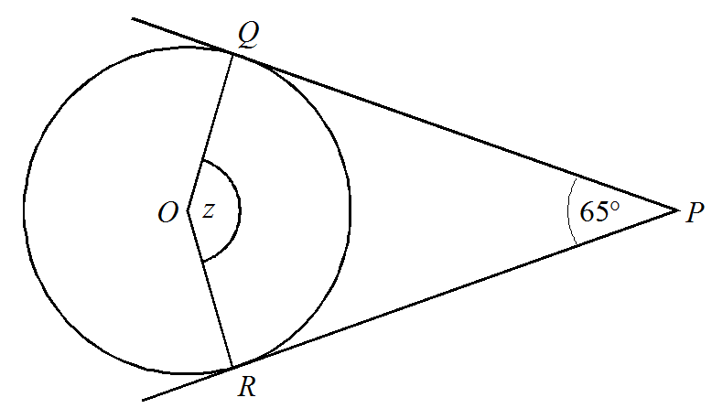
Angle in semicircle is 90°
Zπ
PRACTICE
Angle between tangent and radius is 90°
Which Circle Theorem? (2)
Identify which circle theorems you could use to solve each question.
Opposite angles of cyclic quadrilateral add to 180°
Reveal
Angles in same segment are equal
?
115°
Angle at centre is twice angle at circumference
Lengths of the tangents from a point to the circle are equal
Two angles in isosceles triangle the same
Angles of quadrilateral add to 360°
Identify which theorem you would use — then find the angle.

Slide 16
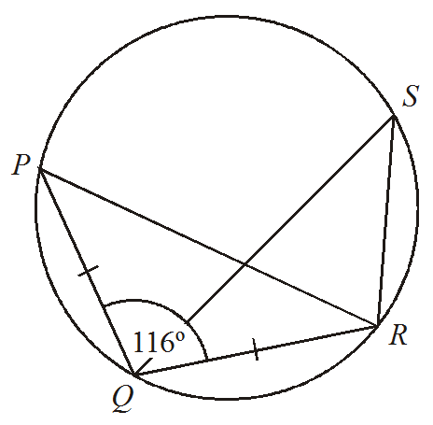
Zπ
PRACTICE
Angle in semicircle is 90°
Which Circle Theorem? (3)
Identify which circle theorems you could use to solve each question.
Angle between tangent and radius is 90°
Reveal
Opposite angles of cyclic quadrilateral add to 180°
?
Angles in same segment are equal
32°
Angle at centre is twice angle at circumference
Lengths of the tangents from a point to the circle are equal
Two angles in isosceles triangle the same
Angles of quadrilateral add to 360°
Identify which theorem you would use — then find the angle.

Slide 17
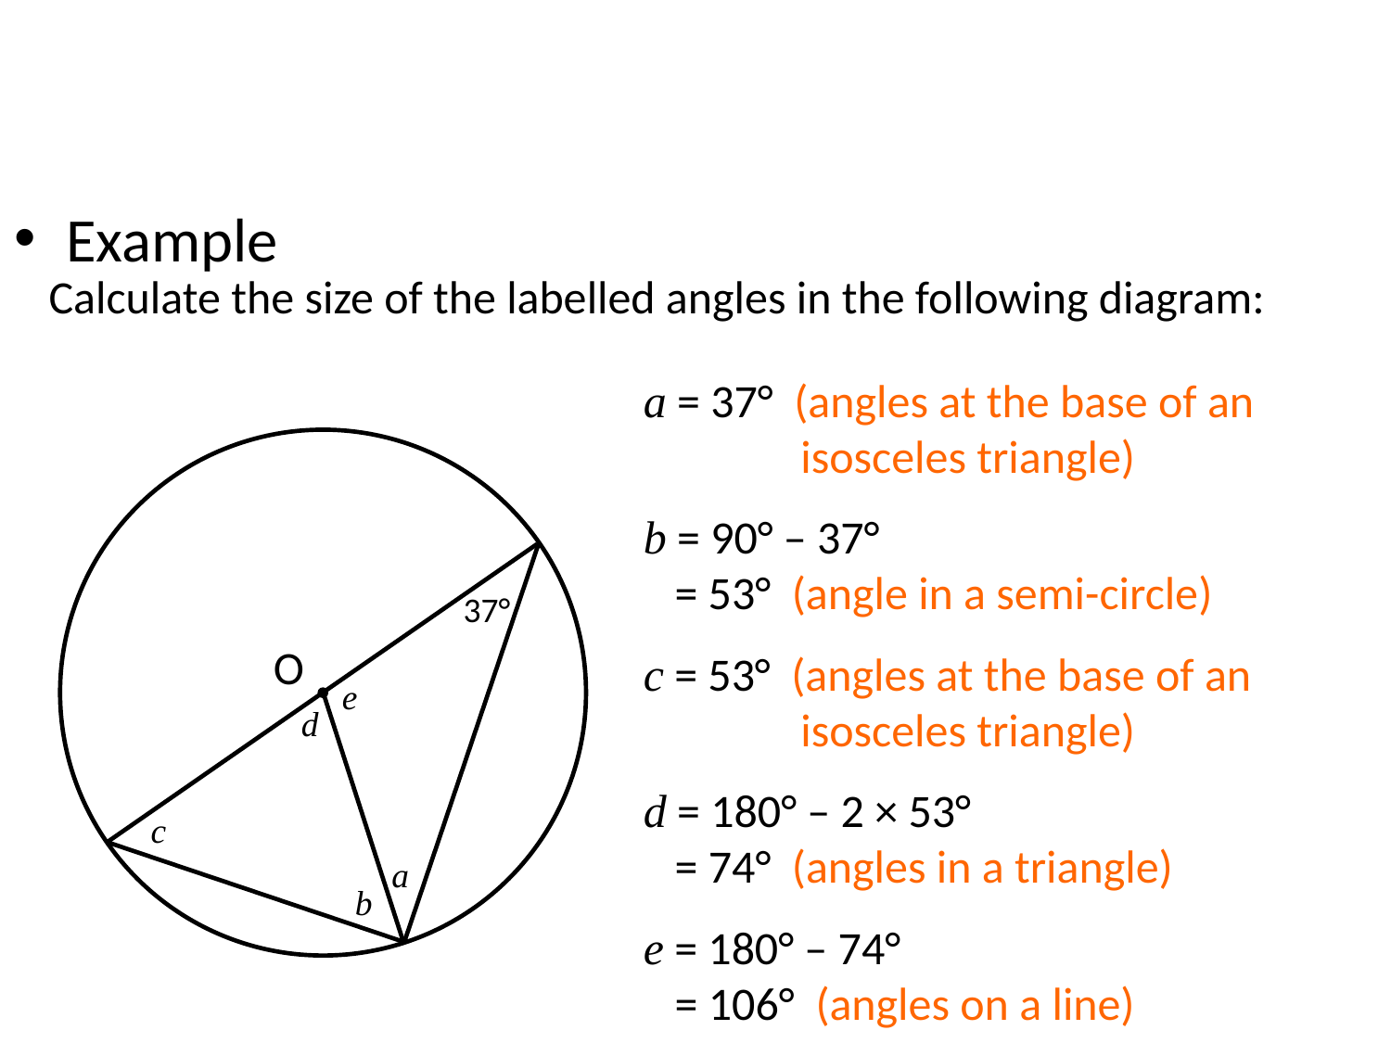
Zπ
WORKED EXAMPLE
Calculate the Labelled Angles (1)
Work through one angle at a time, giving a reason for each.

Slide 18
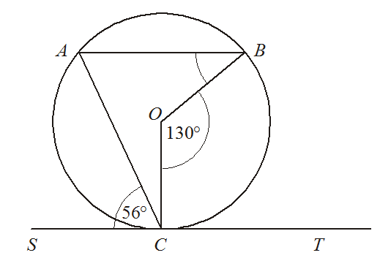
Angle in semicircle is 90°
Zπ
PRACTICE
Which Circle Theorem? (4)
Angle between tangent and radius is 90°
Identify which circle theorems you could use to solve each question.
Opposite angles of cyclic quadrilateral add to 180°
Reveal
31°
Angles in same segment are equal
?
Angle at centre is twice angle at circumference
Lengths of the tangents from a point to the circle are equal
Two angles in isosceles triangle the same
Angles of quadrilateral add to 360°
Identify which theorem you would use — then find the angle.

Slide 19
Zπ
WORKED EXAMPLE
Calculate the Labelled Angles (1)
Calculate the size of the labelled angles in the following diagram:
a = 37° (angles at the base of an
isosceles triangle)
b = 90° – 37°
= 53° (angle in a semi-circle)
37°
O
c = 53° (angles at the base of an
isosceles triangle)
e
d
d = 180° – 2 × 53°
= 74° (angles in a triangle)
c
a
b
e = 180° – 74°
= 106° (angles on a line)
Look for a semicircle, a radius-tangent, or a cyclic quadrilateral first.

Slide 20
Zπ
WORKED EXAMPLE
Calculate the Labelled Angles (2)
a = 90° – 51°
= 39° (angle in a semi-circle)
c
b = 180° – (90° + 44°)
= 46° (angles in a triangle)
d
O
44°
b
c = b = 46° (angles in the same
segment)
51°
a
d = 51° (angles in the same
segment)
Chain the theorems: one angle unlocks the next.

Slide 21
Zπ
WORKED EXAMPLE
Calculate the Labelled Angles (3)
b = c = (180° – 128°) ÷ 2
= 26° (angles at the base of
an isosceles triangle)
c
f
b
d
128°
d = 33° (angles at the base of an
isosceles triangle)
O
e = 180° – 2 × 33°
= 114° (angles in a triangle)
e
33°
a
f = 180° – (e + c)
= 180° – 140°
= 40° (opposite angles in a
cyclic quadrilateral)
Chain the theorems: one angle unlocks the next.

Slide 22
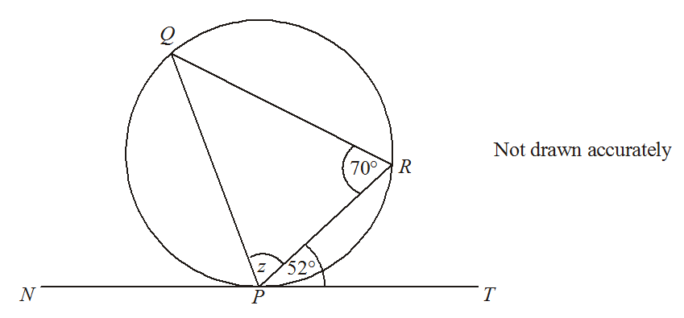
Zπ
CHECK YOUR UNDERSTANDING
Alternate Segment
z = 58°
?
Use the alternate segment theorem.

Slide 23
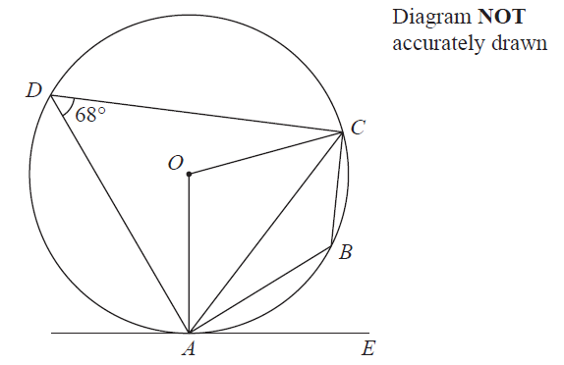
Zπ
CHECK YOUR UNDERSTANDING
IGCSE Jan 2014 (R)
Angle ABC =
Angle AOC =
Angle CAE =
?
?
?
112°
136°
68°
Give a reason:
Give a reason:
Give a reason:
?
?
?
Supplementary angles of cyclic quadrilateral add up to 180.
Angle at centre is double angle at circumference.
Alternate Segment Theorem.
Give a reason for every angle you write down.

Slide 24
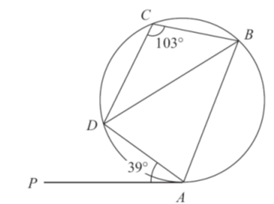
Zπ
HARDER QUESTIONS
IGCSE May 2013
?
39
?
64
?
77
Determine angle ADB.
Several theorems combine in one diagram.

Slide 25
Zπ
PART 2
Past-Paper Questions
Every angle needs a REASON — write the theorem in words.
1
Mark what you know on the diagram
2
Spot the theorem (centre? tangent? cyclic quad?)
3
Find one angle, then chain to the next
4
Give a reason for EVERY step

Slide 26
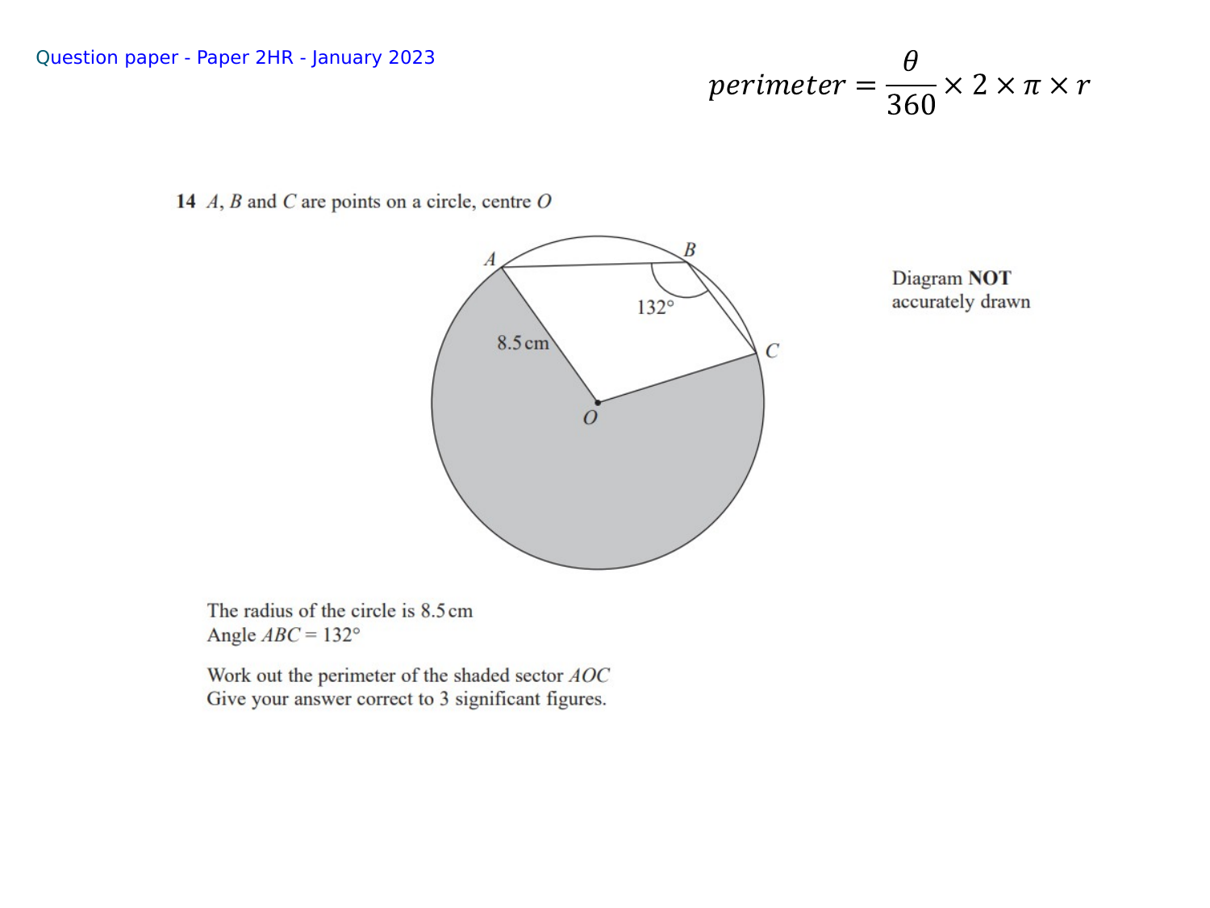
Zπ
PAST-PAPER QUESTION
Question 1 · Jan 2023 · Paper 2HR

Slide 27
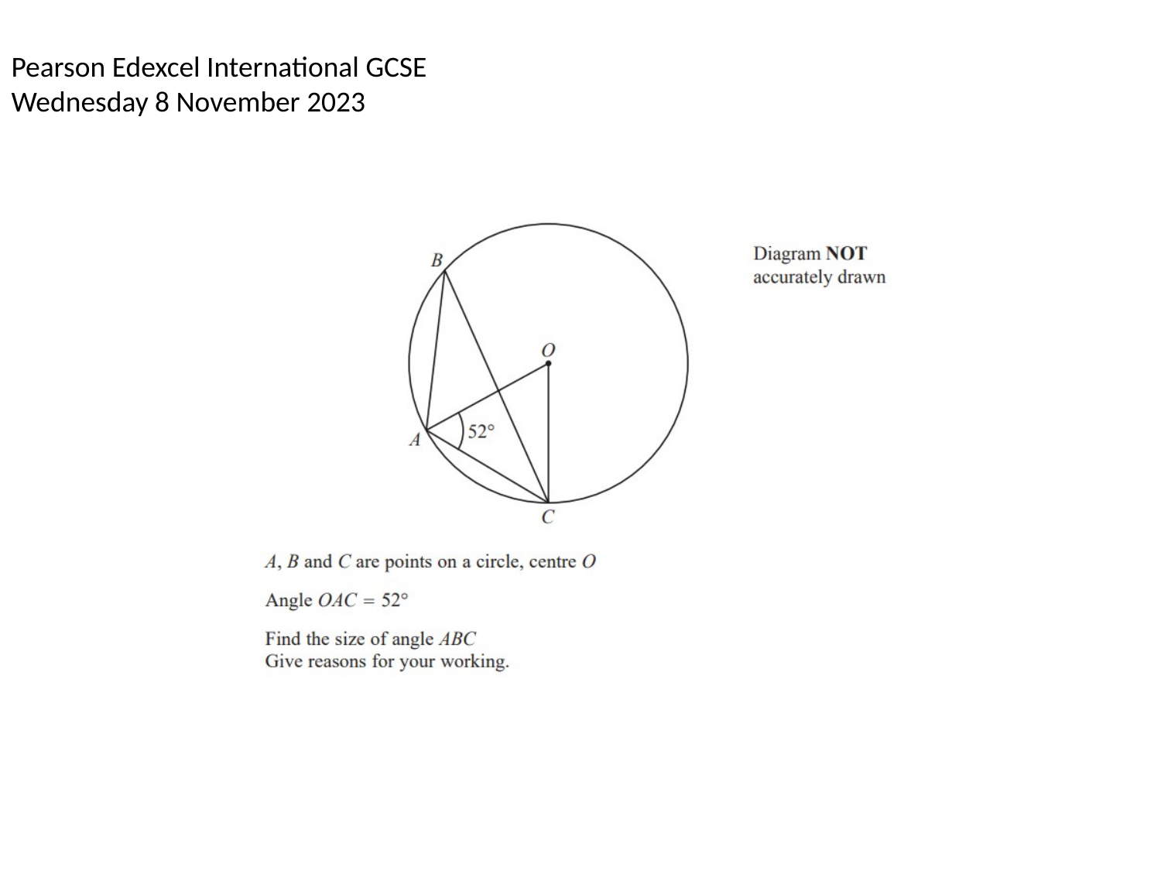
Zπ
PAST-PAPER QUESTION
Question 2 · Nov 2023

Slide 28
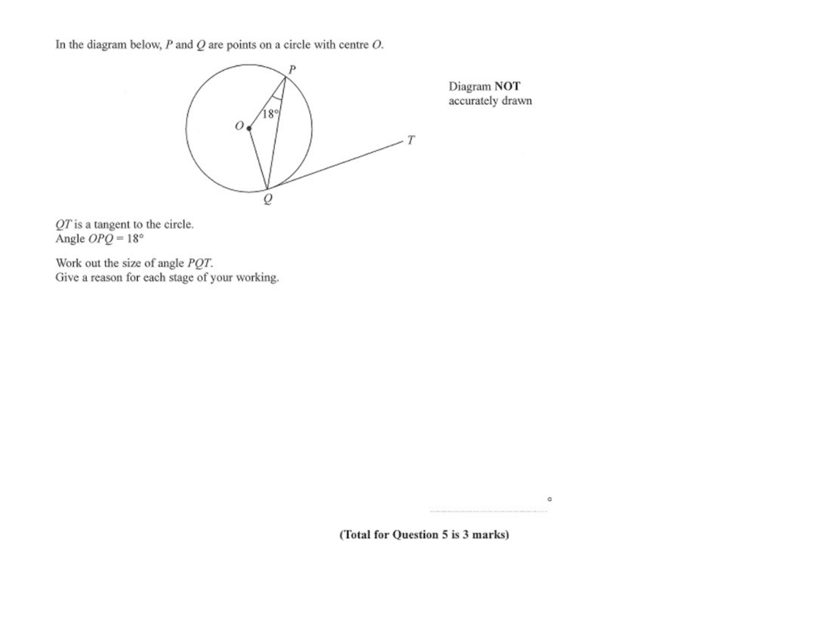
Zπ
PAST-PAPER QUESTION
Question 3

Slide 29
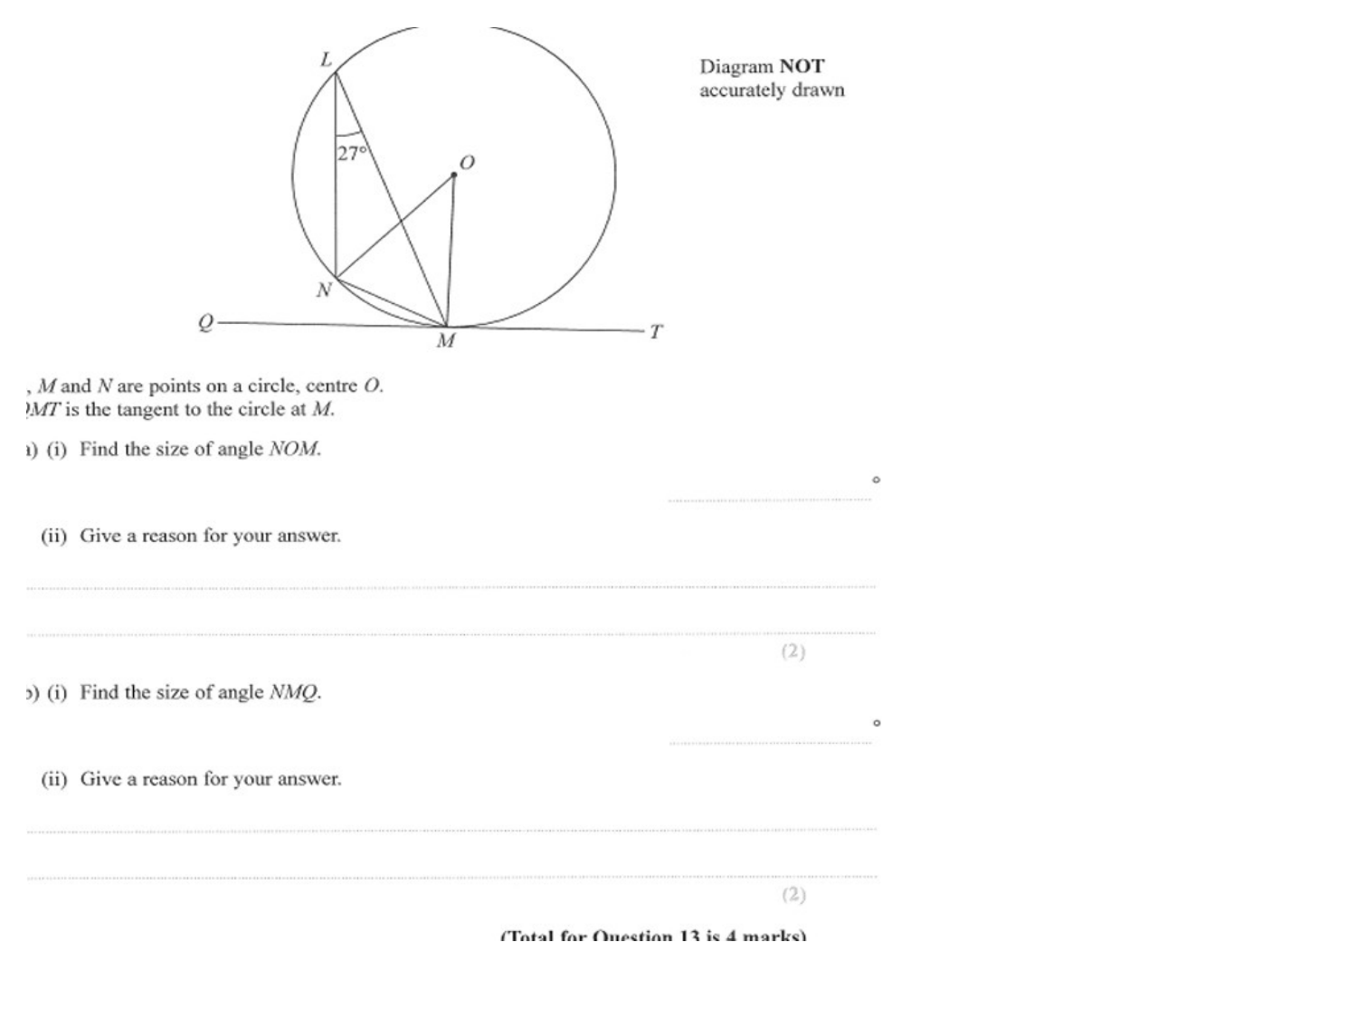
Zπ
PAST-PAPER QUESTION
Question 4

Slide 30
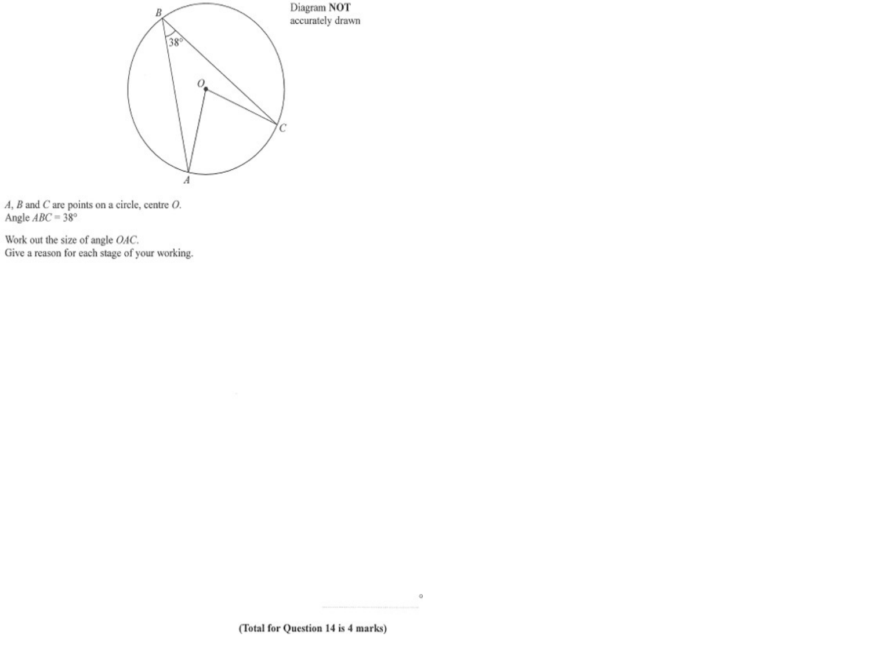
Zπ
PAST-PAPER QUESTION
Question 5

Slide 31
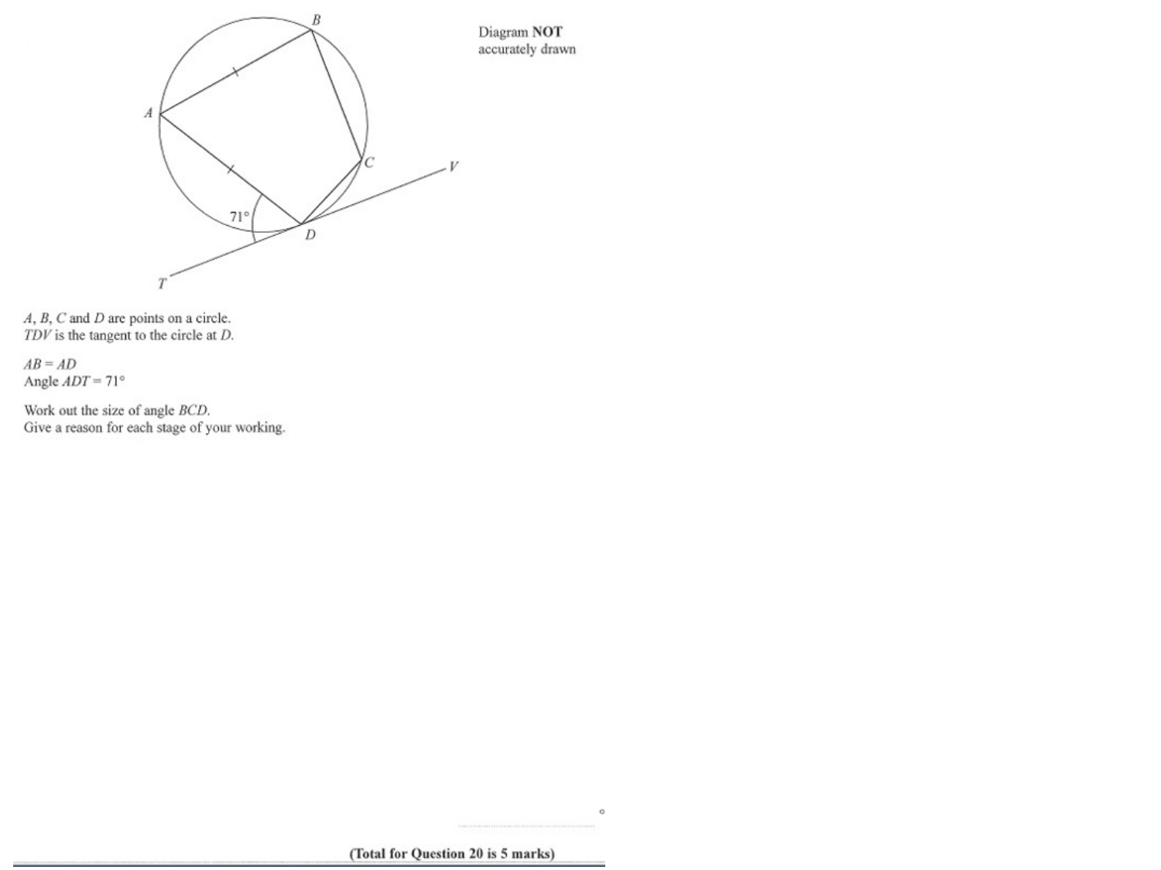
Zπ
PAST-PAPER QUESTION
Question 6

Slide 32
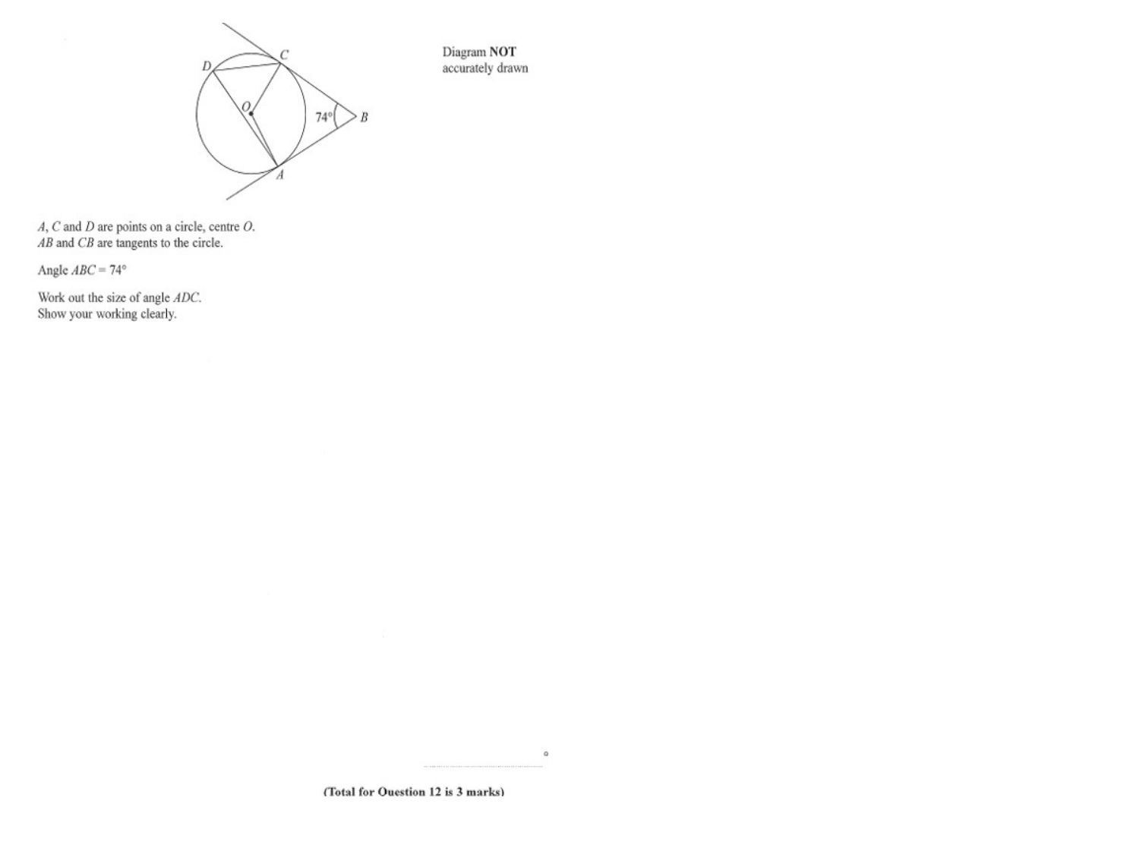
Zπ
PAST-PAPER QUESTION
Question 7

Slide 33
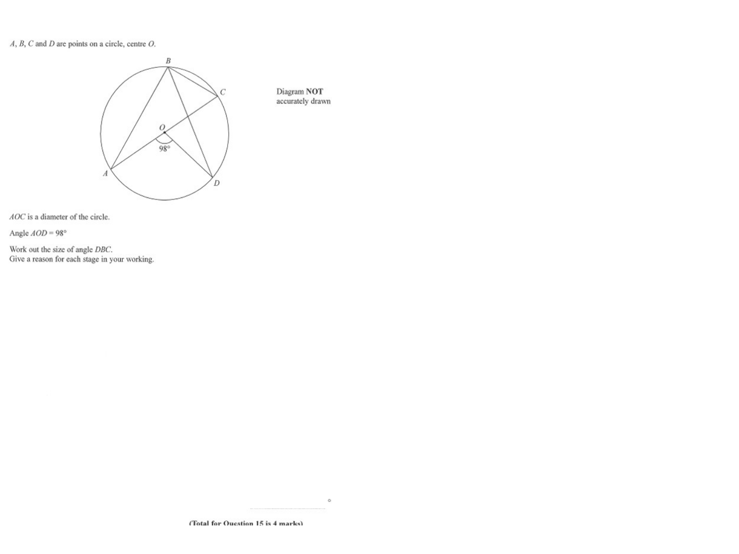
Zπ
PAST-PAPER QUESTION
Question 8

Slide 34
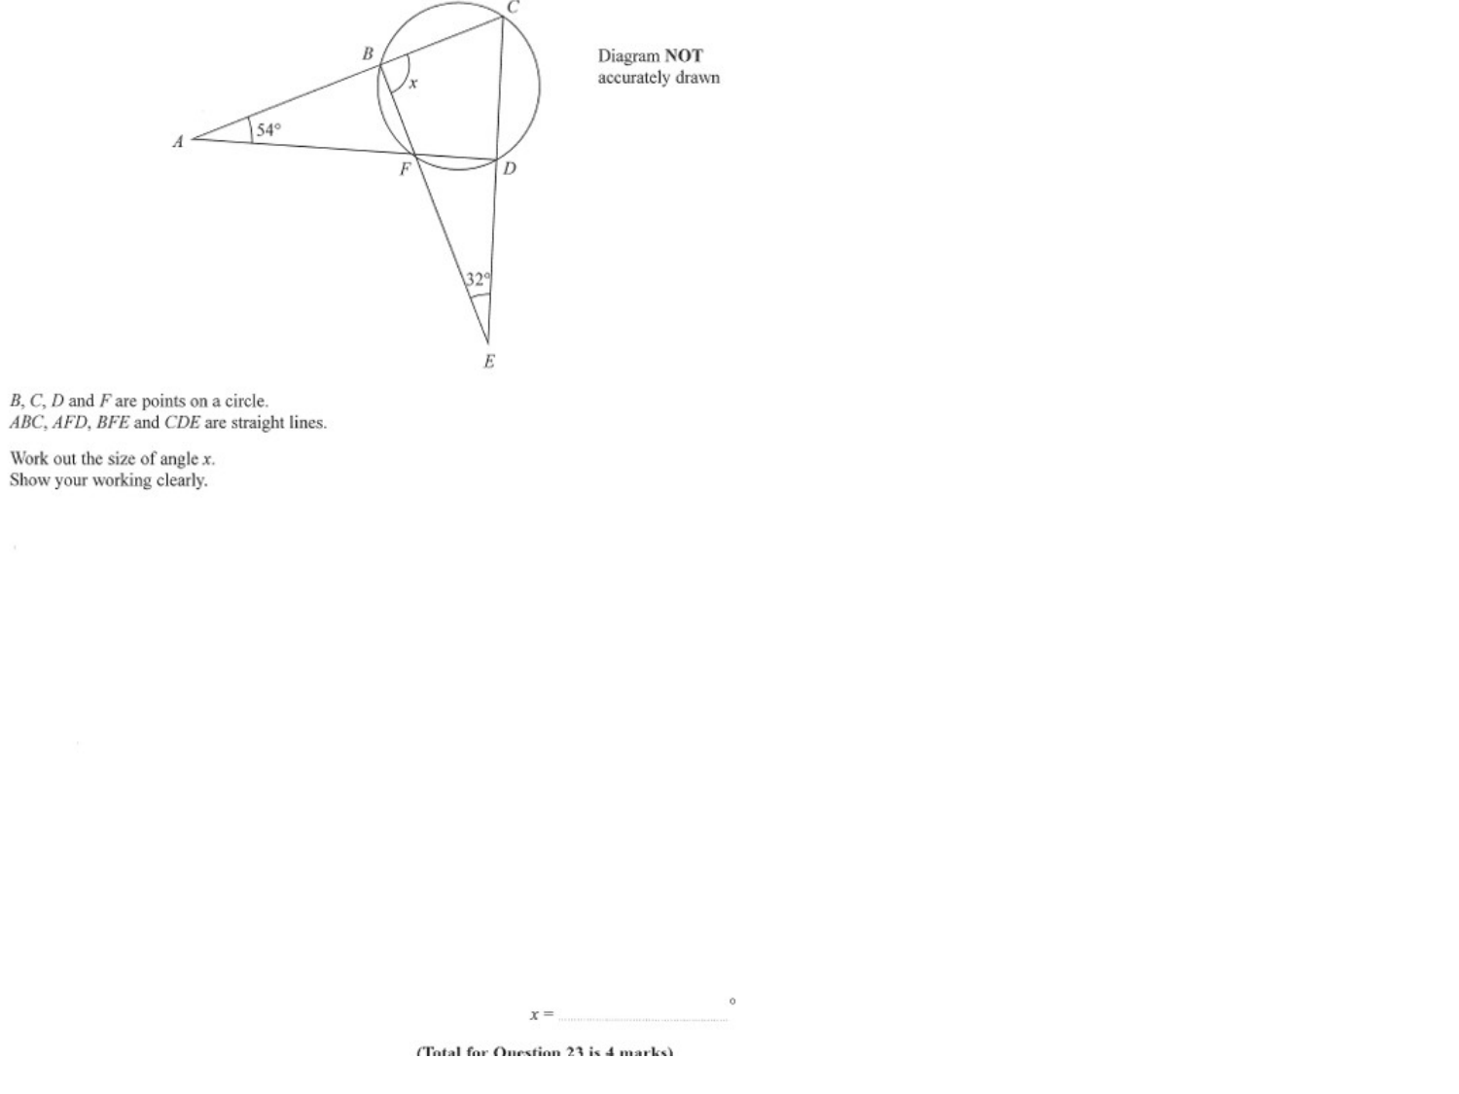
Zπ
PAST-PAPER QUESTION
Question 9

Slide 35
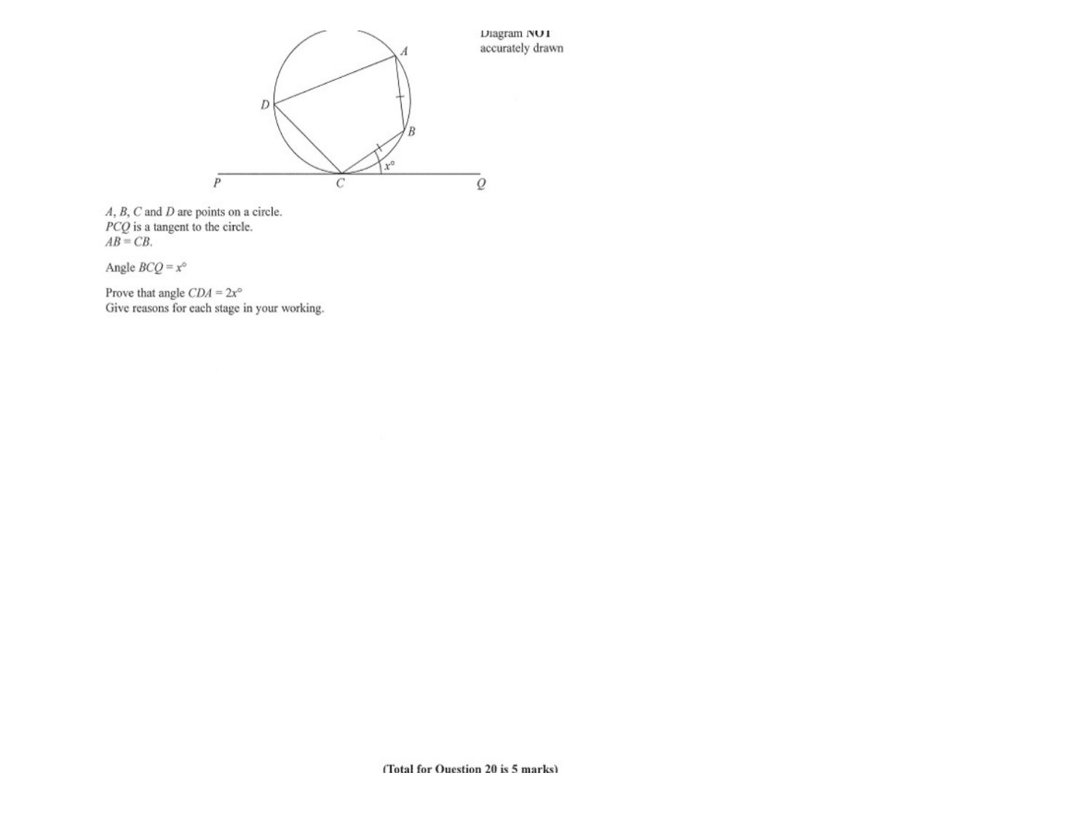
Zπ
PAST-PAPER QUESTION
Question 10

Slide 36
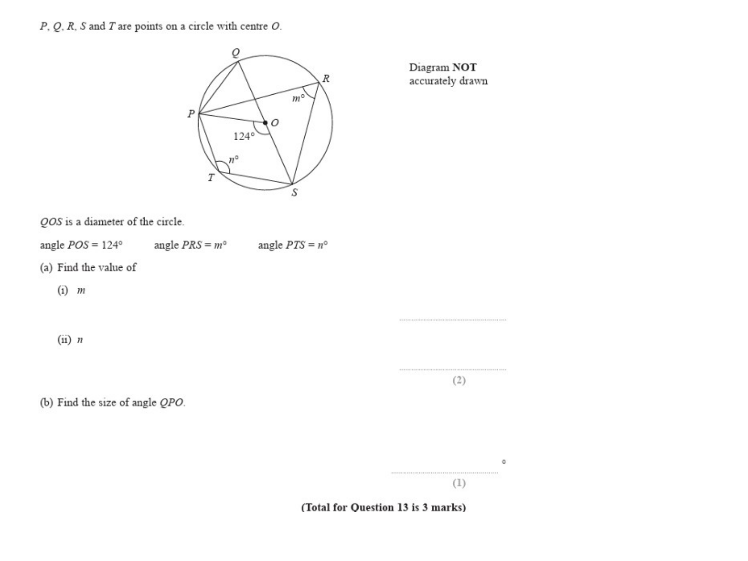
Zπ
PAST-PAPER QUESTION
Question 11

Slide 37
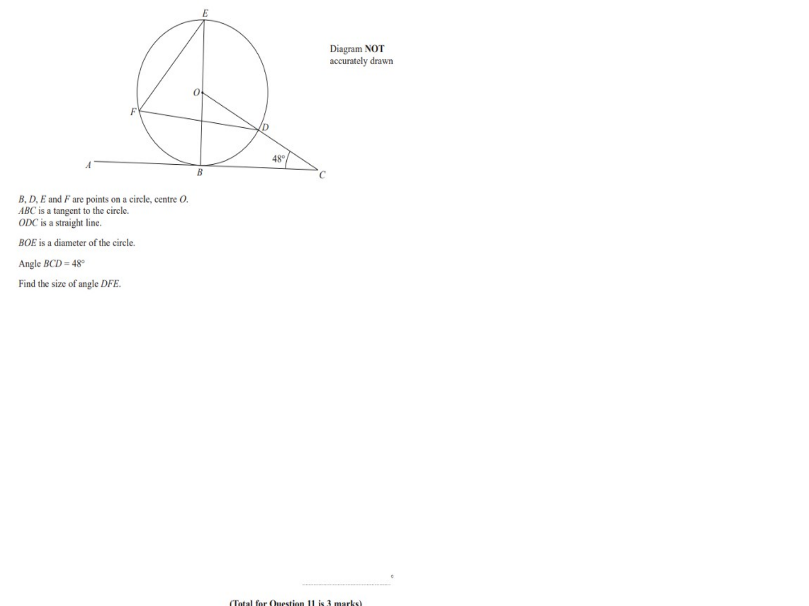
Zπ
PAST-PAPER QUESTION
Question 12

Slide 38
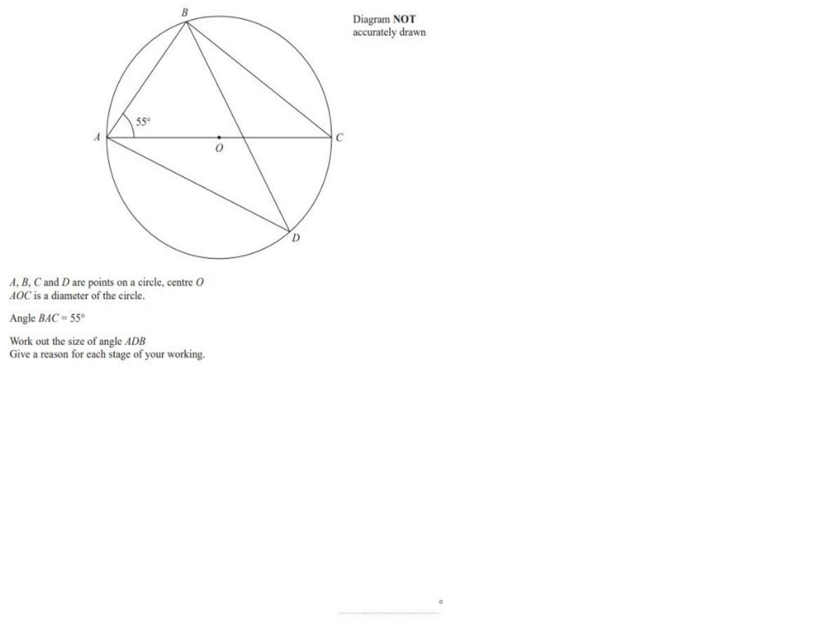
Zπ
PAST-PAPER QUESTION
Question 13

Slide 39
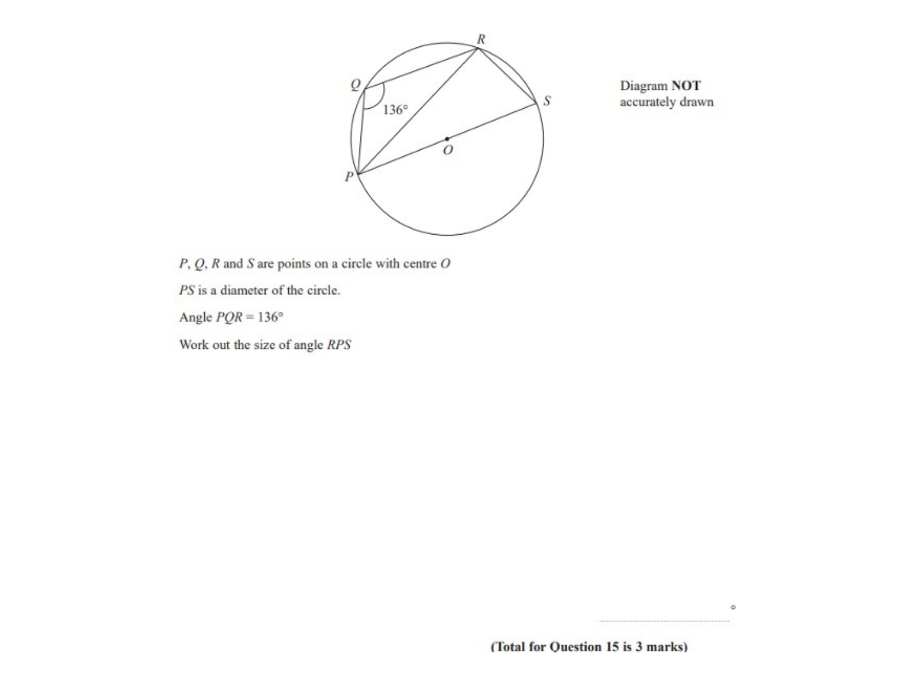
Zπ
PAST-PAPER QUESTION
Question 14

Slide 40
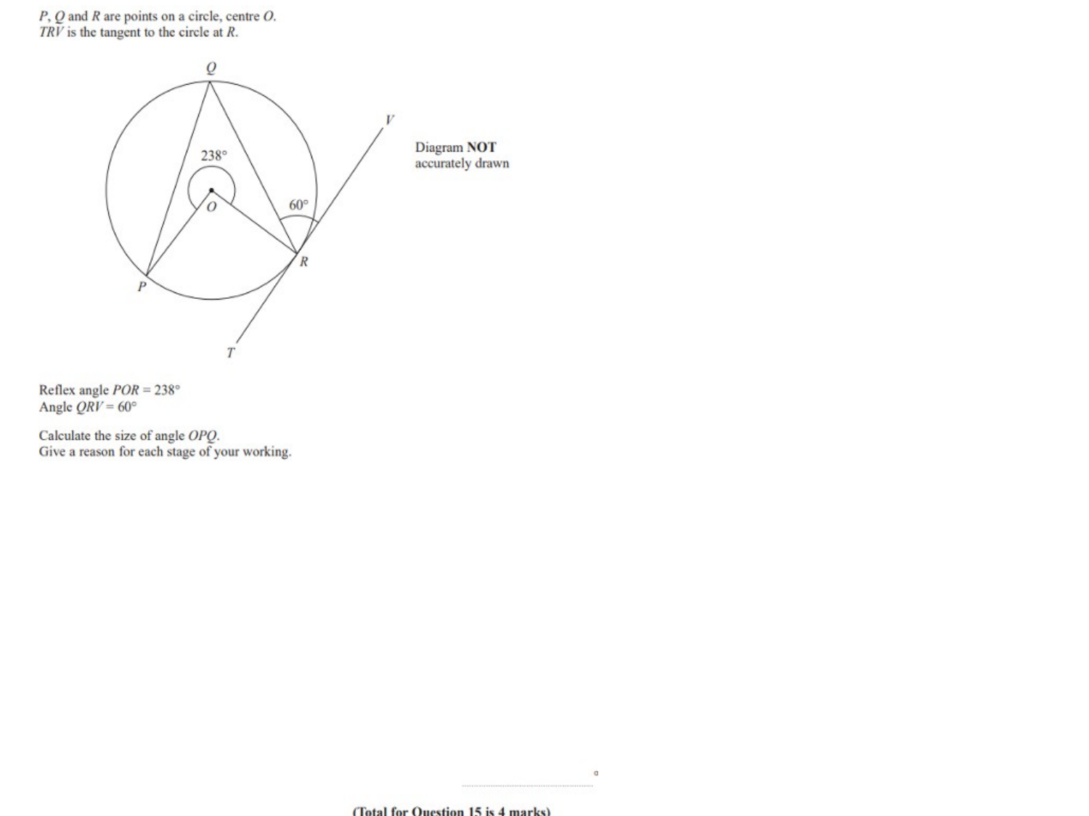
Zπ
PAST-PAPER QUESTION
Question 15

Slide 41
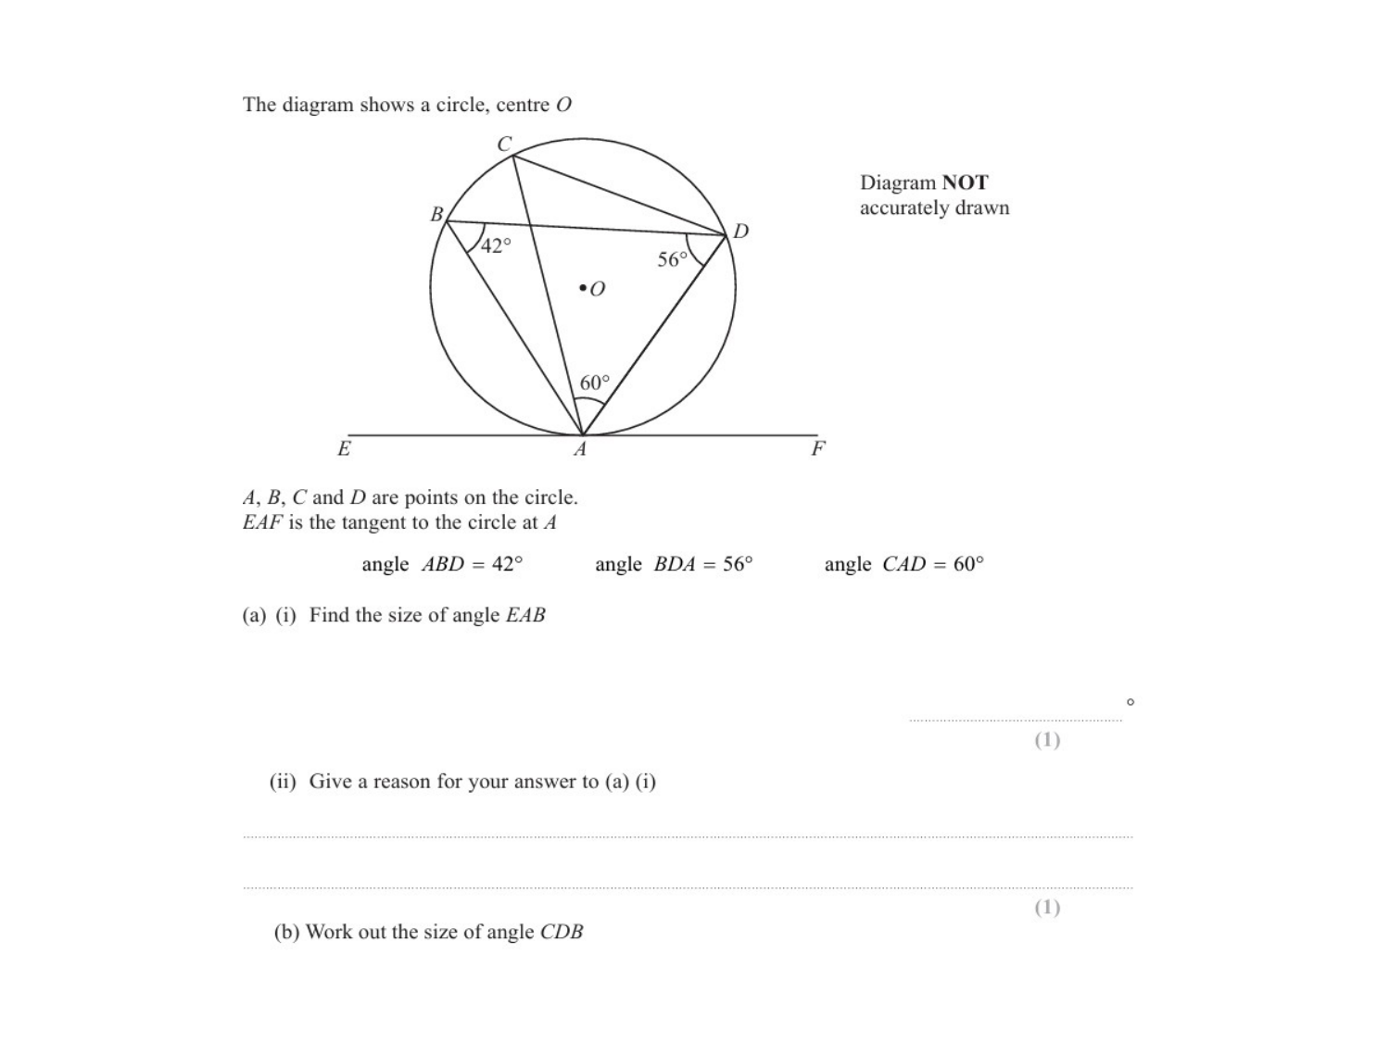
Zπ
PAST-PAPER QUESTION
Question 16

Slide 42
Zπ
RECAP
Key Takeaways
Angle in a semicircle = 90°; angle between a radius and a tangent = 90°.
Angles in the same segment are equal.
The angle at the centre is TWICE the angle at the circumference.
Opposite angles of a cyclic quadrilateral add up to 180°.
Tangent–chord angle = angle in the alternate segment; two radii → isosceles triangle.
Golden rule: never write an angle without its reason — the reason carries the mark.

