Slide 1
Zπ
Zπ MATHS HUB
Pearson Edexcel IGCSE (9–1) · Higher Tier
Chords, Secants & Tangents
Intersecting Chord Theorem · Intersecting Secant Theorem · Tangent–Secant · Finding Lengths
Zahra Sheikh Ali
IGCSE Mathematics Teacher · M.Sc. Differential Geometry & Geometric Control
☎ 66613748 ✉ zahraa.sheikhali@outlook.com

Slide 2
Zπ
LESSON OVERVIEW
Theorems About LENGTHS
These theorems are about LENGTHS, not angles. When two lines cut a circle, the products of their segments are equal.
Chord, secant or tangent?
Intersecting chord theorem
Intersecting secant theorem
1
2
3
Substituting into the formula
Finding full lengths
Past-paper questions
4
5
6
Key words: chord · secant · tangent · segment · product · external part

Slide 3
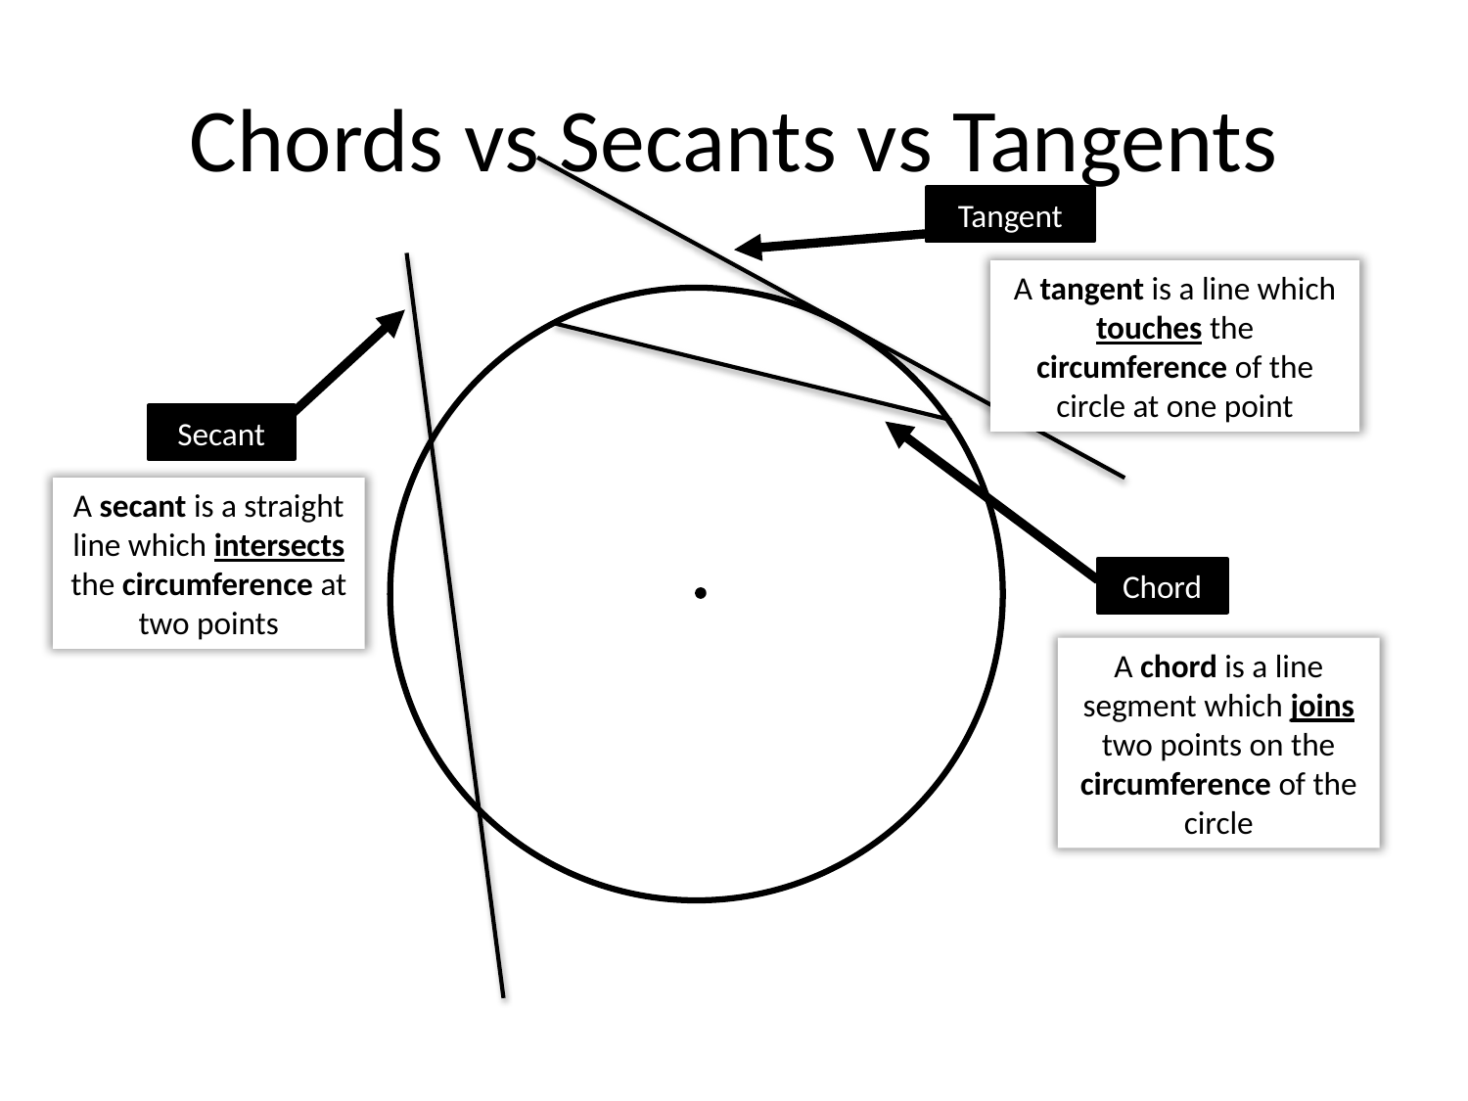
Zπ
THE VOCABULARY
Chords vs Secants vs Tangents
Tangent = touches at ONE point. Secant = cuts through at TWO points. Chord = joins two points on the circumference.

Slide 4
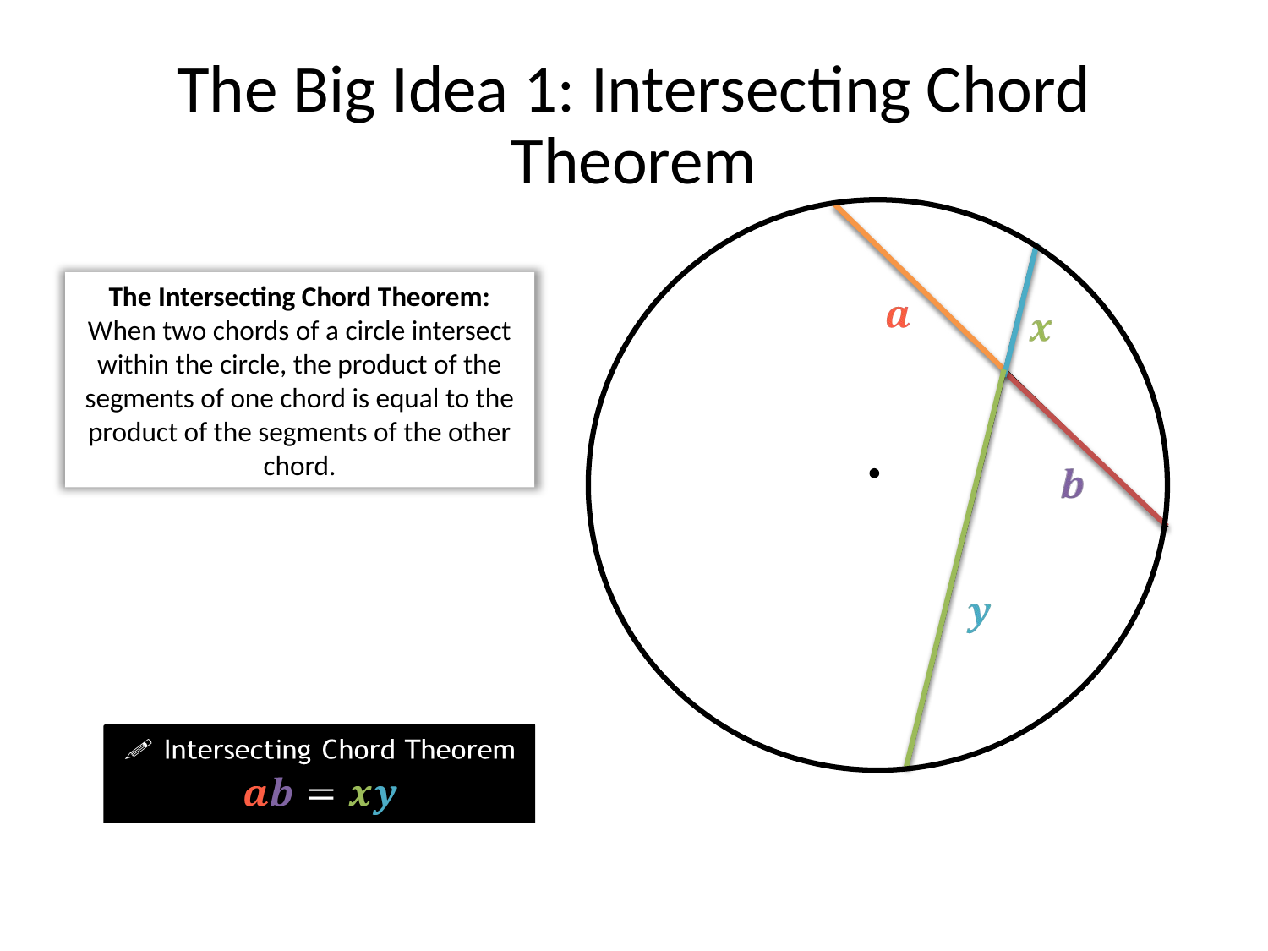
Zπ
BIG IDEA 1
The Intersecting Chord Theorem
When two chords cross INSIDE the circle, the product of the two parts of one chord = the product of the two parts of the other.

Slide 5
Zπ
THE TWO RULES
Learn These Two Formulas
Both rules say the same thing: the two products are EQUAL. Only where the lines meet changes.
Chords meet INSIDE
Secants meet OUTSIDE
Two chords cross inside the circle.
a × b = c × d
Multiply the two parts of each chord.
Two secants meet at a point outside.
a × (a + b) = c × (c + d)
OUTSIDE part × WHOLE length, for each secant.
Outside the circle: external part × the WHOLE secant.

Slide 6
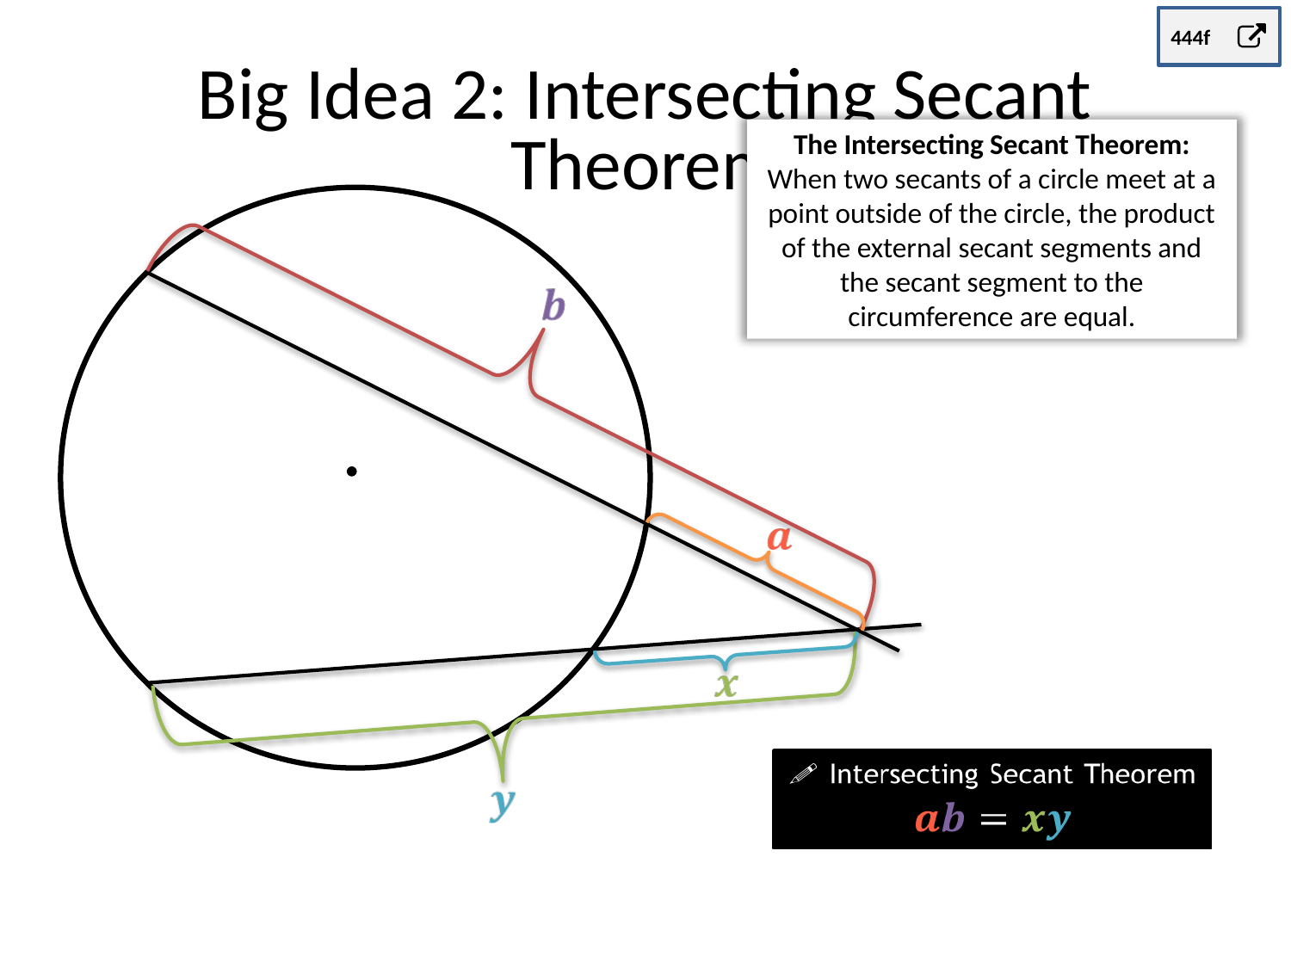
Zπ
BIG IDEA 2
The Intersecting Secant Theorem
When two secants meet OUTSIDE the circle, external part × whole secant = external part × whole secant.

Slide 7

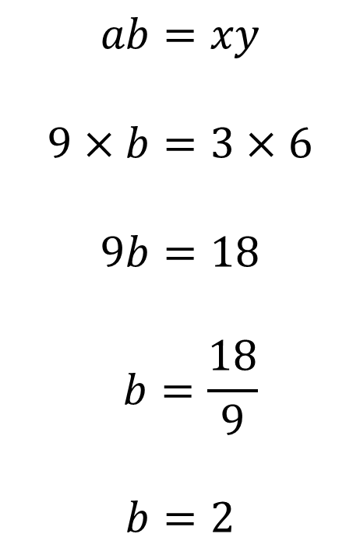





Zπ
WORKED EXAMPLE
Substitute into the Formula
Substitute into the formula
Label each segment, then substitute. You often get an equation to solve for x.

Slide 8


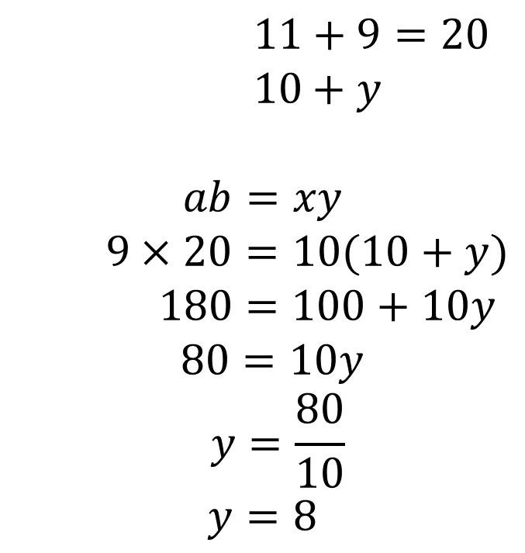




Zπ
WORKED EXAMPLE
Finding the FULL Lengths of the Secants
Full lengths:
Find the lengths of the full secants
Careful: the secant length is the OUTSIDE part PLUS the part inside the circle — not just one piece.

Slide 9


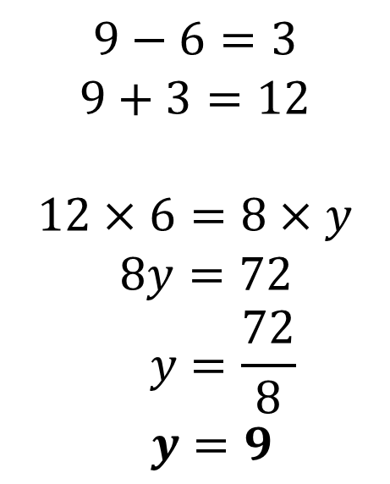



Zπ
TEST YOUR UNDERSTANDING
Your Turn
?
?
?
Decide first: do the lines meet inside (chords) or outside (secants)?

Slide 10
Zπ
TEST YOUR UNDERSTANDING
Your Turn
?
?
?
Decide first: do the lines meet inside (chords) or outside (secants)?

Slide 11
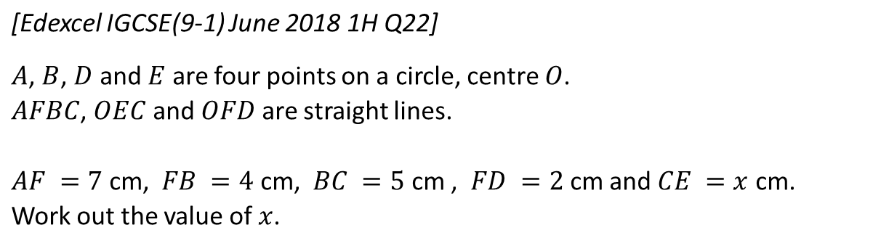
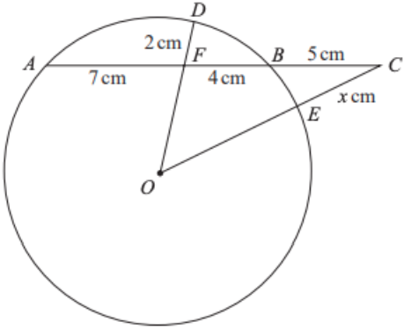
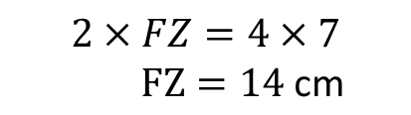
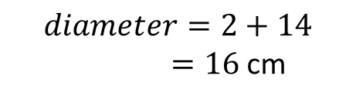



EXERCISE
Zπ
Mixed Practice
N
?
?
?
Set up the equation, then solve for the unknown length.

Slide 12
Zπ
PART 2
Past-Paper Questions
Set up the product equation, then solve.
1
Chords inside → a × b = c × d
2
Secants outside → external × whole
3
Label every segment on the diagram
4
Solve the equation for x

Slide 13
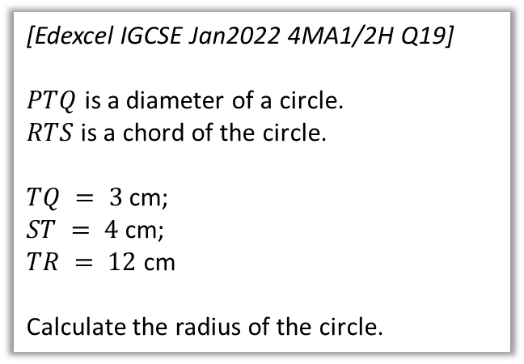
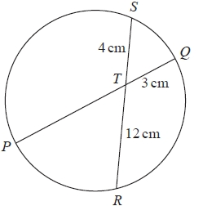
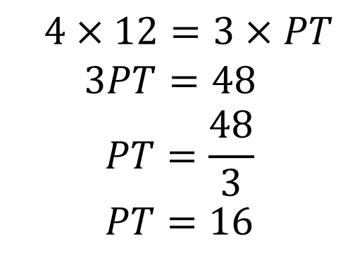
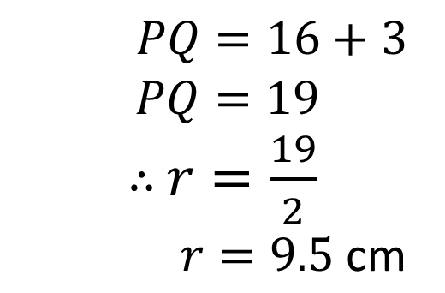
Zπ
PAST-PAPER QUESTION
Question 1 · Exam question
?
?

Slide 14
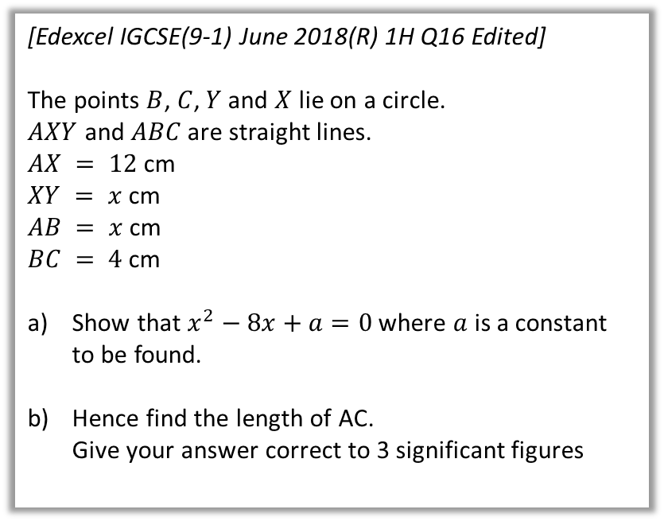
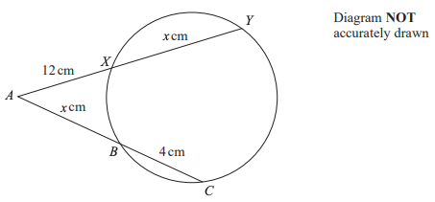
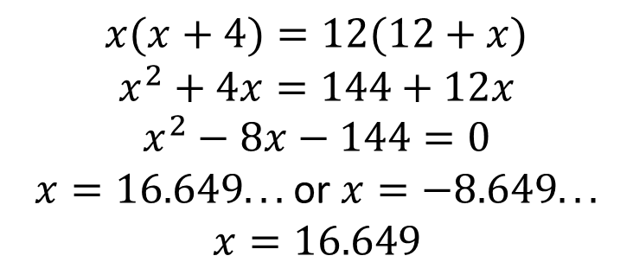
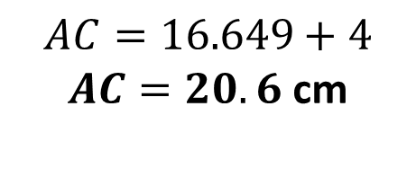
PAST-PAPER QUESTION
Zπ
Question 2 · Exam question
?

Slide 15
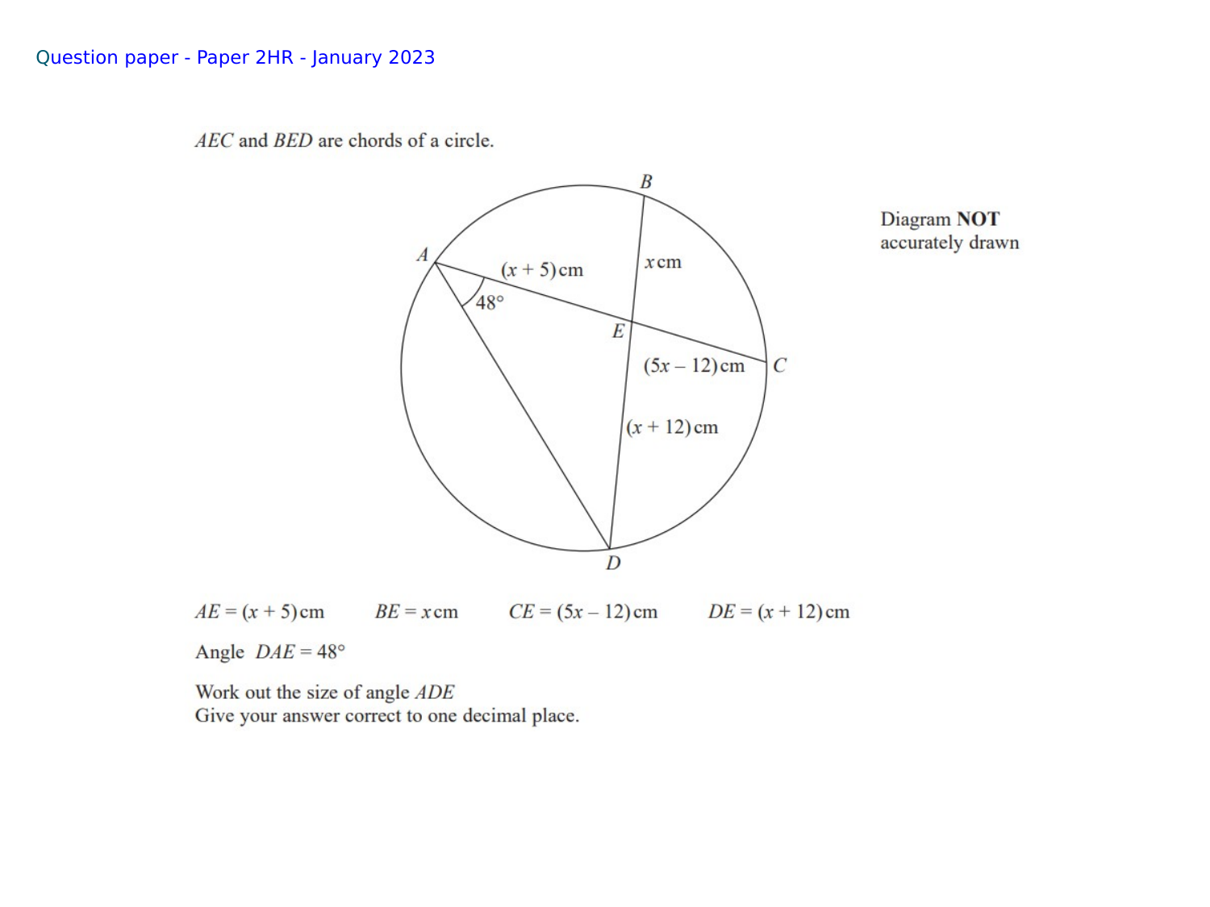
Zπ
PAST-PAPER QUESTION
Question 3 · Jan 2023 · Paper 2HR — chords AEC and BED

Slide 16
Zπ
RECAP
Key Takeaways
A TANGENT touches at one point; a SECANT cuts through at two; a CHORD joins two points on the circumference.
Chords crossing INSIDE: a × b = c × d (product of the parts of each chord).
Secants meeting OUTSIDE: external part × WHOLE secant = external part × WHOLE secant.
The ‘whole’ secant = the outside part PLUS the inside part — add them before multiplying.
Label the diagram, substitute, then solve the equation.
Golden rule: inside → part × part; outside → outside × whole.

