Slide 1
Zπ
Zπ MATHS HUB
Pearson Edexcel IGCSE (9–1) · Higher Tier
a² + b² = c²
Pythagoras’ Theorem
a² + b² = c² · Finding the Hypotenuse · Finding a Shorter Side · Problem Solving
Zahra Sheikh Ali
IGCSE Mathematics Teacher · M.Sc. Differential Geometry & Geometric Control
☎ 66613748 ✉ zahraa.sheikhali@outlook.com

Slide 2
Zπ
LESSON OVERVIEW
Sides of a Right-Angled Triangle
Pythagoras links the three SIDES of a right-angled triangle. No angles needed — if a question gives you two sides and a right angle, think Pythagoras.
The hypotenuse
a² + b² = c²
Finding the hypotenuse
1
2
3
Finding a shorter side
Problem solving
Past-paper questions
4
5
6
Key words: hypotenuse · right angle · square · square root · 3 significant figures

Slide 3
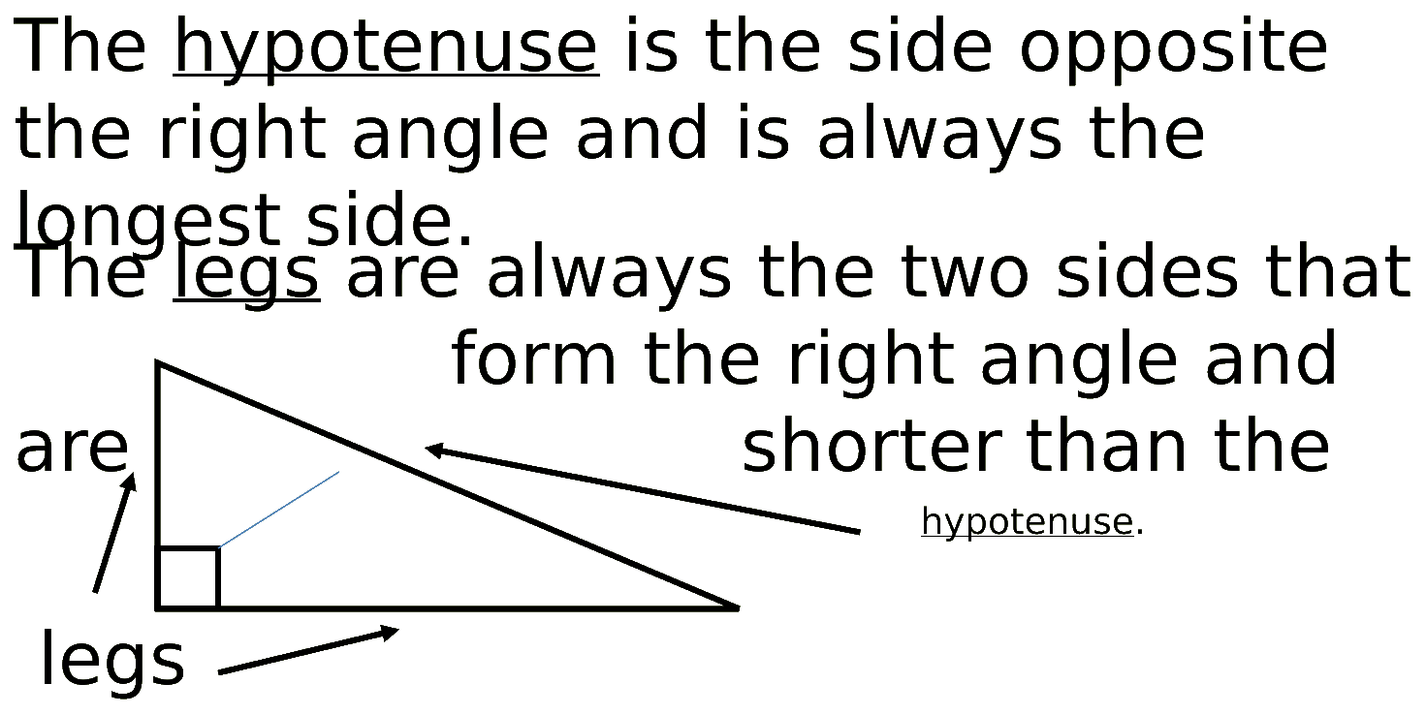
Zπ
THE FIRST STEP
Finding the Hypotenuse
The hypotenuse is OPPOSITE the right angle and is always the longest side. Label it c.

Slide 4
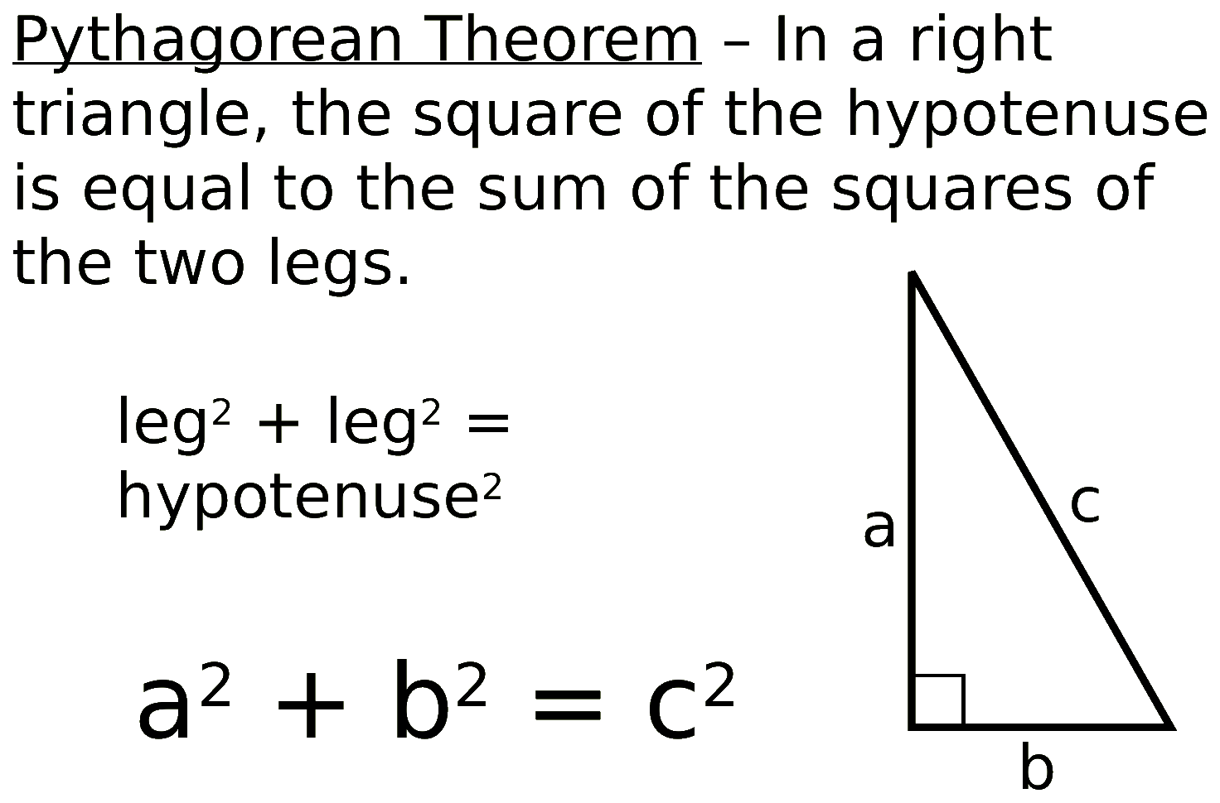
Zπ
THE KEY IDEA
Pythagoras’ Theorem
“The square of the hypotenuse equals the sum of the squares of the other two sides.” a² + b² = c²

Slide 5
Zπ
THE TWO CASES
Add or Subtract?
Which side are you looking for? The hypotenuse → ADD. A shorter side → SUBTRACT.
Finding the HYPOTENUSE → ADD
Finding a SHORTER SIDE → SUBTRACT
c² = 3² + 4² = 9 + 16 = 25
c = √25 = 5
b² = 13² − 6² = 169 − 36 = 133
b = √133 = 11.5
c
13
3
b
4
6
The hypotenuse is the LONGEST side — your answer must be bigger than both other sides.
A shorter side must be SMALLER than the hypotenuse — a good check.
Always square first, then add or subtract, then square-root at the end.

Slide 6
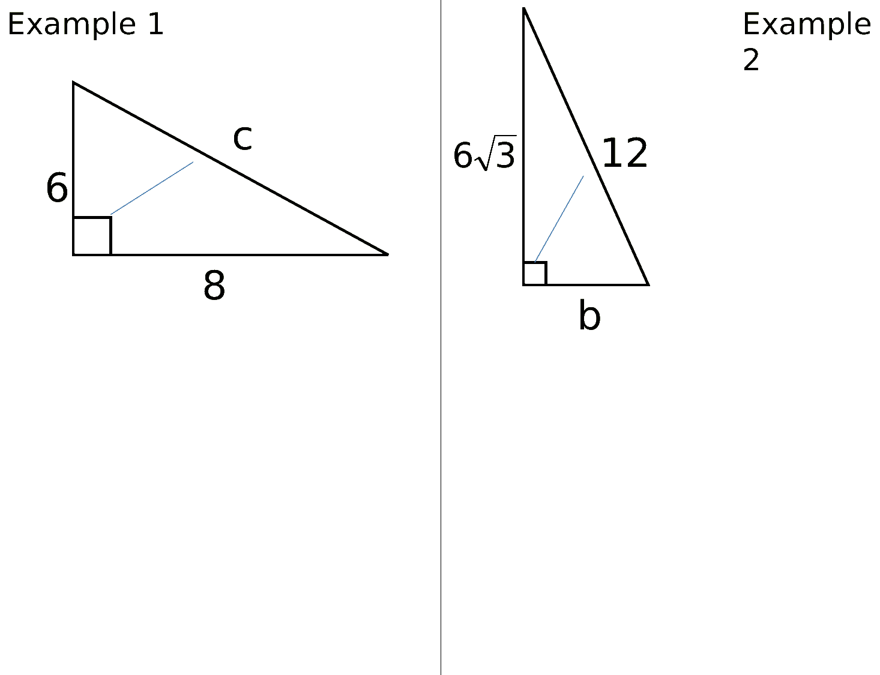
Zπ
WORKED EXAMPLES
From the Original Lesson
Example 1 finds the hypotenuse (add). Example 2 finds a shorter side (subtract).

Slide 7
Zπ
THE METHOD
Four Steps Every Time
1
1. Label the hypotenuse (opposite the right angle).
Common mistakes
Adding when you should subtract — check which side is the hypotenuse.
Forgetting the square root at the end.
Rounding too early — keep full accuracy until the last step.
Mixing units — make them match first.
2
2. Decide: is the unknown the hypotenuse (ADD) or a shorter side (SUBTRACT)?
3
3. Square the two known sides, then add or subtract.
4
4. Square-root to finish. Round as asked (often 3 s.f.).
Hypotenuse → ADD. Shorter side → SUBTRACT.
Look for the right angle first — no right angle means no Pythagoras.

Slide 8
Zπ
PROBLEM SOLVING
Where Pythagoras Hides
Exam questions rarely say ‘use Pythagoras’. You must spot the right-angled triangle inside the shape.
Rectangle / square
the DIAGONAL splits it into two right-angled triangles
Isosceles triangle
drop the HEIGHT to the middle of the base — it makes a right angle
Circle
an angle in a SEMICIRCLE is 90° — so the diameter is the hypotenuse
Trapezium / compound shape
split it into a rectangle and a right-angled triangle
Area given
use area to find the missing length first, then Pythagoras
Draw the right-angled triangle on the diagram, label the sides, then use a² + b² = c².

Slide 9
Zπ
PART 2
Past-Paper Questions
Sides only, with a right angle — these are all Pythagoras questions.
1
Find the right-angled triangle
2
Label the hypotenuse
3
Add for the hypotenuse, subtract for a shorter side
4
Square-root, then round as asked

Slide 10
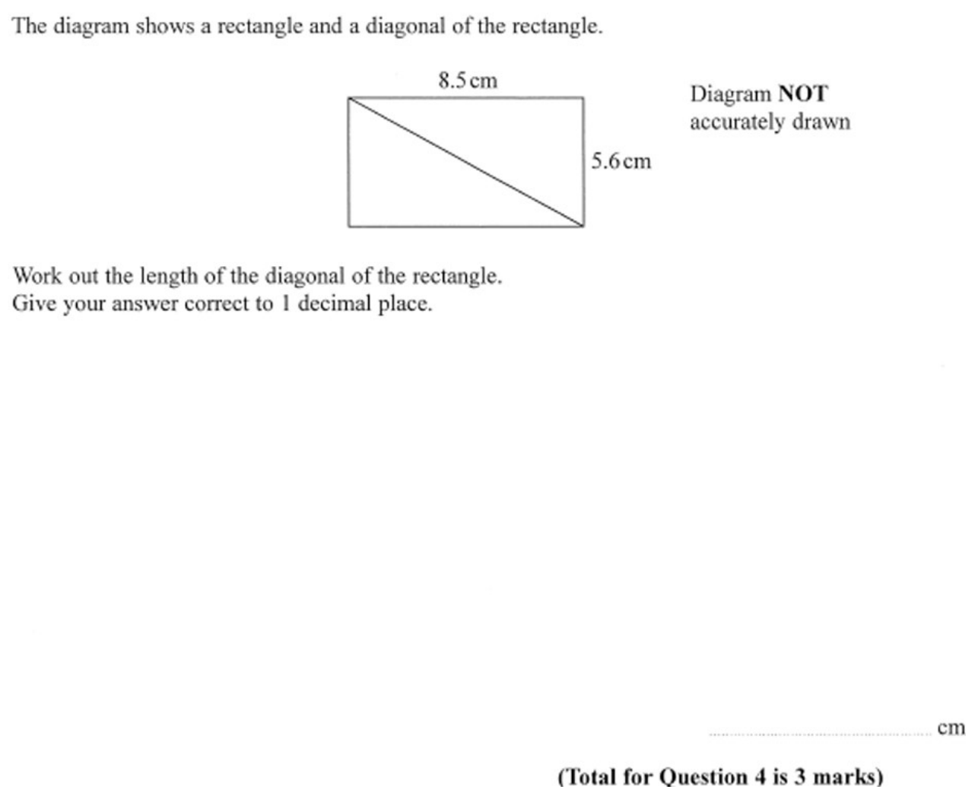
Zπ
PAST-PAPER QUESTION
Question 1

Slide 11
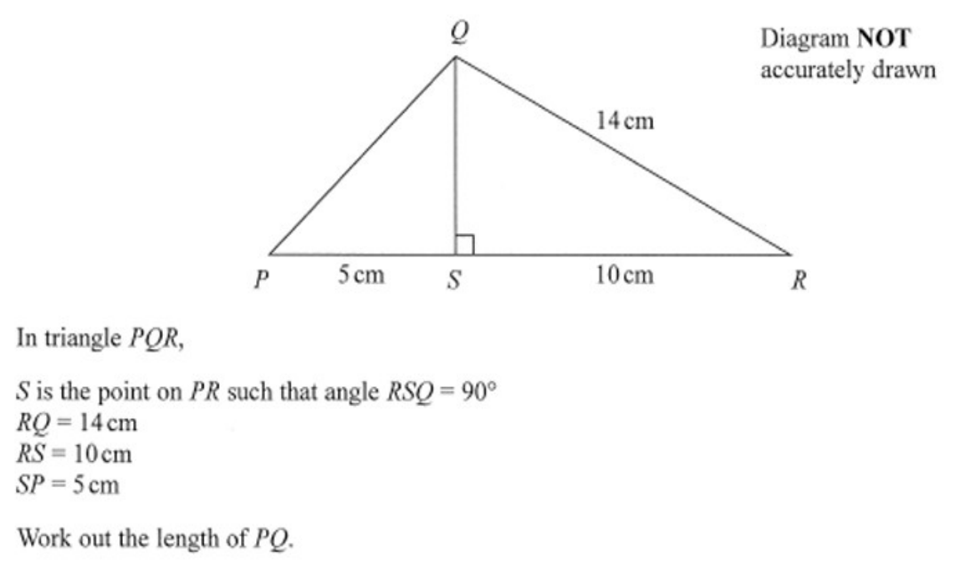
Zπ
PAST-PAPER QUESTION
Question 2

Slide 12
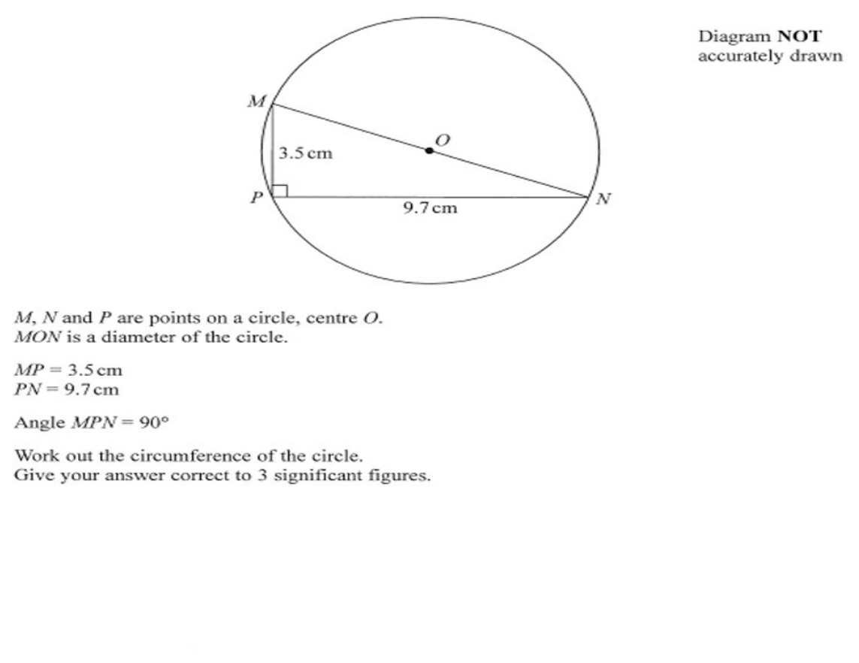
Zπ
PAST-PAPER QUESTION
Question 3

Slide 13
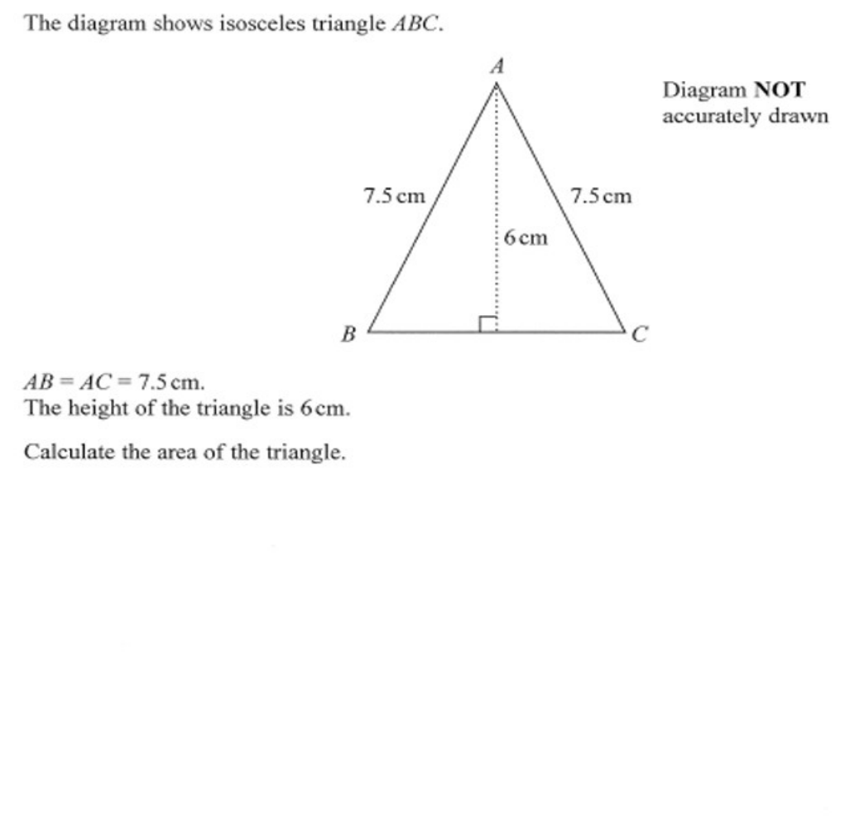
Zπ
PAST-PAPER QUESTION
Question 4

Slide 14
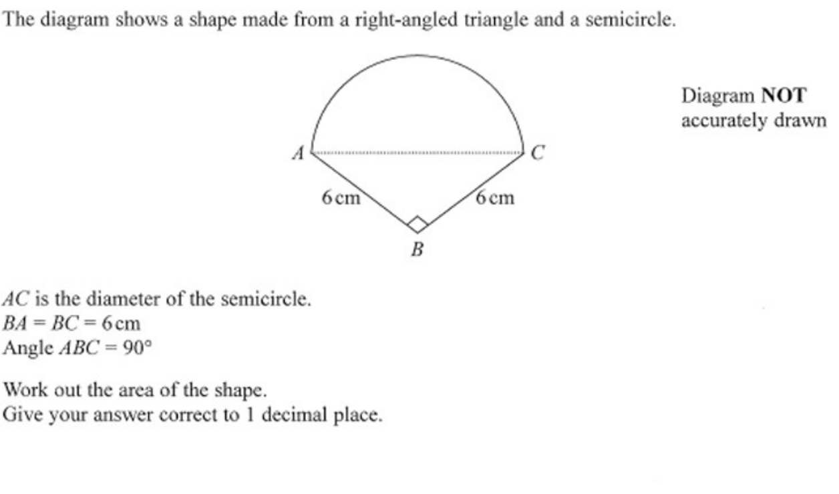
Zπ
PAST-PAPER QUESTION
Question 5

Slide 15
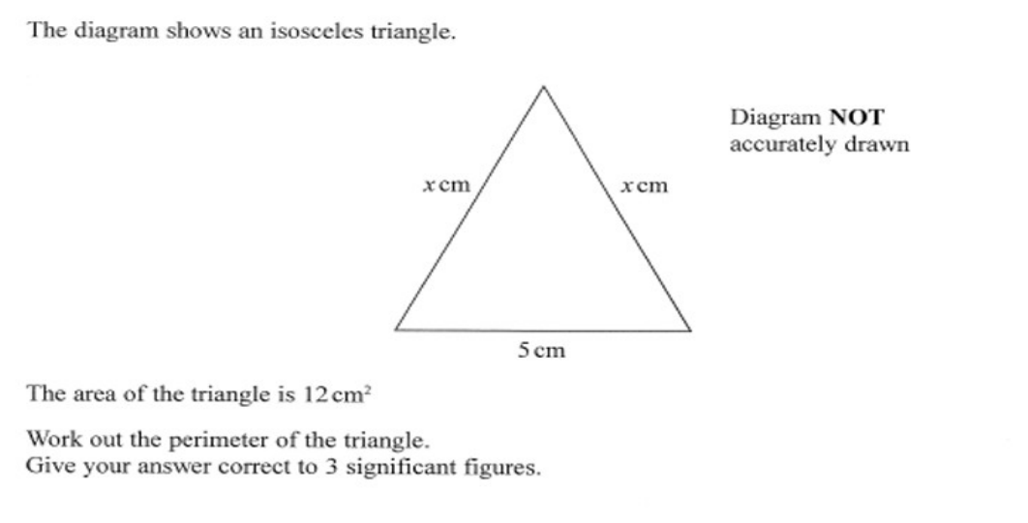
Zπ
PAST-PAPER QUESTION
Question 6

Slide 16
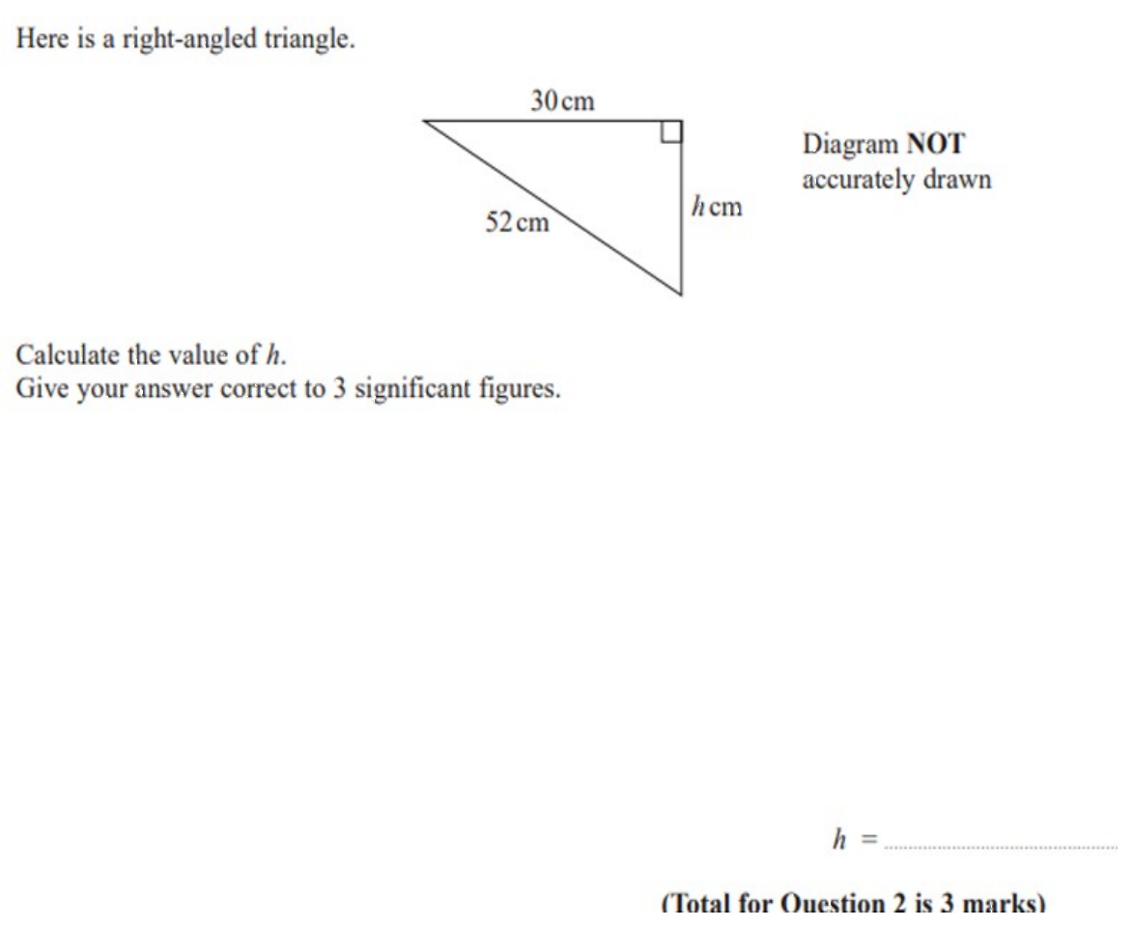
Zπ
PAST-PAPER QUESTION
Question 7

Slide 17
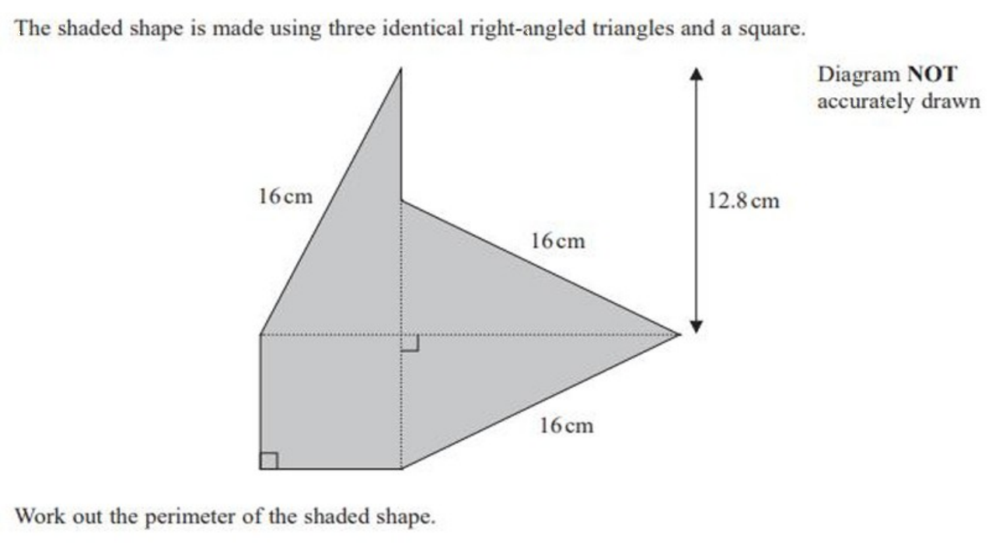
Zπ
PAST-PAPER QUESTION
Question 8

Slide 18
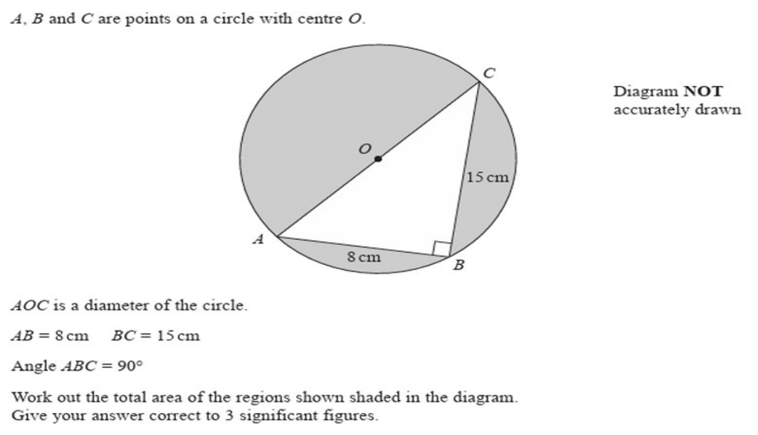
Zπ
PAST-PAPER QUESTION
Question 9

Slide 19
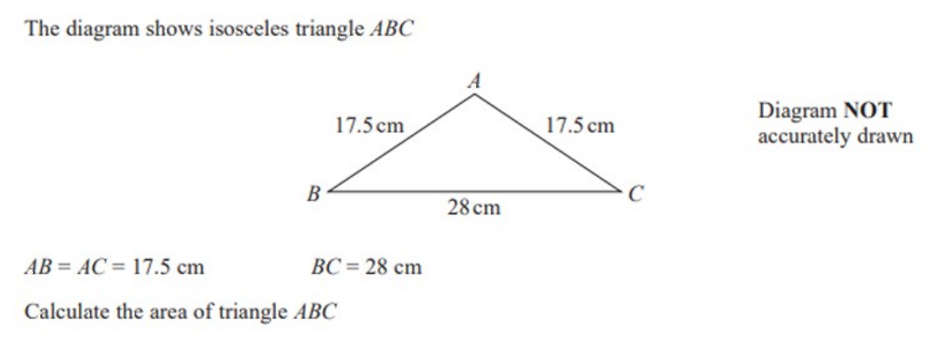
Zπ
PAST-PAPER QUESTION
Question 10

Slide 20
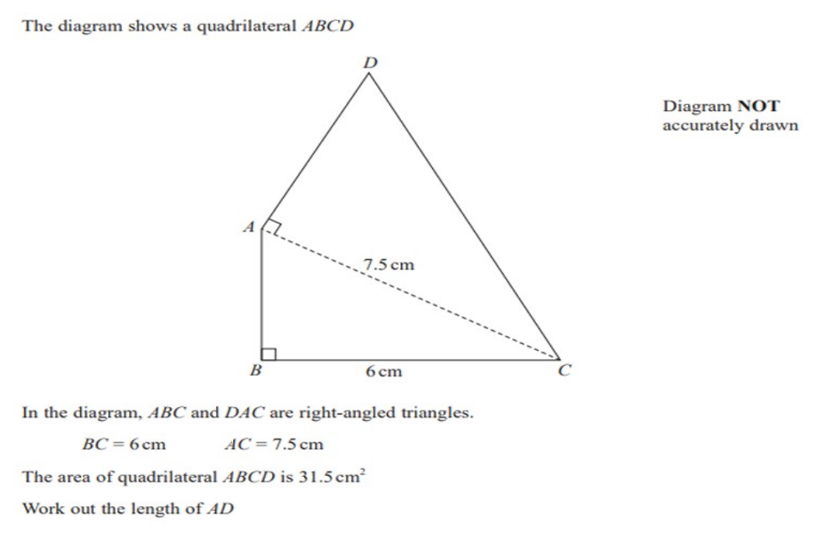
Zπ
PAST-PAPER QUESTION
Question 11

Slide 21
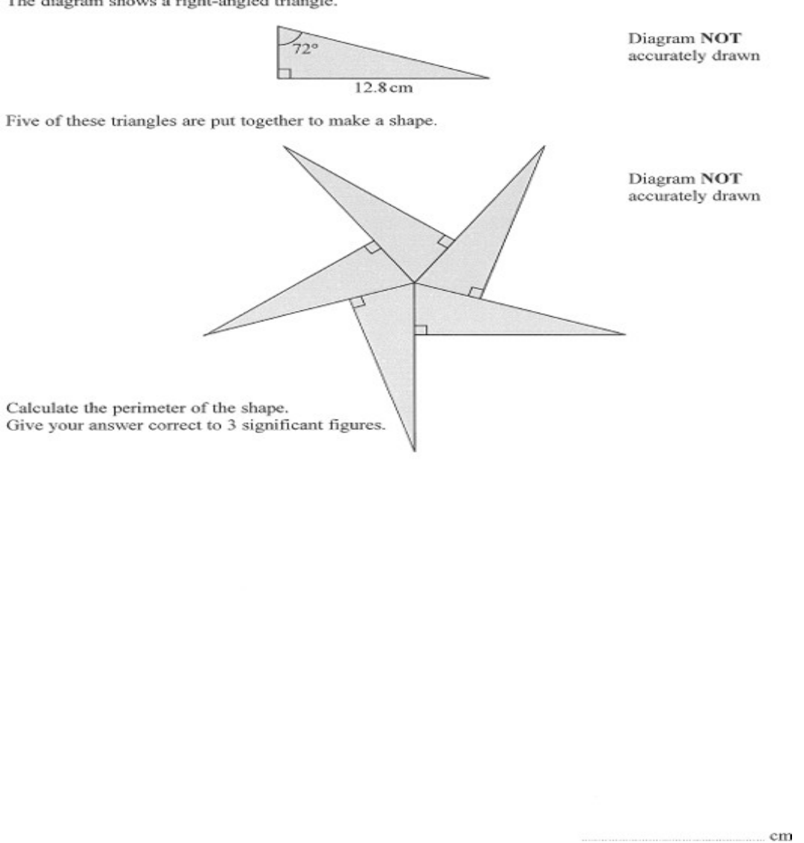
Zπ
PAST-PAPER QUESTION
Question 12

Slide 22
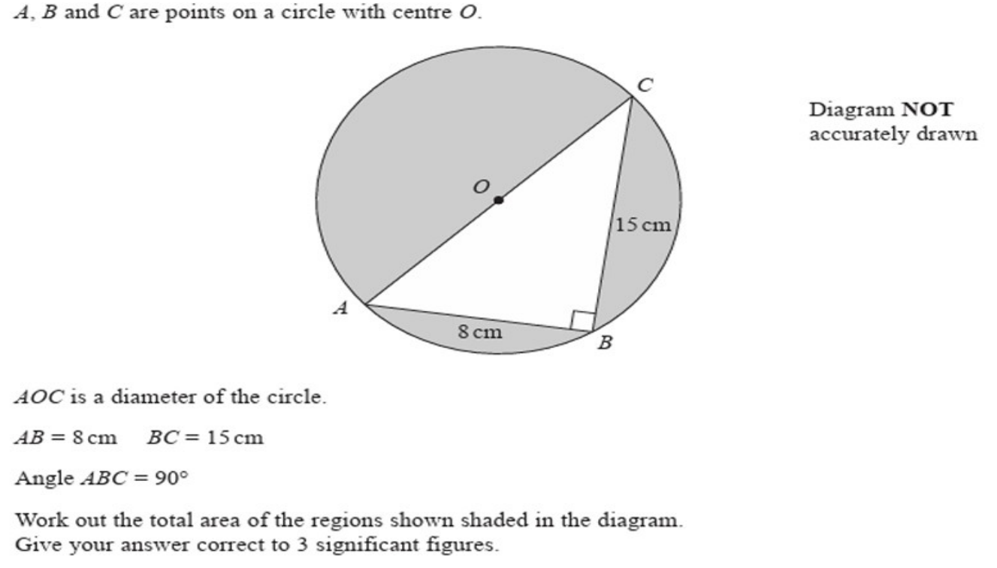
Zπ
PAST-PAPER QUESTION
Question 13

Slide 23
Zπ
RECAP
Key Takeaways
Pythagoras works ONLY in a right-angled triangle: a² + b² = c².
The hypotenuse (c) is opposite the right angle and is the longest side.
Finding the hypotenuse → ADD the two squares, then square-root.
Finding a shorter side → SUBTRACT the squares, then square-root.
Look for hidden right-angled triangles: diagonals, heights of isosceles triangles, semicircles.
Golden rule: two sides and a right angle → Pythagoras. An angle involved → use trigonometry instead.

