Slide 1
Zπ
Zπ MATHS HUB
Pearson Edexcel IGCSE (9–1) · Higher Tier
SOH CAH TOA
Trigonometry — SOHCAHTOA
Opposite, Adjacent & Hypotenuse · sin, cos, tan · Finding Sides · Finding Angles
Zahra Sheikh Ali
IGCSE Mathematics Teacher · M.Sc. Differential Geometry & Geometric Control
☎ 66613748 ✉ zahraa.sheikhali@outlook.com

Slide 2
Zπ
LESSON OVERVIEW
Sides AND Angles
Trigonometry links the SIDES and the ANGLES of a right-angled triangle. If a question involves an angle (other than the right angle), use SOHCAHTOA — not Pythagoras.
Labelling O, A, H
SOH CAH TOA
Choosing the ratio
1
2
3
Finding a missing SIDE
Finding a missing ANGLE
Past-paper questions
4
5
6
Key words: opposite · adjacent · hypotenuse · sine · cosine · tangent · inverse · elevation · depression

Slide 3
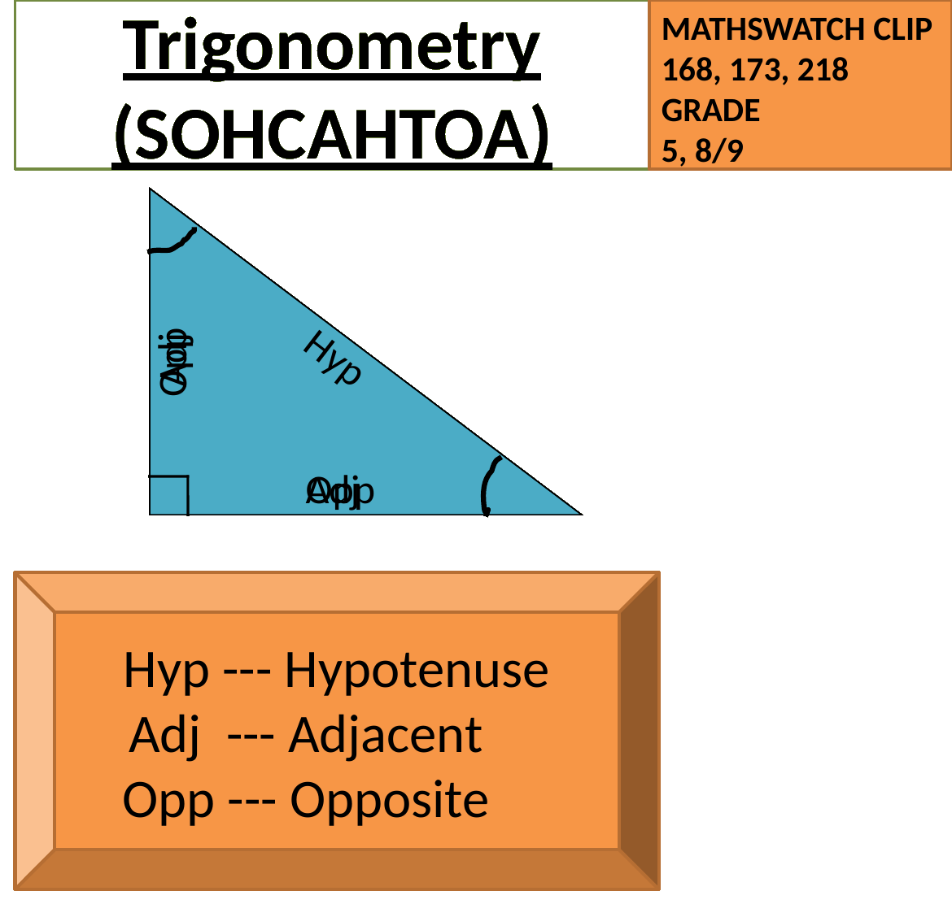
Zπ
STEP 1
Labelling the Sides: O, A, H
Label from the ANGLE you are given. H is opposite the right angle; O is opposite the angle; A is next to it.

Slide 4
Zπ
STEP 1
How to Label Every Time
Start at the angle θ, never at the right angle. The labels CHANGE if the angle changes.
HYPOTENUSE (H)
opposite the RIGHT ANGLE — always the longest side. It never changes.
Hyp
Opposite
OPPOSITE (O)
opposite the angle θ — it does not touch θ.
θ
Adjacent
ADJACENT (A)
next to the angle θ (and not the hypotenuse).
Tip: find H first (opposite the right angle), then O (opposite θ) — the last one is A.

Slide 5
Zπ
THE KEY IDEA
SOH · CAH · TOA
Three ratios. Pick the one that uses the two sides in your question.
SOH
CAH
TOA
sin θ =
O
cos θ =
A
tan θ =
O
H
H
A
O
A
O
S
H
C
H
T
A
Cover what you want: O = S × H, H = O ÷ S, and so on — the same formula triangle idea.

Slide 6
Zπ
STEP 2
Choosing the Right Ratio
1
Label the three sides O, A, H from the given angle.
Example
Given: angle 30° and the hypotenuse 10. Want: the opposite.
O and H → use SIN.
sin 30° = O ÷ 10
O = 10 × sin 30° = 5
2
Tick the two sides in the question: the one you KNOW and the one you WANT.
3
Those two letters tell you the ratio: O & H → SIN, A & H → COS, O & A → TAN.
4
Write the equation, then rearrange to find the unknown.
O & H → SIN. A & H → COS. O & A → TAN.
The side you are NOT using does not appear — ignore it.

Slide 7
Zπ
THE RATIOS
Sine, Cosine and Tangent
Task – Use your calculator to find the following
1) sin 79° =
0.982
2) cos 28° =
0.883
3) tan 65° =
2.14
4) cos 11° =
0.982
5) sin 34° =
0.559
6) tan 84° =
9.51
7) tan 49° =
1.15
8) sin 62° =
0.883
9) tan 6° =
0.105
10) cos = 0.559
56°
Each ratio compares two sides of the right-angled triangle.

Slide 8
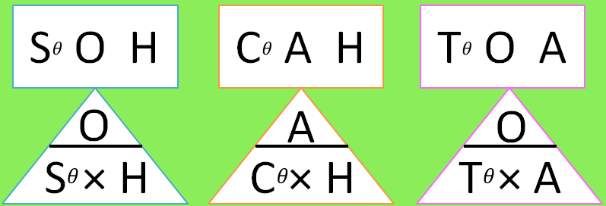
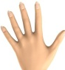
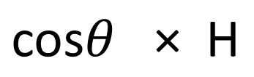
Zπ
FINDING A SIDE
Worked Example — Missing Side
Find p.
H
38°
8cm
p
A
The thing I need to find is A, so…
A =
Substituting the items from my diagram…
p = cos38 × 8
p = 6.3040869029cm
p = 6.30cm (3s.f.)
Label, choose the ratio, substitute, then rearrange. Multiply when the unknown is on top; divide when it is underneath.

Slide 9
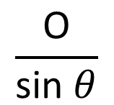
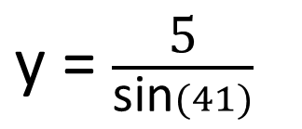
Zπ
FINDING A SIDE
Worked Example — Missing Side (2)
H
Find y.
y
5cm
O
41°
The thing I need to find is H, so…
H =
Substituting the items from my diagram…
y = 7.621265434cm
y = 7.62cm (3s.f.)
When the unknown is on the BOTTOM of the fraction, divide: H = O ÷ sin θ.

Slide 10

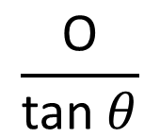
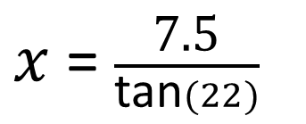


Zπ
FINDING A SIDE
Worked Example — Missing Side (3)
If they describe what’s needed in terms of the CORNERS of the shape, just give it your own letter first before you start!
Find AC.
7.5cm
O
22°
A
C
A
The thing I need to find is A, so…
A =
Substituting the items from my diagram…
Check: the hypotenuse must always be the LONGEST side.

Slide 11
Zπ
FINDING AN ANGLE
Use the INVERSE Function
Given TWO SIDES and asked for the angle? Work out the ratio, then use sin⁻¹, cos⁻¹ or tan⁻¹ on your calculator.
Example: O = 8, A = 12
The inverse keys
O and A → use TAN
tan θ = 8 ÷ 12 = 0.6667
θ = tan⁻¹ (0.6667)
= 33.7° (1 d.p.)
sin⁻¹ — when you used O and H
cos⁻¹ — when you used A and H
tan⁻¹ — when you used O and A
On the calculator: SHIFT (or 2nd) then sin / cos / tan
Check your calculator is in DEGREE mode!
Two sides → find the angle with the INVERSE (sin⁻¹, cos⁻¹, tan⁻¹).

Slide 12


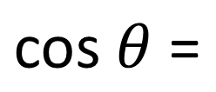

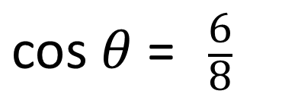
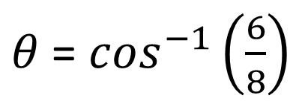
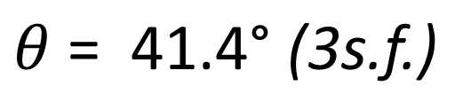
Zπ
FINDING AN ANGLE
Worked Example from the Lesson
H
Find g.
g
8cm
6cm
A
Substituting the items from my diagram…
Write the ratio as a fraction first, then apply the inverse.

Slide 13
Zπ
APPLICATIONS
Angles of Elevation & Depression
Both angles are measured from the HORIZONTAL. Draw the right-angled triangle, then use SOHCAHTOA.
Angle of ELEVATION
Angle of DEPRESSION
Looking UP at something.
Measured from the horizontal, upwards.
e.g. a ladder against a wall; looking up at a balloon.
Looking DOWN at something.
Measured from the horizontal, downwards.
e.g. from the top of a cliff down to a boat.
The angle of depression from the top equals the angle of elevation from the bottom (alternate angles).

Slide 14
Zπ
PART 2
Past-Paper Questions
These all involve an ANGLE — so use SOHCAHTOA.
1
Label O, A, H from the given angle
2
Pick the ratio: SOH, CAH or TOA
3
Side wanted → rearrange; angle wanted → inverse
4
Round as asked (3 s.f. or 1 d.p.)

Slide 15
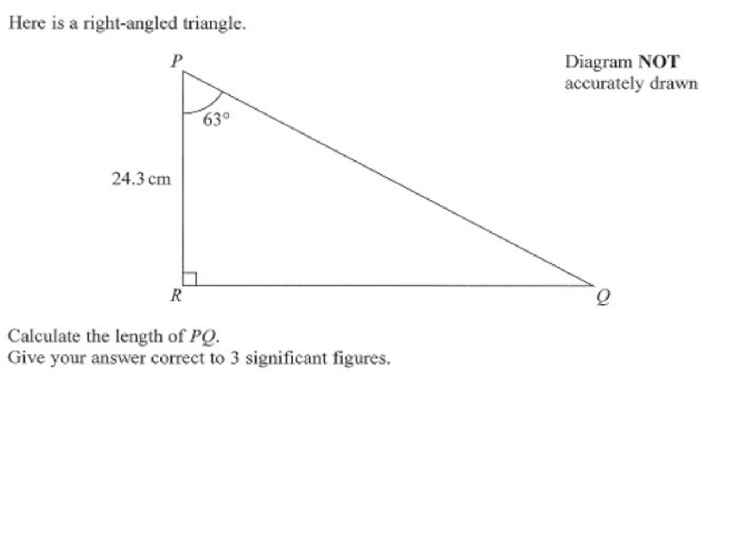
Zπ
PAST-PAPER QUESTION
Question 1

Slide 16
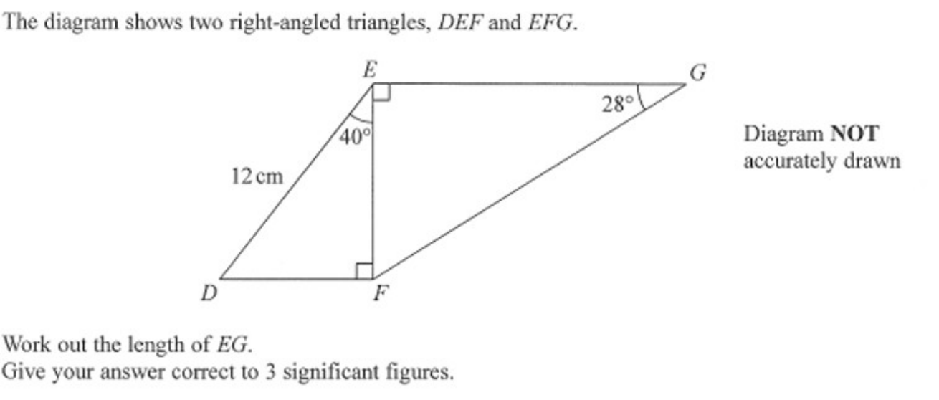
Zπ
PAST-PAPER QUESTION
Question 2

Slide 17
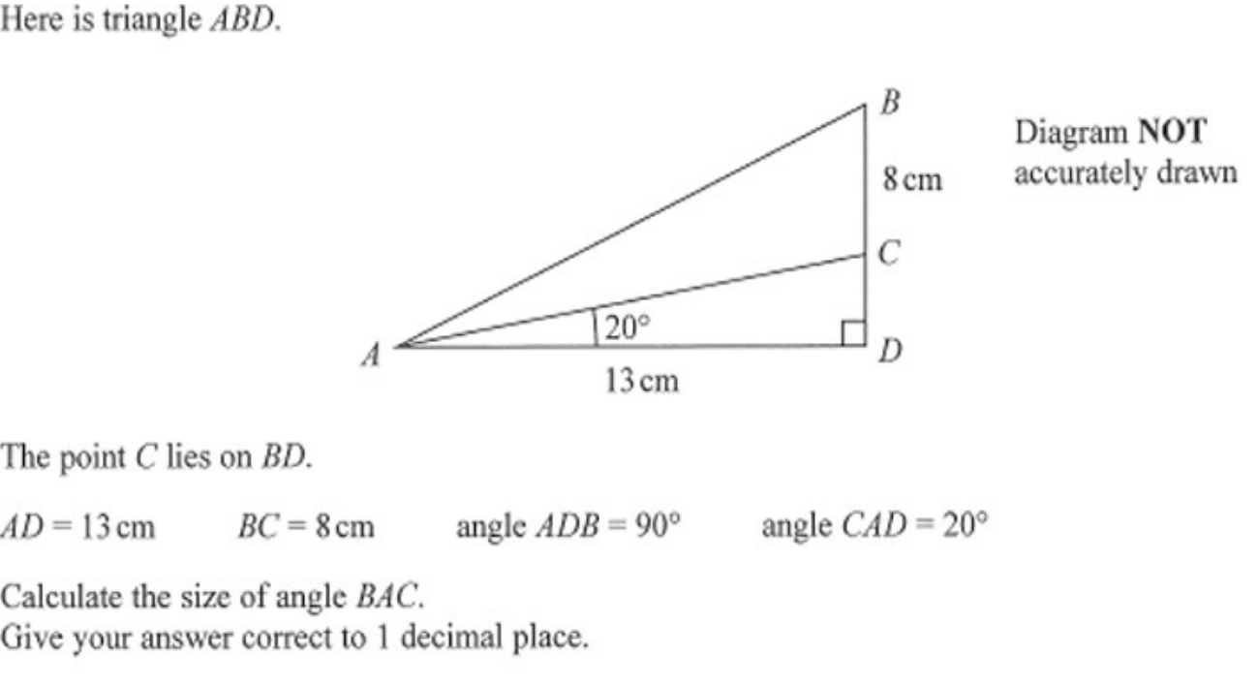
Zπ
PAST-PAPER QUESTION
Question 3

Slide 18
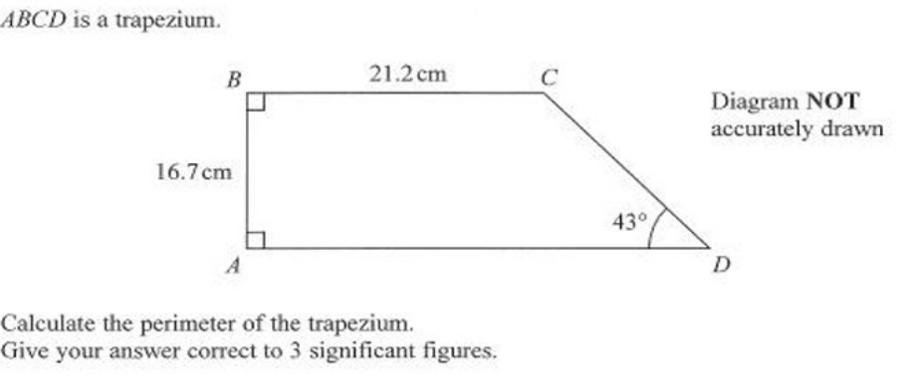
Zπ
PAST-PAPER QUESTION
Question 4

Slide 19
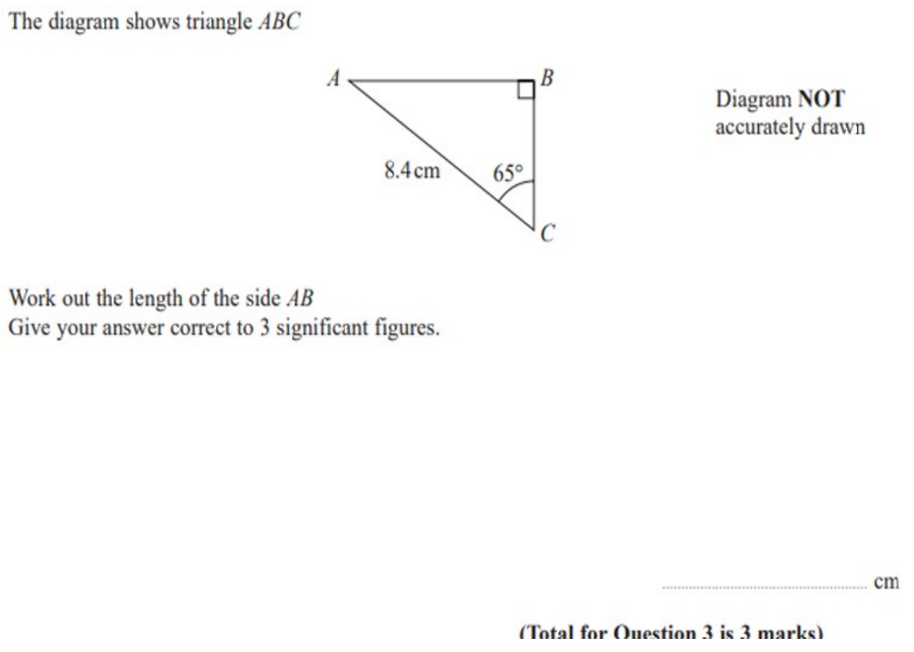
Zπ
PAST-PAPER QUESTION
Question 5

Slide 20
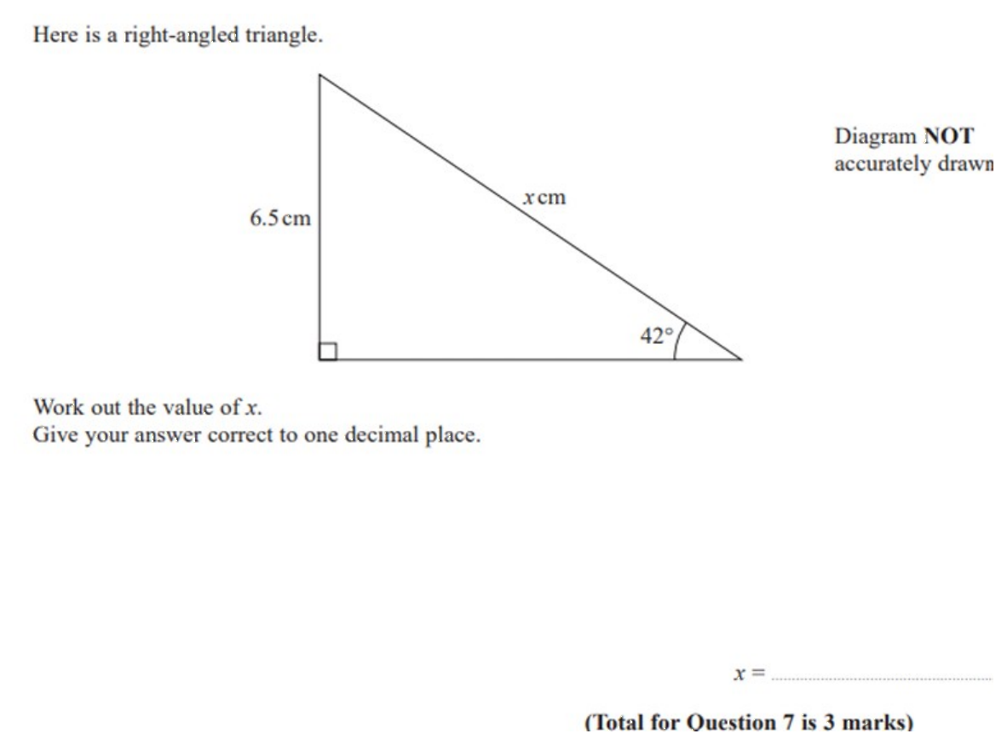
Zπ
PAST-PAPER QUESTION
Question 6

Slide 21
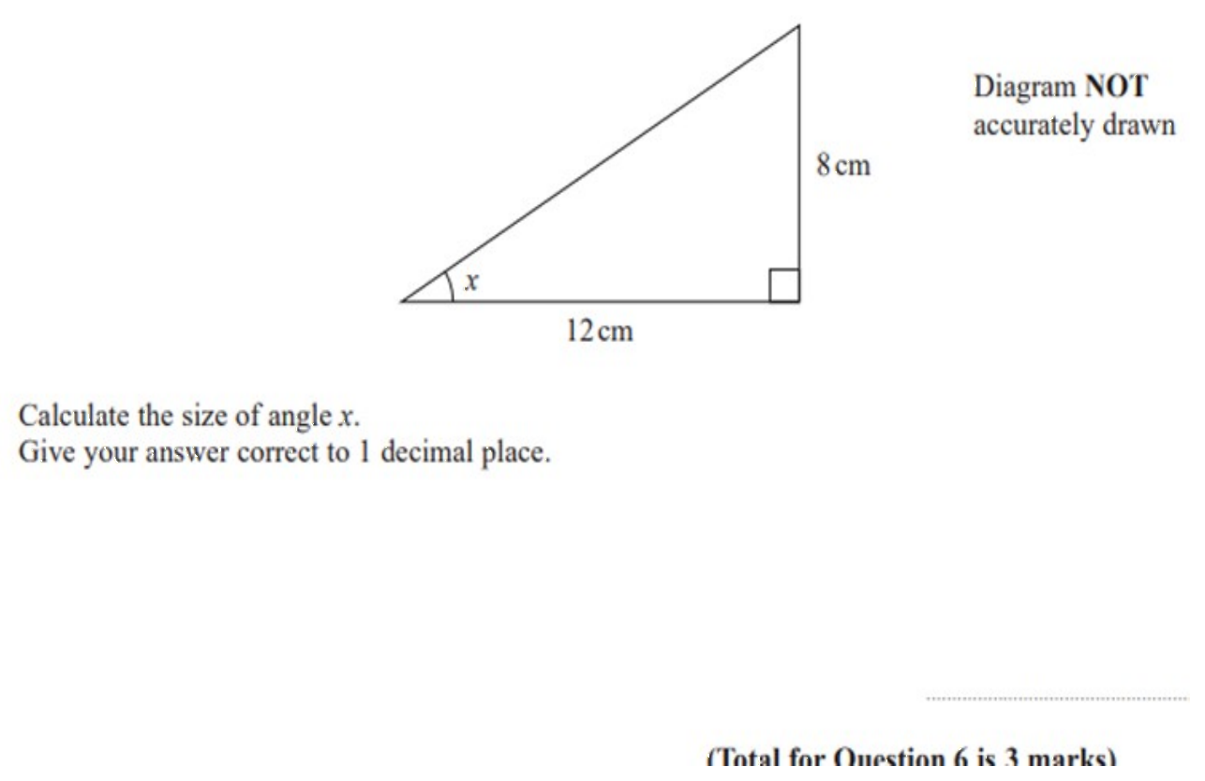
Zπ
PAST-PAPER QUESTION
Question 7

Slide 22
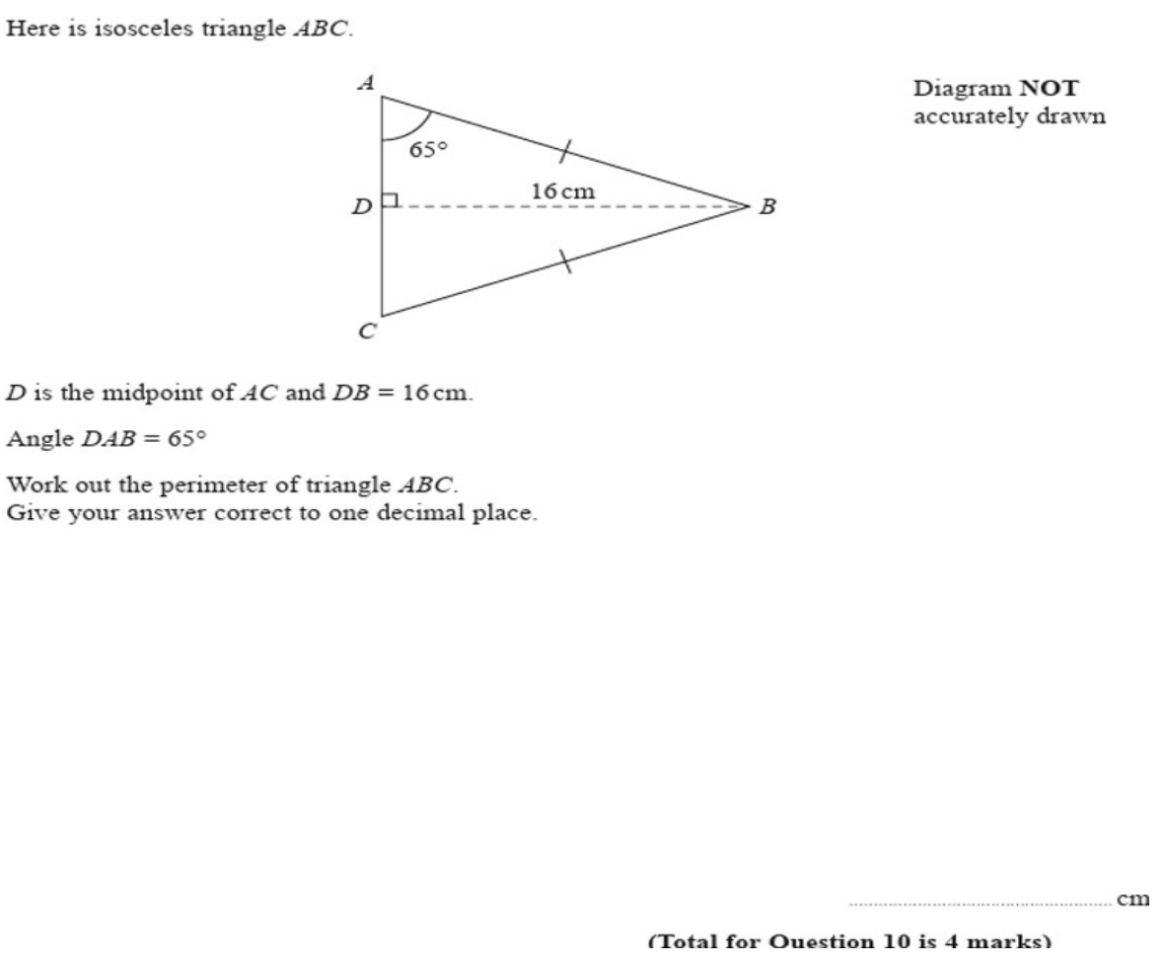
Zπ
PAST-PAPER QUESTION
Question 8

Slide 23
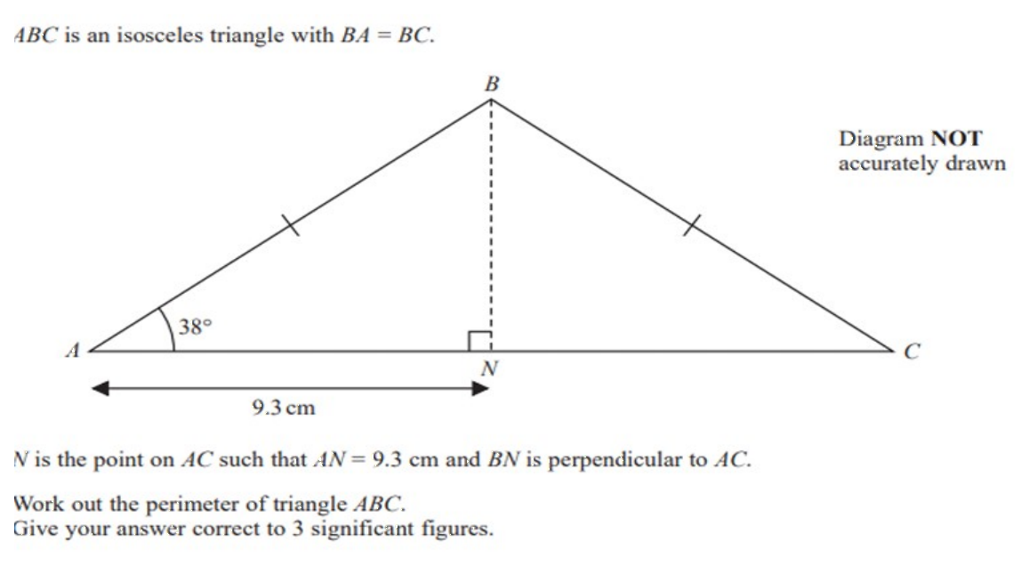
Zπ
PAST-PAPER QUESTION
Question 9

Slide 24
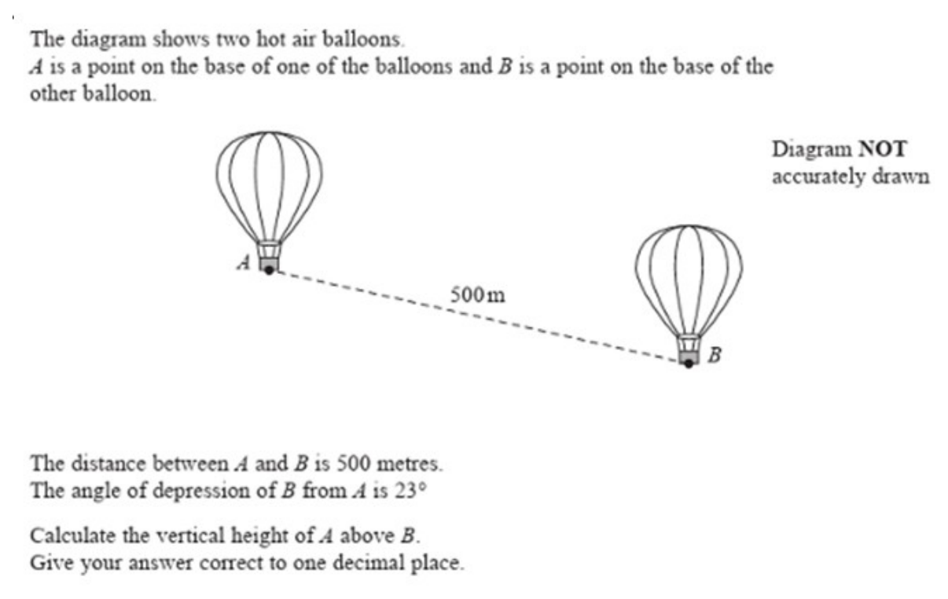
Zπ
PAST-PAPER QUESTION
Question 10

Slide 25
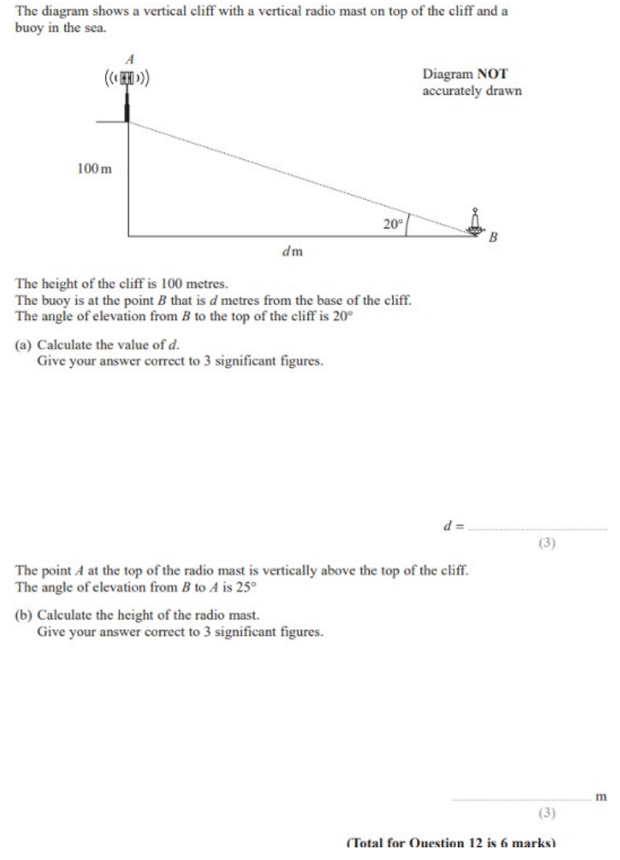
Zπ
PAST-PAPER QUESTION
Question 11

Slide 26
Zπ
RECAP
Key Takeaways
Label O, A, H from the ANGLE — never from the right angle.
SOH: sin θ = O/H. CAH: cos θ = A/H. TOA: tan θ = O/A.
Pick the ratio using the two sides you KNOW and WANT.
Finding a side: substitute and rearrange (multiply or divide).
Finding an angle: work out the ratio, then use sin⁻¹, cos⁻¹ or tan⁻¹ — in DEGREE mode.
Golden rule: an angle involved → SOHCAHTOA. Only sides and a right angle → Pythagoras.

