Slide 1
Zπ
Zπ MATHS HUB
Pearson Edexcel IGCSE (9–1) · Higher Tier
a² = b² + c² − 2bc cos A
Advanced Trigonometry
The Sine Rule · The Cosine Rule · Area of a Triangle · Choosing the Right Rule
Zahra Sheikh Ali
IGCSE Mathematics Teacher · M.Sc. Differential Geometry & Geometric Control
☎ 66613748 ✉ zahraa.sheikhali@outlook.com

Slide 2
Zπ
LESSON OVERVIEW
For ANY Triangle — Not Just Right-Angled
SOHCAHTOA only works in right-angled triangles. The sine and cosine rules work in ANY triangle. The hardest part is choosing which one — that is the next slide.
Labelling a, b, c / A, B, C
WHICH rule to use
The sine rule
1
2
3
The cosine rule
Area = ½ ab sin C
Past-paper questions
4
5
6
Key words: sine rule · cosine rule · included angle · opposite · inverse · 3 significant figures

Slide 3
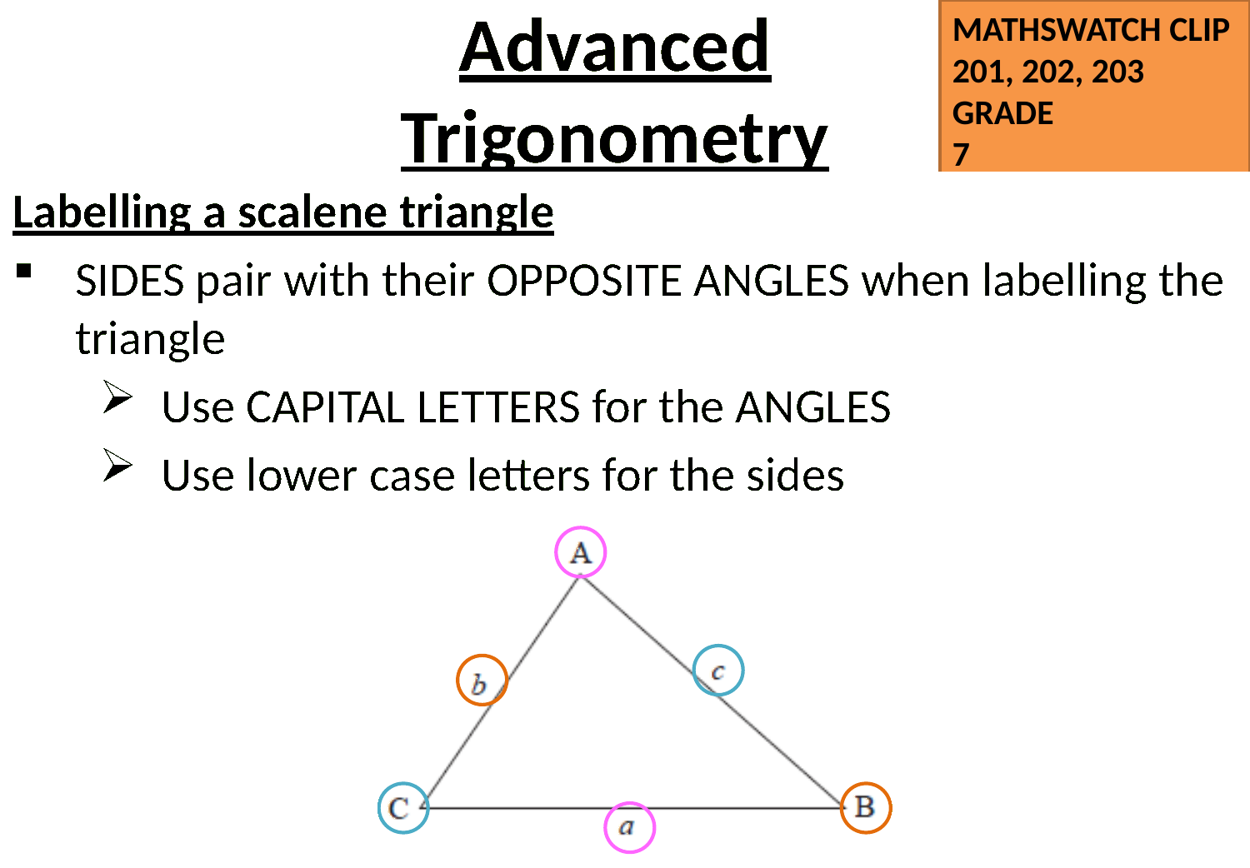
Zπ
STEP 1
Labelling a Triangle
Side a is OPPOSITE angle A, side b is opposite B, side c is opposite C. Capital = angle, small = side.

Slide 4
Zπ
THE KEY IDEA
Which Rule Do I Use?
Count what you have. The pattern of what is given tells you the rule.
USE THE SINE RULE
USE THE COSINE RULE
When you have TWO SIDES and TWO OPPOSITE ANGLES ,
and ONE of them is missing.
The sides and angles come in OPPOSITE PAIRS — you know a pair, and half of another pair.
When you have THREE SIDES and ONE ANGLE,
and ONE of them is missing.
No opposite pair is complete — the angle sits BETWEEN two known sides, or you know all three sides.
a ↔ A and b ↔ B
2 sides + the angle BETWEEN them → find the 3rd side
3 sides → find any angle
(a side and the angle facing it)
Find a SIDE or an ANGLE.
Sine: a side and the angle opposite it. Cosine: no complete pair — 3 sides, or 2 sides + the angle between.

Slide 5
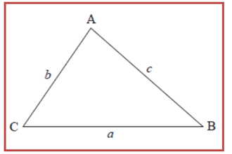
Zπ
THE SINE RULE
Two Versions — Same Rule
Put the thing you WANT on top. That keeps the algebra easy.
When you have:
TWO SIDES
TWO OPPOSITE ANGLES ,
and ONE of them is missing.
Finding a SIDE
Finding an ANGLE
a
=
b
=
c
sin A
=
sin B
=
sin C
sin A
sin B
sin C
a
b
c
Sides on top — multiply to find the side.
Sines on top — then use sin⁻¹ at the end.
You only ever need TWO of the three fractions — the pair you know and the pair you want.

Slide 6
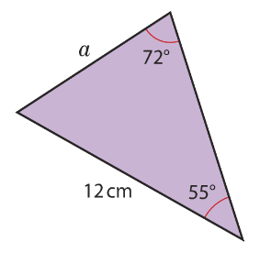




Zπ
SINE RULE · EXAMPLE
Finding a Side
Find a.
Two angles and one side given → sine rule. Match each side with the angle opposite it.

Slide 7
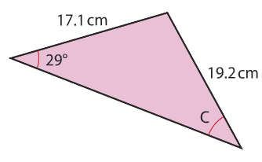





Zπ
SINE RULE · EXAMPLE
Finding an Angle
Find c.
Flip the formula so the sines are on top, then finish with sin⁻¹.

Slide 8
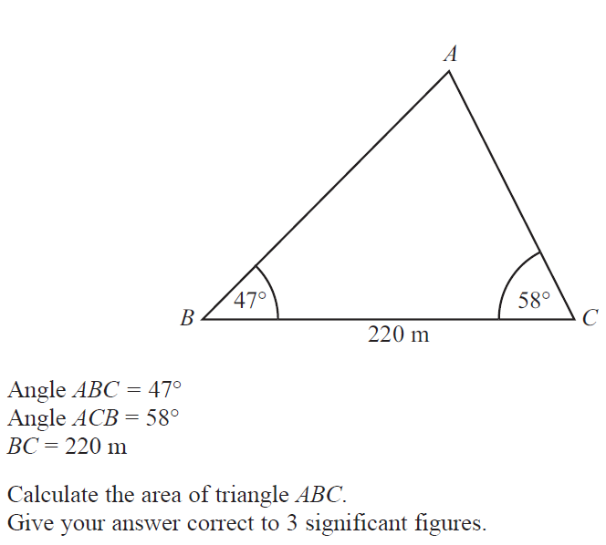
Zπ
SINE RULE · EXAM QUESTION
Your Turn
Exam question
Identify the opposite pairs first, then substitute.

Slide 9
Zπ
SINE RULE · EXAM QUESTION
Your Turn
The angle of elevation of the top of a column measured from point A, is 20º. The angle of elevation of the top of the statue is 25º. Find the height of the statue when the measurements are taken 50 m from its base
180 – 115 = 65º
T
180 – 110 = 70º
180 – 70 = 110º
Angle ATC =
Angle BCA =
Angle ACT =
65º
110º
C
70º
53.2 m
5º
25º
20º
A
50 m
B
Identify the opposite pairs first, then substitute.

Slide 10
Zπ
THE COSINE RULE
Two Forms — Side or Angle
The angle A always sits opposite the side a. Label the triangle before you substitute.
When you have:
Three SIDES
One ANGLE ,
and ONE of them is missing.
Finding a SIDE
Finding an ANGLE
a² = b² + c² − 2bc cos A
cos A =
b² + c² − a²
2bc
You know: all THREE sides. Then use cos⁻¹.
You know: two sides (b, c) and the angle BETWEEN them (A).
Don't forget the square root at the end!
The angle you find is opposite the side a.
Largest angle is always opposite the LONGEST side — useful for checking.

Slide 11
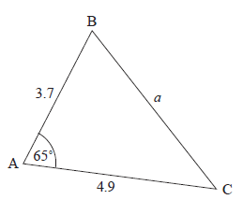




Zπ
COSINE RULE · EXAMPLE
Finding a Side
Find a.
Two sides and the angle BETWEEN them → cosine rule.

Slide 12
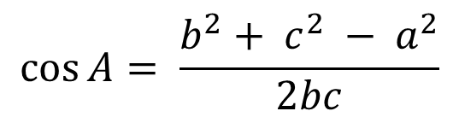
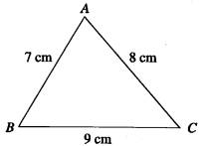
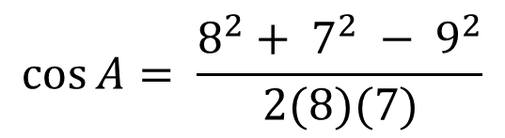
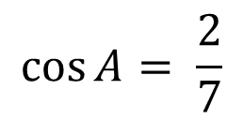
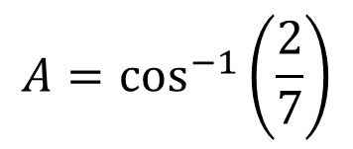


Zπ
COSINE RULE · EXAMPLE
Finding an Angle
Find the size of angle BAC
All three sides given → rearrange for cos A, then use cos⁻¹.

Slide 13
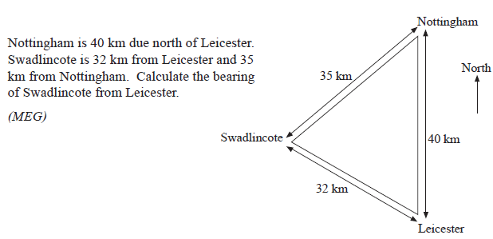
Zπ
COSINE RULE · PROBLEM SOLVING
In Context
Draw the triangle, label it, then decide the rule.

Slide 14
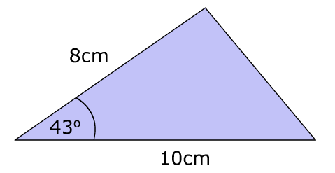
Zπ
AREA OF A TRIANGLE
Area = ½ ab sin C
Discussion – Is it possible to find the area of this triangle from the information given, using methods you already know?
Use when you know TWO SIDES and the angle BETWEEN them. The angle must be between the two sides.

Slide 15
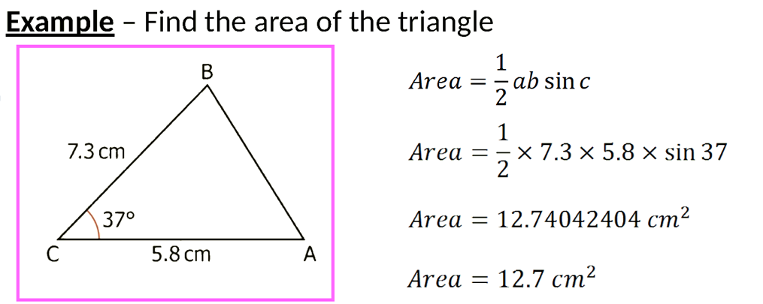
Zπ
AREA · EXAMPLE
Finding the Area
Two sides and the included angle → ½ ab sin C.

Slide 16
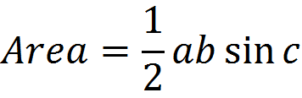

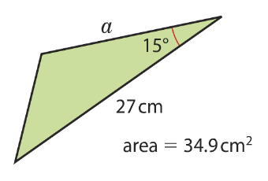



Zπ
AREA · EXAMPLE
Working Backwards from the Area
Find the missing side or angle, given the area
Given the area, substitute and solve for the missing side or angle.

Slide 17
Zπ
SUMMARY
The Decision Table
Look at what the question GIVES you, then pick the rule.
What you are given
Rule to use
Find
2 angles + 1 side
SINE RULE
a side
2 sides + 1 angle opposite one of them
SINE RULE
an angle
2 sides + the angle BETWEEN them
COSINE RULE
the 3rd side
3 sides
COSINE RULE
any angle
2 sides + the angle BETWEEN them
AREA = ½ ab sin C
the area
Ask yourself: do I have a SIDE and the ANGLE OPPOSITE it? Yes → sine rule. No → cosine rule.

Slide 18
Zπ
PART 2
Past-Paper Questions
Decide the rule first — then label, substitute and solve.
1
Label a, b, c and A, B, C
2
Complete opposite pair? → SINE
3
3 sides, or 2 sides + included angle? → COSINE
4
Area wanted? → ½ ab sin C

Slide 19
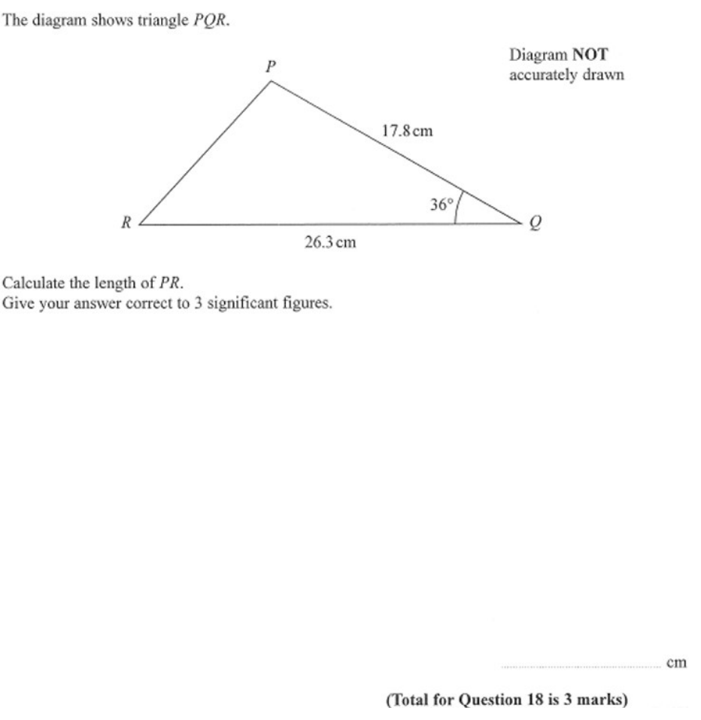
Zπ
PAST-PAPER QUESTION
Question 1

Slide 20
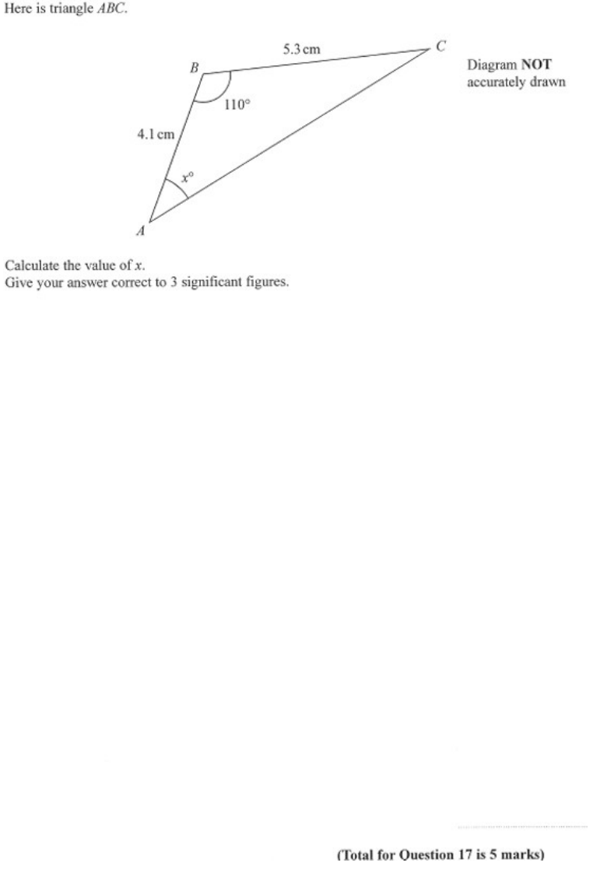
Zπ
PAST-PAPER QUESTION
Question 2

Slide 21
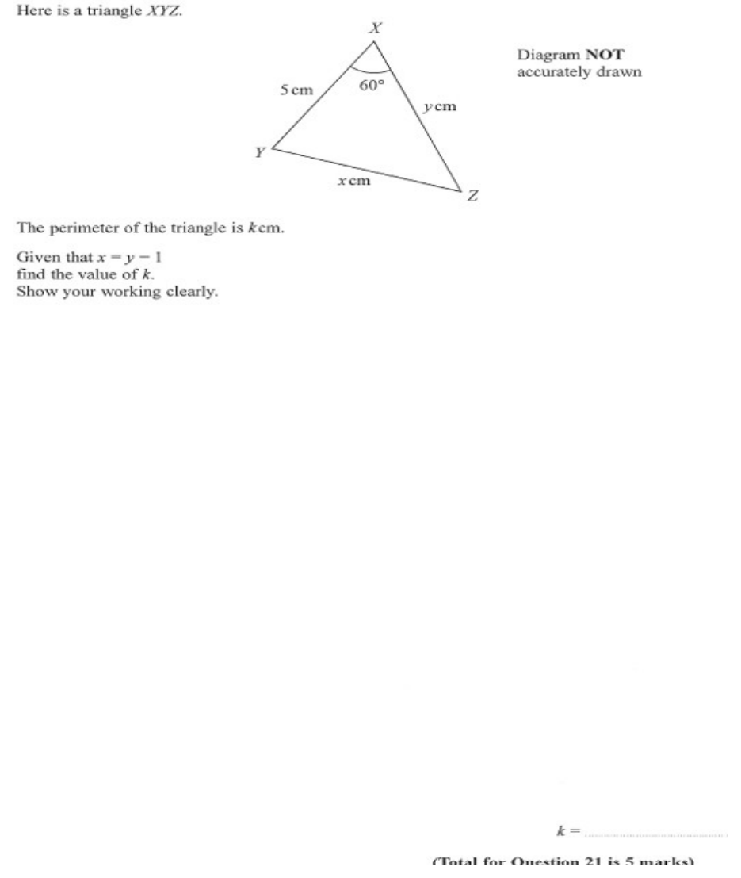
Zπ
PAST-PAPER QUESTION
Question 3

Slide 22
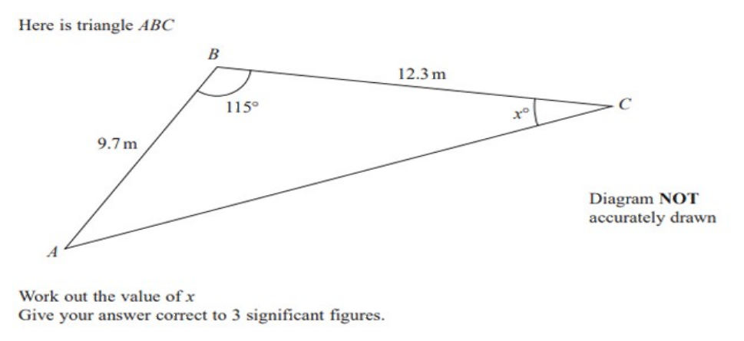
Zπ
PAST-PAPER QUESTION
Question 4

Slide 23
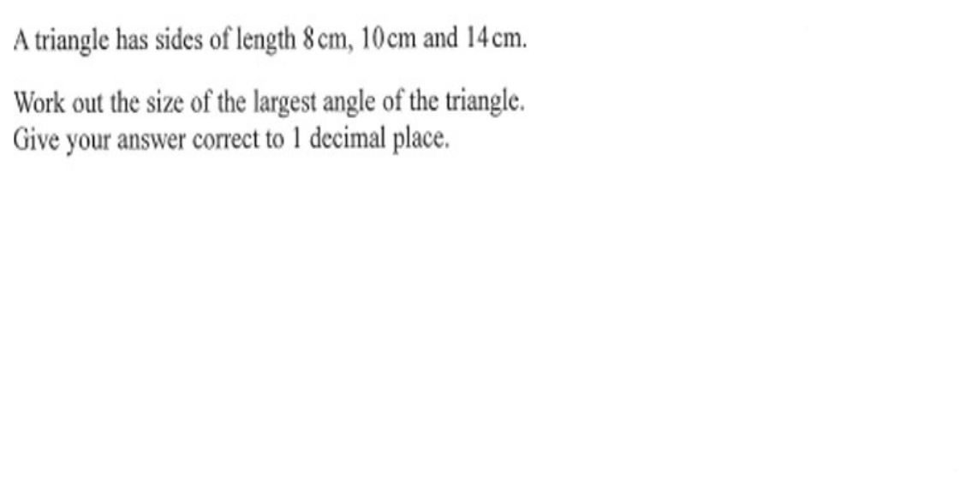
Zπ
PAST-PAPER QUESTION
Question 5

Slide 24
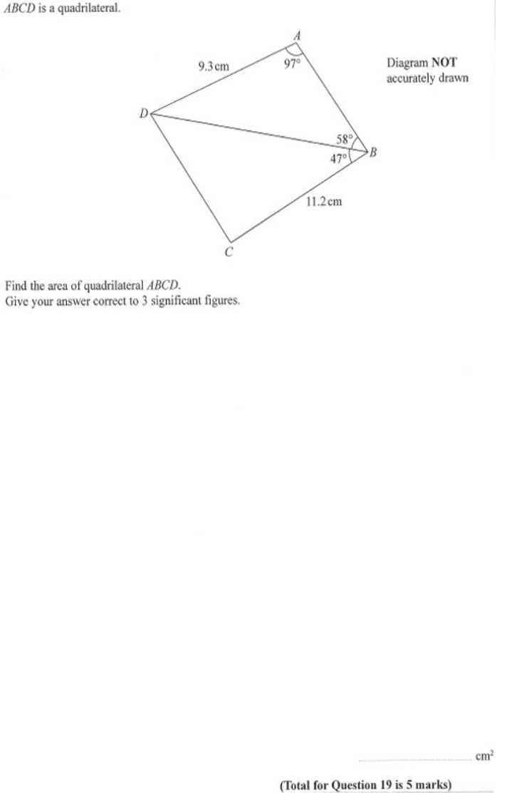
Zπ
PAST-PAPER QUESTION
Question 6

Slide 25
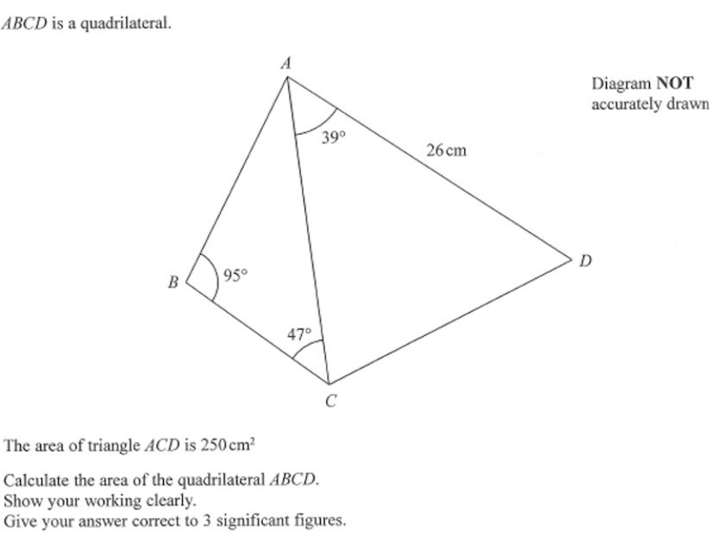
Zπ
PAST-PAPER QUESTION
Question 7

Slide 26
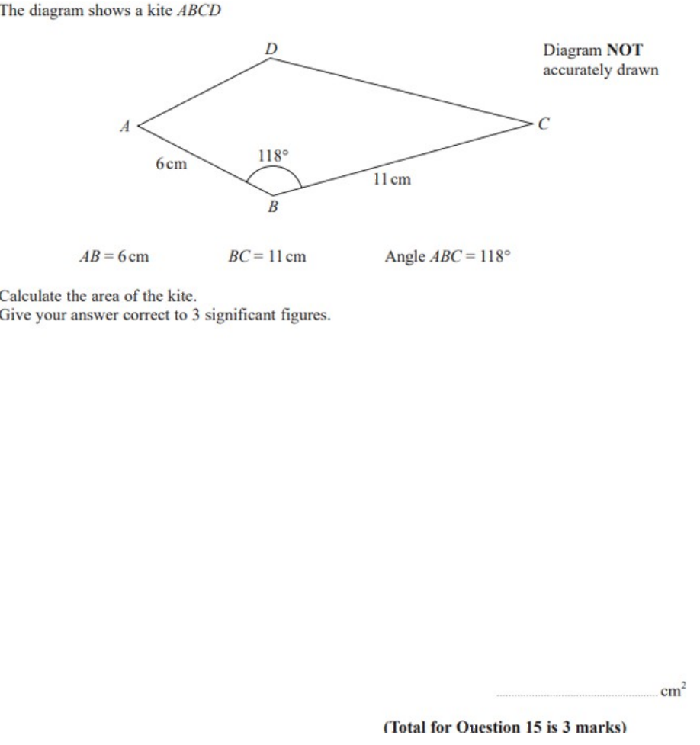
Zπ
PAST-PAPER QUESTION
Question 8

Slide 27
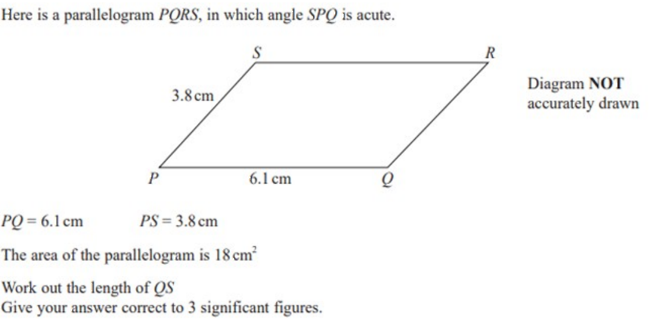
Zπ
PAST-PAPER QUESTION
Question 9

Slide 28
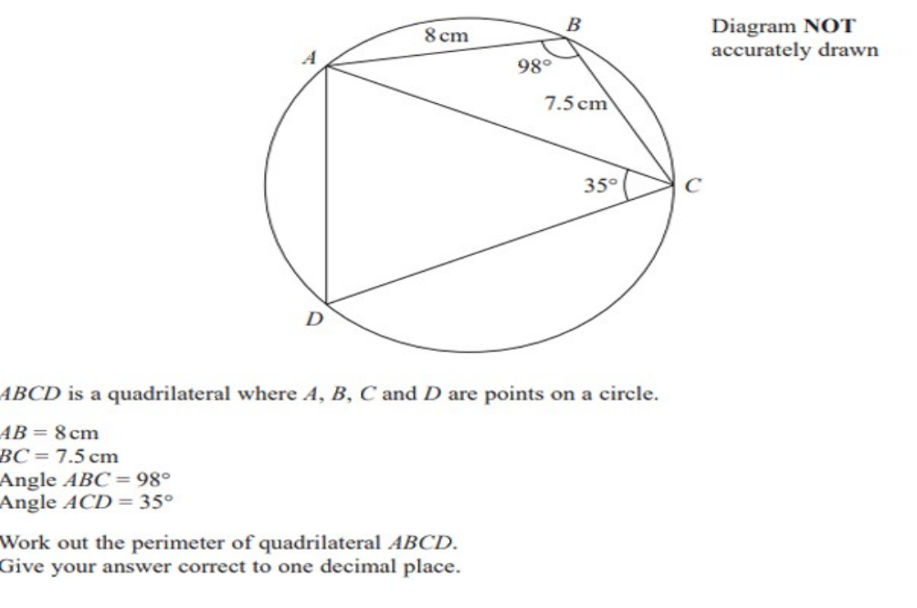
Zπ
PAST-PAPER QUESTION
Question 10

Slide 29
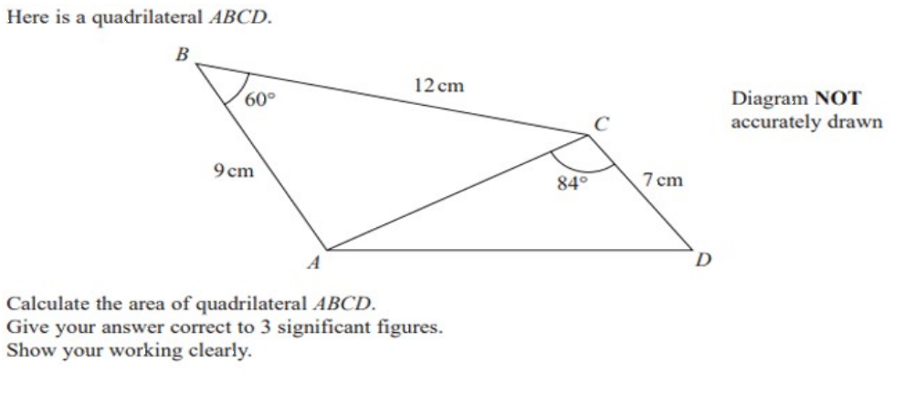
Zπ
PAST-PAPER QUESTION
Question 11

Slide 30
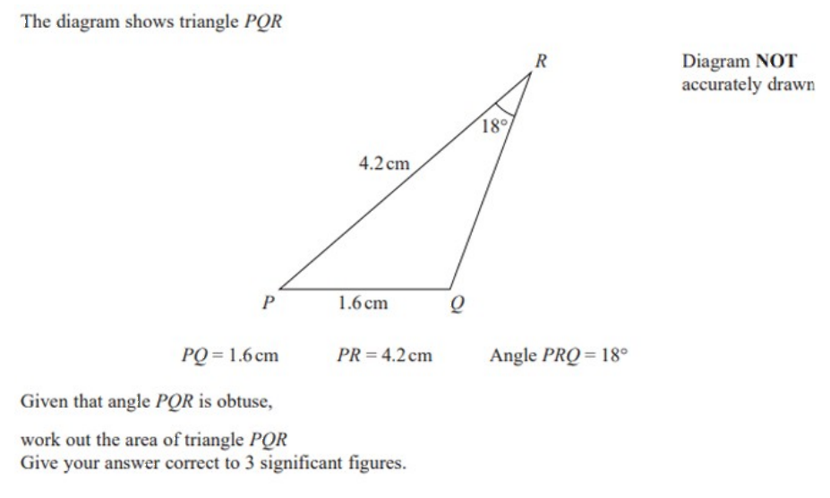
Zπ
PAST-PAPER QUESTION
Question 12

Slide 31
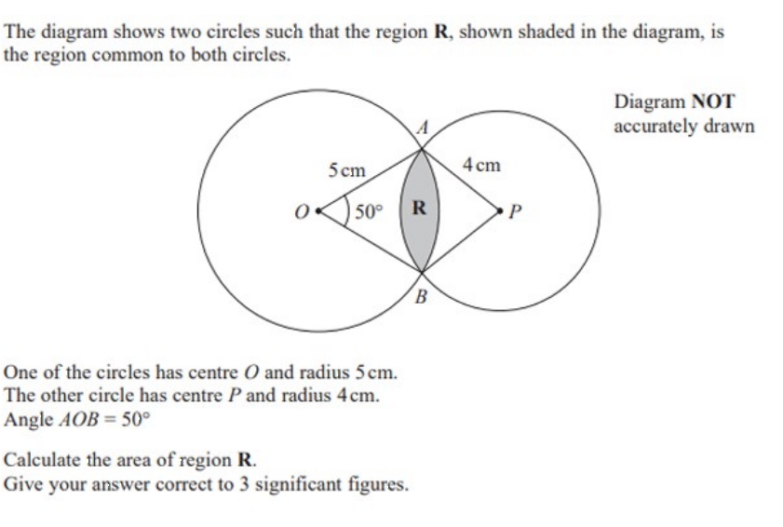
Zπ
PAST-PAPER QUESTION
Question 13

Slide 32
Zπ
RECAP
Key Takeaways
Both rules work in ANY triangle — not just right-angled ones.
SINE RULE: use when you have a SIDE and the ANGLE OPPOSITE it (two angles and two sides, one missing).
COSINE RULE: use when there is no complete pair — three sides, or two sides and the angle BETWEEN them.
Finding an angle? Rearrange, then use sin⁻¹ or cos⁻¹ — in DEGREE mode.
Area of any triangle = ½ ab sin C — the angle must be BETWEEN the two sides.
Golden rule: a side with its opposite angle → SINE. Otherwise → COSINE.

