Slide 1
Zπ
Zπ MATHS HUB
Pearson Edexcel IGCSE (9–1) · Higher Tier
Trigonometry in 3D
Finding the Right-Angled Triangle · Space Diagonals · Angle Between a Line and a Plane
Zahra Sheikh Ali
IGCSE Mathematics Teacher · M.Sc. Differential Geometry & Geometric Control
☎ 66613748 ✉ zahraa.sheikhali@outlook.com

Slide 2
Zπ
LESSON OVERVIEW
3D Is Just 2D — Twice
There is NO new formula. You find a right-angled triangle INSIDE the 3D shape, draw it flat, and use Pythagoras or SOHCAHTOA — usually twice.
Spotting the triangle
Draw it out FLAT
Pythagoras first
1
2
3
Then SOHCAHTOA
Angle: line & plane
Past-paper questions
4
5
6
Key words: cuboid · prism · pyramid · plane · space diagonal · base · vertical height · midpoint

Slide 3
Zπ
THE METHOD
Four Steps Every Time
The whole topic is this routine — learn it and every question becomes the same.
1
Find the right-angled triangle in the 3D shape
2
Draw that triangle FLAT, on its own
3
Missing a side? Use PYTHAGORAS on the base first
4
Then use SOHCAHTOA for the angle

Slide 4
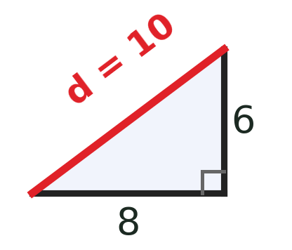
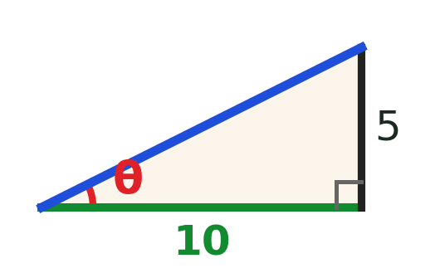
Zπ
THE KEY IDEA
Almost Always TWO Triangles
The side you need is usually a DIAGONAL of the base. You cannot see its length — so find it with Pythagoras first.
Triangle 1 — in the BASE (flat)
Triangle 2 — the UPRIGHT one
Use PYTHAGORAS to find the base diagonal.
e.g. base 8 cm by 6 cm:
d² = 8² + 6² = 100
d = 10 cm
Now use SOHCAHTOA with the diagonal.
e.g. height 5 cm, diagonal 10 cm:
tan θ = 5 ÷ 10 = 0.5
θ = tan⁻¹(0.5) = 26.6°
This diagonal is the link between the two triangles.
The diagonal from step 1 is the ADJACENT side here.
Pythagoras in the base → then SOHCAHTOA going up.

Slide 5
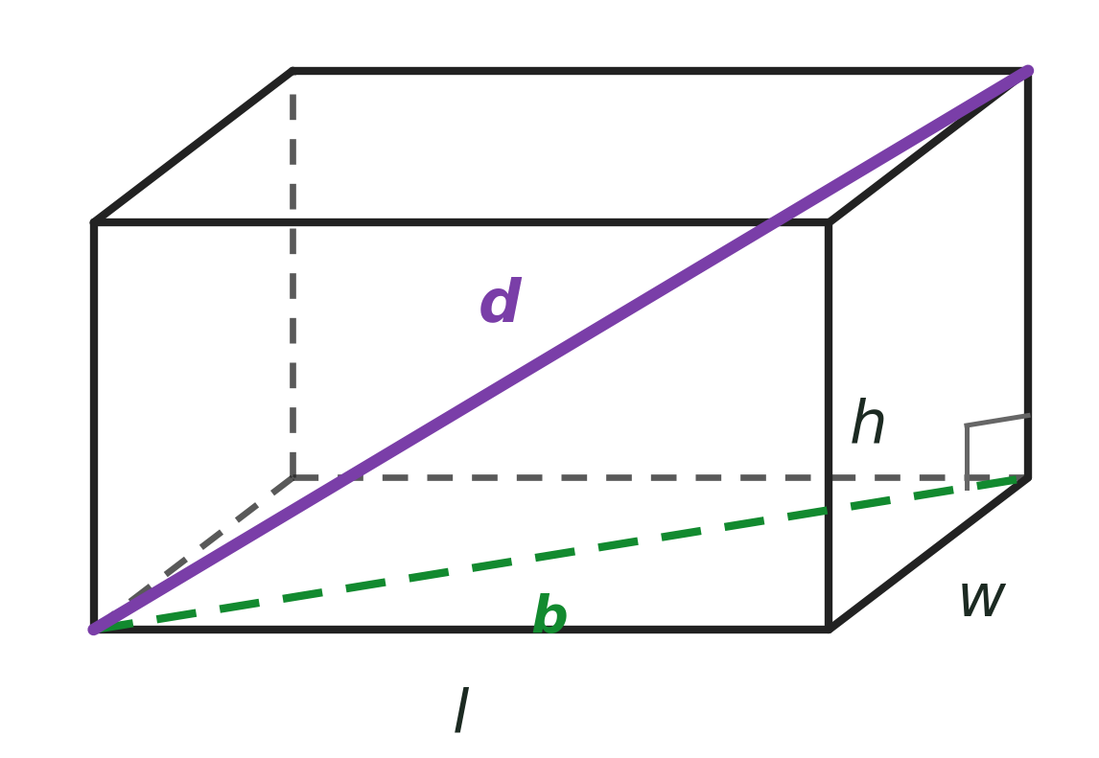
Zπ
THE SPACE DIAGONAL
The Longest Line in a Cuboid
The space diagonal goes corner-to-opposite-corner THROUGH the solid. It uses all three dimensions.
The formula
d = √( l² + w² + h² )
Why? Pythagoras TWICE:
1. base diagonal: b² = l² + w²
2. space diagonal: d² = b² + h² = l² + w² + h²
e.g. 3 × 4 × 12 cuboid: d = √(9 + 16 + 144) = √169 = 13 cm
You do not have to memorise it — doing Pythagoras twice gives the same answer.

Slide 6
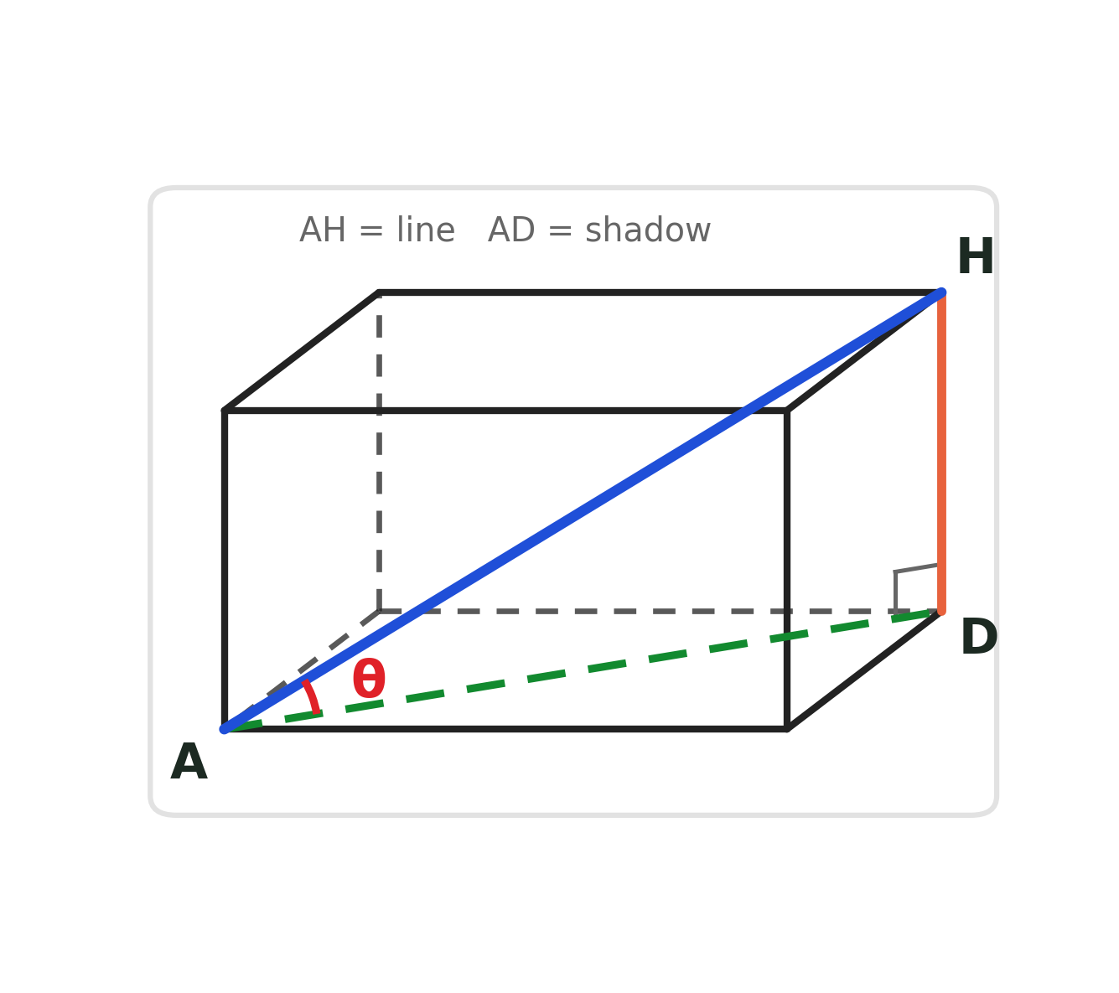
Zπ
THE HARD PART
Angle Between a Line and a Plane
‘The angle between AH and the base’ — what does that mean? Drop the line down onto the plane.
Take the line (e.g. AH). Find the point where it MEETS the plane (A).
1
From the other end (H), drop straight DOWN onto the plane. Call that point D.
2
The angle you want is between the line AH and its ‘shadow’ AD on the plane.
3
Triangle AHD is right-angled at D — now use SOHCAHTOA.
4
The ‘shadow’ of the line on the plane is nearly always a DIAGONAL of the base.

Slide 7
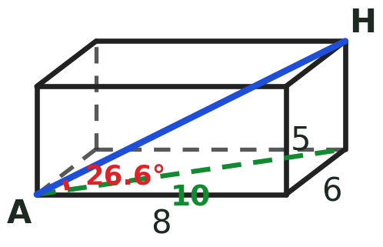
Zπ
WORKED EXAMPLE
Cuboid: Angle Between AH and the Base
1
Cuboid with base 8 cm × 6 cm and height 5 cm.
Watch out
Use the BASE DIAGONAL, not a base edge.
Draw the triangle flat before substituting.
Keep full accuracy — round only at the end.
Check: the angle should be less than 90°.
2
Base diagonal (Pythagoras): d = √(8² + 6²) = √100 = 10 cm
3
Upright triangle: opposite = 5 (height), adjacent = 10 (diagonal)
4
tan θ = 5 ÷ 10 → θ = tan⁻¹(0.5) = 26.6°
Angle between AH and the base = 26.6°
Same routine for pyramids: find the base diagonal (or half of it) first.

Slide 8
Zπ
PYRAMIDS & PRISMS
Small Differences to Watch
Same method — but be careful WHICH length you need.
PYRAMID — apex above the CENTRE
the vertical height meets the base at the CENTRE, so you use HALF the base diagonal
SLANT EDGE vs SLANT HEIGHT
edge → use half the diagonal; face height → use half the base EDGE
MIDPOINTS
‘M is the midpoint of GH’ — halve that length before you start
PRISM
the cross-section is a flat 2D shape — work in that plane first
Always sketch the 2D triangle separately — it is the single best habit in this topic.

Slide 9
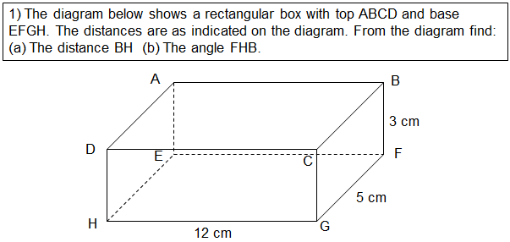
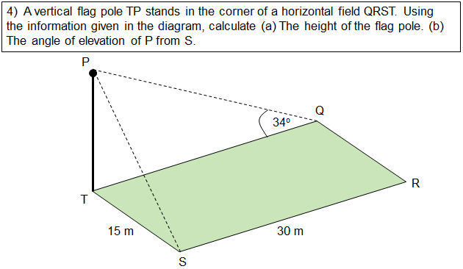
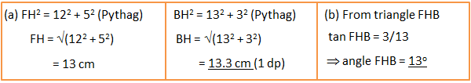
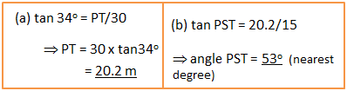
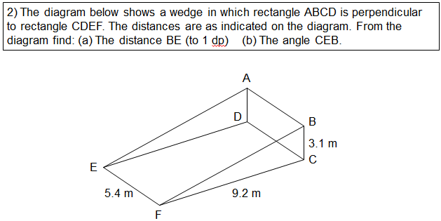
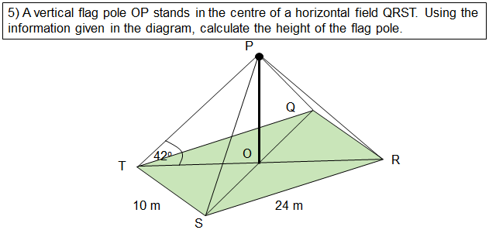
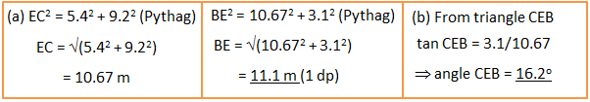
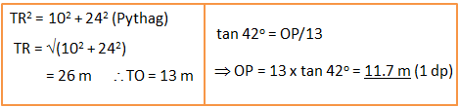
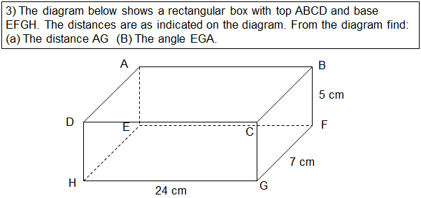
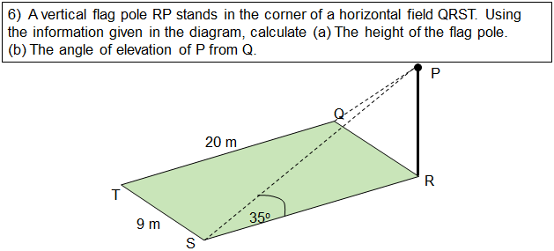
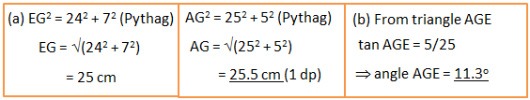
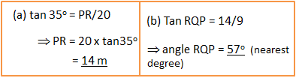
Zπ
TASK
Trig in 3D Shapes — Worksheet
Find the right-angled triangle, draw it flat, then Pythagoras → SOHCAHTOA.

Slide 10
Zπ
PART 2
Past-Paper Questions
Cuboids, cubes, prisms, pyramids and cones — same routine every time.
1
Sketch the right-angled triangle FLAT
2
Pythagoras for the hidden diagonal
3
SOHCAHTOA for the angle
4
Round as asked (usually 3 s.f. or 1 d.p.)

Slide 11
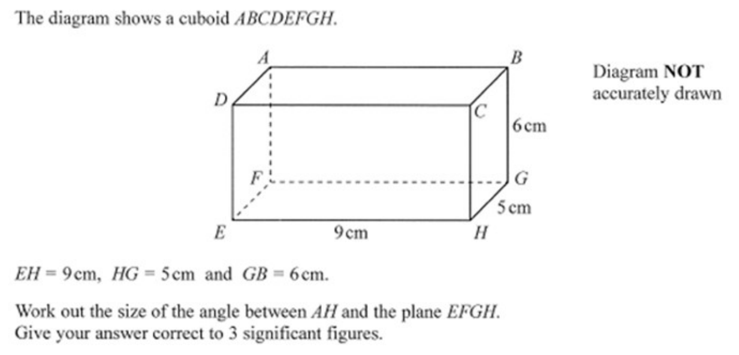
Zπ
PAST-PAPER QUESTION
Question 1

Slide 12
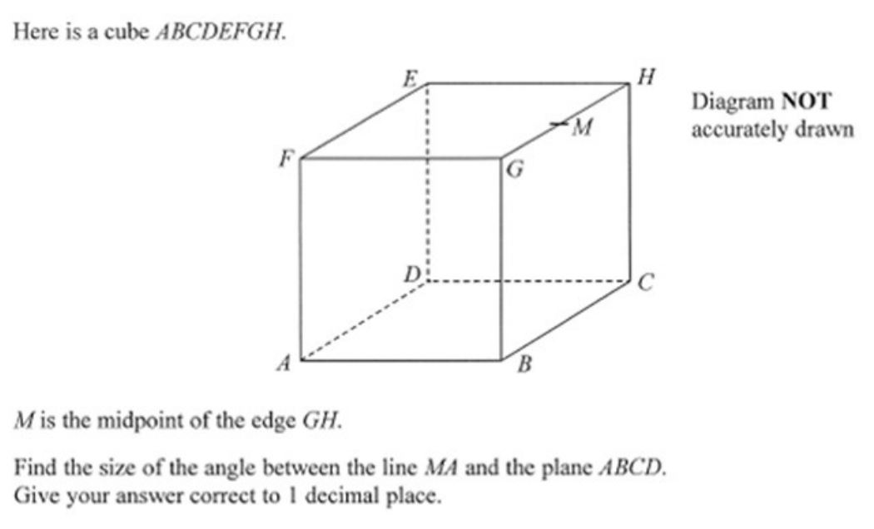
Zπ
PAST-PAPER QUESTION
Question 2

Slide 13
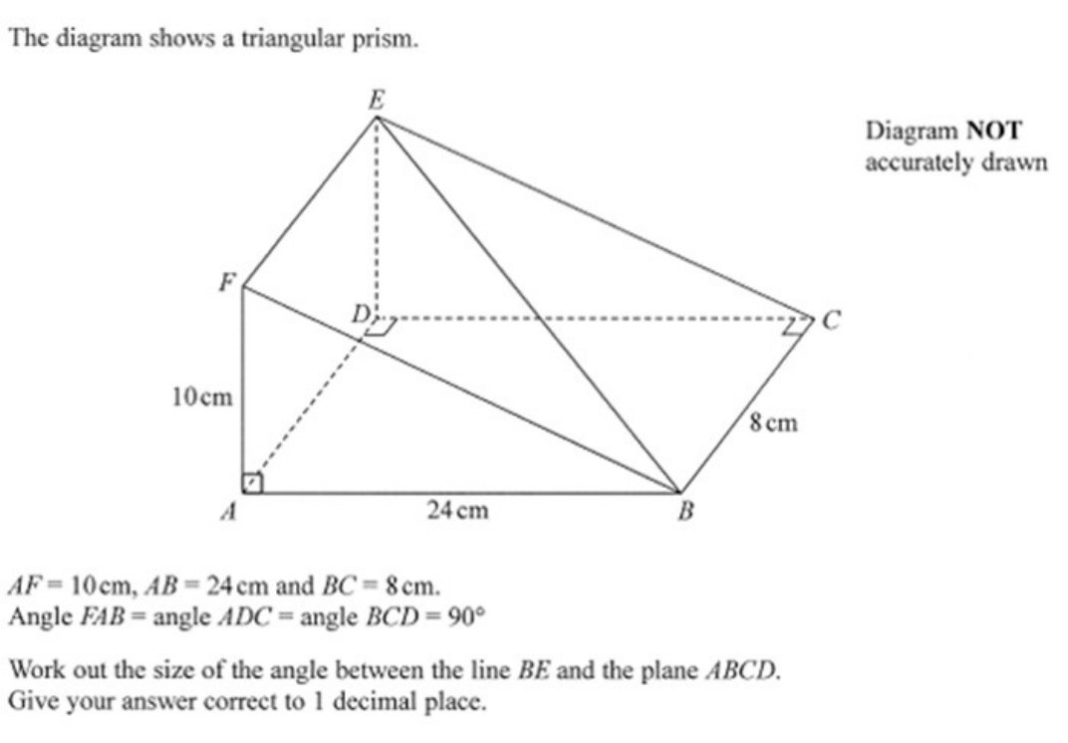
Zπ
PAST-PAPER QUESTION
Question 3

Slide 14
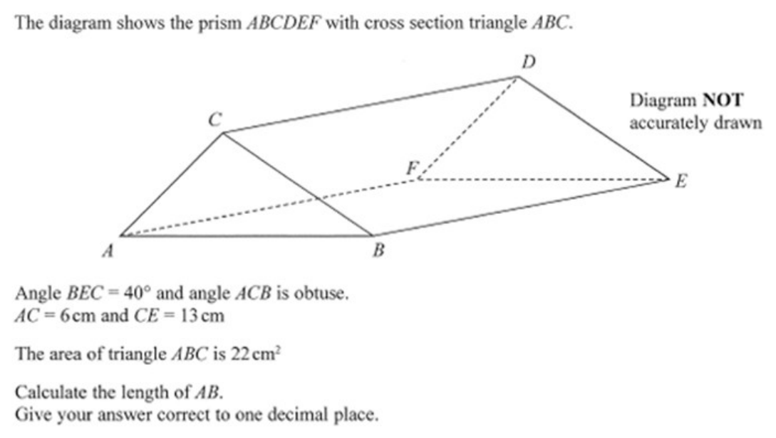
Zπ
PAST-PAPER QUESTION
Question 4

Slide 15
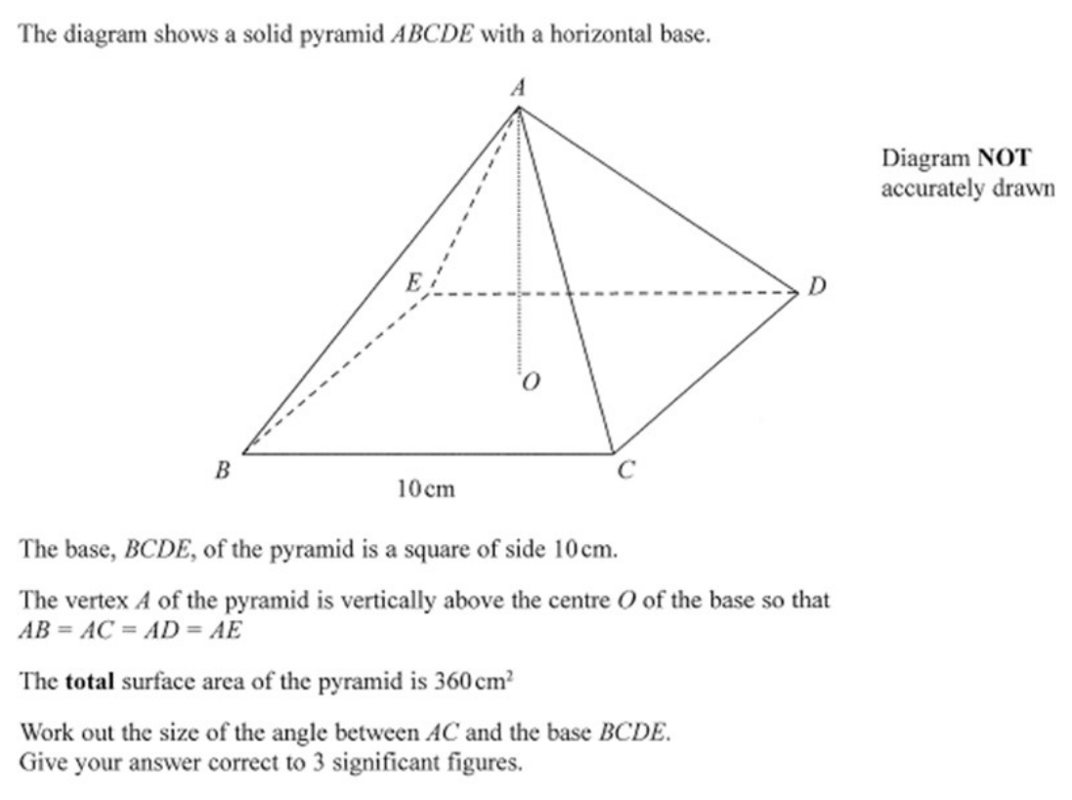
Zπ
PAST-PAPER QUESTION
Question 5

Slide 16
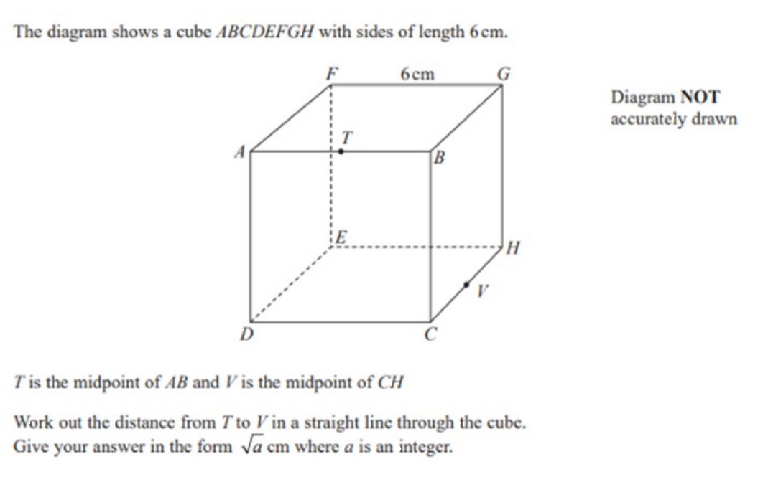
Zπ
PAST-PAPER QUESTION
Question 6

Slide 17
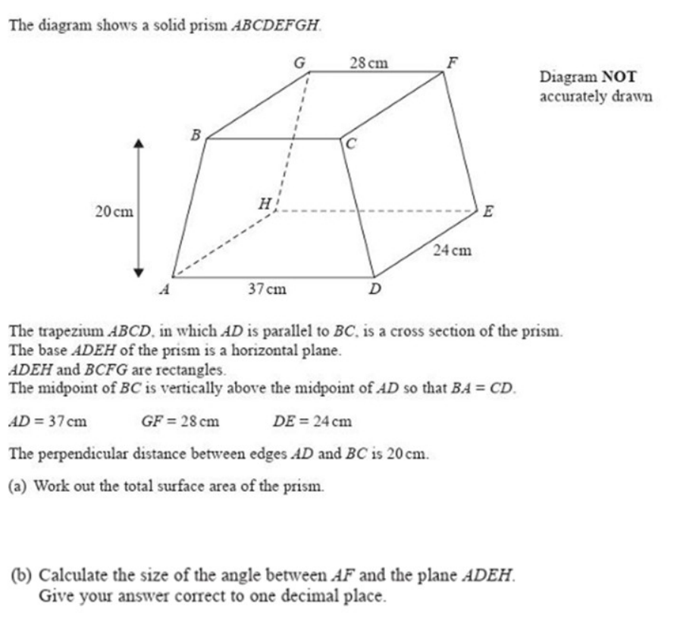
Zπ
PAST-PAPER QUESTION
Question 7

Slide 18
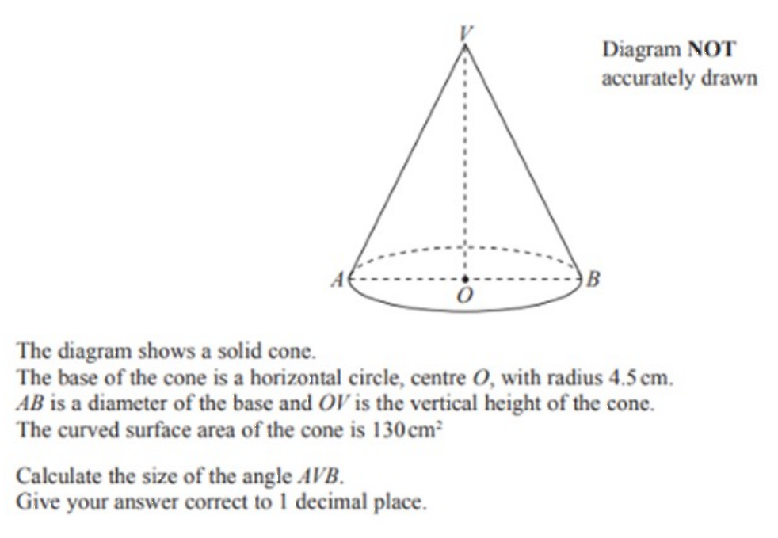
Zπ
PAST-PAPER QUESTION
Question 8

Slide 19
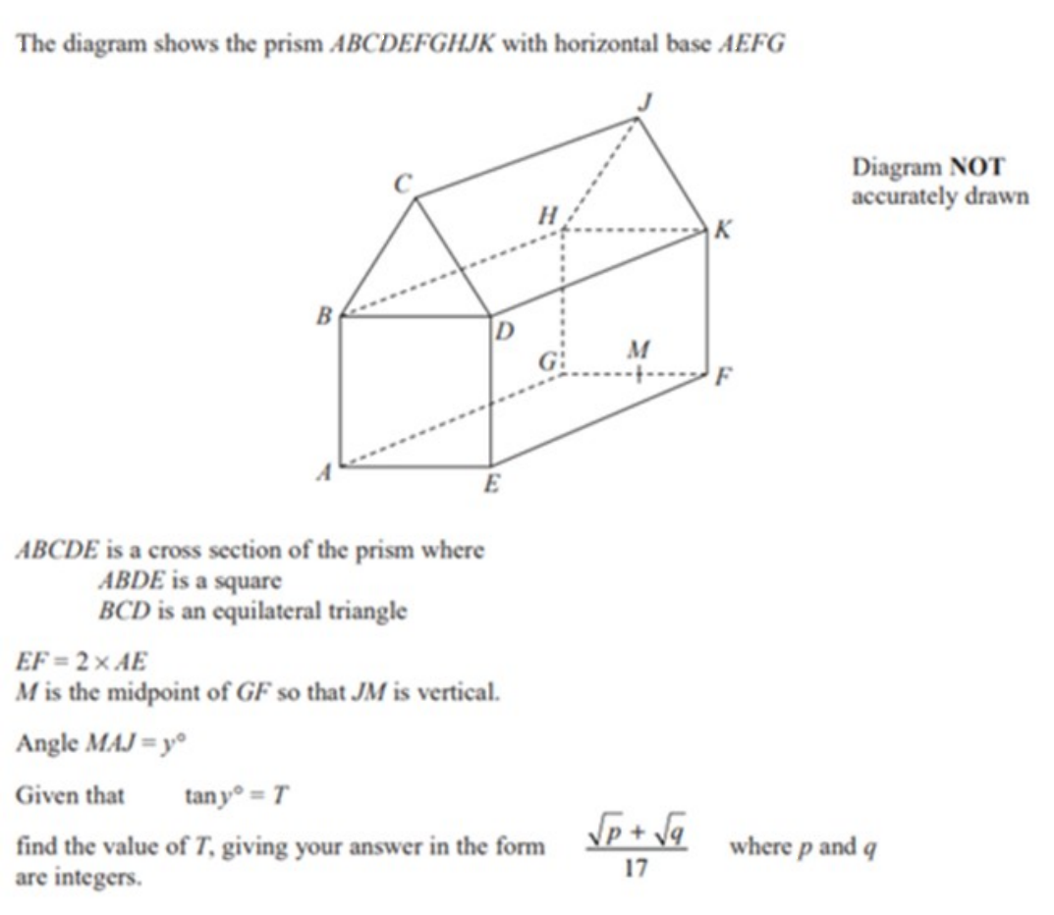
Zπ
PAST-PAPER QUESTION
Question 9

Slide 20
Zπ
RECAP
Key Takeaways
3D trigonometry uses NO new formulas — find a right-angled triangle inside the shape.
Draw that triangle FLAT on its own before substituting anything.
The hidden length is usually a base DIAGONAL — find it with Pythagoras first.
Then use SOHCAHTOA (or the sine/cosine rule) in the upright triangle.
Angle between a line and a plane = the angle between the line and its ‘shadow’ on the plane.
Golden rule: Pythagoras in the base, then SOHCAHTOA going up.

