Slide 1
Zπ
Zπ MATHS HUB
N
Pearson Edexcel IGCSE (9–1) · Higher Tier
Bearings
Measured from NORTH · Clockwise · Always Three Figures · Back Bearings
Zahra Sheikh Ali
IGCSE Mathematics Teacher · M.Sc. Differential Geometry & Geometric Control
☎ 66613748 ✉ zahraa.sheikhali@outlook.com

Slide 2
Zπ
LESSON OVERVIEW
Three Rules, Every Time
A bearing is a direction. Measure it from NORTH, go CLOCKWISE, and write it with THREE figures. Get those three right and bearings are easy.
Measure from NORTH
Go CLOCKWISE
Always 3 figures
1
2
3
‘A from B’ — where to draw N
Back bearings (±180°)
Past-paper questions
4
5
6
Key words: bearing · north line · clockwise · three figures · back bearing · angles on parallel lines

Slide 3
Zπ
THE KEY IDEA
What Is a Bearing?
A bearing is a measure of DIRECTION.
N
000°
NW
315°
NE
045°
Measured from the NORTH line
1
always start at north (000°)
Measured CLOCKWISE
W
270°
E
090°
2
never anticlockwise
Written with THREE figures
3
SW
225°
SE
135°
60° is written 060°
S
180°
From NORTH · CLOCKWISE · THREE FIGURES

Slide 4
Zπ
THE GOLDEN RULE
‘The Bearing of A from B’
When it is the bearing
of something from something:
N
N
Something
Something
Something
Something
use a North line at the point that is after the “from”
Draw the North line at the point AFTER the word ‘from’. That is where you are standing.

Slide 5
Zπ
THE GOLDEN RULE
Where Do I Put the North Line?
“Find the bearing of A FROM B” — you are standing at B, looking at A. So the North line goes at B.
Bearing of A FROM B
Remember
You are at B (after the ‘from’).
1. Draw the North line at B.
2. Turn CLOCKWISE from north.
3. Stop when you point at A.
4. Write it with 3 figures.
The North line is ALWAYS at the point you are standing at.
If the diagram has no North line there — draw one!
North lines are PARALLEL — use alternate/co-interior angles.
Bearings can be anything from 000° to 360°.
‘from’ tells you where to STAND — that is where the North line goes.

Slide 6
Zπ
EXAMPLE
Bearing of B from A — the BACK Bearing
What is the bearing of B from A?
The bearing of A from B is 060˚
N
The bearing of B from A is 240˚
Can you explain why?
A
60˚
B
Now stand at A. The answer is 240° — exactly 180° more than 060°. Can you explain why?

Slide 7
Zπ
BACK BEARINGS
The ± 180° Rule
The bearing of A from B and the bearing of B from A always differ by 180°. This is because the North lines are parallel.
If the bearing is LESS than 180°
If the bearing is MORE than 180°
ADD 180°
e.g. bearing of A from B = 060°
→ bearing of B from A = 060 + 180 = 240°
SUBTRACT 180°
e.g. bearing of A from B = 240°
→ bearing of B from A = 240 − 180 = 060°
Answers must stay between 000° and 360° — that is why you add OR subtract.
Back bearing = original ± 180°

Slide 8
TASK
Zπ
Find the Bearing of B from A
Task: Find the bearing of B from A
B
2) 3)
5) 6)
7) 8) 9)
068˚
B
32˚
B
328˚
A
117˚
68˚
063˚
A
A
221˚
A
270˚
A
41˚
68˚
B
B
A
B
248˚
A
A
32˚
B
248˚
041˚
148˚
B
117˚
41˚
32˚
B
A
Nine to try. North line at A each time, then measure clockwise.

Slide 9
Zπ
EXAM TECHNIQUE
Common Mistakes to Avoid
Most lost marks come from these four things.
✗
Measuring from the wrong point
Read the ‘from’ carefully — that is where you stand.
✗
Going anticlockwise
Bearings are ALWAYS clockwise from north.
✗
Writing 60° instead of 060°
Three figures — always. Add a leading zero.
✗
Forgetting the North line
If it is not drawn, draw it yourself at the right point.
✗
Not using parallel north lines
Alternate and co-interior angles solve most exam questions.
Bearings questions often combine with SOHCAHTOA or the sine/cosine rule — sketch the triangle.

Slide 10
Zπ
PART 2
Past-Paper Worksheets
North line at the ‘from’ point, clockwise, three figures.
1
Mark the North line at the right point
2
Use parallel north lines (alternate angles)
3
Back bearing? ± 180°
4
Write your answer with three figures

Slide 11
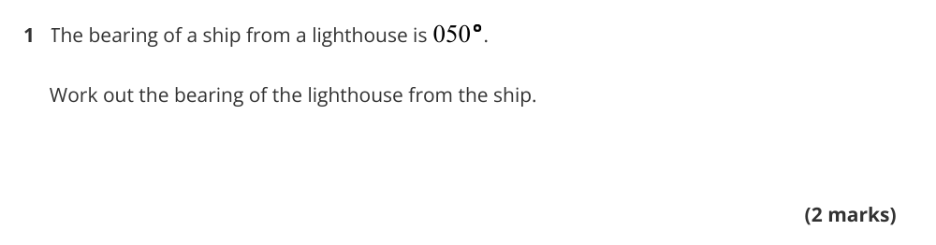
Zπ
PAST-PAPER WORKSHEET
Question Set 1

Slide 12
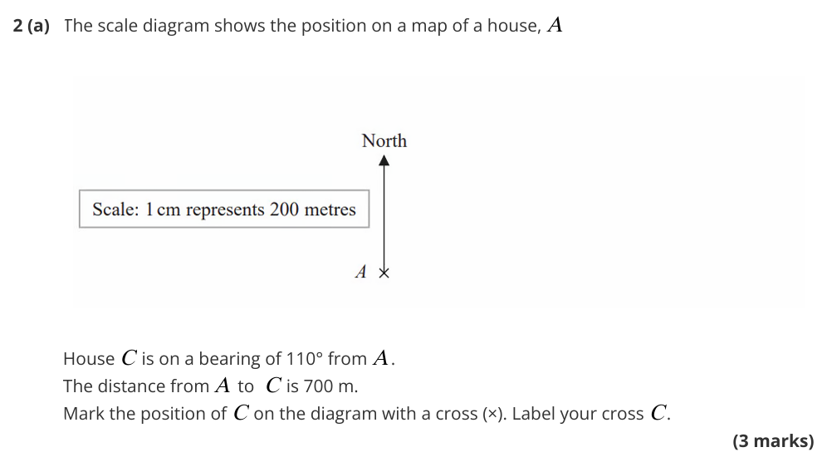
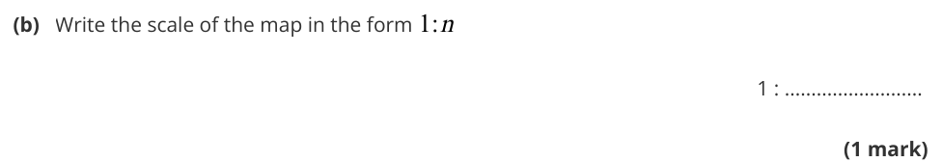
Zπ
PAST-PAPER WORKSHEET
Question Set 2

Slide 13

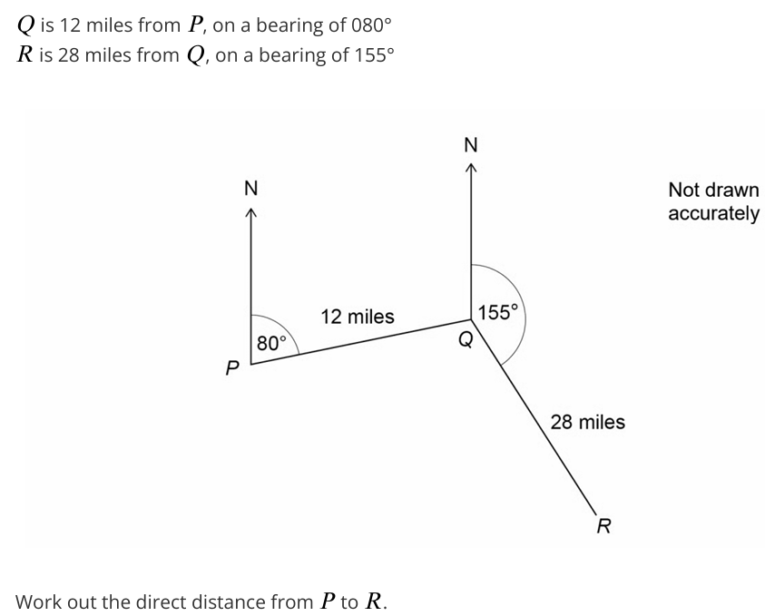
Zπ
PAST-PAPER WORKSHEET
Question Set 3

Slide 14
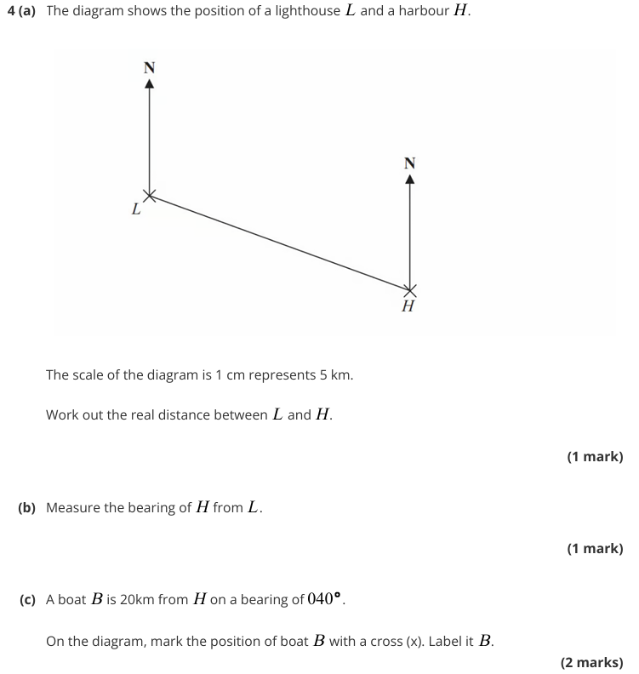
Zπ
PAST-PAPER WORKSHEET
Question Set 4

Slide 15
Zπ
RECAP
Key Takeaways
A bearing is measured from NORTH, CLOCKWISE, with THREE figures (060° not 60°).
‘The bearing of A from B’ — stand at B: the North line goes at B.
North lines are PARALLEL — use alternate and co-interior angles.
Back bearing = original ± 180° (add if under 180°, subtract if over).
Bearings often combine with trigonometry — sketch the triangle and label it.
Golden rule: the word ‘from’ tells you where to put the North line.

