Slide 1
Zπ
Zπ MATHS HUB
Pearson Edexcel IGCSE (9–1) · Higher Tier
Constructions
Ruler & Compasses · Triangles · Perpendicular & Angle Bisectors · Perpendiculars · Special Angles
Zahra Sheikh Ali
IGCSE Mathematics Teacher · M.Sc. Differential Geometry & Geometric Control
☎ 66613748 ✉ zahraa.sheikhali@outlook.com

Slide 2
Zπ
LESSON OVERVIEW
Drawing Accurately with Compasses
A construction is an ACCURATE drawing made with a ruler and a pair of compasses. Never rub out your arcs — they show your method and earn the marks.
The equipment
Constructing triangles
Can a triangle be made?
1
2
3
Perpendicular & angle bisectors
Perpendiculars to a line
Special angles & nets
4
5
6
Key words: construction · arc · bisector · perpendicular · equidistant · compasses

Slide 3
Zπ
BEFORE YOU BEGIN
The Equipment You Need
Constructions are marked on ACCURACY. The right tools — and a sharp pencil — make all the difference.
A ruler
marked in cm and mm — for straight lines and measuring
1
A pair of compasses
for drawing arcs and circles — the heart of every construction
2
A protractor
for measuring and drawing angles
3
A sharp pencil
fine lines are accurate lines — keep it sharp
4
Golden rule of constructions: NEVER rub out your arcs — they are your working.

Slide 4
Zπ
PART 1
Constructing Triangles
Given some sides and angles, draw the triangle accurately.
1
1 side + 2 angles — use a protractor
2
2 sides + the angle between — protractor + compasses
3
3 sides (SSS) — compasses only
4
Label every point clearly

Slide 5
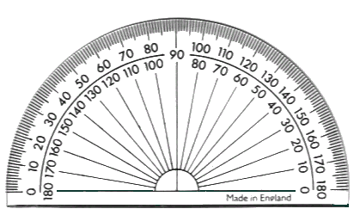
CONSTRUCTING A TRIANGLE
Zπ
Given 1 Side and 2 Angles
To construct a triangle, given 1 side and 2 angles.
Construct a triangle of side, 9 cm with angles of 35º and 65º.
1. Draw a straight line 9 cm long.
2. Use a protractor to draw angles of 35º and 65º on either end of line.
3. Draw straight lines from A and B to point of intersection to form the triangle.
A
B
9 cm
Draw the side first, then use a protractor for the two angles at each end — where the lines cross is the third vertex.

Slide 6
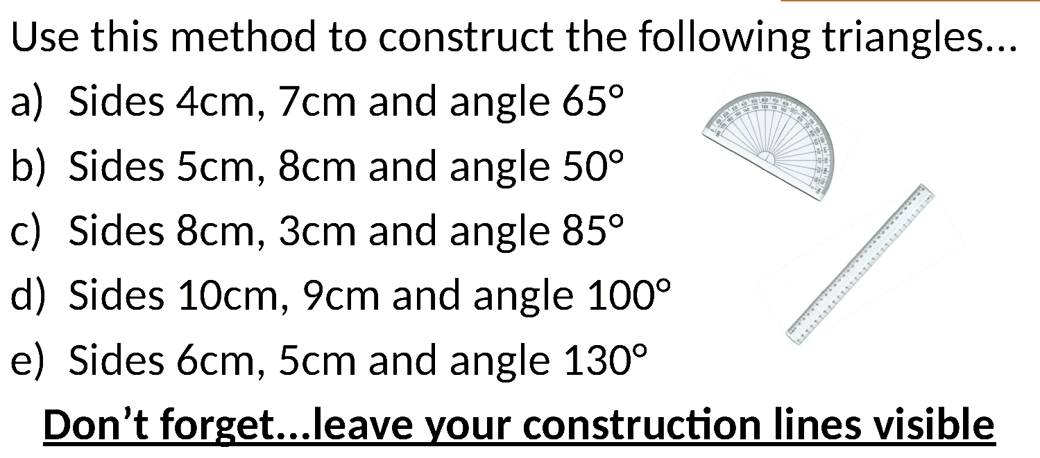
Zπ
CONSTRUCTING A TRIANGLE
Given 1 Side and 2 Angles— Compasses and Ruler
Draw the base, then set the compasses to each other side and draw arcs from each end. They cross at the third corner.

Slide 7
CONSTRUCTING A TRIANGLE
Zπ
Given 2 Sides and 1 Angle
To construct a triangle, given 2 sides and 1 angle.
Construct a triangle of sides, 10 cm and 7cm with an angle of 115º.
1. Draw a straight line 10 cm long.
2. Use a protractor to draw an angle of 115º on either end of line.
3. Mark off a length of 7 cm.
4. Join end points to form the required triangle.
7 cm
115º
A
B
10 cm

Slide 8
CONSTRUCTING A TRIANGLE
Zπ
Given 3 Sides
To construct a triangle, given 3 sides.
Construct a triangle of sides 7 cm, 3½ cm and 10 cm.
1. Using the longest side as the base, draw a straight line 10 cm long.
2. Set compass to 7 cm, place at A and draw an arc.
3. Set compass to 3½ cm, place at B and draw an arc to intersect the first one.
4. Draw straight lines from A and B to point of intersection.
7 cm
3½ cm
A
B
10 cm

Slide 9
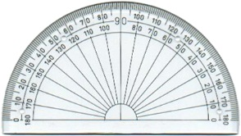
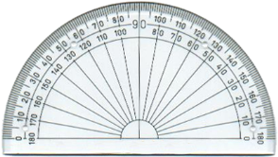
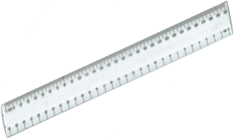
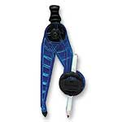
Zπ
CONSTRUCTING A TRIANGLE
Constructing from 1 side, 2 angles (ASA)
1) 45°, 50°, 7cm
2) 30°, 70°, 3cm
3) 70°, 110°, 6.5cm
4) 53°, 20°, 6cm
5) 120°, 42°, 12.5cm
6) 135°, 12°, 9cm
Constructing from 2 sides, 1 angle (SAS)
1) 45°, 4cm, 7cm
2) 30°, 6cm, 3cm
3) 70°, 4.5cm, 6.5cm
4) 53°, 8cm, 11cm
5) 120°, 4cm, 12.5cm
6) 135°, 9cm, 9cm
Constructing from 3 sides (SSS)
1) 8cm, 10cm, 6cm 2) 7cm, 4cm, 9cm
3) 11cm, 6cm, 8cm 4) 2.5cm, 3cm, 4.5cm
5) 6.2cm, 4.5cm, 7.3cm 6) 9cm, 10cm, 3.6cm

Slide 10
Zπ
CAN A TRIANGLE BE MADE?
The Triangle Inequality
The two shorter sides must ADD UP to more than the longest side. Otherwise the arcs never meet.
Works ✓
Impossible ✗
7 cm, 6 cm, 4 cm
4 + 6 = 10 > 7 ✓
The two shorter sides beat the longest — the triangle closes.
2 cm, 10 cm, 7 cm
2 + 7 = 9 < 10 ✗
The two short sides cannot reach across — the arcs never meet.
Shorter + shorter > longest → the triangle can be built.

Slide 11
Zπ
TASK
Which Side Lengths CANNOT Make a Triangle?
Task – Which of these groups of side lengths CANNOT be used to construct a triangle?
 | Side 1 | Side 2 | Side 3
1 | 12 cm | 8 cm | 7 cm
2 | 9 cm | 12 cm | 4 cm
3 | 8 cm | 15 cm | 7 cm
4 | 18 cm | 3 cm | 20 cm
5 | 8 cm | 8 cm | 17 cm
6 | 19 cm | 7 cm | 13 cm
7 | 9.3 cm | 18 cm | 7.2 cm
8 | 50 cm | 26 cm | 23 cm
9 | 40 cm | 41 cm | 82 cm
10 | 99 cm | 2 cm | 100 cm
Test each row: do the two shorter sides add up to more than the longest?

Slide 12
Zπ
PART 2
Bisectors
‘Bisect’ means cut exactly in half.
1
Perpendicular bisector — cuts a LINE in half at 90°
2
Angle bisector — cuts an ANGLE in half
3
Same compass width for both arcs
4
Join the crossing points

Slide 13
Zπ
THE WORDS
Perpendicular & Bisector
Two words to know before you start.
PERPENDICULAR
BISECTOR
At right angles (90°).
A perpendicular line meets another at exactly 90°.
Cuts exactly in HALF.
A bisector divides a line or an angle into two equal parts.
A PERPENDICULAR BISECTOR cuts a line in half AND at 90°.

Slide 14
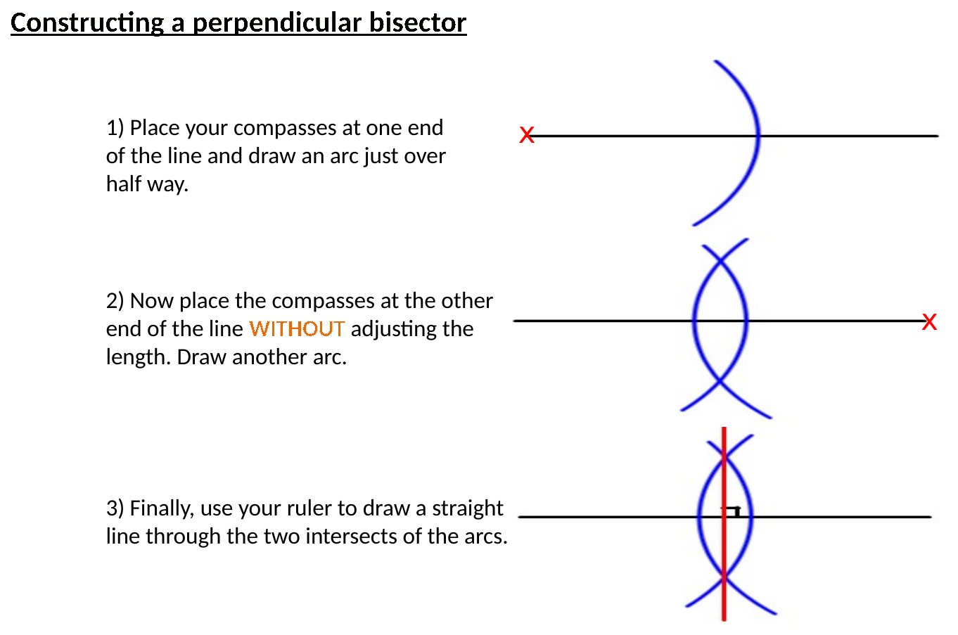
Zπ
PERPENDICULAR BISECTOR
How to Construct It
Compasses more than half the line. Draw arcs from EACH end, then join where they cross — above and below.

Slide 15
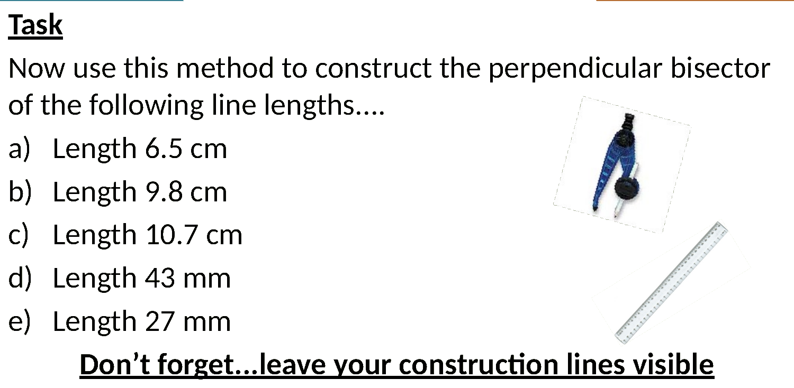
Zπ
PERPENDICULAR BISECTOR
The Finished Construction
Every point on this line is EQUIDISTANT from the two ends — that is what a perpendicular bisector is.

Slide 16
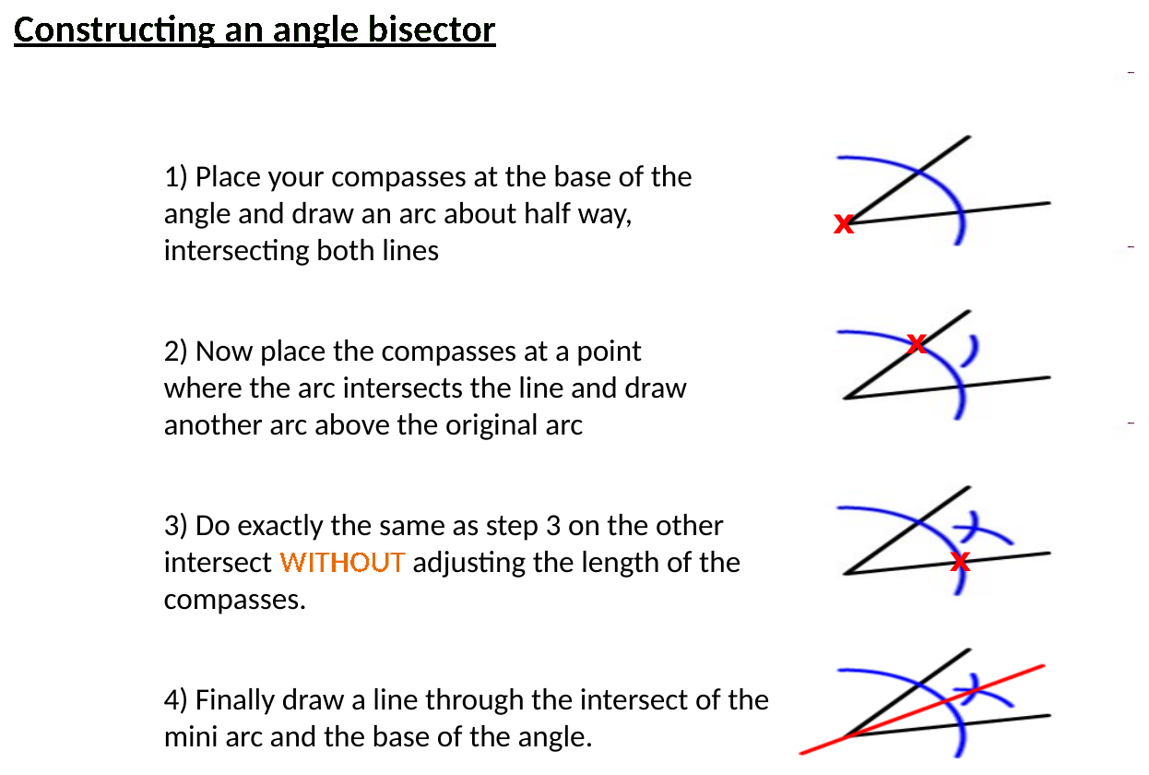
Zπ
ANGLE BISECTOR
How to Construct It
Arc from the corner to cross both arms, then arcs from those two points. Join the corner to where they cross.

Slide 17
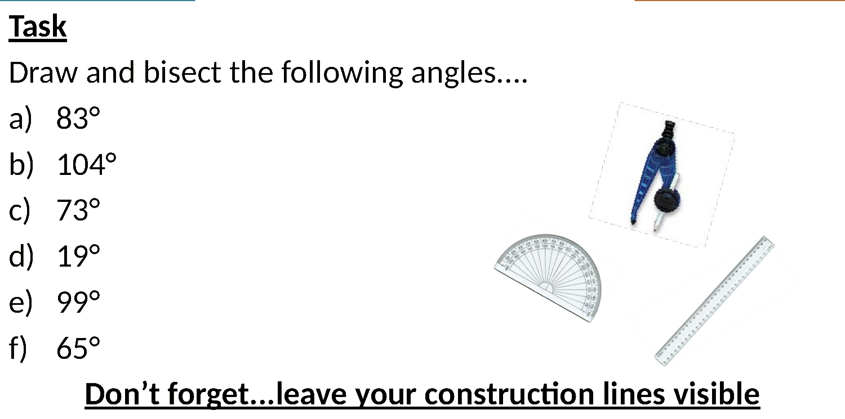
Zπ
ANGLE BISECTOR
The Finished Construction
Every point on this line is EQUIDISTANT from the two arms of the angle.

Slide 18
Zπ
PART 3
Perpendiculars to a Line
The shortest distance from a point to a line is the PERPENDICULAR distance.
1
Shortest distance = perpendicular distance
2
From a point to a line: drop a perpendicular
3
At a point on a line: raise a perpendicular
4
Same arc method as a bisector

Slide 19
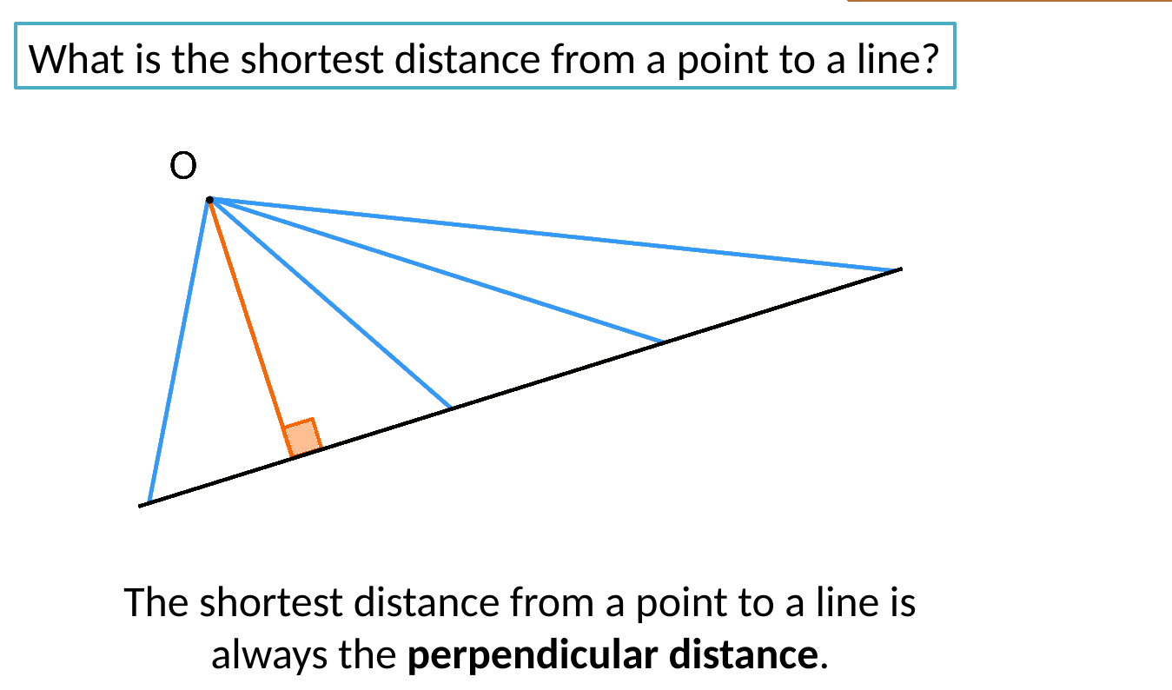
Zπ
PERPENDICULARS
The Shortest Distance from a Point to a Line
The shortest route from a point to a line is always the PERPENDICULAR — straight down at 90°.

Slide 20
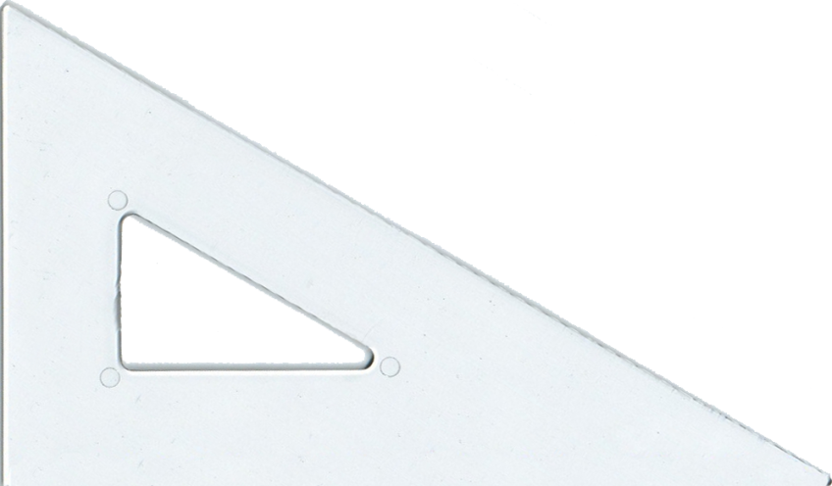
Zπ
PERPENDICULARS
Perpendicular from a Point to a Line
Draw a straight line using a ruler.
Place the set square on the ruler and use the right angle to draw a line perpendicular to this line.
Arcs from the point cross the line twice; then bisect that section to drop the perpendicular.

Slide 21
Zπ
PERPENDICULARS
Draw Parallel Lines
Place the set square on the ruler and use it to draw a straight line perpendicular to the ruler’s edge.
Slide the set square along the ruler to draw a line parallel to the first.
Arcs from the point cross the line twice; then bisect that section to drop the perpendicular.

Slide 22
Zπ
PART 4
Special Angles & Shapes
Using only compasses, you can build exact angles and shapes.
1
Regular hexagon — 6 arcs round a circle
2
60° — the equilateral-triangle angle
3
30° and 45° — by bisecting
4
Dividing a line into equal parts

Slide 23
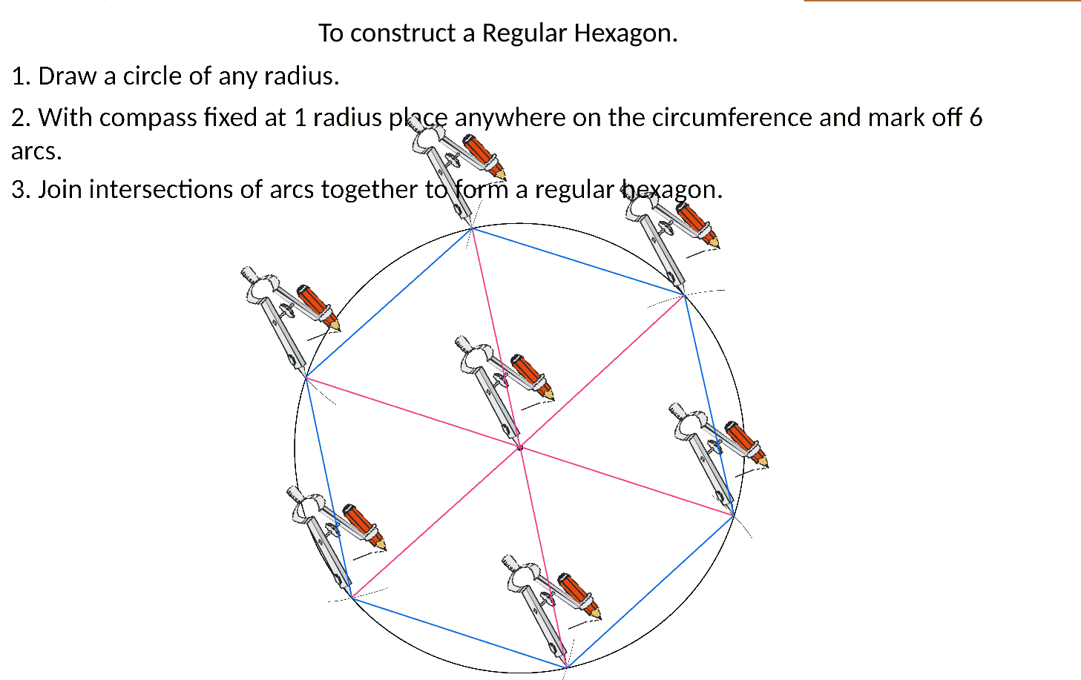
Zπ
CONSTRUCTION
A Regular Hexagon
The radius steps exactly 6 times around a circle. Mark 6 arcs, then join them.

Slide 24
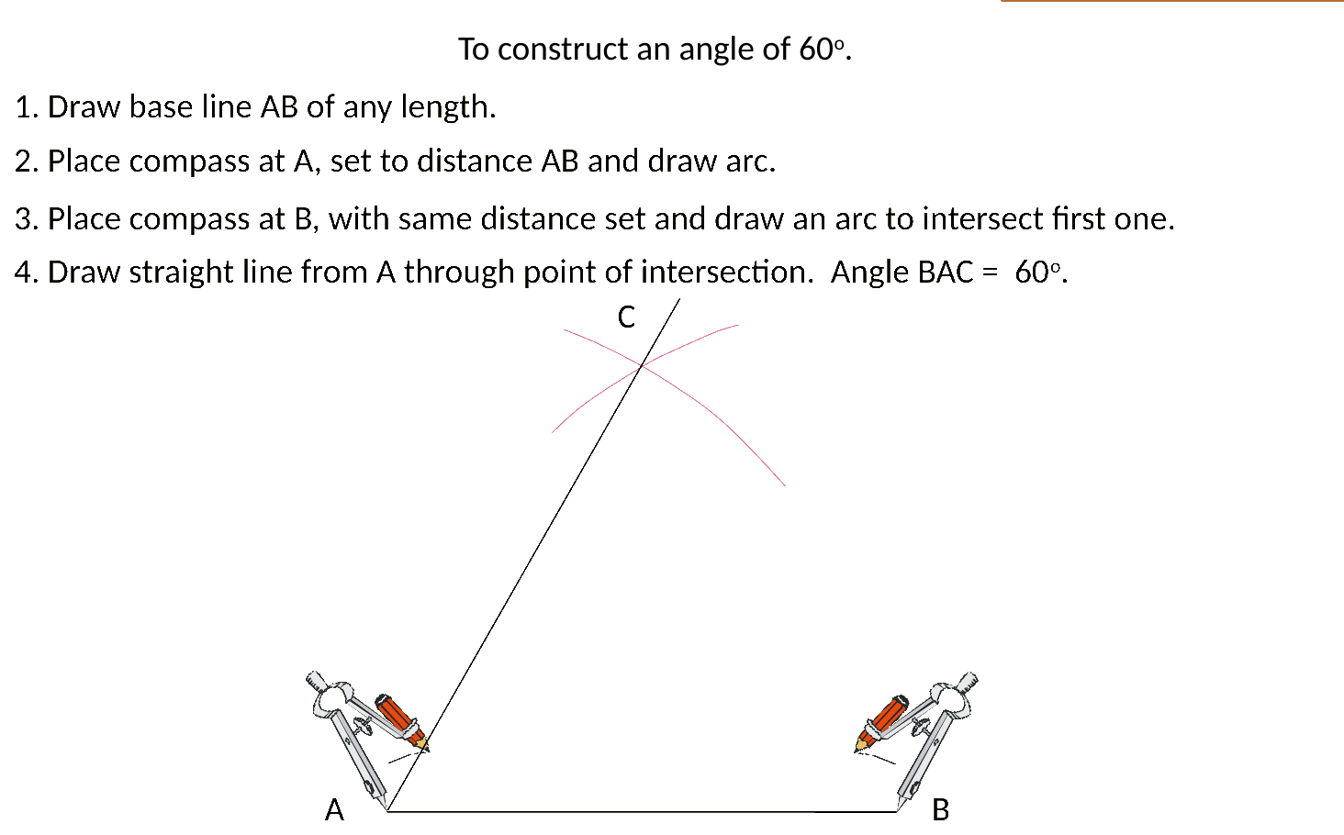
Zπ
CONSTRUCTING ANGLES
An Angle of 60° — the equilateral-triangle angle
Equal arcs from both ends of the base make an equilateral triangle — so the angle is exactly 60°.

Slide 25
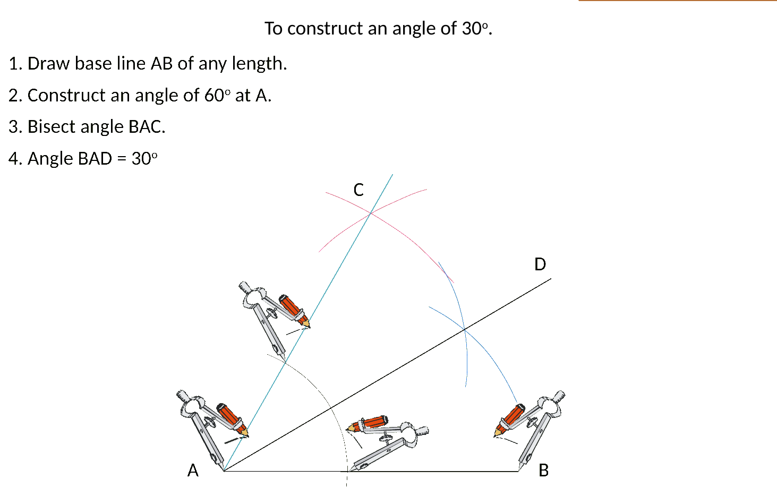
Zπ
CONSTRUCTING ANGLES
An Angle of 30°
Construct 60° first, then BISECT it — half of 60° is 30°.

Slide 26
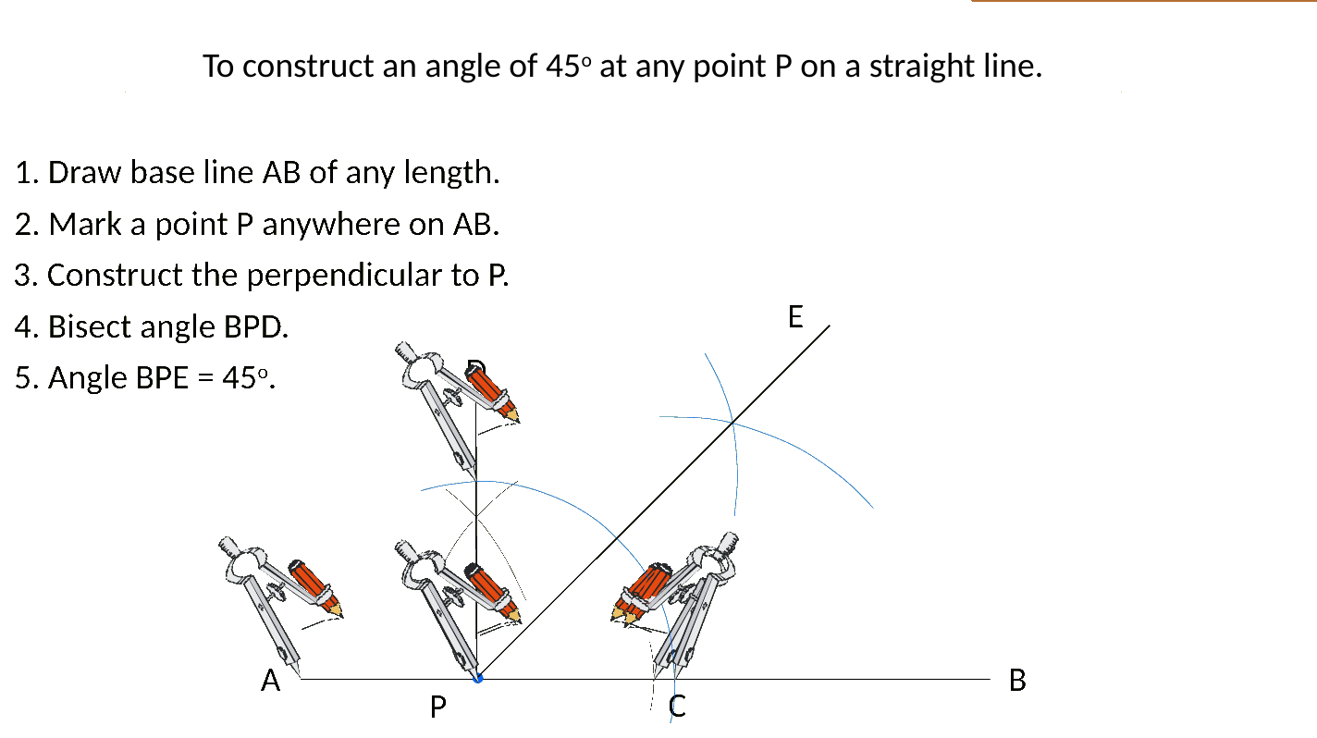
Zπ
CONSTRUCTING ANGLES
An Angle of 45°
Construct a perpendicular (90°) at the point, then bisect it — half of 90° is 45°.

Slide 27
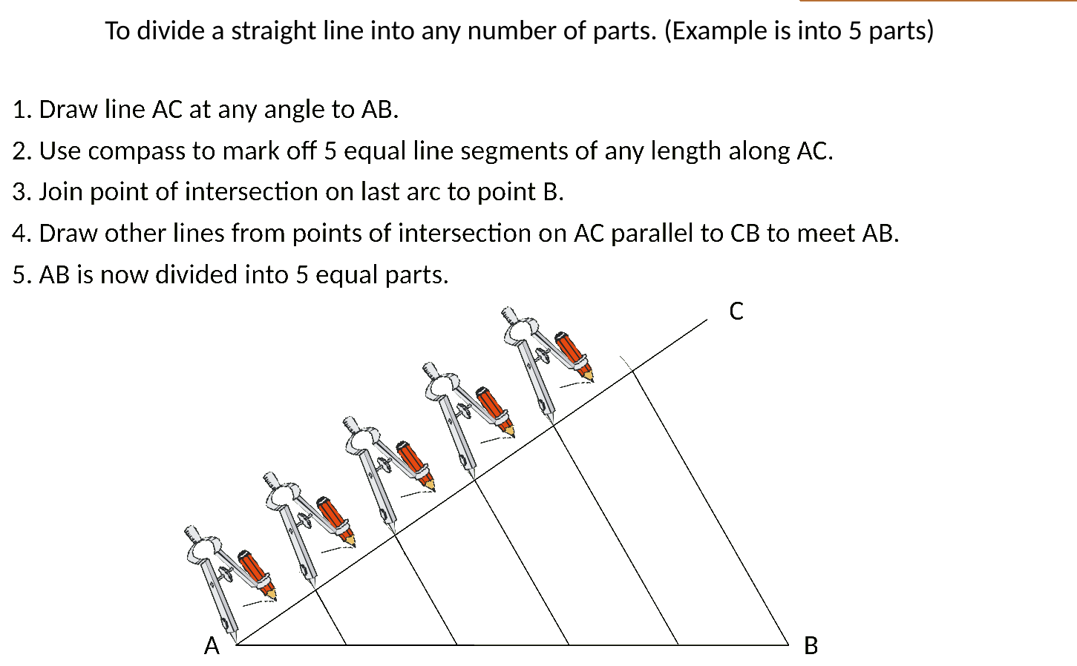
Zπ
CONSTRUCTION
Dividing a Line into Equal Parts
Draw a second line at an angle, step off equal lengths, then draw parallels back to the original line.

Slide 28
Zπ
RECAP
Key Takeaways
Constructions are ACCURATE drawings with a ruler and compasses — keep your arcs.
Triangle can be made only if the two shorter sides add to MORE than the longest.
Perpendicular bisector: arcs from each end — every point is equidistant from the two ends.
Angle bisector: arc across both arms, then arcs from those — splits the angle in half.
60° from an equilateral triangle; bisect for 30°; perpendicular then bisect for 45°.
Golden rule: never rub out your construction arcs — they show the method and carry the marks.

