Slide 1
Zπ
Zπ MATHS HUB
Pearson Edexcel IGCSE (9–1) · Higher Tier
Area & Perimeter
Perimeter · Rectangles · Triangles · Parallelograms · Trapezia · Circles · Compound Shapes
Zahra Sheikh Ali
IGCSE Mathematics Teacher · M.Sc. Differential Geometry & Geometric Control
☎ 66613748 ✉ zahraa.sheikhali@outlook.com

Slide 2
Zπ
LESSON OVERVIEW
Area vs Perimeter
PERIMETER is the distance AROUND a shape (add up the sides). AREA is the space INSIDE it. Perimeter is a length (cm); area is square units (cm²).
Perimeter of any shape
Rectangles & triangles
Parallelograms & trapezia
1
2
3
Circles: circumference & area
Compound shapes
Past-paper questions
4
5
6
Key words: perimeter · area · base · height · π · radius · diameter · compound shape · units²

Slide 3
Zπ
THE KEY IDEA
Area Formulas at a Glance
Learn these five — every compound shape is built from them.
Shape
Area formula
Rectangle
base × height
Triangle
½ × base × height
Parallelogram
base × height
Trapezium
½ (a + b) × height
Kite
½ × diagonal₁ × diagonal₂
Circle
π × radius²
Perimeter is always just the total distance round the edge — add every side.

Slide 4
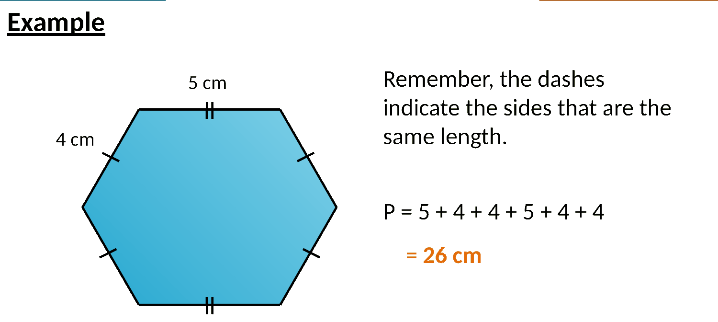
Zπ
PERIMETER
The Distance Around a Shape
Add up every side. Dashes mean sides are equal — use that to find missing lengths.

Slide 5
Zπ
RECTANGLES
Area = base × height
9cm
4cm
36cm²
Area = base × height. Perimeter = 2 × (base + height).

Slide 6
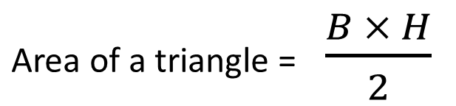
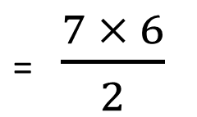
Zπ
TRIANGLES
Area = ½ × base × height
What is the area of this triangle?
6 cm
7 cm
= 21 cm²
Use the PERPENDICULAR height, not the slant side — the height must be at 90° to the base.

Slide 7
Zπ
PARALLELOGRAMS
Area = base × height
We can ignore this length
4.9 cm
4.5 cm
7 cm
Area of a parallelogram = b × h
= 7 × 4.5
= 31.5 cm²
Same as a rectangle: base × perpendicular height. Ignore the slant length.

Slide 8
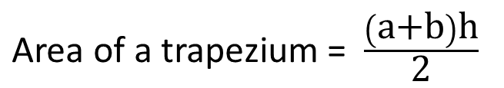
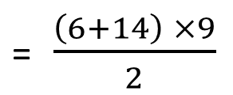
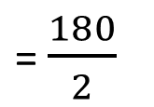
Zπ
TRAPEZIA
Area = ½ (a + b) × height
Find the area of this trapezium
6 m
9 m
14 m
= 90 m²
Average the two parallel sides, then multiply by the height between them.

Slide 9
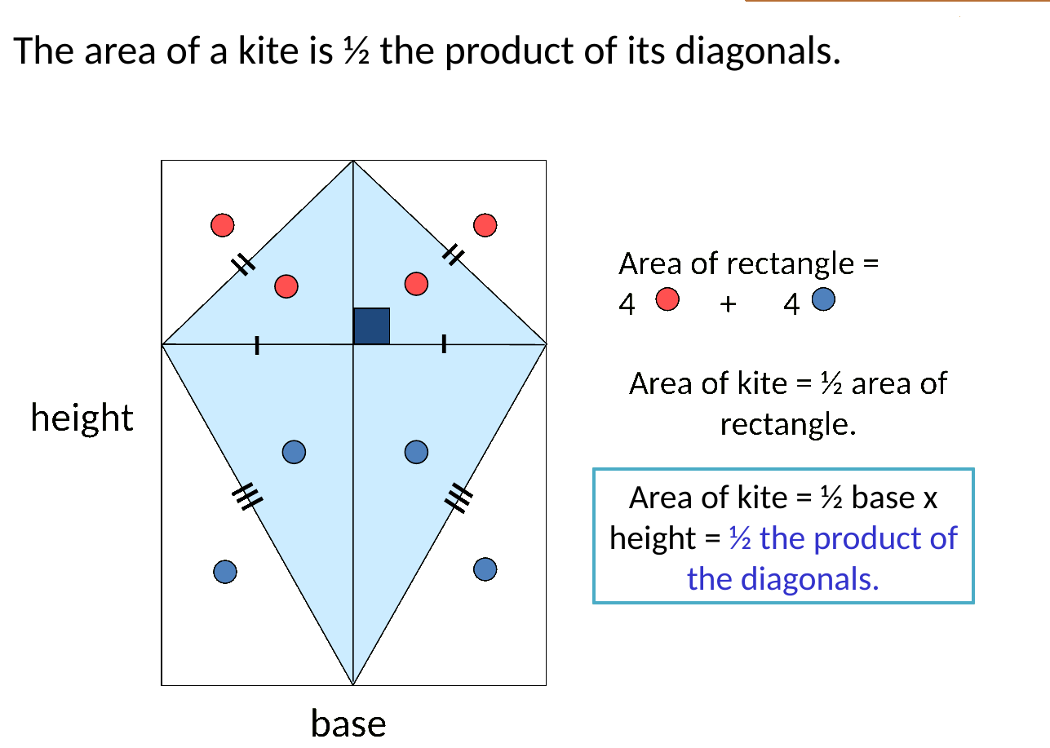
Zπ
KITES
Area = ½ × diagonal₁ × diagonal₂
A kite is half of the rectangle around it — multiply the two diagonals and halve.

Slide 10
Zπ
CIRCLES
Circumference & Area
Radius r is centre to edge; diameter d = 2r. Two formulas — do not mix them up.
CIRCUMFERENCE (perimeter)
AREA
C = π × d
or C = 2 × π × r
“Cherry Pie’s Delicious” → C = πd
A = π × r²
Square the radius FIRST, then × π.
“Apple Pies are Too” → A = πr²
If given the diameter, halve it to get r before using A = πr².

Slide 11
Zπ
CIRCLES
Circumference & Area
Radius r is centre to edge; diameter d = 2r. Two formulas — do not mix them up.
Task – Find the circumference of these circles WITHOUT a calculator
Task – Find the AREA of these circles using a calculator. Give your answers to 2 d.p
C = πd
1)
4 cm
16 cm
= 3.14 × 4
201.09 cm²
= 12.56 cm
C = 2πr
2)
9 m
132.75 cm²
= 2 × 3.14 × 9
13 cm
= 56.52 m

Slide 12
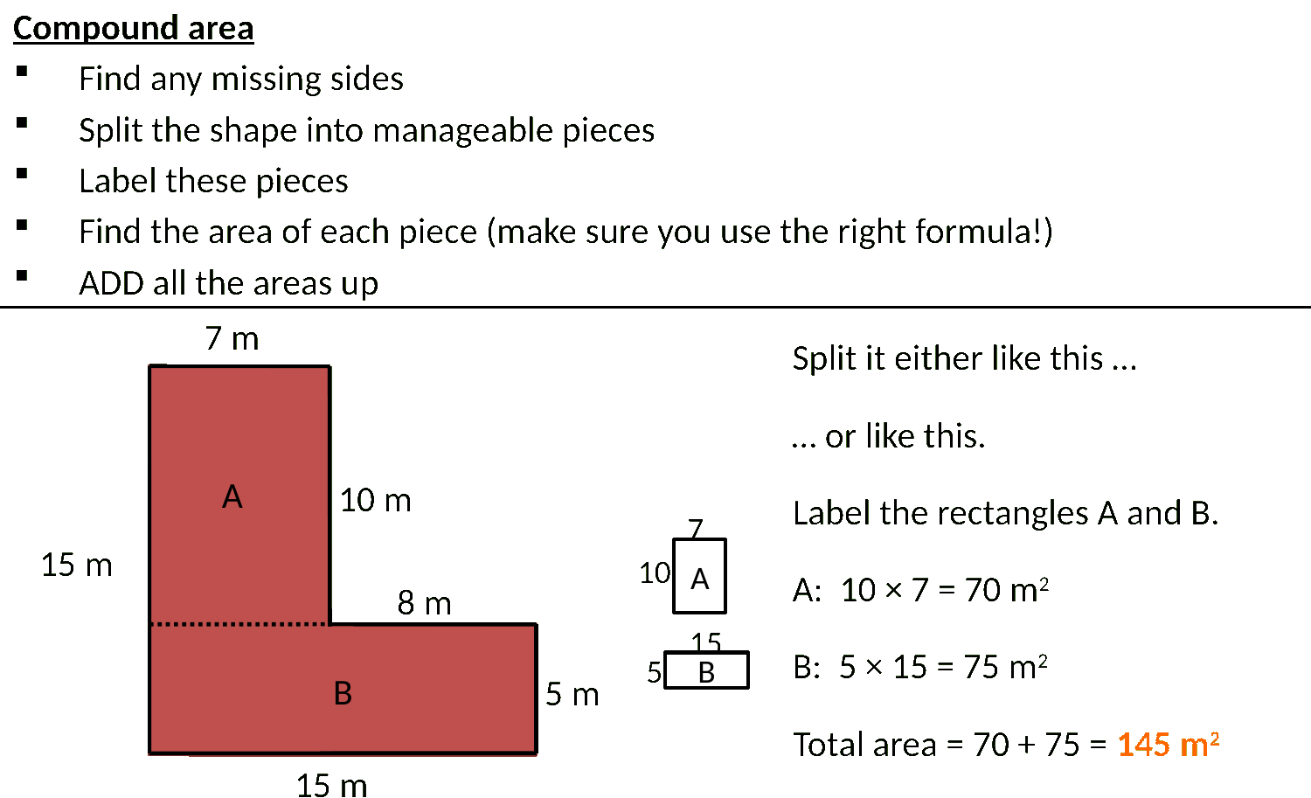
Zπ
COMPOUND SHAPES
Split Into Simple Shapes
Break the shape into rectangles, triangles and parts of circles, work out each area, then add (or subtract).

Slide 13
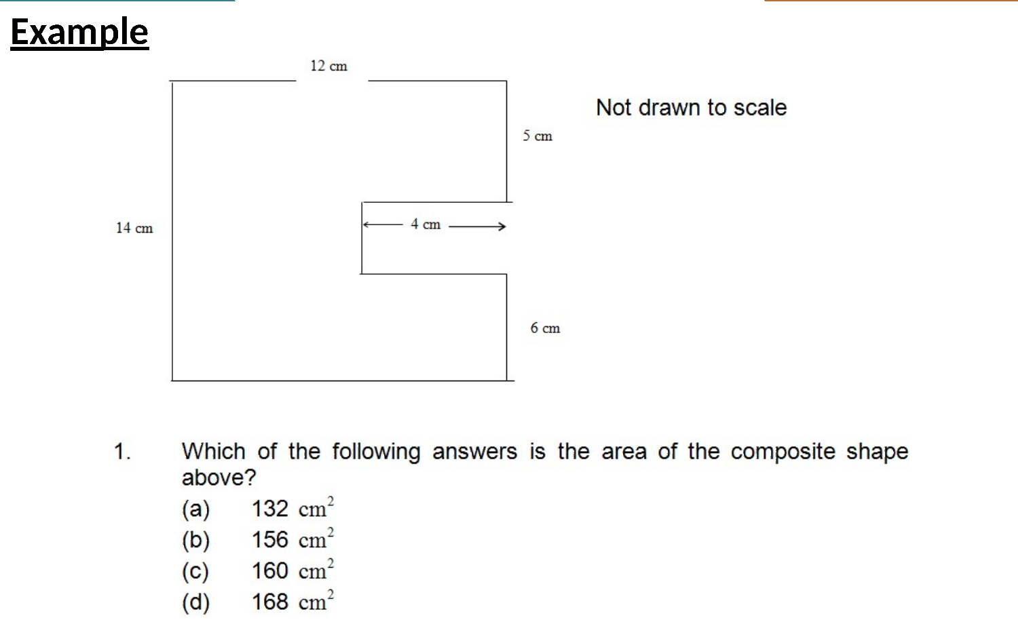
Zπ
COMPOUND SHAPES
Worked Example
Find each piece separately, then combine. Watch the units — area is always squared.

Slide 14
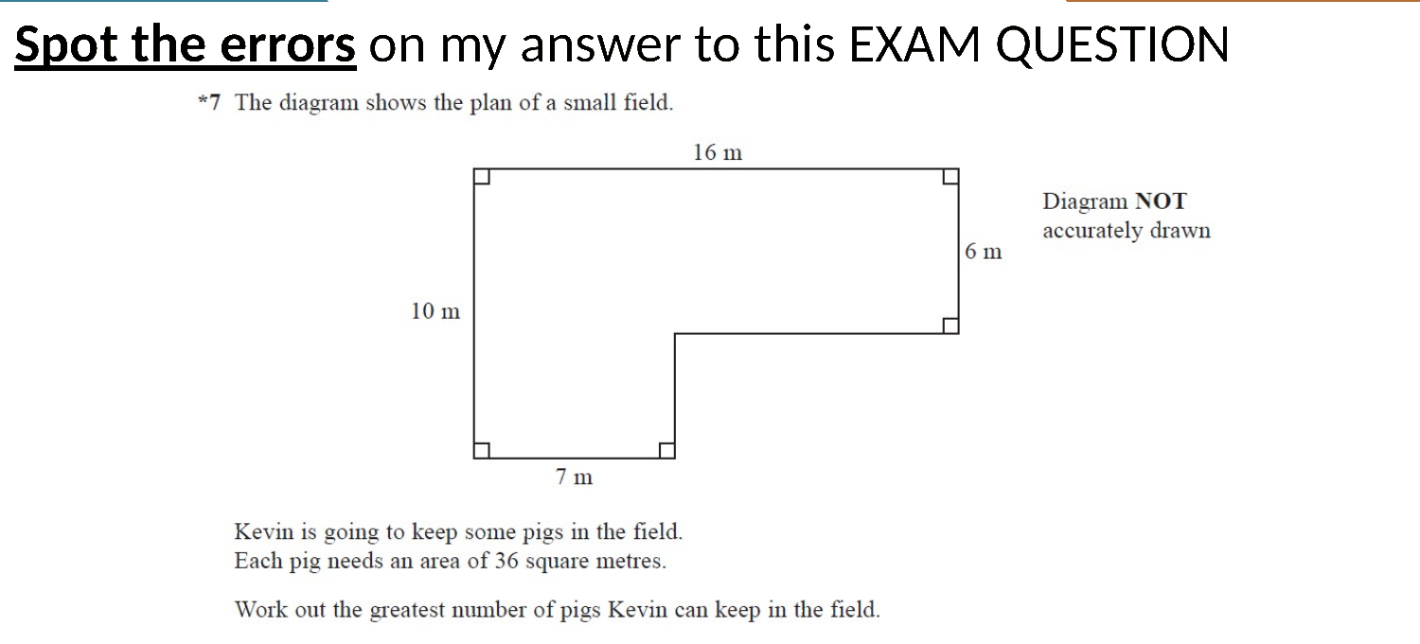
Zπ
COMPOUND SHAPES
Spot the Errors
Common slips: using slant height, forgetting to halve, or mixing up area and perimeter.

Slide 15
Zπ
COMPOUND SHAPES
The Method
Never try to do it in one go. Split, solve, combine.
SPLIT the shape into simple parts (rectangle, triangle, semicircle).
1
Work out any MISSING lengths from the ones you are given.
2
Find the area of EACH part separately.
3
ADD the parts — or SUBTRACT if a piece is cut out.
4
For the PERIMETER of a compound shape, add only the OUTSIDE edges — not the split lines.

Slide 16
Zπ
PART 2
Past-Paper Questions
Split compound shapes, use the right formula, watch the units.
1
Which simple shapes make it up?
2
Find missing lengths first
3
Add or subtract the areas
4
Area in units², perimeter in units

Slide 17
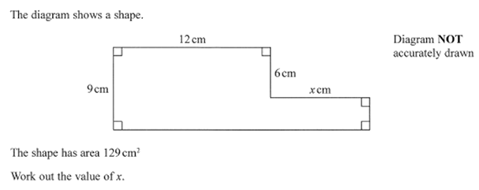
Zπ
PAST-PAPER QUESTION
Question 1

Slide 18
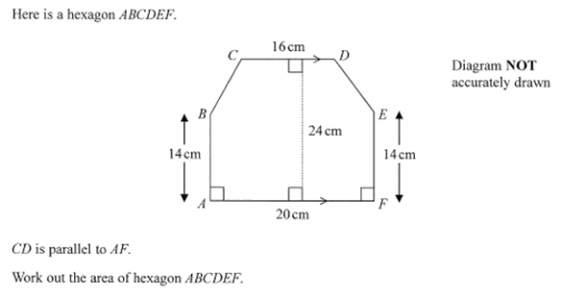
Zπ
PAST-PAPER QUESTION
Question 2

Slide 19
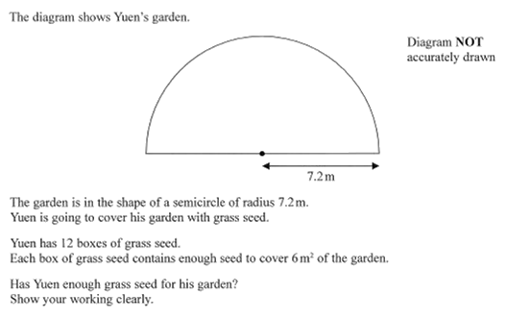
Zπ
PAST-PAPER QUESTION
Question 3

Slide 20
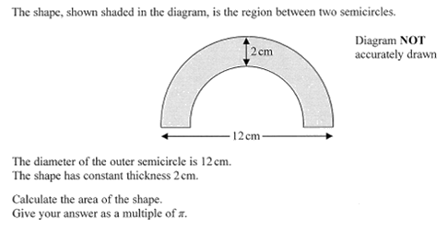
Zπ
PAST-PAPER QUESTION
Question 4

Slide 21
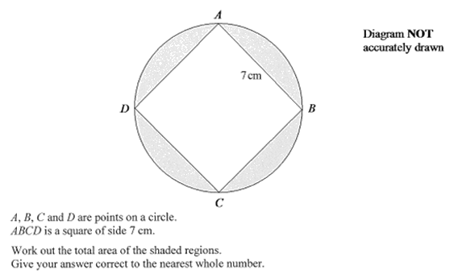
Zπ
PAST-PAPER QUESTION
Question 5

Slide 22
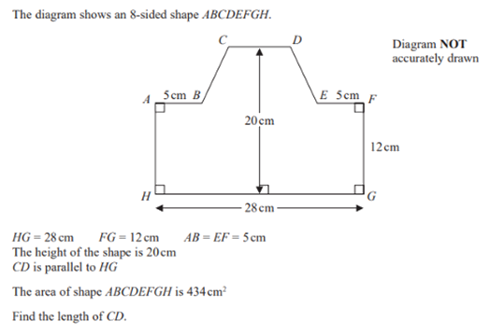
Zπ
PAST-PAPER QUESTION
Question 6

Slide 23
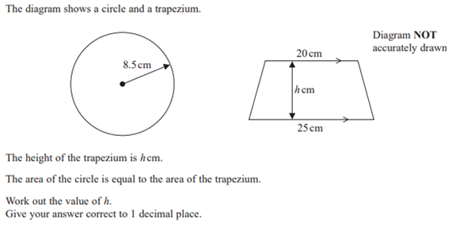
Zπ
PAST-PAPER QUESTION
Question 7

Slide 24
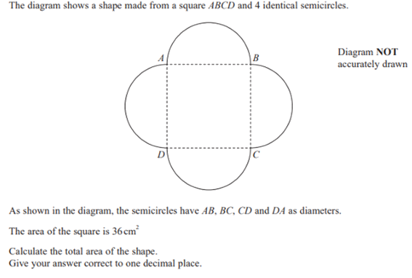
Zπ
PAST-PAPER QUESTION
Question 8

Slide 25
Zπ
RECAP
Key Takeaways
Perimeter = distance around (a length); Area = space inside (square units).
Rectangle & parallelogram: base × height. Triangle: ½ base × height.
Trapezium: ½(a + b) × height. Kite: ½ × diagonal₁ × diagonal₂.
Circle: circumference C = πd, area A = πr² (square the radius first).
Compound shapes: split into simple parts, then add or subtract.
Golden rule: always use the PERPENDICULAR height, and keep area in square units.

