Slide 1
Zπ
Zπ MATHS HUB
Pearson Edexcel IGCSE (9–1) · Higher Tier
r
θ
r
O
Sectors of a Circle
Arc Length · Sector Area · Sector Perimeter · Finding the Radius or Angle
Zahra Sheikh Ali
IGCSE Mathematics Teacher · M.Sc. Differential Geometry & Geometric Control
☎ 66613748 ✉ zahraa.sheikhali@outlook.com

Slide 2
Zπ
LESSON OVERVIEW
Four Things to Do with a Sector
A SECTOR is a ‘slice’ of a circle — two radii and the arc between them. Everything comes from one idea: a sector is a FRACTION (θ/360) of the whole circle.
Arc length
Area of a sector
Perimeter of a sector
1
2
3
Finding the radius
Finding the angle
Past-paper questions
4
5
6
Key words: sector · arc · radius · angle θ · fraction of the circle · π

Slide 3
Zπ
THE KEY IDEA
A Sector Is a Fraction of the Circle
The angle θ out of 360° tells you the fraction. Multiply the WHOLE-circle formula by θ/360.
Fraction of circle =
θ
360
r
θ
r
Arc length = θ/360 × πd
O
Sector area = θ/360 × πr²
Whole circle: circumference = πd, area = πr². A sector is just θ/360 of each.

Slide 4
Zπ
IDEA 1 · ARC LENGTH
The Curved Edge
The arc is the curved part. It is θ/360 of the whole circumference.
Formula
Arc length =
θ
× πd
r
360
θ
r
Example: θ = 90°, r = 8 cm
= 90/360 × π × 16
= ¼ × 50.27 = 12.6 cm
O
Arc length = θ/360 × πd (use d = 2r).

Slide 5
Zπ
IDEA 2 · AREA OF A SECTOR
The Space Inside the Slice
The sector area is θ/360 of the whole circle’s area. Square the radius.
Formula
Area =
θ
× πr²
r
360
θ
r
Example: θ = 90°, r = 8 cm
= 90/360 × π × 8²
= ¼ × 201.06 = 50.3 cm²
O
Sector area = θ/360 × πr² (square r first).

Slide 6
Zπ
IDEA 3 · PERIMETER OF A SECTOR
Arc + Two Radii
A very common mistake: forgetting the two straight edges. The perimeter goes all the way round.
Formula
Perimeter =
r
arc length + r + r
θ
r
Example: arc 12.6, r = 8
P = 12.6 + 8 + 8
= 28.6 cm
O
(add the two radii)
Perimeter = arc length + 2r. Never forget the two radii!

Slide 7
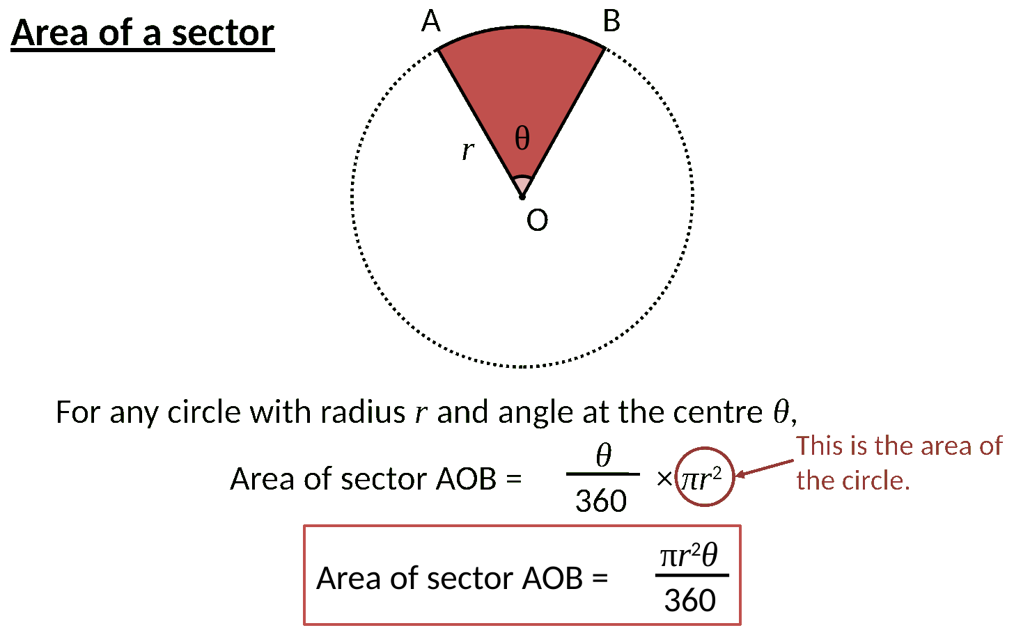
Zπ
FROM THE LESSON
Area of a Sector — the Formula
Area of sector AOB = θ/360 × πr². θ is the angle at the centre.

Slide 8
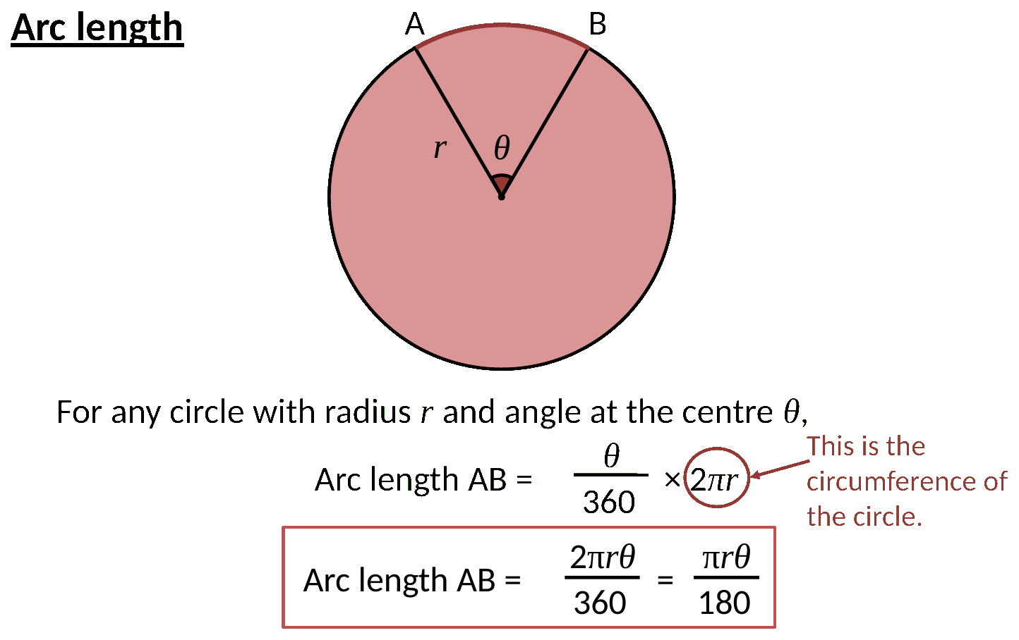
Zπ
FROM THE LESSON
Arc Length — the Formula
Arc length AB = θ/360 × πd. It is a fraction of the circumference.

Slide 9
Zπ
IDEA 4 · WORKING BACKWARDS
Given the Arc/Area, Find r or θ
Put the numbers you know into the formula, then REARRANGE to find the missing radius or angle.
Find the RADIUS (area given)
Find the ANGLE (arc given)
Area 40 cm², angle 90°:
40 = 90/360 × π × r²
40 = 0.25 × π × r²
r² = 40 ÷ 0.7854 = 50.9
r = √50.9 = 7.14 cm
Arc 11 cm, radius 7 cm:
11 = θ/360 × π × 14
11 = θ/360 × 43.98
θ/360 = 11 ÷ 43.98 = 0.25
θ = 0.25 × 360 = 90°
Substitute what you know, then rearrange for r (take the square root) or θ.

Slide 10
Zπ
SUMMARY
The Four Sector Formulas
Everything is θ/360 of the whole circle.
What you want
Formula
Arc length
θ/360 × πd
Area of sector
θ/360 × πr²
Perimeter of sector
arc length + 2r
Find radius / angle
substitute, then rearrange
Always check whether the question wants the ARC only, or the whole PERIMETER (arc + 2r).

Slide 11
Zπ
PART 2
Past-Paper Questions
Decide which of the four you need, then substitute θ/360.
1
Arc, area, or perimeter?
2
Perimeter = arc + 2r
3
Given arc/area → rearrange for r or θ
4
Round as asked

Slide 12
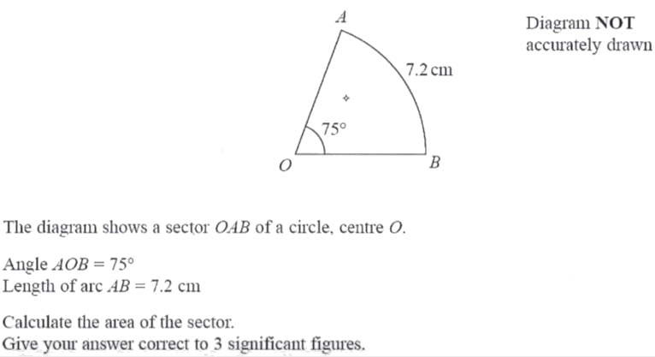
Zπ
PAST-PAPER QUESTION
Question 1

Slide 13
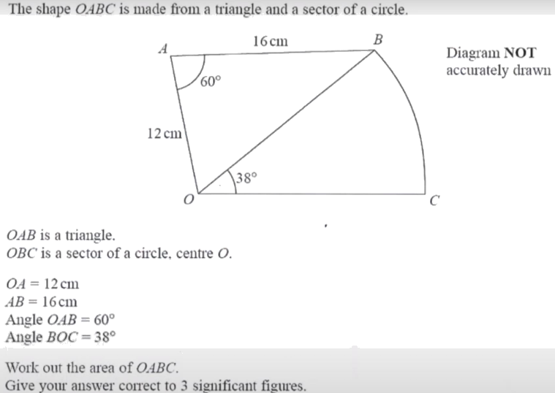
Zπ
PAST-PAPER QUESTION
Question 2

Slide 14
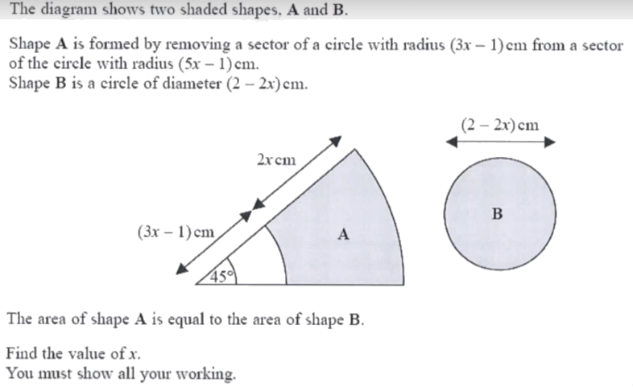
Zπ
PAST-PAPER QUESTION
Question 3

Slide 15
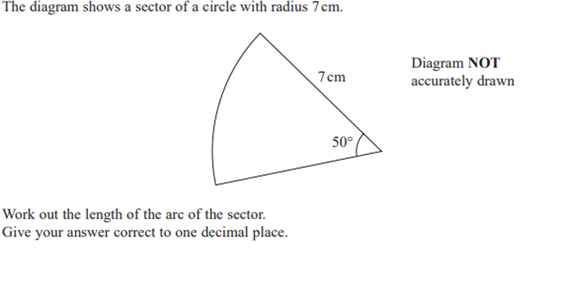
Zπ
PAST-PAPER QUESTION
Question 4

Slide 16
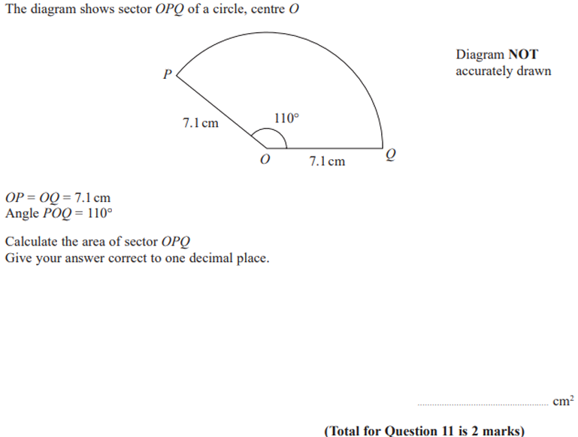
Zπ
PAST-PAPER QUESTION
Question 5

Slide 17
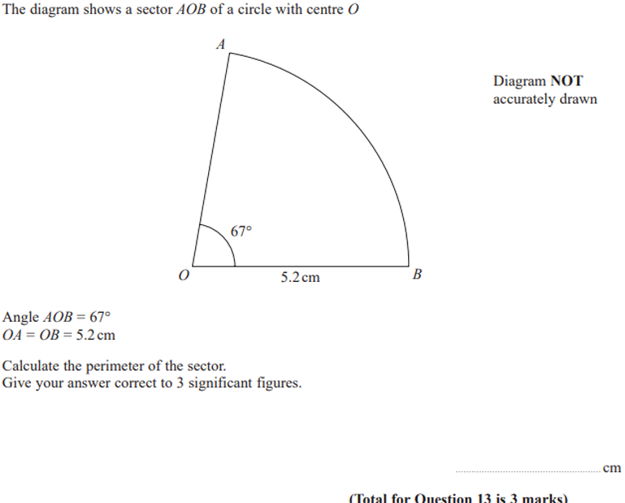
Zπ
PAST-PAPER QUESTION
Question 6

Slide 18
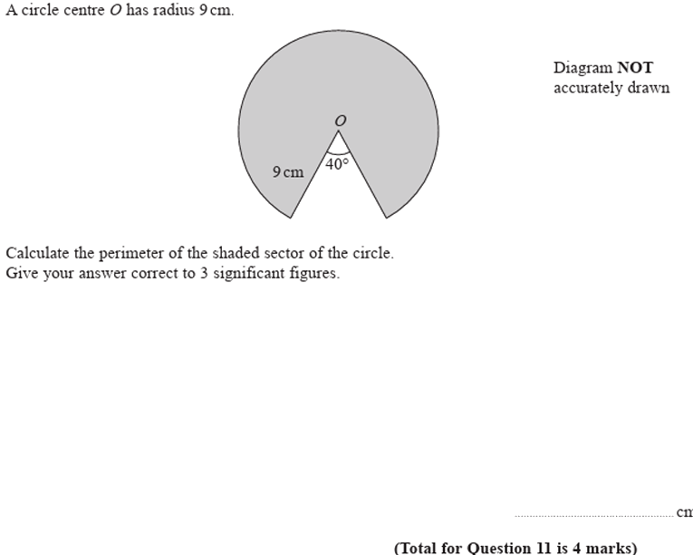
Zπ
PAST-PAPER QUESTION
Question 7

Slide 19
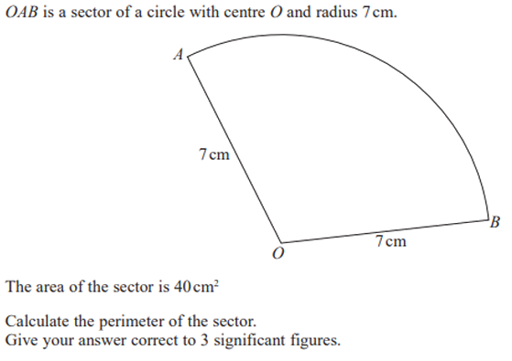
Zπ
PAST-PAPER QUESTION
Question 8

Slide 20
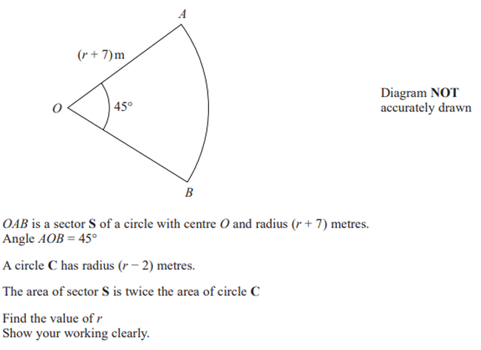
Zπ
PAST-PAPER QUESTION
Question 9

Slide 21
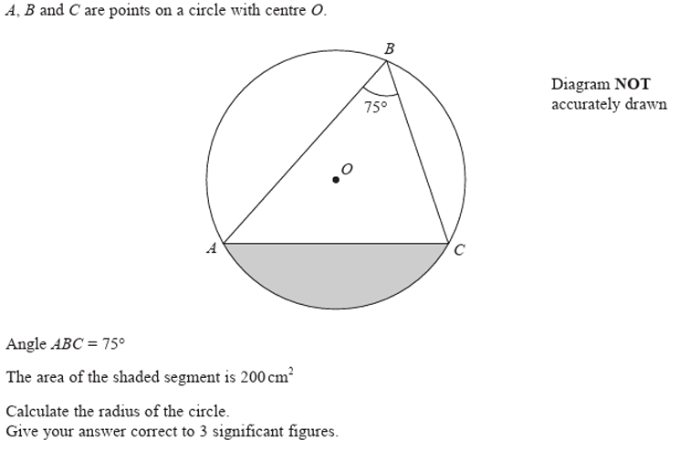
Zπ
PAST-PAPER QUESTION
Question 10

Slide 22
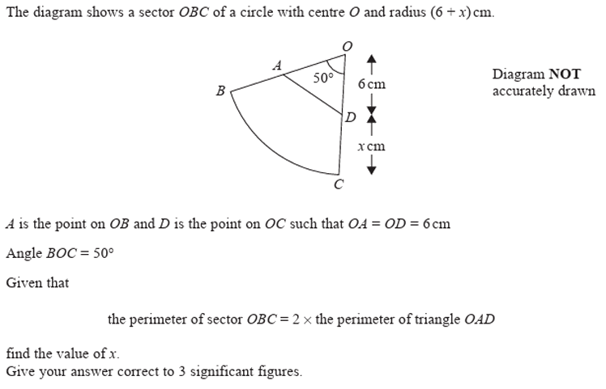
Zπ
PAST-PAPER QUESTION
Question 11

Slide 23
Zπ
RECAP
Key Takeaways
A sector is a fraction θ/360 of the whole circle — that one idea gives every formula.
Arc length = θ/360 × πd (the curved edge).
Area of a sector = θ/360 × πr² (square the radius first).
Perimeter of a sector = arc length + 2r — never forget the two radii.
Given the arc or area, substitute and rearrange to find the radius (√) or the angle.
Golden rule: work out the fraction θ/360 first — then it is just circumference or area.

