Slide 1
Zπ
Zπ MATHS HUB
Pearson Edexcel IGCSE (9–1) · Higher Tier
Volume & Surface Area
Cuboids · Prisms · Cross-sections · Surface Area from Nets · Compound Solids
Zahra Sheikh Ali
IGCSE Mathematics Teacher · M.Sc. Differential Geometry & Geometric Control
☎ 66613748 ✉ zahraa.sheikhali@outlook.com

Slide 2
Zπ
LESSON OVERVIEW
Solids: Space Inside, Surface Outside
VOLUME is the space inside a solid (cubic units, cm³). SURFACE AREA is the total area of all its faces (square units, cm²). Two different measures — keep them apart.
Volume of a cuboid
Volume of any prism
Surface area from a net
1
2
3
Surface area of a prism
Compound solids
Past-paper questions
4
5
6
Key words: volume · surface area · cuboid · prism · cross-section · net · face · cm³ vs cm²

Slide 3
Zπ
THE KEY IDEA
Any Prism: Area of Cross-section × Length
A prism has the SAME cross-section all the way through. Find that area, then multiply by the length.
L
Volume of a prism = area of cross-section × length
CSA
L
Cuboid (a rectangular prism)
Triangular / other prism
V = length × width × height
e.g. 13 × 8 × 5 = 520 cm³
V = (area of the triangle) × length
Work out the cross-section area first.
CSA
Volume is always in CUBIC units (cm³, m³) — three lengths multiplied.

Slide 4
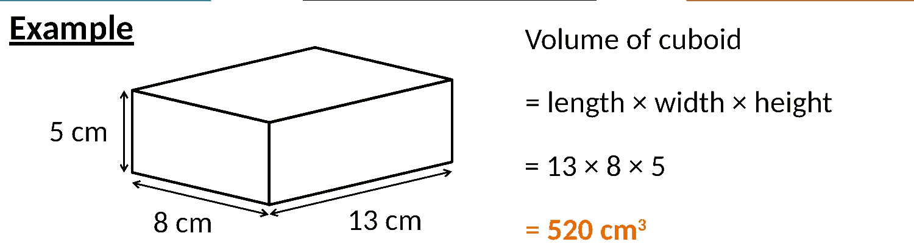
Zπ
VOLUME
Volume of a Cuboid
V = length × width × height. Multiply the three dimensions together.

Slide 5
Zπ
VOLUME
Volume of a Triangular Prism
7.2 cm
4 cm
5 cm
Area of cross-section = ½ × 5 × 4 =
10 cm²
Volume of prism = 10 × 7.2 =
72 cm³
V = (area of the triangle) × length, Work out the cross-section area first.

Slide 6
Zπ
COMPOUND SOLIDS
Split Into Simple Solids
3 cm
We can think of the shape as two cuboids joined together.
3 cm
4 cm
Volume of the green cuboid
= 6 × 3 × 3 = 54 cm³
6 cm
Volume of the blue cuboid
= 3 × 2 × 2 = 12 cm³
Total volume
5 cm
= 54 + 12 = 66 cm³
Break the solid into cuboids (or prisms), find each volume, then add — or subtract a piece that is cut out.

Slide 7
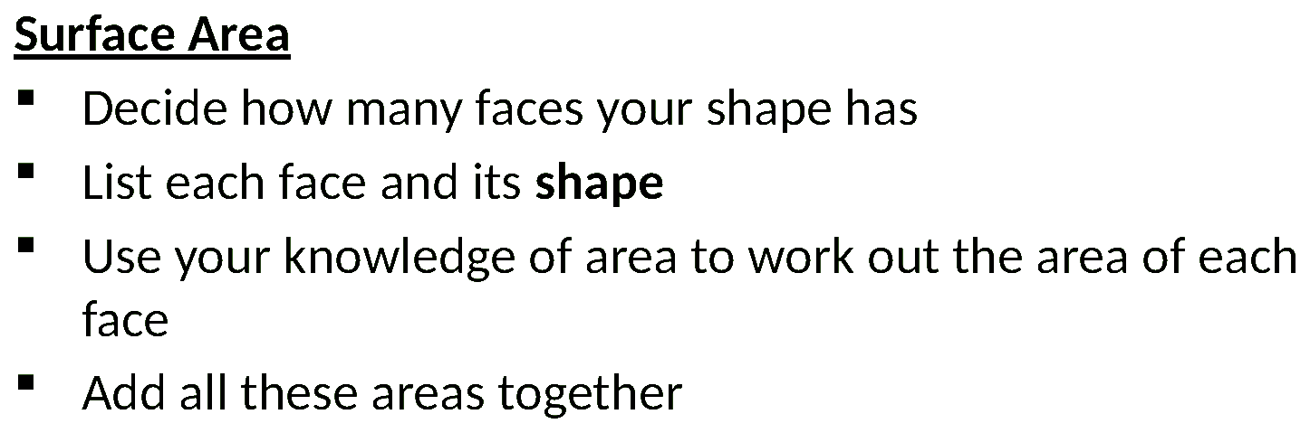
Zπ
SURFACE AREA
Count the Faces
Surface area = the total of ALL the faces. List each face, find its area, then add them up.

Slide 8
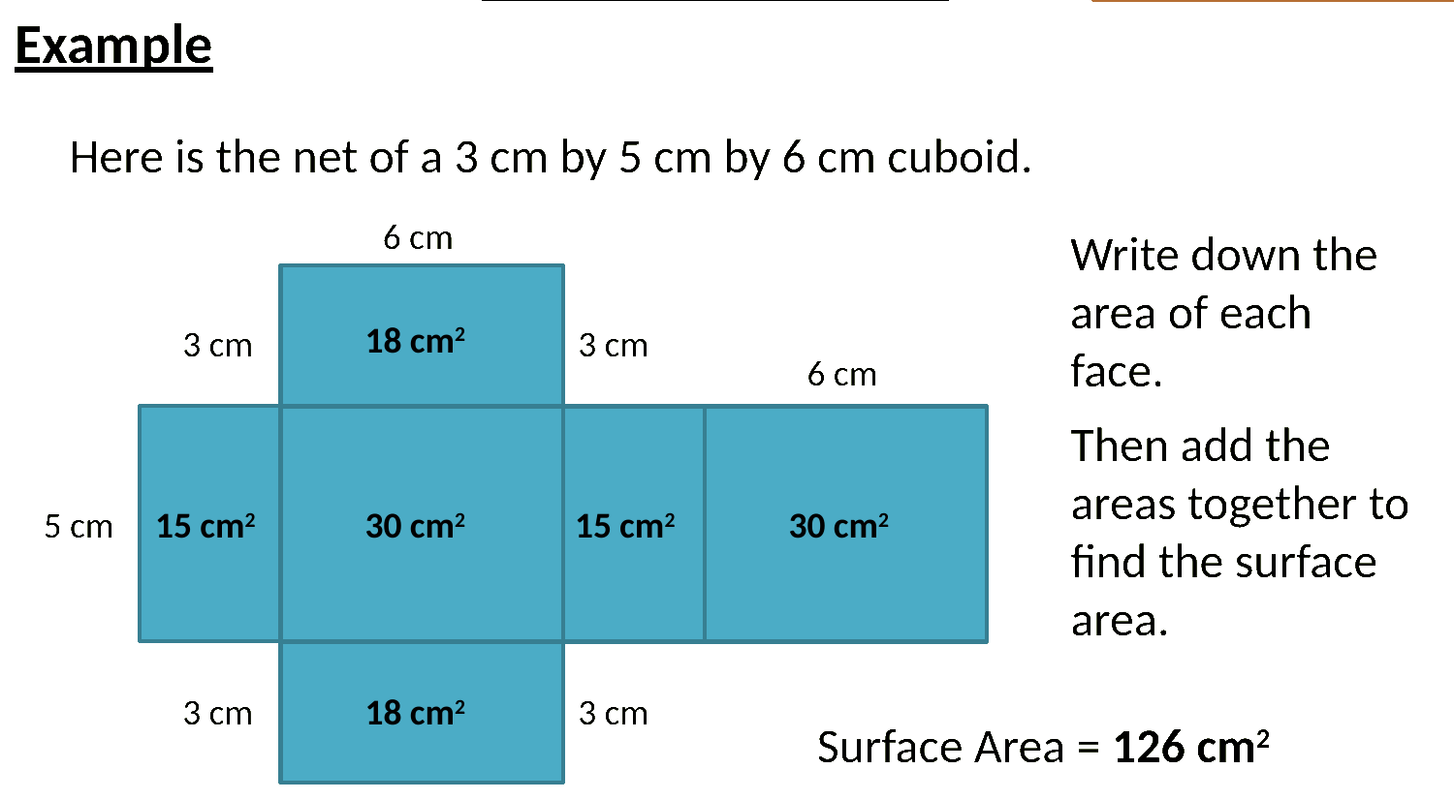
Zπ
SURFACE AREA
Using the Net of a Cuboid
Open the solid into a net. A cuboid has 3 pairs of equal rectangles — find each pair and add.

Slide 9
Zπ
SURFACE AREA
Surface Area of a Prism
3
(4 × 3) ÷ 2 = 6
4
3
(4 × 3) ÷ 2 = 6
4
5 cm
5 × 10 = 50
3 cm
5
10
10 cm
3 × 10 = 30
3
4 cm
10
+
4
4 × 10 = 40
10
132 cm²
Two identical end faces + the rectangles around the sides. Add every face.

Slide 10
Zπ
DON'T LOSE MARKS
Units & Common Mistakes
Two easy marks to protect on every question.
Volume uses CUBIC units
cm³, m³ — three lengths multiplied
Surface area uses SQUARE units
cm², m² — it is an area
Match the units first
don't mix cm and m — convert before calculating
Surface area = EVERY face
don't forget the hidden back and bottom faces
A prism must have a constant cross-section
a pyramid or cone does NOT — different formula
Read the question: does it want VOLUME (space inside) or SURFACE AREA (outside)?

Slide 11
Zπ
PART 2
Past-Paper Questions
Cuboids and prisms — decide volume or surface area, then work face by face.
1
Is it volume or surface area?
2
Prism → cross-section × length
3
Surface area → add every face
4
Cubic units for volume, square for area

Slide 12
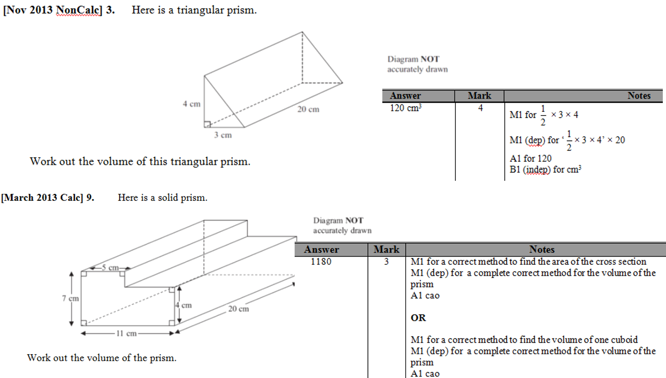
Zπ
PAST-PAPER QUESTION
Question 1

Slide 13
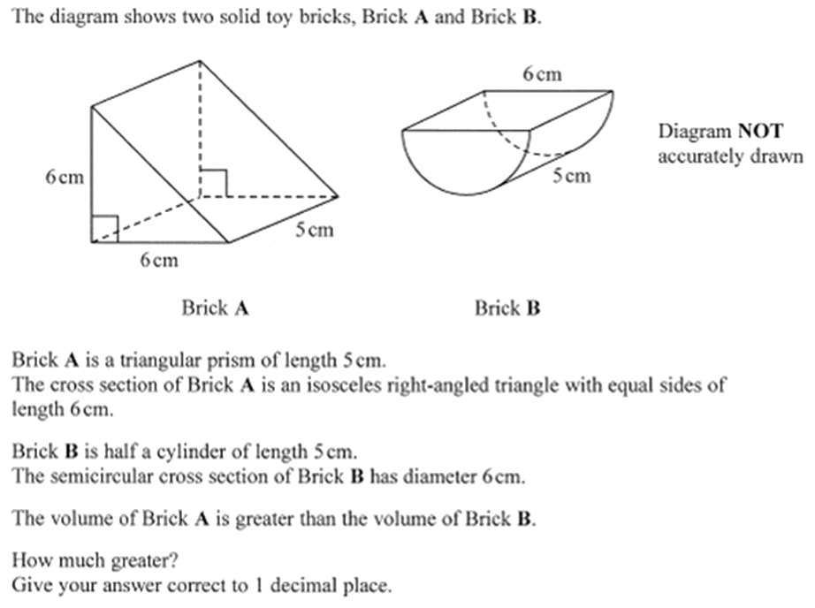
Zπ
PAST-PAPER QUESTION
Question 2

Slide 14
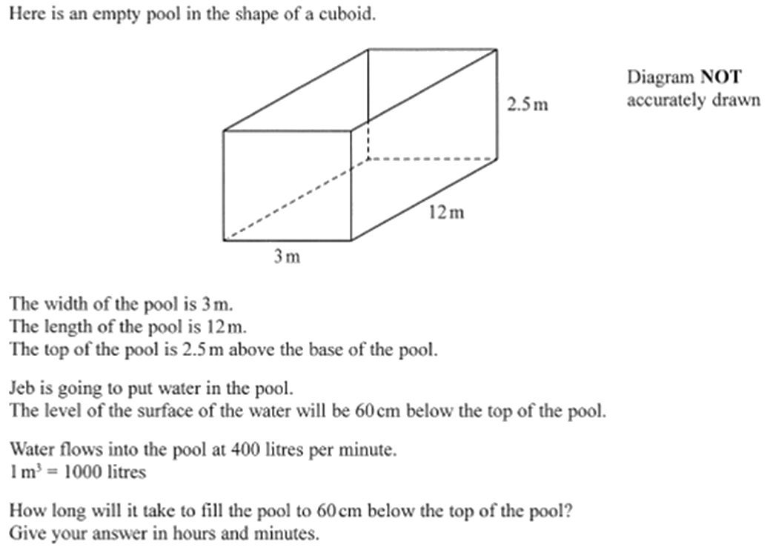
Zπ
PAST-PAPER QUESTION
Question 3

Slide 15
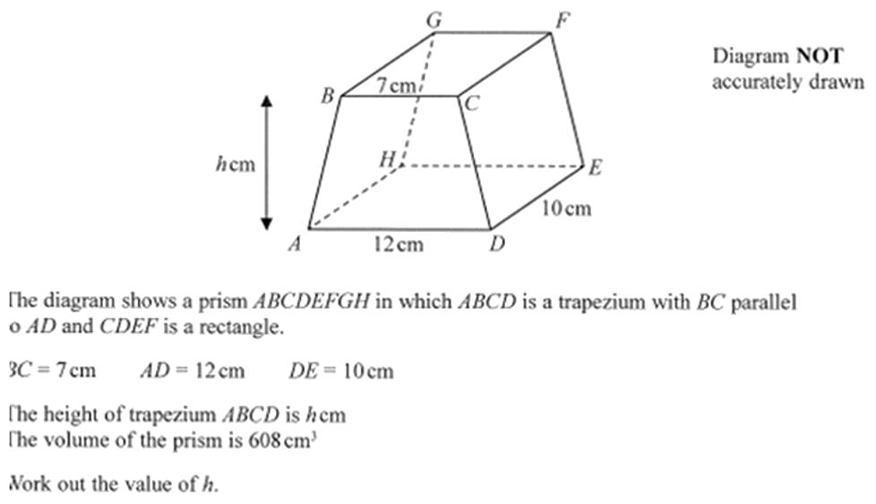
Zπ
PAST-PAPER QUESTION
Question 4

Slide 16
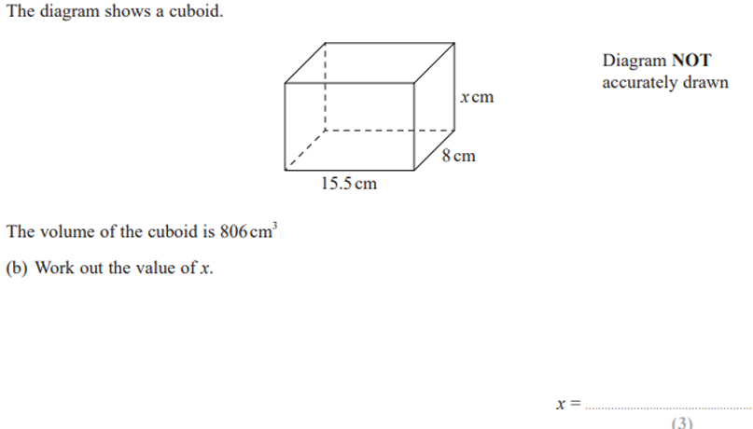
Zπ
PAST-PAPER QUESTION
Question 5

Slide 17
Zπ
RECAP
Key Takeaways
Volume of a prism = area of cross-section × length.
Cuboid: V = length × width × height (cubic units).
Surface area = the total area of every face — use a net so you miss none.
Compound solids: split into simple parts, then add or subtract.
Volume is cm³; surface area is cm² — never mix them, and match units first.
Golden rule: prism volume is always cross-section × length; surface area is every face added up.

