Slide 1
Zπ
Zπ MATHS HUB
Pearson Edexcel IGCSE (9–1) · Higher Tier
Sphere, Cylinder & Cone
Volume & Surface Area of Curved Solids · Hemispheres · Slant Height
Zahra Sheikh Ali
IGCSE Mathematics Teacher · M.Sc. Differential Geometry & Geometric Control
☎ 66613748 ✉ zahraa.sheikhali@outlook.com

Slide 2
Zπ
LESSON OVERVIEW
The Three Curved Solids
Cylinders, spheres and cones all use π. Learn the four formulas below — volume and surface area for each — and know when to halve for a hemisphere.
Cylinder: V & surface area
Sphere: V & surface area
Cone: V & slant height
1
2
3
Hemispheres
Formula summary
Past-paper questions
4
5
6
Key words: π · radius · height · slant height · curved surface · hemisphere · frustum

Slide 3
Zπ
THE KEY IDEA
The Formulas You Must Know
These are given rarely — learn them. r = radius, h = height, l = slant height.
Solid
Volume
Surface area
Cylinder
πr²h
2πr² + 2πrh
Sphere
4/3 πr³
4πr²
Cone
1/3 πr²h
πr² + πrl
Hemisphere
2/3 πr³
3πr²
Cone slant height: l = √(r² + h²) by Pythagoras. Hemisphere surface = curved 2πr² + flat circle πr² = 3πr².

Slide 4
Zπ
CYLINDER
Volume & Surface Area
A cylinder is a prism with a circular cross-section. Volume = area of circle × height.
Volume = Cross-Sectional Area × Height
Volume = πr²h
Surface area = 2πr² + 2πrh
Example: r = 7 cm, h = 20 cm
V = π × 7² × 20
= π × 49 × 20
= 3080 cm³ (3 s.f.)
Two circle ends: 2πr²
The curved side rolls out into a rectangle:
2πr × h
Curved surface only = 2πrh (no ends).
h
CSA
Volume = πr²h. Total surface area = 2πr² + 2πrh.

Slide 5
Zπ
CYLINDER
Where the Surface Area Comes From
πr²
Open out
circumference
Removing top and bottom
SURFACE AREA = 2πr² + 2πr×h
h

πr²
Unroll the curved surface: it becomes a rectangle of width 2πr (the circumference) and height h.

Slide 6
Zπ
CYLINDER
Find raduis
Find the radius of the cylinder.
r m
1.5m
Volume = 2.44 m³
Unroll the curved surface: it becomes a rectangle of width 2πr (the circumference) and height h.

Slide 7
Zπ
SPHERE
Volume & Surface Area
A sphere needs only the radius. Cube the radius for volume; square it for surface area.
Volume = 4/3 πr³
Surface area = 4πr²
Example: r = 3 cm
V = 4/3 × π × 3³
= 4/3 × π × 27
= 113 cm³ (3 s.f.)
Example: r = 3 cm
A = 4 × π × 3²
= 4 × π × 9
= 113 cm² (3 s.f.)
HEMISPHERE = half a sphere: volume 2/3 πr³, total surface 3πr² (curved + flat circle).

Slide 8
Zπ
SPHERE
Worked Example (Volume & Surface Area)
Task – Find a) VOLUME b) SURFACE AREA
a)
3.2 m
b)
SA = 4 x π x 3.2² = 128.7 m²
V = 4/3 πr³ and SA = 4πr². Cube the radius for volume, square it for area.

Slide 9
Zπ
CONE
Volume, Slant Height & Surface Area
A cone is a third of the cylinder that would contain it. For surface area you need the SLANT height l.
Volume = 1/3 πr²h
Surface area = πr² + πrl
Uses the VERTICAL height h.
Example: r = 3, h = 4
V = 1/3 × π × 9 × 4 = 37.7 cm³
Slant height: l = √(r² + h²)
r = 3, h = 4 → l = √(9+16) = 5
Curved surface only = πrl.
Add the base circle πr² for the total.
Volume uses VERTICAL height h; curved surface uses SLANT height l = √(r²+h²).

Slide 10
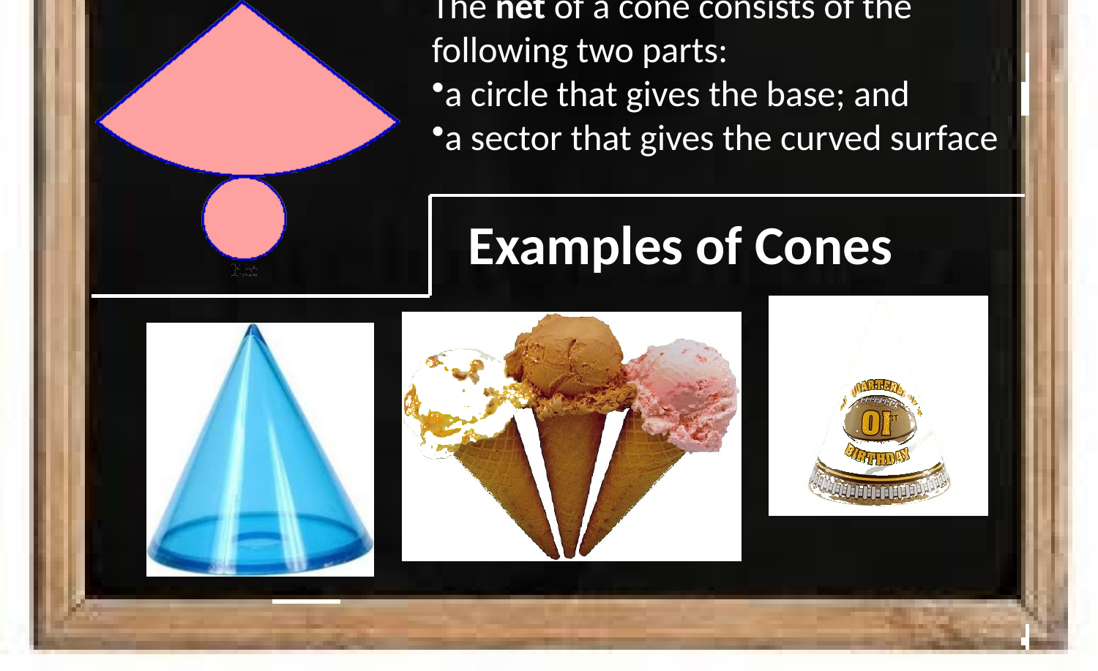
Zπ
CONE
The Net of a Cone
A cone opens into a circle (the base) and a sector (the curved surface).

Slide 11

Zπ
CONE
Worked Example
4.8 cm
6.2 cm
Surface Area of a Cone
= πr² + πrl
= π(3.1)² + π(3.1)(7.8)
= 106.15
Find the slant height with Pythagoras first, then use πr² + πrl for the surface area.

Slide 12
Zπ
SUMMARY
Choosing & Combining
Many exam solids are COMBINATIONS — e.g. a hemisphere on a cylinder. Work out each part, then add.
Volume tips
Surface area tips
Cylinder: πr²h
Cylinder: 2πr² + 2πrh
Sphere: 4/3 πr³ (hemisphere: halve it)
Sphere: 4πr²
Cone: 1/3 πr²h (uses vertical height)
Cone: πr² + πrl (slant height l)
Combined solid → add the parts
Combined: count only the OUTSIDE surfaces
When two solids join, the touching faces are hidden — do not include them in the surface area.

Slide 13
Zπ
PART 2
Past-Paper Questions
Pick the solid, choose volume or surface area, then substitute.
1
Cylinder, sphere or cone?
2
Volume or surface area?
3
Cone needs slant height l = √(r²+h²)
4
Combined solid → add the parts

Slide 14
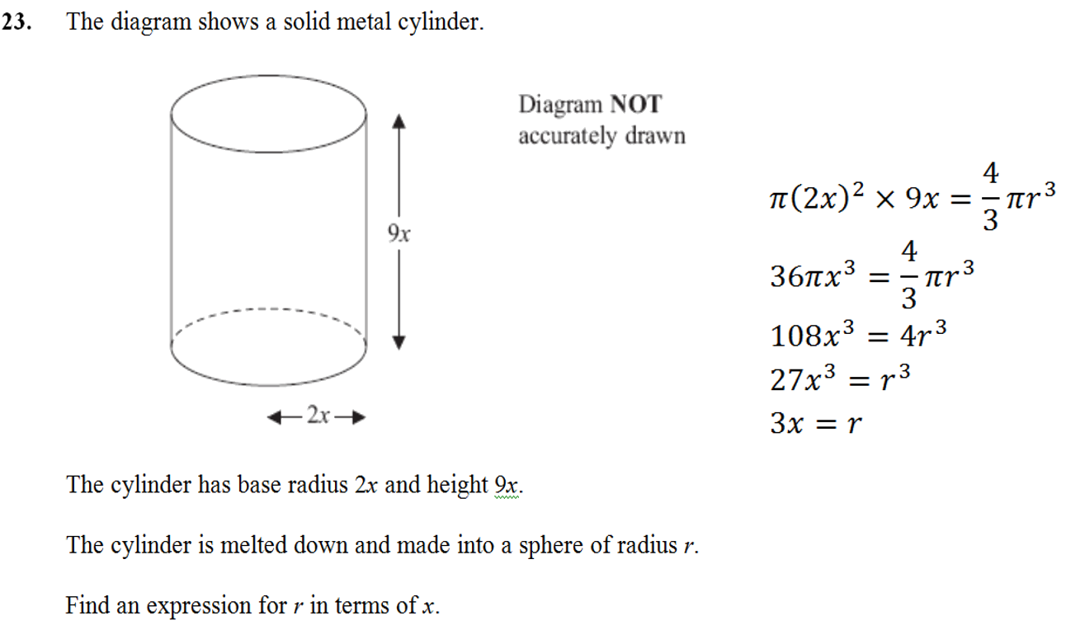
Zπ
PAST-PAPER QUESTION
Question 1

Slide 15
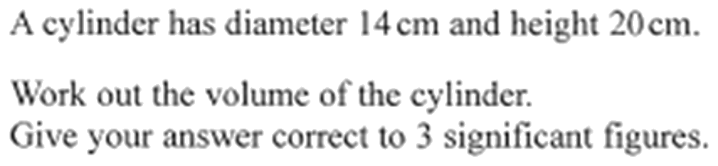
Zπ
PAST-PAPER QUESTION
Question 2

Slide 16
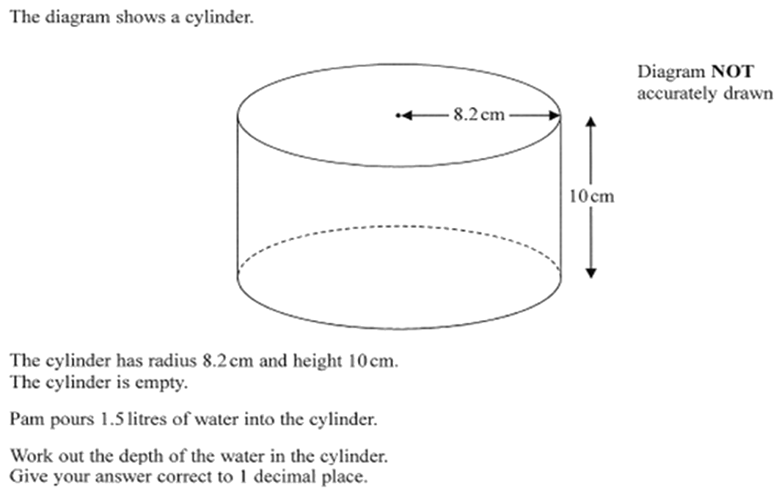
Zπ
PAST-PAPER QUESTION
Question 3

Slide 17
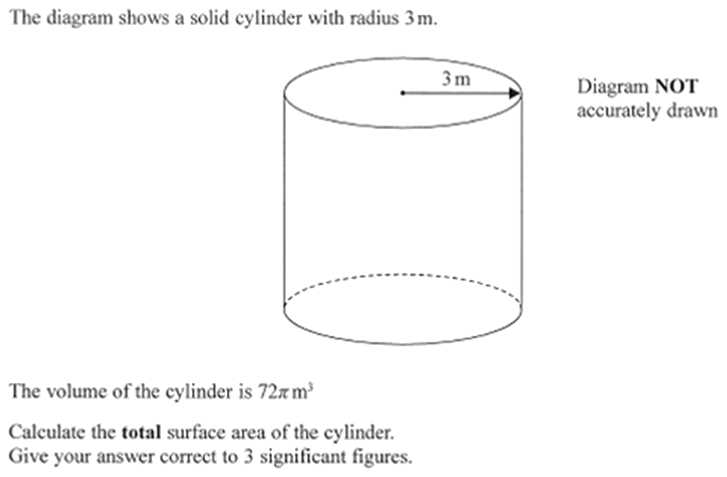
Zπ
PAST-PAPER QUESTION
Question 4

Slide 18
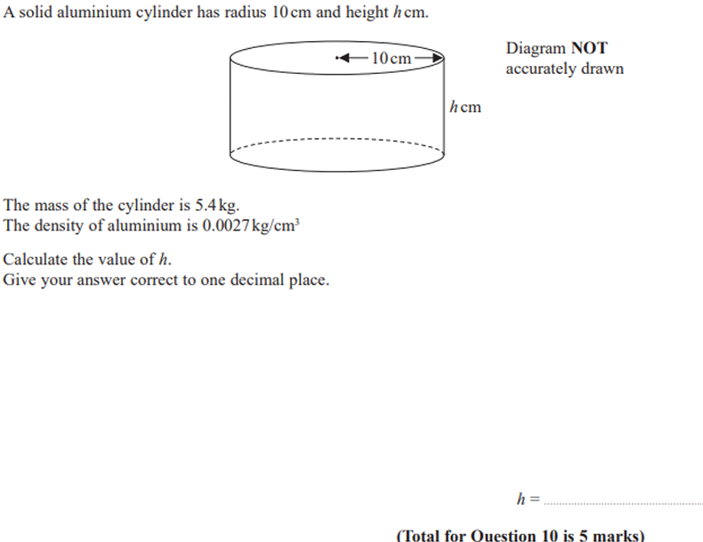
Zπ
PAST-PAPER QUESTION
Question 5

Slide 19
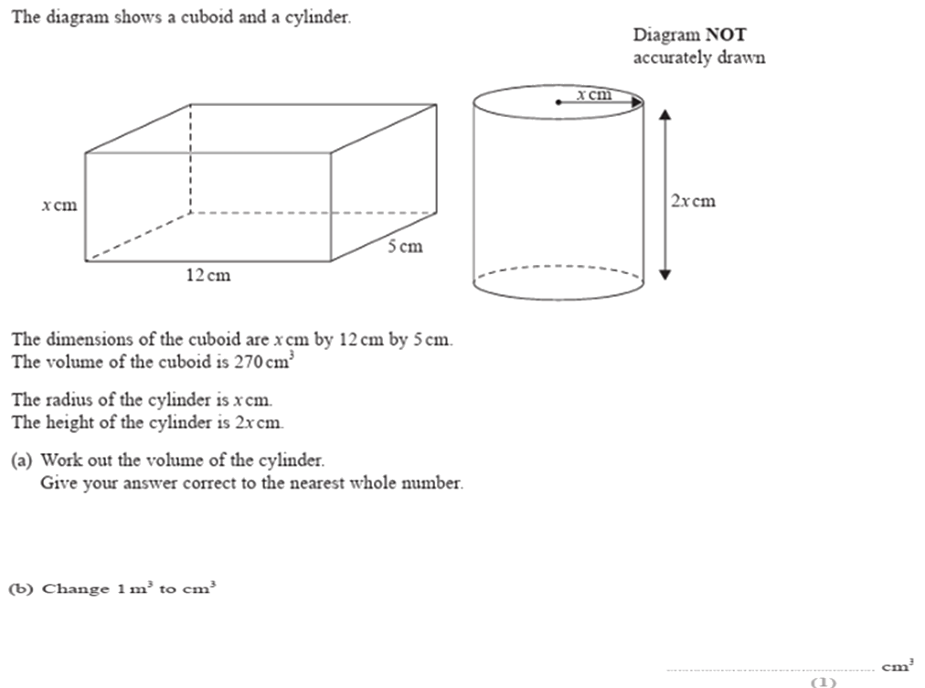
Zπ
PAST-PAPER QUESTION
Question 6

Slide 20
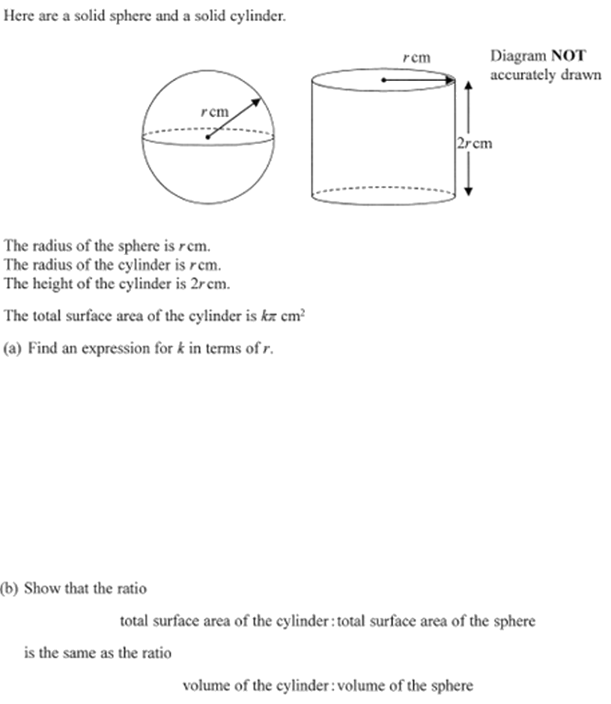
Zπ
PAST-PAPER QUESTION
Question 7

Slide 21
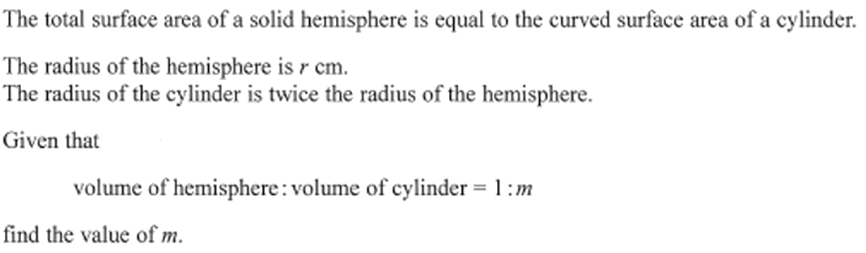
Zπ
PAST-PAPER QUESTION
Question 8

Slide 22
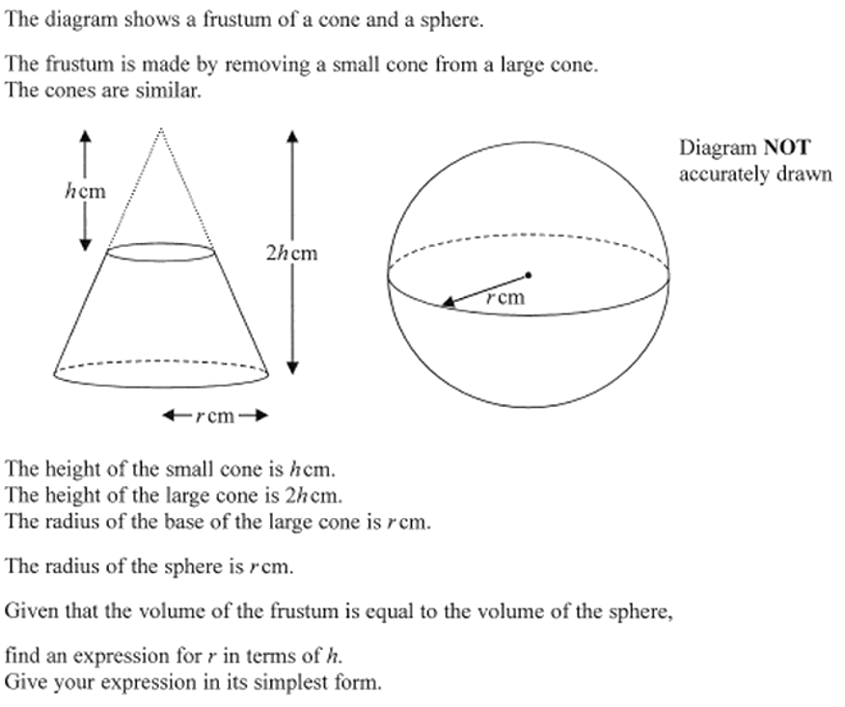
Zπ
PAST-PAPER QUESTION
Question 9

Slide 23
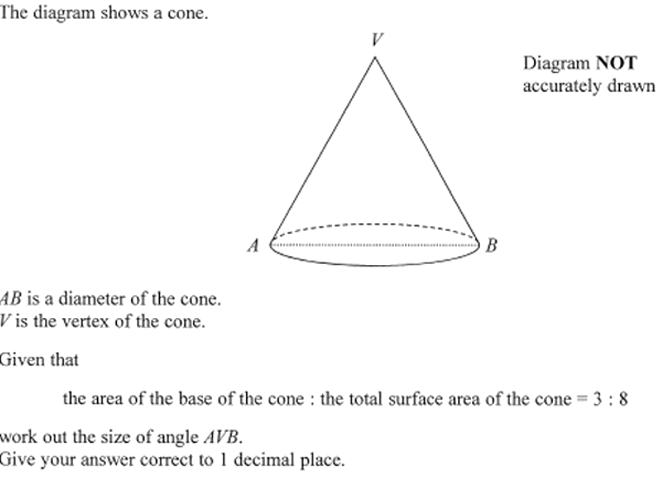
Zπ
PAST-PAPER QUESTION
Question 10

Slide 24
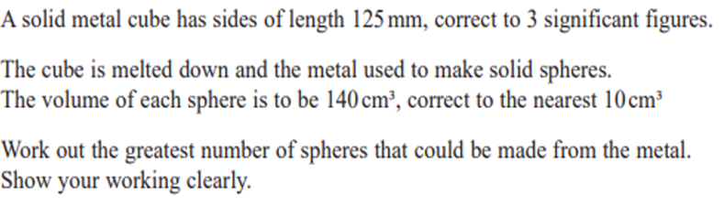
Zπ
PAST-PAPER QUESTION
Question 11

Slide 25
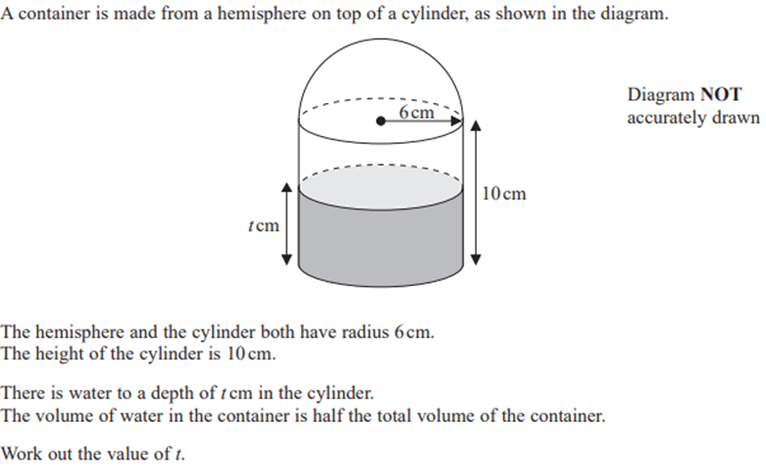
Zπ
PAST-PAPER QUESTION
Question 12

Slide 26
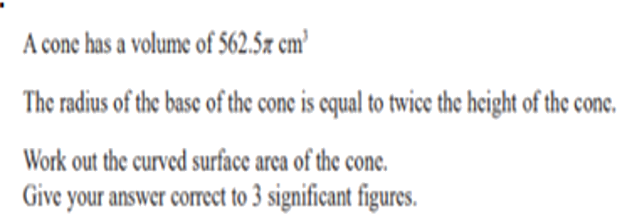
Zπ
PAST-PAPER QUESTION
Question 13

Slide 27
Zπ
RECAP
Key Takeaways
Cylinder: volume πr²h, surface area 2πr² + 2πrh.
Sphere: volume 4/3 πr³, surface area 4πr² (hemisphere: 2/3 πr³ and 3πr²).
Cone: volume 1/3 πr²h (vertical height); curved surface πrl, total πr² + πrl.
Cone slant height: l = √(r² + h²) by Pythagoras.
Combined solids: add each part; ignore the hidden touching faces for surface area.
Golden rule: volume uses the vertical height; the cone’s curved surface uses the slant height.

