Slide 1
Zπ
Zπ MATHS HUB
Pearson Edexcel IGCSE (9–1) · Higher Tier
Similar Shapes
Similarity · Scale Factor · Finding Missing Lengths · Similar Triangles
Zahra Sheikh Ali
IGCSE Mathematics Teacher · M.Sc. Differential Geometry & Geometric Control
☎ 66613748 ✉ zahraa.sheikhali@outlook.com

Slide 2
Zπ
LESSON OVERVIEW
Same Shape, Different Size
Two shapes are SIMILAR if one is an enlargement of the other. Their angles are equal and their sides are in the same ratio — the SCALE FACTOR.
What ‘similar’ means
Equal angles, sides in ratio
The scale factor
1
2
3
Finding missing lengths
Similar triangles & parallel lines
Past-paper questions
4
5
6
Key words: similar · enlargement · scale factor · ratio · corresponding sides · corresponding angles

Slide 3
Zπ
THE KEY IDEA
What Makes Two Shapes Similar
Similar = same shape, different size. An enlargement keeps the shape identical but changes the size.
Corresponding ANGLES
Corresponding SIDES
are EQUAL.
The shape does not change — only the size — so every angle stays the same.
are IN PROPORTION.
Every side is multiplied by the SAME number — the scale factor.
To be similar: all corresponding angles equal AND all corresponding sides in the same ratio.

Slide 4
Zπ
THE SCALE FACTOR
How Many Times Bigger?
The scale factor k links the two shapes. Find it by dividing a pair of corresponding sides.
scale factor k =
a length on the BIG shape
matching length on the SMALL shape
Making it BIGGER
Making it SMALLER
small → big: MULTIPLY by k
e.g. k = 3, side 4 cm → 4 × 3 = 12 cm
big → small: DIVIDE by k
e.g. k = 3, side 12 cm → 12 ÷ 3 = 4 cm
Always divide big by small to get the scale factor — it should be greater than 1.

Slide 5
Zπ
WORKED EXAMPLE
Finding a Missing Length
1
Two similar shapes. Matching sides: 5 cm (small) and 15 cm (big).
Method
Match a pair of sides you know BOTH of.
Divide big ÷ small to get the scale factor k.
Multiply by k to enlarge; divide by k to reduce.
Check the angles are equal first.
2
Scale factor k = 15 ÷ 5 = 3
3
Another small side is 4 cm. Find the matching big side.
4
4 × 3 = 12 cm
Missing side = 12 cm
Make sure you pair CORRESPONDING sides — the ones in the same position.

Slide 6
Zπ
SIMILAR TRIANGLES
Parallel Lines Make Similar Triangles
A line parallel to one side of a triangle creates a smaller, SIMILAR triangle. Equal angles prove it.
A
Why they are similar
BE parallel to CD, so:
• angle A is shared
• equal corresponding angles (parallel lines)
→ triangle ABE is similar to triangle ACD.
So the sides are in proportion:
AB/AC = AE/AD = BE/CD.
B
E
C
D
Watch for shared angles and parallel sides — they signal similar triangles.

Slide 7
Zπ
SIMILAR TRIANGLES
Parallel Lines Make Similar Triangles
In the diagram below BE is parallel to CD and all measurements are as shown.
Calculate the length CD
Calculate the perimeter of the Trapezium EBCD
A
A
4.2 m
6 m
6.3m
9 m
B
E
4.8 m
2.1 m
3 m
C
D
7.2m
C
7.2m
D
Watch for shared angles and parallel sides — they signal similar triangles.

Slide 8
Zπ
EXAM TECHNIQUE
A Reliable Method
Follow the same four steps every time.
Identify the corresponding sides (same position in each shape).
1
Find the scale factor: divide a BIG side by its matching SMALL side.
2
Multiply (to enlarge) or divide (to reduce) to find the missing length.
3
For triangles, redraw them the same way up so the pairs line up.
4
Corresponding sides are OPPOSITE equal angles — that is how you pair them correctly.

Slide 9
Zπ
PART 2
Past-Paper Questions
Pair corresponding sides, find the scale factor, then multiply or divide.
1
Match corresponding sides
2
Scale factor = big ÷ small
3
Multiply to enlarge, divide to reduce
4
For triangles, use equal angles

Slide 10
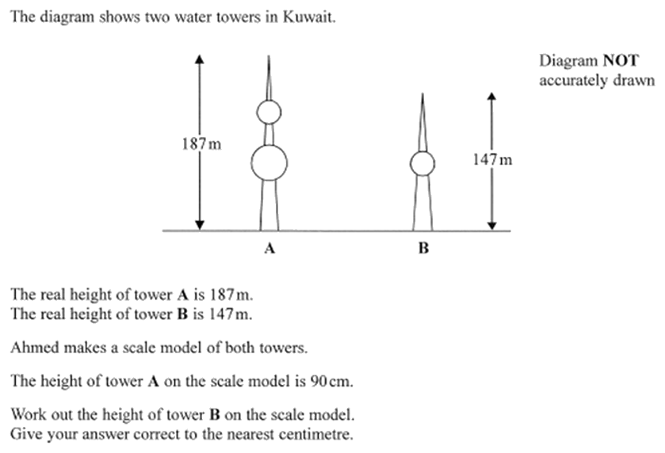
Zπ
PAST-PAPER QUESTION
Question 1

Slide 11
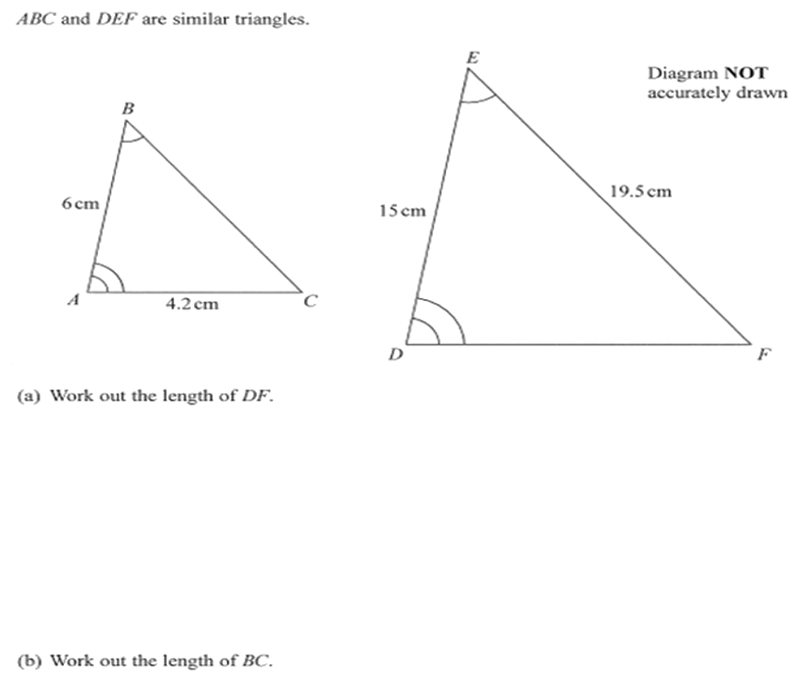
Zπ
PAST-PAPER QUESTION
Question 2

Slide 12
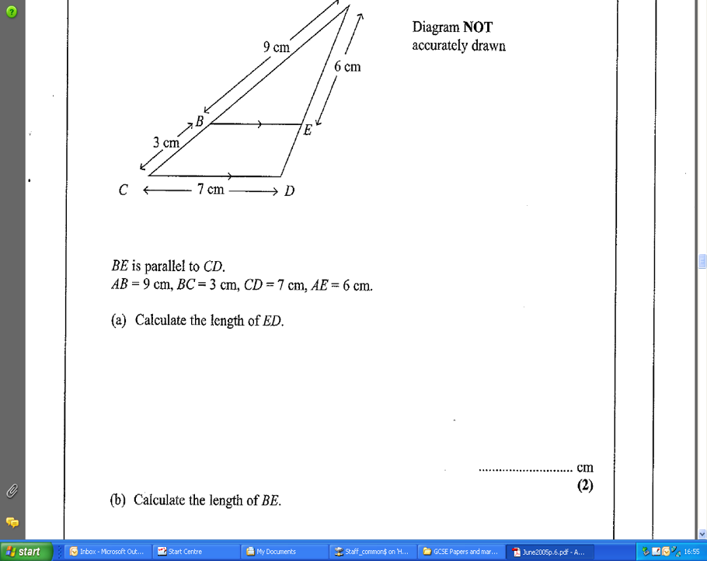
Zπ
PAST-PAPER QUESTION
Question 3

Slide 13
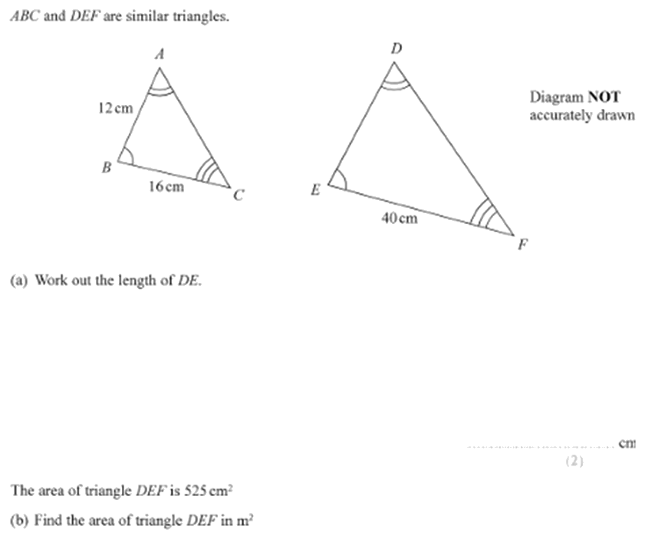
Zπ
PAST-PAPER QUESTION
Question 4

Slide 14
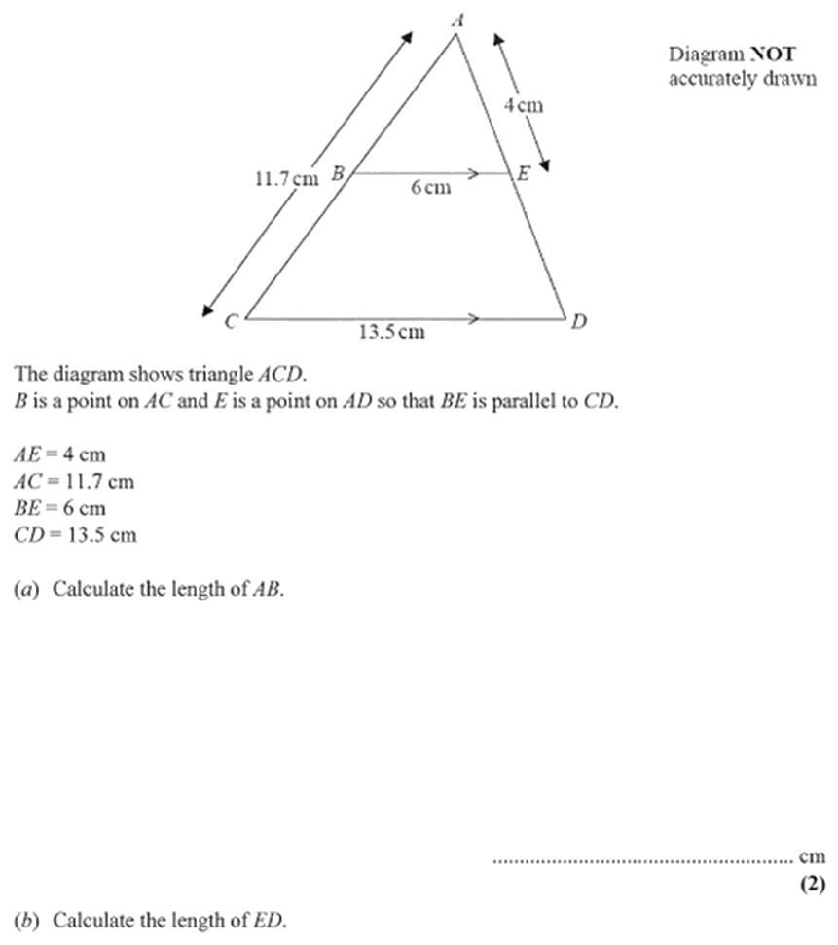
Zπ
PAST-PAPER QUESTION
Question 5

Slide 15
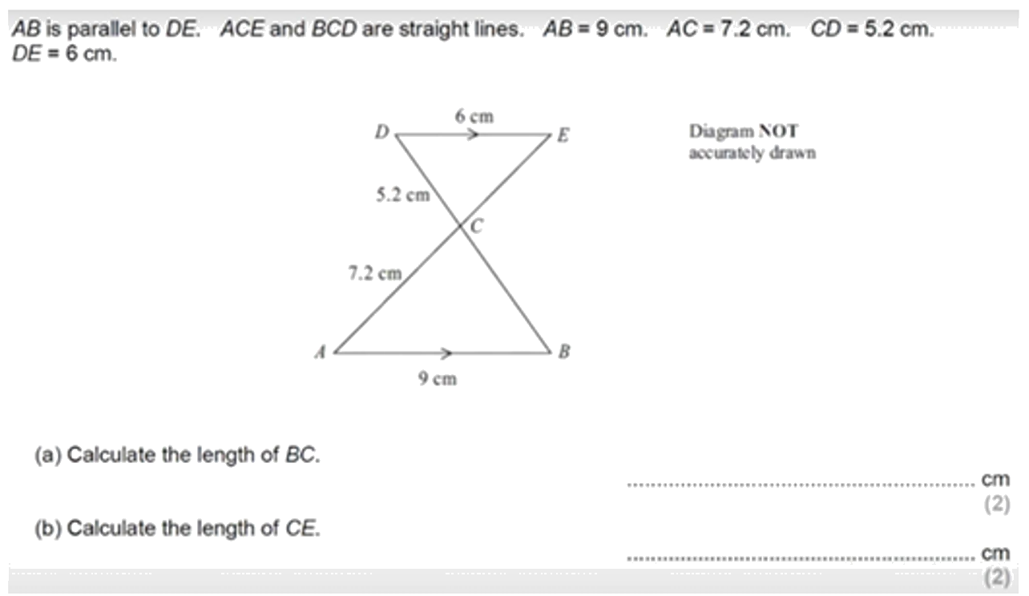
Zπ
PAST-PAPER QUESTION
Question 6

Slide 16
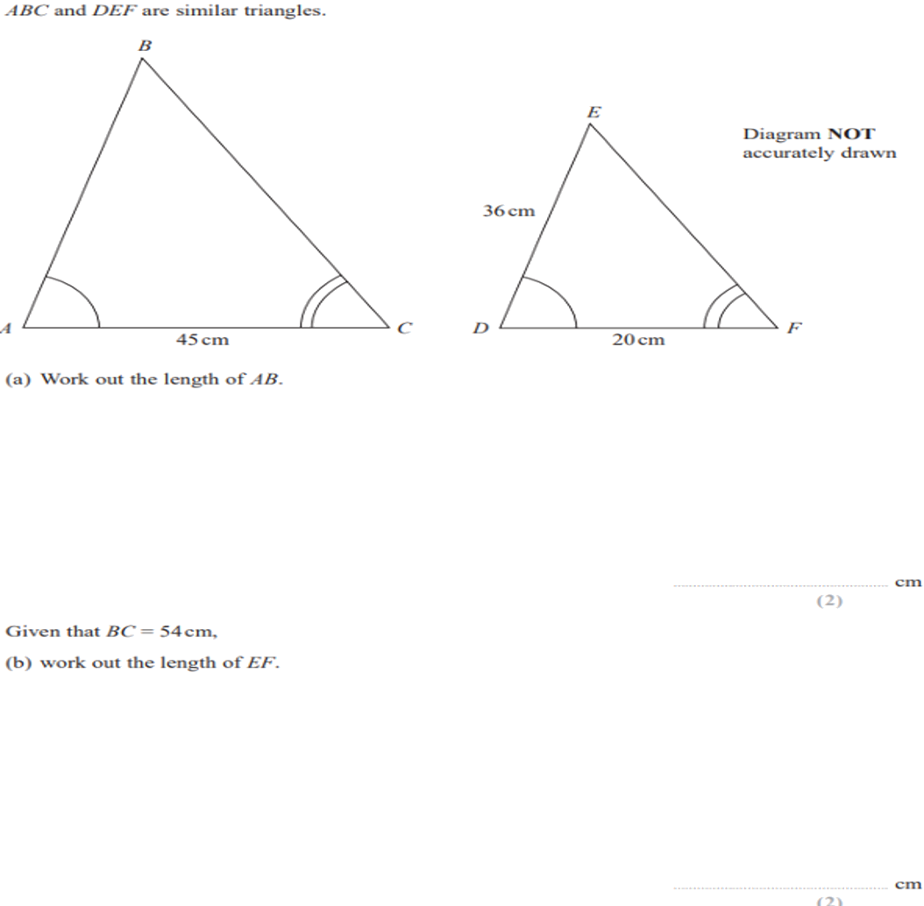
Zπ
PAST-PAPER QUESTION
Question 7

Slide 17
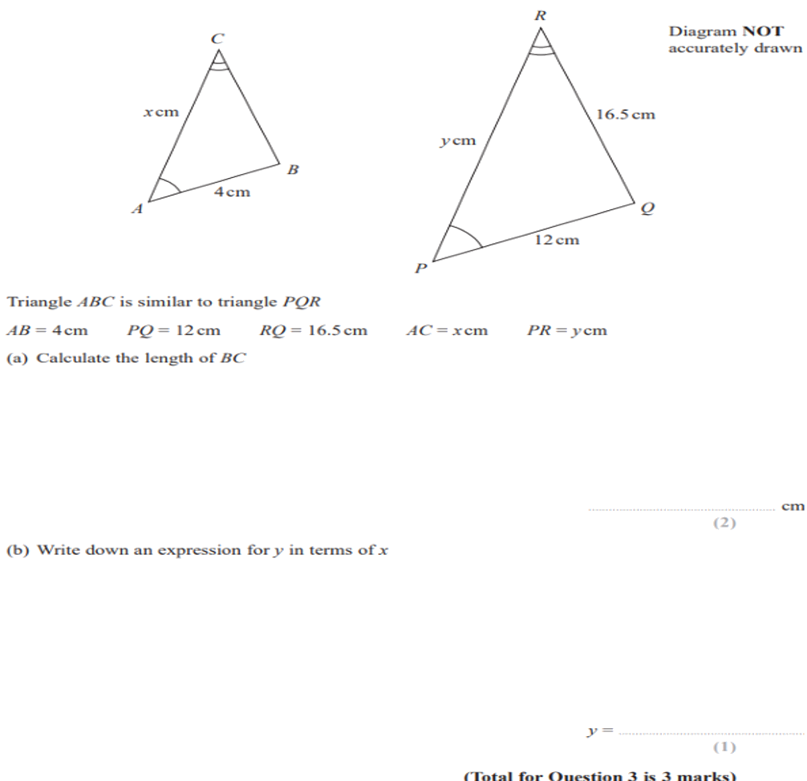
Zπ
PAST-PAPER QUESTION
Question 8

Slide 18
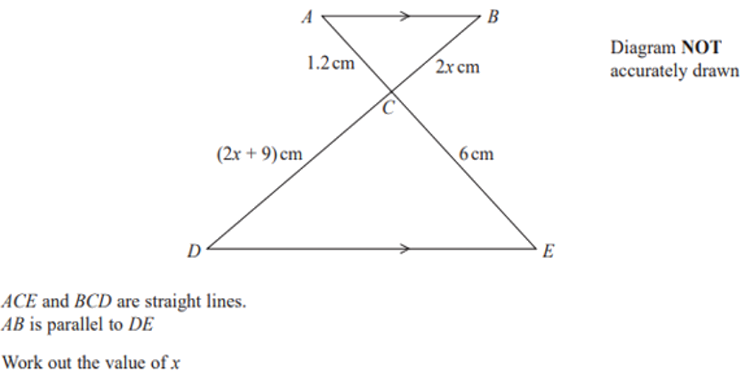
Zπ
PAST-PAPER QUESTION
Question 9

Slide 19
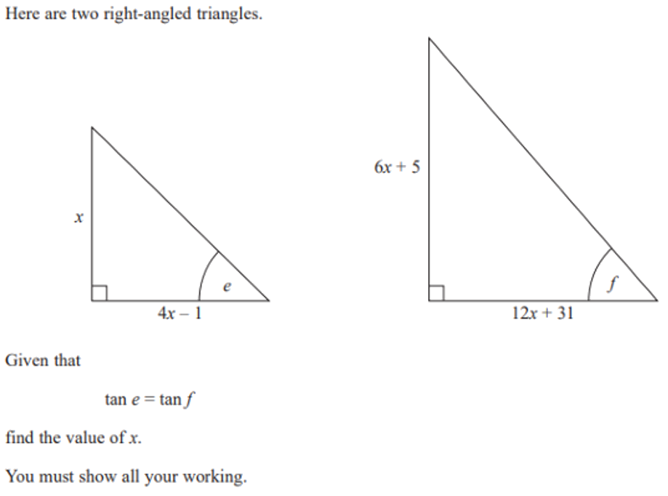
Zπ
PAST-PAPER QUESTION
Question 10

Slide 20
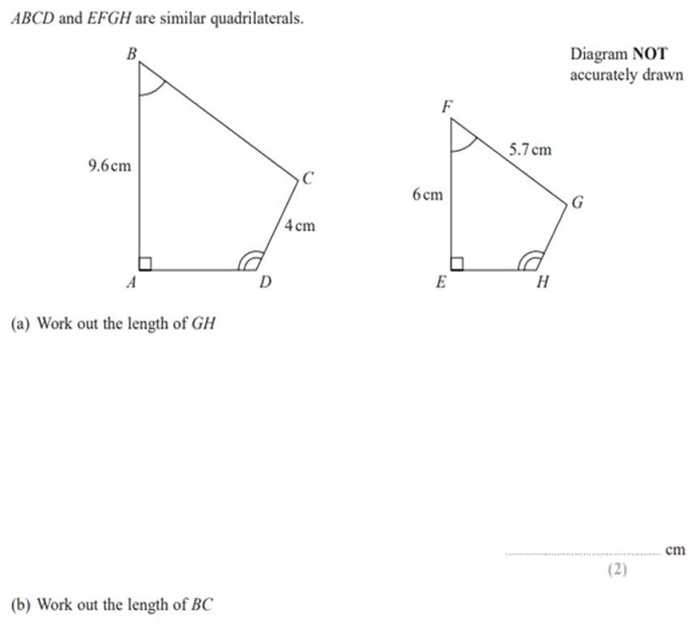
Zπ
PAST-PAPER QUESTION
Question 11

Slide 21
Zπ
RECAP
Key Takeaways
Similar shapes: same shape, different size — an enlargement.
Corresponding angles are EQUAL; corresponding sides are IN PROPORTION.
Scale factor k = a big length ÷ its matching small length.
Enlarge by multiplying by k; reduce by dividing by k.
A line parallel to one side of a triangle makes a smaller SIMILAR triangle.
Golden rule: pair corresponding sides, find the scale factor, then multiply or divide.

