Slide 1
Zπ
Zπ MATHS HUB
Pearson Edexcel IGCSE (9–1) · Higher Tier
Similar Shapes: Area & Volume
Area Scale Factor k² · Volume Scale Factor k³ · Working Backwards
Zahra Sheikh Ali
IGCSE Mathematics Teacher · M.Sc. Differential Geometry & Geometric Control
☎ 66613748 ✉ zahraa.sheikhali@outlook.com

Slide 2
Zπ
LESSON OVERVIEW
Length, Area & Volume Grow Differently
When you enlarge a shape by a scale factor k, the AREA and VOLUME grow FASTER. Area by k², volume by k³. This one idea answers every question here.
Length × k
Area × k²
Volume × k³
1
2
3
Working backwards (roots)
The summary table
Past-paper questions
4
5
6
Key words: linear scale factor · area scale factor · volume scale factor · k² · k³ · square root · cube root

Slide 3
Zπ
THE KEY IDEA
Length ×k, Area ×k², Volume ×k³
Enlarge a cube by scale factor k = 3. The lengths triple, but the area and volume grow much faster.
LARGE
SMALL
LENGTH
× 3
× 3
each length triples (k)
1 cm
AREA
× 9
3 cm
each face: 3² = 9 (k²)
VOLUME
× 27
So a shape 3 times as long has 9 times the area and 27 times the volume.
the whole solid: 3³ = 27 (k³)

Slide 4
Zπ
THE RULE
The Three Scale Factors
If the LENGTH scale factor is k, then…
LENGTH
AREA
VOLUME
× k
× k²
× k³
sides, heights, radii, perimeters
surface area, cross-section
capacity, mass (same material)
Length × k → Area × k² → Volume × k³

Slide 5
Zπ
AREA SCALE FACTOR
Worked Example: Area × k²
Q: Two rectangles are similar. Their matching sides are 5 cm and 15 cm. The small rectangle has area 8 cm². Work out the area of the large rectangle.
Area
= ?
Solution
Area
8 cm²
1. Length scale factor:
k = 15 ÷ 5 = 3
2. Area scale factor:
k² = 3² = 9
3. Large area = 8 × 9 = 72 cm²
5 cm
15 cm
Square the length scale factor to get the AREA scale factor: area × k².

Slide 6
Zπ
VOLUME SCALE FACTOR
Worked Example: Volume × k³
Q: Two solids are mathematically similar. Their matching edges are 2 cm and 6 cm. The small solid has volume 8 cm³. Work out the volume of the large solid.
V = ?
Solution
1. Length scale factor:
k = 6 ÷ 2 = 3
2. Volume scale factor:
k³ = 3³ = 27
3. Large volume = 8 × 27 = 216 cm³
2 cm
V = 8 cm³
6 cm
Cube the length scale factor to get the VOLUME scale factor: volume × k³.

Slide 7
Zπ
WORKING BACKWARDS
From Area or Volume to Length
Given the AREA or VOLUME ratio, find the LENGTH scale factor by taking a ROOT. Undo the power.
From AREA → length
From VOLUME → length
Area scale factor = 9
Length k = √9 = 3
Take the SQUARE ROOT of the area ratio to get the length ratio.
Volume scale factor = 27
Length k = ³√27 = 3
Take the CUBE ROOT of the volume ratio to get the length ratio.
Length ← √(area) · Length ← ³√(volume). Find the length SF first, then go where you need.

Slide 8
Zπ
SUMMARY
The One Table to Remember
Everything flows from the LENGTH scale factor k.
Quantity
Scale factor
To go backwards
Length
× k
—
Area
× k²
take the square root
Volume
× k³
take the cube root
Most mistakes: using k for area or volume. Always square for area, cube for volume.
Same material? Then mass scales like volume — × k³.

Slide 9
Zπ
PART 2
Past-Paper Questions
Find the length scale factor, then square for area or cube for volume.
1
Length SF from a pair of sides
2
Area → × k² (or √ to reverse)
3
Volume/capacity/mass → × k³ (or ³√)
4
Show the power clearly

Slide 10
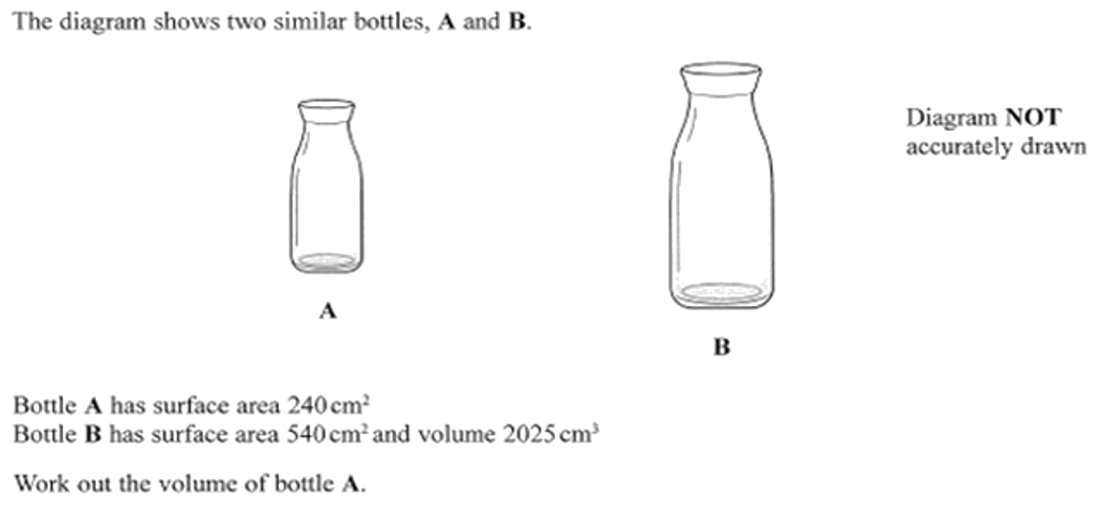
Zπ
PAST-PAPER QUESTION
Question 1

Slide 11
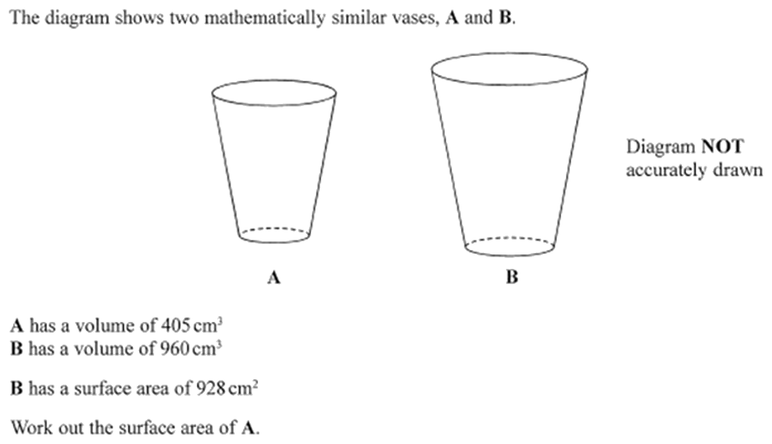
Zπ
PAST-PAPER QUESTION
Question 2

Slide 12
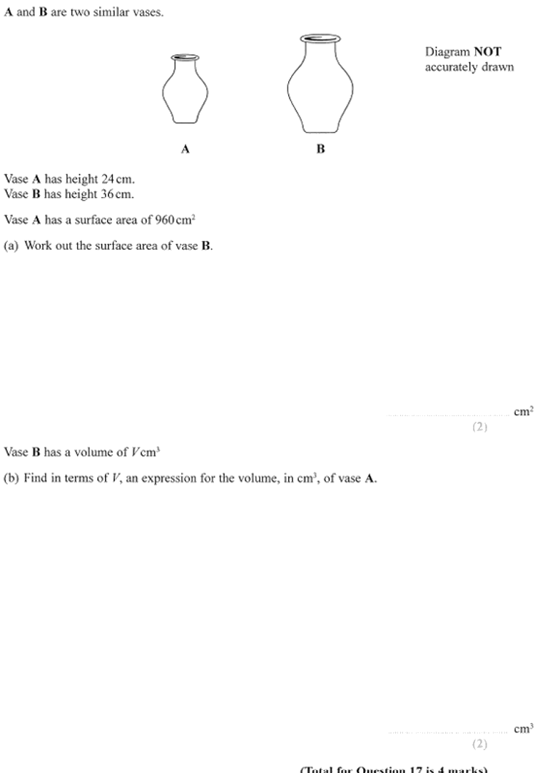
Zπ
PAST-PAPER QUESTION
Question 3

Slide 13
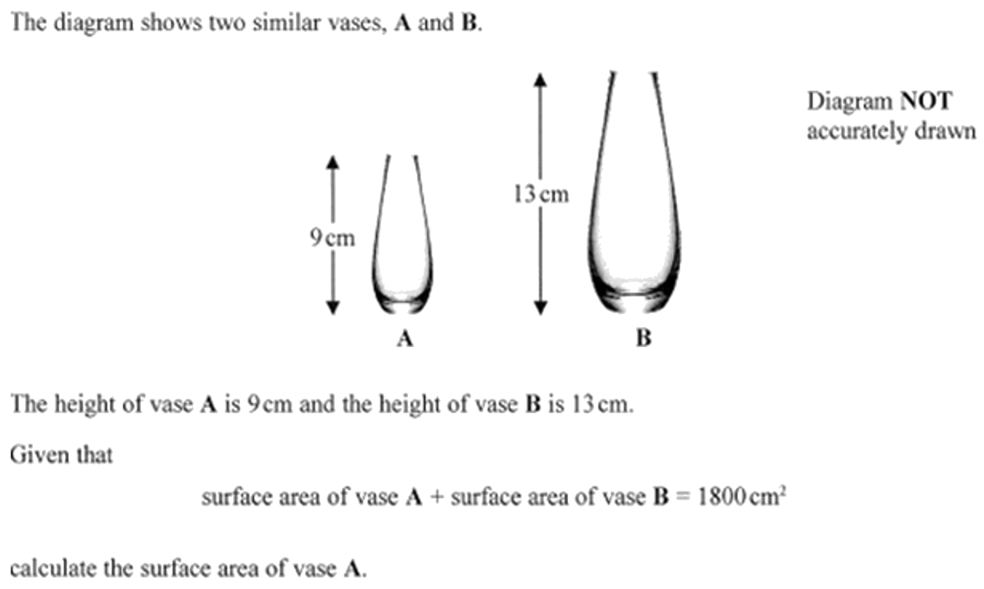
Zπ
PAST-PAPER QUESTION
Question 4

Slide 14
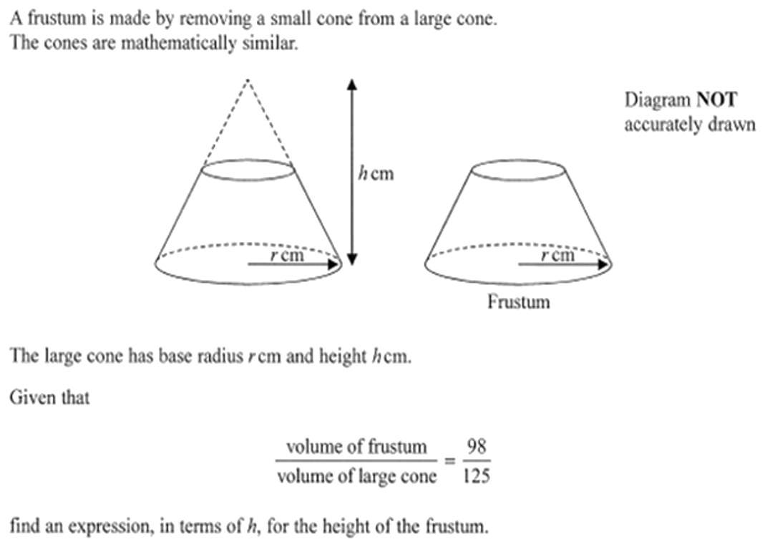
Zπ
PAST-PAPER QUESTION
Question 5

Slide 15
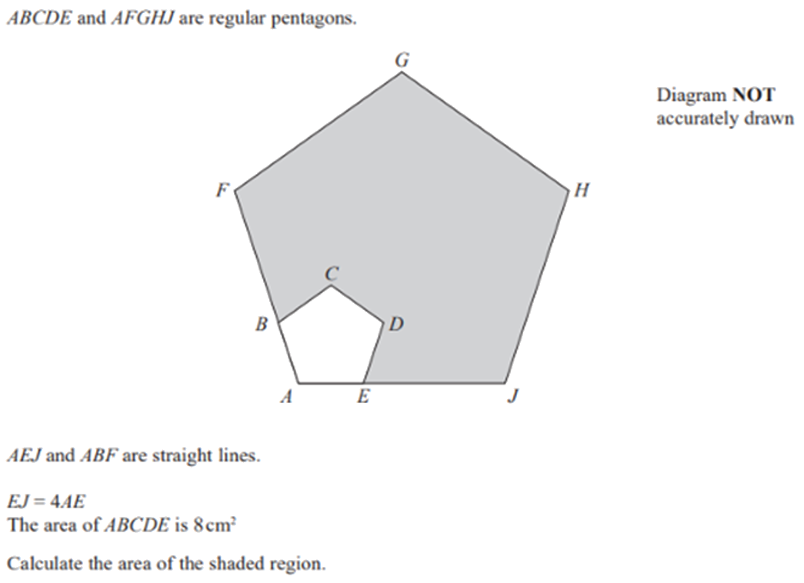
Zπ
PAST-PAPER QUESTION
Question 6

Slide 16
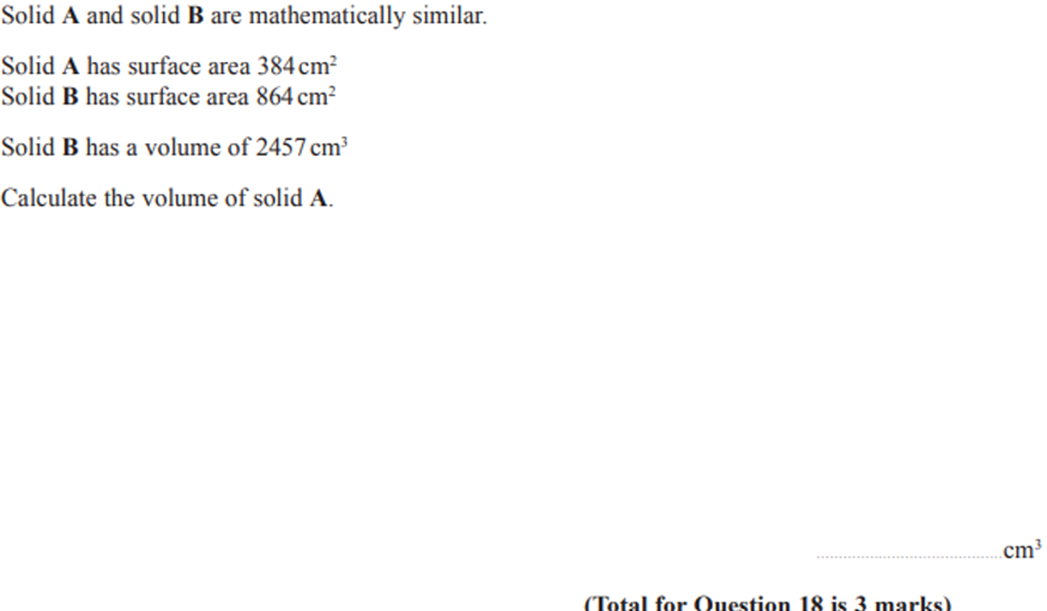
Zπ
PAST-PAPER QUESTION
Question 7

Slide 17
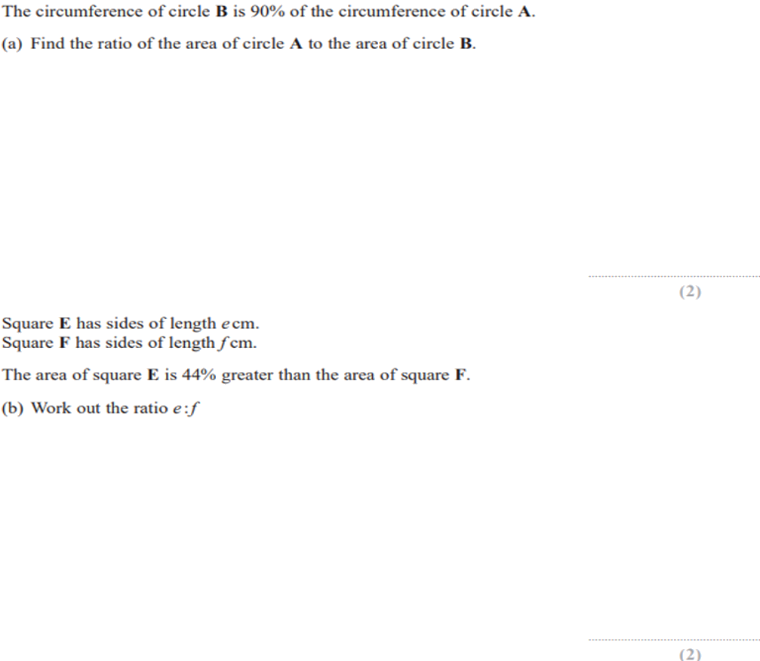
Zπ
PAST-PAPER QUESTION
Question 8

Slide 18
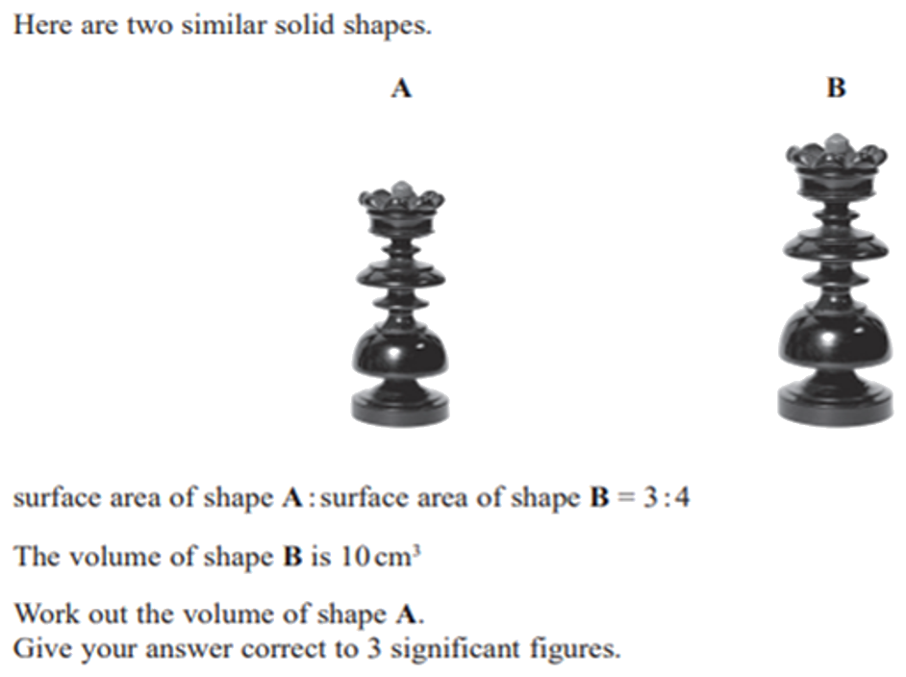
Zπ
PAST-PAPER QUESTION
Question 9

Slide 19
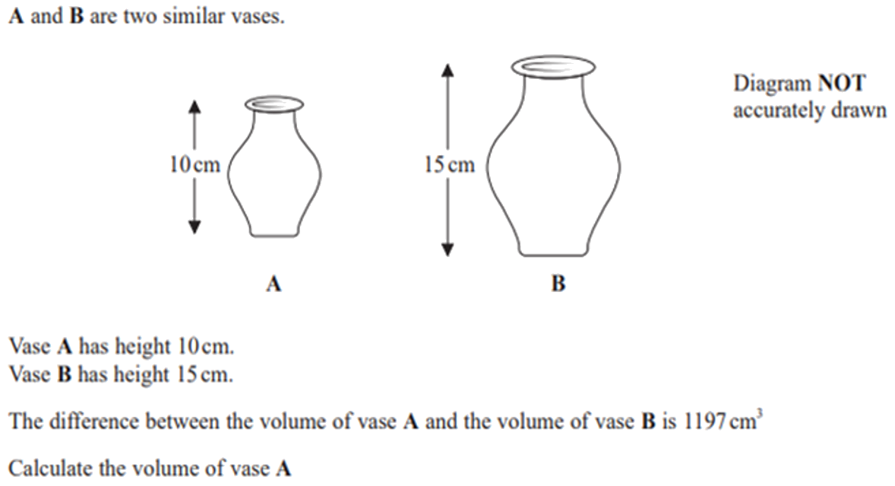
Zπ
PAST-PAPER QUESTION
Question 10

Slide 20
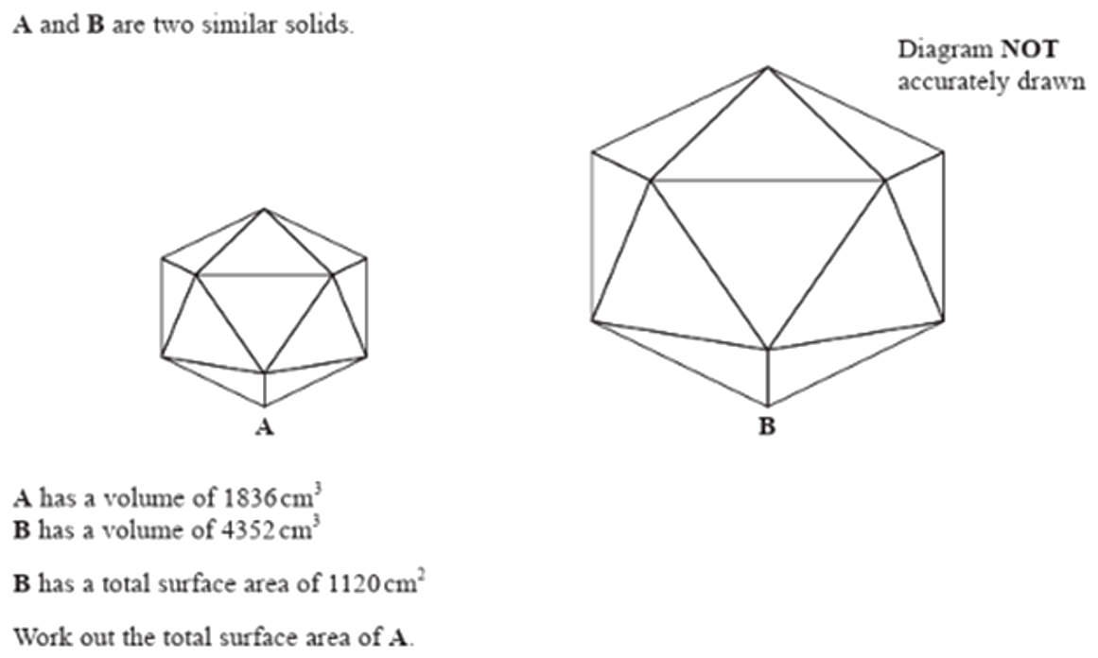
Zπ
PAST-PAPER QUESTION
Question 11

Slide 21
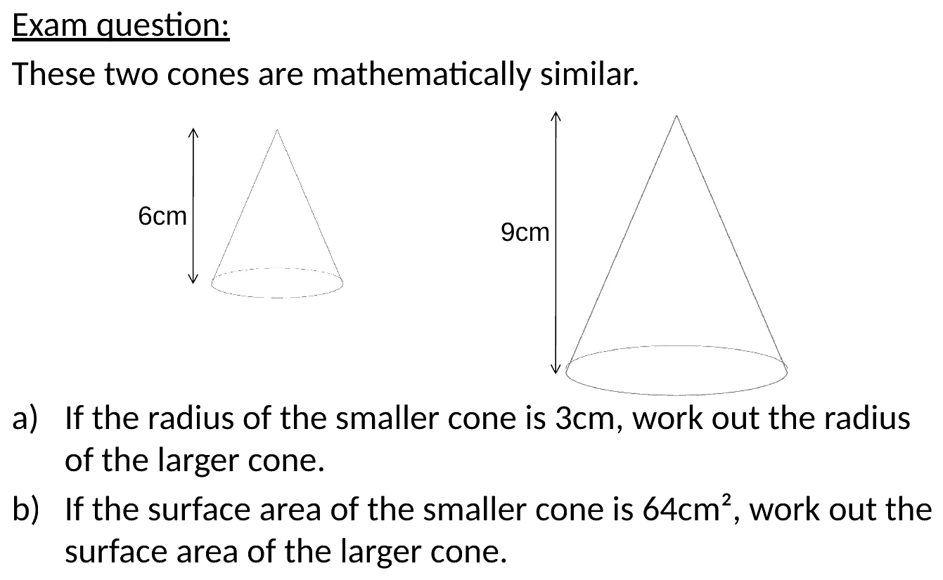
Zπ
PAST-PAPER QUESTION
Question 12

Slide 22
Zπ
RECAP
Key Takeaways
Enlarging by length scale factor k: area × k² and volume × k³.
Always find the LENGTH scale factor first, then square or cube it.
Surface area scales by k²; capacity and mass (same material) scale by k³.
Working backwards: length = √(area ratio) = ³√(volume ratio).
Never use k by itself for an area or a volume — that is the classic mistake.
Golden rule: length ×k, area ×k², volume ×k³ — and take roots to reverse it.

